Slide 1
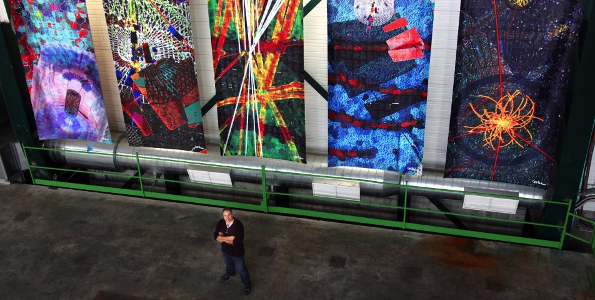


CREATIONS Summer school 2018
Prof. Zacharoula Smyrnaiou
NKUA

Slide 2
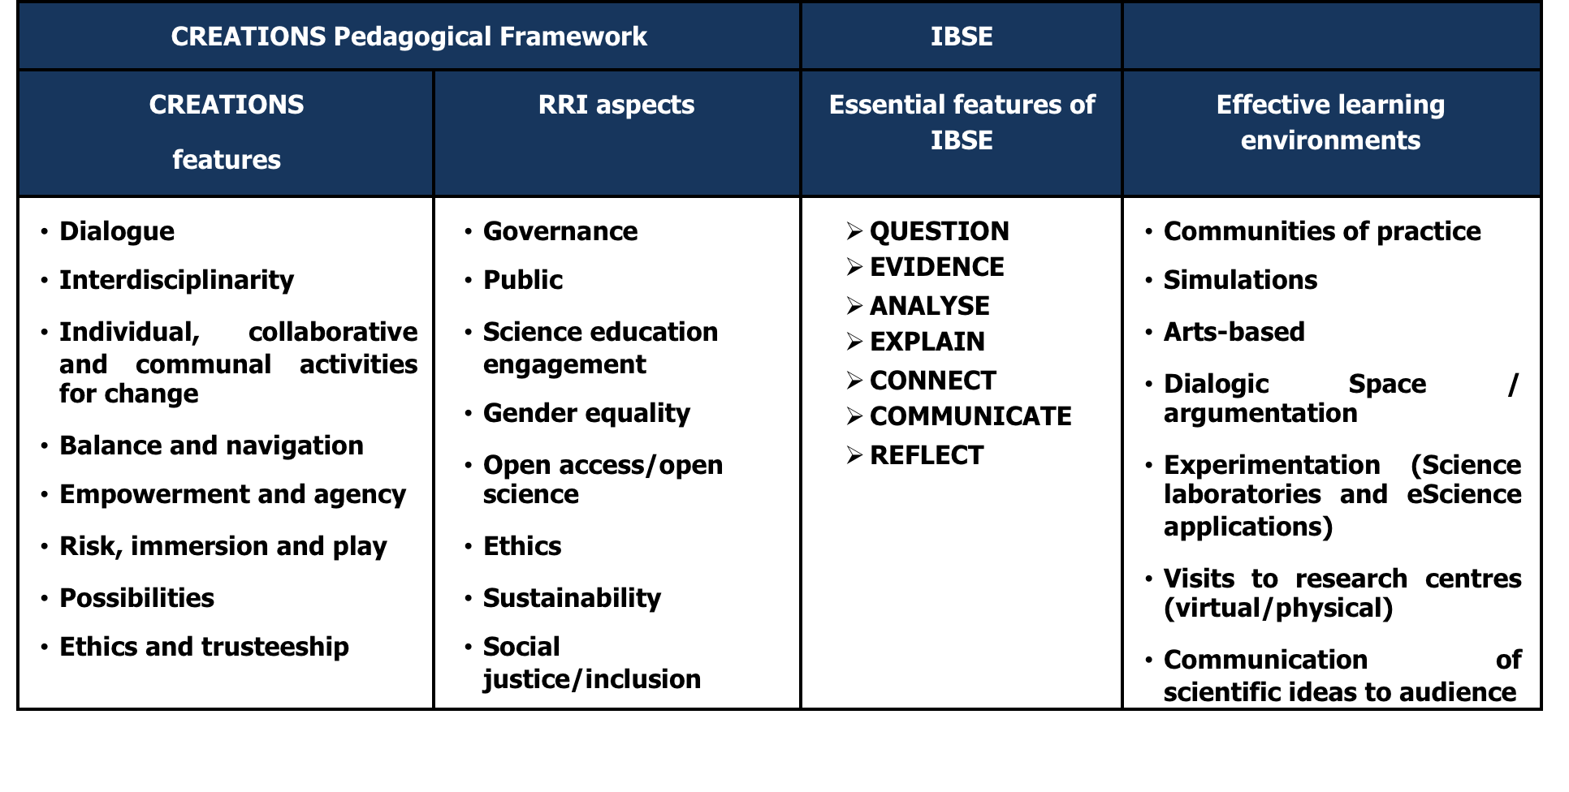
The Pedagogical Framework of CREATIONS
Integrate the proposed features of CREATIONS
Including effective learning environments

Slide 3
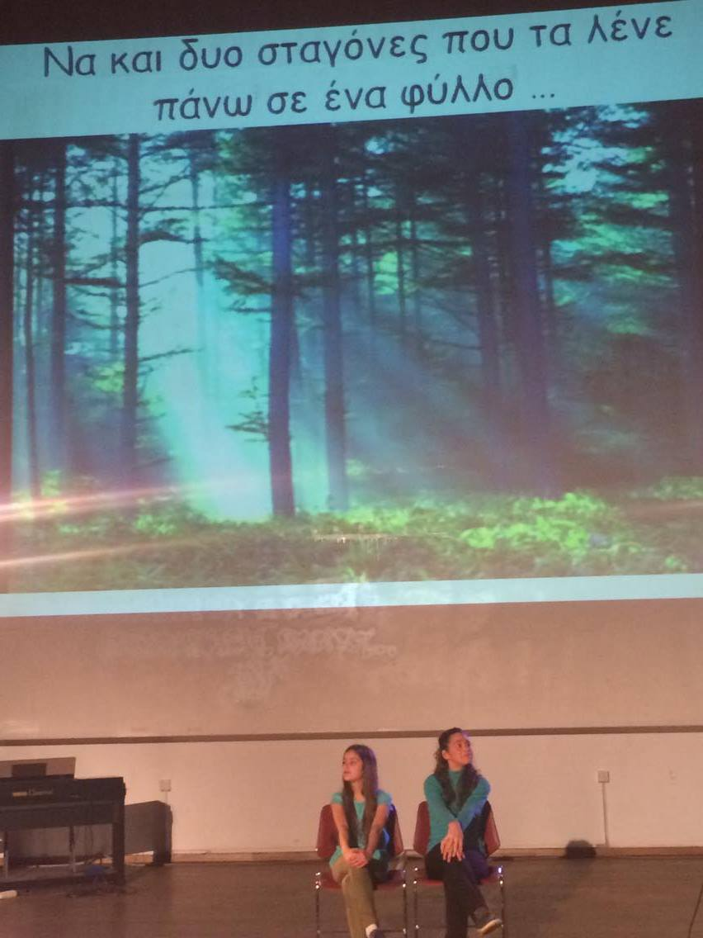

Slide 4
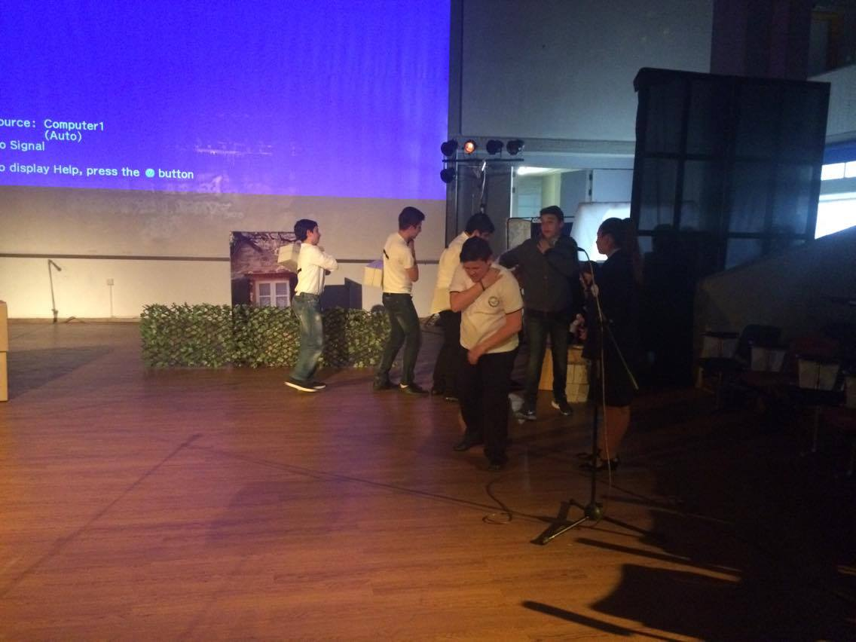

Slide 5
Workshop 1
Please give a definition of creativity or key words that are included in this concept

Slide 6

Creativity in science education definition:
‘Purposive and imaginative activity generating outcomes that are original and valuable in relation to the learner. This occurs through critical reasoning using the available evidence to generate ideas, explanations and strategies as an individual or community, whilst acknowledging the role of risk and emotions in interdisciplinary contexts’ (D2.1, p66)

Slide 7
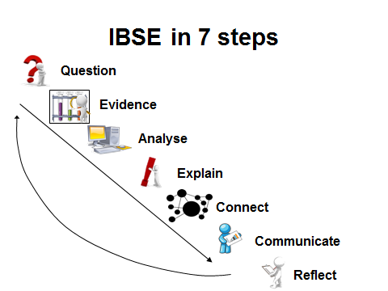

Slide 8
Videos (Science with
First video (Moby & The Void Pacific Choir - Are You Lost In The World Like Me? )
https://www.youtube.com/watch?v=VASywEuqFd8&feature=youtu.be
Second video (3D projections by choreographer )
https://www.facebook.com/motamuseum/videos/1338777072852356/?hc_ref=PAGES_TIMELINE

Slide 9
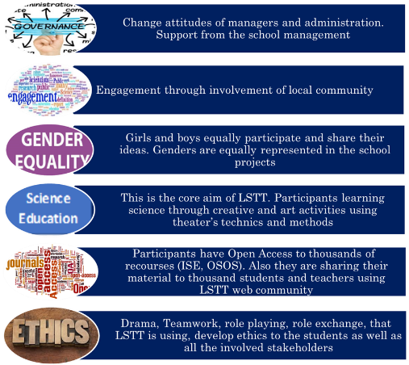
Responsible Research and Innovation

Slide 10
Workshop 2
Please comment the following images
….
….

Slide 11
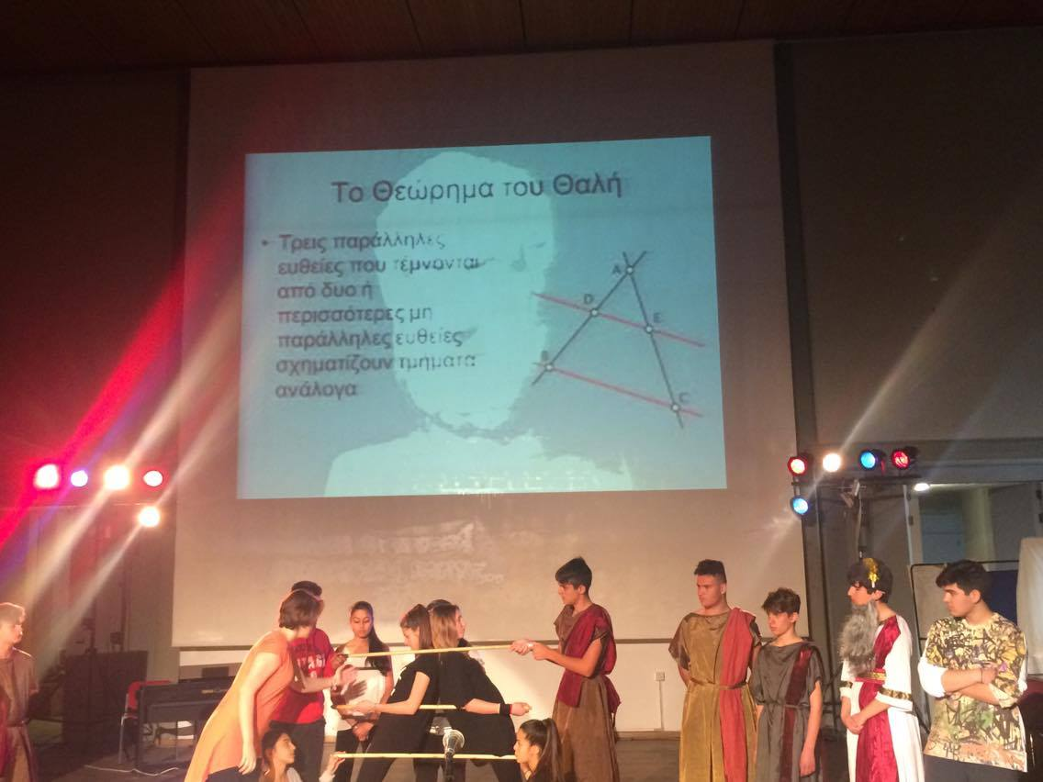

Slide 12
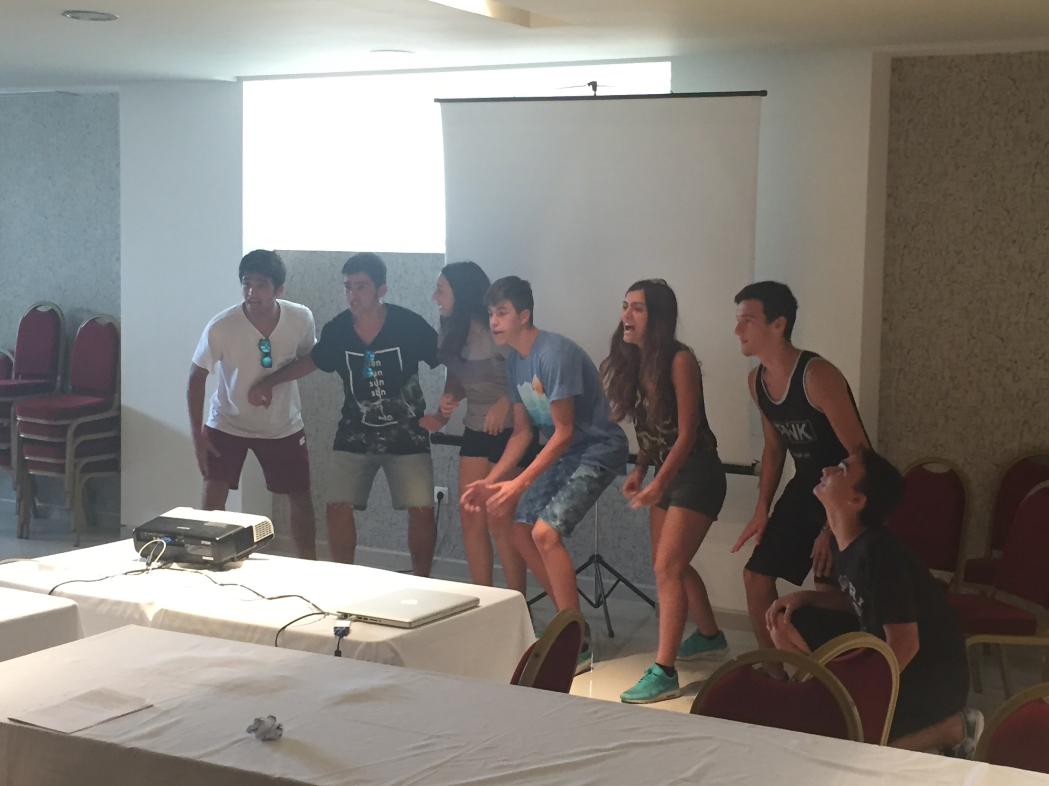

Slide 13
Embodied Learning
Full body movements
Gestures
Facial expressions
Emotional involvement
Analogical Reasoning
Familiarization with the base
Finding common characteristics between the base and the target concept
Underlining the parts where the analogy collapses
Multiple representational systems
Verbal communication
Non-verbal communication (Embodied Learning)/kinesthetic representation
Digital representation
Art

Slide 14
Workshop 3
Choose a scientific topic
Discuss it in the context of RRI. For example, what could be the role of society or the socio-cultural context?
Discuss it in the framework of Inquiry. For example, what could be the dissemination activities?
Discuss it in the framework of Creativity.
Discuss it in the framework of Embodied learning (facial expressions, body movements, emotional engagement, ...) and / or Analogical Reasoning,
Discuss it in the framework of different semiotic systems)

Slide 15
Discussion
Contemporary Theoretical Frameworks (RRI, Inquiry, Creativity, Embodied Systems, Representational / Semiotic Systems, Analogical Reasoning)
The role of the socio-cultural context? (the age of the scientist, nowadays, current issues that concern the citizens, ...)
The role of different learning objects? (literature, history, ...)
The role of different representational systems? (digital, corporeal, verbal ...)
The role of theater technics (pauses, boxing narratives, backstage scenes, theatrical play (space delimitation, emotional expression, team building, confidence building)

