Slide 1

Notes:
This guide explains how to set up an online account with the “Inspiring Science Education” (ISE) portal through the ISE UK community. It is specifically designed for teachers. Registration should take no more than 5 minutes.

Slide 2
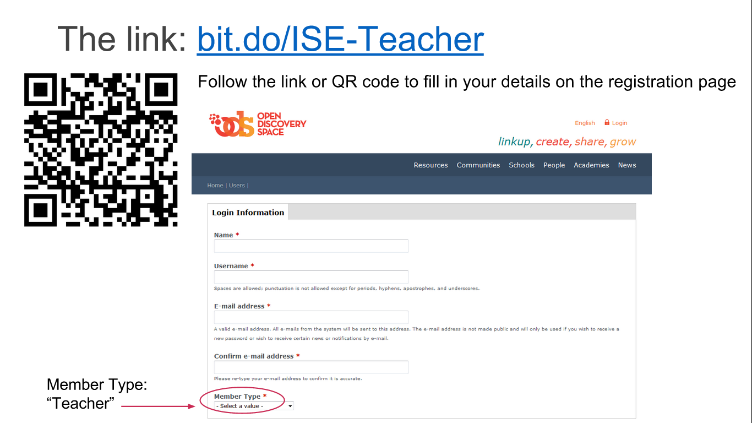
Notes:
The link and QR code above will take you to the Open Discovery Space registration page which is where you register for ISE. Enter your own information, choosing a unique username and member type “Teacher”. You will not set a password until the next step.
After your account has been approved by an admin, you will receive an email with a link to page where you can set your password for the ISE page. Your username or email address, together with your password, will allow you to login to ISE in future and save/edit lesson plans.

Slide 3
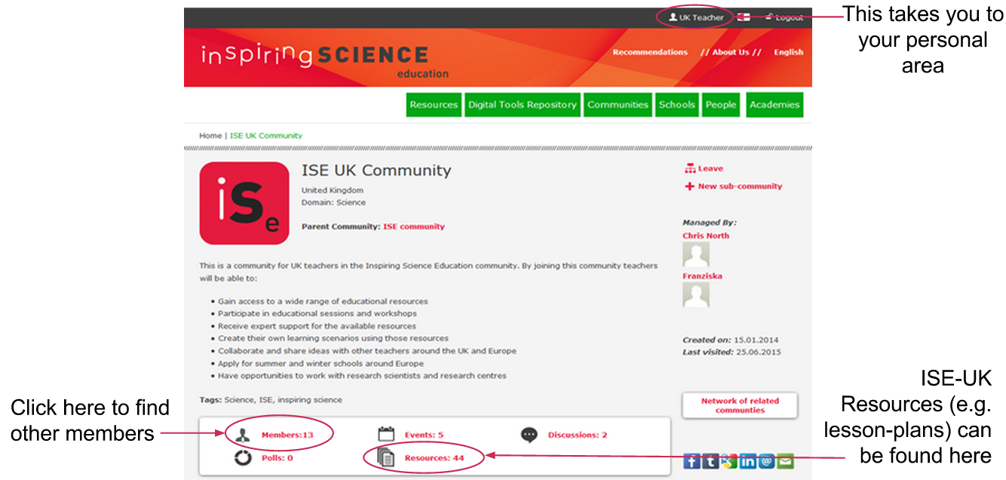
You will receive an email to set your password, click on the link and follow the instructions
After successful registration you should find yourself at the front page of the UK community of the ISE
Notes:
After you have completed the registration process, you should find yourself at the front page of the ISE UK community (or else go to http://portal.opendiscoveryspace.eu/community/ise-uk-community-568351). There are various links on this page. If you click on your username towards the top right of the screen you will go to your personal area. Members will take you to a list of other teachers and users of the ISE UK community and resources takes you to a list of all ISE-UK resources, like lesson plans and web apps.

Slide 4

Congratulations! You have completed registration and are now a member of ISE!
To learn how to prepare and deliver a lesson plan in your classroom, check out this powerpoint.
For information on why ISE is useful and how to build your own Demonstrators from scratch, go to these slides.
Notes:
Congratulations on completing your registration with Inspiring Science Education. Further guides will follow soon.

