Slide 1
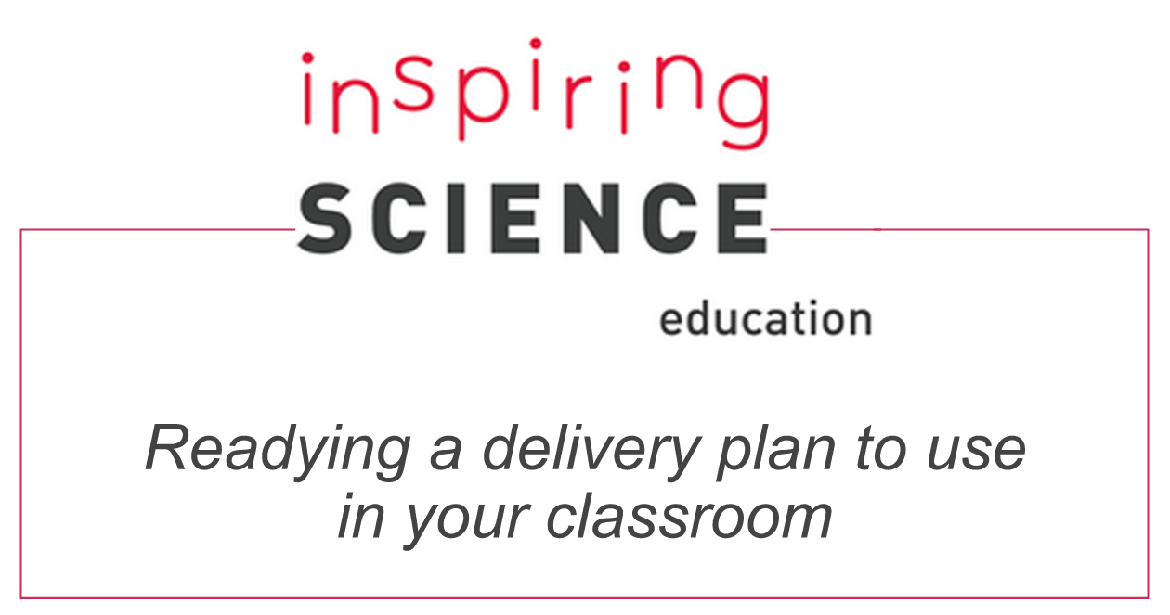
Notes:
Thank you for using the Inspiring Science Education (ISE) Portal. This guide will walk you through the steps of readying, editing and delivering a demonstrator (or lesson plan) for use in your classroom.
We describe the pathway to one specific lesson but the steps can be adjusted for any other lessons offered by the ISE Portal.

Slide 2
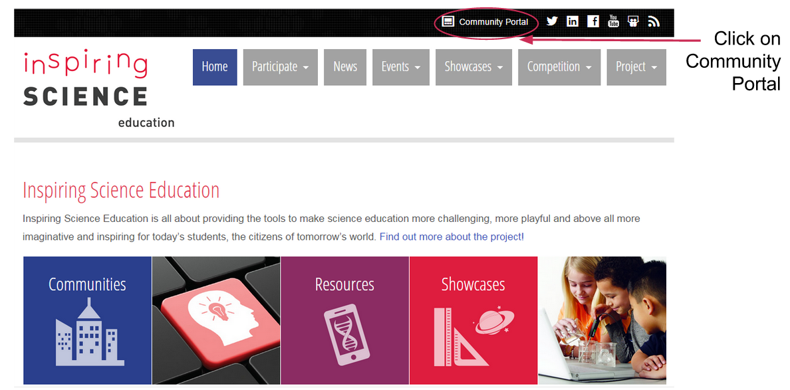
Go to the Inspiring Science Education homepage inspiringscience.eu
Notes:
Start on the ISE homepage http://inspiringscience.eu and click the link to the Community Portal (top right of the screen)
You should now enter your login details (username or email and password). If you haven’t registered yet, we have a simple guide to this process at http://portal.opendiscoveryspace.eu/eo-resource-view/832714 or you can click on “Join now” and work through the steps.

Slide 3
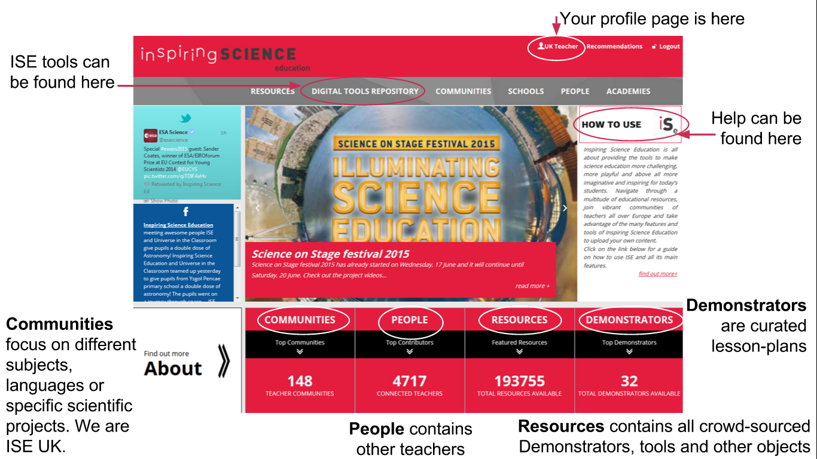

Slide 4
Join the ISE UK Community
Notes:
It is useful to join the ISE UK community where we have some very good resources and links to others.

Slide 5
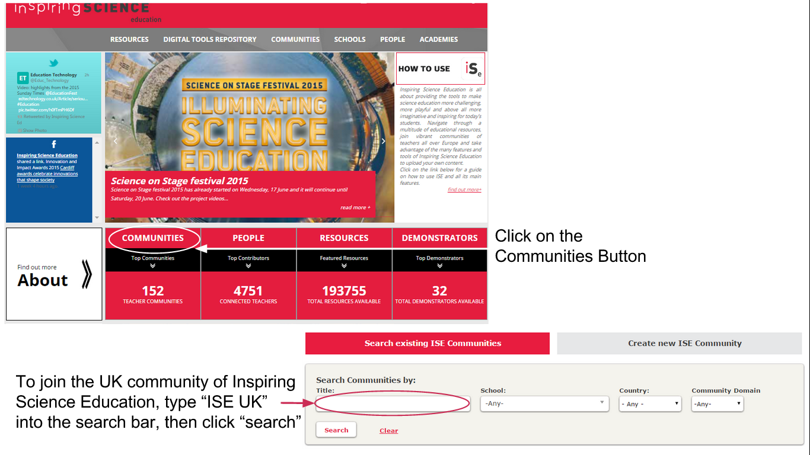
Notes:
From the Inspiring Science Education home page, click on Communities and search for the “ISE UK” community on the next page. Alternatively follow this link directly: http://portal.opendiscoveryspace.eu/community/ise-uk-community-568351

Slide 6
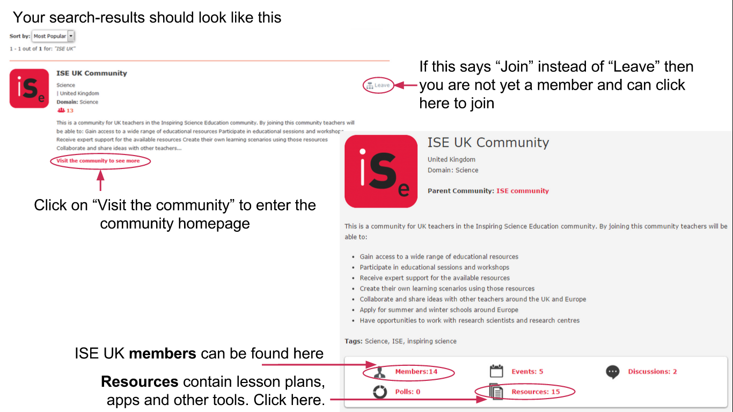
Notes:
Visit the community page and click the “Join” button if you are not yet a member. An admin from the group will have to approve your request but this shouldn’t take too long.
There is a lot of information available from the ISE UK community page. You can view other members as well as find resources such as lesson plans, web apps, and other tools. For now, click on the “Resources” button.

Slide 7
Using a “Demonstrator” or pre-made lesson plan
Notes:
We have now navigated our way into a community and found a list of resources. The ISE portal has many Demonstrators which are a specific type of resource comprising pre-existing lesson plans. The next steps describe how you can easily implement these with your class.

Slide 8
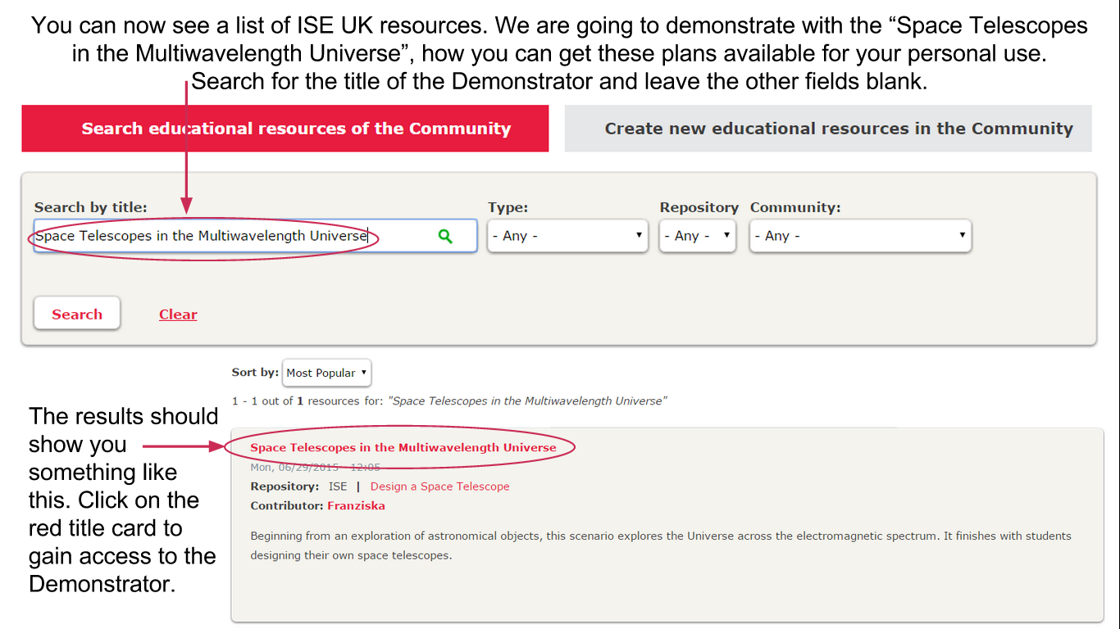
Notes:
You should be able to see a list of ISE UK resources. Most of these links go directly to the lesson plans. We are going to start with the “Space Telescopes in the Multiwavelength Universe” demonstrator. Search for this title now and leave the other fields empty.
Click on the red title card to gain access to the Demonstrator, this should take you to the homepage.

Slide 9
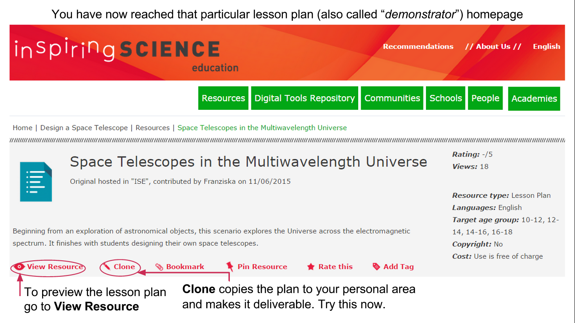
Notes:
This is the homepage for this lesson plan (also referred to as a “Demonstrator”).
You can check whether the lesson plan matches what you expect by clicking on “View Resource” which will give you a preview. If this is the lesson plan you want to use, click on the “Clone” button which copies the plan to your own personal area and makes it deliverable.

Slide 10
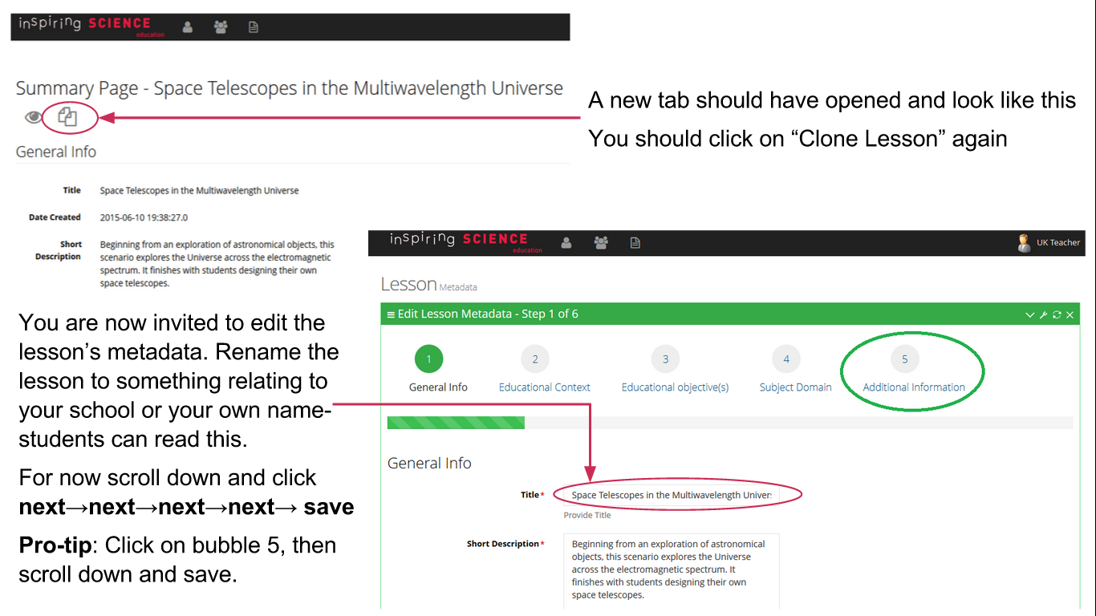
Notes:
Your browser will have opened a new tab where you have to click the “Clone Lesson” button again.
The next page invites you to edit the lesson’s Metadata. We recommend renaming the lesson under the “General Info” to something relating to your school or your own name. Students will be able to see this title when you deliver the lesson.
Check the information on each page, scroll down and press “next”. Do this for each of the 5 pages of metadata, then “Save” the lesson. You can achieve the same result by clicking on bubble 5 and pressing “Save” but this doesn’t allow you to check the information.

Slide 11
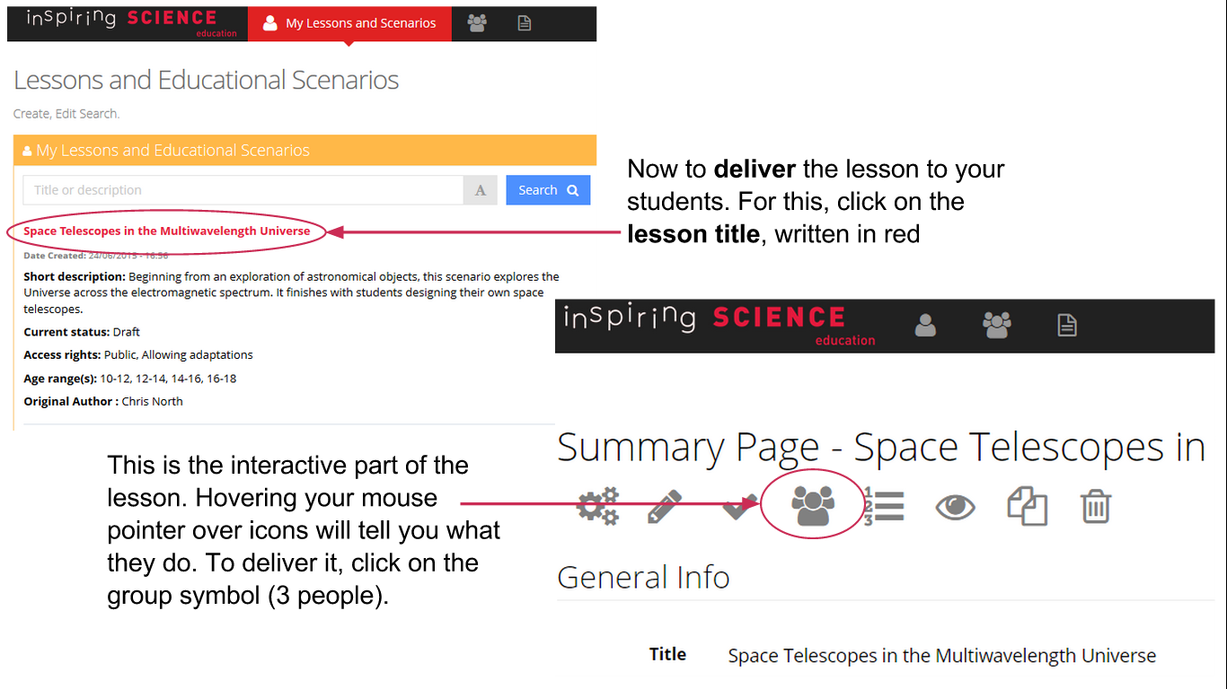
Notes:
You are now ready to deliver the lesson to your students. You should be on your personal lessons and scenarios if you have followed all the previous steps. Click on the red lesson title which will bring you into the interactive part of the lesson. Hovering your mouse pointer over icons will tell you what they do.
For now, let’s deliver the lesson by clicking on the “Deliver” symbol (group of three people).

Slide 12
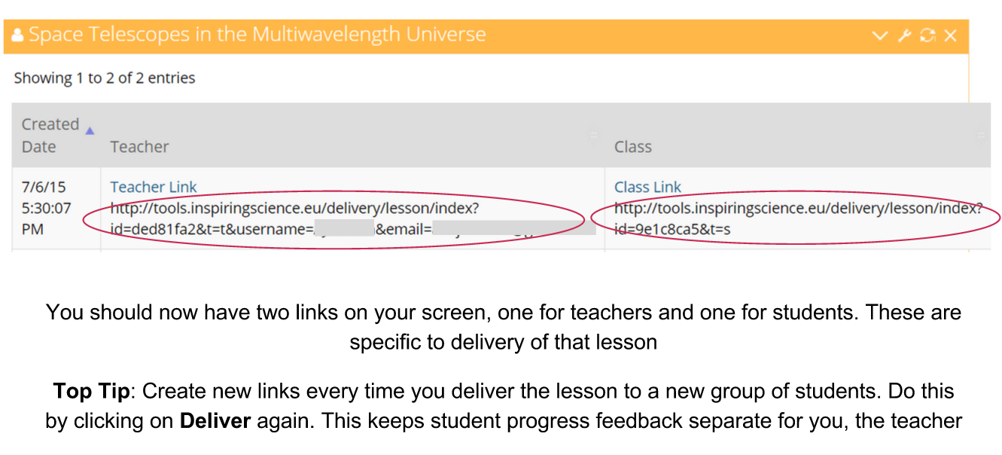
Notes:
The page will now show you a teacher and a student link. Students use their link to enter the lesson and the teacher link gives you a view with more information. These links are specific to the delivery of that lesson and allow you to view all students progress.
It is recommended to create new links every time you deliver a lesson to a new group of students. This means you will view student feedback separately for each class. You do this by clicking on the “Deliver” button again (the group of 3 people).

Slide 13

Good luck delivering these lessons to your classes!
The ISE platform contains thousands or resources and lesson plans so please explore to find Demonstrators relevant for your classes.
If you still haven’t registered on ISE, we have a powerpoint explaining how to do this here.
To find out more tips for using the ISE platform check this out.

