Slide 1

Notes:
Thank you for using the Inspiring Science Education (ISE) Portal. This guide explains why the ISE Demonstrators are a useful way to deliver lessons as well as providing some useful tips and tricks for exploring the network of communities and how to add and create your own effective demonstrators.

Slide 2
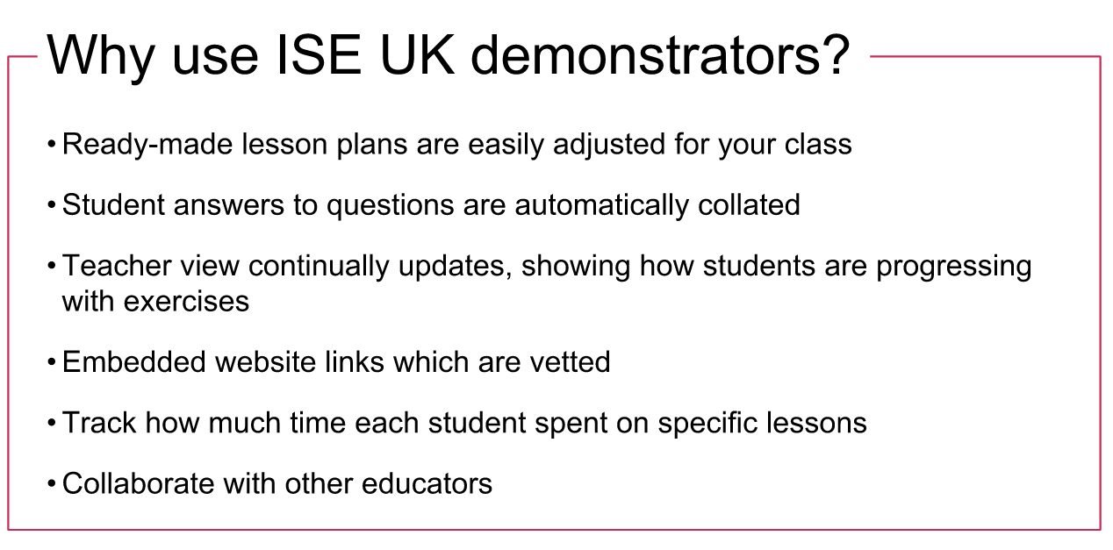
Notes:
There are some very good reasons for using ISE UK demonstrators to deliver your lessons.
A demonstrator is a ready-made, ready-to-deliver lesson plan which is still flexible enough for you to adjust and alter to the specific needs of each class.
You can set questions within the lesson plan and the student’s answers are automatically collected together.
The teacher view for each lesson is continually updating so you can always see how much progress individual students are making with exercises.
All lesson plans can have website links embedded in them and these links have been checked and vetted.
As a teacher you can see how much time each student has spent on specific lessons or exercises which is great for homework exercises.
A final advantage to the ISE platform is that you can share lessons and alterations with other educators via the communities.

Slide 3
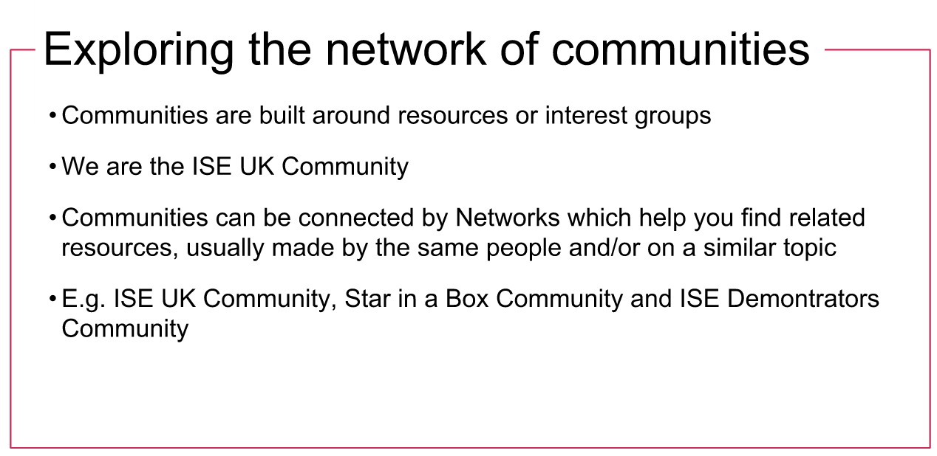
Notes:
Communities are built around resources or common interests.
We are the community of ISE users in the UK and have our own selection of resources.
Joining different communities enables you to find resources around certain topics or lesson plans. You might just find exactly what you are looking for.

Slide 4
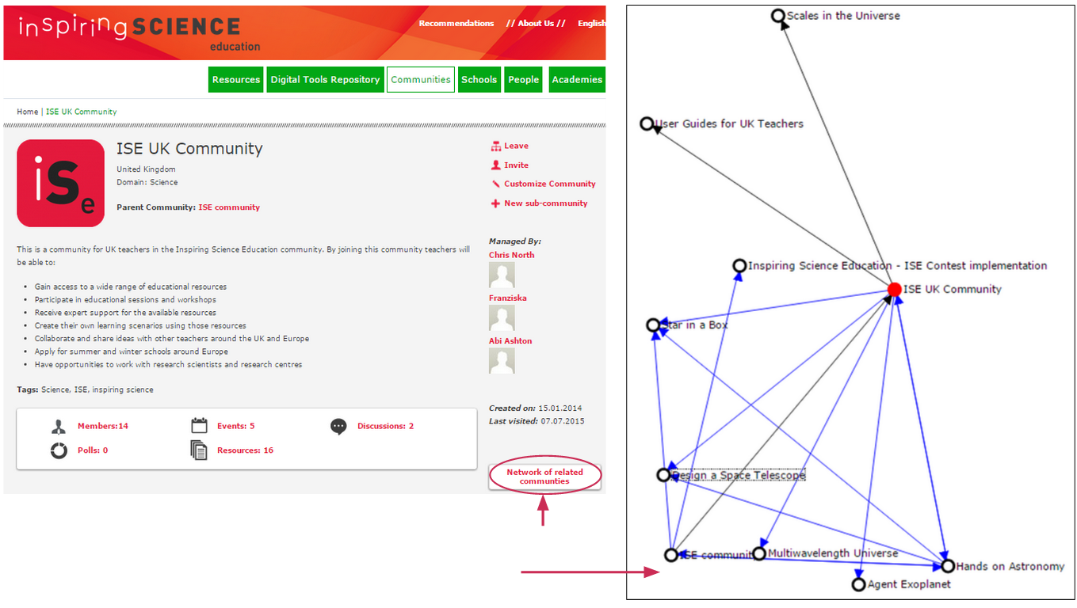
ISE UK Community Homepage
Try checking out the “Network of related communities”
This will take you to a page like this Network Map
Notes:
ISE UK Community Home page can be found here: http://www.opendiscoveryspace.eu/community/ise-uk-community-568351
This shows you the network of related communities; clicking on their name will take you to that community’s home page. Using the community network allows you to find lesson plans related to those you have already used. Networks link communities together and visually connect related or similar Communities.

Slide 5
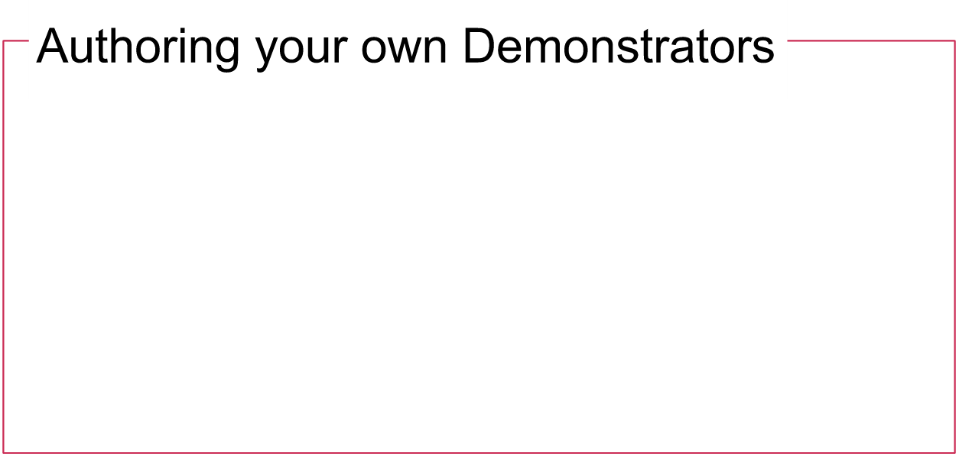
You probably already know how to clone and deliver pre-made demonstrators. If not check out this powerpoint
You can also write you own demonstrators from scratch
These can then be shared with other educators and you can see any demonstrators they choose to make public
To make your own demonstrator, log-in to the ISE platform and go to the resources page of the ISE UK Community page
Notes:
Authoring your own demonstrators gives you full control over what content your students will encounter. This allows you to tailor your lesson plan closely to the material you need to cover.

Slide 6
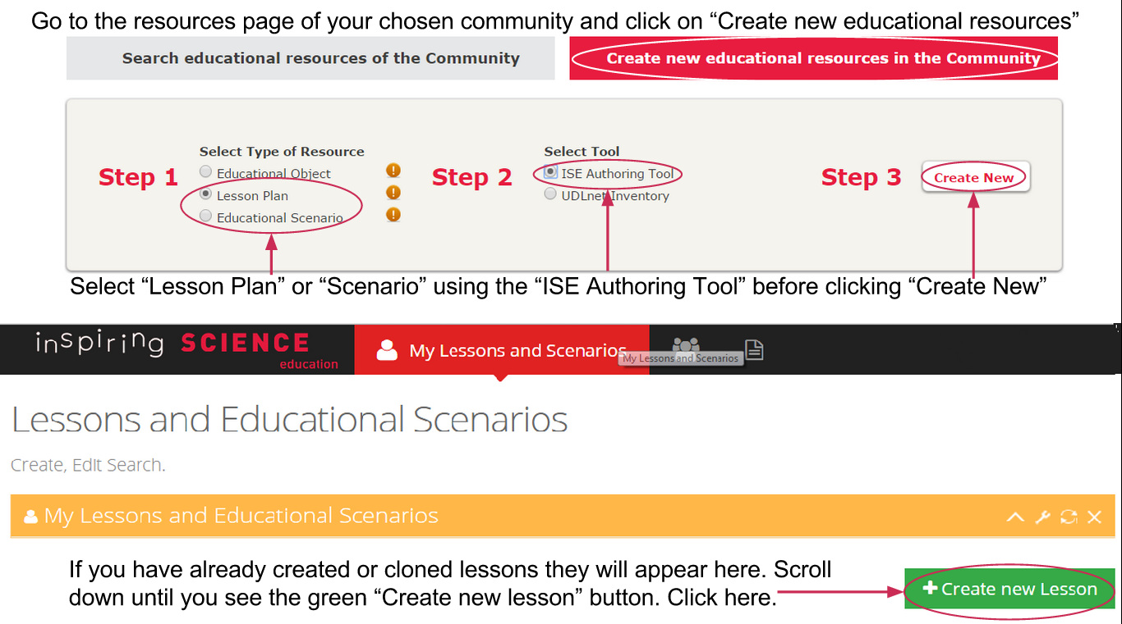
Notes:
First choose the community your resource will be embedded in. If it is a new topic, consider creating a new sub-community. If it is related to an existing lesson, consider creating it within the appropriate community for that resource.
Go to the resources page of your chosen community and click on the “Create new educational resources in the Community” tab. Select “Lesson Plan” or “Scenario” along with the “ISE Authoring Tool” before going to “Create New”.
The following page will show you a list of all lessons you have created or cloned. Scroll down or shrink this list to see the “Create new lesson” button. This will take you to the Demonstrator construction pages.

Slide 7
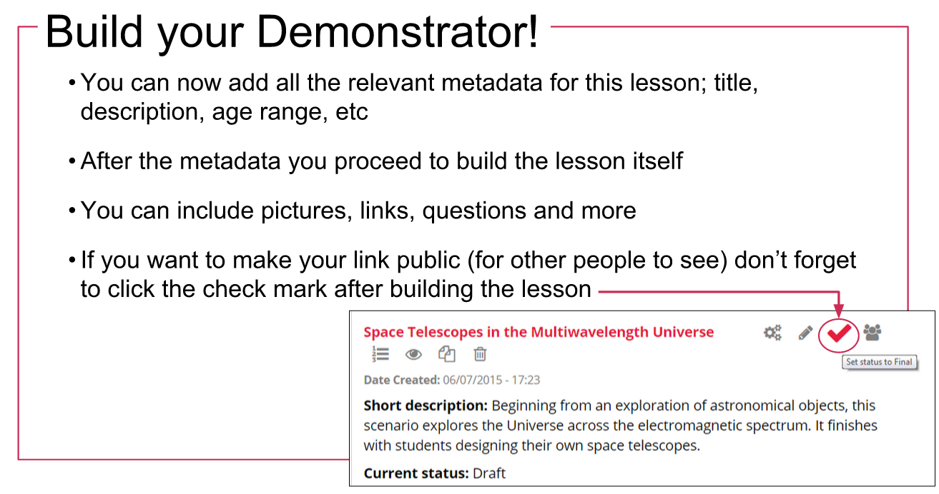
Notes:
Now you have to create the Metadata for this demonstrator. This includes the title of the lesson, a brief description, recommended age range as well as other relevant details. You can still edit Metadata later.
Once the Metadata is complete, you create the lesson itself; adding pictures, links and questions as you go.
Once your lesson is complete it will be saved to your list as a “Draft”. If you want to make this lesson publicly viewable you need to click the check-mark that appears when you hover the mouse over the pink lesson title.

Slide 8
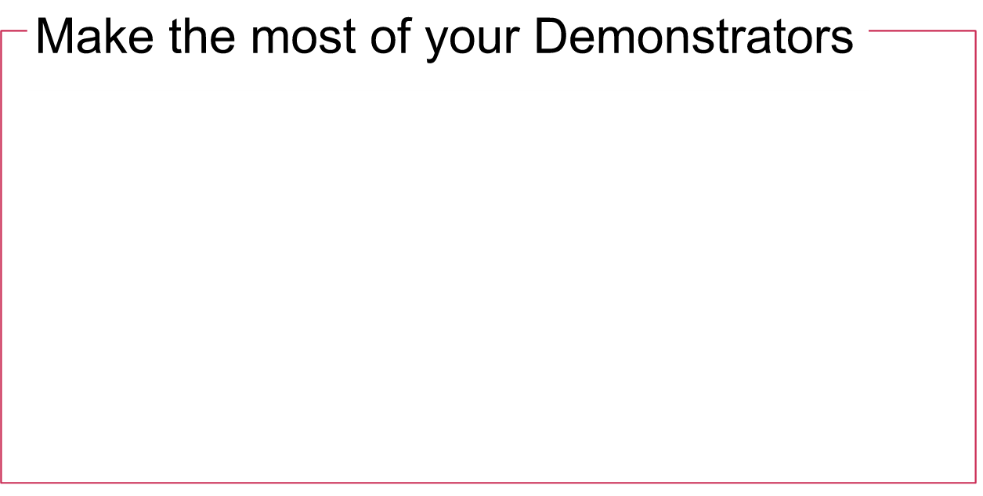
Make sure Demonstrators are in the right community, this makes them easier for other to find and use
Embedding links in the lesson makes it more interactive and gives you more control
Aim to set questions specific to learning outcomes, making progress easier to monitor
Don’t forget to follow the 5 steps of the ISE lesson plan; Orienting & Asking Questions, Hypothesis Generation & Design, Planning & Investigation, Analysis & Interpretation, Conclusion & Evaluation
Notes:
There are several ways to make sure that your Demonstrators are most useful for you, your class and other educators.
Make sure that Demonstrators are in the right community, this makes them easier for others to find and helps you keep track of similar or related resources.
Embedding links (to web apps or pages) within the lesson, makes it more interactive for students and gives you more control. The students can be directed straight to the relevant information.
Aim to set questions at each stage of the lesson. These questions can be specific to learning outcomes for your students making it easier for you to monitor their progress and understanding.
We recommend to build your lesson plan around the 5 steps of the Inspiring Science Education format. These are Orienting & Asking Questions; Hypothesis Generation & Design; Planning & Investigation; Analysis & Interpretation and Conclusion & Evaluation. These 5 steps mimic the scientific method.

Slide 9

You should now be confident to design, build and implement your own Demonstrators as well as understanding some of the benefits of the ISE platform.
For tips on how to register check out this Registration Guide or if you want to clone and deliver an existing Demonstrator go to our Guide to Delivering a Lesson
Notes:
You should now be confident to design, build and implement your own Demonstrators as well as understand some of the benefits of the ISE platform.
For tips on how to register check out http://portal.opendiscoveryspace.eu/eo-resource-view/832714 or if you want to clone and deliver an existing Demonstrator go to http://portal.opendiscoveryspace.eu/eo-resource-view/832722 for more information.

