Slide 1





Open Discovery Space Summer School 2014
Marathon, Greece, July 13-18
Educational Scenario of Ezgililer Educational Ins.

Slide 2
Basic info on the scenario:
Name of participant: Ugur Altunbayrak
School: Ezgililer Educational Institute
Country: Turkey
Title of scenario: Giving some exercises to 7th grade students about “Simple Machines”
Short description/main idea: Nowadays, 11-13 years old students are using social media. If the teachers give some homeworks by using social media, students should do their duties so easily and savorily.

Slide 3
Educational objectives and pupils’ competences targeted:
Lesson : Science
Grade : 7th
Unit / Subject : Force & Motion / Simple Machines
Educational Obj. : Students should be provided to recognize the simple machines and to understand their facilities without looking at mathematical relations about simple machines.
Pupil’s Competences Targeted: Students are provided to learn simple machines such as screw, spinning wheel, cutter, wheel with the help of research method.

Slide 4
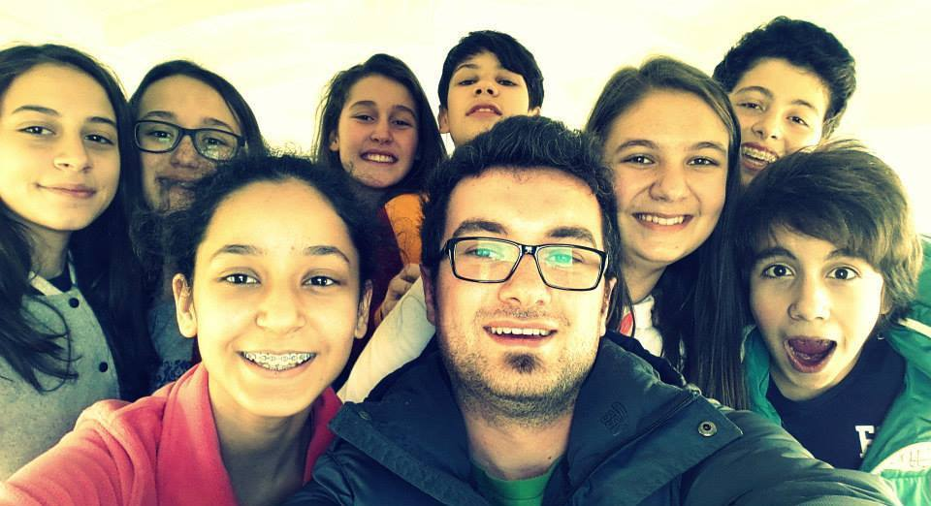
Pupils’ ages:
Our Pupils are going 7th grade class. They are beetween 11-12 years old.

Slide 5

Curriculum areas/ domains involved:
Our lesson’s name is Science & Technology and it has 3 different areas of science. Physics, Chemistry and Biology.

Slide 6
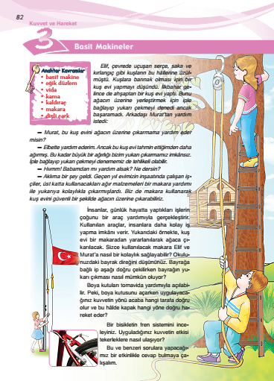
Curriculum areas/ domains involved:
My scenerio is about unit of “Force and Motion” in the domain of physics. I chose subject of “Simple Machines”.

Slide 7
Which school needs does your scenario address?
Secondary school needs that scenario address.

Slide 8
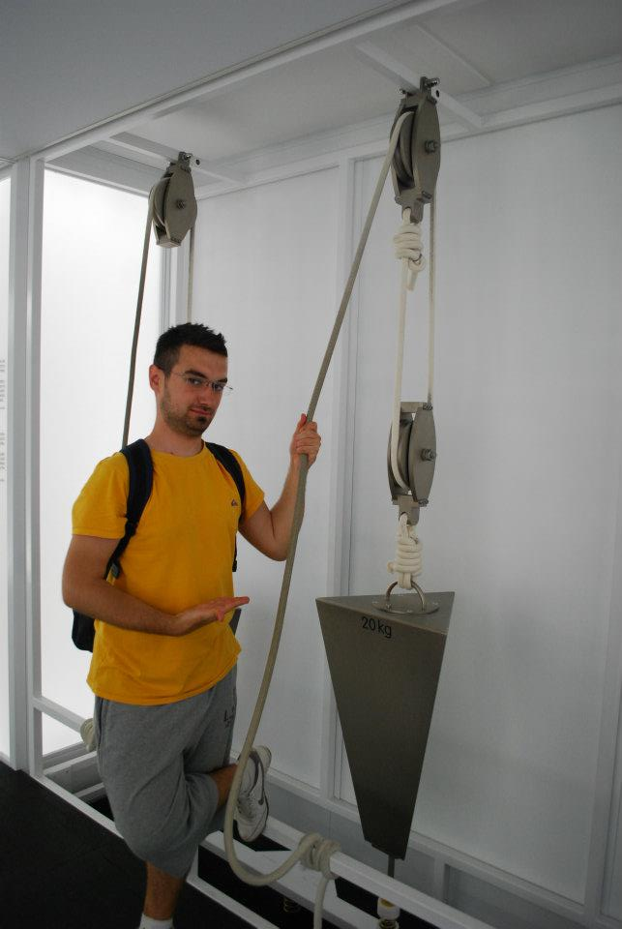
Parental engagement
  Parents can help to pupils during implement. For example, they can go out and look around and find to help some simple machines examples.

Slide 9
Parental engagement
  Which school needs does their engagement in this scenario intend to serve?
  All kind of schools can do this engagement in this scenario intend to serve. Because

Slide 10

Parental engagement
  We are expected benefits from parents’ engagement in this scenario that give feedback about pupils’ learning process.
  They can use mobile contact, sms or e-mails.

Slide 11
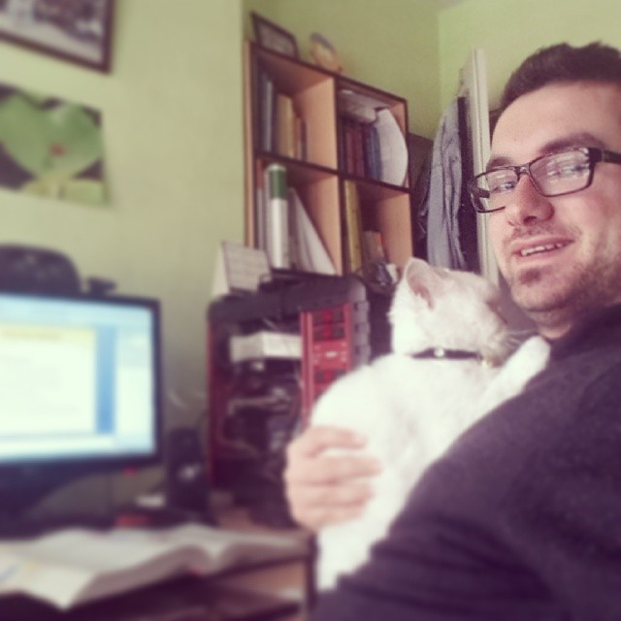
Phase 1: Preparation
  Teacher need to do before implementing the scenario:
Preparation to their subject.

Slide 12
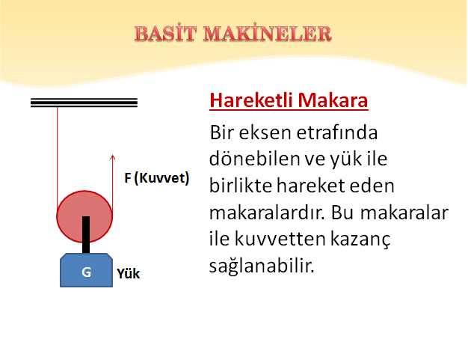
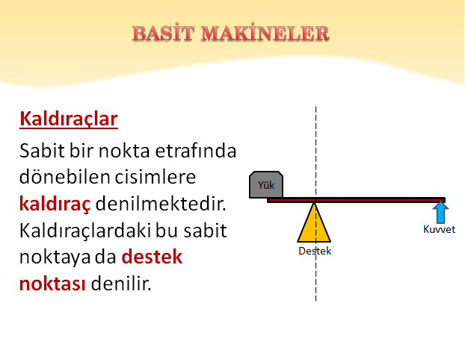

Phase 1: Preparation
  Teacher need to do before implementing the scenario:
Teach subject to the pupils.

Slide 13

Phase 1: Preparation
  Teacher need to do before implementing the scenario:
Give homework them about simple machines in their life.

Slide 14
Phase 1: Preparation
  Teacher need to do before implementing the scenario:
Pupils will take photos about simple machines.
They will make collage with some mobile phone apps.

Slide 15
Phase 1: Preparation
  Teacher need to do before implementing the scenario:
And they will share it on Instagram with #SimpleMachinesEzgililer hastag.

Slide 16
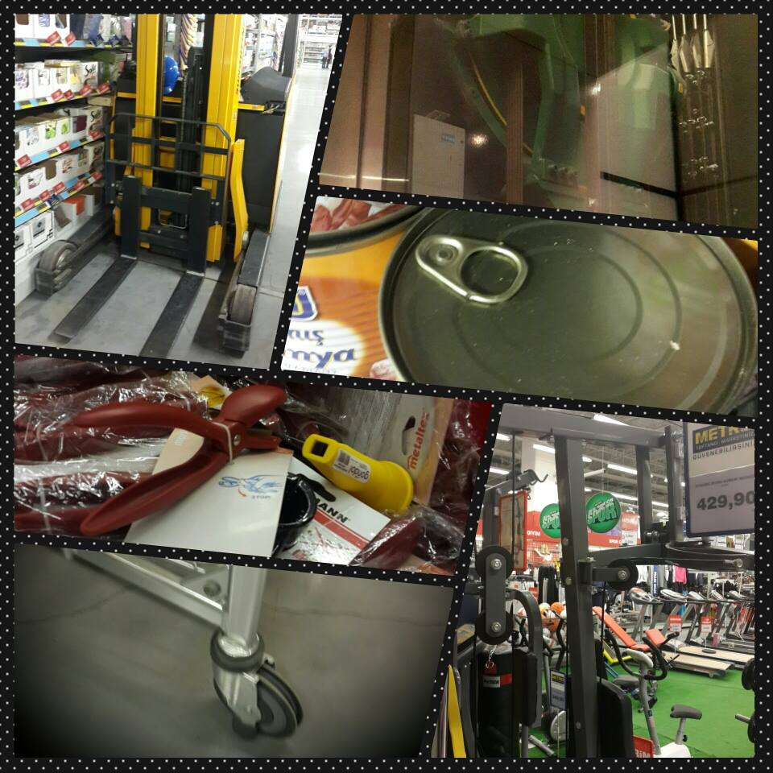
Phase 2: Implementation
  After pupils’ implementing, teacher will check collages from Instagram.

Slide 17

Phase 2: Assessment
Teacher will make some comments for assesment from Instagram.
After homework finish, teacher discusses with the pupils in the classroom.

Slide 18
Resources
7th Grade Science Book, Ministry of National Education Published http://www.meb.gov.tr/Ders_Kitaplari/2012/IlkOgretim/Devlet/FenVeTeknoloji/FenVeTeknoloji_7_%20DK.pdf
Ministry of National Education, 7th Grade Yearly Plan of Science Lesson
http://www.egitimhane.com/7-sinif-fen-ve-teknoloji-unitelendirilmis-yillik-plan-2013-2014-d115725.html
Instagram Apps for Mobile Phones
https://play.google.com/store/apps/details?id=com.instagram.android&hl=tr
Photo Grid Collage Apps for Mobile Phones
https://play.google.com/store/apps/details?id=com.roidapp.photogrid&hl=tr
Teacher Aid Pro Apps for Mobile Phones
https://play.google.com/store/apps/details?id=com.glen.apps.TeacherAidePro&hl=tr

Slide 19
Thanks for Listening...
Ugur Altunbayrak
Science Teacher
Ezgililer Education Ins.
Samsun, Turkey
uguraltunbayrak@gmail.com

