Slide 1
Open Discovery Space
Task 3.6
Towards a community of Virtual Schools
National Coordinators’ Meeting, Belgrade, 30/9/2013

Slide 2
ODS Facts
ODS Facts
66565 learning objects.
554 connected teachers.
73 Communities.

Slide 3
The fundamentals of online communities
Clarity & relevance.
Addressing participating teachers’ intrinsic needs.
Generic online communities tend to “die” quickly. Communities targeting groups of teachers with common needs and interests will “live longer” (Widenman 2010; Carr & Chambers, 2006).
Access to content that is directly useful to someone’s teaching (Widenman 2010; Baek & Barab, 2005). At the early stages of community development, National Coordinators who may be experts in particular fields should contribute to certain communities with content, tools, scenarios, etc. or work towards locating and engaging experienced teachers and contributors.

Slide 4
The fundamentals of online communities
Trust, empathy, support.
Creating a community of teachers who are not afraid to critically discuss their teaching approach, methods & material. (Widenman 2010; Baek & Barab, 2005; Lock, 2006).
Teachers will not share their approach with peers for fear of exposing any possible weaknesses and will not criticize the teaching methods of others. (Widenman 2010; Baek & Barab, 2005; Barab, 2006; Scheckler, 2010).
A good opportunity for building trust among participants in the pilots and Change Agents are the T3.5 workshops (see Ms Chelioti’s presentation at the NC’s meeting on 30-9-2013, slides 10-18). There are some trust building games that you may use in the workshop too. For ideas, see http://www.wilderdom.com/games/TrustActivities.html. Get them to explore common areas of interest. If they start working together (sharing ideas, scenarios, etc.), you have the first core members of a thematic digital community.

Slide 5
The fundamentals of online communities
Pseudo-communities vs. true communities.
Projecting an image of competence rather than exposing your real work.
Keeping a balance between good quality and participation.
Resource sharing can be informal: Suggesting a link or a tool that a teacher has found useful is a good approach. Communities should not become victims of the “fallacy of originality” (i.e. everything has to be original).

Slide 6
The fundamentals of online communities
Formal recognition: Participation in a community’s life is low when members participate on a voluntary basis than when participation is part of a more formal process (Widenman 2010).
A Schoolmaster may establish a semi-formal structure in which teachers are evaluated on their use and support of (their own) online teaching/learning communities in ODS.
Your ‘Change Agent’ as your best community builder.

Slide 7
An example
Let Us Share The Music
“Let Us Share The Music” is a multiple-site-link scenario in which all participants (remote sites) collaborate with each other in order to create and perform a live music web event. This action aims to develop innovative and advanced teleconference activities that will bring together communities from Greece -or any other country in Europe- where formal music education, or special music tuition, is scarce or impossible (Petros Stergiopoulos EA, 2013).
http://dma.ea.gr/en/node/13

Slide 8
T 3.6 Virtual Schools
A Virtual School will involve teachers participating in the pilots and have an interest in specific thematic areas.
A continuous process of experience exchange.
Focusing on the further development of their change management skills.
Designing a processes that would guarantee the sustainability of the community across groups of teachers (locally, regionally, nationally and across different countries).

Slide 9
D 3.4
The corresponding deliverable produced will be D 3.4 (Report on Development of the Virtual School Community), aiming to report on the experience and support of the deployment in other schools, beyond the ones participating in the project.
Examples of Virtual Schools may engage teachers that are involved in the Discover the Cosmos portal or the Galileo Teachers Training Program, who will be encouraged to create their own ODS community, share a certain volume of lesson plans and scenarios and track its progress through specific metrics (see slides 10-12) with the help of National Coordinators and Task Participants.
National Coordinators should agree by early November the number of these pilot Virtual Schools. Ideally, there should be between 4 to 6 Virtual Schools.

Slide 10
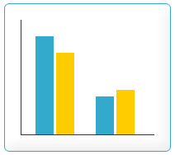
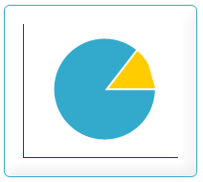


ODS statistics & analytics tool Intrasoft
Dimensions of analysis:
resources importance and use
user engagement and participation
community status
evolution of the ODS Portal
Parameters of events logging mechanism:
Time
Role of users
Geographic area
Portal content
Types of queries:
Community-oriented
Portal-oriented
User-oriented

Slide 11
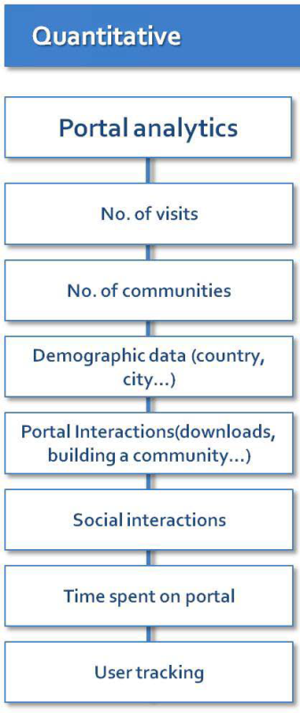
Metrics
Bissinger, K. (2013) T5.4 Pilot Trials Data Collection and Analysis: Current status of evaluation tools and organizing the data collection. University of Bayreuth, NC Meeting, Belgrade 30/9/2013

Slide 12
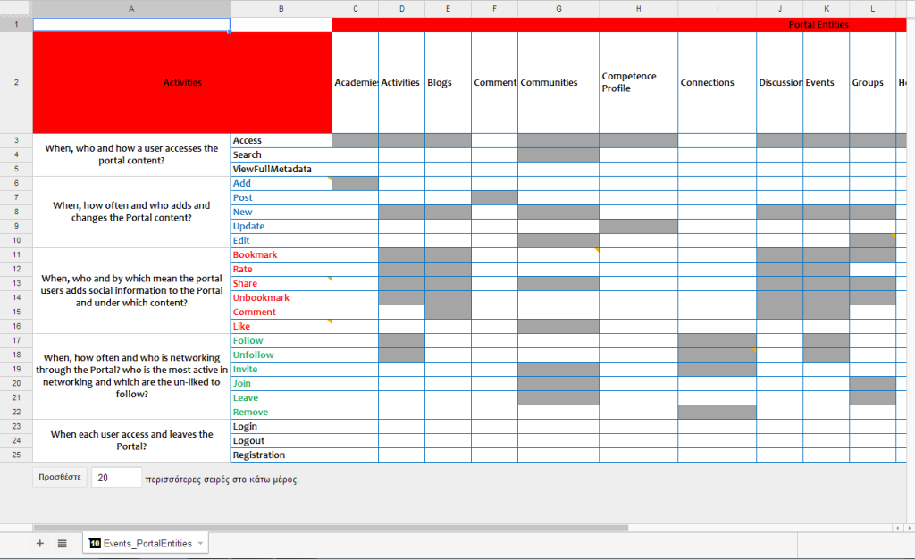
Metrics

Slide 13
Bibliography
Bibliography
Baek, E., & Barab, S. A. (2005). A study of dynamic design dualities in a web-supported community of practice for teachers. Educational Technology & Society, 8(4), 161-177.
Barab, S. (2006). Design-based research. In R. K. Sawyer, (Ed.), The Cambridge handbook of the learning sciences (pp. 153-169). Cambridge: Cambridge University Press.
Bissinger, K. (2013) T5.4 Pilot Trials Data Collection and Analysis: Current status of evaluation tools and organizing the data collection. University of Bayreuth, NC Meeting, Belgrade 30/9/2013
Carr, N., & Chambers, D. P. (2006). Teacher professional learning in an online community: The experiences of the National Quality Schooling Framework Pilot Project. Technology, Pedagogy and Education, 15(2), 143-157.
Lock, J. V. (2006). A New Image: Online Communities to Facilitate Teacher Professional Development. Journal of Technology and Teacher Education, 14 (4), 663-678.
Scheckler, R.K. (2010). Case studies from the Inquiry Learning Forum. In J. O. Lindberg, & A. D. Ologsson (Eds.), Online learning communities and teacher professional development: Methods for improved education delivery. (pp. 43-59). Hershey, PA: IGI Global.
Widenman, H. (2010) . Online Teacher Learning Communities: A Literature Review. Institute for Research on Learning Technologies. Technical Report. University of York.

Slide 14
Thank you for your attention

