Slide 1
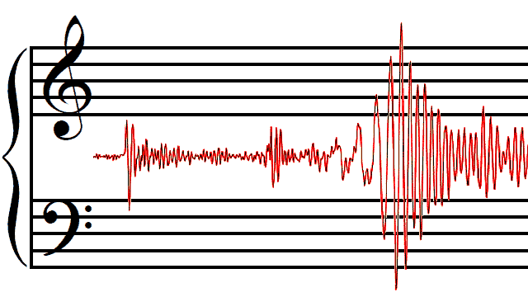



The sound of the earth
E. Chaniotakis, P. Stergiopoulos, J. Alexopoulos
Ellinogermaniki Agogi

Slide 2
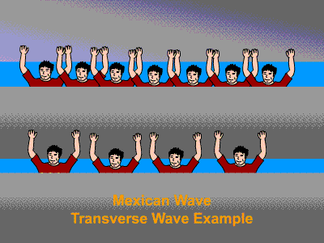

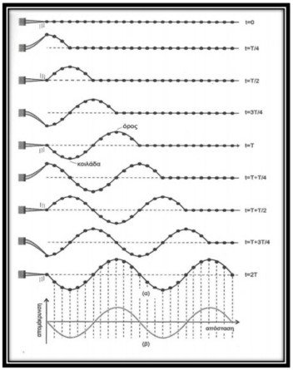
Let’s remember about waves

Slide 3
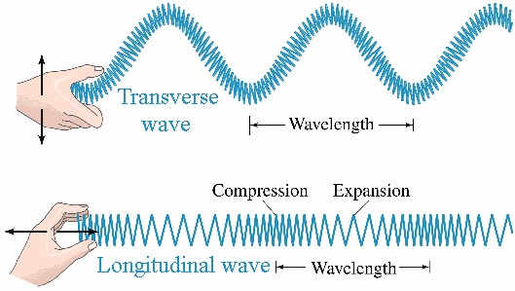
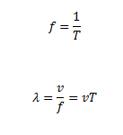
How do waves look like?
What are their fundamental observables?

Slide 4

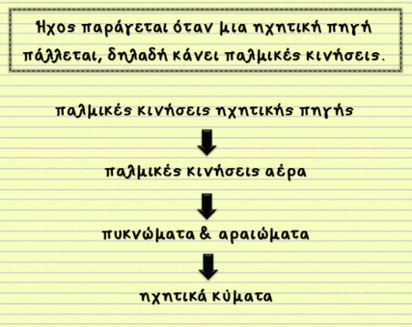
Sound as an example of a wave
https://www.youtube.com/watch?v=aPswnDcteS4
Speed of sound on air (STP) 343m/s

Slide 5
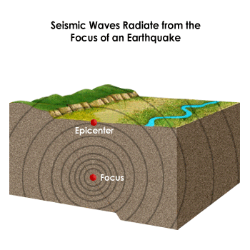
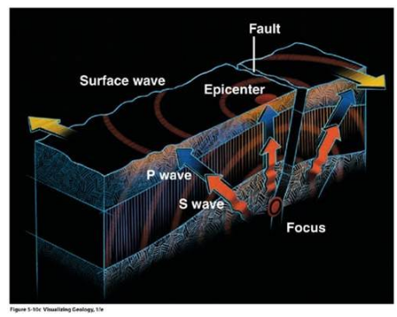
Seismic waves

Slide 6
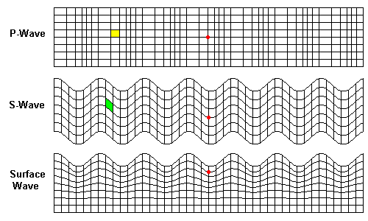
Kinds of seismic waves
  P- κύματα
  διαμήκη, γρήγορα
S-κύματα
εγκάρσια, πιο αργά
Fast-
Longitudinal
Slower-
Transverse
Slower,
more
destructive
Notes:
Up~7km/s, Us~3.5m/s

Slide 7
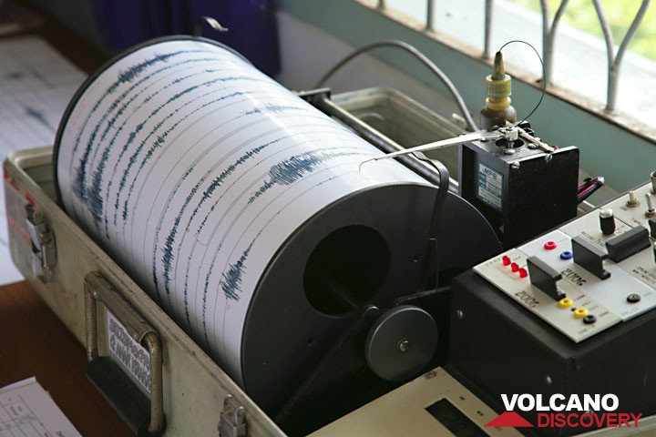
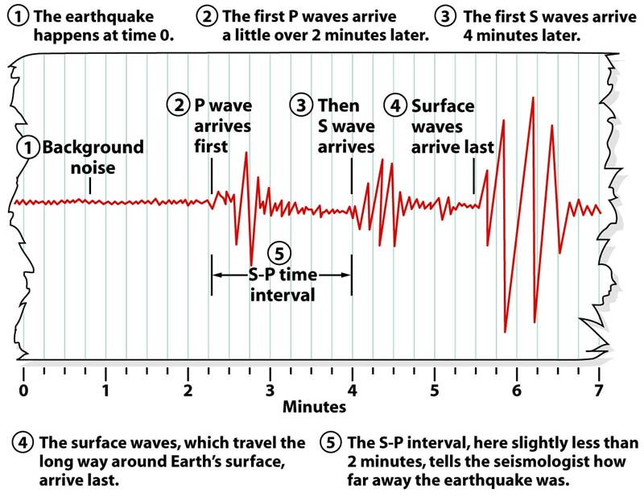
Detecting earthquakes
To detect earthquakes, scientists
use seismometers.
Seismometers produce seismograms.

Slide 8
Studying and combining seismograms from different stations, scientists can draw information regarding the parameters of earthquakes: The epicenter, magnitude, depth and others.
Let’s learn about the epicentre.
http://highered.mheducation.com/sites/dl/free/0073135151/90798/16_08.swf

Slide 9
Let’s consider
Sound is a wave. Earthquakes arrive to us in waves also. Could we listen to earthquakes? To hear the vibrations of earth’s solid crust?
Do earthquakes have their own melody?
Would you like to synthesize your own melody of the earth using data from a seismogram?

Slide 10
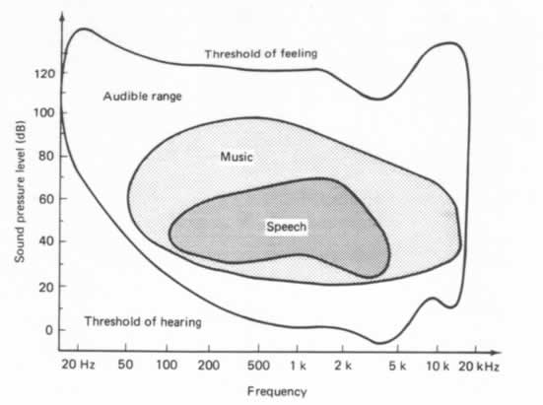
Limits of human hearing
Human ear sensitivity range: 20Hz < f < 20kHz.

Slide 11
Can we hear an earthquake?
Most earthquakes have frequencies <20Hz → we cannot hear them
The sound we hear during earthquakes derives from the oscillation of buildings and their internal structures (glass, bookcases etc)
Let’s see the time evolution of the frequency of an earthquake.

Slide 12
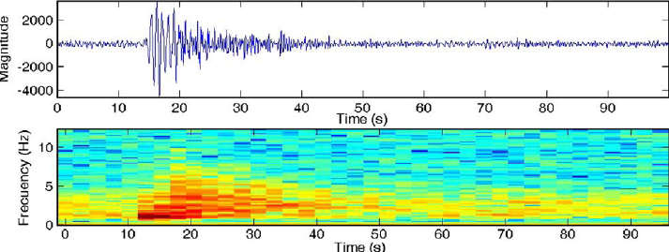
Seismogram and spectrogram for a volcanic earthquake

Slide 13
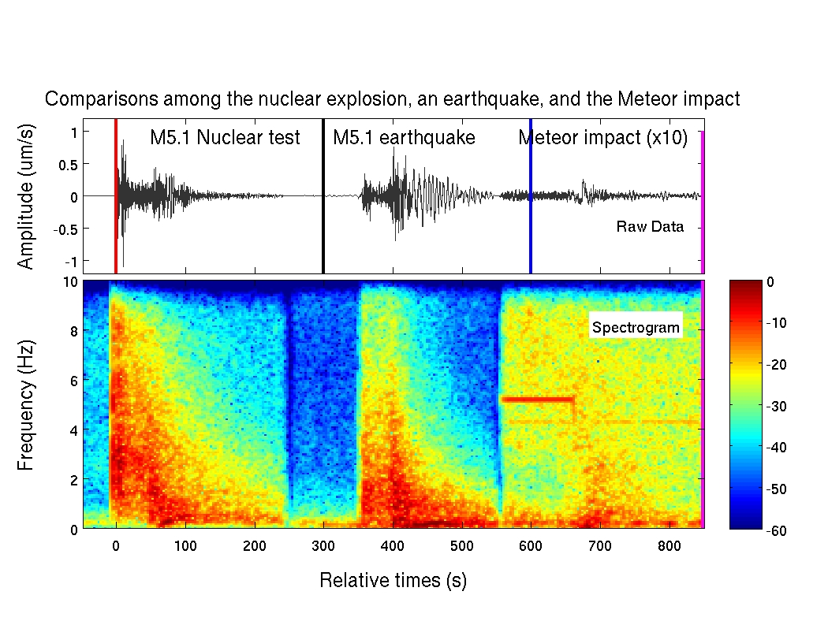
Comparing..
source: http://geophysics.eas.gatech.edu/people/zpeng/EQ_Music/

Slide 14
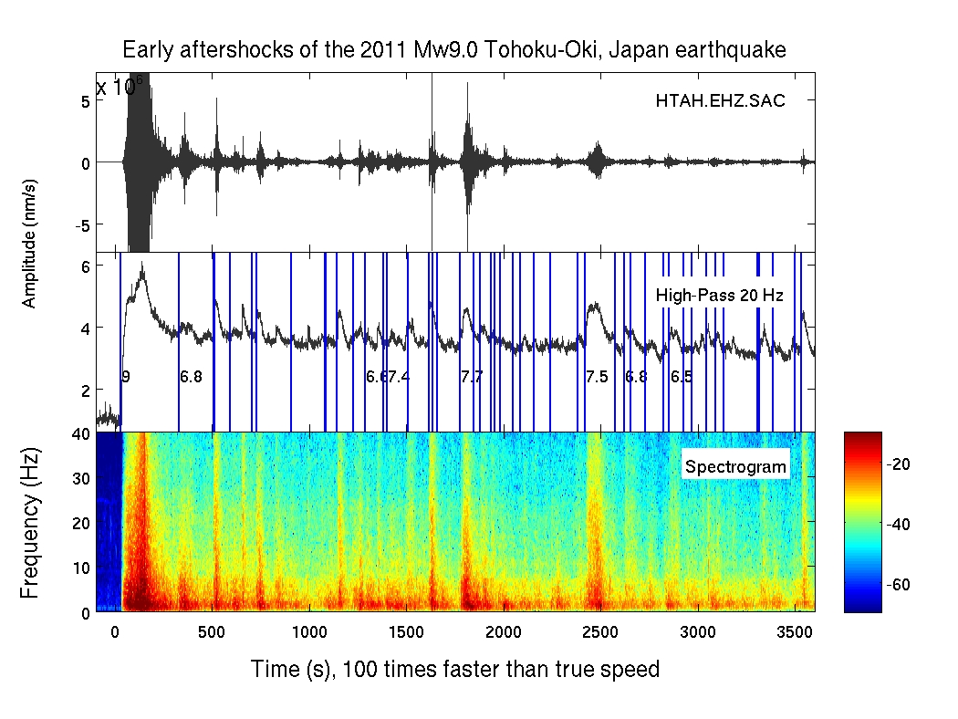
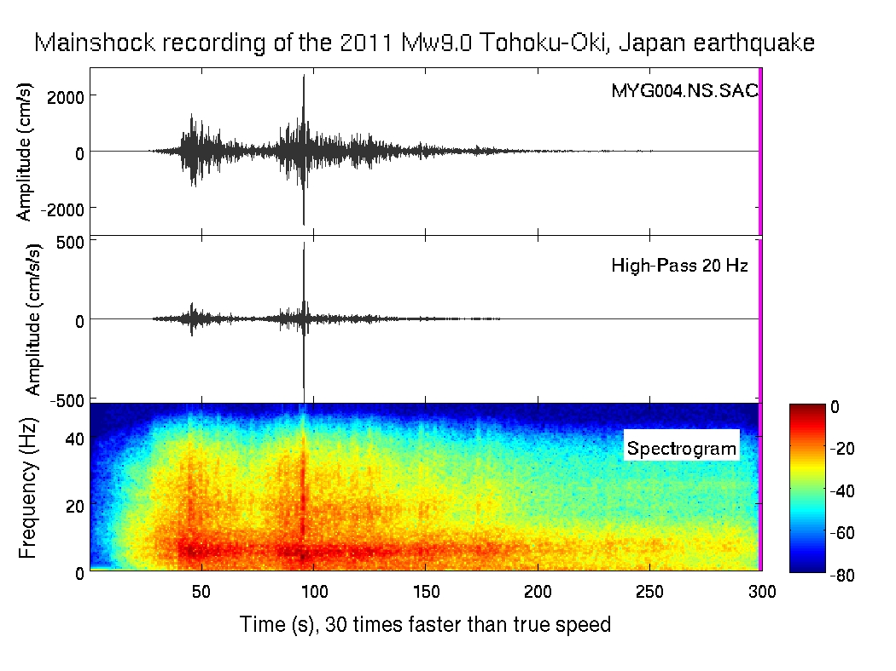
Question
How can we hear a sound with frequency below
20 Hz?
Audio Time Compression

Slide 15
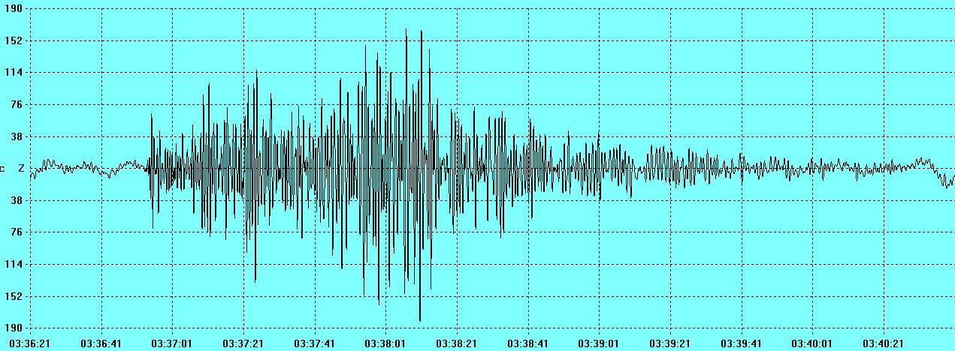
Let’s listen to this earthquake
Source: SSE project, EA: 15_01_2017 http://sse-project.eu
Notes:
Επιπλέον πηγές: http://geophysics.eas.gatech.edu/people/zpeng/EQ_Music/

Slide 16

X44,1
X16
X8
What do you observe?
Can you find a relationship between the pitch of the sound and its duration?
Notes:
Εδώ μπορούμε να επεκταθούμε περεταίρω χρησιμοποιώντας το Audacity
Aν ένας σεισμός έχει διάρκεια 2 λεπτών και συχνότητα που βρίσκεται στην περιοχή των 5 Hz, πόσες φορές πιο «γρήγορα» θα πρέπει να τον «τρέξουμε» για να είναι οριακά πάνω από το όριο ακουστότητας; Πόση θα είναι η διάρκεια του σεισμού που θα ακούσουμε;

Slide 17
Music and earthquakes
Notes:
Aρχή πρακτικής δραστηριότητας

Slide 18
procedure
Divide in groups
Use one or more seismograms
Use a piece of paper and create Cartesian x-y axes matching the axes of the seismogram. Match the axis y=0 with note C4 (optional).
Define 12 equal spaces for the positive y-semi axis and another 12 for the negative semiaxis. Match each space with a note so that in the 12 spaces, we have change by one octave.

Slide 19
Divide the x-axis in equal parts
Divide each part in 4 equal smaller parts.
Place your piece of paper below your seismogram. For every small part in the x-axis find the maximum y- value from the seismogram and note it. Match your points with notes.
When you finalize the matching of maxima and notes launch the online sequencer: https://onlinesequencer.net

Slide 20
Choose your preferred instrument.
Define BPM at value=60
Transfer your notes to the online sequencer and make your own melody.
Notes:
Πόσο πιο γρήγορα «παίζει» η σύνθεσή σας συγκριτικά με τον πραγματικό σεισμό συναρτήσει των BPM;

Slide 21
Thank you!
Please visit our online community:
http://portal.opendiscoveryspace.eu/en/community/sound-earth-848393
Email:
echaniot@ea.gr
Εmmanuel Chaniotakis, Physicist
RnD Department,
Ellinogermaniki Agogi

Slide 22
ANNEX

Slide 23
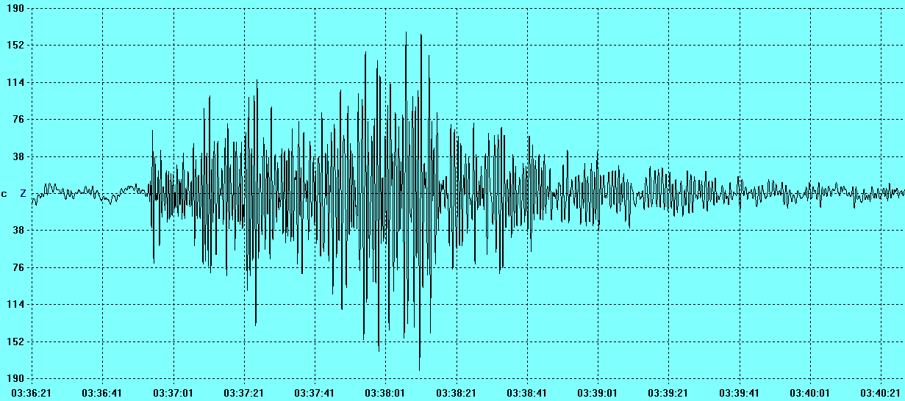
SEISMOGRAMS

Slide 24
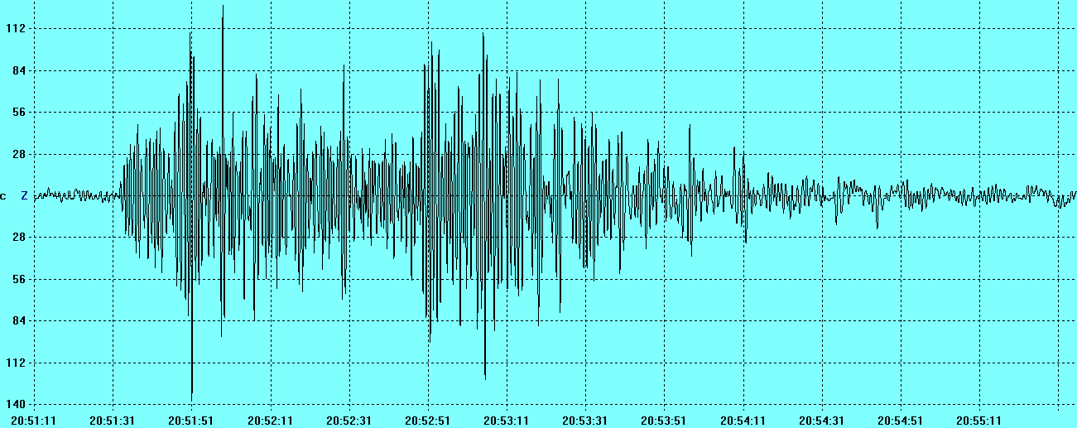

Slide 25
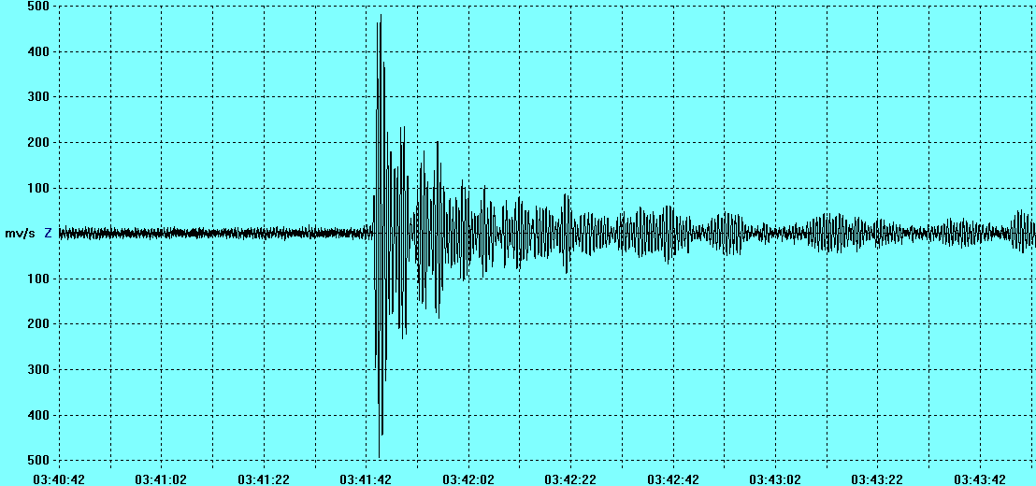

Slide 26
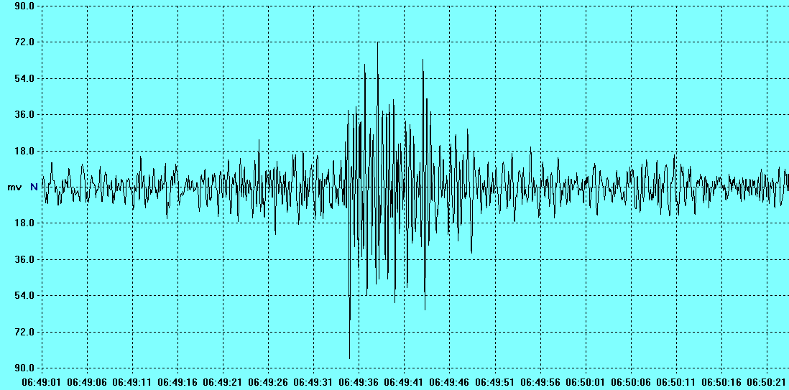

Slide 27
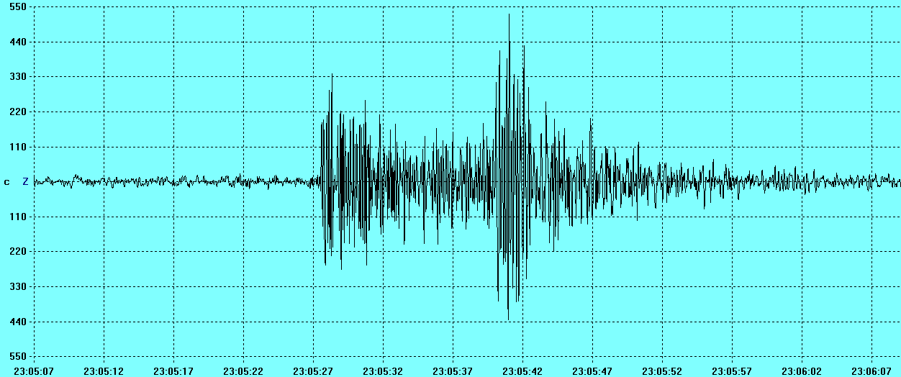

Slide 28
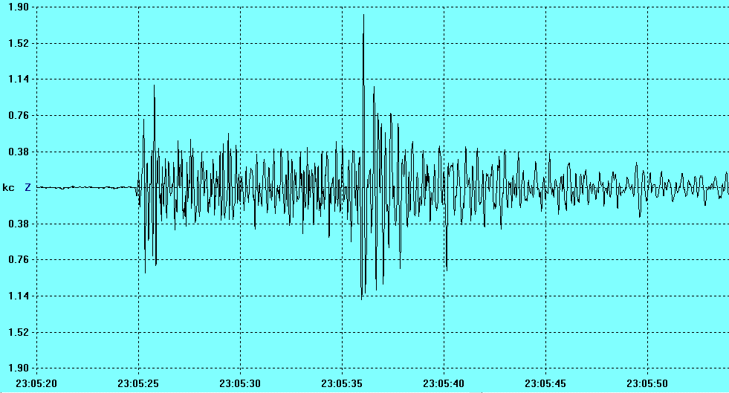

Slide 29
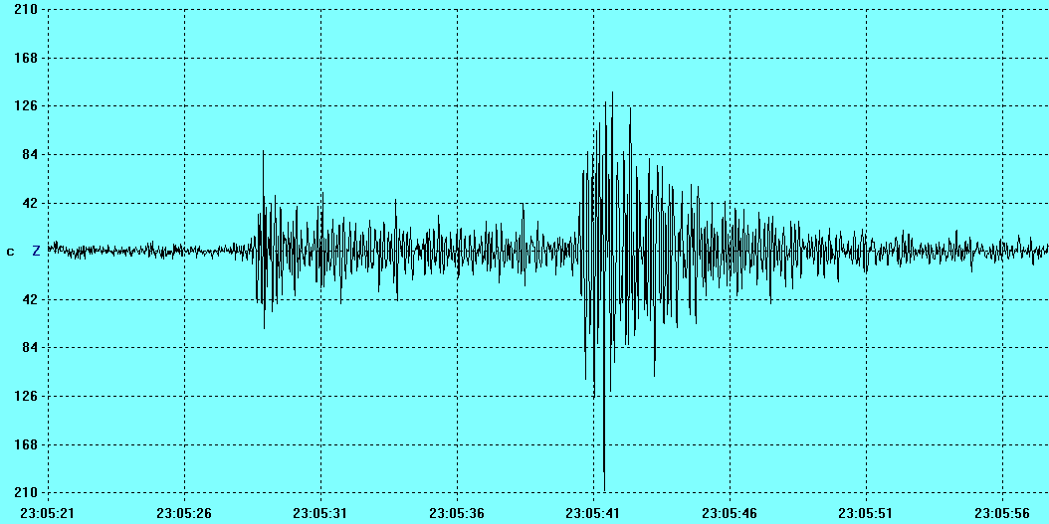

Slide 30
