Slide 1


Teaching with inquiry
Tsourlidaki Eleftheria
Ellinogermaniki Agogi

Slide 2
What is inquiry learning?
"Tell me and I forget,
show me and I remember,
involve me and I understand."
involve me

Slide 3
What is inquiry learning?
Is inquiry something new?

Slide 4
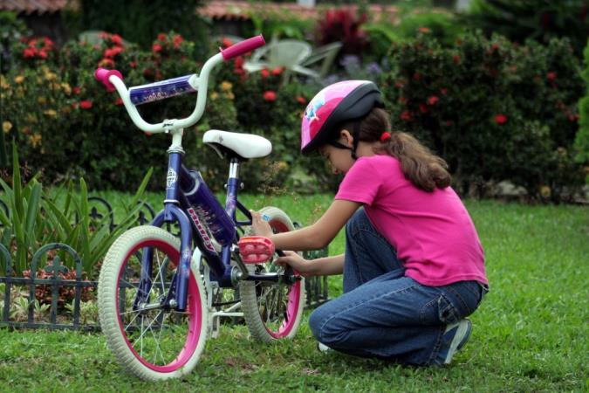
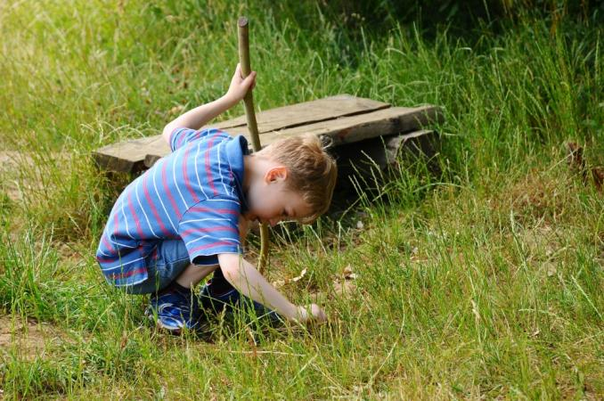

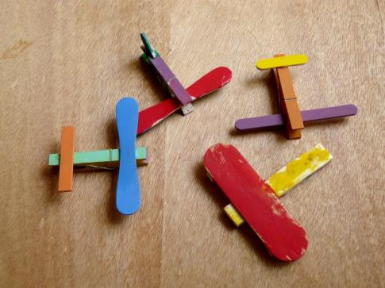
What is inquiry learning?

Slide 5
Inquiry as a teaching approach

Slide 6
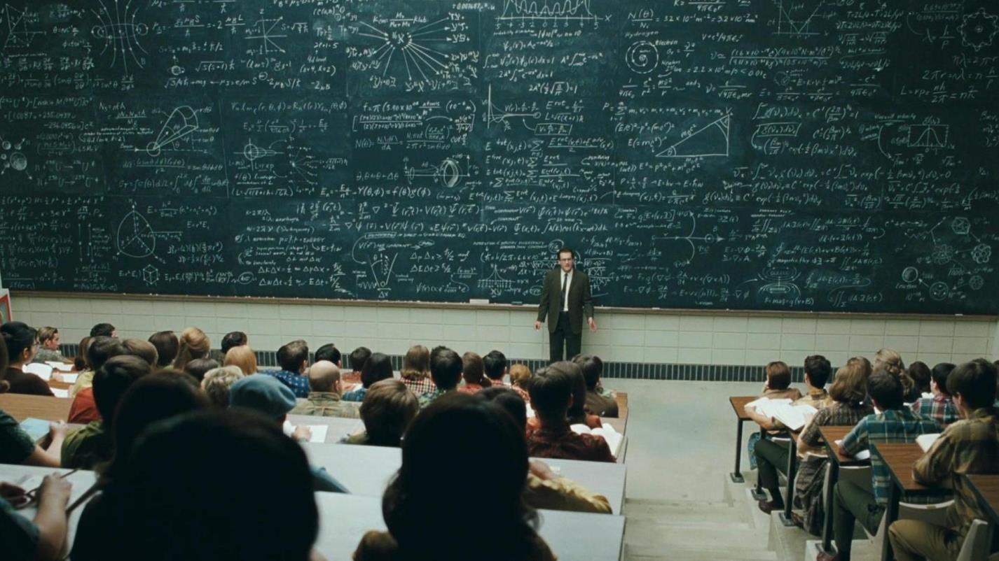

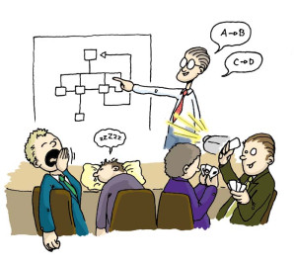

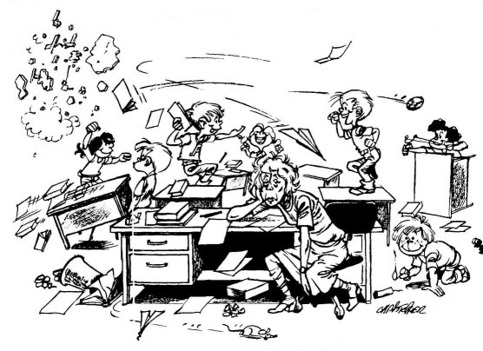

Our role as teachers
(?!?)
The person who knows it all
The one who does all the talking
The keeper of piece and order

Slide 7
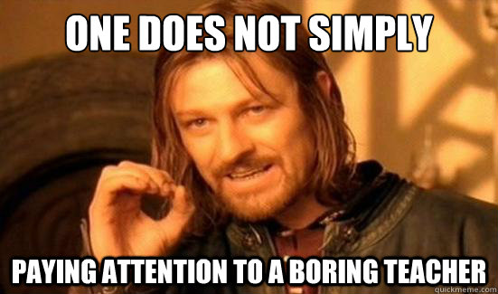

Slide 8
How can inquiry help us change our teaching style?

Slide 9

Giving the floor to the students

Slide 10




What is inquiry learning?
A student-centred approach
Knowledge construction
Teachers and students collaboration
Active involvement in the learning process

Slide 11


What changes with inquiry?
Passive receivers
Focus on content
Teachers knows it all
There is only one correct answer
Active practitioners
Focus on skills
Learn collaboratively
Consider multiple options

Slide 12
What changes with inquiry?
Higher student engagement/motivation
Develops students’ critical thinking skills
Develops students’ problem solving skills
Fosters collaboration
Foster multidisciplinarity

Slide 13
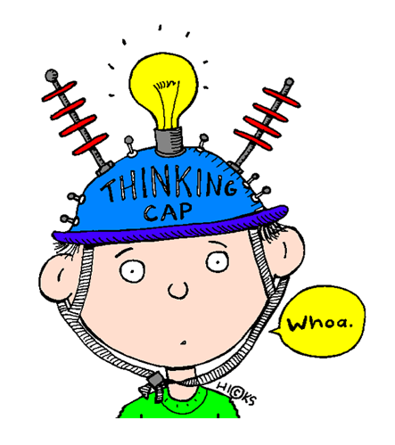
Inquiry in class
Encourage students to:
ask questions
make assumptions
take initiative
engage in hands-on and minds-on activities.
Step into
scientists’ shoes

Slide 14
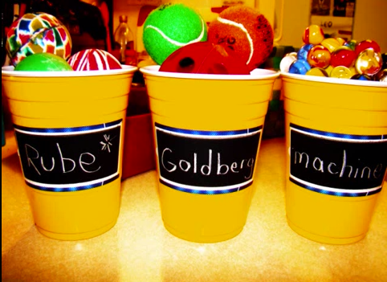

Simulating scientists’ work:
Inquiry in class
Is inquiry difficult to do?

Slide 15
Where do I start from?

Slide 16
Rethinking your teaching style
How do you introduce a subject to your students?
What kind of hands-on activities do you do in your class?
How much time do you spend on lecturing vs hands-on activities?
How do you react to wrong answers?
Do you focus on content or skills?

Slide 17
Introducing inquiry step-by-step
Reducing progressively the degree of guidance in hands-on activities
Increase simple minds-on and hands-on activities
Encourage student to make hypotheses even if they are wrong
Get your students thinking and do not let them expect all answers from you.

Slide 18
How can I introduce inquiry to my students?

Slide 19
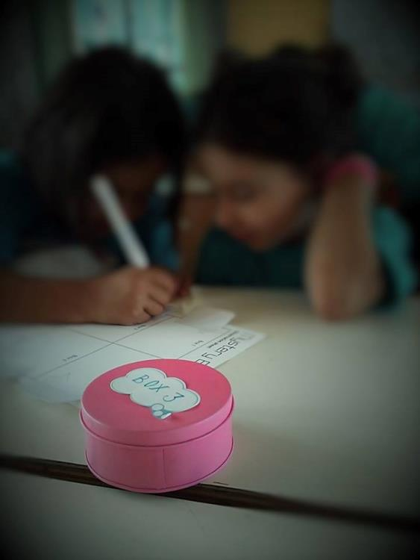
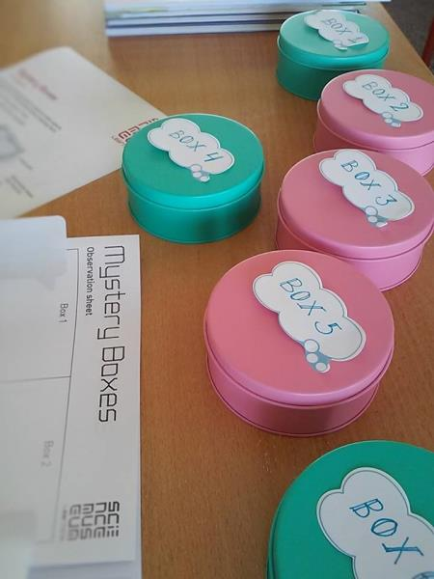
Simulating scientists’ work
The mystery boxes

Slide 20
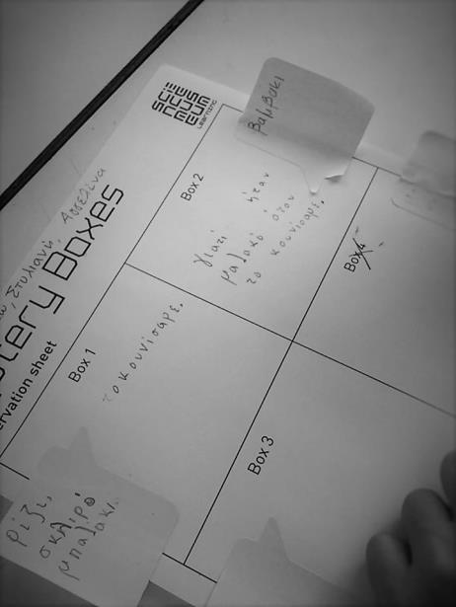
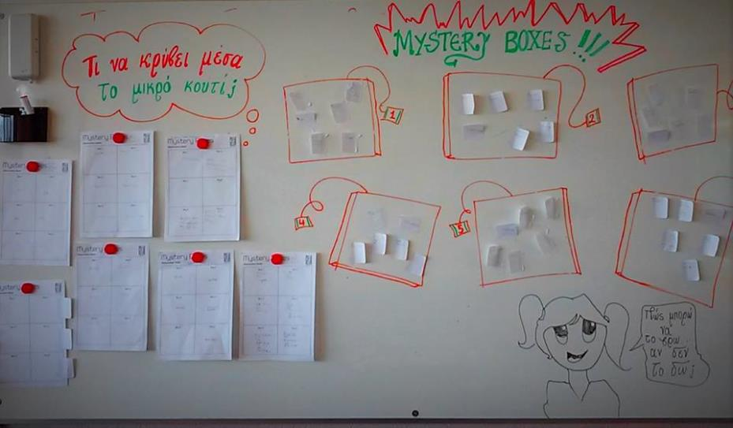
Simulating scientists’ work:
How can I introduce inquiry to my students?

Slide 21
The basic steps of inquiry for themed activities

Slide 22
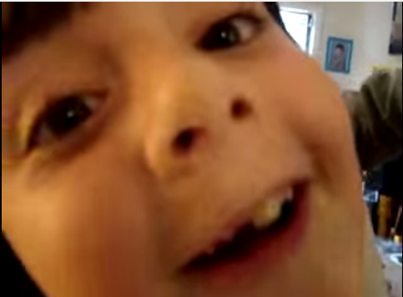
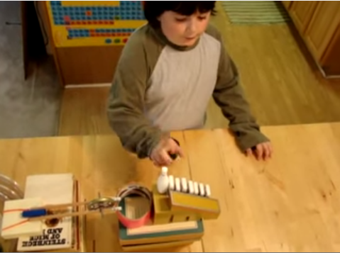
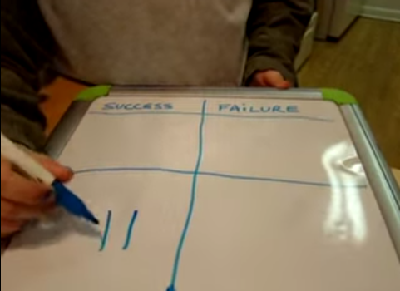
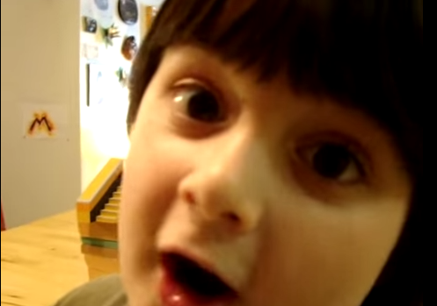
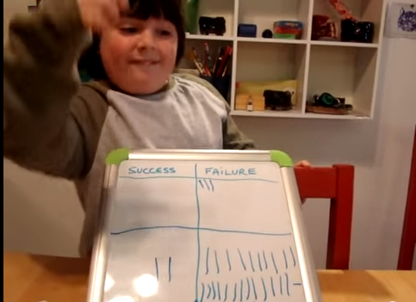
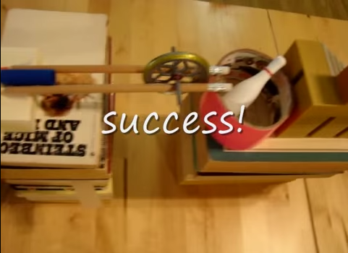
The basics: Following Audri’s steps
Introduction to the subject
Presentation of each component and method
Hypothesis
Reflection
Conclusion
Testing

Slide 23
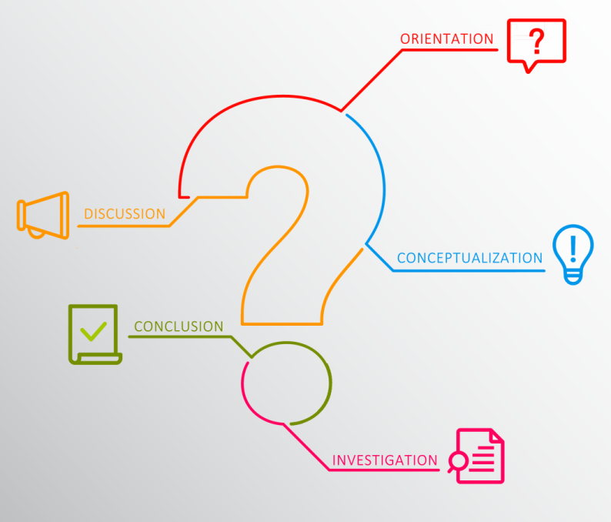
The Inquiry Cycle
Getting students attention
Presenting the results and reflecting
Discussing concepts and making hypotheses
Doing an experiment or an exploration
Drawing conclusions

Slide 24
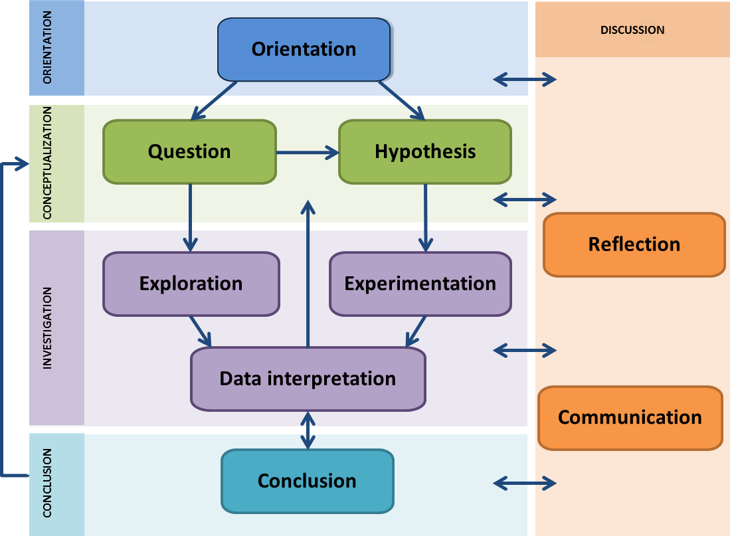
The EUSPACE Inquiry Cycle
  Pedaste, M.; Mäeots, M.; Siiman L. A., de Jong, T., van Riesen, S. A. N., Kamp, E. T., Manoli, C. C.; Zachariac, Z. C.; & Tsourlidaki, E. (2015). Phases of inquiry-based learning: definitions and the inquiry cycle. Educational Research Review, 14, 47-61. DOI: 10.1016/j.edurev.2015.02.003

Slide 25
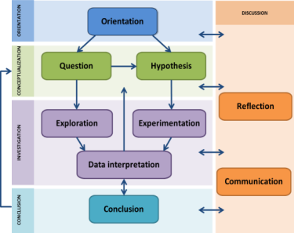
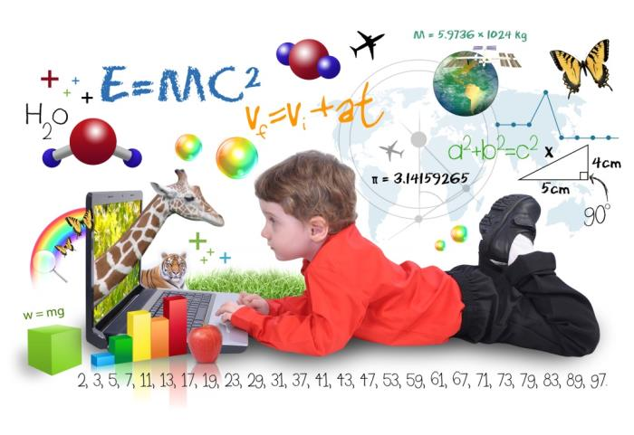
Orientation
Stimulating students’ interest and curiosity towards the problem at hand
Main Skills involved
Active Listening
Speaking

Slide 26
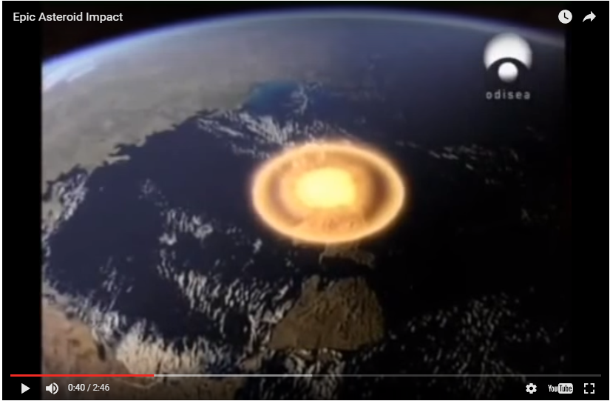
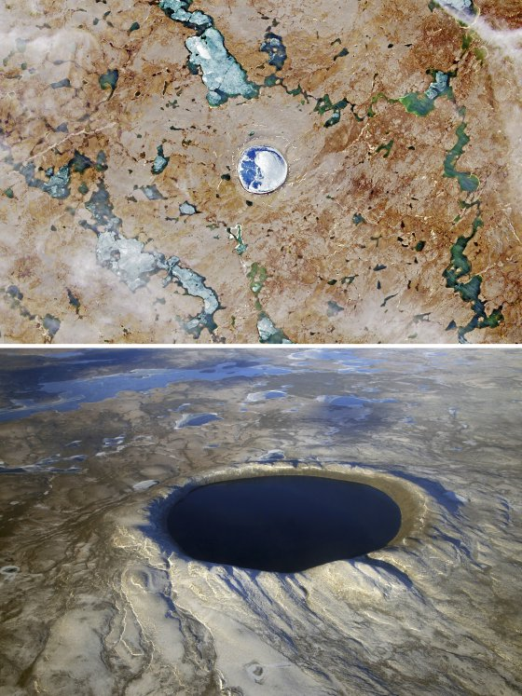
Craters on Earth

Slide 27

Conceptualization
Understanding the concepts connected to the problem. Formulating questions and hypotheses
Main Skills involved
Critical Thinking
Use of Science
Systems Evaluation

Slide 28

Craters on Earth
What happens when a meteor hits the Earth?
Angle of entry
Momentum
Energy
Mass
Material
Craters!
Explosion!
Dinosaur
Extinction!

Slide 29
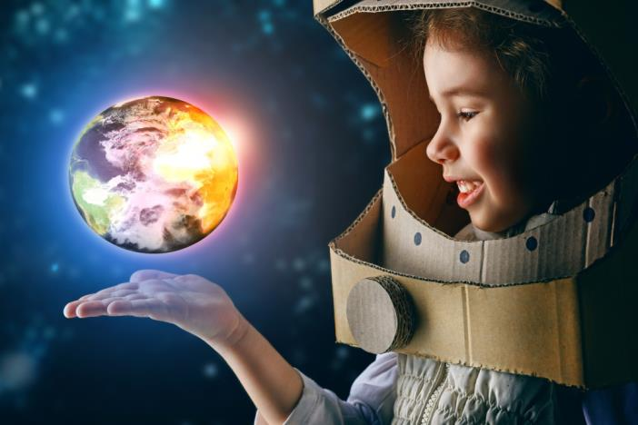
Investigation
Main Skills involved
Complex Problem
Critical Thinking
Judgment and Decision Making
Active Listening
Reading and Comprehension
Monitoring
Active Learning
Time Management
Systems Analysis
Social Perceptiveness
Use of Science
Systems Evaluation
Use of Mathematics
Quality Control Analysis
Setting-up an experiment, gathering and interpreting data and/or observations.

Slide 30
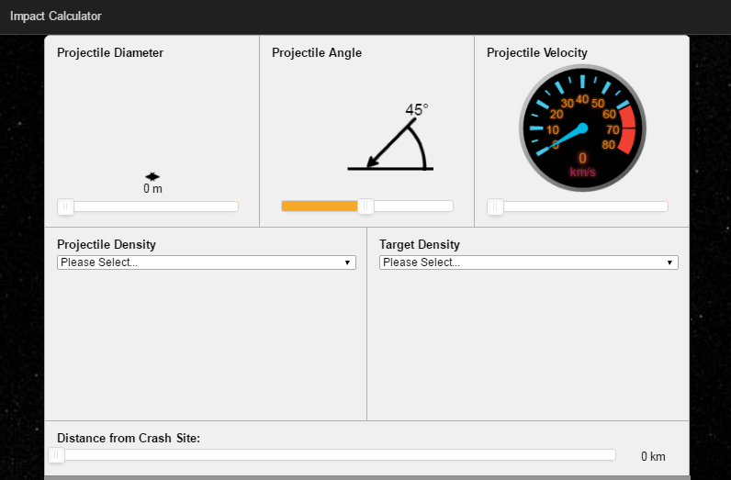
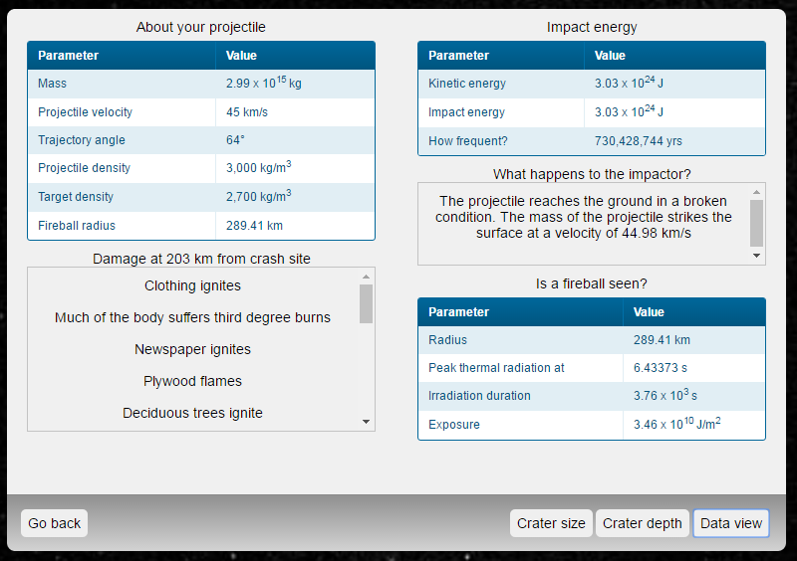
Craters on Earth

Slide 31

Conclusion
Main Skills involved
Critical Thinking
Active Listening
Reading and Comprehension
Speaking
Monitoring
Active Learning
Writing
Systems Analysis Social Perceptiveness
Use of Science
Systems Evaluation
Use of Mathematics
Drawing conclusions, compering to original hypotheses.

Slide 32
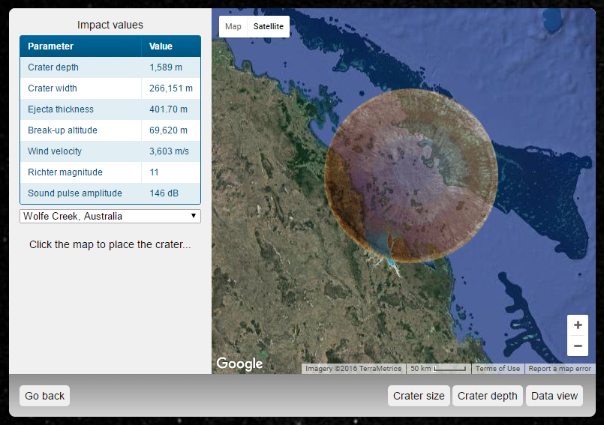
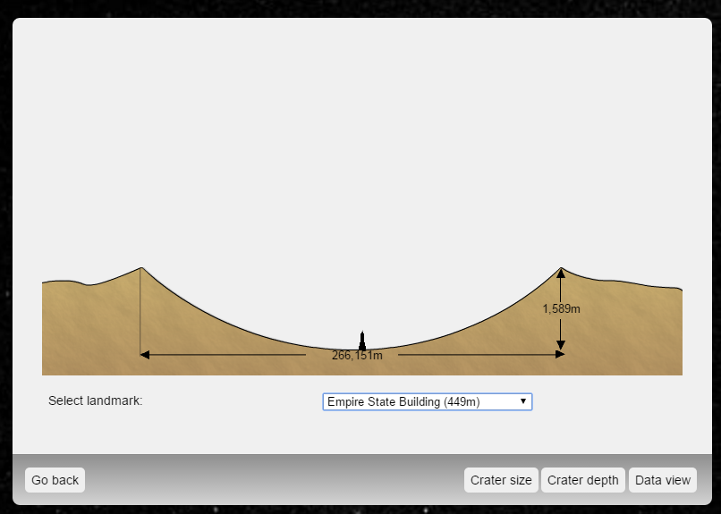
Craters on Earth

Slide 33
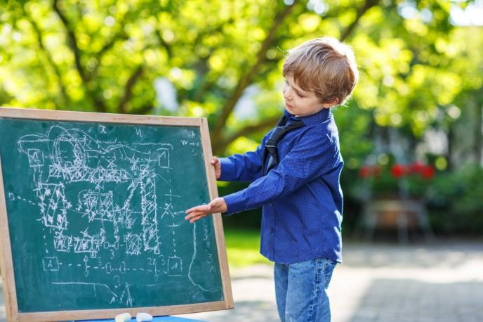
Discussion
Communicating and discussion findings. Reflecting on inquiry.
Main Skills involved
Active Listening
Reading and Comprehension
Speaking
Active Learning
Time Management
Social Perceptiveness

Slide 34
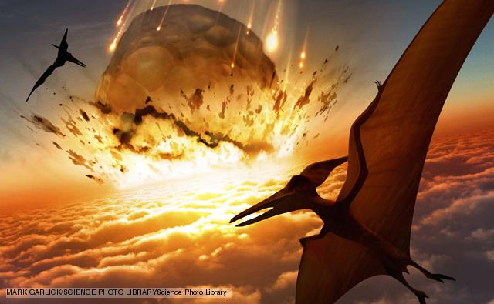
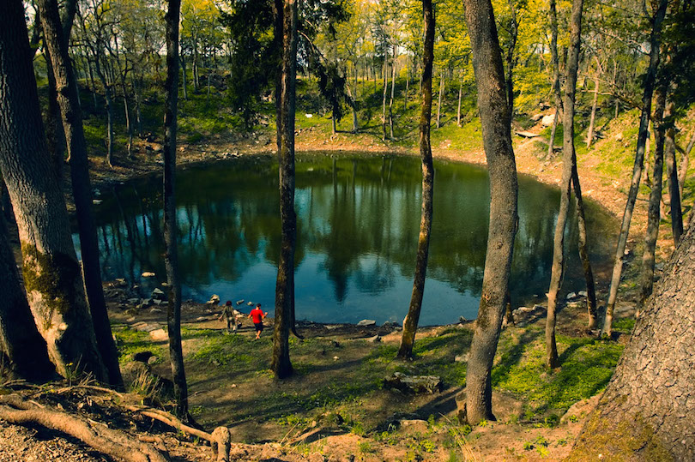
Craters on Earth

Slide 35
Going Interdisciplinary
Meteorites
Astronomy
Just astronomy?
Mathematics
Biology
Physics
Trajectories
Earth History
Chemistry
organics and silicates effecting life
Momentum and energy
Geography
Dinosaurs Extinction
Soil composition
Craters on Earth

Slide 36
The Inquiry Cycle
Cycle

Slide 37
More about inquiry and space
EUSPACE MOOC: Teaching with Space and Astronomy in your Classroom
EUSPACE resources: http://www.space-awareness.org/en/activities/

Slide 38
Happy starry teaching!

