Slide 1
Inspriring a new generation of space explorers
Audrey Korczynska / Jorge Rivero González Leiden University
@space_awe

Slide 2
OBJECTIVES
Use the excitment of space as an inspiration for education
Stimulate interest in space science and careers
Foster inclusion of girls and ethnic minorities in science
Broaden children’s minds
Develop a sense of global citizenship
Notes:
The Space Awareness Projects has the following objectives:
Use the excitment of space as an inspiration for education
Stimulate interest in space science and careers
Foster inclusion of girls and ethnic minorities in science
Broaden children’s minds
Develop a sense of global citizenship

Slide 3
WHO IS SPACE AWARENESS FOR?
Children from 8 to 18 years old
      Primary and secondary school teachers
      Educators
      Families
Notes:
The project is aimed for:
Children from 8 to 18 years old. It is important to start early and follow-up with raising awareness of science, science careers and build a science capital
Primary and secondary school teachers
Educators
Families

Slide 4












PARTNERS AND NETWORKS
Notes:
The project relies on a strong partnership between the 10 organizations, ESA
and space education networks like the GTTP, Scientix, Universe Awareness

Slide 5
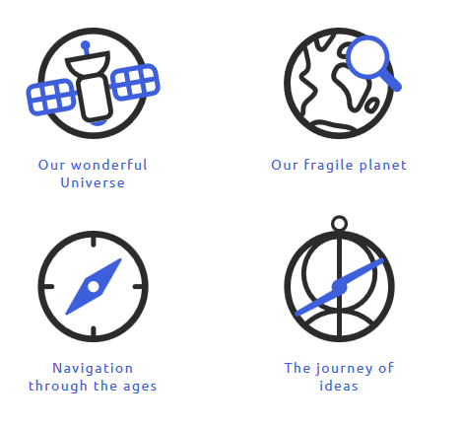
FOUR TOPICS
Notes:
Space Awareness focuses on four topics related to current space missions and global concerns:
Our wonderful Universe : relates to the knowledge and challenges of human space exploration.
Our fragile planet, deals with the major environmental challenges facing the world, the role that the study of other planets can play in understanding these global issues and the importance of Earth satellites in monitoring climate changes.
Navigation through the ages, traces the history of navigation, from the fifteenth-century European explorers and their missions of global discovery, to the importance of Europe’s Galileo programme for the current needs of citizens.
The journey of ideas, highlights the important contributions from Islamic scientists during the Middle Ages to our modern concepts of space and the Universe. It tells the story of a shared history based on tolerance and respect between cultures.

Slide 6
EDUCATIONAL RESOURCES
Existing material aligned with curricula
 | Our wonderful Universe | Our fragile planet | Navigation through the ages
Primary | Sun, Earth, Moon system The Solar System Stars | Seasons Atmosphere | Basic concepts of navigation
Secondary | Sun, Earth, Moon System The Solar System Stars Fundamentalo laws | Composition and structure Atmosphere Climate change Orbit and rotation Seasons | Basic concepts of navigation Latitude Longitute
Notes:
During the first months of the project, a study in 10 countries (Europe and Africa) allowed to identify entry points for space in school curricula. Topics for primary and secondary schools were listed for each Space Awareness category.
Exisitng educational resources in relation with each topic were selected to facilitate the use of the activities by teachers in curricula.

Slide 7
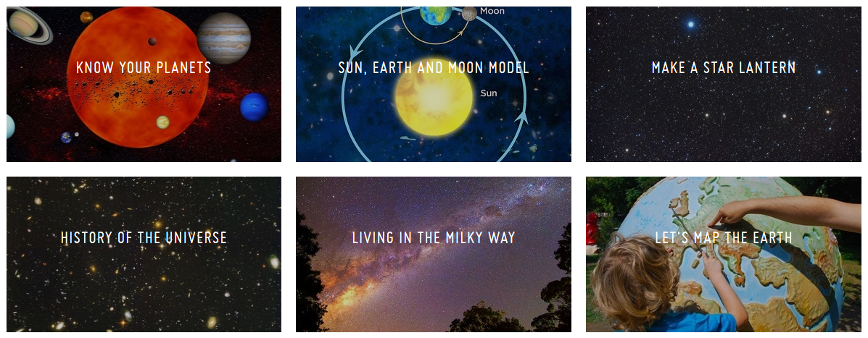
EDUCATIONAL ACTIVITIES
Notes:
We developed 42 educational activities that can be found online. 20 for primary levels and 22 for secondary levels on the topics Our fragile planet, Our wonderful Universe, and Navigation through the ages. The activities belonging to the Journey of ideas are ready but will be included on the website by next week.
Activites are available in English, worksheets for students are translated in 11 languages.
All activities were peer-reviewed by both an astronomer and an educator through the platform AstroEdu.

Slide 8
SPECIAL KITS
The Climate Box
Navigation through the ages
The Journey of Ideas
Notes:
3 educational kits have been created within the project. The kits offer a series of activities related to a specific topic.

Slide 9
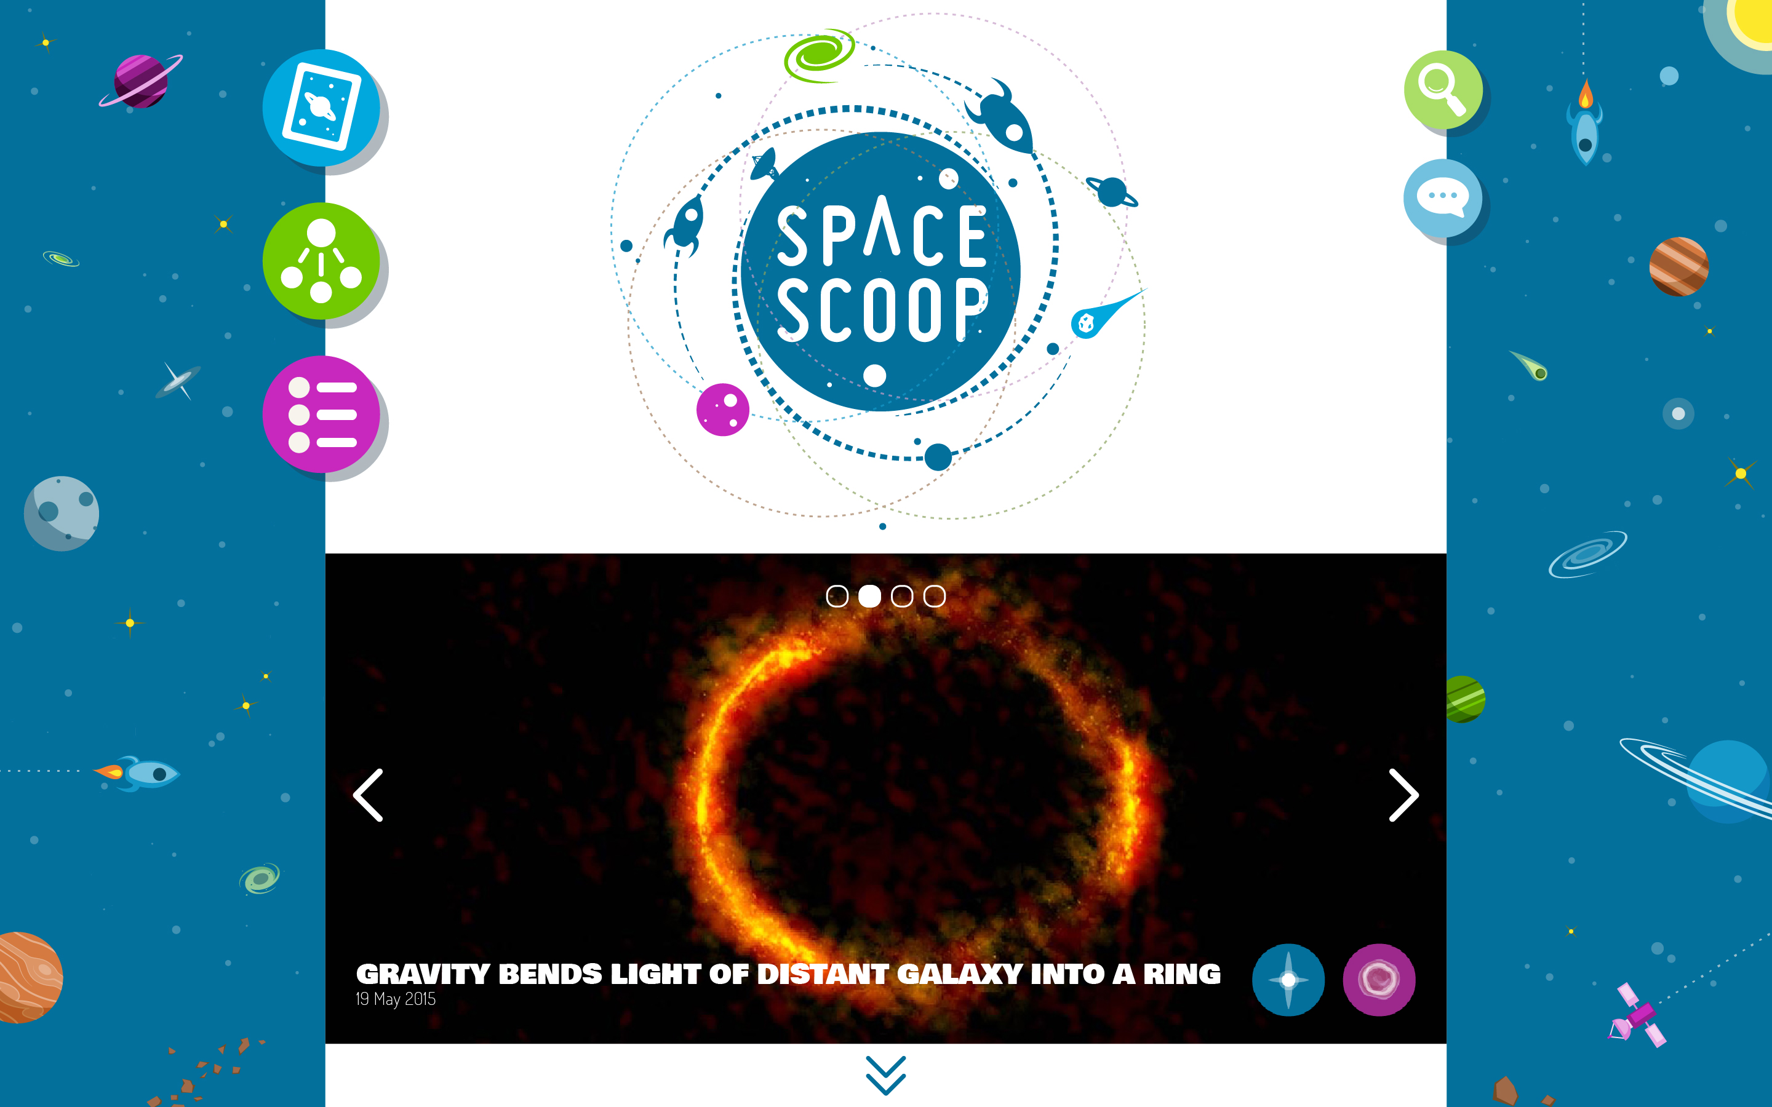
SPACE SCOOPS
Notes:
Space Scoop is a news service for kids, accessible online at a kids website “www.spacescoop.org” Also for teenagers and adults on www.space-awareness.org
The idea behind is to share the excitement of the latest discoveries in space science and show there is still a lot to discover about the universe.
Press releases from different partner institutes and agencies are published at the same time as the regular release on a more kids friendly way.

Slide 10
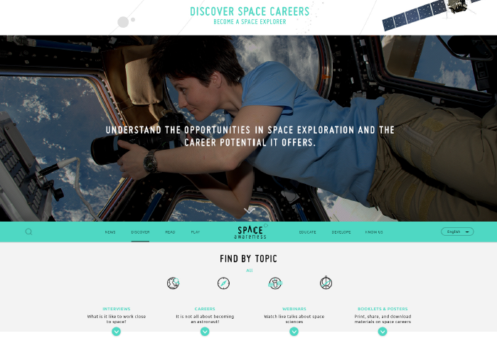
SPACE CAREER HUB
Notes:
A career hub in the website offers video interviews of scientists, information about different careers, and live webinars to connect from the classroom with scientists.

Slide 11
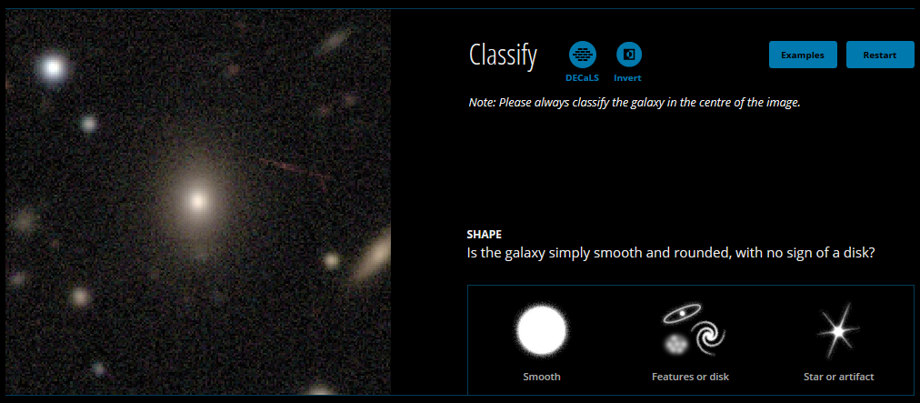
CITIZEN SCIENCE AND APPS
Notes:
A repository of citizen science initiatives, apps, and games has been created. Citizen science might be an inspiring and interesting way to contribute to current scientific studies and get a taste of research. Show opportunities to get involved and different ways of teaching. To know more about citizen science, you can follow the first Space Awareness online course .

Slide 12
SUPPORT FOR EDUCATORS
                To use space resources with confidence
                To learn methods to be inclusive while teaching
                To use more ICT
                To apply inquiry and inspirational methods
                To inform about space careers from early ages
More on www.space-awareness.org/skills
Notes:
To support teachers in using the material and understand the potential benefits, Space Awareness creates different professional development tools:
Four online courses (MOOC), the first course ended at the beginning of October but you can still register and follow the course on your own. The first MOOC introduce the use of space for education and shared methods to teach in a diverse classroom, use ICT tools, and IBSE methods. The second MOOC will be availble in January 2017 and will be about Navigation through the ages. 2 following MOOCs about Our fragile planet and Our wonderful Universe.
Guidelines
Local teacher trainings and this international workshop

Slide 13
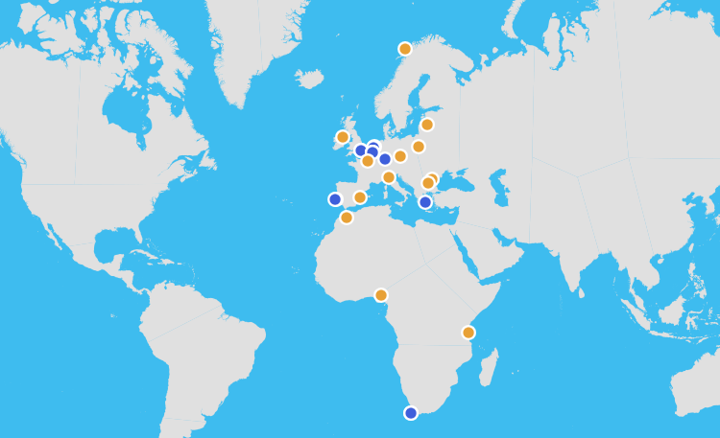
22 NATIONAL CONTACTS
Notes:
The project develops its activities through national contacts around Europe and Africa. Some of your national contacts are here, so don’t hesitate to ask the organisers if your contact is attending the workshop to be put into contact.

Slide 14
GET INVOLVED!
                From October 2016 to April 2017, Space Awareness tests its educational activities: we need your feedback to improve!
                How can I help?
                1/ Choose and activity you like in www.space-awareness.org
                2/ Implement the activity with your students
                3/ Fill in the feedback form at www.space-awareness.org/feedback
Notes:
Get Involved!
From October 2016 to April 2017, Space Awareness tests its educational activities: we need your feedback to improve!
How can I help?
1/ Choose and activity you like in www.space-awareness.org
2/ Implement the activity with your students
3/ Fill in the feedback form at www.space-awareness.org/feedback

Slide 15
COMING UP IN 2017!
                Free online courses for educators: “Navigation through the ages”, “Our wonderful Universe”, “Our fragile planet”
                New career material and interviews
                Monthly webinars
                The Journey of Ideas, complete educational kit
                Local teacher training
Notes:
Coming up in 2017
Free online courses for educators: “Navigation through the ages”, “Our wonderful Universe”, “Our fragile planet”
New career material and interviews
Monthly webinars
The Journey of Ideas, complete educational kit
Local teacher training

Slide 16
DON’T MISS NEW OPPORTUNITIES AND RESOURCES
And share your comments and pictures!
                Facebook: Space Awareness
                Twitter: @space_awe
                Instragram: space_awe
                Subscribe to the Space Awareness newsletter
                Contact the project team at euspaceawe@eun.org
                All information on www.space-awareness.org
Notes:
DON’T MISS NEW OPPORTUNITIES AND RESOURCES by checking updates on our website, different social media and subscribe to our newsletter!

Slide 17
SPACE AWARENESS THIS WEEK
                Wednesday 19 October
                9:30 - Plenary talk: “Intercultural education on the example of the Space Awareness Islamic Heritage kit”
                14:00 – Discussion: “Let’s talk about gender balance and inclusion through space” and “Space Girl & Space Boy” (careers)
                16:00 – Workshop: “Navigation through the ages” and “Teaching with Inquiry”

Slide 18
SPACE AWARENESS THIS WEEK
                Friday 21 October
                14:00 – Workshop: “Our wonderful Universe” and “Space Scoop: astronomy news service for kids”
                16:00 – Workshop: “Islamic heritage”
                Saturday 22 October
                11:00 – Workshop: “The Climate Box”

Slide 19



www.space-awareness.org
euspaceawe@eun.org
@space_awe
facebook.com/spaceawe

