Slide 1


Inquiring fundamental particles and neutrinos through CLIL: having an interactive simulating environment as a common ground
Zacharoula Smyrnaiou Evagelia Petropoulou
zsmyrnaiou@ppp.uoa.gr liana.petropoulou@gmail.com
Educational Technology Lab, National Kapodistrian
University of Athens, School of Philosophy, Faculty of Philosophy, Education and Psychology, Department of Education
http://etl.ppp.uoa.gr/_content/index2_en.htm

Slide 2
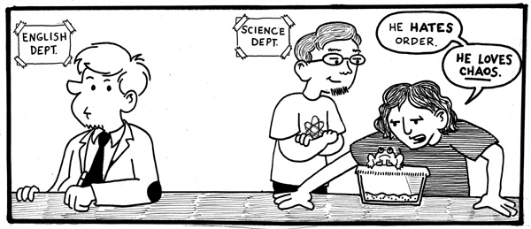
Content and Language Integrated Learning (CLIL) is a dual-focused educational approach in which a non-native language is used for the learning and teaching of both content and language (Dalton-Puffer & Smit, 2007; Marsh, 2012; Coyle, et al., 2010)
What is CLIL?
https://chrispearce.wordpress.com/2013/01/page/3/

Slide 3
Joint Role of Content and Language
content
language
CLIL
Language identifies the intrinsic functionality of the language to serve as a means for/through/of learning
Content determines the language needed in CLIL

Slide 4
Language & content
Inclusive
social skills (communication and co-operation)
personal skills (creativity and imagination)
Flexible
lifelong learning skills (critical and analytical thinking)
Language and the non-language content on a continuum
Approaches, methods, curriculum models
Developing cross-curricular skills and competences

Slide 5
The 4Cs Conceptual Framework (Coyle, 1999)
Communication
Culture
Content
Cognition
Ref. Coyle (1999, 2005)

Slide 6
Core features of CLIL methodology
Core features
Authenticity & Visual material
Use of modern tools in classroom
Scaffolding
Enriching interactive learning environment
Cooperative group work
Multiple focus approach

Slide 7

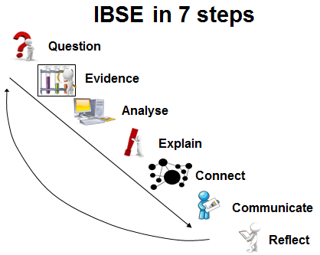
Science teaching requirements
Ref. IBSE Best Practice of Pathway, Summer School, (Rosi, 2013)

Slide 8

‘Inquiring the Ghost Particle’ scenario
Identity of the scenario
Subject Domain: English, Physics,
Arts
2nd and – 3rd grade students of
Junior high school
Extension to physics curriculum
Age range: 12-14

Slide 9
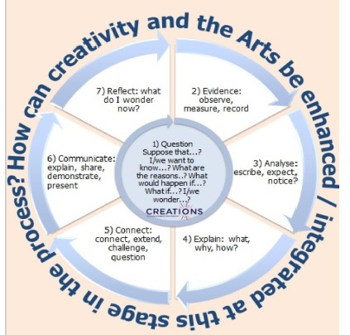
Implementation of scenario guided on the Inquiry-based science approach (a)
Question: online brainstorming activities (‘What is the world made of?)
Evidence: search the internet to find information on fundamental particles
(‘Who was the neutrino proposed by and When? How it was it discovered? What is it? Does it have mass? How fast does it travel?)
Analysis: video – matching scientific ideas/ principles with visual representations
Explanation: reading comprehension to explore and connect evidence with more complex scientific ideas.

Slide 10
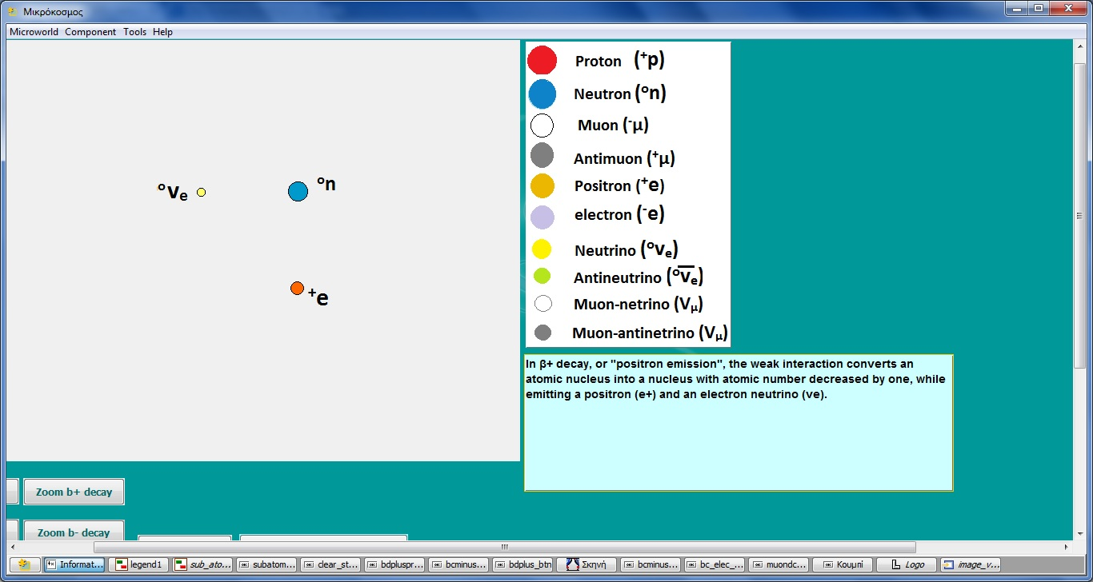
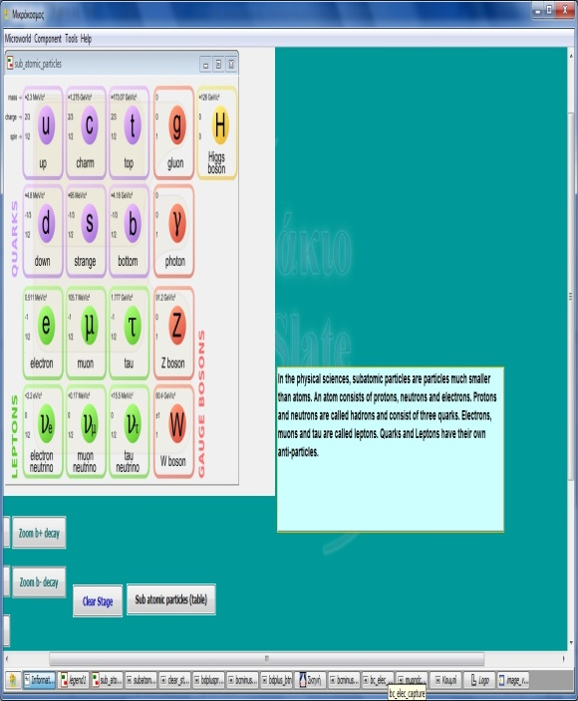
Implementation of scenario guided on the Inquiry-based science approach (b)
Connection : hands-on experimentation with interactive simulation projecting ‘positron emission’ and a B-decay.

Slide 11
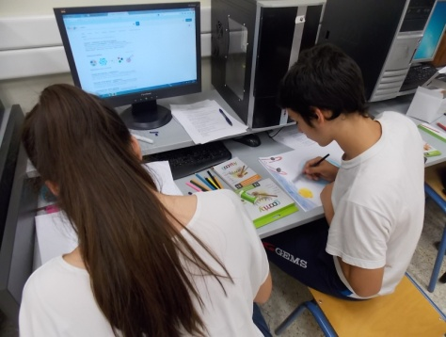
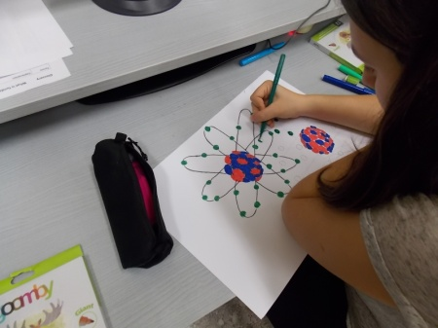
Implementation of scenario guided on the Inquiry-based science approach (c)
Communication: students’ engagement in creating their own simulation of particle decays – communication of acquired knowledge
Reflection: students’ engagement in multiple assignments that combine art and science (drawings, posters, digital comics, short theatrical plays, etc.)

Slide 12



Assessment filters and objectives
Regarding Science/Content
develop abilities necessary to do scientific inquiry
develop understandings about scientific inquiry
identify questions and concepts that guide scientific investigations
use technology to improve investigations and understanding of scientific concepts
recognize, analyze and imagine alternative explanations and models
Dual structure assessment:
inter-workgroup assessment
external –workgroup assessment
Students’ beliefs and cognitive
development
Regarding Language
Cognition: Develop thinking skills which link concept formation, understanding and language
Culture: Exposure to alternative perspectives and shared understandings
Communicate: Develop communication skills; using language to learn whilst learning to use language
a pre-evaluation questionnaire
a post evaluation questionnaire

Slide 13

Conclusions
shared interaction
active learning
mediate social aspects of learning
knowledge construction
reflection and creative manipulation
think about what they want to say and how to say it
classroom transforms into a subject of enquiry
personal link with learning
trigger autonomous pursue of knowledge

Slide 14
Thank you!!!
Acknowledgments: The European funded CREATIONS project http://creations-project.eu/about/

