Slide 1
Showing our students the Bigger Picture through a federation of online labs: How to use the “Big Ideas of Science” in order to interconnect different subject domains.
Eleftheria Tsourlidaki
Ellinogermaniki Agogi

Slide 2


Wind energy
radiation
electricity
equations
forces
DNA
magnets
ph
friction
vectors
Life cycle
alkalis
molecules
photons
functions
gravity
kinematics
galaxies
Biosphere
Photosynthesis
Solubility
Mitosis
Ampere's law
Catalysts
Energy
Wind energy
Thermodynamics

Slide 3

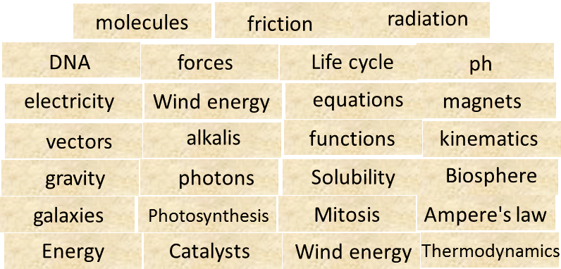
Wind energy
radiation
electricity
equations
forces
DNA
magnets
ph
friction
vectors
Life cycle
alkalis
molecules
photons
functions
gravity
kinematics
galaxies
Biosphere
Photosynthesis
Solubility
Mitosis
Ampere's law
Catalysts
Energy
Wind energy
Thermodynamics

Slide 4
The Big Ideas of Science

Slide 5
The Big Ideas of Science
There are four fundamental interactions/forces in nature; gravitation, electromagnetism, strong-nuclear and weak nuclear. All phenomena are due to the presence of one or more of these interactions. Forces act on objects and can act at a distance through a respective physical field causing a change in motion or in the state of matter.
Gravitational Interaction
Strong Nuclear Interaction
Galaxy interactions
Free fall motion
Tides
Electromagnetism
Weak Nuclear Interaction

Slide 6
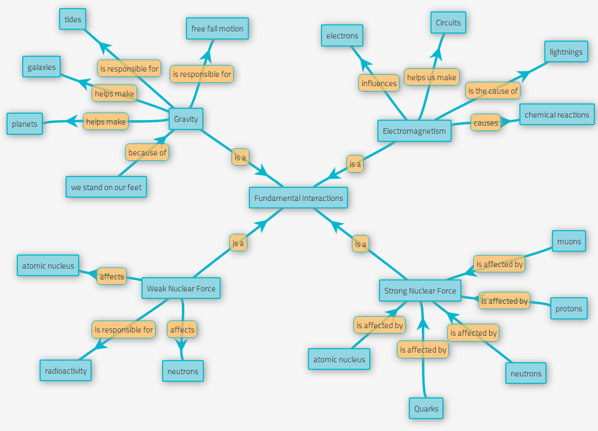

Slide 7
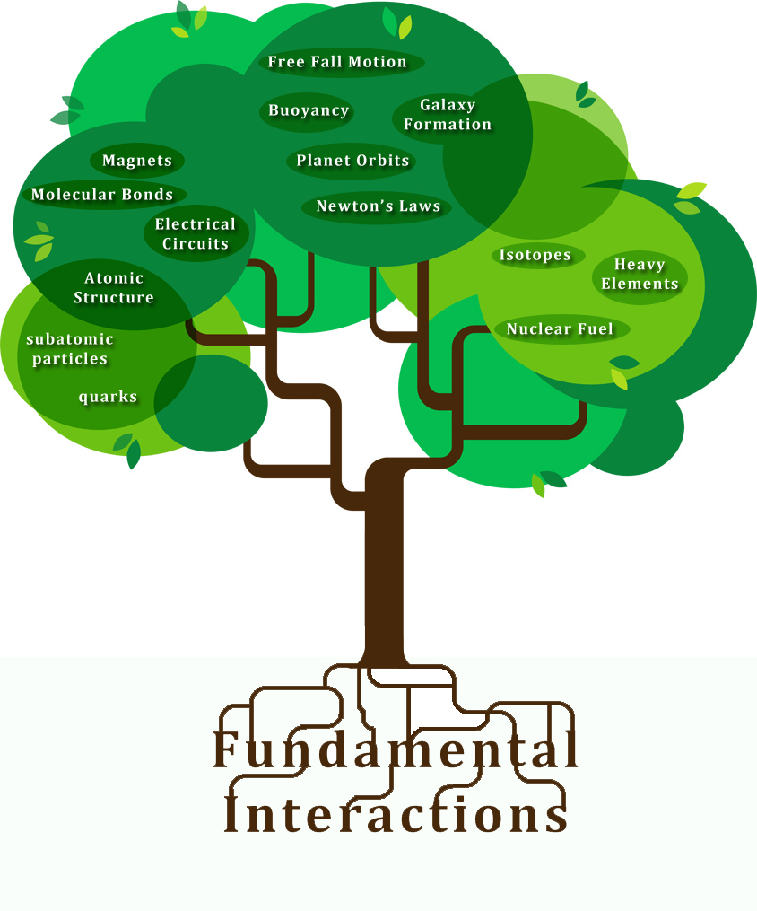

Slide 8
What are the Big Ideas of Science
We refer to “Big Ideas” as:
“A set of cross-cutting scientific concepts that describe the world around us and allow us to conceive the connection between different natural phenomena”.

Slide 9
What are the Big Ideas of Science
Connects different subject domains of science.
Develop a deeper understanding of each concept while moving from one grade to the next.

Slide 10
What are the Big Ideas of Science
It is the common ground behind different natural phenomena.
They can enable learners as individuals to understand aspects of the world around them.
Understand certain concepts and the connection between different principles and phenomena which at first sight might appear to be irrelevant.

Slide 11
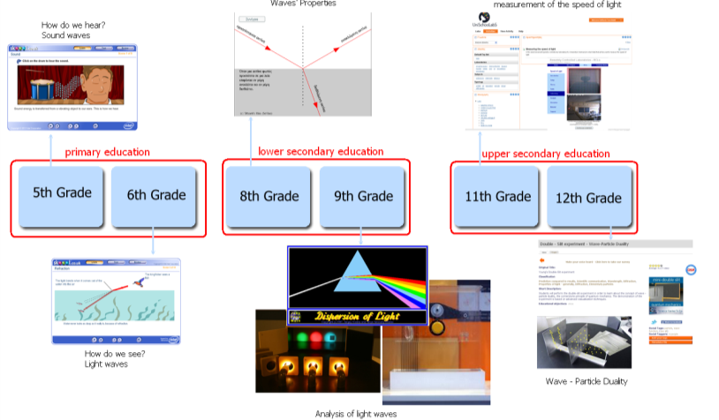
From small to Big Ideas of Science: Connecting different concept between them
Make connections to subject taught in previous classes.
Give insights for subject that they students will be taught in next classes.

Slide 12
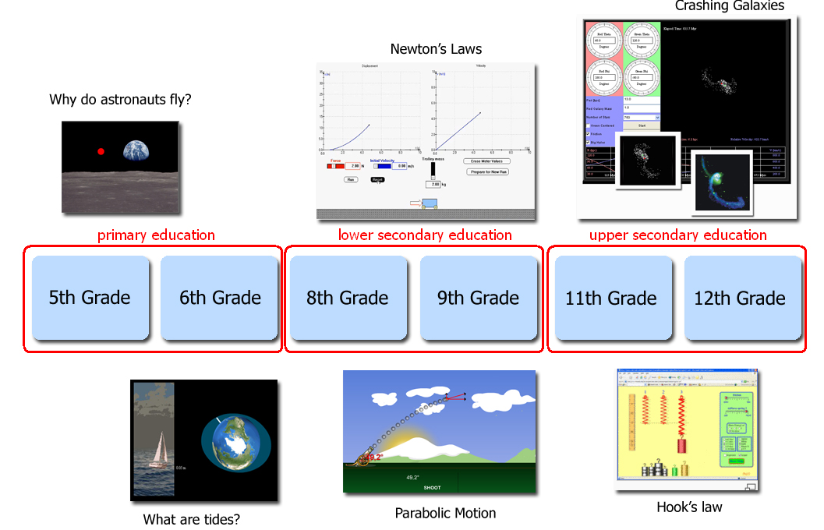
From small to Big Ideas of Science: Deepening the understanding of a concept
Demonstrate different aspects of the same concept.
Connect concepts to every day life.

Slide 13
What are the Big Ideas of Science
General Level
Big Ideas that are completely generic and apply to all fields of science.
Specific Level
Reflect the principle ideas of our world and that to their total will cover all different subject-domains of science.

Slide 14
Brainstorming
What are the Big Ideas of science according to you?
Notes:
Give 10 minutes to participants to write down their own “Big Ideas”.
Put them all in a slide and discuss them.
Present Harlen’s and our set and check for similarities.
Discuss with teachers on which they like best.

Slide 15
The Big Ideas of Science Set A
Big Ideas of Science
1. Energy is conserved; it cannot be created or destroyed. | 5. All matter and radiation exhibit both wave and particle properties.
2. There are four fundamental interactions/forces in nature; | 6. Evolution is the basis for both the unity of life and the biodiversity of organisms (living and extinct).
3. Earth is a very small part of the Universe. | 7. Organisms are organized on a cellular basis and require a supply of energy and materials.
4. All matter in the Universe is made of very small particles. | 8. Earth is a system of systems which influences and is influenced by life on the planet.
It can only transform from one form to another. The transformation of energy can lead to a change of state or motion.
gravitation, electromagnetism, strong-nuclear and weak nuclear. All phenomena are due to the presence of one or more of these interactions. Forces act on objects and can act at a distance through a respective physical field causing a change in motion or in the state of matter.
Organisms pass on genetic information from one generation to another.
The Universe is comprised of billions of galaxies each of which contains billions of stars and other celestial objects.
All life forms on our planet are based on a common key component.
They are in constant motion and the bonds between them are formed by interactions between them.
The processes occurring within this system shapes the climate and the surface of the planet.

Slide 16
The Big Ideas of Science Set B
Big Ideas of Science
1. All material in the Universe is made of very small particles. | 6. The solar system is a very small part of one of billions of galaxies in the Universe.
2. Objects can affect other objects at a distance. | 7. Organisms are organized on a cellular basis.
3. Changing the movement of an object requires a net force to be acting on it. | 8. Organisms require a supply of energy and materials for which they are often dependent on or in competition with other organisms.
4. The total amount of energy in the Universe is always the same but energy can be transformed when things change or are made to happen. | 9. Genetic information is passed down from one generation of organisms to another.
5. The composition of the Earth and its atmosphere and the processes occurring within them shape the Earth’s surface and its climate. | 10. The diversity of organisms, living and extinct, is the result of evolution.

Slide 17
The Big Ideas of Science
Which of the two sets is closer to the Big Ideas you thought?
Which of the two sets is more appropriate according to your opinion?
Is there something missing or something unnecessary?

Slide 18
From Small to Big Ideas of Science
How do we connect every day teaching with
the Big Ideas of Science?

Slide 19
From Small to Big Ideas of Science
Every educational activity has certain educational objectives/learning goals. Educational objectives set on an activity are very targeted and directly related to that activity.
The Big Ideas of Science
Cognitive Educational Objectives: Types of Knowledge
Factual Knowledge
Conceptual Knowledge
Procedural Knowledge
Meta-cognitive Knowledge
Educational objectives set on multiple educational activities can correspond to the same Big Idea thus allowing students to identify the connection between different activities and concepts.

Slide 20
From Small to Big Ideas of Science
An example
The movement of celestial objects.
Cognitive Objective (Types of Knowledge):
Factual: Gravity is responsible for the movement of Celestial objects.
Conceptual: Learn about the gravitational field
Why magnets can attract iron objects.
Cognitive Objective (Types of Knowledge):
Factual: Magnets attract iron object due to the electromagnetic force.
Conceptual: Learn about the electromagnetic field
There are four fundamental interactions/forces in nature;
gravitation, electromagnetism, strong-nuclear and weak nuclear. All phenomena are due to the presence of one or more of these interactions. Forces act on objects and can act at a distance through a respective physical field causing a change in motion or in the state of matter.

Slide 21
From Small to Big Ideas of Science
An example
The movement of celestial objects.(Galaxy Crash Lab)
Cognitive Objective (Types of Knowledge):
Factual: Gravity is responsible for the movement of Celestial objects.
Conceptual: Learn about the gravitational field
Particle acceleration. (The LHC Game)
Cognitive Objective (Types of Knowledge):
Factual: Charged Particles are affected by the the electromagnetic force.
Conceptual: Learn about the electromagnetic field
BIG IDEA: There are four fundamental interactions/forces in nature;
gravitation, electromagnetism, strong-nuclear and weak nuclear. All phenomena are due to the presence of one or more of these interactions. Forces act on objects and can act at a distance through a respective physical field causing a change in motion or in the state of matter.

Slide 22
The Big Ideas of Science in Go-Lab

Slide 23
Making a federation using The Big Ideas of Science
Place each lab in the right place, based on the concept it explores.
Interconnect different labs using the concepts behind them.
Connecting different concept between them
Connecting different concepts with everyday life
Deepening the understanding of a concept

Slide 24
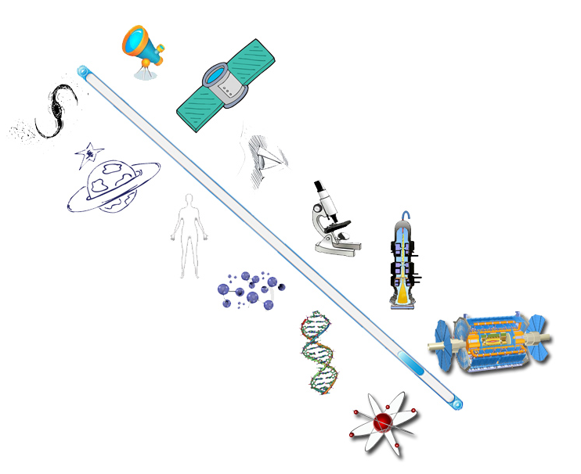
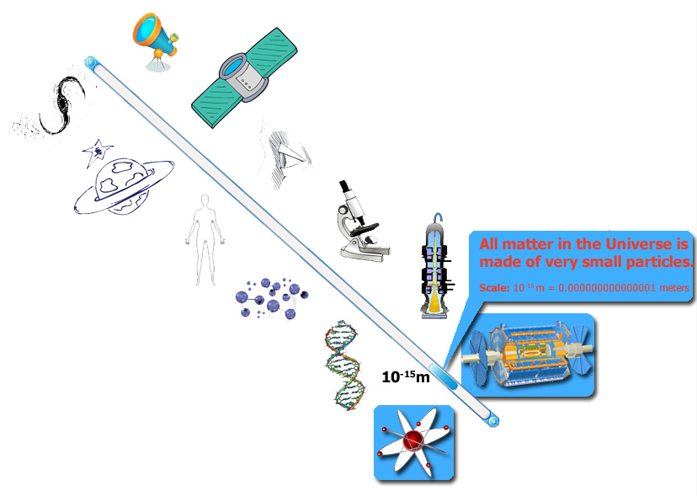
Connecting different concept between them: From small to Big Ideas of Science
Galaxy Crash
Faulkes Telescopes
Presenting the online labs with the context of our world
In connection to the Big Ideas of Science
Craters on Earth and Other Planets
DIGITAL SYSTEMS
Electricity
VISIR
ELVIS
Radioactivity
HYPATIA
Methyl Orange
CERNLand
LHC Game

Slide 25
Making a federation using The Big Ideas of Science
Traditional Search engines
Big Ideas Recommendation System
Search by subject
Age range
Language
Keywords
Suggestions on different subjects but common Big Ideas

Slide 26
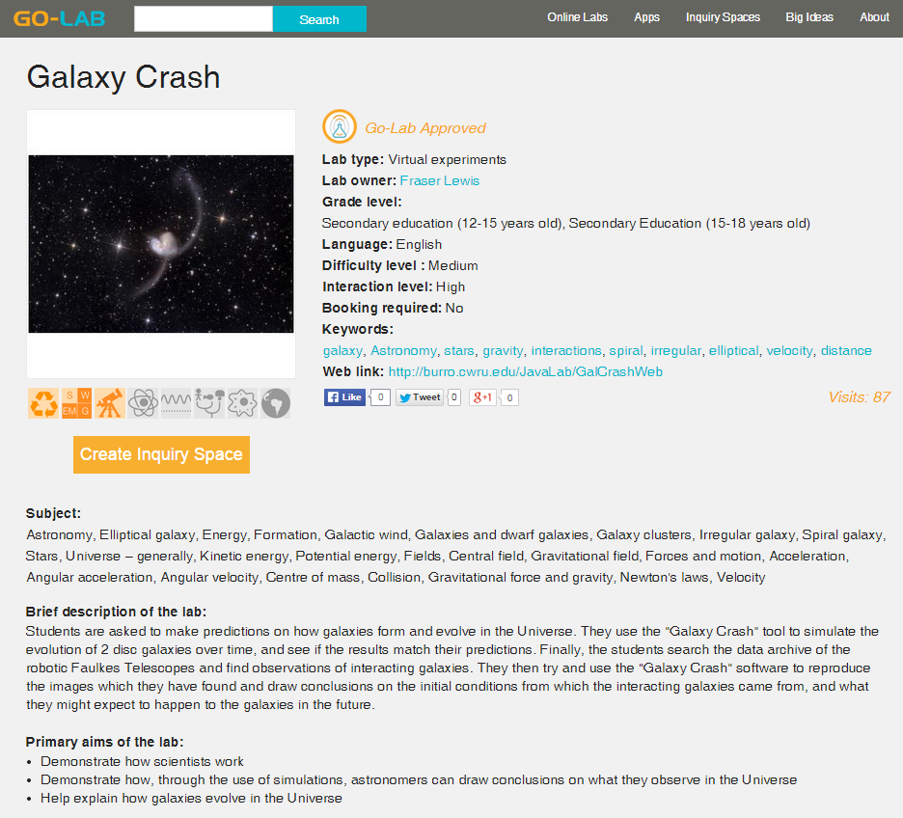

Slide 27
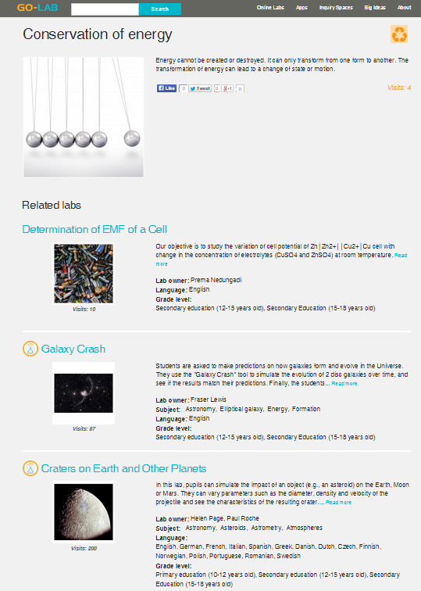

Slide 28
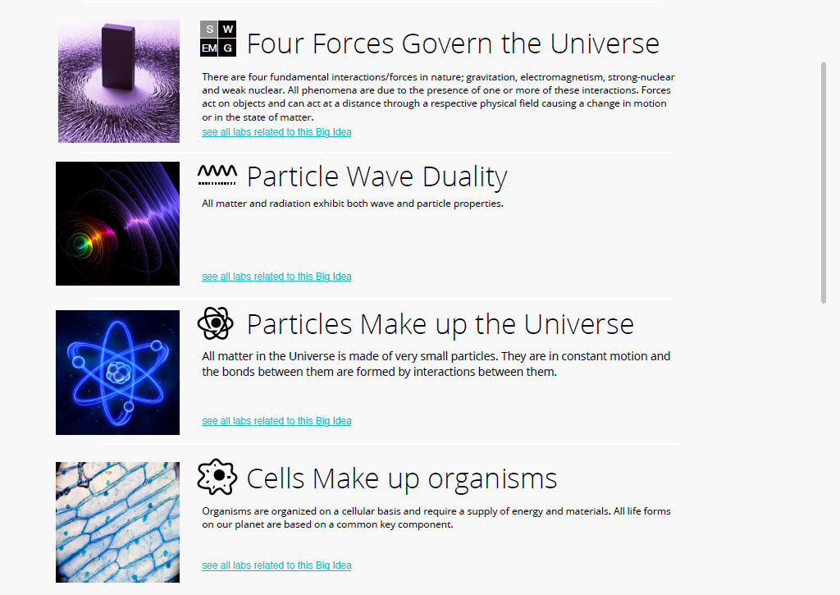

Slide 29
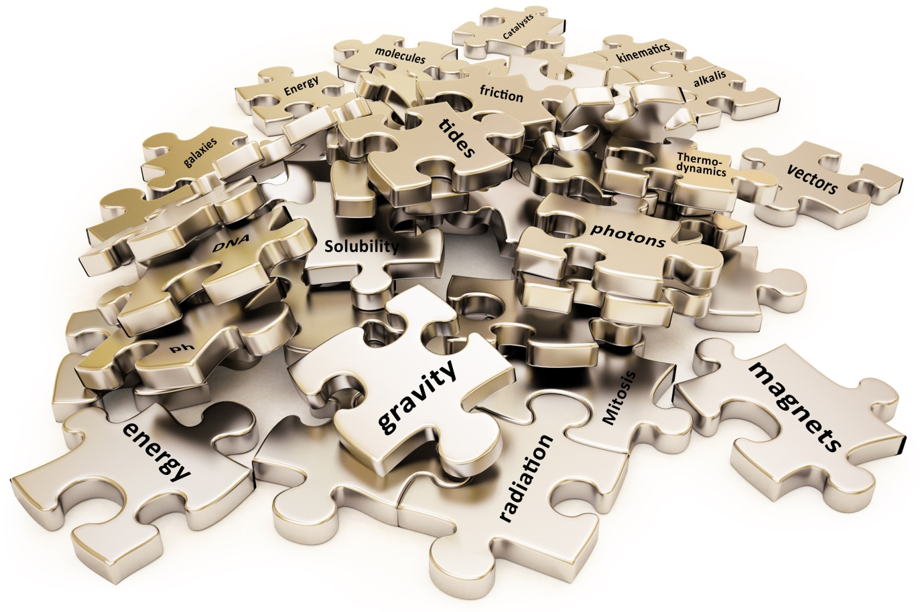


Slide 30
More information
Official Website: http://go-lab-project.eu/project
Digital repository: http://www.golabz.eu/
Registration for the pilot phase:
http://go-lab-project.eu/call-for-schools/
Contact
Tsourlidaki Eleftheria – eleftheria@ea.gr
Mavromanolakis Georgios – gmavroma@ea.gr

