Slide 1





Open Discovery Space Summer School 2014
Marathon, Greece, July 13-18
Educational Scenario

Slide 2
Basic info on the scenario:
Name of participant: Vasile Roman
School No. 7 “Sf. Maria” Timisoara
Country: Romania
Title of scenario: Methods for solving arithmetic problems
Short description/ main idea:
During the four class will present several methods for solving arithmetic problems:
- Method of Analytical; - Method of false assumptions;
- Method of reduction in establishment; - Figurative way;
- Comparison method; - Synthetic method;
Also presented three problems Agility.

Slide 3
Educational objectives and pupils’ competences targeted:
At the end of the activity students will be able to:
Specify the steps to solve a math problem;
Select appropriate methods for the problem to be solved;
Solve arithmetic problems using at least one of the methods presented;
To write and solve math problems after a given model.

Slide 4
Pupils’ ages:
The whole activity of during the 4 hours will focus on original software.
This activity is recommended to be sustained in the fourth grade and fifth grade, with students aged between 10-12 years.

Slide 5
Curriculum areas/ domains involved:
The lesson is part of the curricular area "Math and Science", and the subject is "Mathematics".
Considering the fact that software achieve two students were involved in the fifth grade, respectively, sixth grade we can talk about interdisciplinarity, so we have optional subject "Web Design" discipline for which we designed a program (curriculum ) own.

Slide 6
Which school needs does your scenario address?
Through this work we follow:
Skills in solving practical problems in real life, by students.
Developing mathematical reasoning in students.
Preparing pupils for national assessments in sixth grade and eighth grade.
Detection, preparation and involvement in the development of software capable of performing students in the field of ICT.

Slide 7
Parental engagement
  How are pupils’ parents engaged in the process or/ and implementation of the educational scenario? What is their role?
  For better collaboration parents - student - teacher, I created a wiki site. Address is: http://wikigen7.wikispaces.com/
  This is based on a user name and password created at the invitation of the teacher, so students and parents can publish or study different software products made ​​by students.
  The teacher provides models, and workloads students.
  In a meeting with the parents they were informed about the existence of this platform, how to use and they agreed that students access and publish materials on site.
  No user name and password: information on the site can not be viewed.
  Which school needs does their engagement in this scenario intend to serve?
  We want as close a connection between parents - student - teacher.

Slide 8
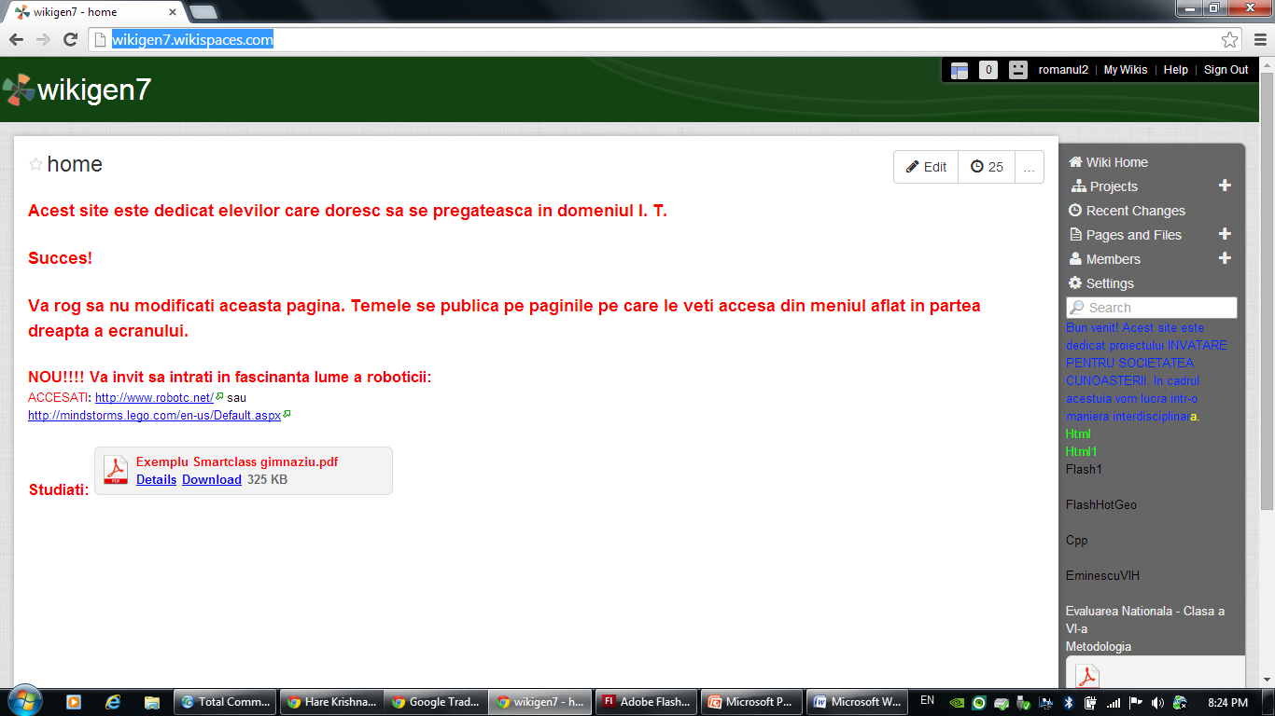
Wiki main page

Slide 9
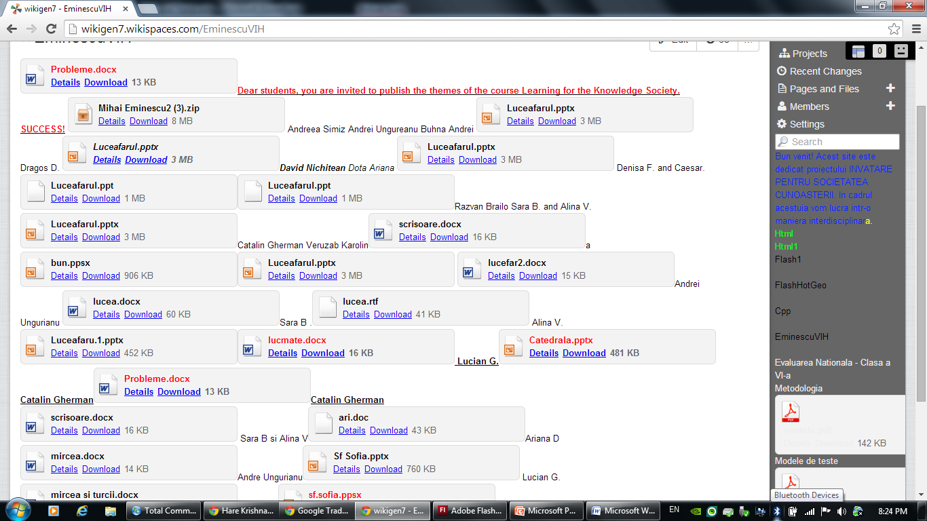
Student achievement:

Slide 10
Parental engagement
  What are the expected benefits from parents’ engagement in this scenario?
  We want a more efficient communication between the three factors mentioned above and a cart full transparency in the instructive - educational school.

Slide 11
Phase 1: Preparation
  For the activities to be completed stages:
  Communication to parents the information needed to access the wiki site.
  Obtaining parental consent for publication by students of software products made ​​by them.
  Copying software on a computer connected to the projector and smart board.
  Copy the software on each of the 25 computers in the lab to be going.

Slide 12
Phase 2: Implementation
  Lessons will be conducted in a laboratory with smart board, black board, videoprojector and 25 computers.
  Initially students will study to the computer problems proposed by the teacher.
  After that they will be evaluated automatically by the software will present problems to the smart board.
  It will also work on black board for further details.

Slide 13
Phase 2: Assessment
Student assessment will be as follows:
The software provides a grade for each student for each problem solved.
Software red marks each student's error, so both students and teachers know exactly which student errors.
The teacher can record the marks obtained by each student.
Mention that the numbers that appear in the problems are randomly generated, so each student solve problems with different dates.
Students can be assessed by how smart board shows the problems studied.

Slide 14
Resources
  Resources used in this activity are:
  Network with 25 computers;
  Original product software "Methods for solving arithmetic problems"
  Projector and smart board;
  Wiki site: http://wikigen7.wikispaces.com/
  Collection of math problems: Mate 2000 - Publisher Parallel 45, Bucharest.
  Math book.
  Software that are published at:
  http://scoala7timisoara.ro/softorig/metode/index2.html

Slide 15
Thanks for your attention.

