Slide 1
Ecosystem Forest - focused on food chains
Nicole Riegler, Austria

Slide 2
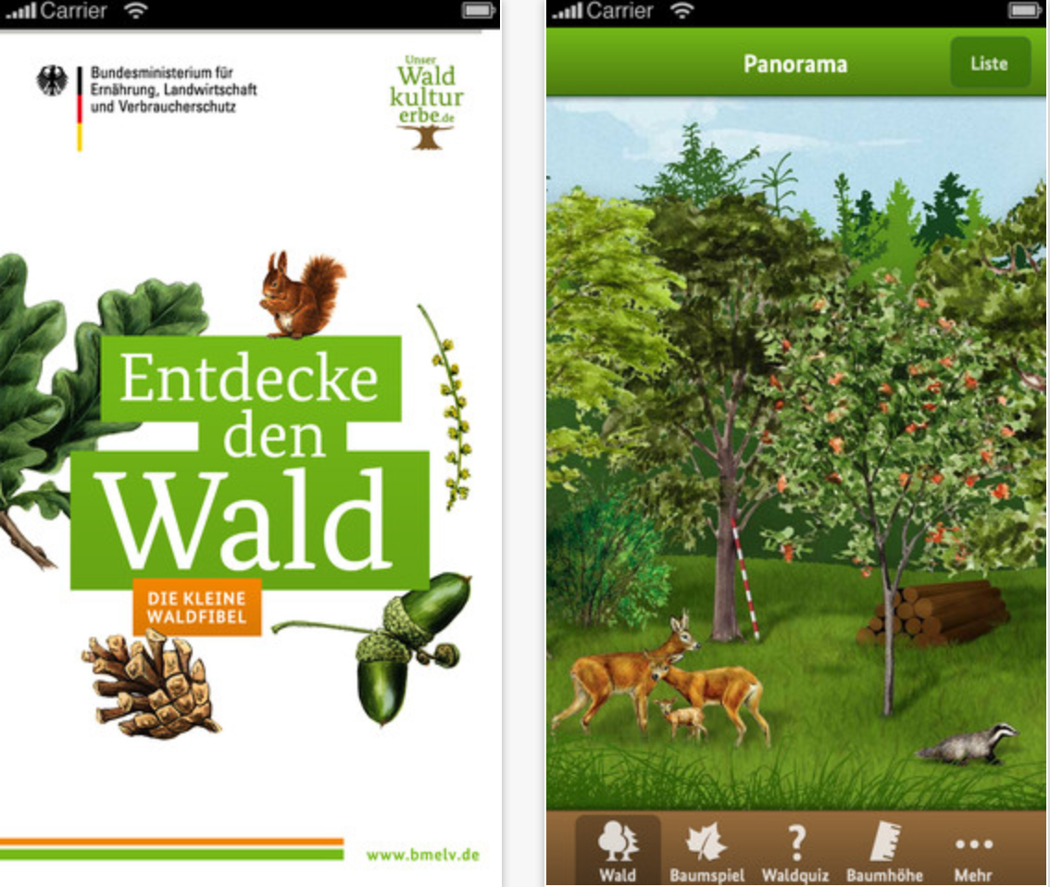
Section A: For the teacher

Slide 3
A1: Educational context
2 lessons (additional part on the Moodle platform)
Setting: in the classroom with our mobile PC room (iPad)
iPads, App "Waldfibel" - https://itunes.apple.com/de/app/die-waldfibel/id453746100?mt=8
curriculum: Ecosystem forest, food chains, food net and food pyramide, role of an hunter, critical thinking (What if scenario)

Slide 4
A2: Rationale
Why you propose the scenario? I want to show the students the correlation of the animals in the forest.
What problem you address? lack of interest
goals: They should see the importance of every animal in a forest. Also the role of a hunter

Slide 5
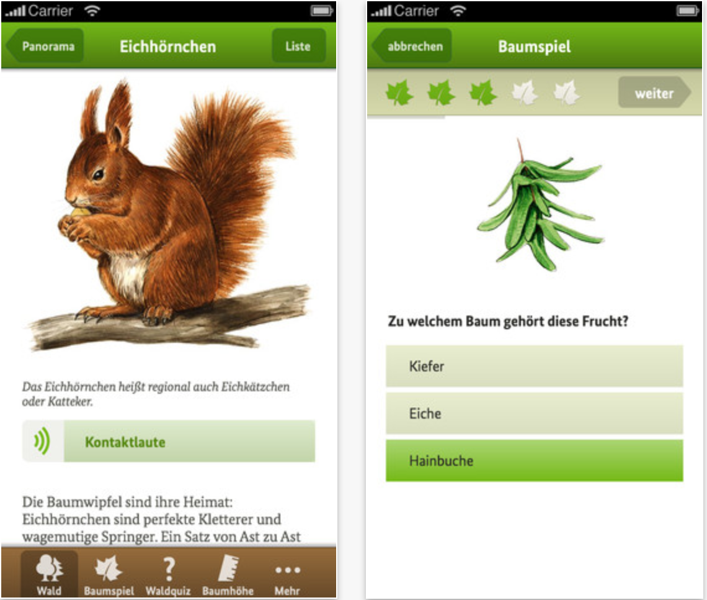
Section b: For the student

Slide 6
B1: Beginning
Situation: You are in a forest where a hunter killed all birds. What do you think will this forest look like? Which animals will live there? What happend to this ecosystem?
Goal definition: Find out that every animal has an important role in our ecosystem forest!
Minimal set of initial knowledge: knowledge of some animals of a forest

Slide 7
B2: Middle
Activities:
Working with the App „Waldfibel“
group discussion: What will happen if I take out all "birds" in the forest?
play the online game (bring the animals in the correct order)
Posting comments in a forum
Materials and tools: iPads, App "Waldfibel"
Rules for the game: students get 4-6 different animals and should name them and bring them in the correct order.
Timeframe: 1 lesson collecting information (App)
1 lesson: discussion, playing and drawing conclusions
Learning supports: App, teacher as a coach

Slide 8
B3: End
Attainment of goal: Understanding the food chains and food net. Interpretation of the consequences of an intrusion in the ecosystem forest.
Final product: discussion on the topic food chains in a forum at the Moodle platform of the school

