Slide 1
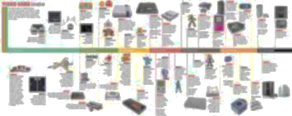
History of ICT = history of human society
Snežana Marković, Serbia

Slide 2
Section A: For the teacher

Slide 3
A1: Educational context
Time frame: three classes and two homeworks through two weeks.
Setting: in the school and at home, using the internet.
School resources: Computer lab
Curriculum mapping: Computer scieance, 1st grade in secondary school (15th-year old students). Lesson: „History of ICT“

Slide 4
A2: Rationale
Reasions for proposing the scenario: to make this theme more understandable for students, to increase motivation for exploring and learning history of computing, which is impornat for increase understanding of possibilities of computers today. This scenario engages the students in construction of knowledge and making connections with other subjects.

Slide 5
A2: Rationale
Problem that is addressed: It is hard to memorise the facts that is not understandible for students. Lack of literature. Poor connection with historical context causes missunderstundings of the facts.
Some teachers make this very
boaring

Slide 6
A2: Rationale
Teacher’s goals are: to help students to understand developing of ICT, to make crossculicular connesctions, to understand importance of information and communication technologies in history and human’s socciety.

Slide 7
Section b: For the student

Slide 8
B1: Beginning
Situation: Working three clases at school and two weeks at home.
Goal definition: Imagine that there are research teams and Ministry that fundes research about history of ICT and its connection with develop of human society (role play game).
Four teams („researchers“) reveal historical and scientific facts within its field of activity. 5th team („judges“) evaluates relevancy of each finding.
Minimal set of initial knowledge is history, mathematics, physics and computer science lessons from elementary school.

Slide 9
B2: Middle

Slide 10
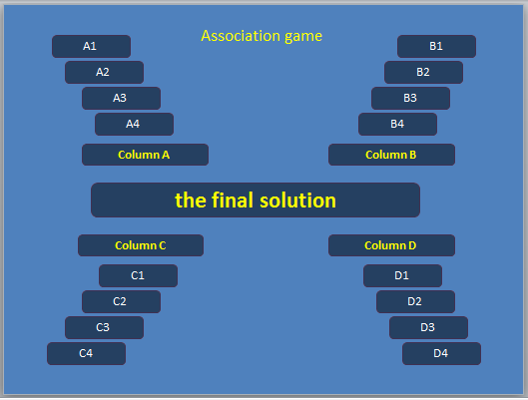
Warming-up: Association game
Activities
Step 1 – first class
Solutions:
Hardware
Communication
Software
Human society
Final:
History of ICT

Slide 11
Association game
Activities
Itroduction in theme and form the groups
Bases on the results (according to word they guess), whole class is dividing into 5 groups:
Four groups for working on the timeline
One grup for judginig
If not works, backup option is „Wheel of Fortune“ or throwing cubes

Slide 12
Step 2 – first homework
Activities
Teacher defines the axis and categories on the timeline from prehistory to the present, coordinate division into groups (at the begining), give the guidelines for homework.
Students puts the objects (decriptions, pictures, examples, simulations etc.) in web-tool for designing timeline during one week.

Slide 13
Step 3 – second class
Activities
Review the homework.
Discussion
Instructions for the second homework:

Slide 14
Step 4 – second homework
Activities
Review work of the other groups. Rate the relevancy of each object in the timeline.
Three days before deadline, judges makes the final decision.

Slide 15
Step 5 – third class
Activities
Final review.
Conclusions and results of judging

Slide 16
Materials and tools
PowerPoint – based Association game
Internet browser
Web tool for comunication (LMS or social network)
Web tool for timeline (it will be described later ☺)
Web tool for assessment (it will be described later ☺)

Slide 17
Embedded (focal) content & Content resources
Students includes materials from internet, other literature or created by themselves

Slide 18
Rules, Division of labor, Timeframe
Members of four teams during first 4 days in each week:
finding facts and materials
evaluate relevance of items (for their own and others group) on the timeline
Judges during the last 3 days in each week:
evaluate relevance of items on the timeline
gives the points

Slide 19
Learning supports
Teacher monitors the work.
Giving support through LMS or appropriate community on social network they use

Slide 20
B3: End
Design purpose: providing closure to the activity
Attainment of goal: identification of key points in the development of ICT, understanding the role of ICT in developing of human society.
Final product: timeline

Slide 21
Thank you for your attention!
Snežana Marković, Belgrade, Serbia
snesska.markovic@gmail.com
Skype: snesskich
snezanamarkovic.wordpress.com

