Slide 1
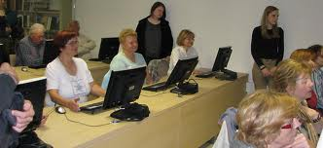

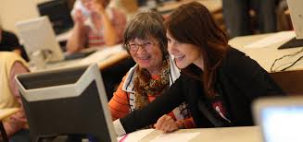
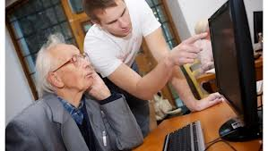
GENERATIONS @ SCHOOL
Polona Crtalic, Slovenia

Slide 2
Section A: For the teacher

Slide 3
A1: Educational context
Time frame: 7 month (from September till April)
Setting: primary & high school, elderly home
School resources: computer labs
Curriculum mapping: science & technology (social, personal & civic education)

Slide 4
A2: Rationale
Why you propose the scenario?
  To show students that having digital skills is important now,
  to share their knowledge with people in need (of that kind of knowledge)
What problem you address?
  Many older people who are isolated, excluded or unrelated to each other for various reasons.
  Huge number of middle aged (unemployed) people with no digital skills.(The use of computers in companies is growing.)
  Many young children are exposed to the different threats with the use of computers.

Slide 5
A2: Rationale
What your (i.e. teacher’s) goals are?
  Students should realise the importance of getting digital skills.
  Students should explore the level of knowledge different generations have and how this affects their lifes.
  Student should connect to different generations and share their knowledge of different digital skills to them.
  Students should explore different tools, programs, applications they think are important (or people they have connected with needs to know).
  Organize a week (bringing different generations @ school and teach them/teach in elderly homes for those who are somehow disabled). --> durring our school's project week.

Slide 6
Section b: For the student

Slide 7
B1: Beginning
Imagine being born 50/60/70 etc. years ago. Were there any computers? What was digital skills of the people at that time? What knowledge of using computers do this people have now?
Imagine being born in 2004. How much time do you think would you spend on computers? Try to think what is the risk of using computers a lot and being very young?
Imagine being unemployed, trying to find a job which requires different digital skills and you don't have a money to pay for some computer lessons.
Can we change that? (raise the knowledge, help the people to get the skills for new jobs, prevent young children with raising awareness of taking risks with using computers...)
Try to find people of different age with different needs, somehow connected with digital skills. Try to connect with them (in defferent ways).

Slide 8
B2: Middle
Activities: exploring different programs, applications, ways of connecting, going to elderly home, primary schools, employment offices etc, making posters and other kinds of advertising (using digital skills/tools), search for ways to connect with each other,...
Materials and tools: computers, different programs, applications,

Slide 9
B2: Middle
Embedded (focal) content: Office (Excel, Word, Power Point, image editing program)
Content resources: Internet, applications, books, newspapers,
Rules: connect with at least one person and help this person, advertise, write a report
Division of labor: form groups based on age/people's interests/student interest, they can decide how to divide the labor (exploring/making different things in groups)

Slide 10
B2: Middle
Timeframe (overall duration, frequency etc.):
7 month (2 hours per week in school, at least 1 hour per week at home/elderly home/primary school...)
Learning supports (coaching, scaffolding, benchmark lessons, ad hoc lectures, etc): video tutorials, online materials, elearning, creating online group, forum ...

Slide 11
B3: End
Design purpose: providing closure to the activity
Attainment of goal: greater computer skills of older people, greater awerness of younger people, feel the satisfaction of connecting different generations to work together.
Final product (if any): different kinds of advertisment (web pages, posters, ...)

Slide 12
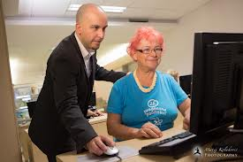
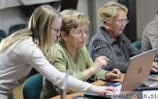
THANK YOU FOR YOUR ATENTION
:-)

