Slide 1
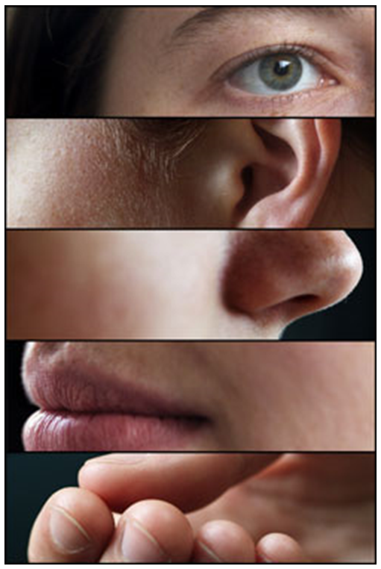

Slide 2
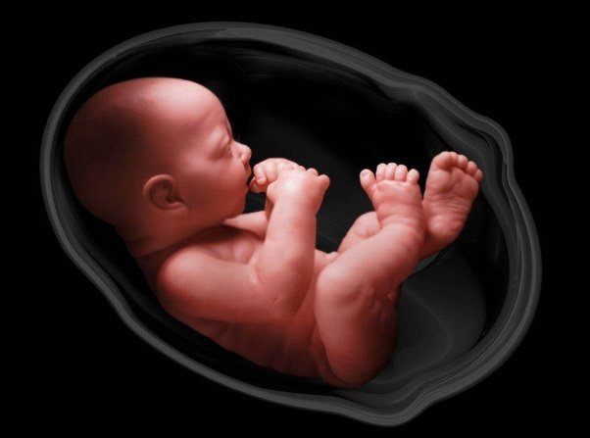
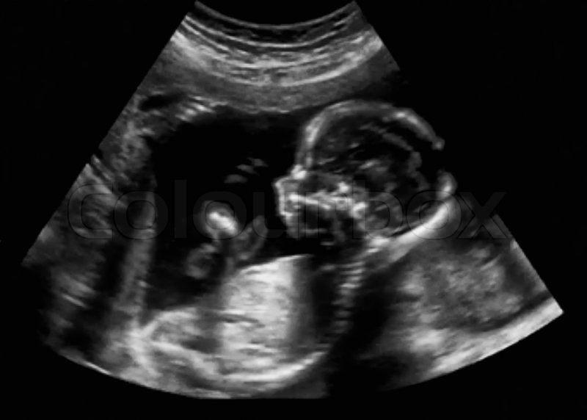
What is sound?

Slide 3
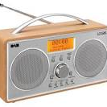
Sound in vacuum – radio on batteries

Slide 4
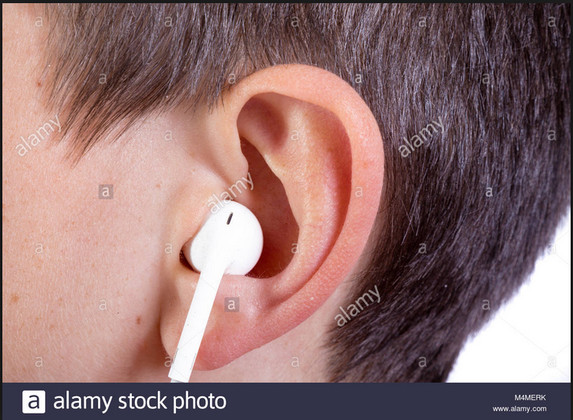
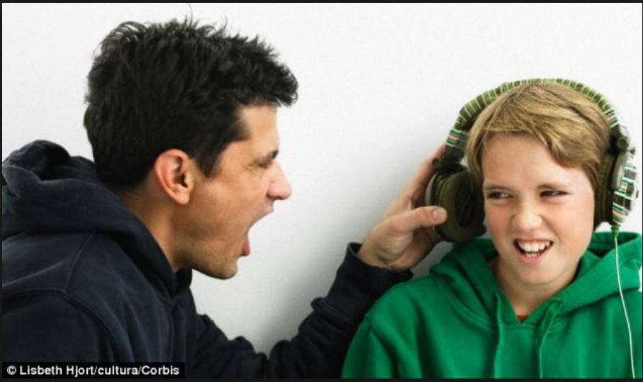
Start from a context pupils might be interested in
– EAR DAMAGE
https://www.nidcd.nih.gov/health/noise-induced-hearing-loss

Slide 5
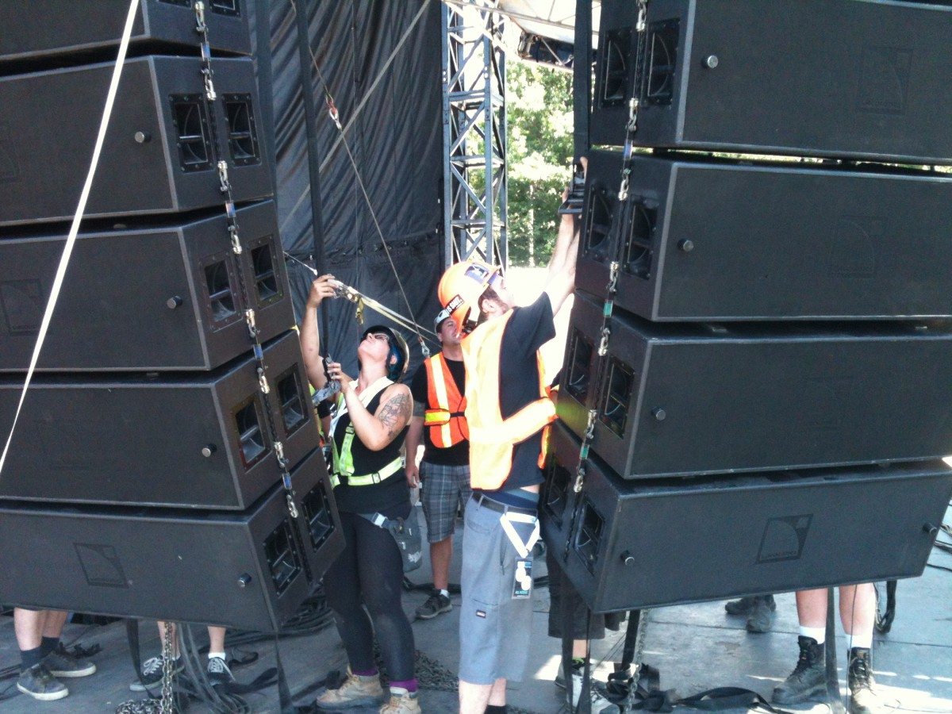
http://metalworksproductions.com/news/big-music-fest-2014-event-recap/attachment/big-music-fest-speaker-set-up/

Slide 6
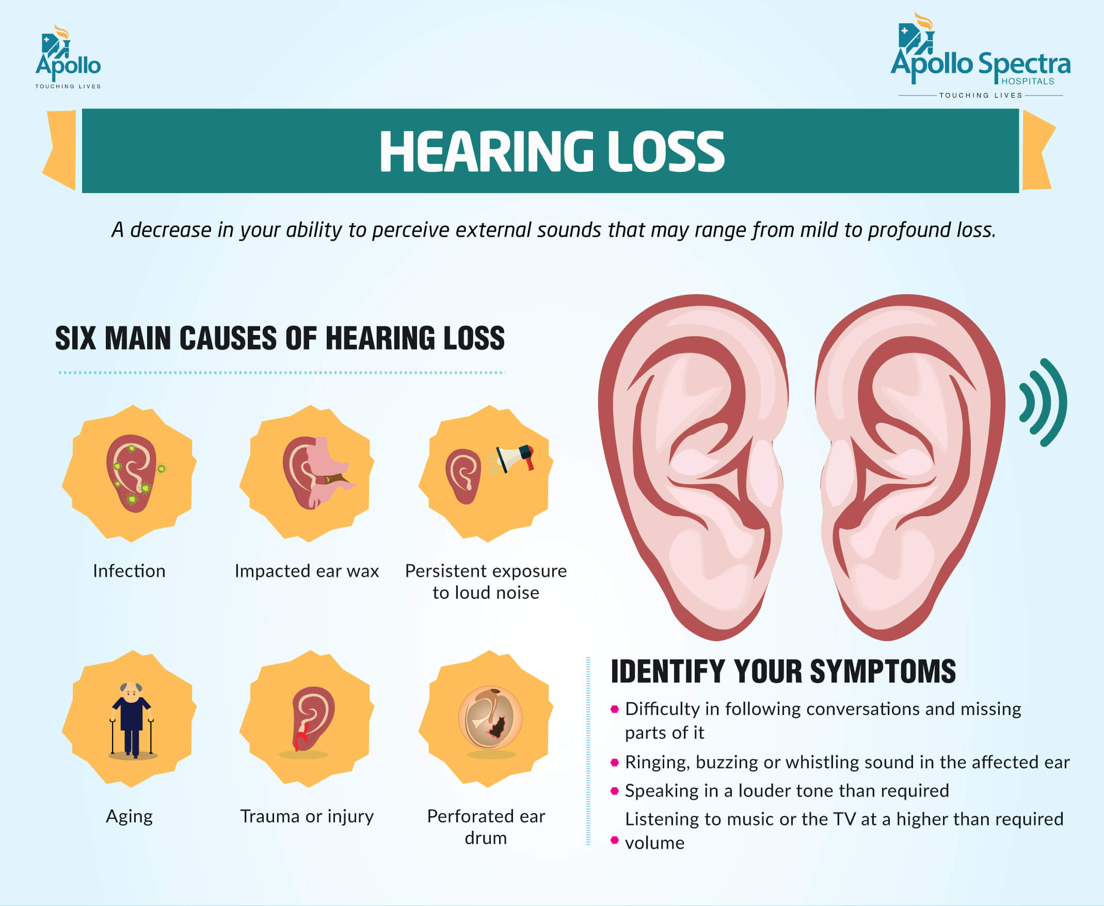

Slide 7
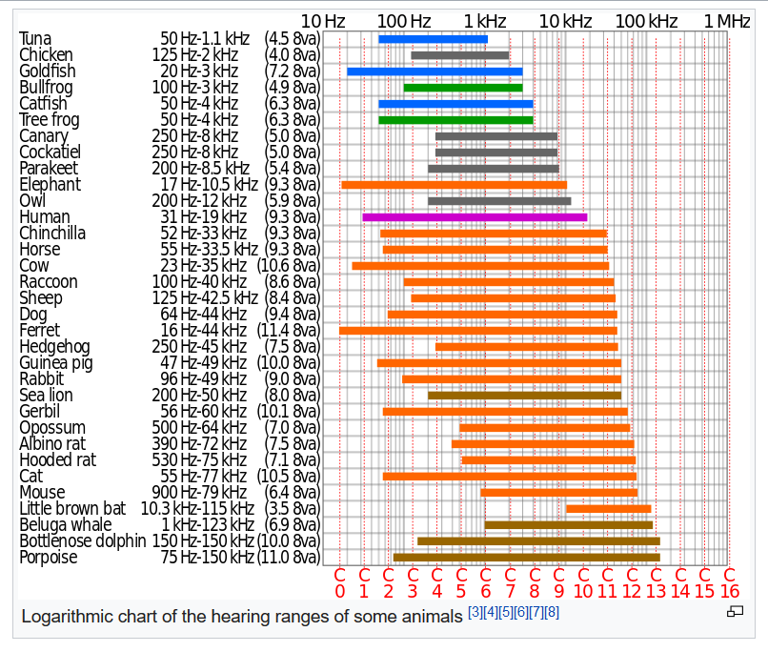
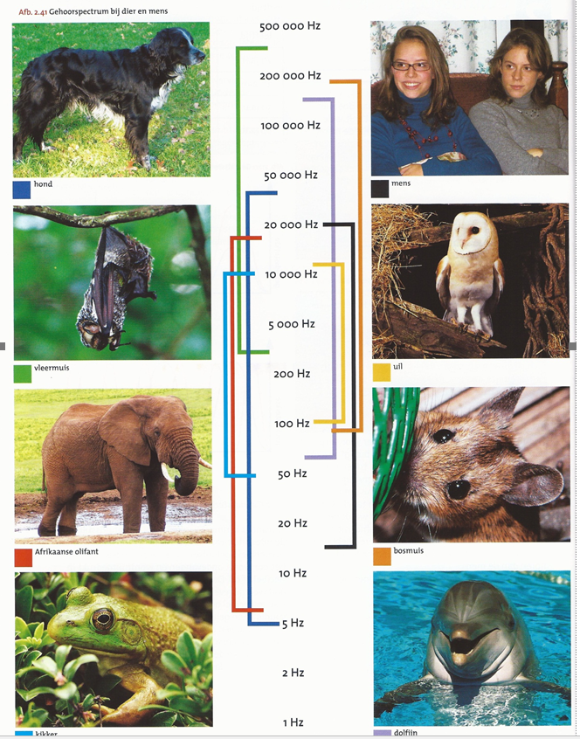

Slide 8

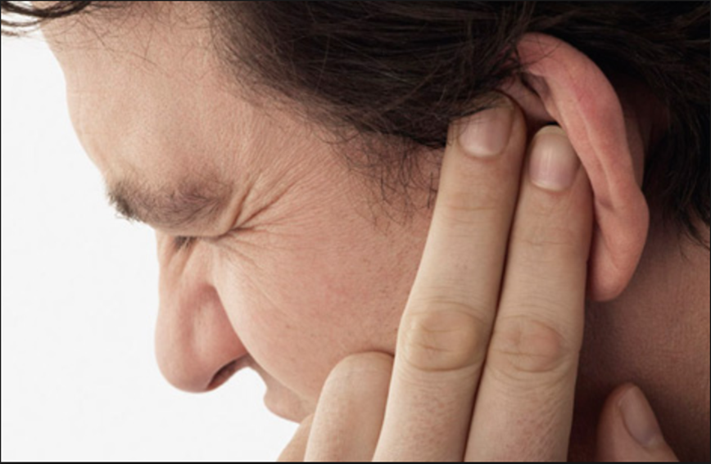
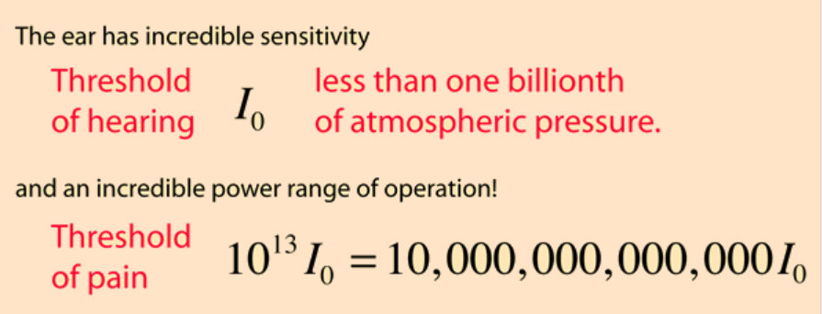
http://hyperphysics.phy-astr.gsu.edu/hbase/Sound/earsens.html

Slide 9
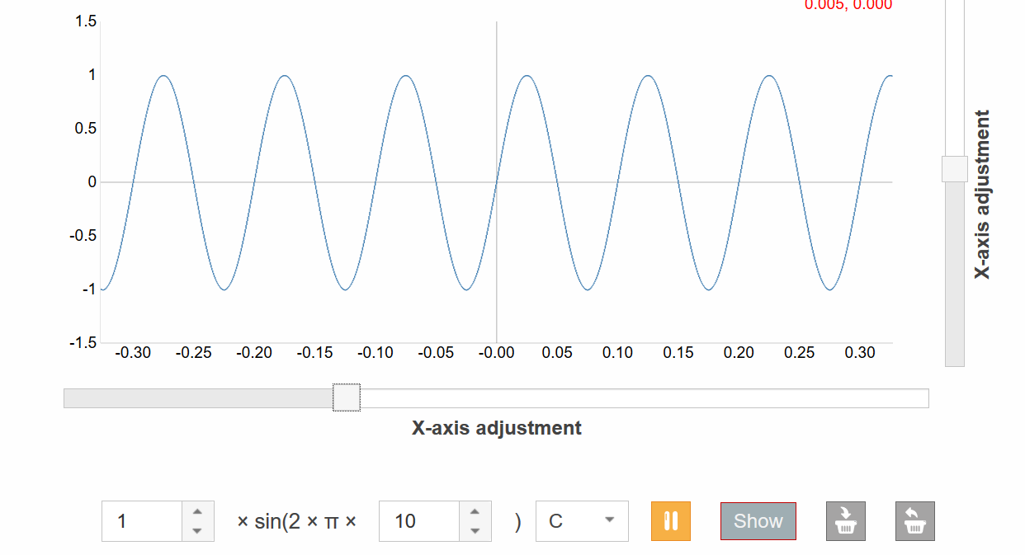
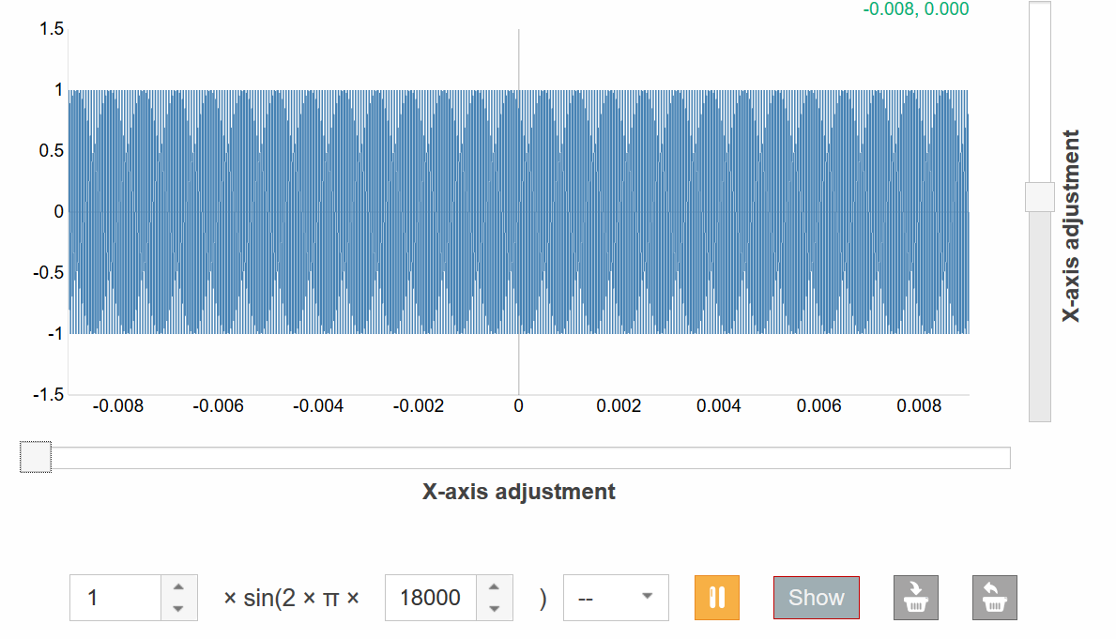

Slide 10
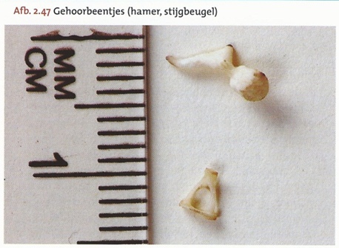

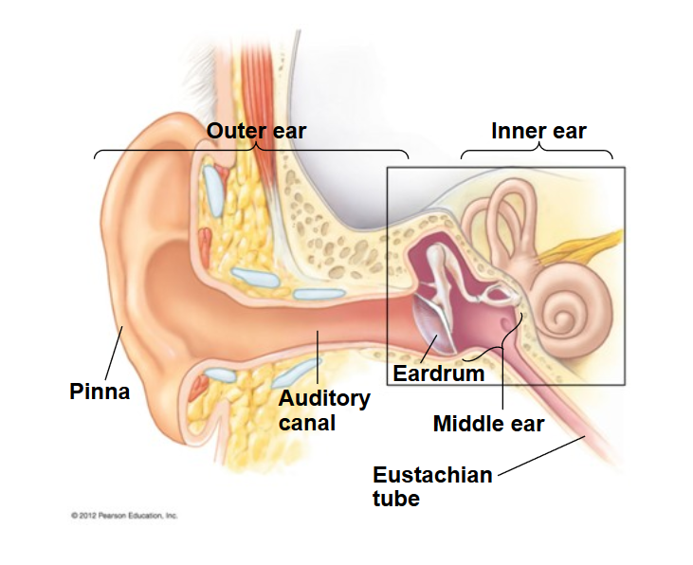
https://slideplayer.com/slide/11729550/#

Slide 11
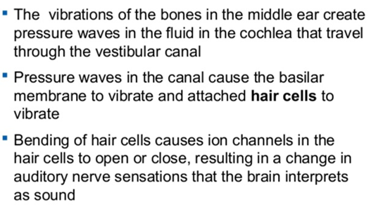
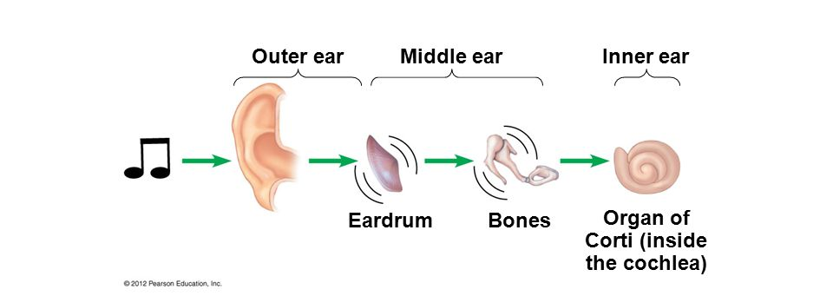

Slide 12
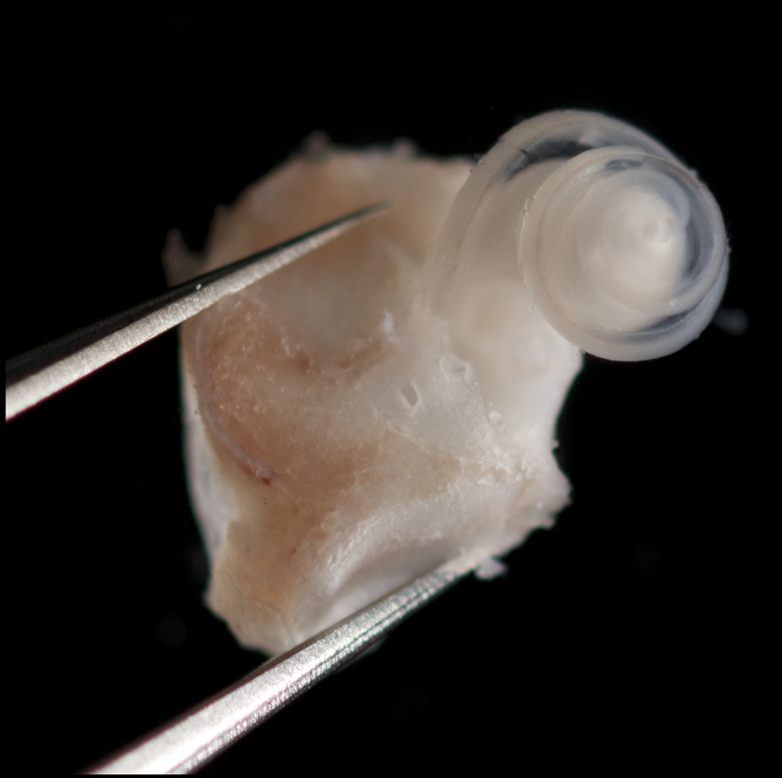
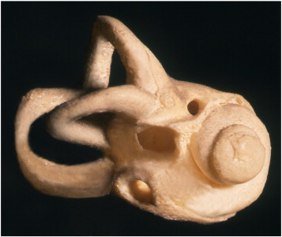
Cochlea and other spiral forms in nature and art
Mathematics
Art
https://www.sciencedirect.com/science/article/pii/S0196070911000305

Slide 13
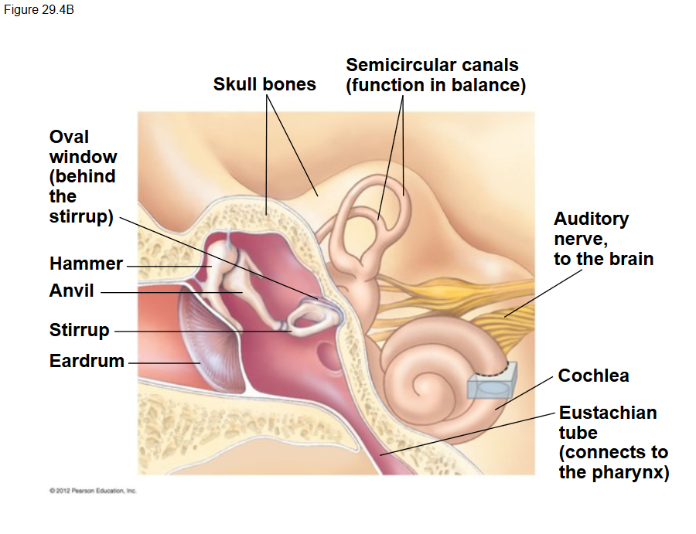

Slide 14
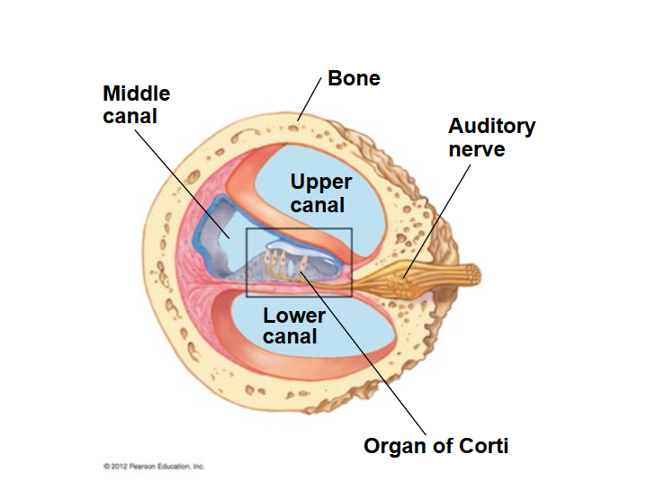

Slide 15
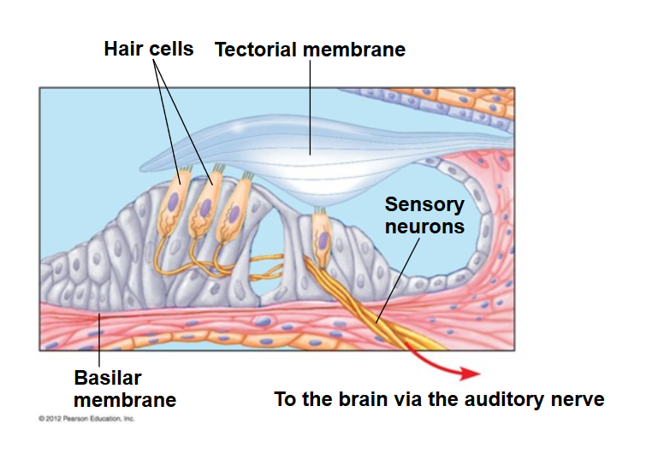
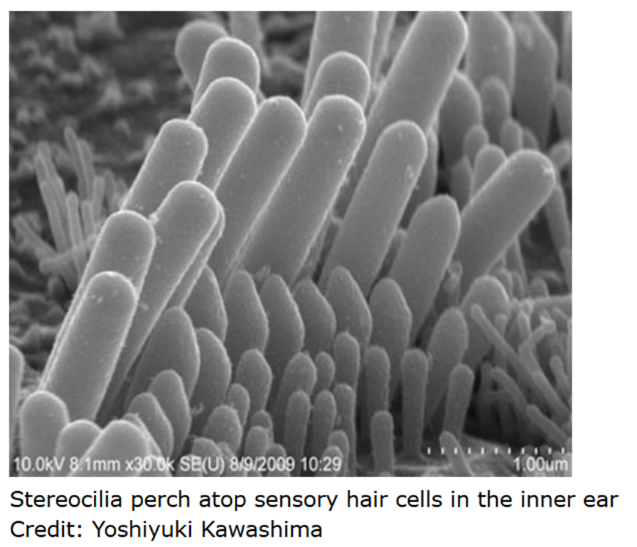

Slide 16
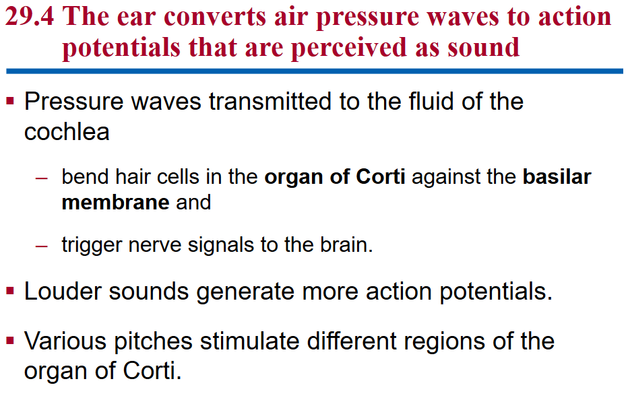

Slide 17
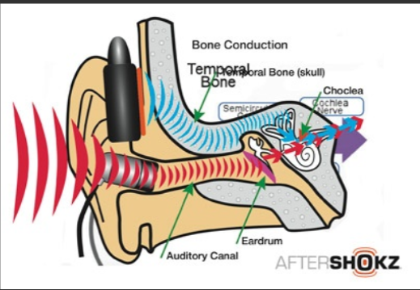
Other ways of hearing:
Can you hear sound with your teeth?
https://prezi.com/view/WTzjbzhQUNtGiNfE4q0k/

Slide 18
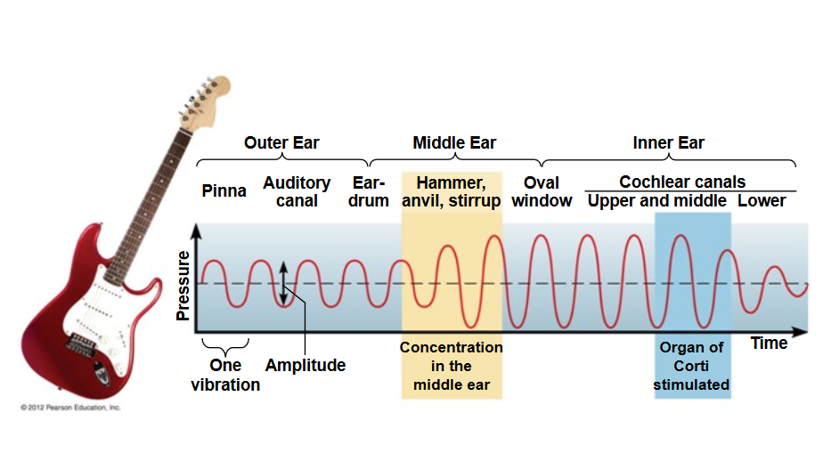
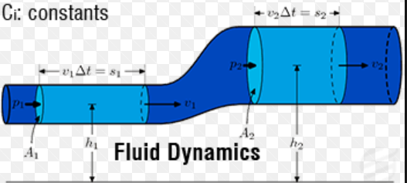

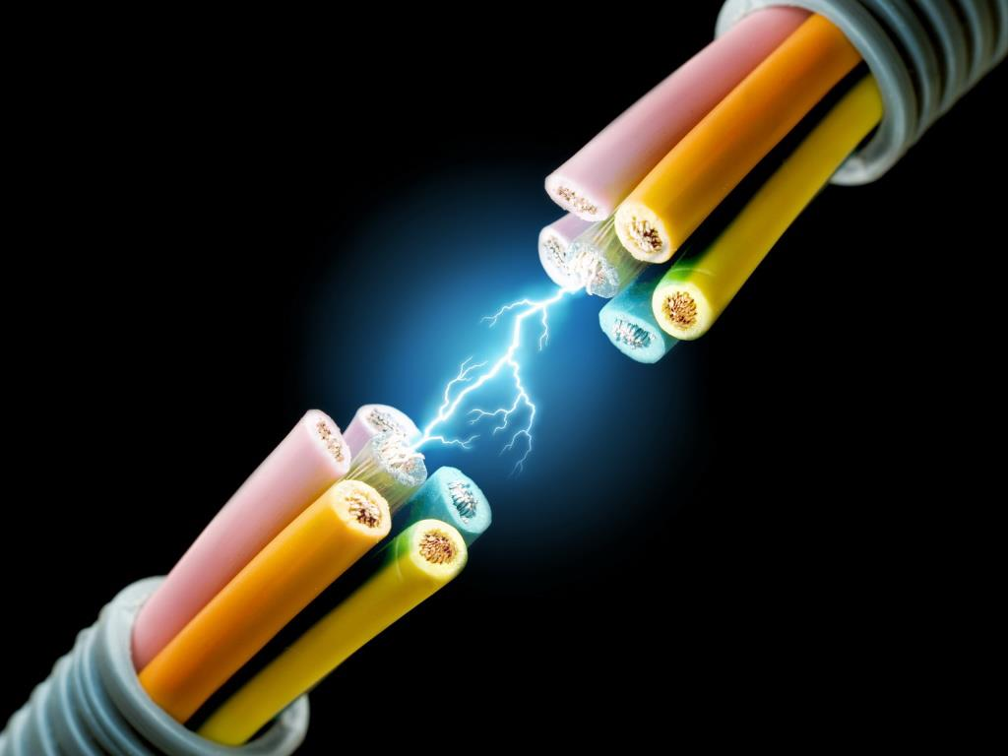
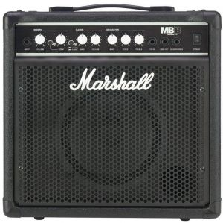
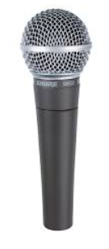
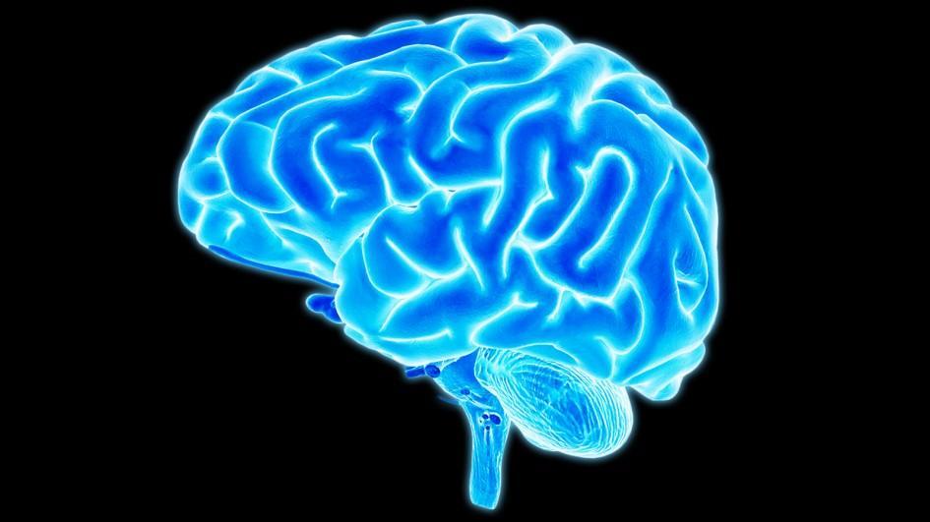

Slide 19
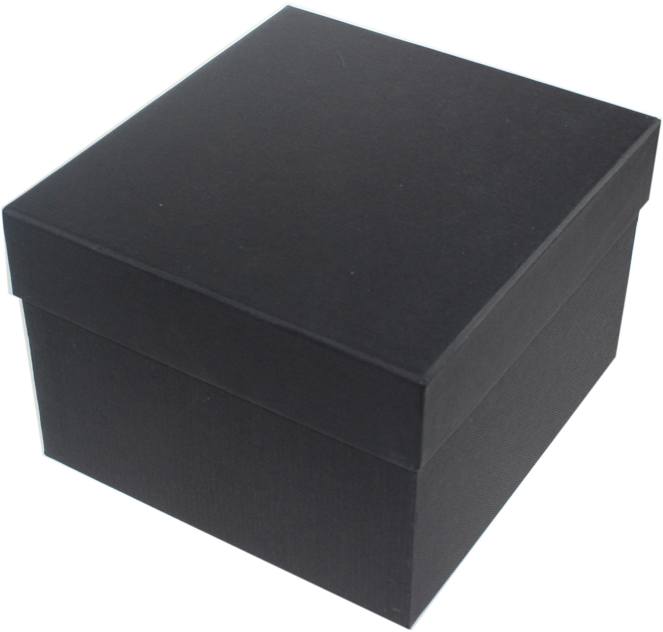
1. Make of model of sound conduction and transduction
2. Prototype a speaker
complementary/in addition to
Señor Domenico’s (a.k.a. Dominiek)
presentation
3. Learning spiral for more depth – Physics, math
further connection and integration of concepts

Slide 20
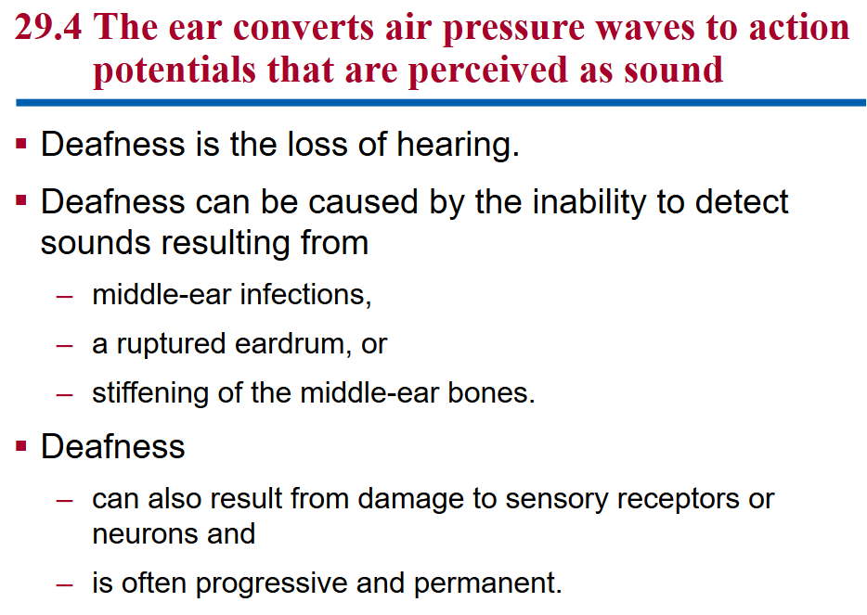

Slide 21
