Slide 1

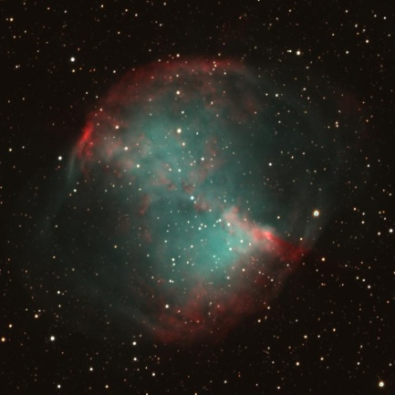
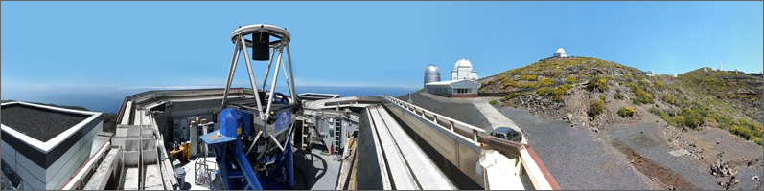


Robotic Telescopes in Education
Astrophysics Research Institute
Liverpool John Moores University
Space Studio Banbury
Dr. Chris Leigh 23rd January 2015

Slide 2
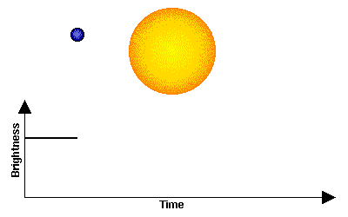
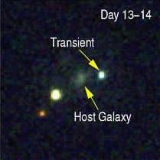
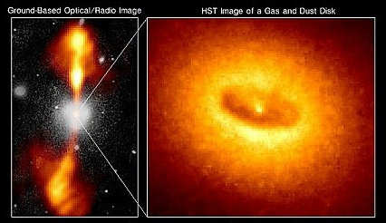
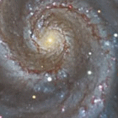
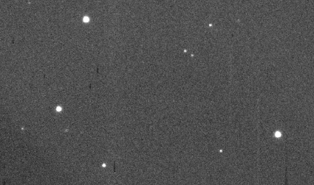
Robotic Telescopes – Why ?
Extra-solar planets
Active Galaxies
Supernova
Gamma Ray Bursts
Designed to investigate how the Universe changes
Able to react quickly to sudden outbursts of energy
Asteroids

Slide 3

Example - The Liverpool Telescope
The Liverpool Telescope is sited on the Spanish island of La Palma.
With the benefit of good weather, dark nights and a 2400m extinct volcano, the Roque de los Muchachos observatory hosts 14 telescopes from a number of EU nations, and is widely considered to be one of the top two observing sites in the northern hemisphere.

Slide 4


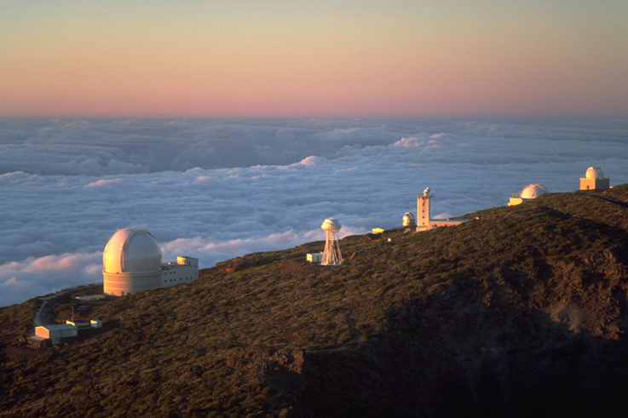


Slide 5


Slide 6
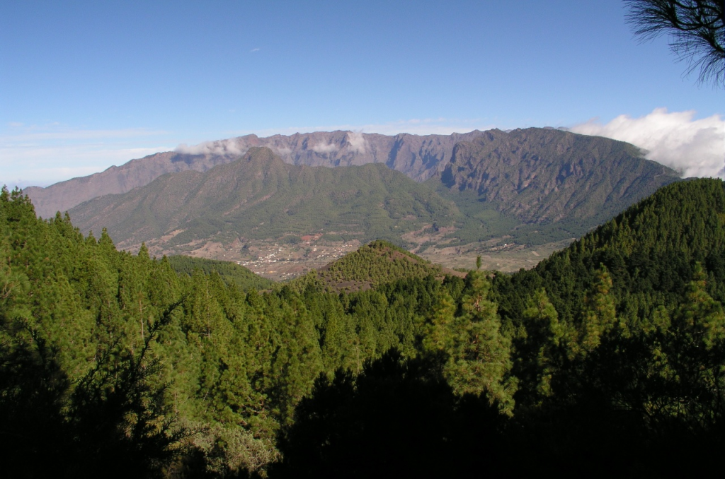
Observatory

Slide 7
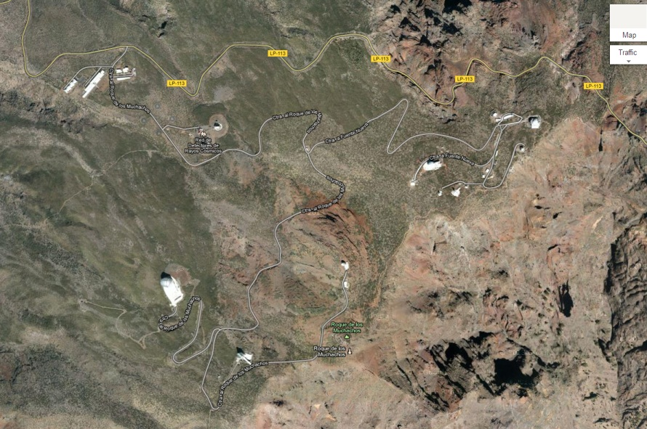
LT
Roque de los Muchachos Observatory

Slide 8
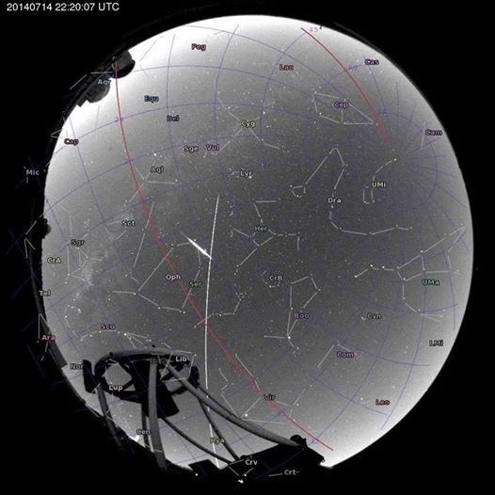
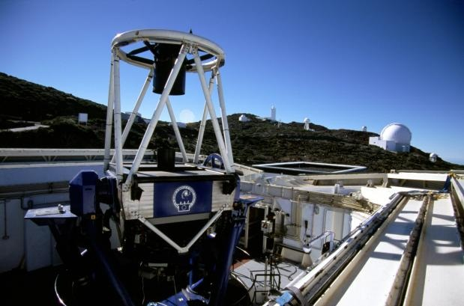
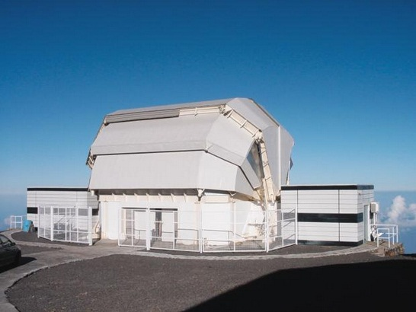
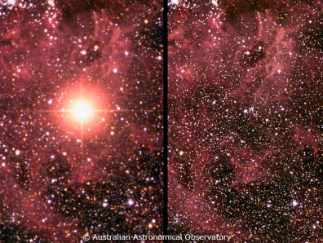
The Liverpool Telescope
Fully robotic 2 metre mirror telescope – Clamshell Enclosure
8.5 m high, 6.5 m wide and weighs 24 tonnes
Designed for rapid response – Supernovae, GRBs, NEOs
Six instruments – IO:O, RISE, RINGO3, FRODOspec, SPRAT, SkyCam
Sophisticated scheduling system – no human intervention
85% used by professional astronomers, 15% UK & Spanish schools

Slide 9
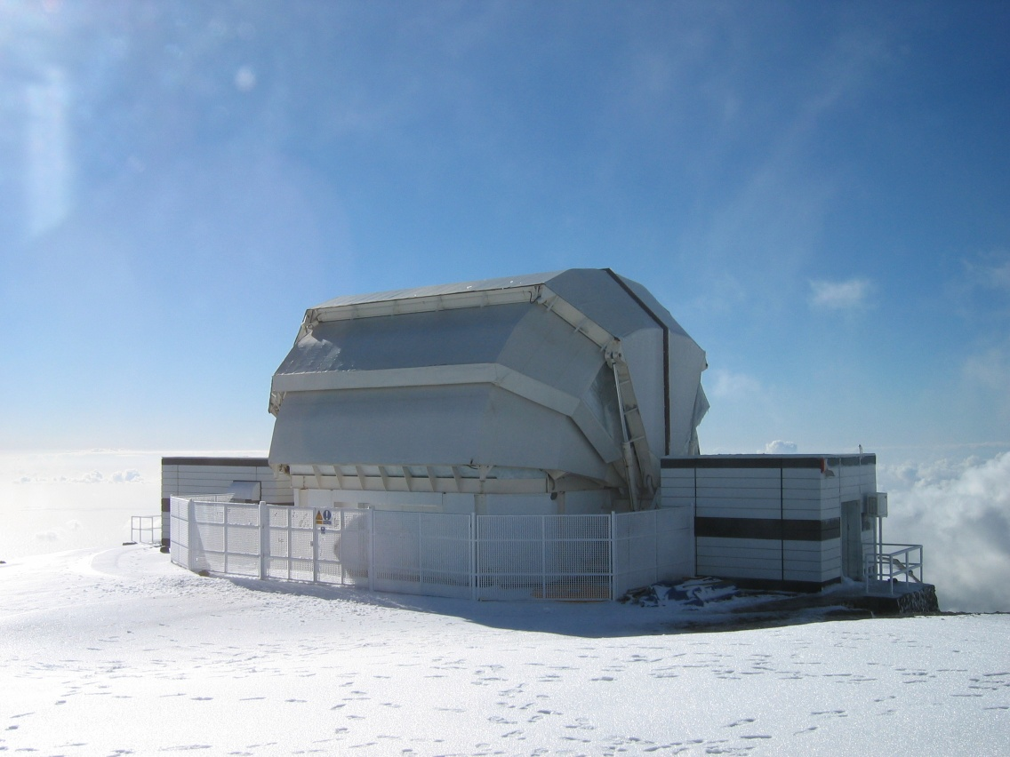
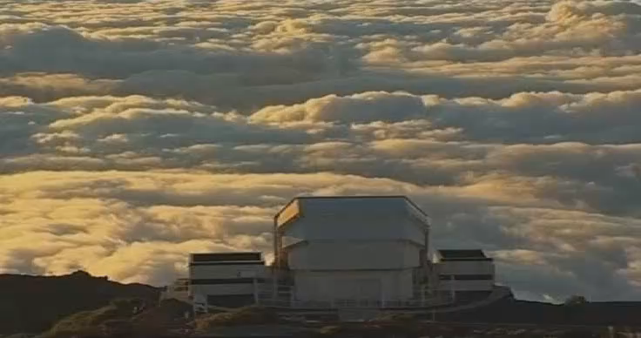
The Liverpool Telescope

Slide 10
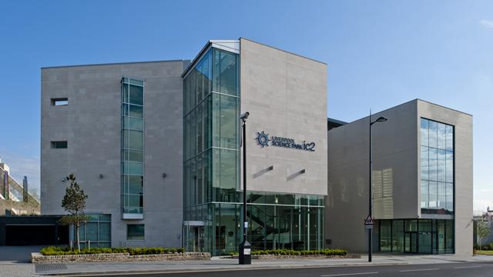
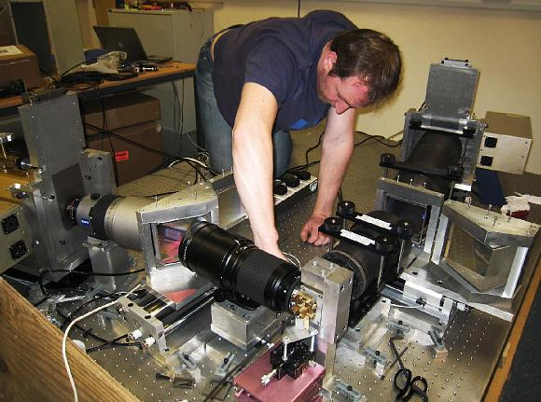
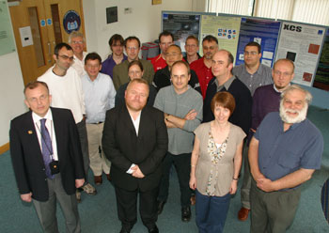
The Astrophysics Research Institute (ARI)
Based in Liverpool Science Park, IC2
Staff Number : 64
30 research staff and lecturers, 18 PhD students
10 on the LT Team and 6 support staff.

Slide 11
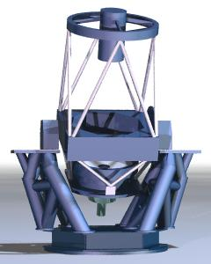
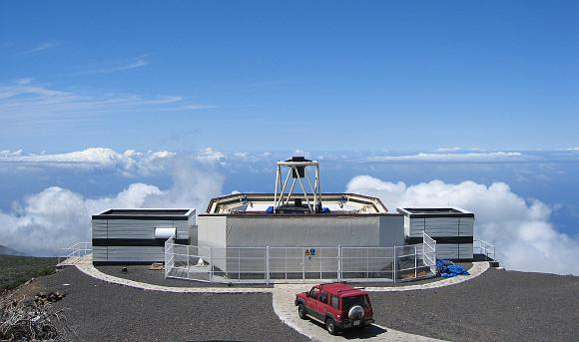
The LT Design
Ritchey-Chrétien Cassegrain
f/10 focus

Slide 12
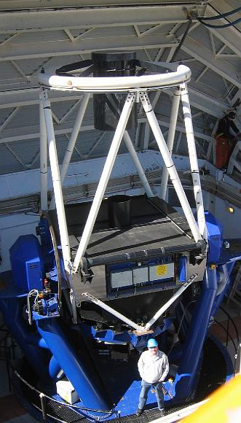
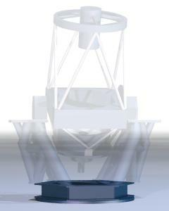
The LT Design

Slide 13
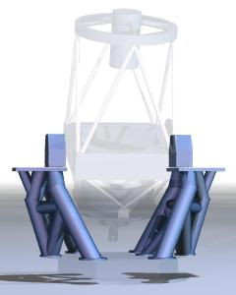
The LT Design

Slide 14
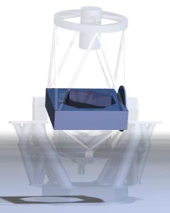
The LT Design

Slide 15
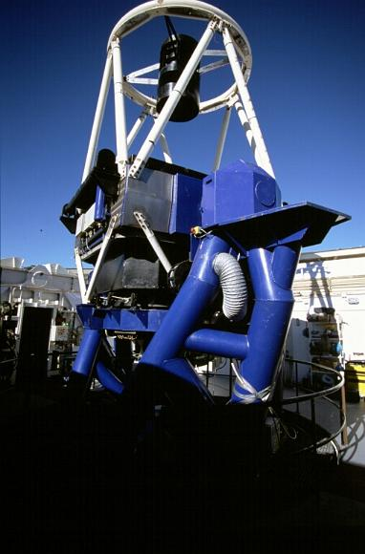
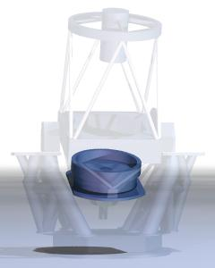
The LT Design

Slide 16
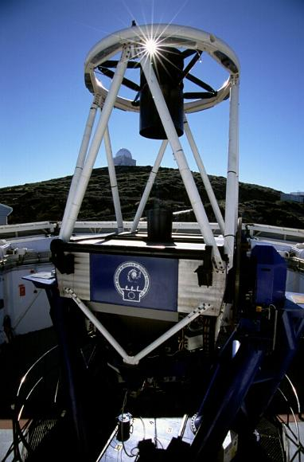
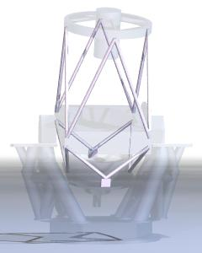
The LT Design

Slide 17
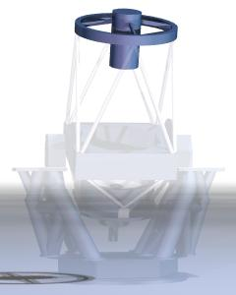
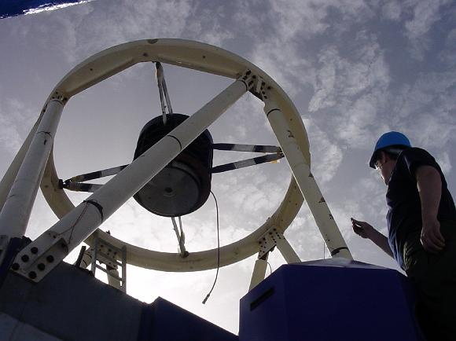
The LT Design

Slide 18
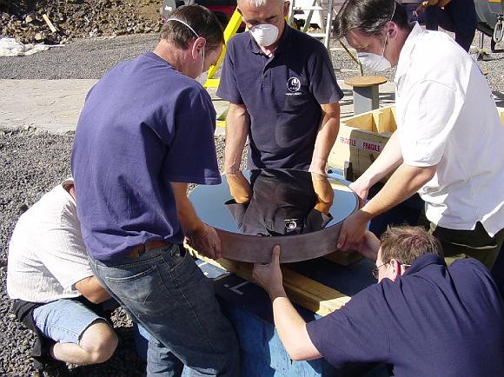
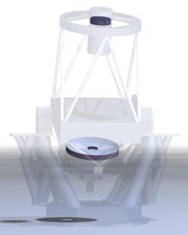
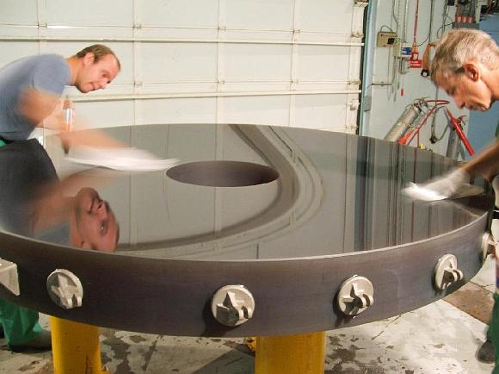
The LT Design

Slide 19
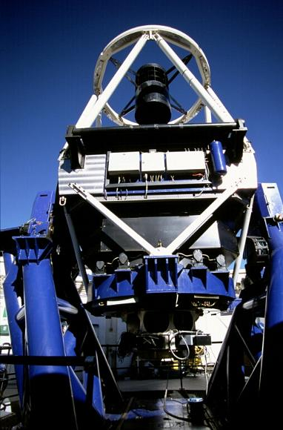
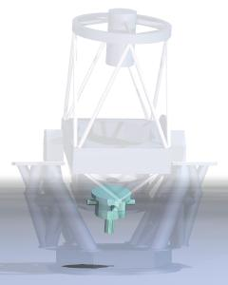
The LT Design

Slide 20
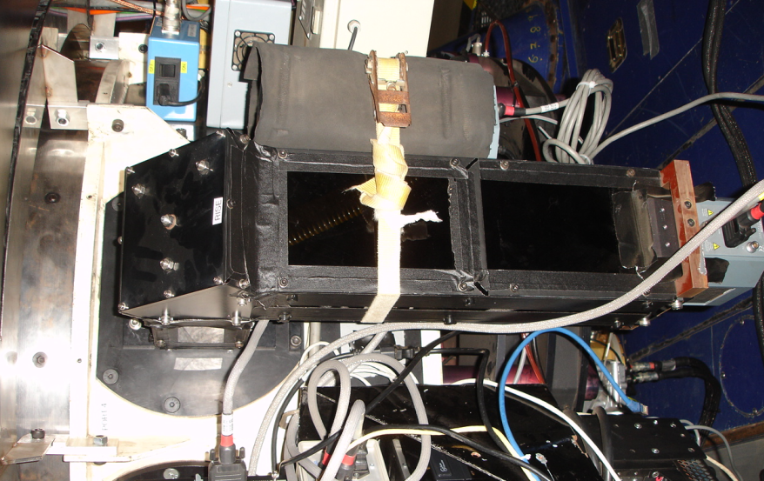
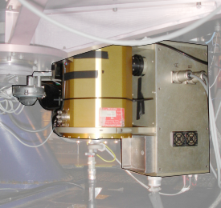
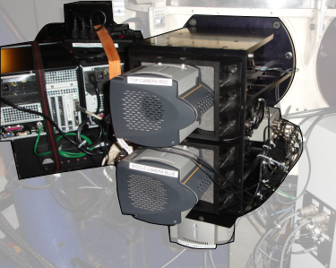
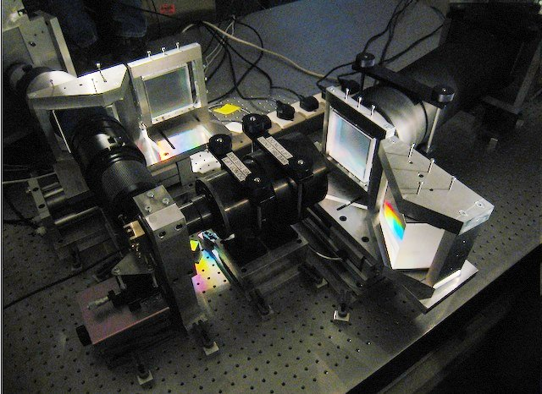
The LT Instruments
RISE
IO:O (4096 px : 10’ FOV)
IO:O (4096 px : 10’ FOV)
RINGO 3
FRODOSpec

Slide 21
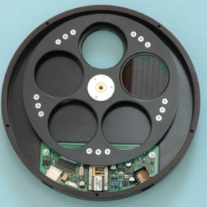
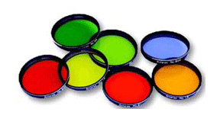
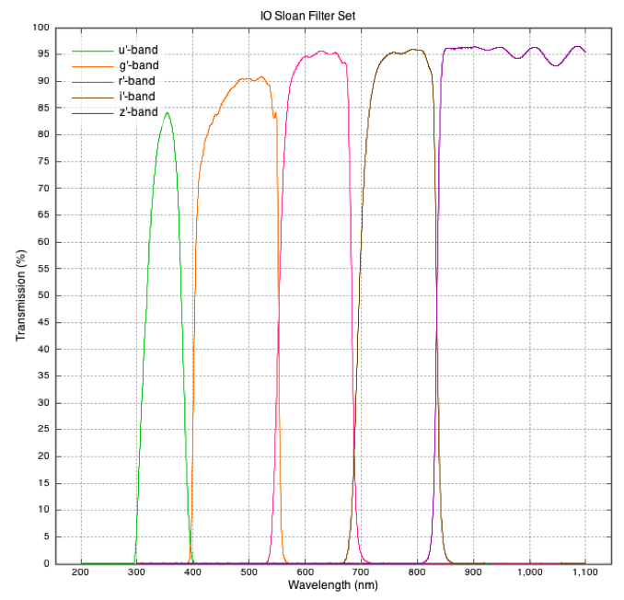
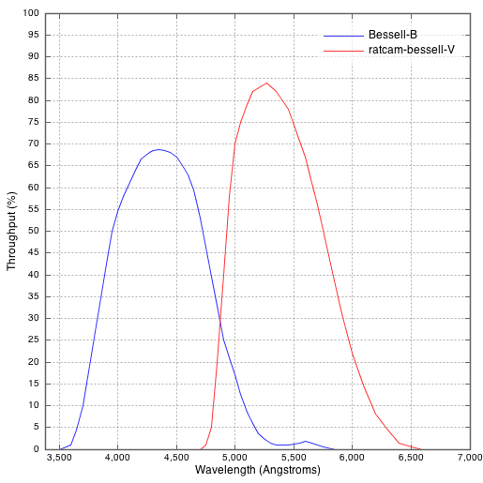
The LT Filters

Slide 22
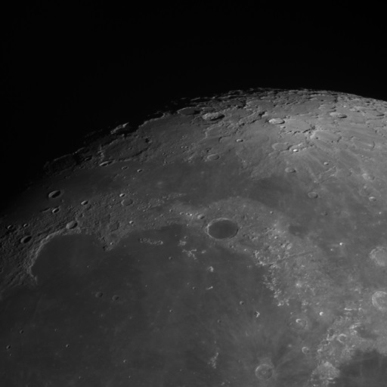
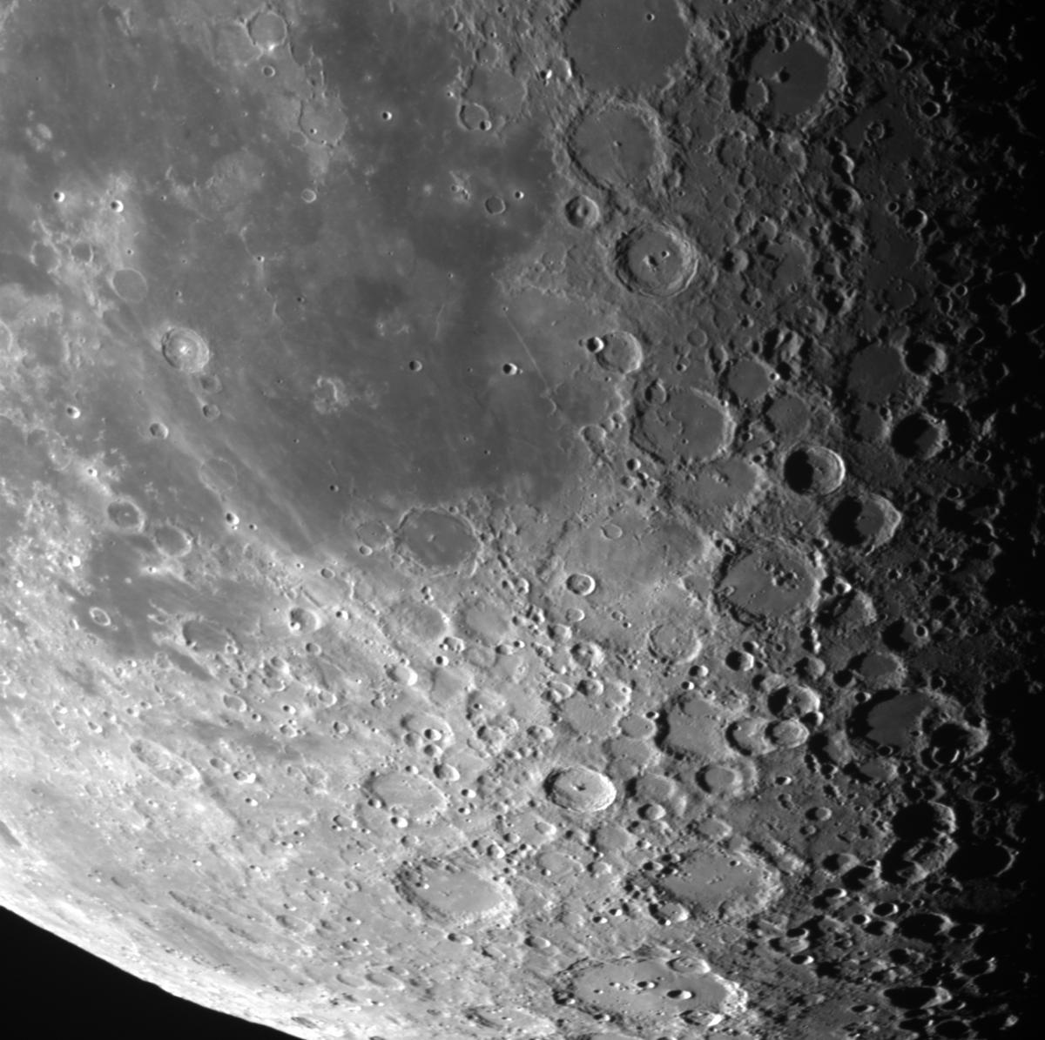
The Results – IO:O

Slide 23
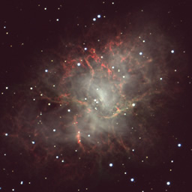
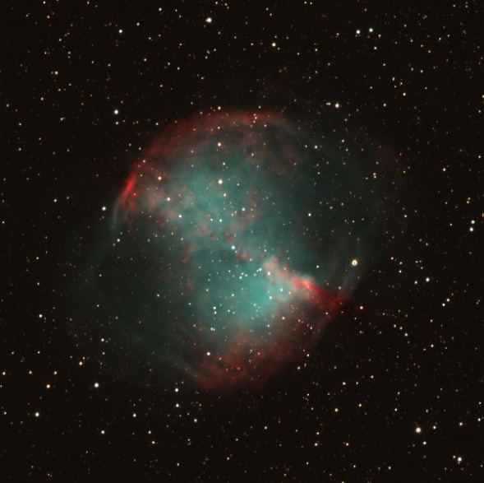
M1 M27

Slide 24
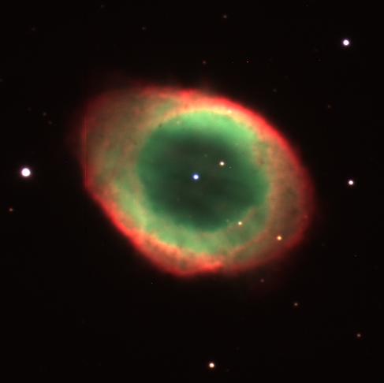

Slide 25
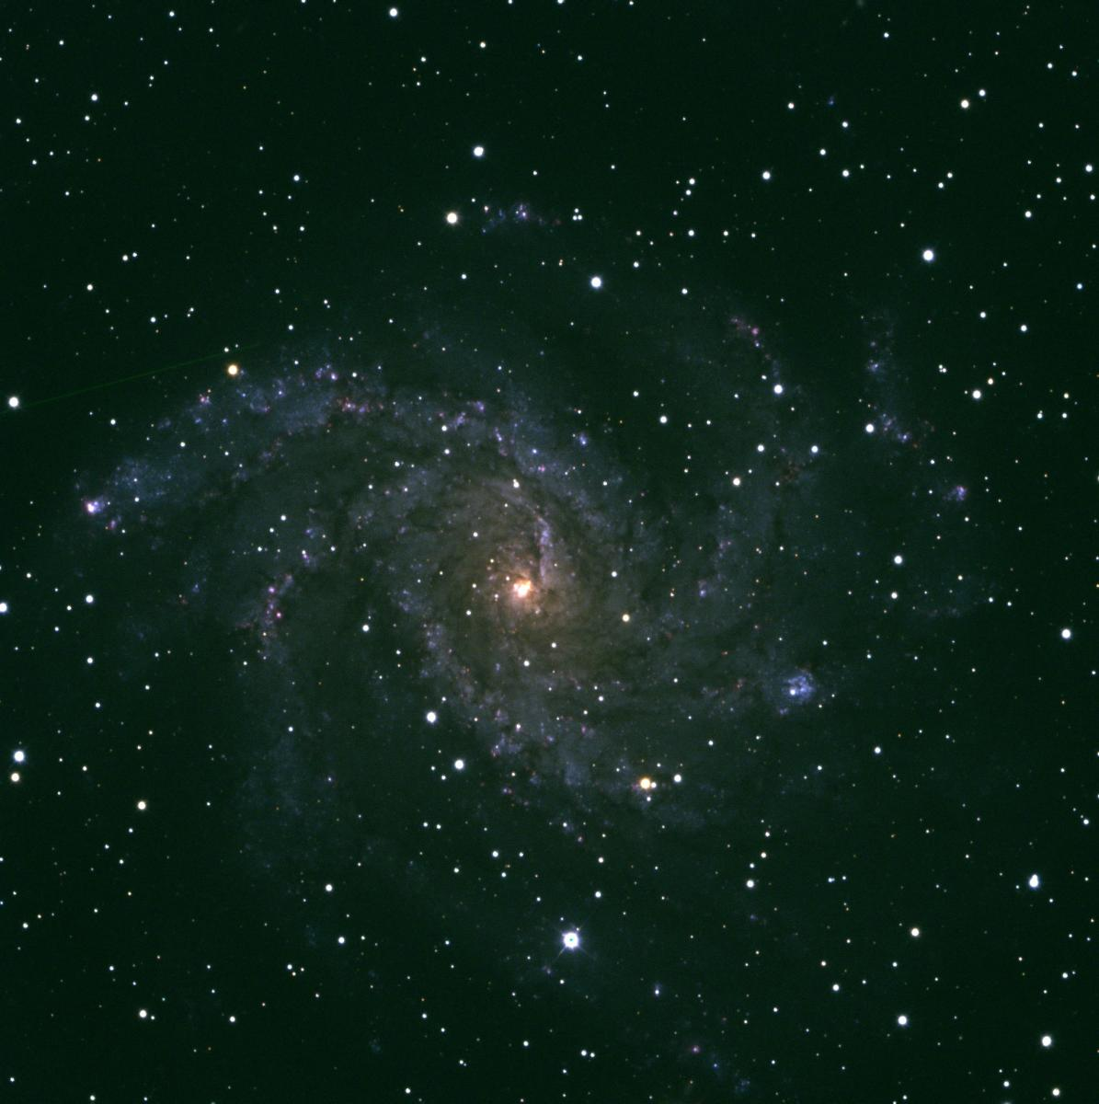

NGC 6946 M88

Slide 26



Jupiter Saturn

Slide 27

National Schools Observatory
Established (2004) to provide schools in the UK and Ireland with access to the Liverpool Telescope through a guided observing system, together with astronomy related content, news and learning activities.

Slide 28


National Schools Observatory (LJMU)
User Accounts
4,241 Teachers ; 14,287 Students
Observing Requests
Total : 85,835 ; average 2,000+ per month in term time.
Website Visits
1,387,512 pages served in 2014;
339,512 visits ; 50% from UK ; 28% USA

Slide 29





Go Observing
Guided Observing System
Designed for ages: 7+
Moon, Planets, Galaxies, Nebulae
Single Filter or
Three Filter (Colour)
Projects:
Exoplanet Transits
NEO, Asteroids
Supernovae

Slide 30




NSO Projects and Activities

Slide 31

Any Questions ?
Astrophysics Research Institute
Liverpool John Moores University
Dr. Chris Leigh

