Slide 1

Playing with the Sims.
How hard can it be?
Antri Avraamidou
Be Creative, Play Digitally
Creativity. Discovery. Games. Learning
5th of July 2013
Crete, Greece

Slide 2
TEACHER’S STUFF

Slide 3
Educational context I
6-8 weeks
In pairs
11-12 year-olds
At home
A computer / The Sims 3 / Players

Slide 4
Educational Context II
Mathematics
Science/Technology
Social, personal and civic education

Slide 5
Rationale
Economic Crisis
maturity
responsibility
11-12 year-olds
Decision - making
Try-out
Problem solving skills

Slide 6
STUDENT’S STUFF

Slide 7
Situation
In this game you play “Gods”. You can control the lives of virtual people, called the Sims and build (or destroy) their houses. You may choose to make their dreams come true… or their worst nightmares.
Sounds easy? Hmmm… Let’s see…

Slide 8
Your Goal
“A couple is expecting a baby and wants you and your partner to renovate their house in order to accommodate the new member. In order to become house renovators though, you first need to demonstrate your skills to create a house and control a family in The Sims 3. Then you will be ready to renovate their house.
Note: Make sure that the family is ALIVE afterwards.”

Slide 9
Minimal set of initial knowledge
What’s a renovator?
How a house is designed?
What are a house’s basic furniture?
Money?

Slide 10
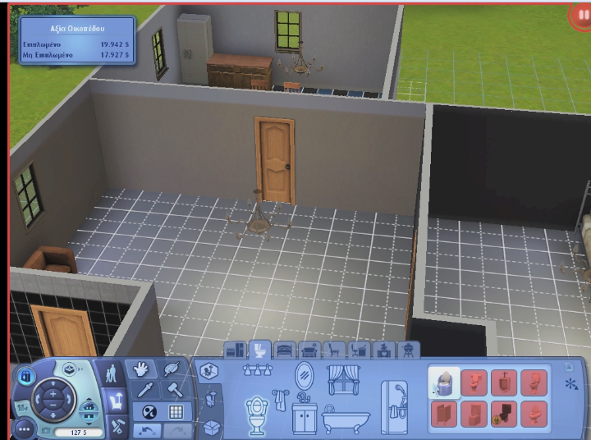

Slide 11
B2a: Middle
Activity one – Getting along with the Sims
Enter a Sims neighborhood of your choice.
Pick a family from the library or create one of your own
Place that family in an empty lot and build that family’s house
Play with the family for 5 Sims days
Rule: make sure the family survives that!

Slide 12
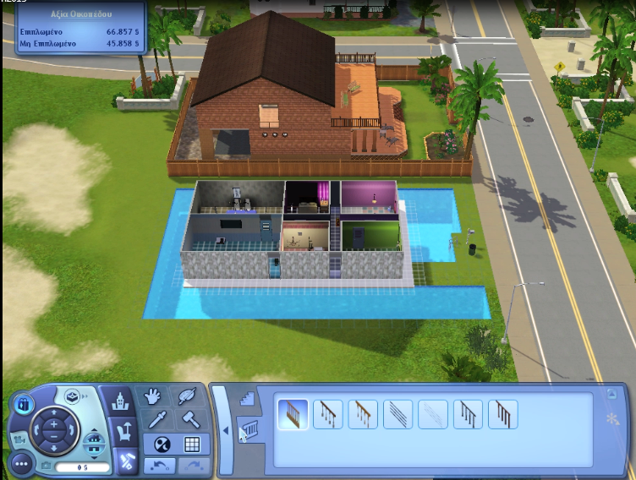
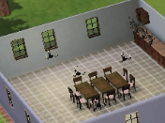
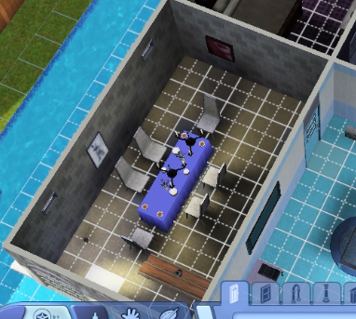

Slide 13
B2b: Middle
Activity two – Become a house renovator
Enter the “Sunset Valley” neighborhood and choose to play with the Family X
This family is expecting a baby. Make changes to the house so that it can accommodate this new member
Play with the family for 5 Sims days
Rule: make sure the family survives and they are ready for the new family member

Slide 14
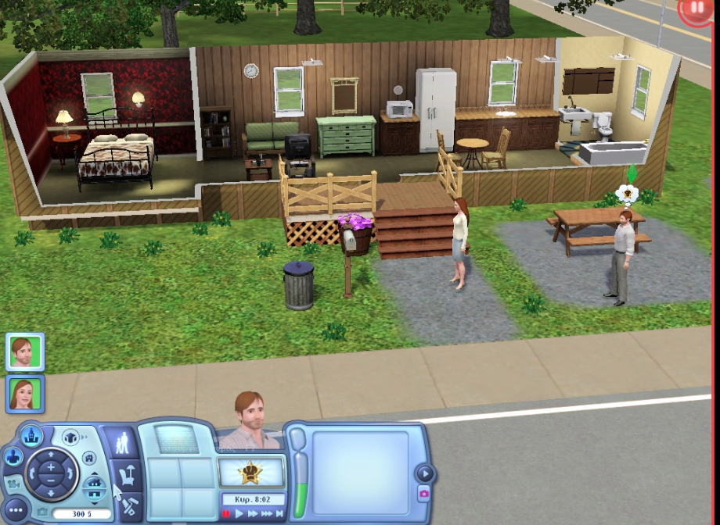
Notes:
when they build something money is subtracted from the family’s account and
when they drag the mouse to create something the game counts automatically the squares used

Slide 15
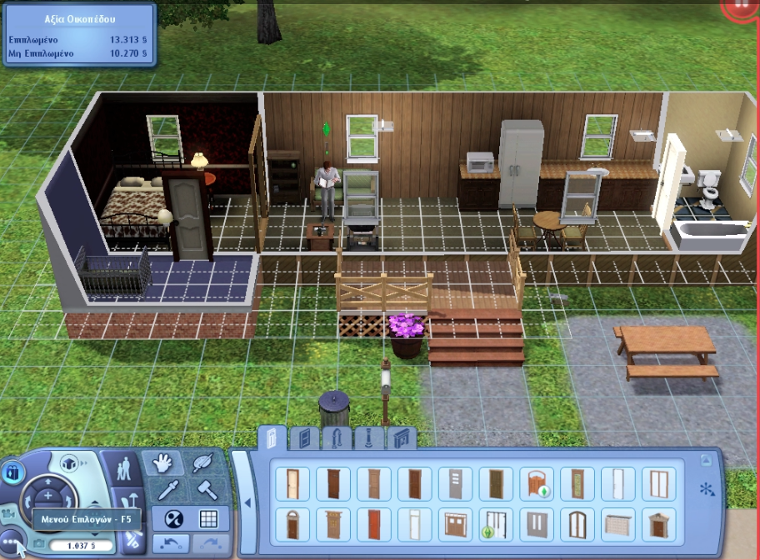

Slide 16
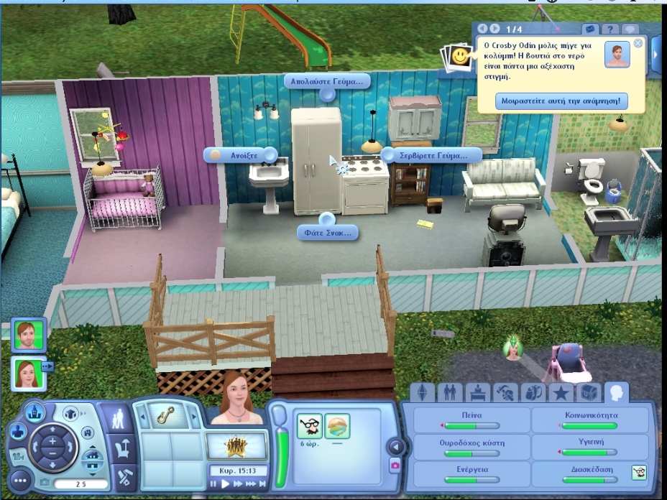

Slide 17
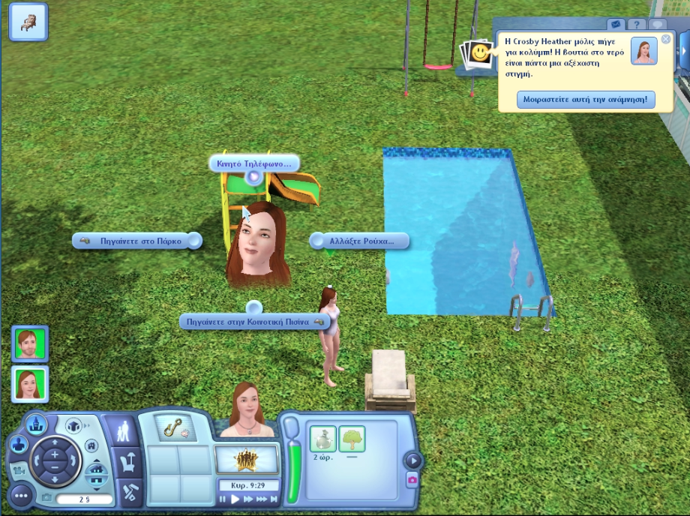

Slide 18
B3: End
After completing each activity, there are going to be classroom discussions for assessment including themes such as:
Dealing with a family (relationships etc)
Designing a house and adding furniture
Editing existing houses with budget constraints/ What were your strategies?
Finding common strategies between pairs
…Emerging themes, teachers’/students’ choice

Slide 19
Thank you for your attention
antri.av@gmail.com

