Slide 1
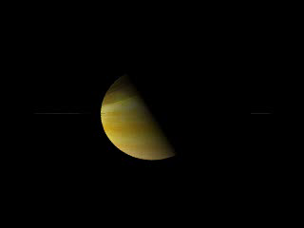
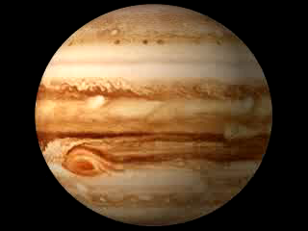
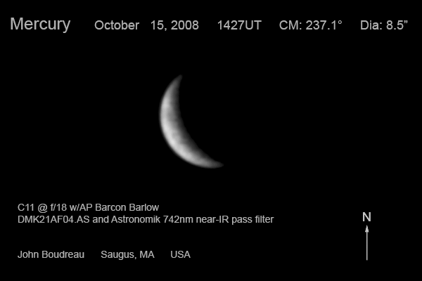
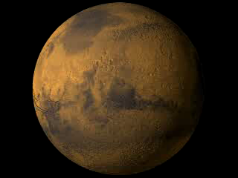
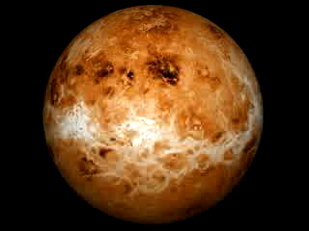
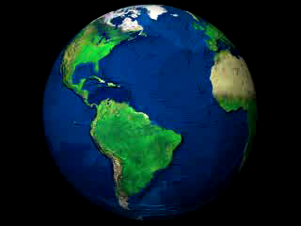



Planetary calculator
Phase1
Choosing the scale
Leonor Cabral – Portugal

Slide 2
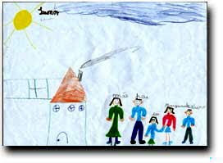


Phase 1 - Engaging students and awakening curiosity
?
Make comments about the drawing!
Notice anything strange?
Is it possible that our brain can always represent the scales in the right way?

Slide 3
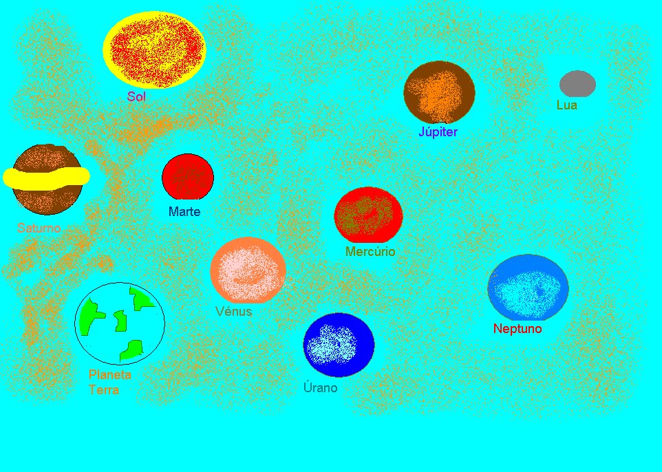
?
Make comments about the drawing!
Are the celestial objects at the right scale?

Slide 4
Is it possible to use the same scale to represent the size of the planets and its distance to the Sun?(1AU = 1cm and size of the Earth= 1cm)
Is it possible to draw on an A4 sheet the Sun and every represented planets?

