Slide 1
Open Schools for Open Societies Summer School 2019

Slide 2
Description of the project
Title: The introduction of a recycling process into a secondary school in Ireland and increasing awareness of the importance of recycling in the local community
Description: In this project students establish a recycling process in a secondary school in Ireland and promoted the importance of recycling in the local community
Learning Objectives:
Understand what is meant by recycling and its importance in relation to preserving the environment
Develop and use project management skills
Develop and use communication skills
Develop and use interpersonal relationship skills

Slide 3
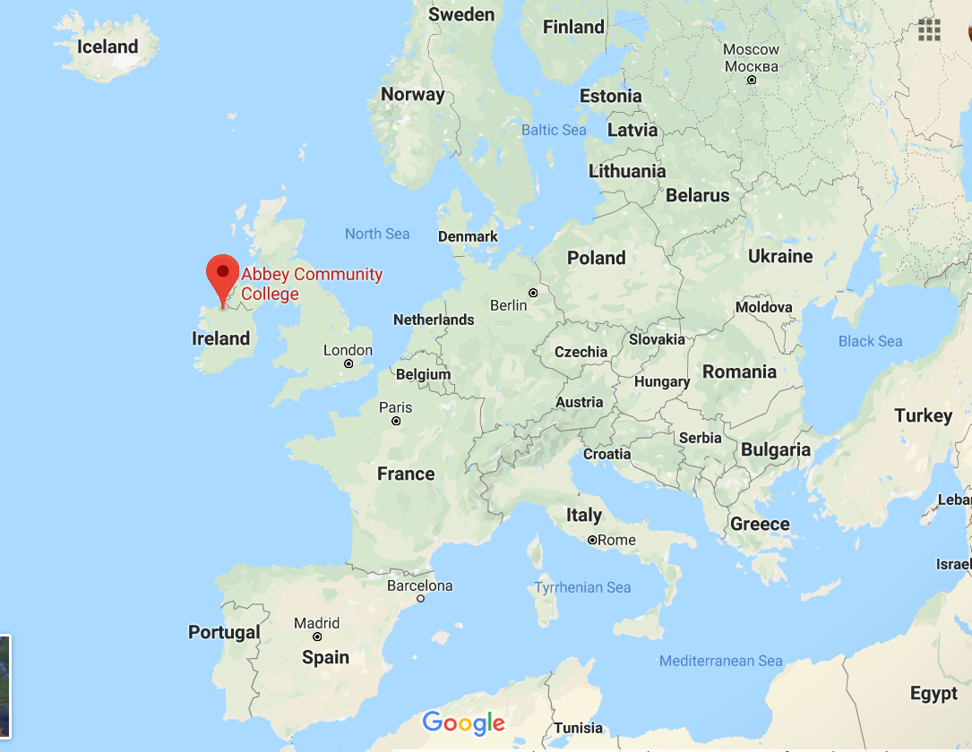
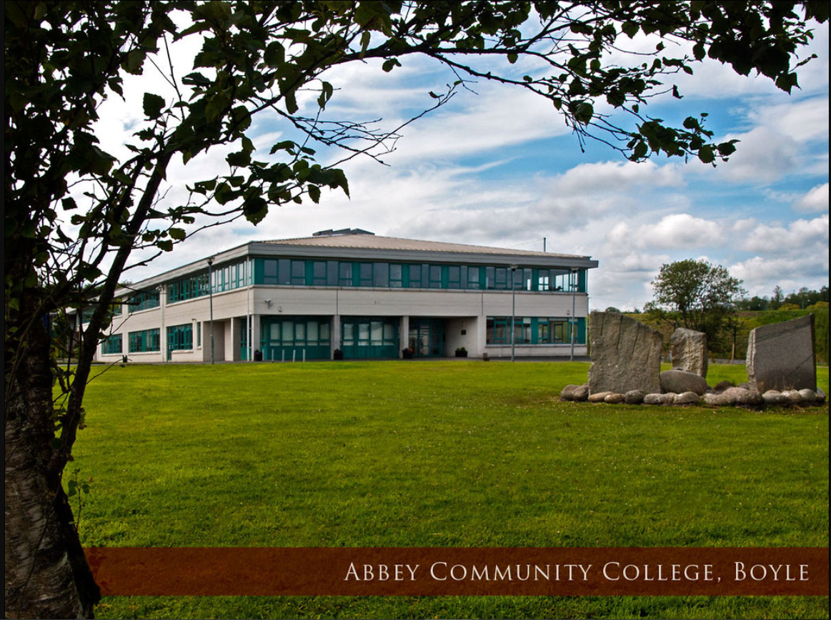
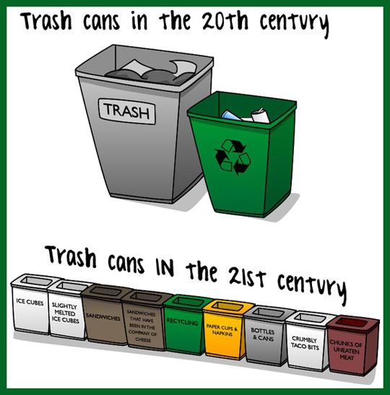
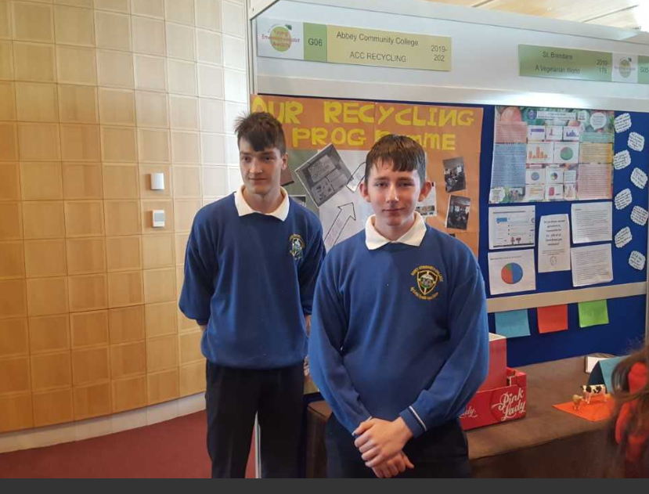
Introduction
Notes:
Identified the problem that the school did not have a recycling process.

Slide 4
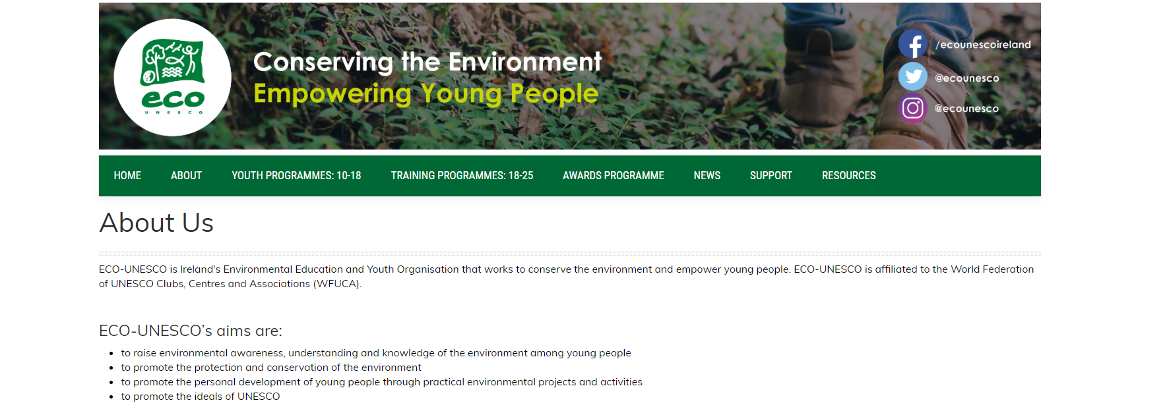
Planning and Design of the Project

Slide 5
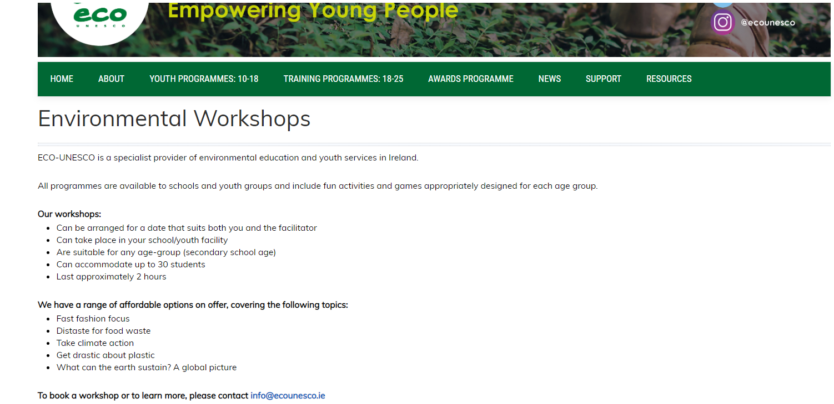
Planning and Design of the Project

Slide 6
https://www.youtube.com/watch?v=bD5AahdcZew

Slide 7
The Team

Slide 8
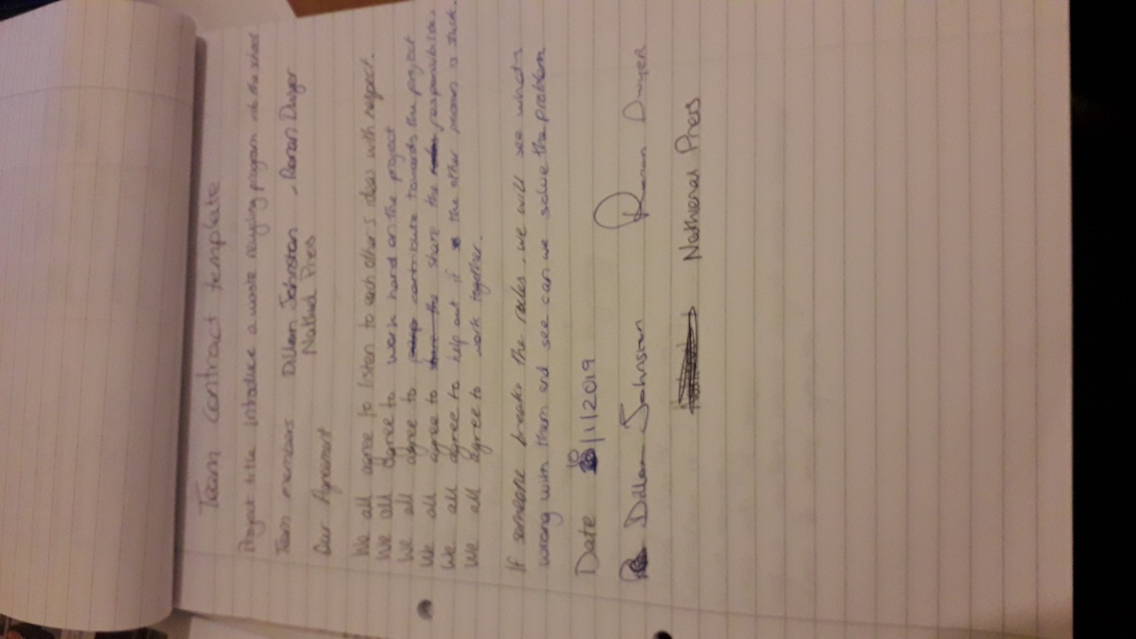
Our contract
The first thing we did was create a contract
Some of the rules we had to follow were

Slide 9
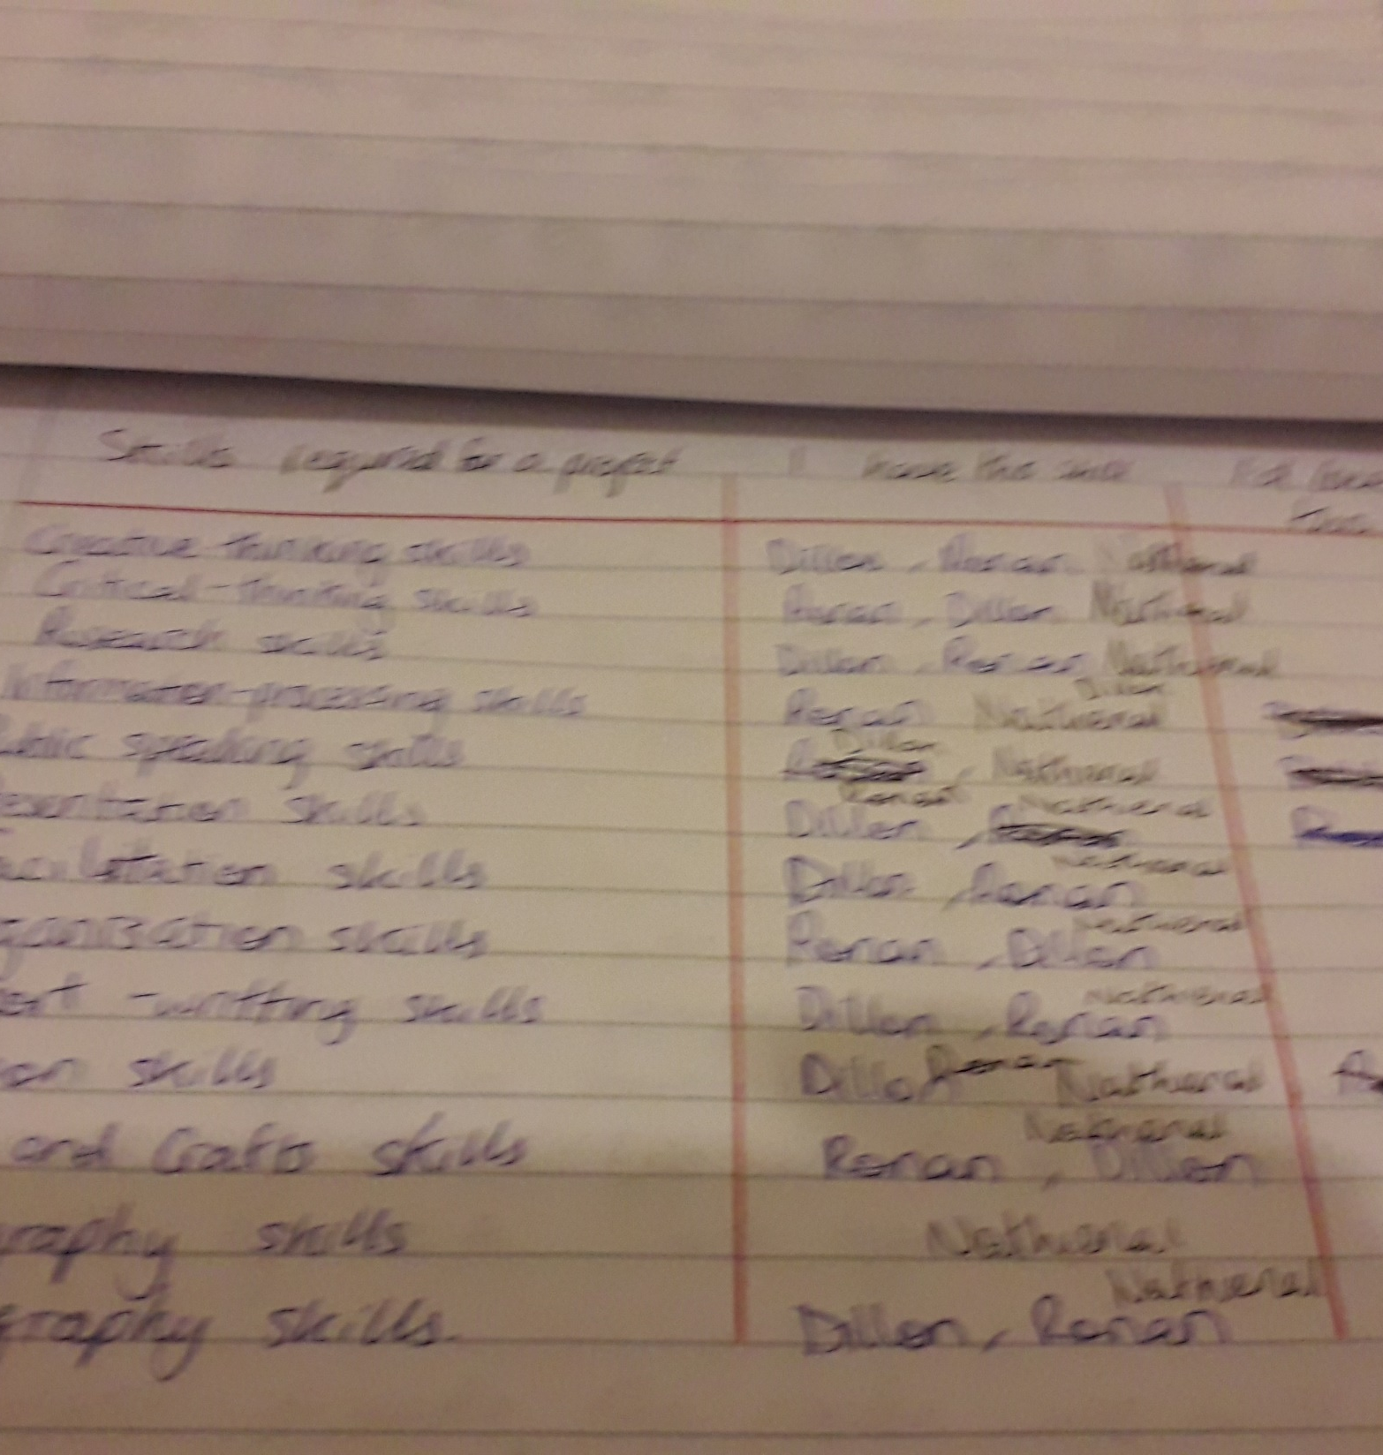
Planning
we instantly decided to set up a recycling system in the school as it was badly needed and it fit the criteria needed to fulfil this project.
We then created a sheet with all the tasks we had to fulfil and a list of all our skills.
Our first problem was Ronan had to leave the group but we got over it
We set up a regular meeting with Mr Costello for mentoring and guidance

Slide 10
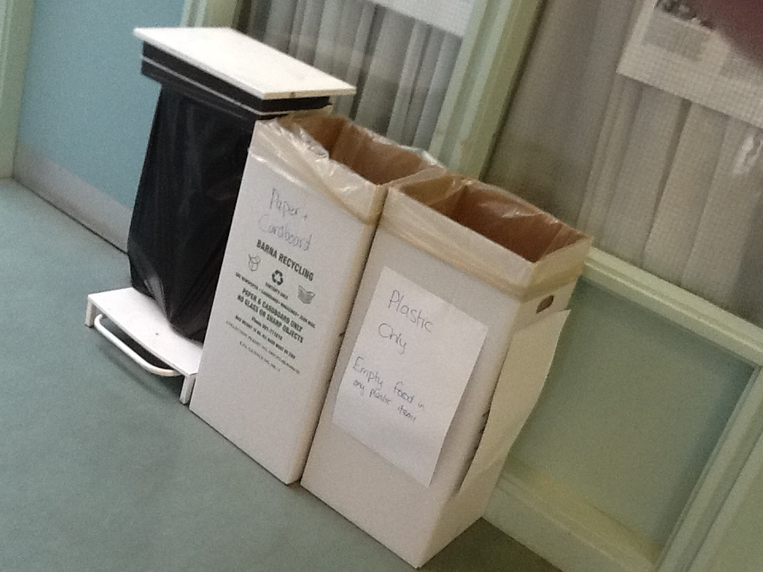
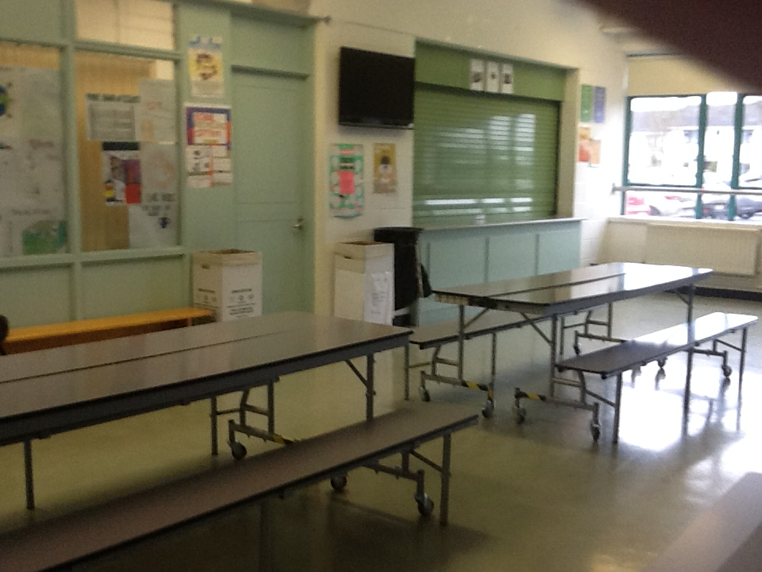
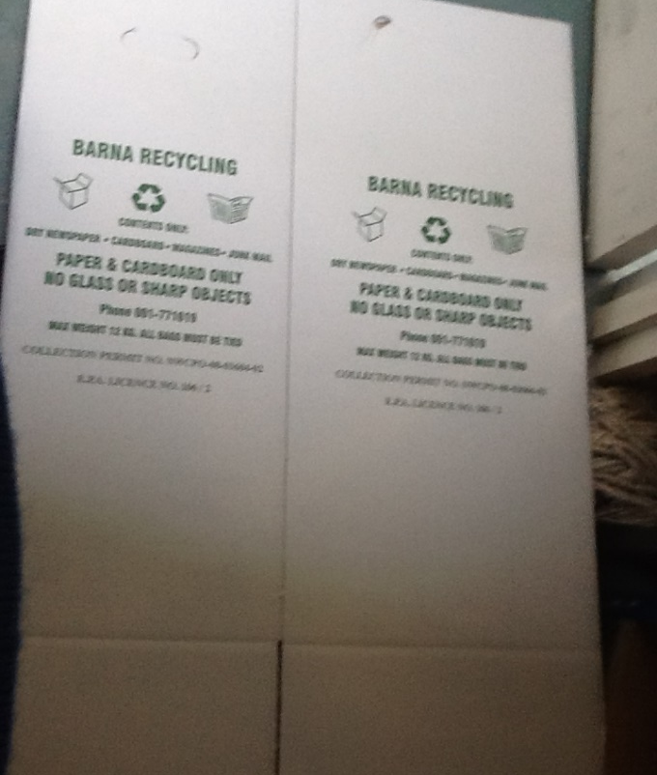
Setting up the Recycling System
We then contacted a local waste company Barna waste and ordered some cardboard box bins which they given to us for free.
Dillon then set them up around the school in strategic places where they would be used most often

Slide 11
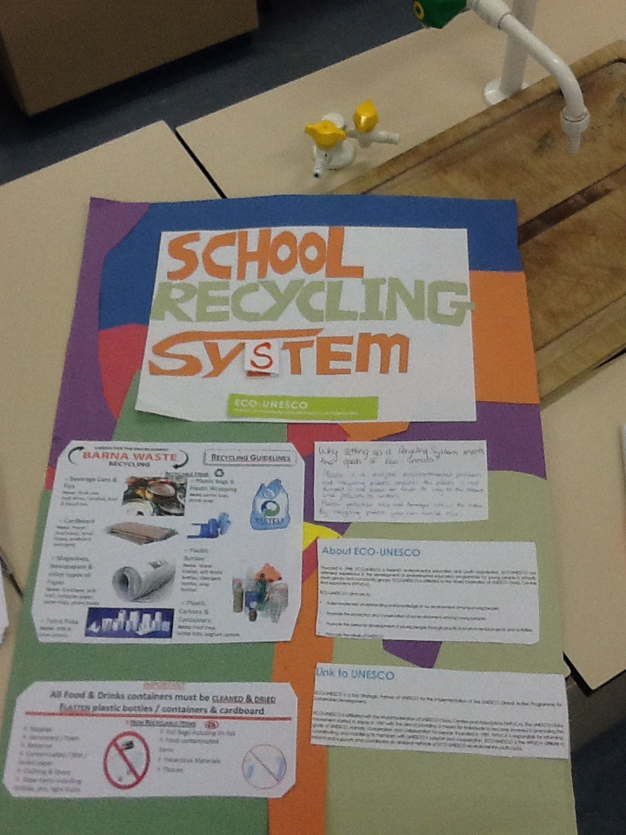
Communication in relation to the Project
Once we had all the bins set up we began to notify people about them and what should go into them
First we made an announcement over the intercom about them and then we made a poster out of recycled paper telling what people should put into them

Slide 12
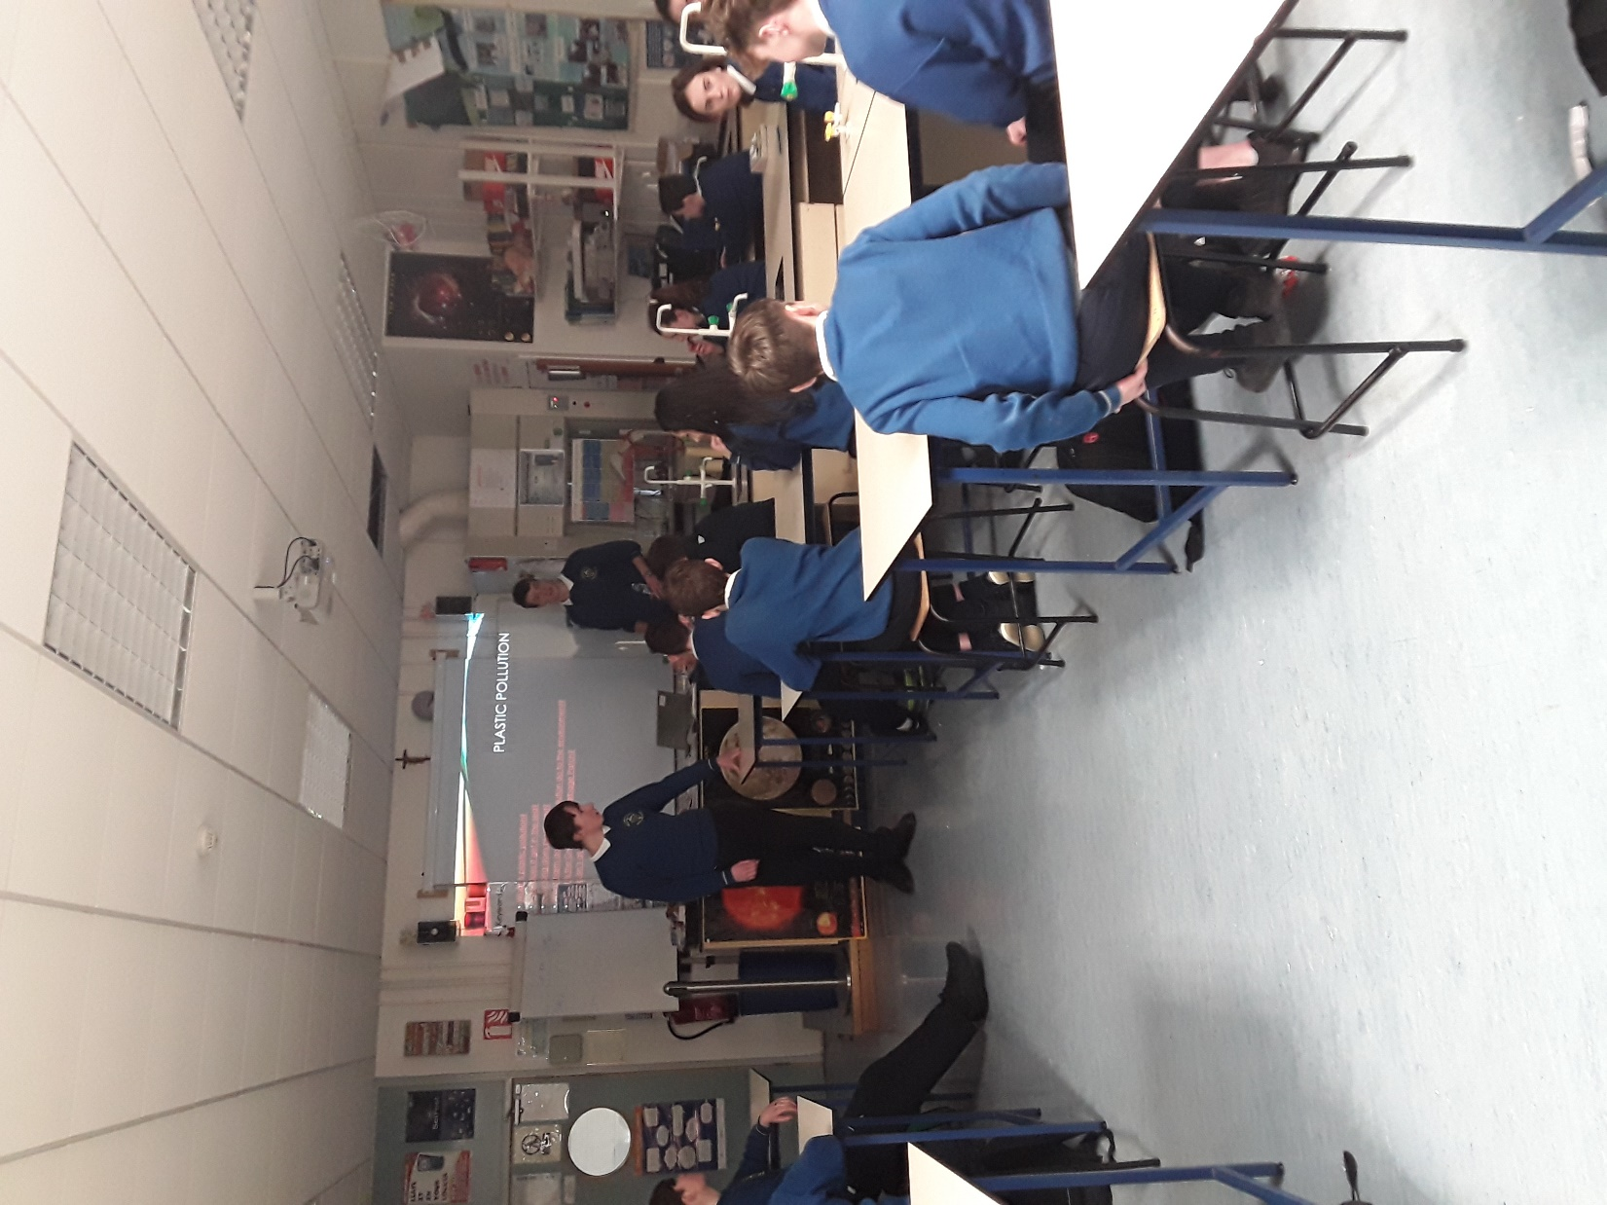
Spreading the word
We decided that the best way to spread the word was a presentation about recycling and our system and how easy it is to do.
We decided to work within our school first and then spread out from that

Slide 13
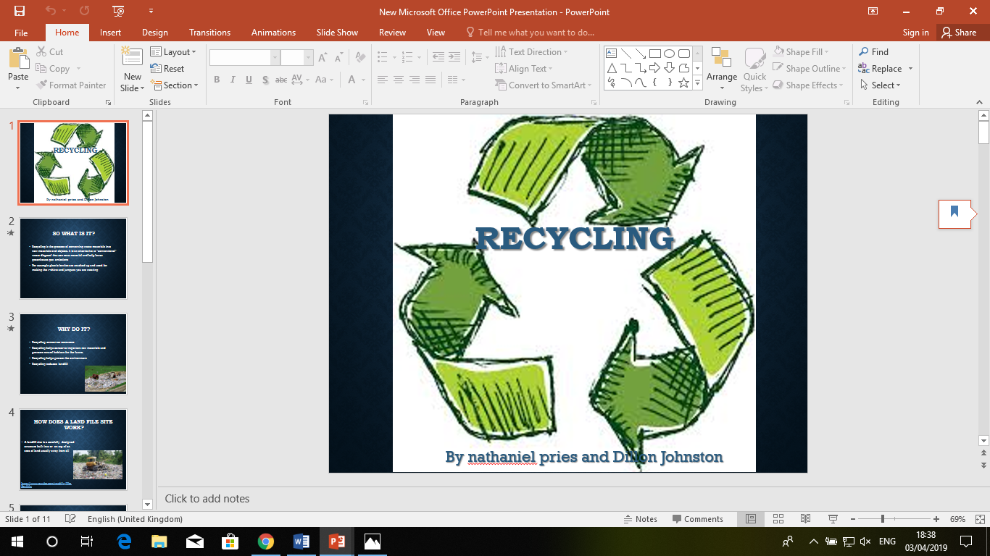
Community Awareness
We then went to the towns three primary schools and presented our project to them.

Slide 14
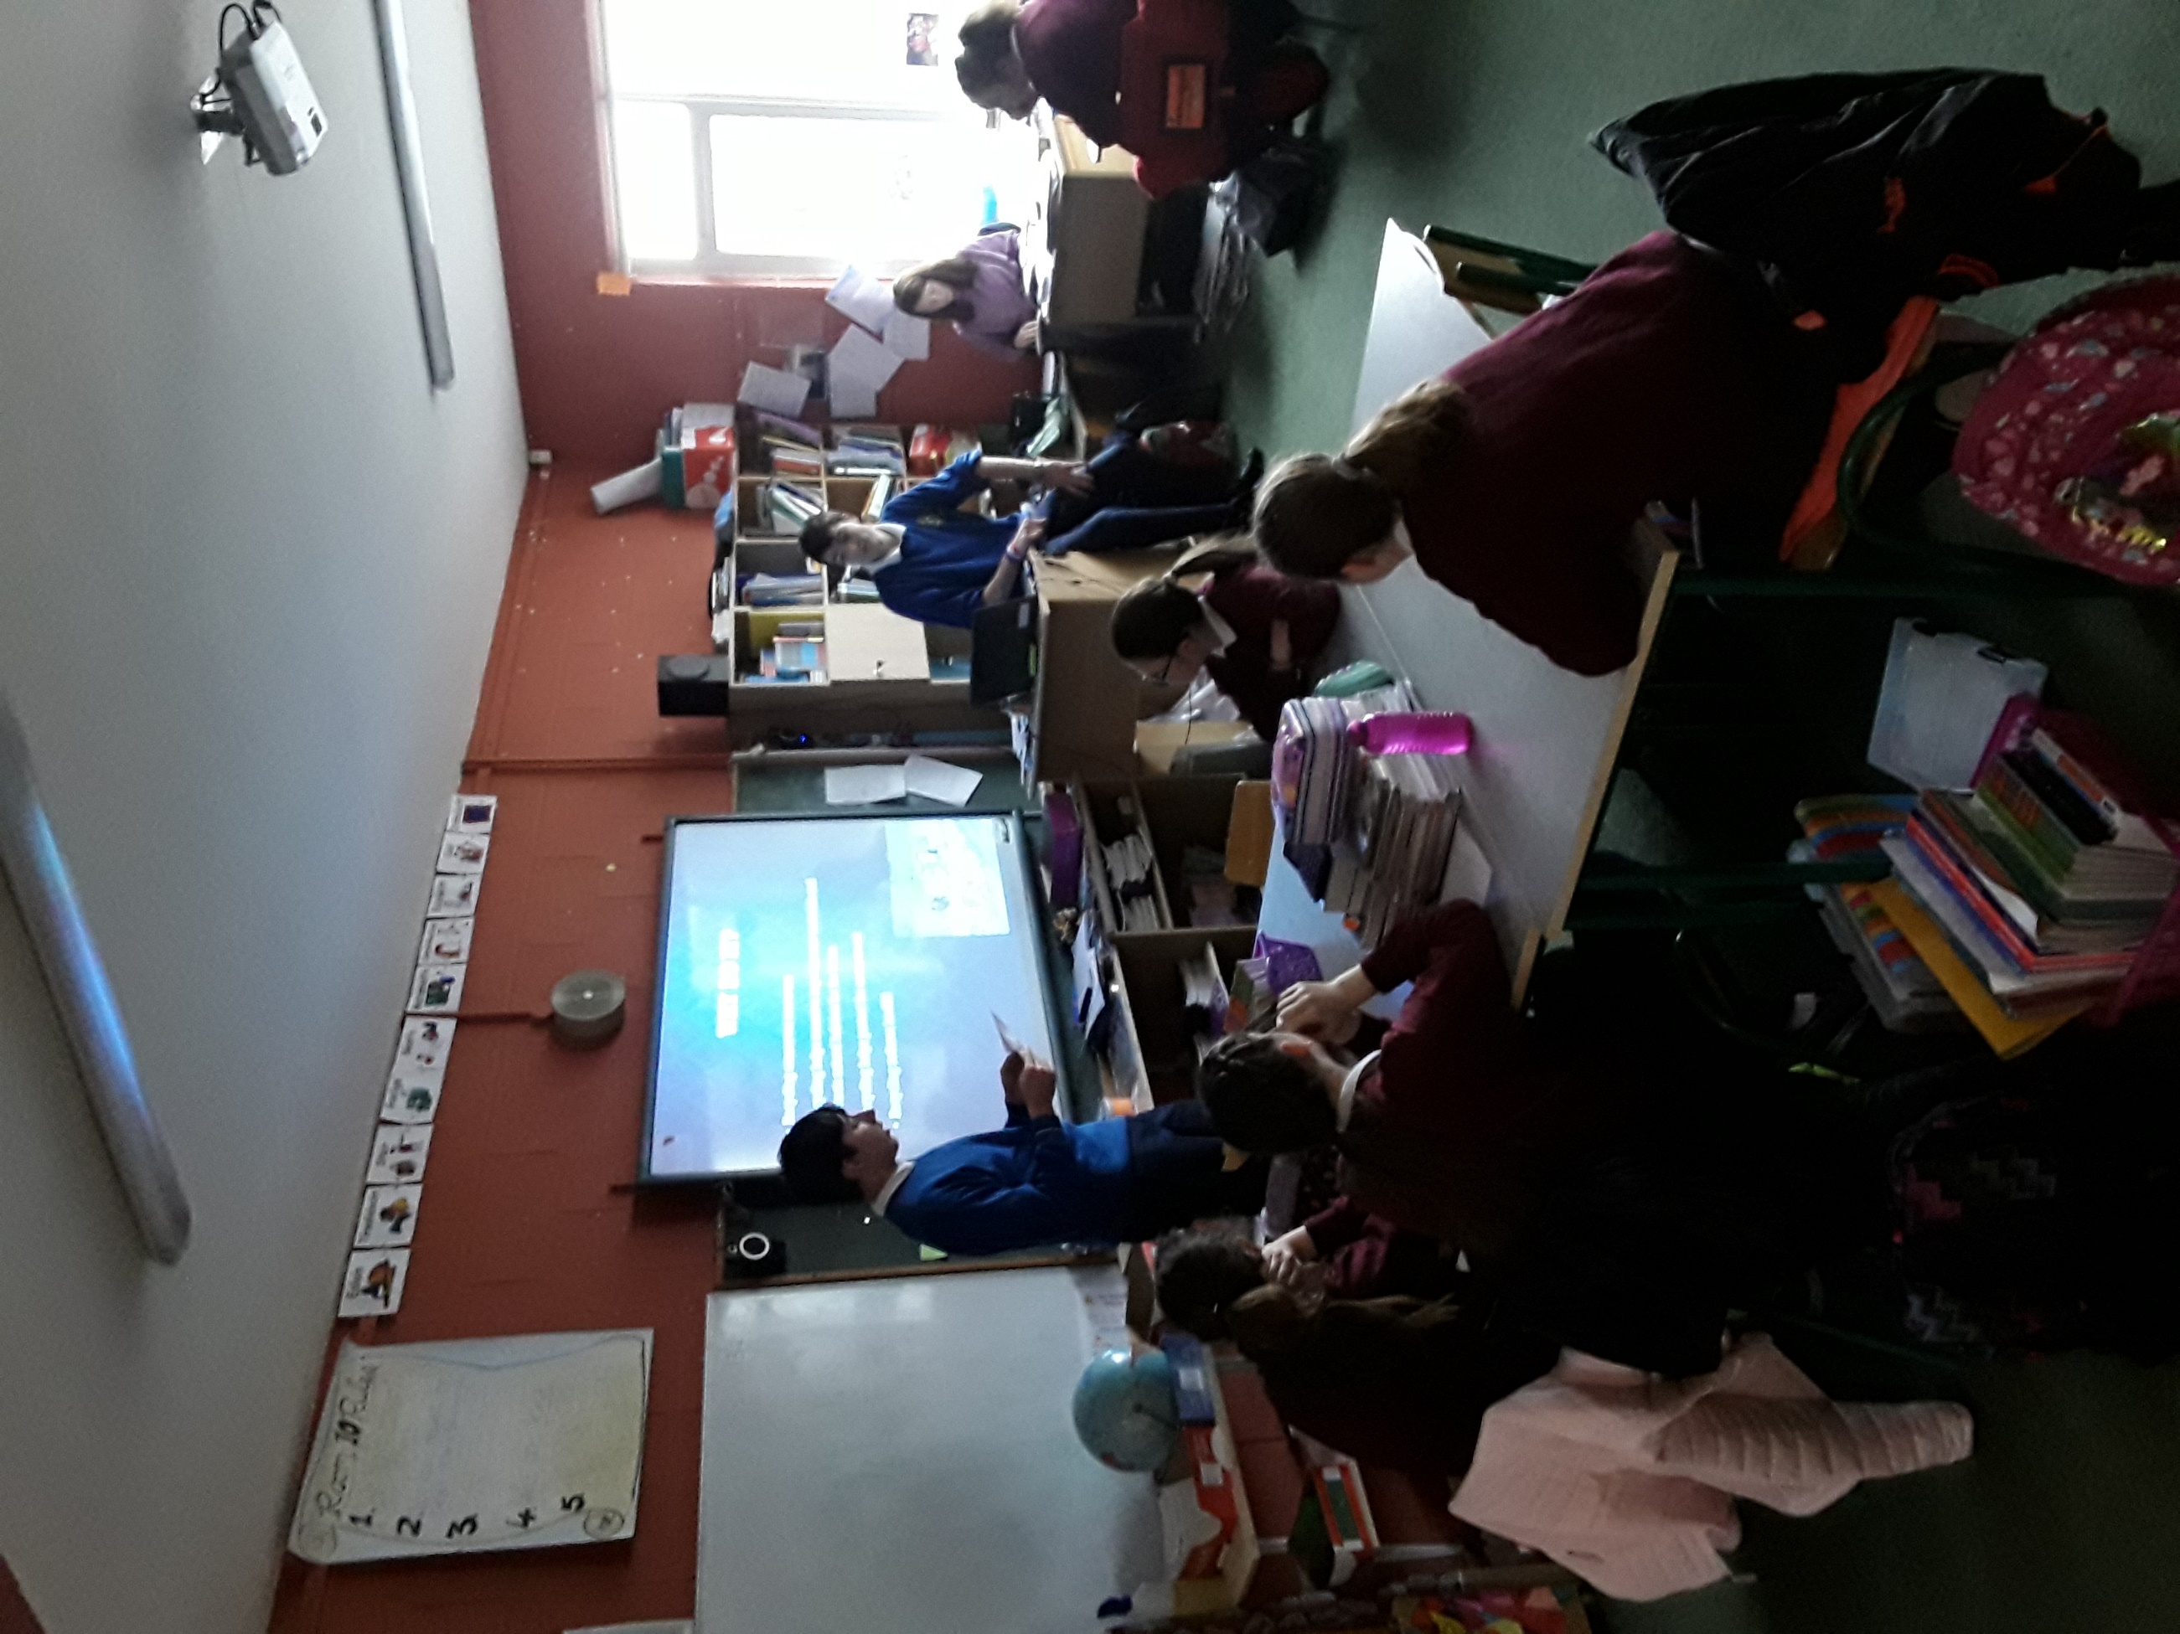
Scoil Na Naingeal Naofa
We first went to the girls school there we presented the PowerPoint to the 5th and 6th classers.
It was 1st thing in the morning so they were not up for a presentation and this was our first presentation outside of our own school.

Slide 15
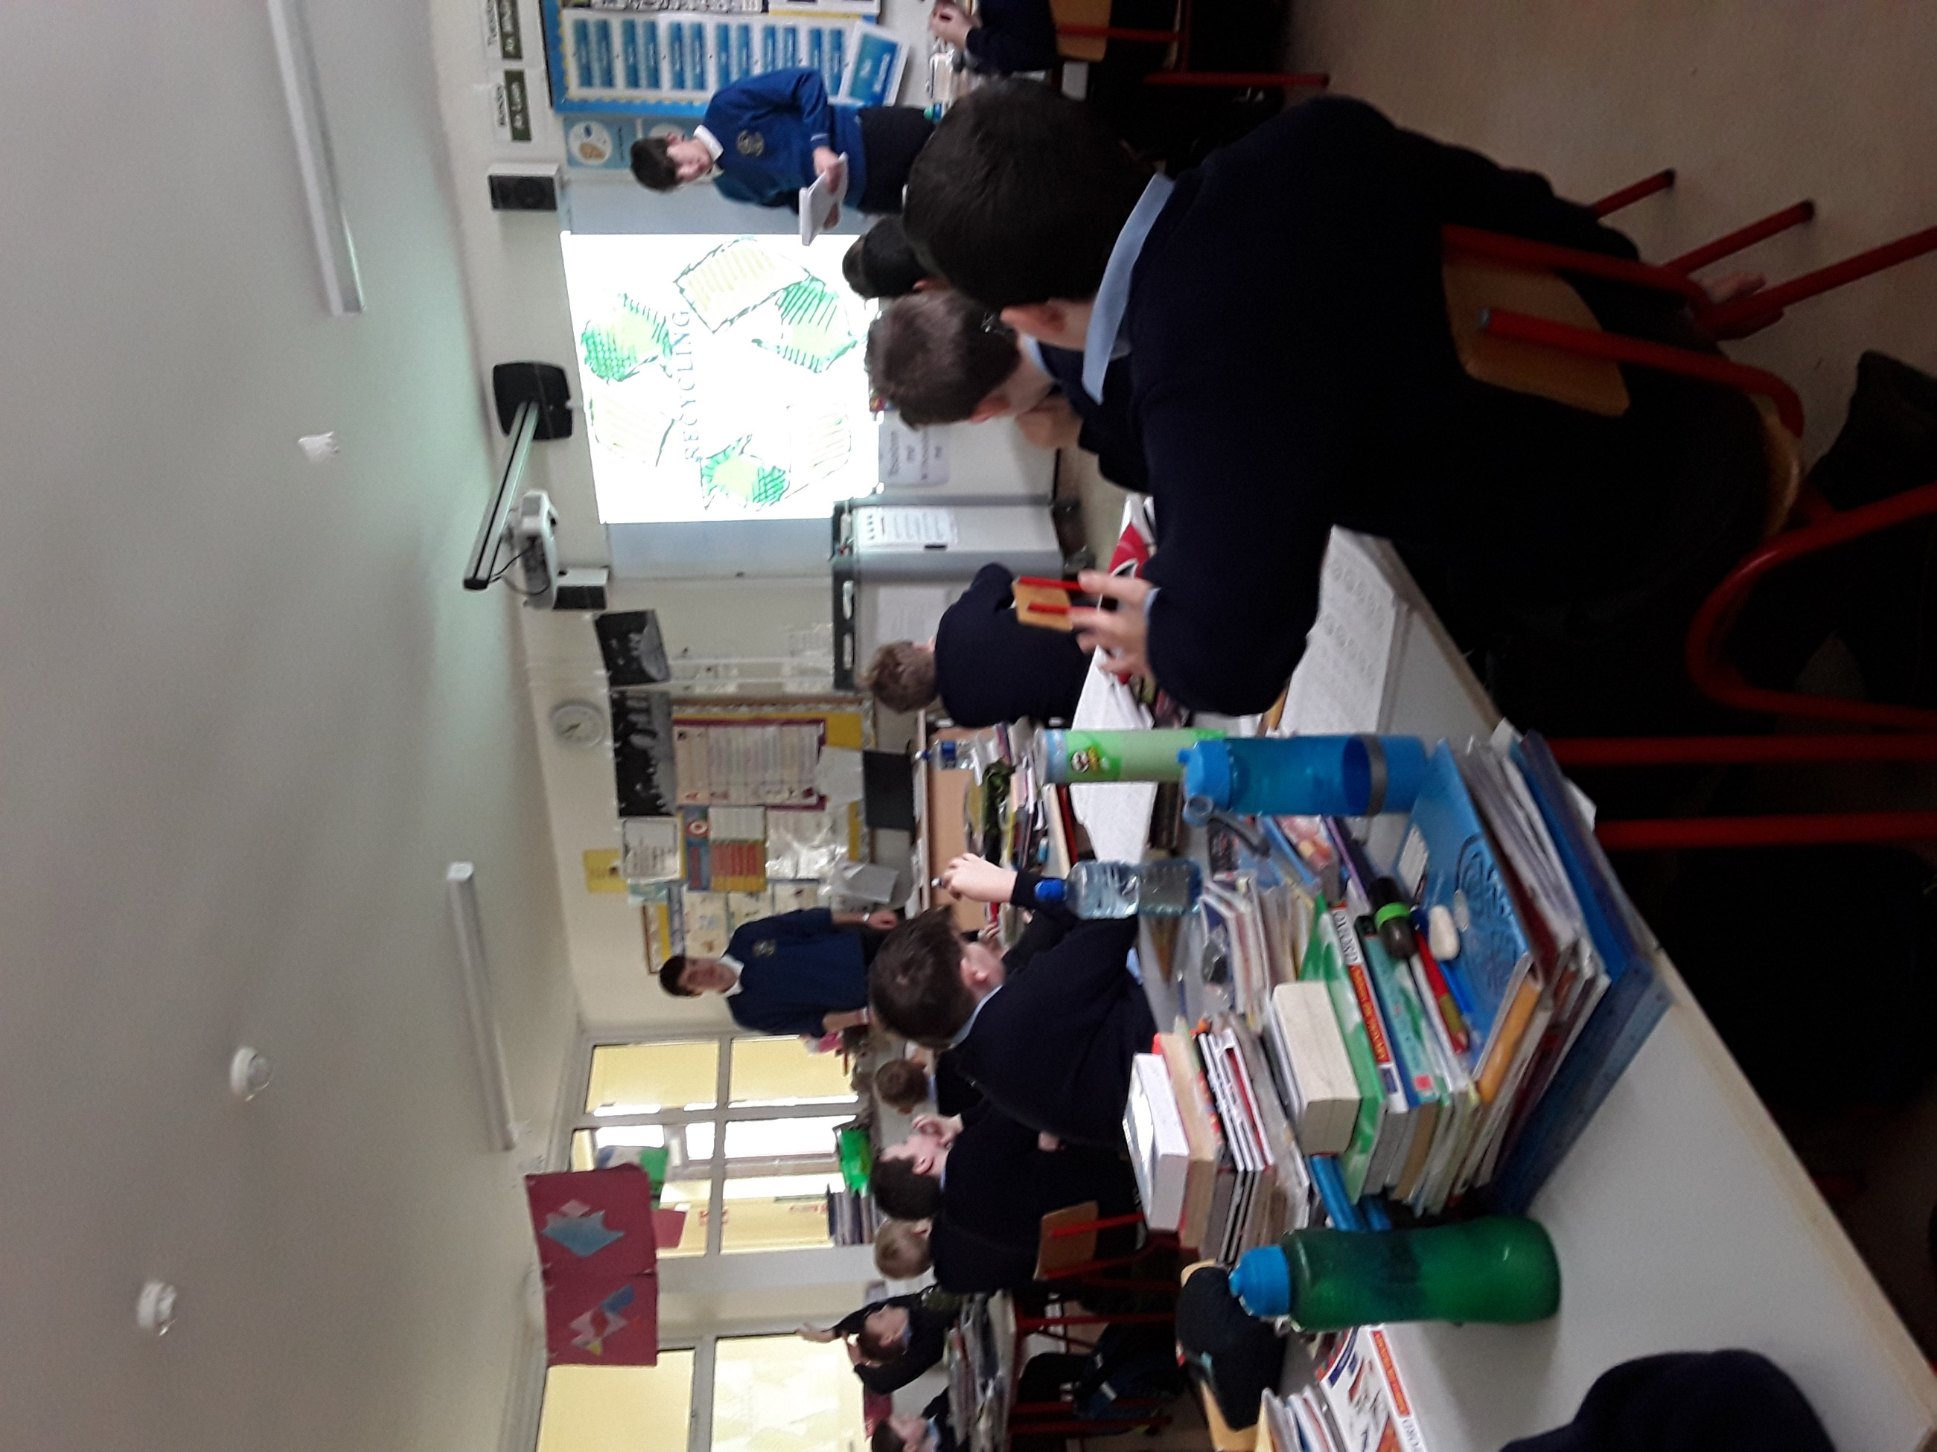
St. Josephs B.N.S.
We then presented the project to the boys school there we showed it to 2nd,3rd and 4th classers
They seemed to be very involved in the presentation which made our job easier

Slide 16
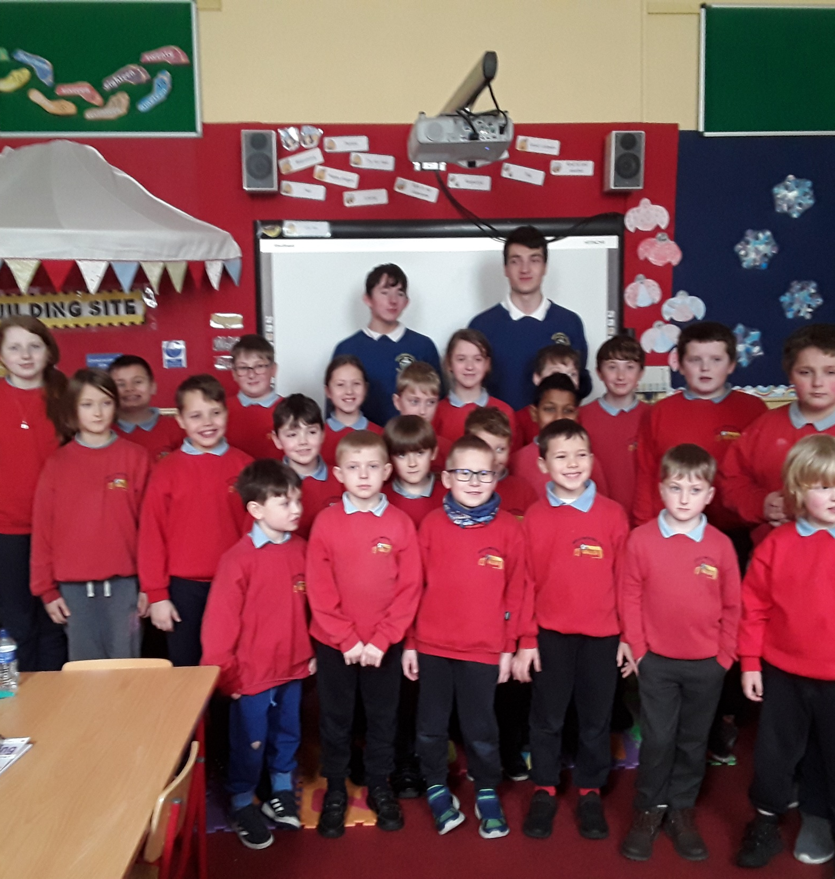
Porochial school
We then went to the Porochail school we decided to go here as the school is very big on recycling and along with St. Josephs have won all green flags.
They were very involved and at some stages even outsmarted us

Slide 17
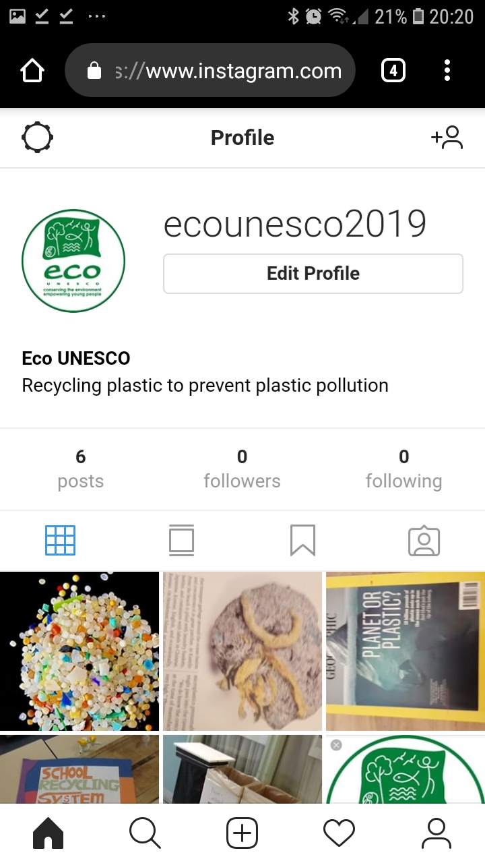
Worldwide Awareness
We then decided to make our voices heard worldwide and the only way we could do this was to create an Instagram profile where we could showcase facts and spread our idea
The account now has over 40 followers from around the world and we would like to say that’s 40 more people aware of our recycling system.

Slide 18
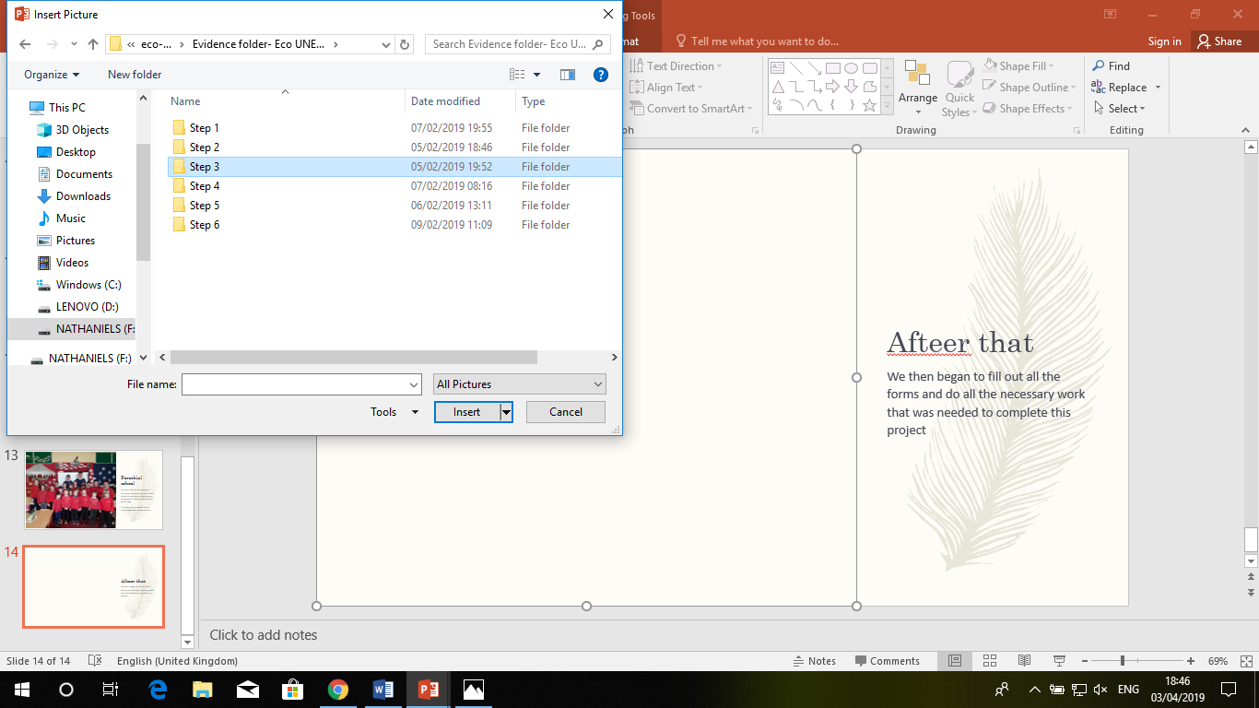
Project Entry and Competition
We then began to fill out all the forms and do all the necessary work that was needed to complete this project entry into the competition for the Young Environmentalist Award 2019

Slide 19
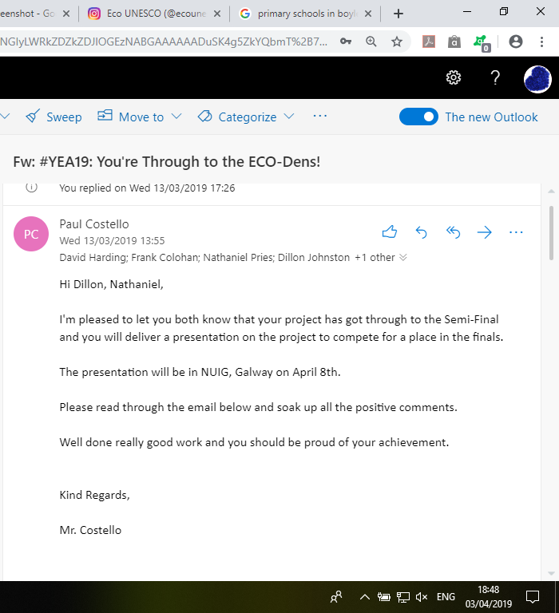
The News
We then sent off all the required information and evidence
We waited for about three weeks and we got an email from Mr. Costello informing us that we got through we wanted to celebrate but we knew we couldn’t we had work to do

Slide 20
ECO-UNESCO's Young Environmentalist Awards
https://www.youtube.com/watch?v=-J9zvBE1-Tw

Slide 21
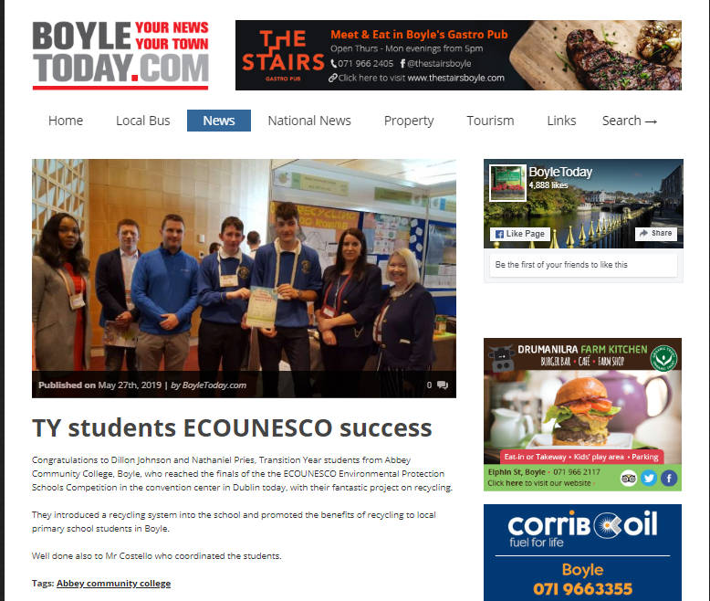
ECO-UNESCO's Young Environmentalist Awards Finals

