Slide 1
The French Revolution – an “As if” scenario
Siegfrid, Austria

Slide 2
Section A: For the teacher

Slide 3
A1: Educational context
Time frame: 2 lessons
Setting: classroom, 3rd form History
No school resources needed
Curriculum: Revolutions, Absolutism, France

Slide 4
A2: Rationale
The scenario shall help the pupils to understand the different perspectives of the three estates at the eve of the French Revolution
The problems addressed are the social imbalances between the three estates
The goal is that the students understand the social imbalances and their impact on world history
The students will have to be familiar with absolutism, Louis XIV, Versailles, the differences between commoners and nobles/clergy

Slide 5
Section b: For the student

Slide 6
B1: Beginning
Activities: Fill in blanks; create questions; role play
History exercise book & pen
Social imbalances at the eve of the French Revolution
History exercise book / history book / handout
First do the gap-fill exercise on the front page of the handout

Slide 7
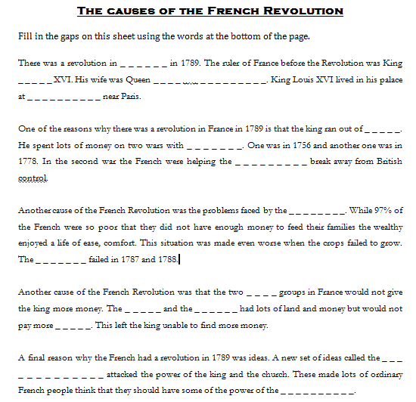

Slide 8
B2: Middle
- Then students are divided into groups (5 to 6 students)
- Each group is assigned a role, in this case one of the estates, reads through the short statements given on the front page of the handout and think about arguments how to stand their ground / improve their situation

Slide 9
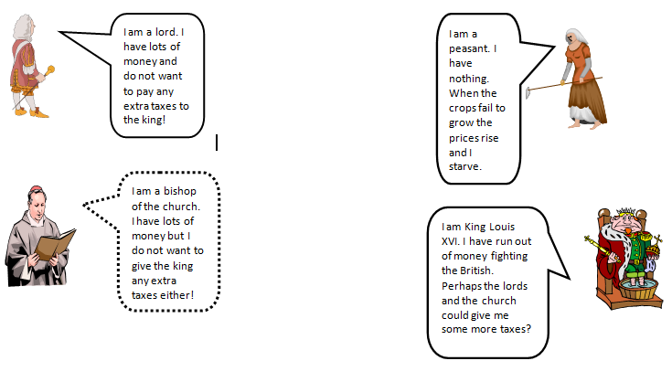

Slide 10
B2: Middle
- Then new groups are formed with one representative of each of the estates
- Now a discussion like it could have happened in the Estates General takes place
- Students present the outcome of their discussions and reflect about the decision process and problems they faced
Timeframe is one lesson
The teacher helps the groups to think of, organise and formulate the questions and (tries to) monitors the discussions

Slide 11
B3: End
The last step is to produce a mind map with all the relevant arguments for each estate.
Homework is to interpret the picture on the flip side of the handout using all the information gathered during the lesson

Slide 12
