Slide 1




Summer School 2015
Mati, Greece, July 12-17
Educational Scenario

Slide 2
Basic info on the scenario:
Name of participant: Niki Kousoureta
School: T.E.E.E.A. B’
Country: Greece
Title of scenario: The atoms –river analogy
Short description/ main idea: Everything around us is “made of” very very small particles (Big Ideas of Science).
Matter is composed of atoms. The more “closer” is one atom to another, the denser is the material. On the contrary, the more “apart” is one atom to another, the less dense is that material.
S.E.N. students experimentally understand better “how light jumps”.

Slide 3
Educational objectives and pupils’ competences targeted:
Carry out an activity about light diffraction.

Slide 4
Pupils’ ages:
15-17 years old
Curriculum areas/ domains involved:
Physics / Light

Slide 5
Which school needs does your scenario address?
Cognitive and Emotional Areas.
Interdisciplinary approach to knowledge –
connection between Physics and Gymnastic.
Increase of students’ Self confidence and Joy.

Slide 6
Innovative characteristics
In what sense is your scenario innovative? What are its innovative aspects with regard to your school context?
Photons, depending on their energy, cosmic ray photons, purple color photons, red color photons, radio waves photons, etc
When a radiation “falls on” the matter, then the atoms absorb and re-emit this radiation. …just like when we go across a river by trotting on the stones!
In a “perfect” material, where atoms are in their seats, light as “…it comes in …it comes out!”

Slide 7
Innovative characteristics
In a material where the atoms are NOT in their places light … is ‘trapped’! … just that we would not pass across a river, as if missing one stone … BLOOM!

Slide 8
Parental engagement
  How are pupils’ parents engaged in the process or/ and implementation of the educational scenario? What is their role?
  Pupil’s parents brought all the materials needed.
  They also carried out and accompanied us at our excursion to the river side. (learning by doing).
  Which school needs does their engagement in this scenario intend to serve?
  Experiential learning.
  Being a active member of the school life. (social school).

Slide 9
Parental engagement
  What are the expected benefits from parents’ engagement in this scenario?
  Enforcement of the bonds between PARENTS – STUDENTS -SCHOOL .

Slide 10
Equal learning opportunities
How do you plan to address pupils with different learning styles and needs through the design and implementation of your scenario?
All the A class students participated in it.

Slide 11

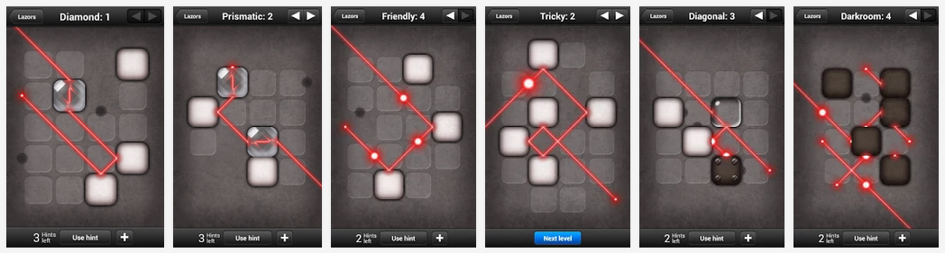
Game-based learning
How could you add a game-based element in your scenario? Please describe your ideas the phases of the scenario (preparation, implementation, assessment) in which you would introduce this aspect.
https://play.google.com/store/apps/details?id=net.pyrosphere.lazors

Slide 12
Phase 1: Preparation
Please describe the preparation that the teacher needs to do before implementing the scenario. Define steps and activities, if applicable.
  Prepare a big space on the schoolyard.
  Put a lot of blue colored patches (plastic, foam, paper) one next to the other, like the picture below.

Slide 13
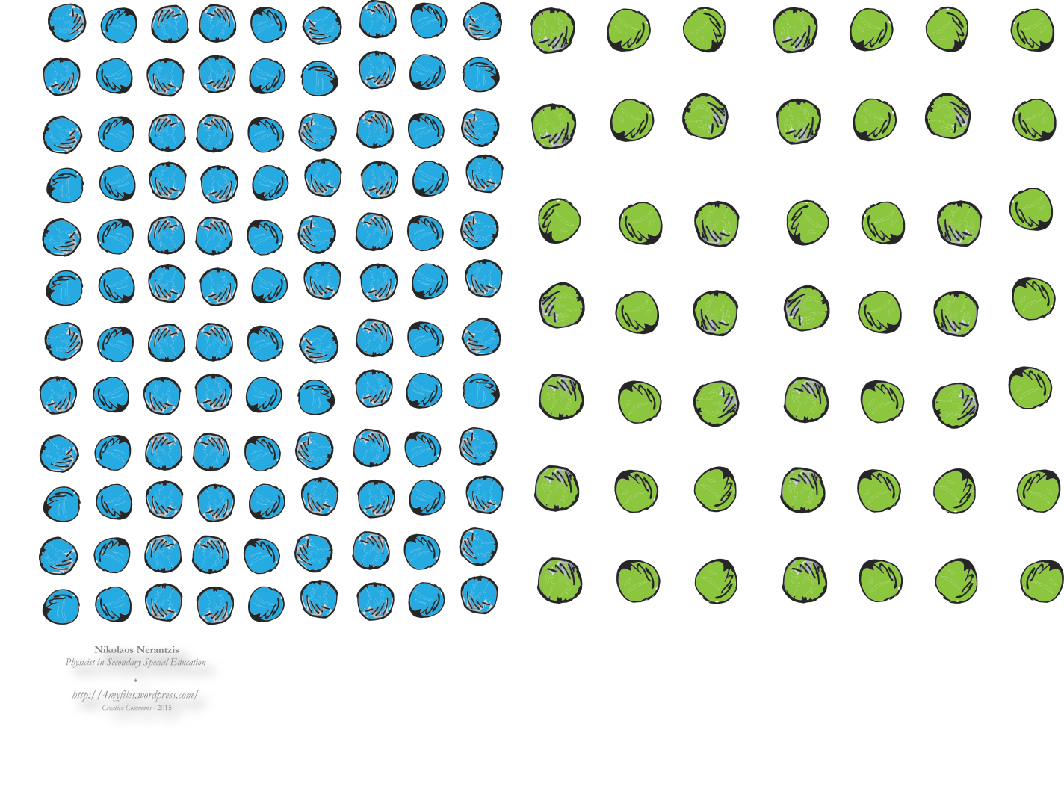
Phase 1: Preparation

Slide 14
Phase 2: Implementation
Please describe the preparation that the teacher needs to do before implementing the scenario. Define steps and activities, if applicable.
  Gather the A class (4-8 students) and give them easy instructions (step by step).
  Teacher goes first and students follow her/him.

Slide 15
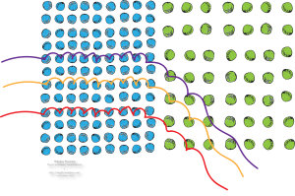
Phase 2: Implementation

Slide 16
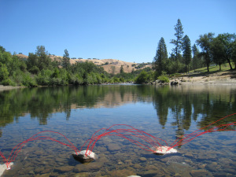
Phase 2: Implementation at the field

Slide 17
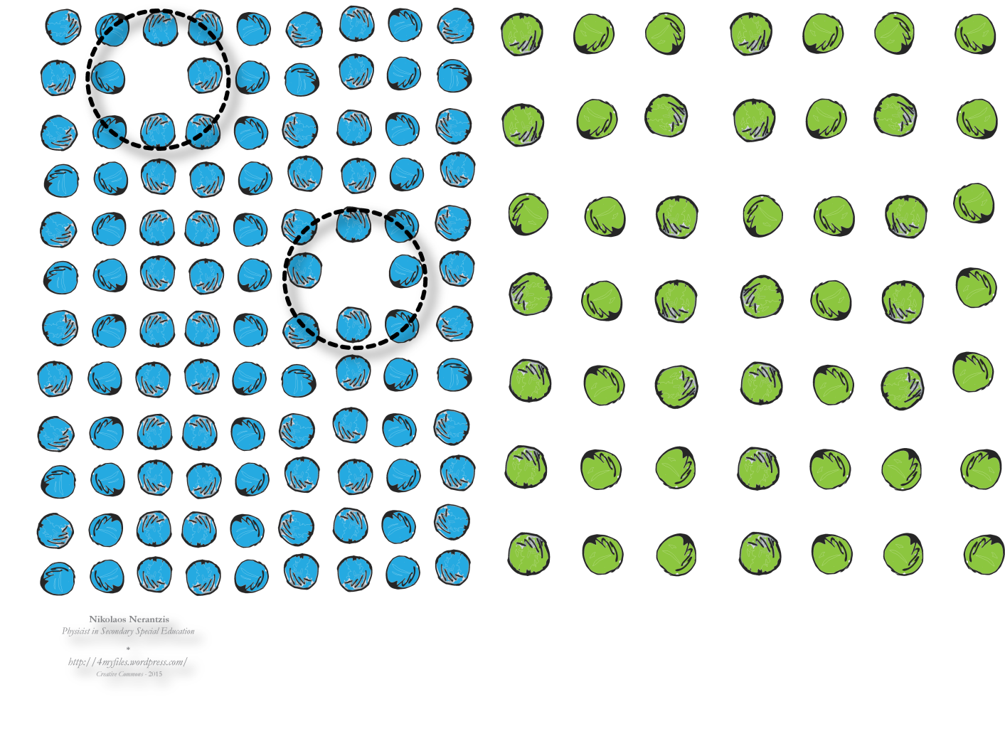
Phase 2: Implementation

Slide 18
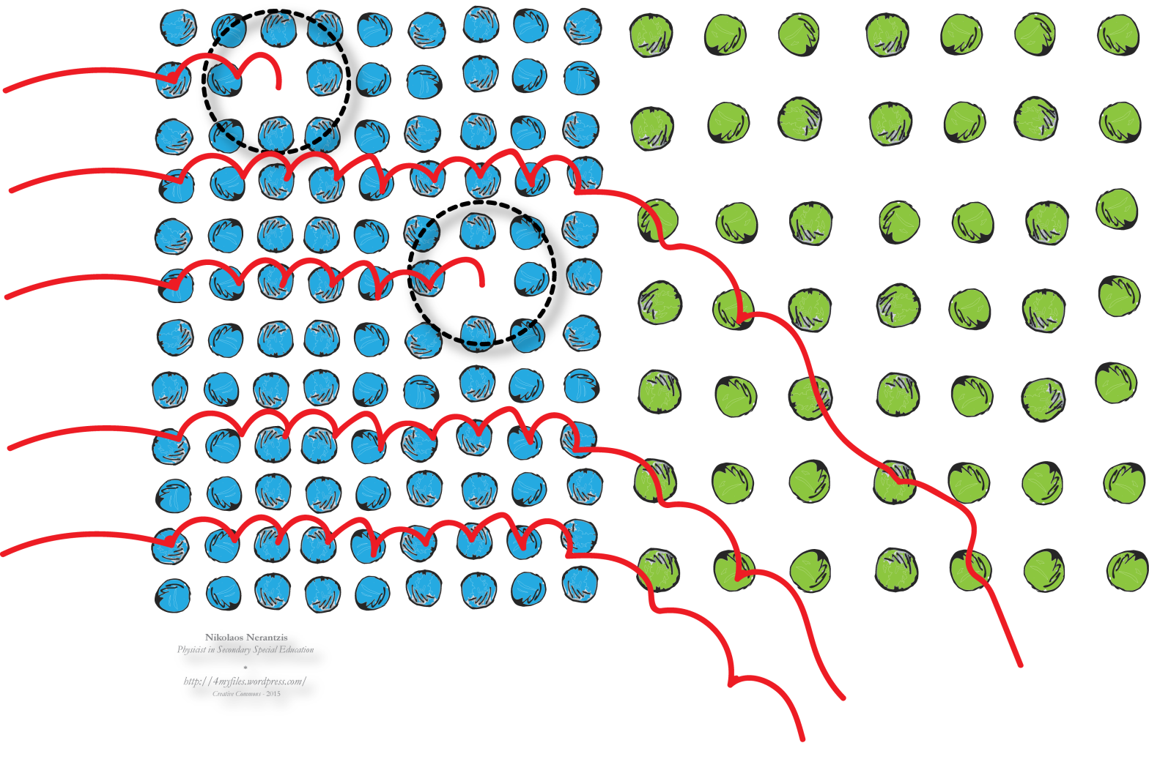
Phase 2: Implementation

Slide 19
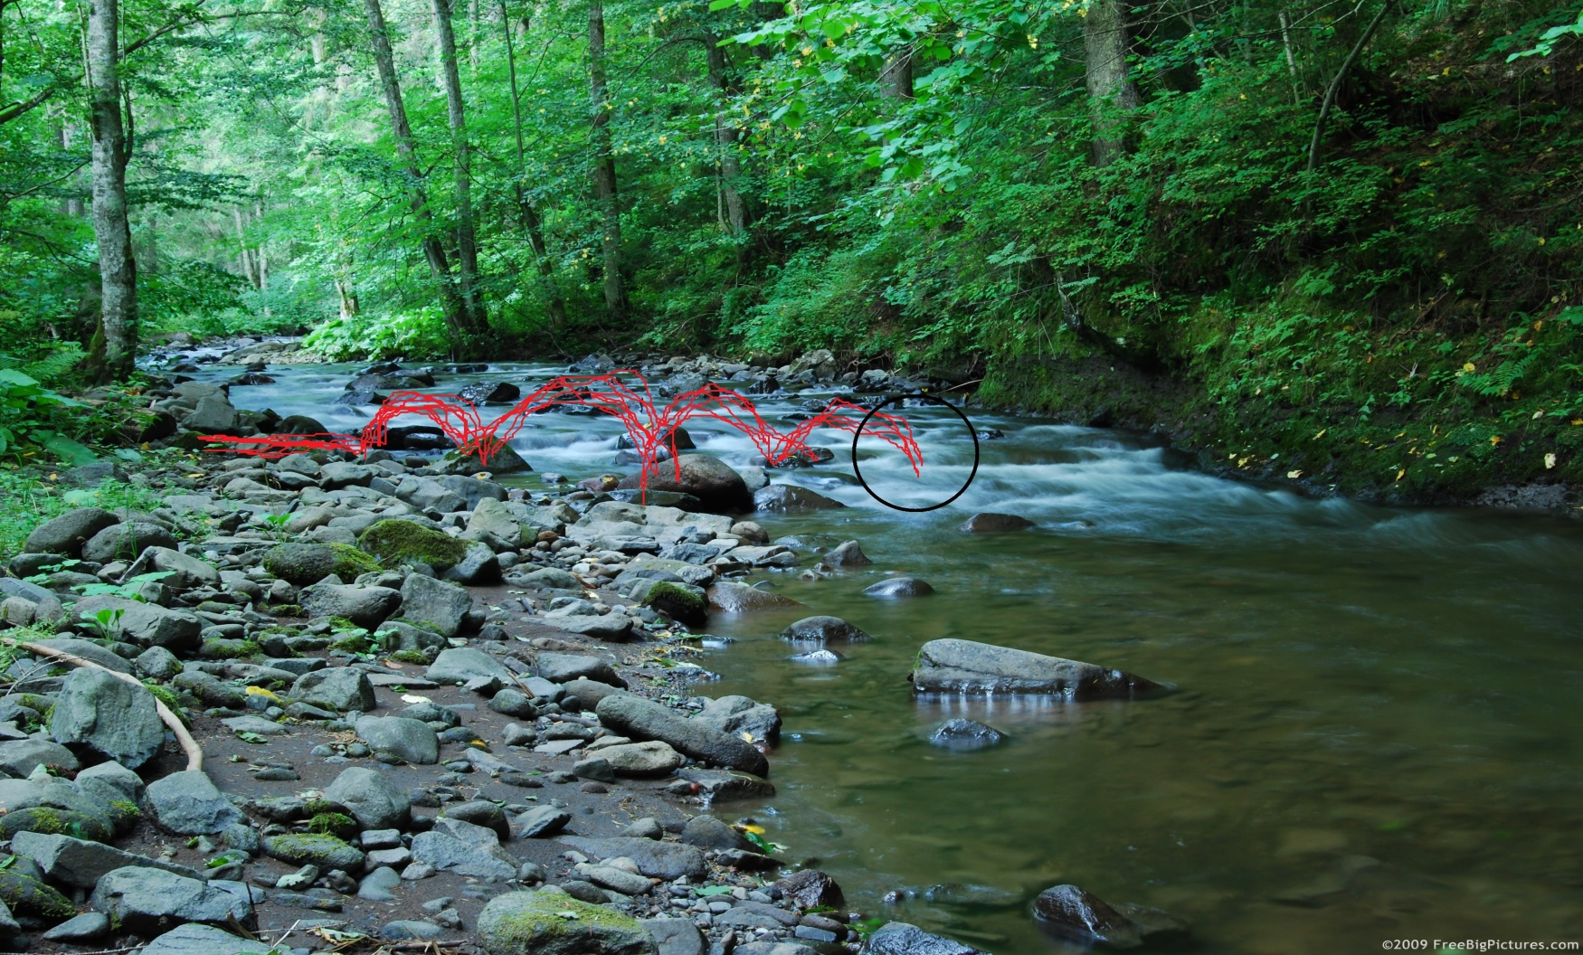
Phase 2: Implementation at the field

Slide 20
Phase 2: Assessment
Please describe how you intend to assess the outcomes of the scenario. Define steps and activities, if applicable.
In the classroom by using the interactive white boards, we found out that all the students understood the cognitive part of this lesson.
Furthermore they all enjoyed the game.

Slide 21
Resources
Please identify at least 5 resources (links, files etc) that will be used in the scenario. You are advised to look for relevant resources on the ODS portal. You can also add external resources.
https://4myfiles.wordpress.com/
https://4myfiles.wordpress.com/2015/04/13/the-atoms-river-analogy/
http://kokopelliraftco.com/blogs/trip-reports/16776229-top-15-packraft-trips-in-2015
http://freebigpictures.com/river-pictures/beck/

Slide 22
If you wish, please, add any other specifications or guidelines

Slide 23
Once you complete this ppt, please upload it on the Summer School’s community in the “Resources area” as an educational object http://portal.opendiscoveryspace.eu/community/ods-summer-school-2015-804293
Also please don’t forget to send it to Eleni Chelioti chelioti@ea.gr

