Slide 1




Summer School 2015 Mati, Greece, July 12-17
Educational Scenario

Slide 2
Basic info on the scenario:
Name of participant: Armin Ohran
School: Jakob-Friedrich-Schöllkopf Schule
Country: Germany
Title of scenario: Inclusion – Examining students‘ willingness and acceptance for different kinds of para-sports? An exemplary class experience

Slide 3
Basic info on the scenario:
Short description/ main idea
This educational scenario is focussing on the following superordinate educational objectives :
1. Sensitising students for inclusive sports
2 . Amplify students’ understanding for sports and depict competencies for actions.
3. Provide a change of perspective for regular students in regard to handicapped students.
This learning scenario consists of four double-lessons (each 90 min). Thereby two units were devoted to blind-man soccer and two to wheelchair basketball.

Slide 4
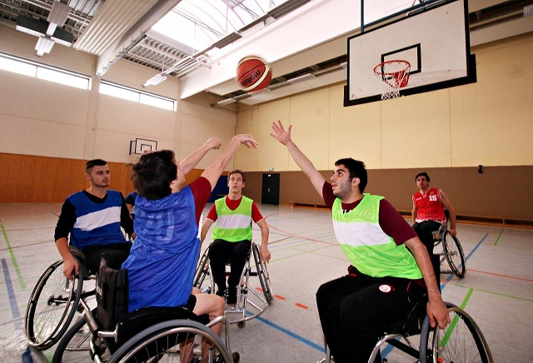
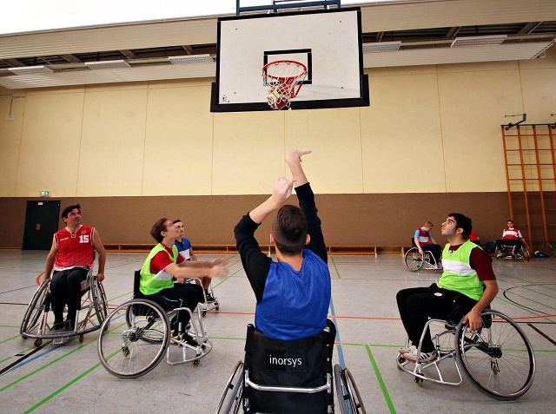

Slide 5
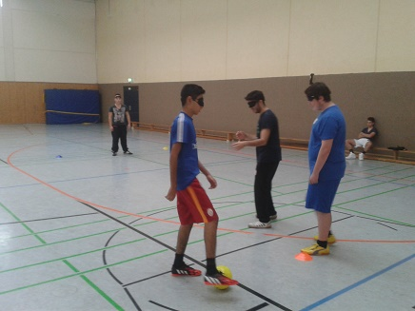
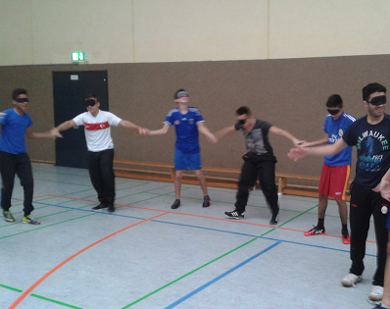

Slide 6
Educational objectives and pupils’ competences targeted:
Sensitising students for inclusive sports
Amplify students’ understanding for sports and depict competencies for actions.
Provide a change of perspective for regular students in regard to handicapped students.

Slide 7
Sports-based targets
1st unit (10/10/2014): Spatial and apperception exercises, learning basic techniques (passing and dribbling)
2nd unit (17/10/2014): Introduction to the games in a playful approach, implementing regular version of the games
3rd unit (07/11/2014): Safety aspects, using the materials, Rules, dribbling and shot
4th unit (14/11/2014): Shot on the basket and teampractical understanding in regard to the games

Slide 8
Pupils’ ages:
16 – 18 years old
Curriculum areas/ domains involved:
Physical Education
→ Wheelchair basketball and blind-soccer is not part of the curriculum
Primary Sport (Soccer or Basketball is part of it)
Students should learn to perform basketball specific motions while sitting in the wheelchair (scoring), students should be capable to perform the basic techniques passing and dribbling.

Slide 9
Which school needs does your scenario address?
Special compulsorily education for handicapped students is planned to be abolished from the school year 2015/2016 onwards.
Consequently parents are allowed to decide on their own if their child will be studying at a special or a regular school – correct or incorrect Decision? -
So we need to prepare us as a school for these new tasks and responsibilities

Slide 10
Innovative characteristics
It was the first time for the students, that they played blind soccer and wheelchair basketball
Also we had a guest (Mister Rieger) during our wheelchair basketball sessions
Mister Rieger is paraplegic and plays wheelchair basketball in a club
In addition I introduce a questionnaire to investigate,
if it´s possible to introduce parasports in the school or will
it be a change in the sensitive way against handicaped
students

Slide 11
Parental engagement
Pupils parents aren´t engaged in this process. It´s a process without parents. The students are 16-18 years old.
You can introduce parents, maybe to organize the equipment (wheelchairs)
Which school needs does their engagement in this scenario intend to serve?
1. Sensitising students for inclusive sports
2. Amplify students’ understanding for sports and
depict competencies for actions.
3. Provide a change of perspective for regular students
in regard to handicapped students.

Slide 12
Equal learning opportunities
The basic sports like basketball and soccer is dependent from the talent of the students
For non-talented students it´s hard to getting better
The parasports has the advantage, that every student is a rookie→ nobody will disregard
One students says „It´s cool to play blind-soccer, because I cannot disgraced myself“

Slide 13
Game-based learning
Date of implementation | Didactical focal point
1st unit (10/10/2014) | Spatial and apperception exercises, learning basic techniques (passing and dribbling)
2nd unit (17/10/2014) | Introduction to the games in a playful approach, implementing regular version of the games
3rd unit (07/11/2014) | Safety aspects, using the materials, Rules, dribbling and shot
4th unit (14/11/2014) | Shot on the basket and teampractical understanding in regard to the games

Slide 14
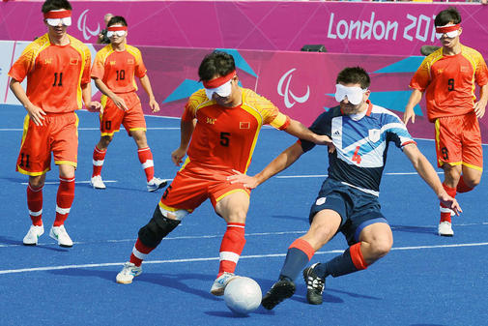
Phase 1: Preparation
It provided good preconditions however, materials such as sport wheelchairs, masks and balls for blind-man soccer needed to be obtained by the teacher himself.

Slide 15
Phase 2: Implementation
Rules of blind-soccer and wheelchair basketball
Knowledge how to introduce this kind of parasports
Blind-soccer→ to help students getting familiarised with the circumstance of “not seeing”
→ Afterwards communication excercises and warm up exercices can be implemented.
→The next lesson should consist of small exercises which will be implemented playfully and represent elements of the final game leading the students to be capable to compete against each other in the end

Slide 16
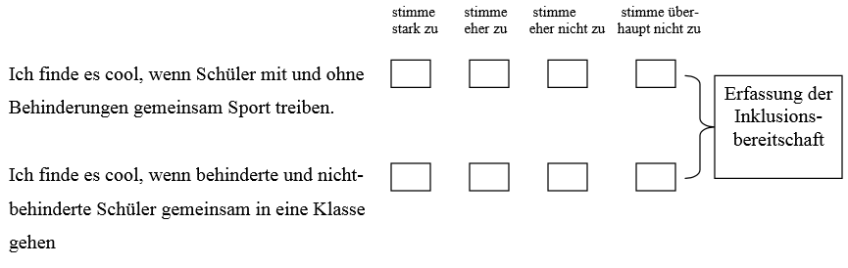
Phase 2: Assessment
Introducing a questionnaire before and after the learning scenario
“I like to make sport with handicapped and non-handicapped students”
“I like it, when handicapped students and non-handicapped students are together in a class”

Slide 17
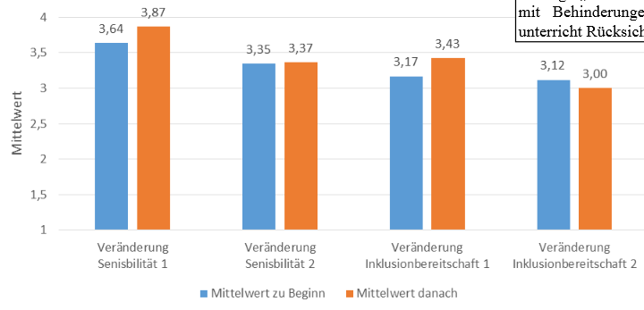
Phase 2: Assessment
You can see a improvement in the part “Sensitivity against handicapped pupils” after the learning scenario

Slide 18
Phase 2: Assessment
„I prefer wheelchair-basketball compared with blind soccer“
→ Students prefered wheelchair-basketball
 | N | Mini-mum | Maxi-mum | Mittel-wert | Standardab-weichung
Wheelchair_vs _Blind_Soccer | 16 | 1,00 | 4,00 | 3,5000 | ,89443

Slide 19
Resources
http://www.teckbote.de/nachrichten/sport_artikel,-Zwischen-Toleranz-und-Training-_arid,85341.html
http://www.blindenfussball.de/pdf/TrainerBuch_Blindenfussball.pdf
http://portal.opendiscoveryspace.eu/de/node/819531

Slide 20
Once you complete this ppt, please upload it on the Summer School’s community in the “Resources area” as an educational object http://portal.opendiscoveryspace.eu/community/ods-summer-school-2015-804293 Also please don’t forget to send it to Eleni Chelioti chelioti@ea.gr

