Slide 1


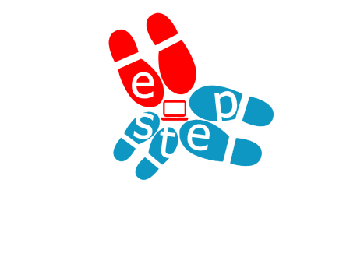


Open Discovery Space Summer School 2014
Marathon, Greece, July 13-18
Educational Scenario

Slide 2
Basic info on the scenario:
Name of participant: Sladjana Trajkovic
School: Techical School ,,May 15” Prokuplje
Country: Serbia
Title of scenario: Learning logarithms in Flipped Classroom
Short description/ main idea: Teaching logarithms in the flipped classroom is a different presentation lessons for the students which shall be learn. The role of students is different in the teaching process – that is equally important role as a teacher. Their task is to examine new teaching topic at home and in the classroom along with them teacher explore and resolve concerns. Edmodo is an excellent platform for creating flipped classroom. It’s possibilities are large. Teacher works with students, collaborate with other teachers and parents, as well as sharing of different experiences and content.

Slide 3
Educational objectives and pupils’ competences targeted:
The overall objectives of hours:
• Connect the acquired knowledge of logarithms to other areas;
• Improving the skills of rapid, rational and accurate computation;
• Developing a capability reasoning by analogy;
• Develop logical thinking, concentration;
• Development of accuracy, precision in work;
• Develop the skills of using the Internet as a source of information;
• Develop a positive attitude towards mathematics;
• Development of communication in a social group (team);
• Develop self-esteem and confidence in their own mathematical abilities.

Slide 4


Pupils’ ages:
The present educational scenario is designed for secondary school students (ages 15-19)
FLIPPED
CLASROOM

Slide 5
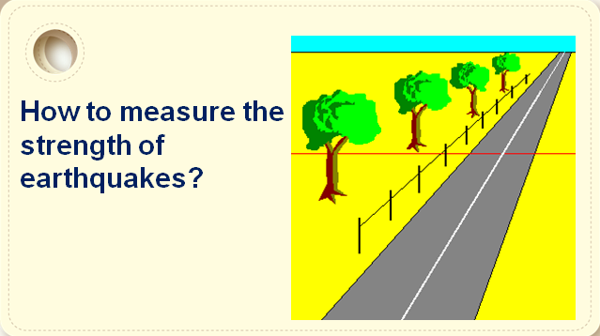
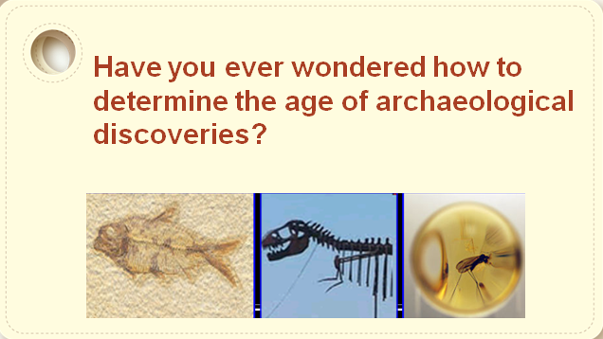
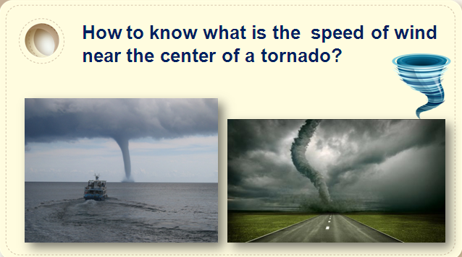
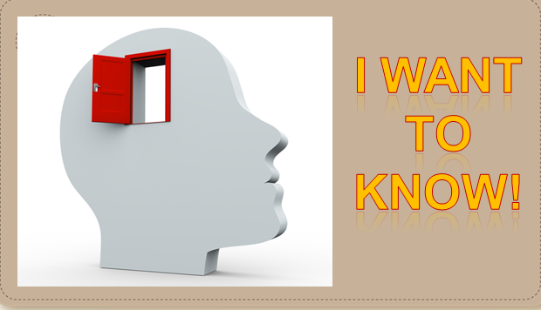
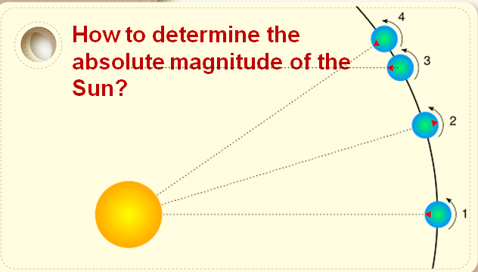
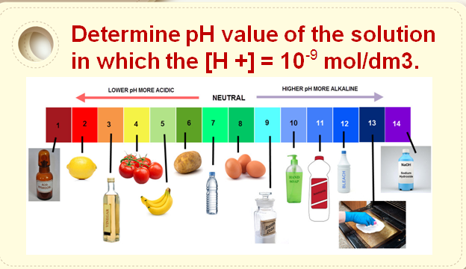
Curriculum areas/ domains involved:
Mathematics
Physic
Chemistry
Arheology
Seizmology
Astronomy

Slide 6
Which school needs does your scenario address?
Students learns and progresses when automatically detects relationships between certain mathematical objects. The teacher should be enabled by using the appropriate forms and methods. Completely teaching skills is to find ways to motivate students to learn.
In flipped classroom, students acquire new knowledge watching video lessons at home. Now, they are working homework in the classroom with them teacher, who instead of teaching materials, refers students to do assignments and encourage their interaction. The role of students is different - they come, ready to class because they were already familiar with the topic, so the class can solve specific tasks. At the moment come with certain attitudes, prior knowledge or questions, are interested in the topic in the learning process getting an equally important role as a teacher. Time is converted to joint research. The material remains available to students on Edmodo network, which means that it can be used whenever necessary.
Edmodo is a service that reminds students on social network. For this reason, this environment can facilitate the work, its interaction with the teacher - student and student - student becomes a direct and strong communication is a daily, content sharing is easy.

Slide 7
Parental engagement
How are pupils’ parents engaged in the process or/ and implementation of the educational scenario? What is their role?
  Edmodo service enables the connection of parents: those obtained with the help of which may be included in the network in order to monitor student work and communication with the teacher. Edmodo is a secure, closed network, making it an very safe environment. Teachers and parents can be confident that children will interact with strangers.
  Which school needs does their engagement in this scenario intend to serve?
  Define together ( teacher and parents) the goals to be achieved with a child who has some gaps in learning
  Provide parents additional materials, instructional sheets for working with children at home
  Allow parents to give their suggestions and proposals (book/ box comments and suggestions, which will be located in the school hall, forum on the school website, etc.).

Slide 8
Parental engagement
  What are the expected benefits from parents’ engagement in this scenario?
  Show parents the results of their participation in school, compared;
  Organization to educate parents about their role, duties and responsibilities in relation to the results of the learning and behavior of students
  More interest in cooperation between parents of those students who have learning difficulties, children in inclusion
  Organize Door’s Open Day in school (Door’s Open Day is a day when parents can visit classes)
  Together with parents define specific topics of workshops to promote cooperation and communication
Open school + Involved parents =
= Successful Students

Slide 9
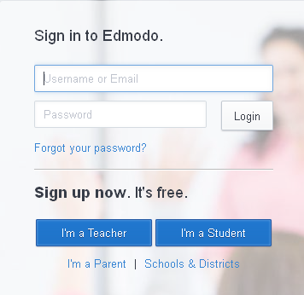
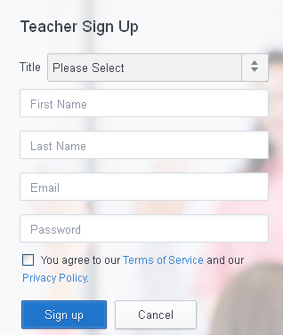
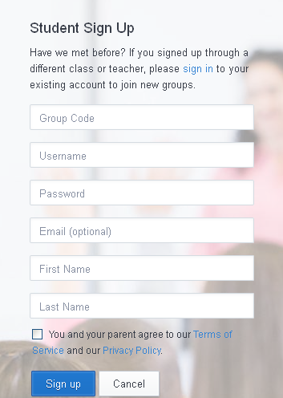
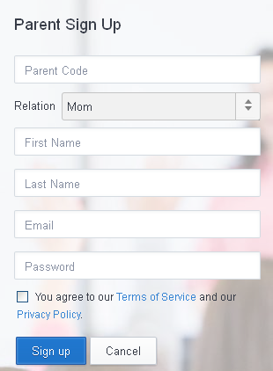
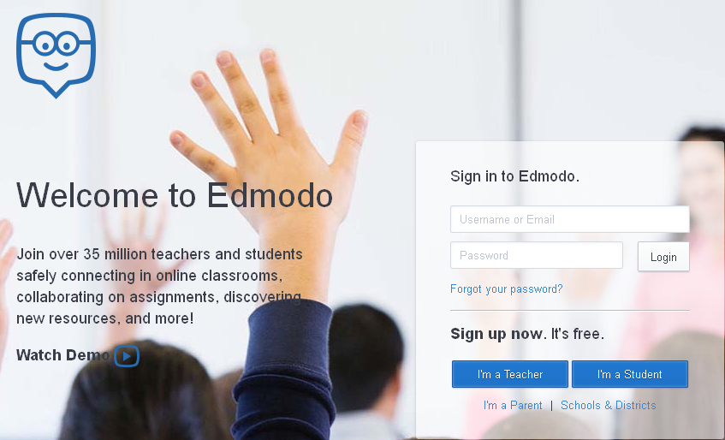
Phase 1: Preparation
Please describe the preparation that the teacher needs to do before implementing the scenario. Define steps and activities, if applicable.
  Create the teaching materials;
  Create Edmodo group for students;
  Before involve underage students on Edmodo, teacher must get permission from a parent. On this occasion teacher can let them know and what Edmodo offers parents.
  Create account in Edmodo for students
  Create instructions for students and parents
  Register parents on Edmodo (needs to have the students registration code; registration and authentification through e-mail.)

Slide 10
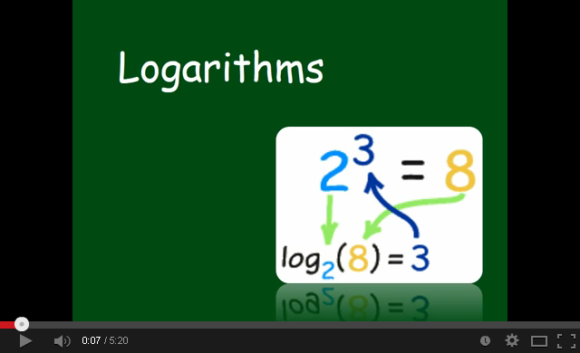
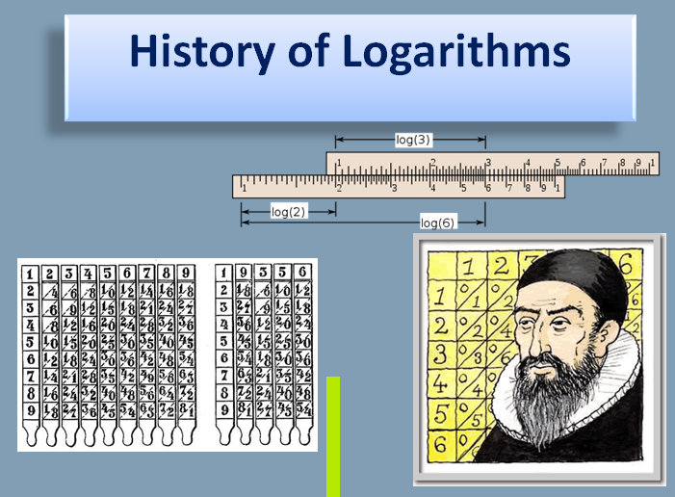
Phase 2: Implementation
Prepared material have been placed in Edmodo clasroom (videos, presentations, word documents, pictures, tables, etc.)
  Create quizzes and surveys;
  Create questionnaire for evaluation the students work;
  Monitor student discussion in Edmodo classrom and answer questions if that necessary.

Slide 11
Phase 2: Assessment
  Teacher lesson begins with a presentation I want to know. It contains a few questions: how to measure the magnitude of earthquake, how to determine wind speed close to tornados; how to determine the age of archaeological finds, to measure the brightness of stars, as determined by the neutrality of the solution.
  Learning logarithms on Edmodo network includes several phases:
  - Setting video lessons Logarithms and their properties,
  - Making tasks that are described in detail in the video,
  - Check learned by solving unfamiliar problems.
  - For students who are interested in the history of mathematics, on Edmodo to set up a video history of logarithms.
  - The teacher set a simple questionnaire asking whether the material presented was unclear receives feedback about the material for learning.
  (The biggest difference between the parent account and student and teacher is that the parent does not have the right and opportunity to write messages and to otherwise participate in working groups, communities. He is on Edmodo solely for monitoring of the child and inform the school or classroom - published by the teacher or school administrator asks for it.)
  All questions about the tasks that the student can not solve alone, or did not understand the contents of video lessons, the student asks the teacher to the next class. The teacher refers students to do assignments.

Slide 12
Phase 2: Assessment
Discussion with students about lesson they learned, problems and ambiguities in learning.
Repeat what are logarithms and which are the basic rules Logarithmic.
If it was an example that students were unable to do so, the teacher works with the students or for example a student who has done the examples.
Teacher divided students into four groups. The task of each group is that for certain numbers and their degrees using arithmetic operations (addition, subtraction, multiplication, division, exponentiation) writing tasks.
Students choose from a group of a group that will do the tasks that they are put together. Each group sets the selected group four task. Winner is a group that has most accurately performed tasks.

Slide 13
Phase 2: Assessment
Homework (in Edmodo clasroom)
1) Each group solved tasks was compiled.
2) See presentation about decadal and natural logarithms.
3) Solve examples which students saw first class (presentation I want to know) using gained knowledge.
4) Find some application for logarithms (in electrical engineering, physics, music, etc ...).

Slide 14
Resources
Resources on the ODS portal
La série harmonique encadre le logarithme
http://i2geo.net/Coll_ChristianMercat/Laserieharmoniqueencadrelelogarithme
The law of the iterated logarithm in probability theory
http://objetoseducacionais2.mec.gov.br/handle/mec/16133

Slide 15

Resources
External resources
Edmodo
https://www.edmodo.com/
Edmodo Tutorial 4 - Parent Log In
https://www.youtube.com/watch?v=2HA_pY5wjHs&hd=1
Parent Guide to Edmodo
https://www.youtube.com/watch?v=XifExVf2Ryw&hd=1
Using Edmodo in the Classroom
https://www.youtube.com/watch?v=iyvqoLYRyVI&hd=1
I want to know –video presentation
https://www.youtube.com/watch?v=s1mPo8epXu8&hd=1
Logarithms
https://www.youtube.com/watch?v=y1IyTQmiIJI&hd=1

