Slide 1





Open Discovery Space Summer School 2014
Marathon, Greece, July 13-18
Educational Scenario

Slide 2
Basic info on the scenario:
Name of participant: BESLE Peggy ; BARRAULT Marie-Hélène
School : Rouvray Saint Denis.
Country: France
Title of scenario: Mathematics flipped classroom
Short description/ main idea: Strengthen ownership of skills by students in this educational concept. A learning path combining: knowledge discovery independently, followed by a time of interaction in class in order to understand the concept.

Slide 3
Educational objectives and pupils’ competences targeted:
Objectives:
- Organizing and managing data proportionality
Competence: The main elements of mathematics
Solve problems involving situations of proportionality.
Reference to curriculum 2008:
Solve problems involving proportionality and particular problems relating to percentages.
- Using a variety of procedures.
- Being able to work in groups

Slide 4
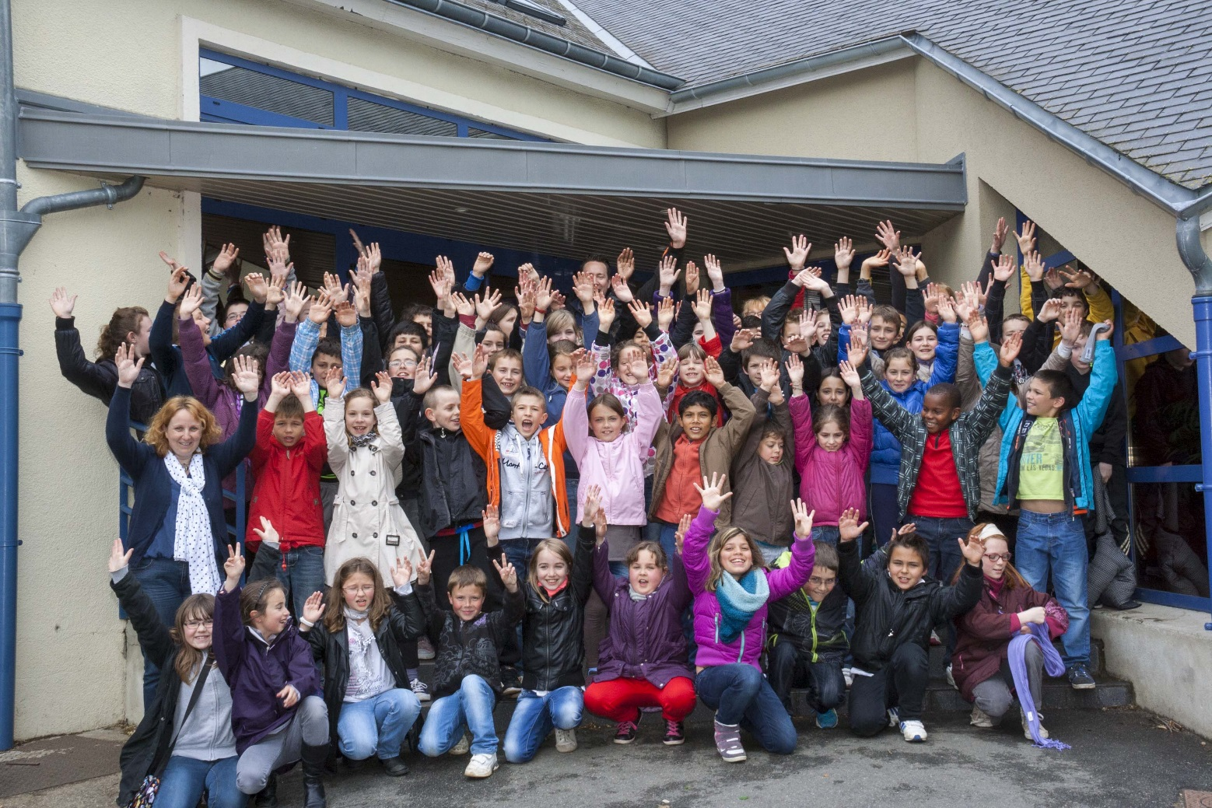
Pupils’ ages:
YEAR ( 10 11 YEARS)
Please describe

Slide 5
Curriculum areas/ domains involved:
mathematical
Problem solving
percentages

Slide 6
Which school needs does your scenario address?
Material: viewer, interactive whiteboard, calculator and laptop, digital workspace : “Itslearning”
Photocopy exercises and self-correcting plug
http://www.youtube.com/watch?v=VjqPIfonmm8

Slide 7
Parental engagement
  How are pupils’ parents engaged in the process or/ and implementation of the educational scenario? What is their role?
  Parents agree to let their children go to the website of the digital workspace at home.
  Teachers organize meeting with parents in order to explain the digital workspace and the education pedagogy of school.
  Teachers insist so that students have an access to Internet at home.

Slide 8
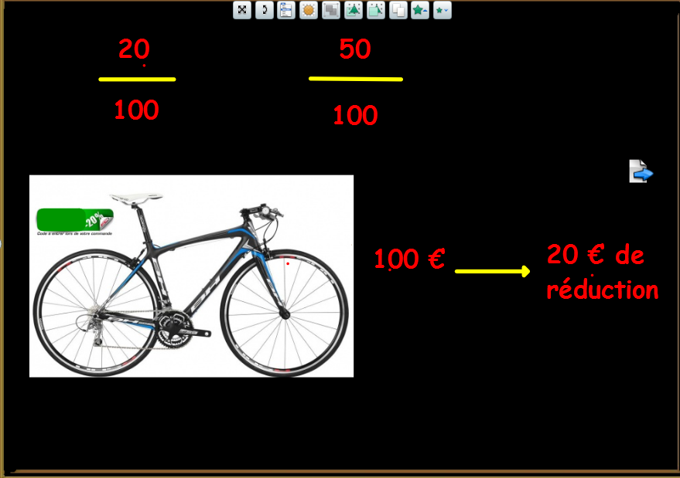
Phase 1: Preparation
.
  Teachers must prepare the video capsule, put it on the digital workspace; Prepare batteries exercises for students to do as a group.
  Prepare auto correction sheets. Teacher prepare the paperboard

Slide 9
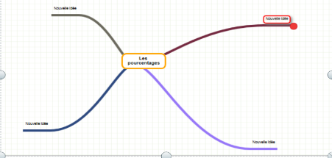
Phase 2: Implementation
  1 )This video capsule helps to explain the concept of percentage Students can watch the capsule at home on the digital workspace or at school before the class.
  2)Students make in class a mental map on percentages
  Organization of ideas :
  In pairs, students will develop the mental map on percentages.
  Pooling through the viewer.
  Choosing a mental map or development of a joint.

Slide 10
Phase 2: Implementation
  Training :
  Students solve problems in groups of 4.
  After, they correct them, themselves.
  Each student works at its pace, and teacher can help students who need more explications.

Slide 11
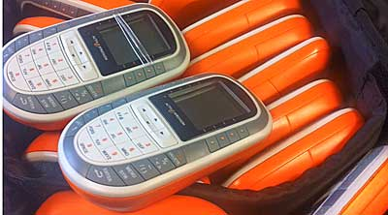
Phase 3 : Evaluation
  The pupils have to create questions for the digital system vote with multiple choices of answers and selection of the just answer so that the other pupils can answer it later in autonomy

Slide 12
Resources
- Mind map online : http://www.framindmap.org/framindmap.html
  - DIGITAL WORKSHOP SPACE : https://www.itslearning.com/Index.aspx?CustomerId=1717
  - Video : http://www.youtube.com/watch?v=VjqPIfonmm8
  - Teacher plan : .
.\inspection\pédagogie inversée les pourcentages.doc

