Slide 1





Open Discovery Space Summer School 2014 Marathon, Greece, July 13-18
Educational Scenario

Slide 2
Basic info on the scenario:
Name of participant: Katarina Veljković
School: Polytehnical school
Country: Serbia
Title of scenario: Find a job - application for the job.
Short description/ main idea: The aims of this project was to overcome the gap between school and life beyond school walls. We wanted that our students experience some real life situations such as a job application, and develop and test the necessary life and career skills.

Slide 3
Educational objectives and pupils’ competences targeted:
Training for independent decision-making and responsibility for their own work presenting themselves and their achievements,
Encouraging creativity and innovative thinking,
Developing digital literacy (with special emphasis on media literacy),
Training for the development of applications and media products that will benefit others,
Develop life and career skills,
Develop the ability to solve problem situations,
Training for work in a team,

Slide 4
Pupils’ ages:
The project involves the 1st and 4nd grade students from two different vocational schools placed in two geographically distant cities, but with common way of thinking, interests, and the profession for which they have been studying.
15 to 18 years

Slide 5
Curriculum areas/ domains involved:
Civic Education
Computer Sciences
Mother tongue
Class of homeroom teacher

Slide 6
Which school needs does your scenario address?
Most students think that school is boring, and that learning is difficult. They often learn only what they have to, obtaining knowledge by reading from the textbooks and listening to teachers’ lectures, as the only resources. In order to prepare students for what they can expect after high school, that is, for most of them, finding a job, we choose the topic of career guidance.
In order to reduce the reproduction of what has student learned and to encourage students involvement, we ventured into a project that has involved a variety of activities on the Internet, within Second Life, Moodle and web conferencing.

Slide 7
Parental engagement
Please describe
How are pupils’ parents engaged in the process or/ and implementation of the educational scenario? What is their role?
During the planning and realization of this project parents were not involved. In order to improve project, it is possible to involve parents in the following way:
Parents will be able to visit online classes and to choose a topic of the subject in class of homeroom teacher.
Parents will be able to make suggestions regarding how to apply for a job and how to write good CV.
Parents will be able to join the discussions during the writing of scenarios on to job interview.
Parents will be able to join the discussions between teacher and students.
Which school needs does their engagement in this scenario intend to serve?
to make parents to understand that the role of computers are increasing on all levels in the students life.
to introduce and inform parents about eLearning platform

Slide 8
Parental engagement
What are the expected benefits from parents’ engagement in this scenario?
The better understanding the needs of their children.
To collaborate with teachers and school administration in creating curriculum.
Looking for jobs

Slide 9
Phase 1: Preparation
Please describe the preparation that the teacher needs to do before implementing the scenario. Define steps and activities, if applicable.
Create and open premium accounts in Second Life.
Moderation of location in Second Life –Koliba
Installation of Sloodle - module for connecting electronic learning platforms Moodle and Second Life – virtual world
Create the teaching materials, instructions, Sludl facilities.

Slide 10
Phase 2: Implementation
Please describe the preparation that the teacher needs to do before implementing the scenario. Define steps and activities, if applicable.
Create Rubrics for evaluation the students work
Create quizzes and surveys
Create the teaching materials, instructions, tasks for students, surveys and tests.

Slide 11
Phase 2: Assessment
Please describe how you intend to assess the outcomes of the scenario. Define steps and activities, if applicable.
Students did surveys and quizzes and create products. Teacher monitors their progress and evaluate the results of their work. At the beginning, the students did a survey based on which we assess their knowledge of the subject which we are studied. This survey was guide for the further working with students, where we pointed out the weaknesses and prejudices usually related to the topic we covered. In the final phase of the project working quiz which we assess the extent of their progress in relation to the initial phase..
In the initial phase of the project in pursuance of activities related to creating Belbin questionnaire, the students were used the table for evaluating work of teams (peer assessment), also they had the opportunity to evaluate the work of their own team and assess their personal contribution to the project (self-evaluation).
After the individual activities, students comment and evaluate the work of the teams (peer evaluation), and evaluate the work of their own team and gives assessment of their contribution in making films (self-evaluation).
The final product of student work - CV and cover letter (specific job), was evaluated by experts from the company (Office of Human Resources, Sintelon doo), of which the students receive feedback on the results (fulfillment of job requirements).

Slide 12
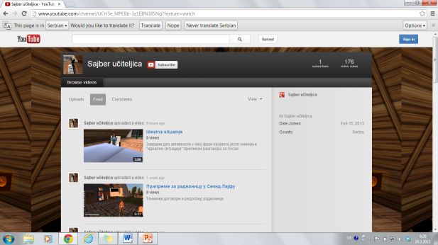
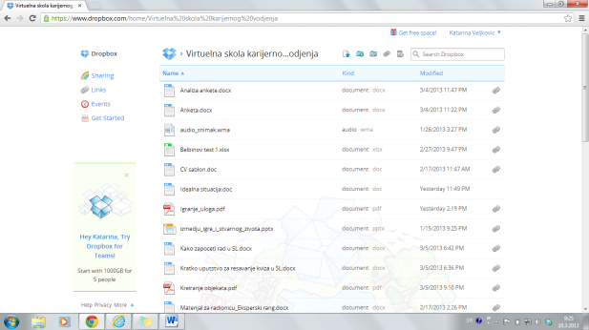
Resources
Please identify at least 5 resources (links, files etc) that will be used in the scenario. You are advised to look for relevant resources on the ODS portal. You can also add external resources.
Web / online service - for videos | You Tube | You Tube channel project: http://www.youtube.com/channel/UCH5e_MPEBb-3z1EIfN385Ng?feature=watch
All materials on the project | SkyDrive location | Skydrive „Team for the 21st century“: http://sdrv.ms/12ZPdIx

Slide 13
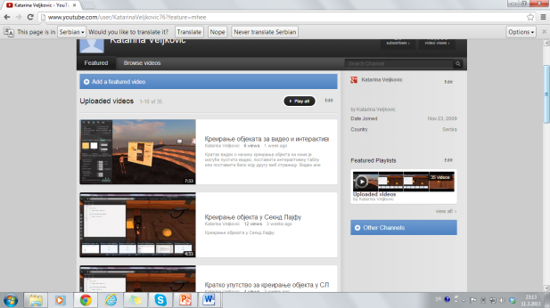
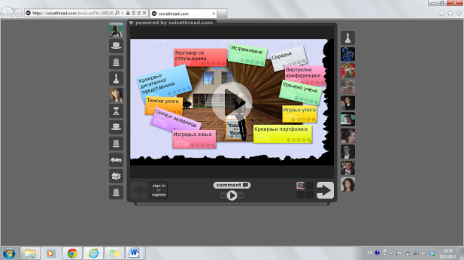
Resources – Cont.
Web / online service - for videos | You Tube | You Tube channel project for teacher: http://www.youtube.com/user/KatarinaVeljkovic76?feature=mhee
Web - Online Services - Introduction of participants in the project | Voice Thread | https://voicethread.com/book.swf?b=3882205

Slide 14
Resources – Cont.
Web - Online Services - Location for creating the object | SandBox | http://maps.secondlife.com/secondlife/Kings%20Bishop/38/227/23
Web - Online Services - Location for creating the object | SandBox | http://maps.secondlife.com/secondlife/Venufalat/69/164/1001
Web - Online Services - Location for recording stories | North pole | http://maps.secondlife.com/secondlife/Porvoo/217/133/128
Web - Online Services - Location for recording the instructions for the workshop "How to Survive in the Wilderness" | EduNation | http://maps.secondlife.com/secondlife/EduNation/128/128/22
Web - online services - Location for download Sloodle Set | English Village | http://maps.secondlife.com/secondlife/English%20Village/134/106/21

