Slide 1




Summer School 2015
Mati, Greece, July 12-17
Educational Scenario

Slide 2
Basic info on the scenario
Name of participants: Eleftheria Karagiorgou, Vasileios Spahos
School:7th High School of Trikala, http://7lyk-trikal.tri.sch.gr/
School’s Community: 7th High School of Trikala/7ο ΓΕΛ Τρικάλων
http://portal.opendiscoveryspace.eu/community/7o-geniko-lykeio-trikalon-817853
Country: Greece
Title of scenario: Programming with Robots
Short description/ main idea:
In the context of Open Discovery Space Project- we entered in the third phase of ODS-, we implemented the project "Programming with Robots" with a view to moving them, making a color separation, getting round any obstacles and controlling them by using tablets via bluetooth. Additionally, we integrated STEM to our robots by using Ph meter for measuring the ph of the liquids.

Slide 3
Educational objectives and pupils’ competences targeted
The students learn to collaborate and to work in team spirit -Collaborative Learning Method.
The students learn through experimentation- Trial and Error Method
The students get familiarized with the development of approaches for problems’ solution.
The teachers engage the students in the learning process by exploiting their skills and abilities.

Slide 4
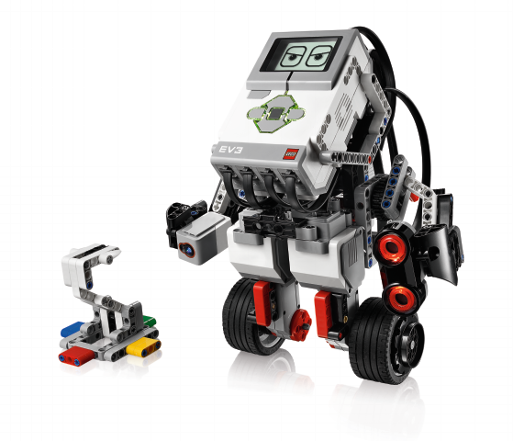
Pupils’ ages
16 and 17 years old, meaning, 1st and 2nd class of High School
Curriculum areas/ domains involved
ICT, Programming, Robotics, Chemistry, Science

Slide 5
Which school needs does your scenario address?
We took into account that both students and teachers of our school wish for and are interested in this action.
The fact that during the last few years the Greek Ministry of Education promotes the "Digital School" which includes some new teaching methods, several innovative actions and the use of digital teaching means.
Robotics includes all the above.

Slide 6
Innovative characteristics:
Change the educational process in the long term through the promotion of STEM.
Make students familiar with the concept of robots, especially in a provincial school like ours.
Students' familiarization with the use of tablets.
Pilot introduction of BYOND (Bring Your Own Device) model, in a subsequent level, through the provision of devices to students from the school and their programming with App Inventor, according to the “NMC Horizon Report: 2015 K-12 Edition”. [6]
The upcoming school year, integrate 3D Printing to Robotics after the donation to our school a 3d printer and so, the students will have the opportunity to design and create parts of the robots, according to the “NMC Horizon Report: 2015 K-12 Edition”. [6]

Slide 7
Parental engagement
  The students’ parents are always informed about the organized project meetings at school, every Sunday afternoon.
  There is a typical phone communication between the students’ parents and the two school teachers who implement the project.
  The students’ parents are always helpful and they are next to their children.
  Their engagement encourages the participation of their children into the project. The parents seem to trust the involved teachers and their purpose.
School
Parents

Slide 8

Parental engagement
  Parental engagement in school and in educational procedure encourages [1]:
  The students’ better school performance
  The students’ good behavior and presence in school
  The students’ greater interest for learning
  The students’ better capabilities and skills

Slide 9
Equal learning opportunities
In our school applies the concept of the “separate but equal” opportunity for all our students. [2], [3]
Nevertheless, in the specific scenario, there are no students with different learning styles, since the two teachers who implement it, have chosen the students, and therefore, the basic criteria of their choice was the good understanding of programming.
So, more or less, the majority of the selected students has the same level of performance.

Slide 10
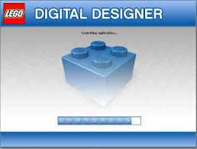
Game-based learning
The concept of “Programming with Robots” includes the idea of game-based learning.
Game-based learning has a great impact on the students’ learning. [4]
In the phase of Preparation , the students construct their robots in the Game-based Robotics Simulator “Lego Digital Designer”. [5]
“Lego Digital Designer” gives the opportunity to design the robot in the virtual environment, before constructing it in real.

Slide 11
Phase 1-2: Preparation-Implementation
Duration | Subject | Activity | Tools | Assessment
Till end of December 2014 | First contact, Introduction | First contact of the students with Robotics, introduction to the subject, guidelines, separation of students in teams-Collaborative Learning Method | Lego Mindstorms NXT, EV3, Lego Digital Designer | NO
8-18 January 2015 | Segregation of duties | Guidelines for each team | Text 2 Mind Map, Lego Mindstorm NXT, EV3, Lego Digital Designer | NO
19 January-1 February 2015 | Proposals for implementation | Each team will propose ideas for the implementation of the robots and their names | Lego Mindstorm NXT, EV3, Lego Digital Designer | NO
2-22 February 2015 | Implementation of the project | Programming the robots to move | Learning Designer, Google Drive, Lego Mindstorm NXT, EV3, Lego Digital Designer | NO
23 February -8 March 2015 | Implementation of the project | Programming the robots to make color separation | Learning Designer, Google Drive, Lego Mindstorm NXT, EV3, Lego Digital Designer | NO
9 - 22 March 2015 | Implementation of the project | Programming the robots to get round any obstacles | Learning Designer, Google Drive, Lego Mindstorm NXT, EV3, Lego Digital Designer | NO
23 March- 5 April 2015 | Implementation of the project | Control the robots by using tablets via bluetooth | Learning Designer, Google Drive, Lego Mindstorms NXT, EV3, Lego Digital Designer, tablets | NO
6 April - 3 May 2015 | Complete implementation | Trial and Error method | Lego Mindstorms NXT, EV3, tablets | NO
4 May -17 May 2015 | Complete project and start preparation for the 3rd Regional Challenge of Educational Robotics on 20th June 2015 | Each team presents its implementations and teachers choose the students for the Challenge | Tablets, Google Drive | A final questionnaire for all the students and the teachers for the assessment of the project
18 May -19 June 2015 | Preparation for the 3rd Regional Challenge of Educational Robotics on 20th June 2015 | Two teams for each challenge: one for the Lyceum Challenge and one for the Open Challenge | Lego Mindstorms NXT, EV3, tablets | Evaluation the day of the Challenge 20-06-2015

Slide 12
Phase 1-2: Preparation-Implementation
Infrastructure: The equipment that will be used for the purpose of the project is:
An ICT Laboratory with 10 PC's which "run" on Window7
An Interactive board in the lab
A projector which is part of the equipment of the lab
A mobile lab with 5 tablets which "run" on Android 4.4 kitkat
2 Lego EV3 packets with an extension packet
2 Lego Mindstorm NXT packets with an extension packet
Collaborating Tools for "Programming with Robots"
1 | Text 2 Mind Map | Assigning roles to every team member
2 | Google Drive | Sharing Documents among the students and implementation of questionnaire. Each student has a google account
3 | Learning Designer | Organizing the lesson
4 | Lego Digital Designer | Games-based Robotics Simulator

Slide 13
Phase 3: Assessment-Students’ Questionnaire through Google Drive
What is the level of your satisfaction about the collaboration with your schoolmates in the context of the project?
What is the level of your satisfaction about the evolution of your capabilities and skills?
How much interesting were the robot constructions?
How difficult were the robot constructions?
What is your personal opinion about the level of collaboration among the students?
How much the level of collaboration among the students was improved because of their participation into the project?
How much, do you think, your school performance was improved because of your participation into the project?
Do you believe that the project affected your job orientation?
Would you participate again into a similar project?
What is the level of your satisfaction about your participation into the program?

Slide 14
Resources
Repository: ODS| UDLnet: Universal Design for Learning: A Framework for Addressing Learner Variability
http://portal.opendiscoveryspace.eu/edu-object/what-makes-udl-different-differentiated-instruction-831334
Repository: ODS | UDLnet: Universal Design for Learning: A Framework for Addressing Learner Variability
http://portal.opendiscoveryspace.eu/edu-object/udl-classroom-831401
Repository: ODS| Teachers' and parents' collaborative community
http://portal.opendiscoveryspace.eu/edu-object/review-good-practices-parental-engagement-669917
Repository: ODS| Δράσεις συνεργασίας σχολείου και γονέων- Κοινότητα ελληνικών σχολείων
http://portal.opendiscoveryspace.eu/node/805496
ODS - Our sub-community “Ομάδα Ρομποτικής 7^{ου} ΓΕΛ Τρικάλων” http://portal.opendiscoveryspace.eu/community/omada-rompotikis-7oy-gel-trikalon-820028

Slide 15
References
http://www.cdc.gov/healthyyouth/protective/parent_engagement.htm - Centers for Disease Control and Prevention
http://teaching.yale.edu/teaching-students-different-learning-styles-and-levels-preparation - Yale Teaching Center
Tomlinson C. A., Javius E. L. (2012), “Teach up for Excellence”, For each to excel, Vol.69, No.5, Pages 28-33, Retrieved from http://www.ascd.org/publications/educational-leadership/feb12/vol69/num05/Teach-Up-for-Excellence.aspx
Kinsheel A., et al., (2013), “Constructivist Game-based Robotics Simulator in Engineering Education”, International Journal of Engineering Education Vol.29, No.4, pp 1024-1036
http://ldd.lego.com/en-us/ - Lego Digital Designer
The NMC Horizon Report: 2015 K-12 Edition

Slide 16
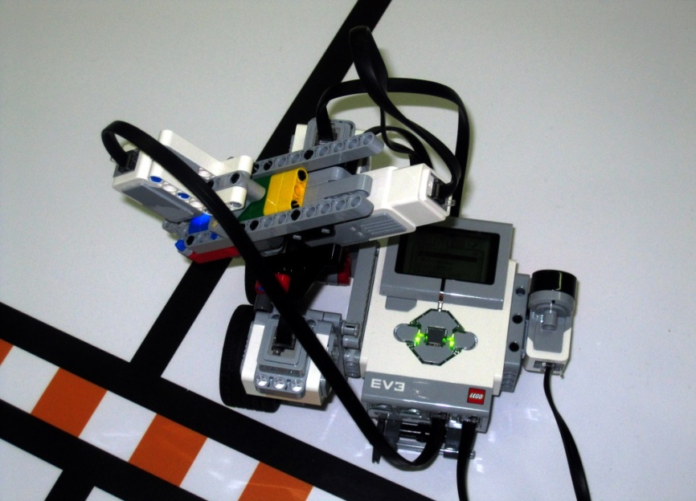
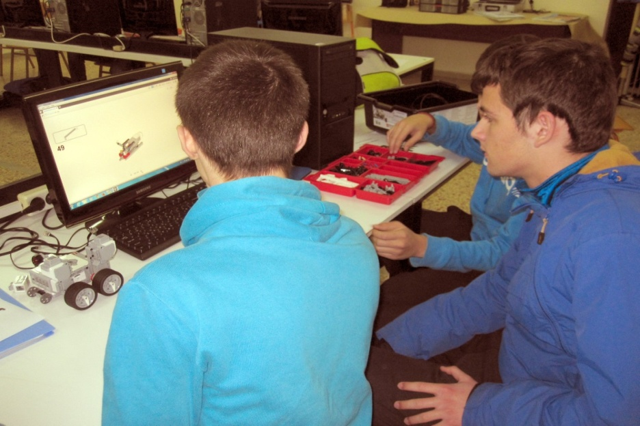
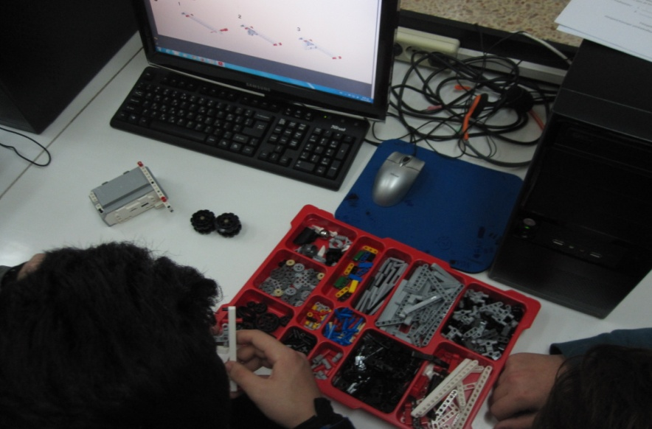
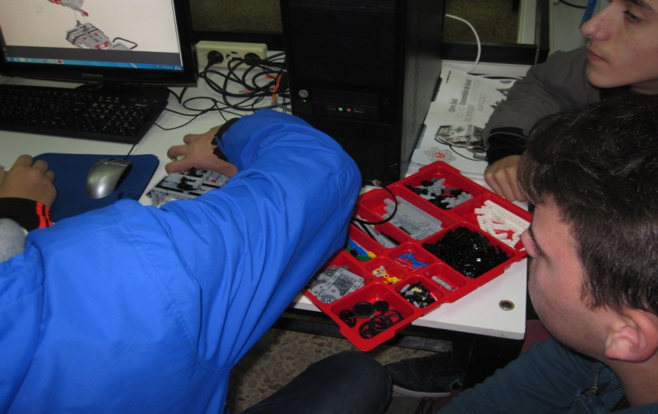
Photos of our Project

Slide 17
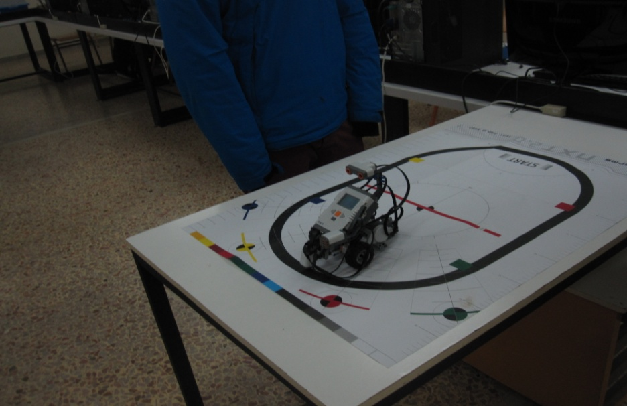
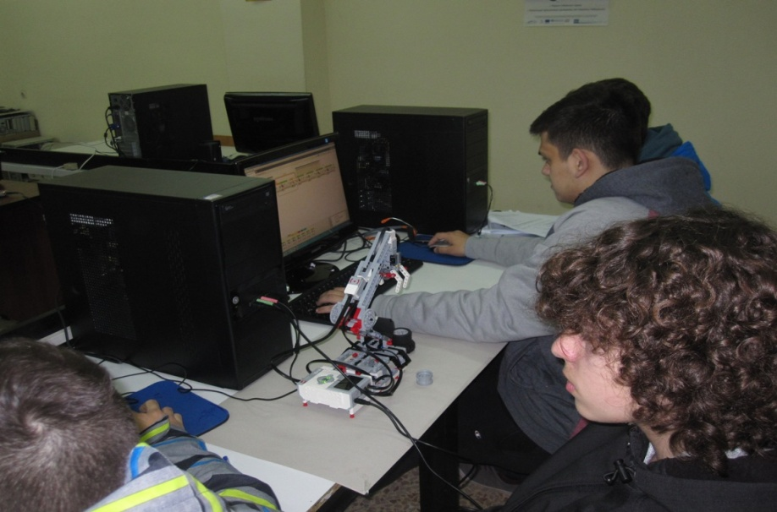
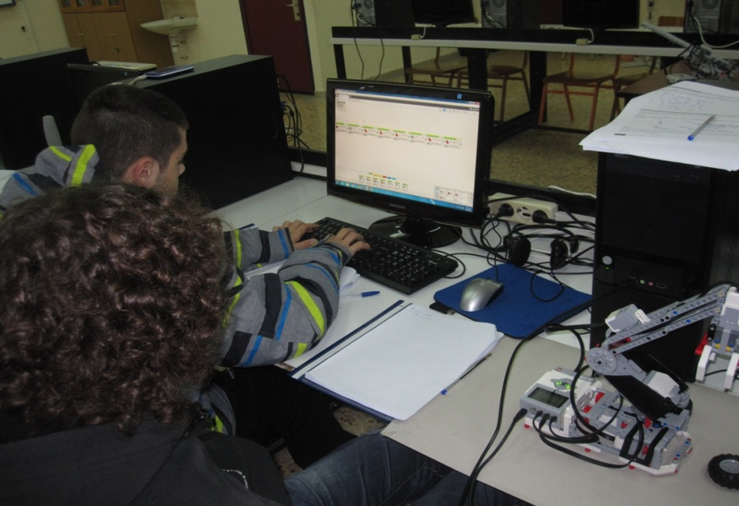
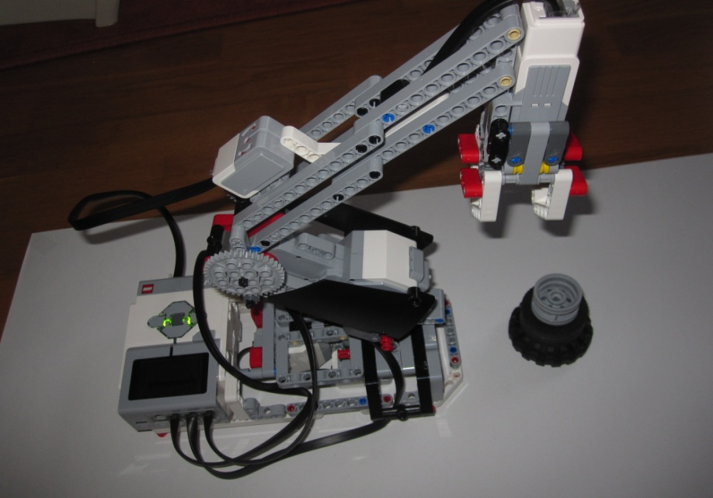
Photos of our Project

