Slide 1





Open Discovery Space Summer School 2014
Marathon, Greece, July 13-18
Educational Scenario

Slide 2
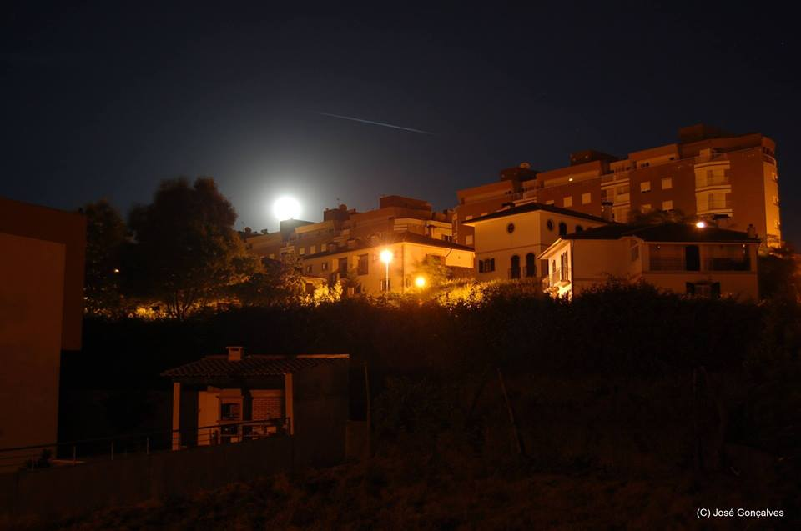









THE LOST WORLD…
… of starry night
How many stars can you see at night?
José Gonçalves
www.eufisica.com

Slide 3
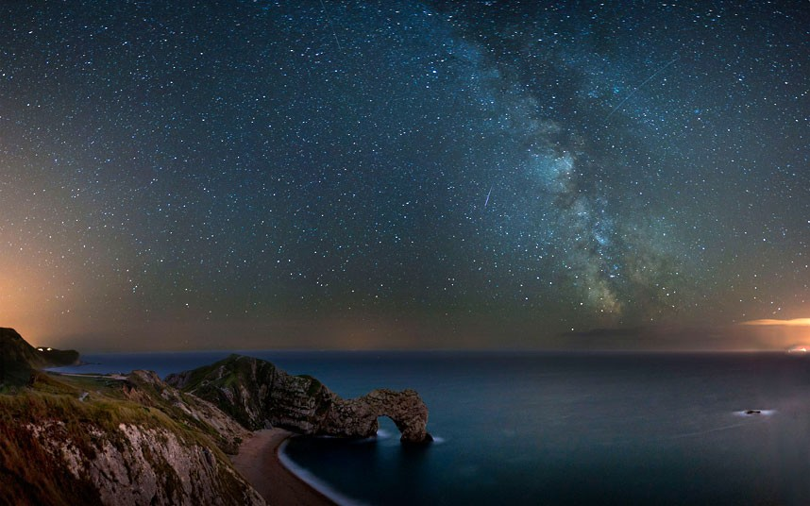


THE LOST WORLD…
The Milky Way fills the night sky over the Durdle Door rock archway on the Jurassic Coast in Dorset, England. The picture was taken by Andrew Whyte, who has a passion for long exposure photography and experimenting with night time shots. Picture: ANDREW WHYTE / CATERS NEWS

Slide 4
Basic info on the scenario:
Name of participant: José Gonçalves
School: E.B. 2,3 de Amarante
Country: Portugal
Title of scenario: THE LOST WORLD… of starry night
How many stars can you see at night?
Short description/ main idea:
The Goal is to carry on a global project conducted by the students with different ages and school years.
We try to engage the students with a talk about light pollution, where pictures and videos were presented. In each grade students tries to find colleagues from the same, upper or lower grades. We want students from the same living area.
The best fit will be groups with one student from 7th grade, one from 8th grade, and one from 9th grade. Different combinations are accepted.

Slide 5
Educational objectives and pupils’ competences targeted:
1. Learn to locate celestial objects and constellations.
2. Relate the intensity of artificial light to the observation of these objects.
3. Understanding the properties of light and the different spectra.
4. Differentiate the different spectra with the respective light sources.
5. Calculate the energy and the expenditure correlated to lamp’s power.
6. Use the spreadsheet for data processing and interpretation.
7. Associate light pollution to energy waste and its impact on astronomical observation.

Slide 6
Pupils’ ages:
+12 age old
This scenario was implemented to all students in the 7th, 8th and 9th grades.

Slide 7
Curriculum areas/ domains involved:
PHYSICS:
Location of celestial objects and constellations (7th grade), the properties of light and the color of objects (8th grade), energy and power (9th grade).
MATHEMATICS:
Build graphs, interpreting data, equations and basic operations.
ICT:
Data analysis and build graphs with a spreadsheet, using Google maps or other geolocation software, Office software.
Other skills were applied in this scneario like communication, operating a spectrometer and a Smartphones / Tablets, leadership, team work, etc.

Slide 8
Which school needs does your scenario address?
Print and copies of documents, computer with internet connection, Stellarium and SalsaJ software, materials and tools to build a spectrometer, interactive whiteboard and Google account (for students and teachers).

Slide 9
Parental engagement
Please describe
  How are pupils’ parents engaged in the process or/ and implementation of the educational scenario? What is their role?
  The parents can guide the children through the geo-localization process. At the same time they can ask students about the problem objectives, why they should study that problem, and why is so important.
  Which school needs does their engagement in this scenario intend to serve?
  The school can be serve with a different way to implement projects, cooperation between students and teachers as well, to improve students’ skills and critical thinking.

Slide 10
Parental engagement
Please describe
  What are the expected benefits from parents’ engagement in this scenario?
  They can learn more about this problem.
  They can improve their knowledge and ICT skills.
  They can pressure local authorities about light pollution.
  They can be a part of the study and understand / remember the scientific method.
  They can communicate and spare some time with their children.

Slide 11
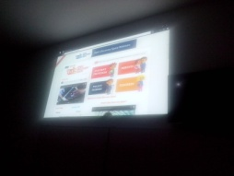
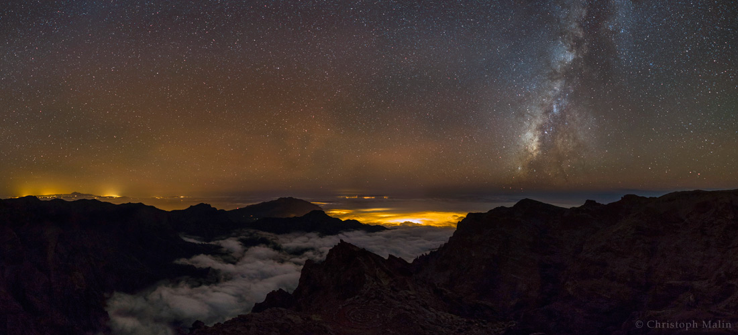
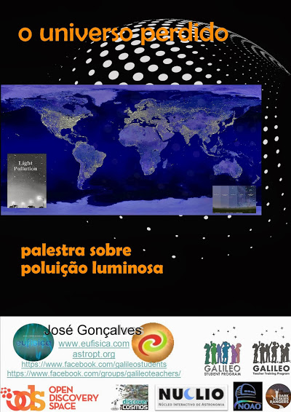
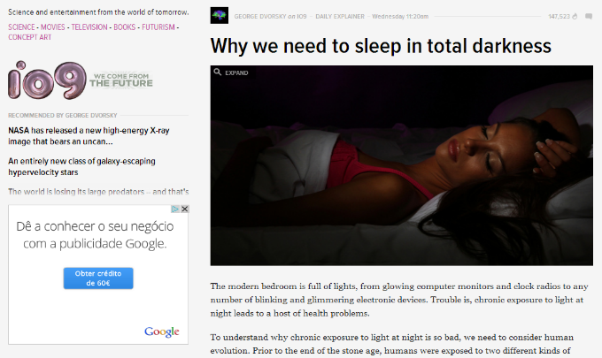
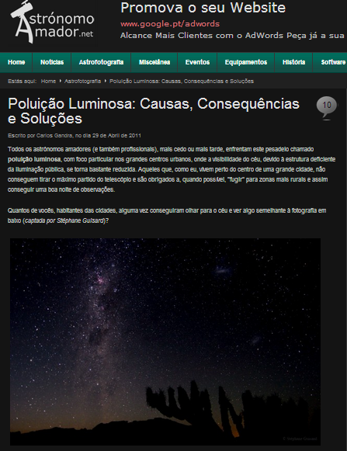
Phase 1: Preparation
It is intended that teams are made ​​between students of different grades.
It’s possible to hold up a lecture to provoke curiosity and can be opened to local community.

Slide 12
Phase 1: Preparation
Economic
production of energy with poluent source
global warming
Environmental
flora, habitats, fauna, ...
Social
light invasion at home
insomnia, stress,
Health

Slide 13
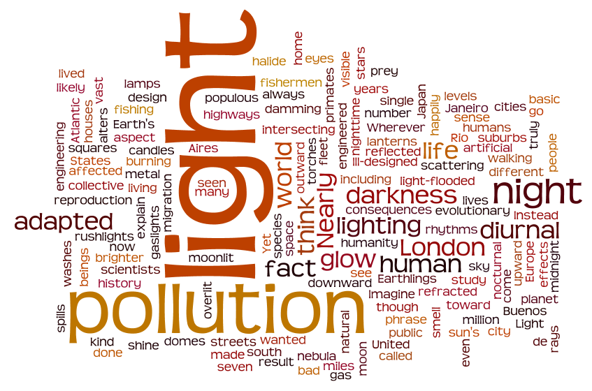
Phase 1: Preparation
Caused by…?
What is the waste?
How many stars can we see?
What is the relationship between energy expenditure and ...?
Can we reduce our expenditure?
Etc…

Slide 14
Phase 2: Implementation
Public Illumination Audit
Artificial Light
Nº Stars
Constelations
Glow effect
City / Countryside
Lamp Type
Power
Energy
Expenditure
Nº Stars
7th Grade
9th Grade
Nº Stars
Lamp Type
Light Color
Spectrum
LED vs Others
8th Grade

Slide 15
Phase 2: Assessment
Each team consists of …
9th grade student
Coordenator
Power
8th grade student
Luminaire type
Lamp type
7th grade student
Stars counting in variable directions
Number of stars in Orion’s constellation
Energy
Data collection
Calculus
Espectrum
Lamp color
Fotography
Important: Geolocalization
Team work between students, students and teachers, and between teachers.

Slide 16




Resources
7th grade – Light Pollution (Discover the Cosmos portal)
8th grade – The colors… (PROFILES portal) and they build a spectrometer and they will introduce in the http://spectralworkbench.org/. Also, the students can analyze the spectrum with SalsaJ and/or analyze images collected by Faulkes Telescopes.
9th grade - audit of streetlights (Dark Skies Rangers website)

Slide 17
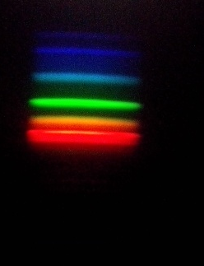
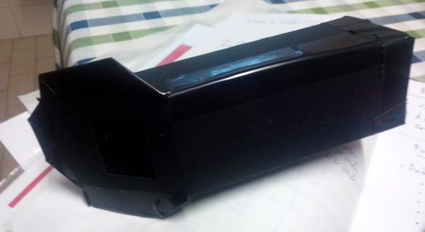
Resources
http://portal.discoverthecosmos.eu/el/node/191453
http://www.slideshare.net/eufisica/light-pollution-dtcportuguese
http://www.slideshare.net/eufisica/palestra-sobre-poluio-luminosa-30356496
http://portal.discoverthecosmos.eu/en/node/195700
http://dsr.nuclio.pt/recursos/
https://www.youtube.com/watch?v=RdwJOAukpiY
http://www.profiles.org.pt/?page_id=156&lang=en

Slide 18
Phase 3: Evidences from observation
Tipo of luminaire | Power / W | n.º of hours per day / h | n.º of hours per year / h | Energy used in one year / Wh | Energy / kWh | Yearly expenditure / euros | Diary expenditure / euros
Globo | 60 | 12 | 4380 | 262800 | 263 | 36,61 | 0,10
USCO | 175 | 12 | 4380 | 766500 | 767 | 106,77 | 0,29
Incandescente | 150 | 12 | 4380 | 657000 | 657 | 91,52 | 0,25
 | Total (3 lamp) | 36 | 13140 | 1686300 | 1686 | 235 | 1
LED | 30 | 12 | 4380 | 131400 | 131 | 18,30 | 0,05
 | LED/Globe | LED/USCO | LED/Incandescent
Savings (EUR) | 18,30 | 88,47 | 73,22 |  |  | E = P x t
% | 50% | 83% | 80%

Slide 19
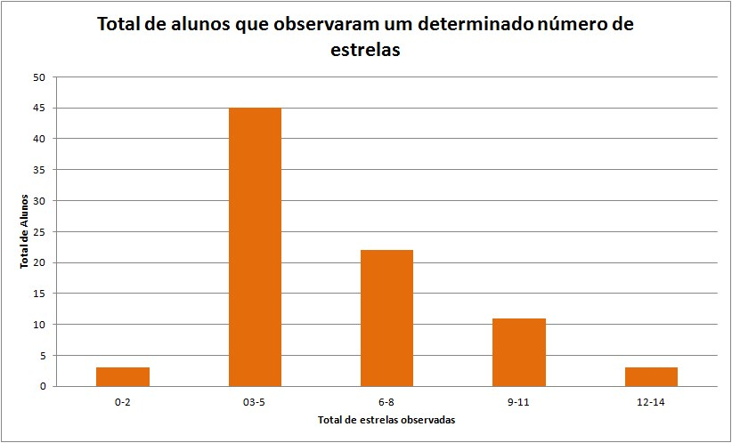
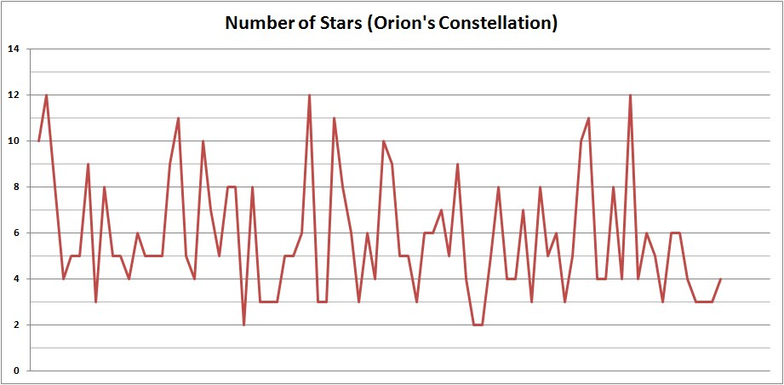
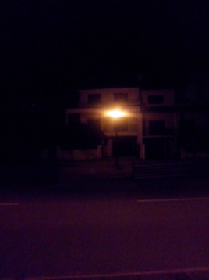
Phase 3: Evidences from observation

Slide 20
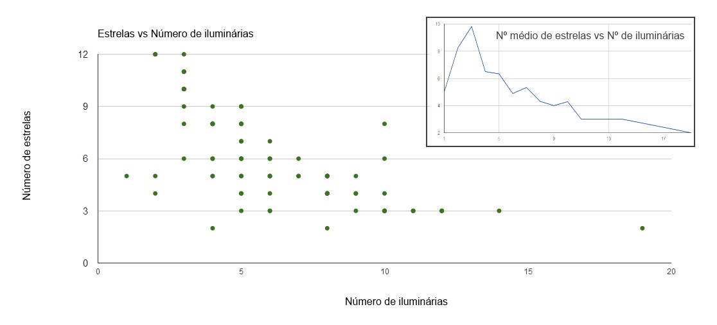
Phase 3: Evidences from observation

Slide 21
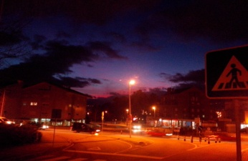
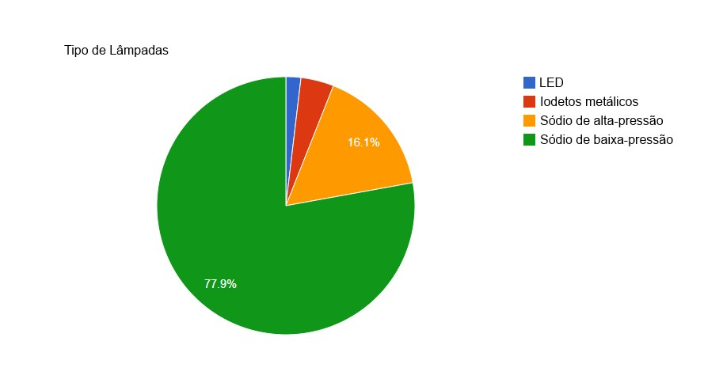
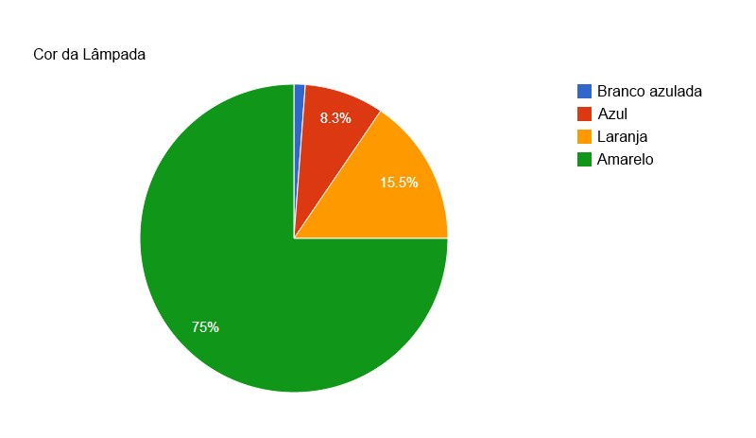
Phase 3: Evidences from observation

Slide 22
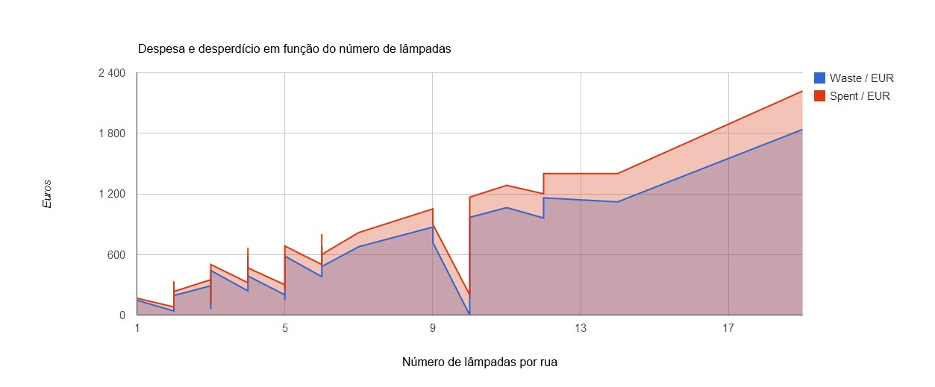
Phase 3: Evidences from observation

Slide 23
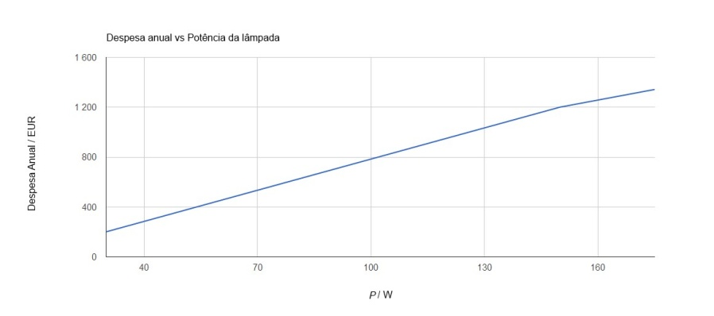
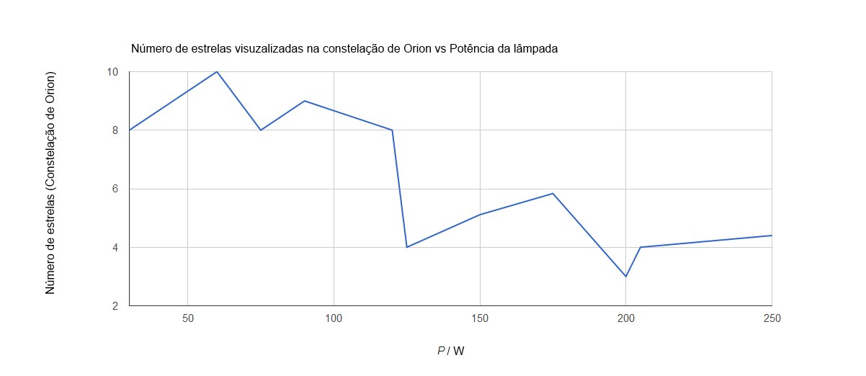
Phase 3: Evidences from observation

Slide 24
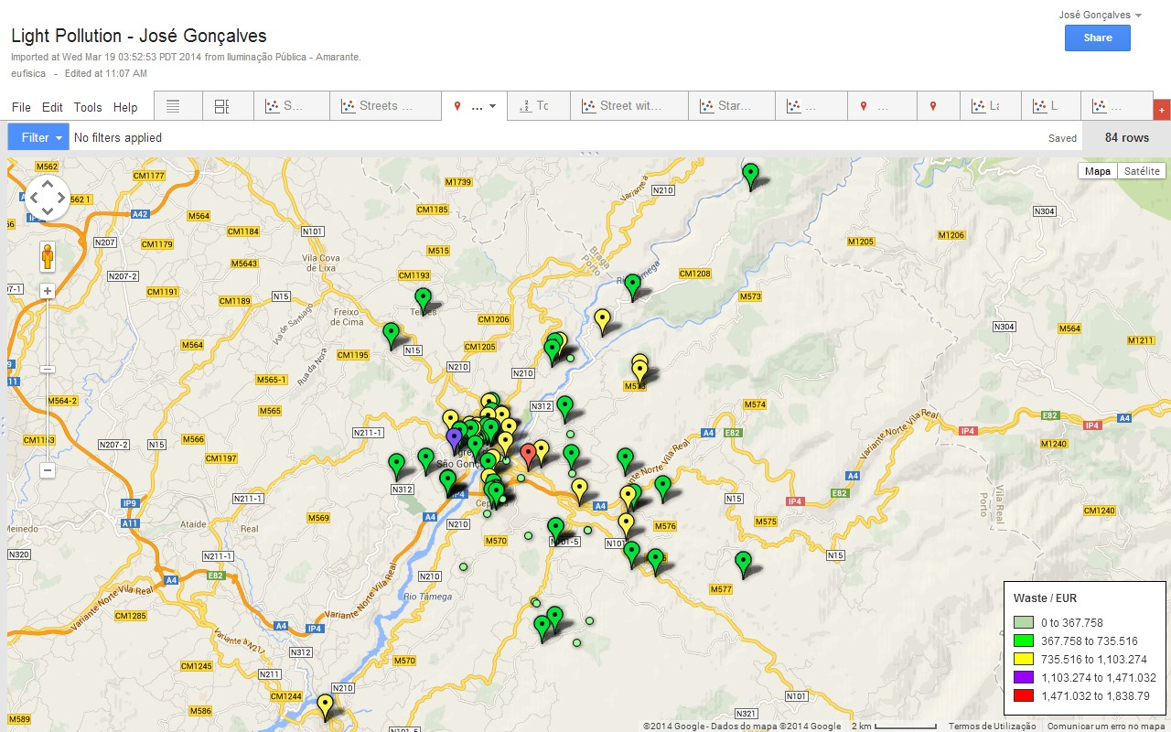
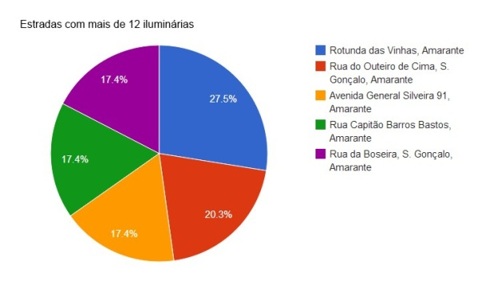
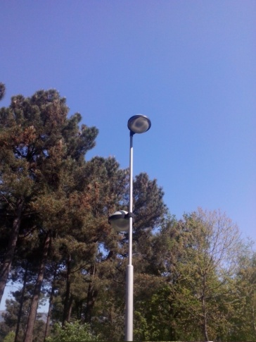
Phase 3: Evidences from observation

Slide 25
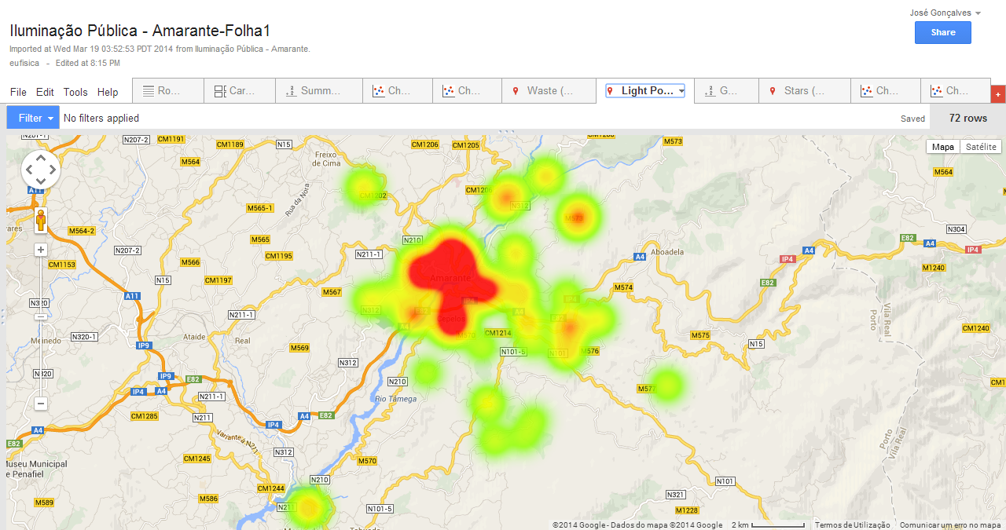
Phase 3: Evidences from observation
http://goo.gl/NKsrB5

Slide 26
Phase 4: Discussion and explanation from ecidence
Observed stars
Power
Expenditure and waste
Energy
Lamp’s color
Constelations
Time

Slide 27
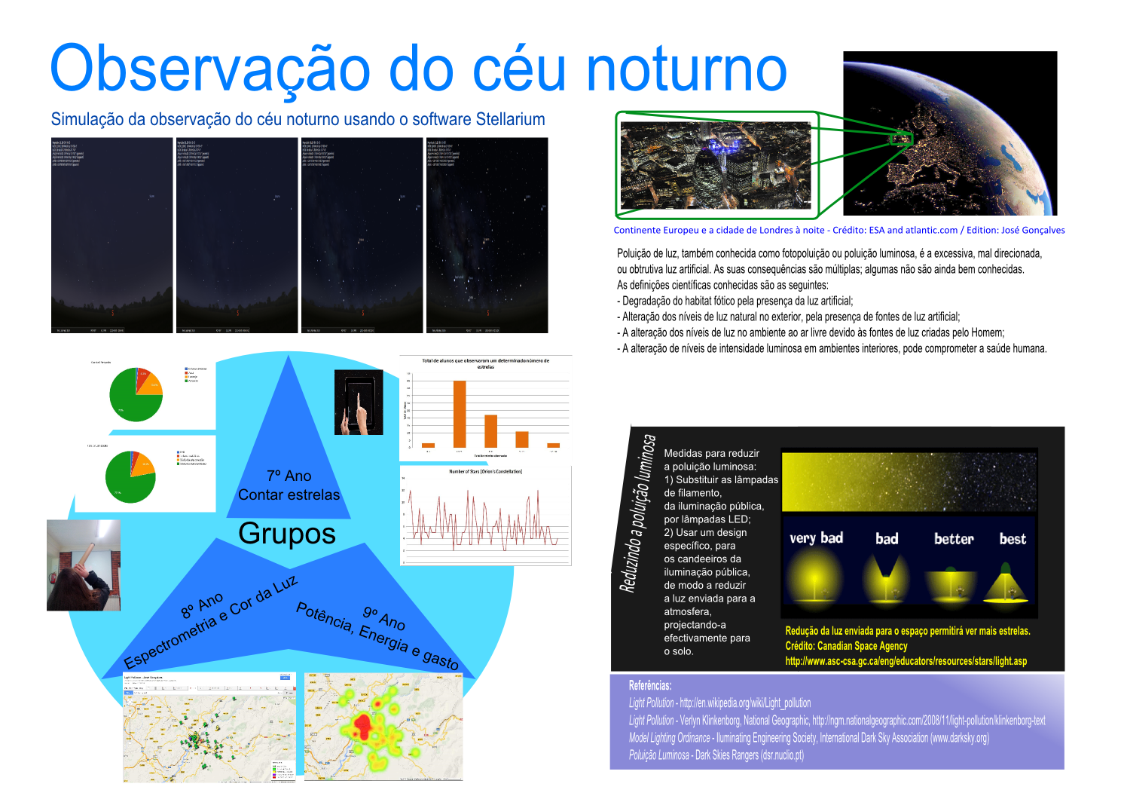
Fase 5: Communicating the results
Poster
Exposition (fotography, models, etc.)
Letter addressed to public authorities
Poem
Music
Public Talk
News (journal, blogs, facebook,...)
School and/or local radio, video, PPT
Etc.

Slide 28
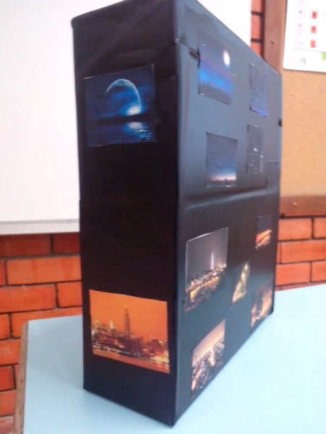
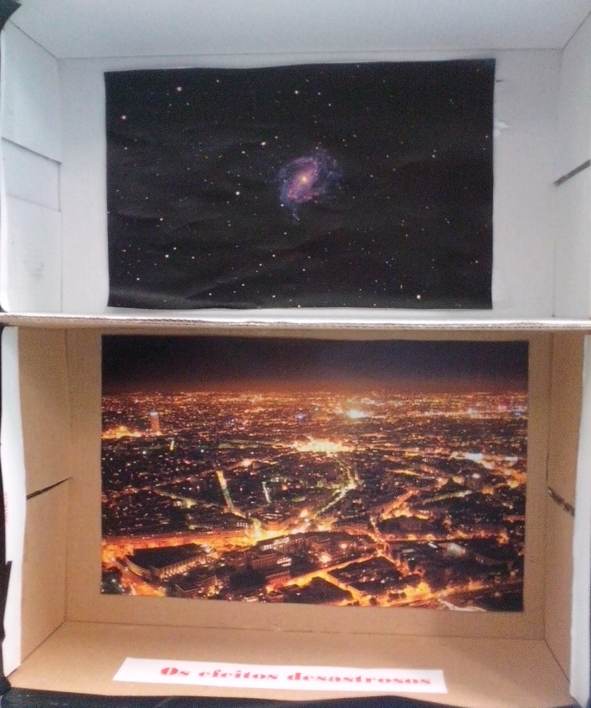
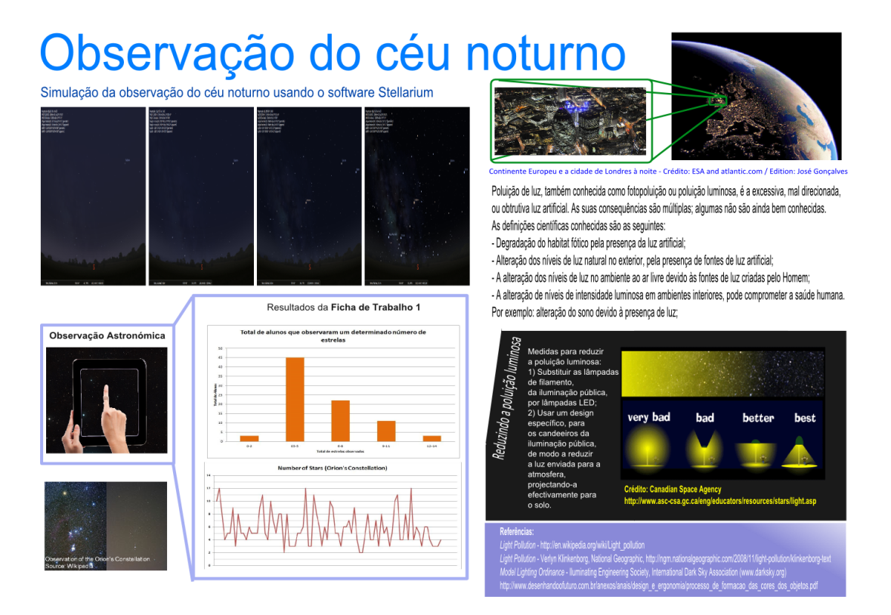
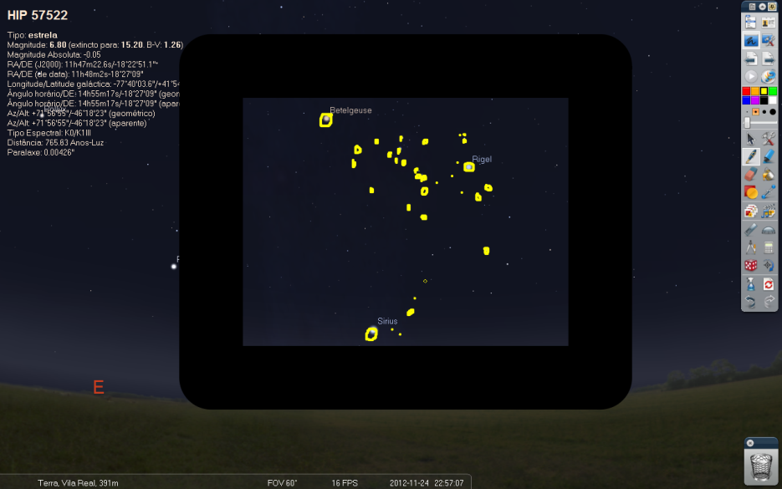
Fase 5: Communicating the results

Slide 29
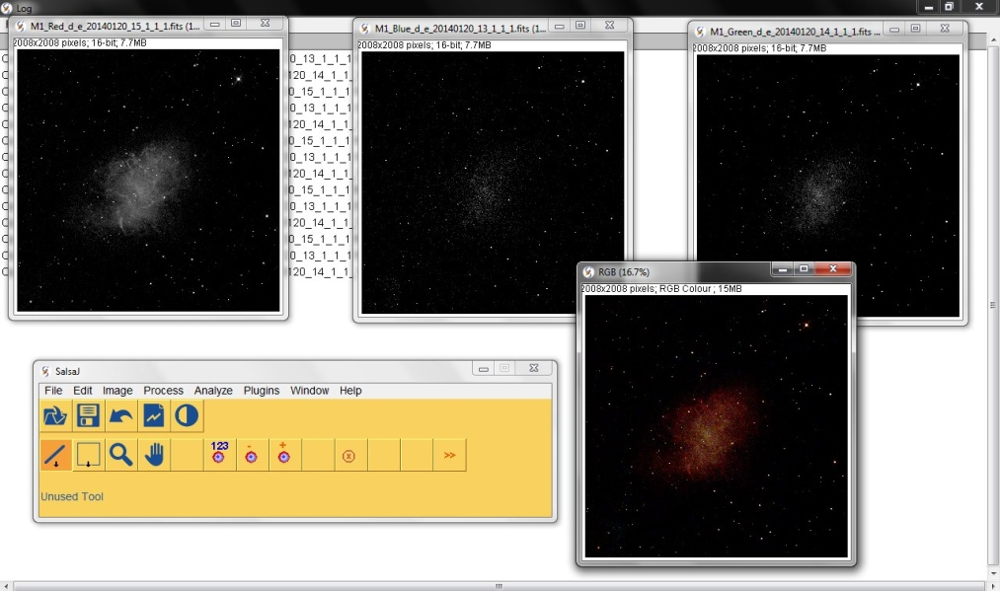
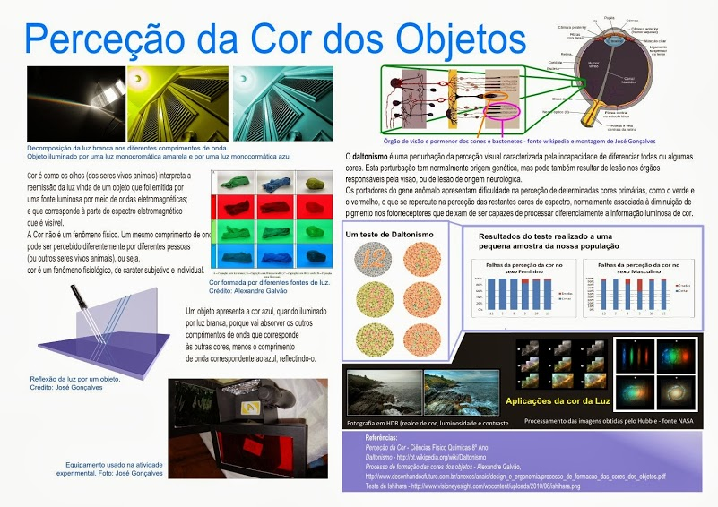
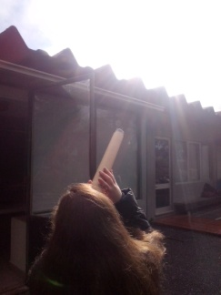
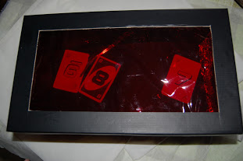
Fase 5: Communicating the results

Slide 30
Fase 6: Reflexion
Geogra-phy
PHYSICS and CHEMIS-TRY
Mathema-tics
LITE-RACY
TIC
STU-DENT
CITI-ZEN-SHIP
LIGHT POLUTION
Economy
Biology (Zoology, Botanics and Health)
COMUNICATION
COOPERATION
History
Psicology
Langua-ges
GLOBALIZATION

Slide 31

THANK YOU!
José Gonçalves
BS and MS in Physics
Skype: eufisica
Email:
eufisica@gmail.com
josegoncalves@eufisica.com

