Slide 1
Interested in bringing innovation into your school?
Then join us on
Open Discovery Space! http://portal.opendiscoveryspace.eu/

Slide 2
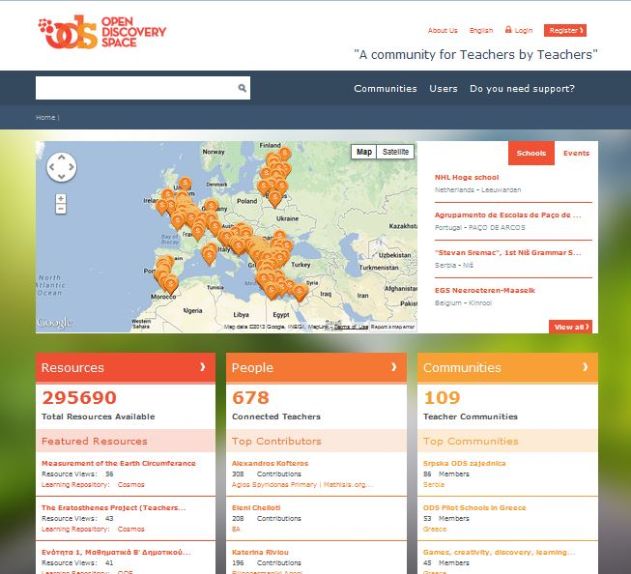
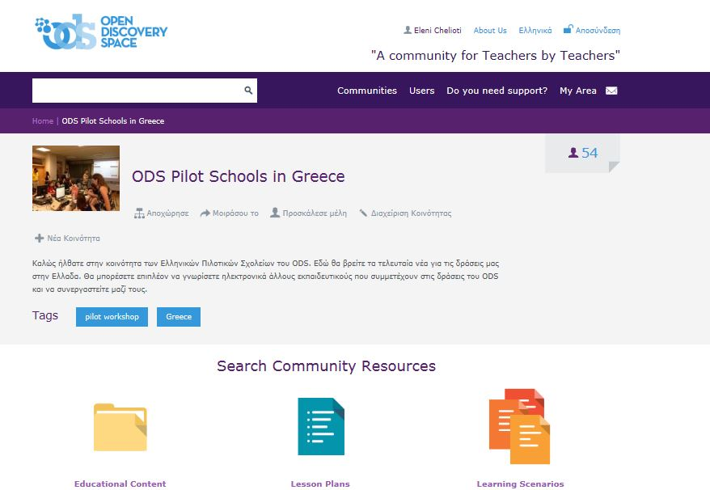
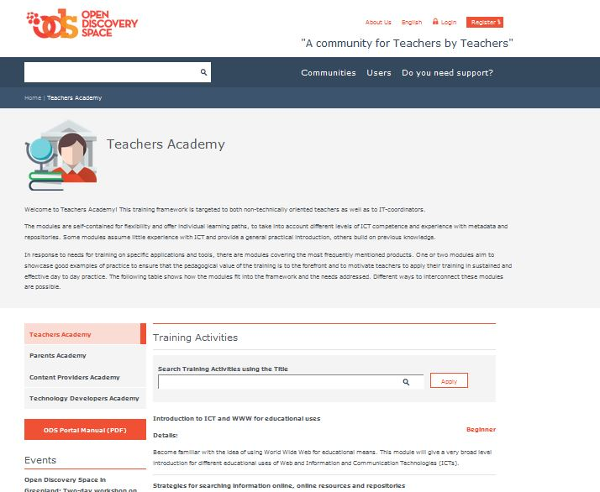
http://portal.opendiscoveryspace.eu/

Slide 3
What can you do through Open Discovery Space?
Create the digital community of your school
Become a member of a vibrant European Network of 2000 schools
Create and share your educational resources (lesson plans, scenarios)
Create and participate in international thematic communities
Participate in Summer and Winter schools for teachers
Participate in international innovative activities
Create the digital library of your school
Participate in online training academies for teachers and parents
Access 1.000.000 educational resources
Use self-assessment and development tools for teachers and schools

Slide 4

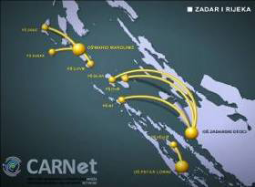
  Cooperation with National Initiatives and Policies

Slide 5
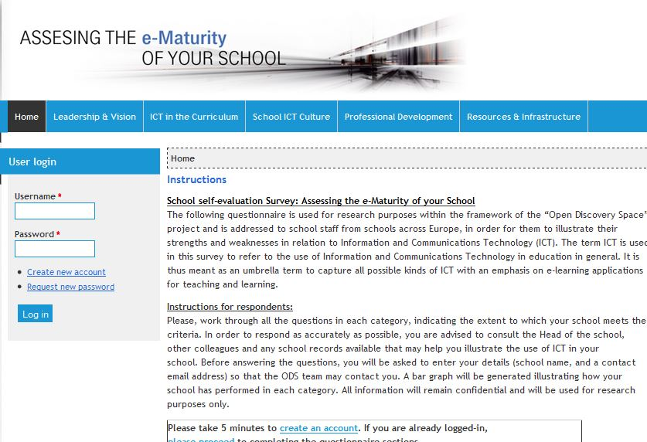
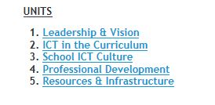
How to become and ODS school- Step 1
Based on the tool introduced by Digital Schools, Ireland
Available in 17 languages
Language | URL
English | http://e-mature.ea.gr/
Greek | http://greece.e-mature.ea.gr/
Dutch | http://dutch.e-mature.ea.gr/
Finnish | http://finland.e-mature.ea.gr/
French | http://france.e-mature.ea.gr/
German | http://german.e-mature.ea.gr/
Italian | http://italy.e-mature.ea.gr/
Portuguese | http://portugal.e-mature.ea.gr/
Estonian | http://estonia.e-mature.ea.gr/
Lithuanian | http://lithuania.e-mature.ea.gr/
Gaelic | http://ireland.e-mature.ea.gr/
Spanish | http://spain.e-mature.ea.gr/
Croatian | http://croatia.e-mature.ea.gr/
Bulgarian | http://bulgaria.e-mature.ea.gr/
Greenlandic | http://greenlandic.e-mature.ea.gr/
Romanian | http://romania.e-mature.ea.gr/
Serbian | http://serbia.e-mature.ea.gr/

Slide 6
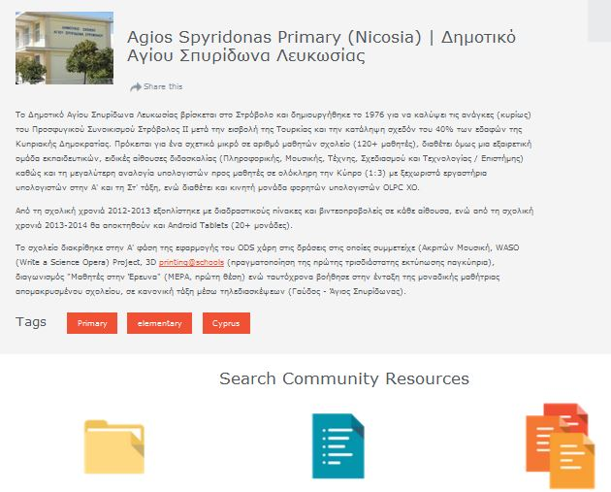
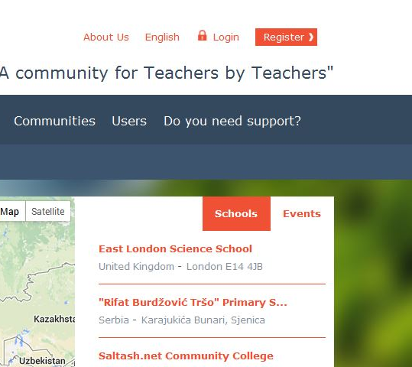
How to become and ODS school- Step 2
Register on ODS portal http://portal.opendiscoveryspace.eu/
…and set-up the community of your school!

Slide 7

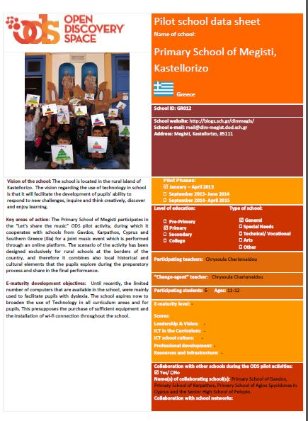
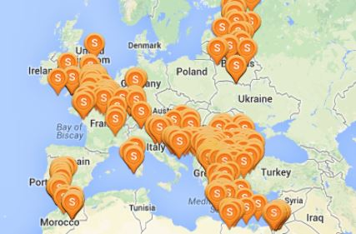
How to become and ODS school- Step 3
Set goals and objectives for the development of your school
Connect with schools from Europe!

Slide 8
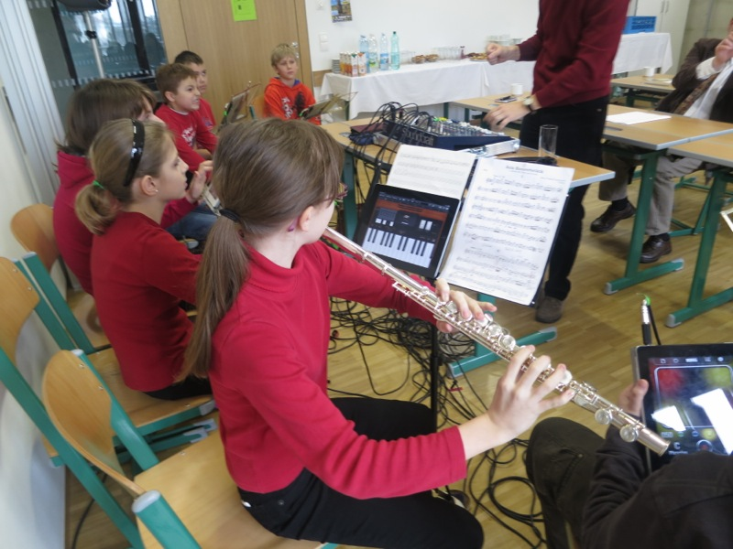
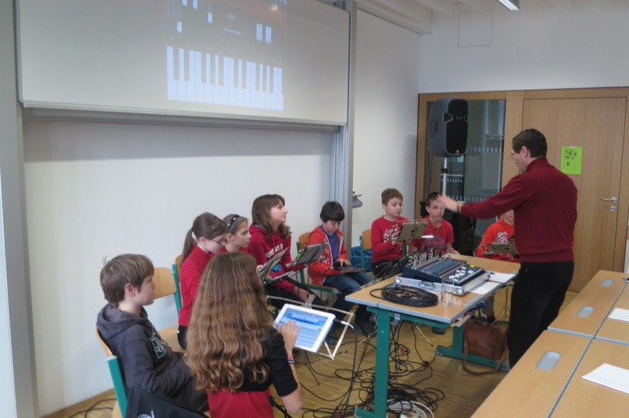
Examples of school activities
Using iPads for Music Education- creating “An iPad Band”, Austria, BG/BRG Schwechat.

Slide 9
Examples of school activities
Connecting schools with Science Centers, using augmented reality equipment and OSR portal pathways- Finland (multiple schools). Video link: http://vimeo.com/61730727

Slide 10
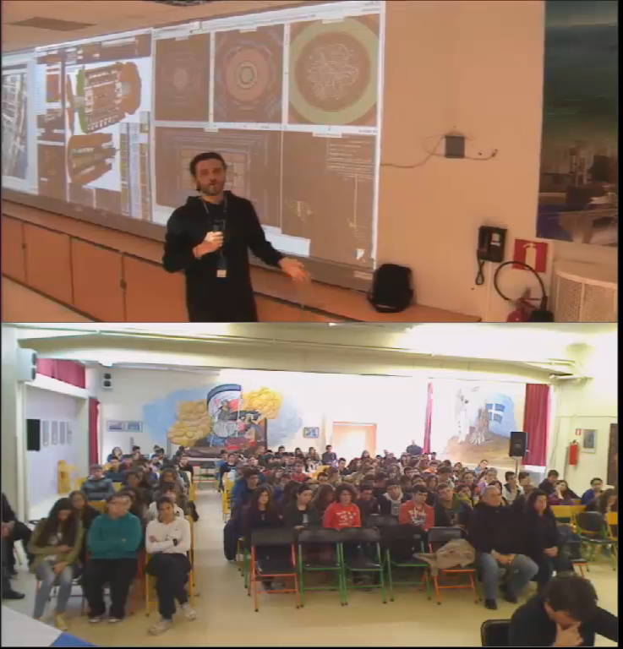
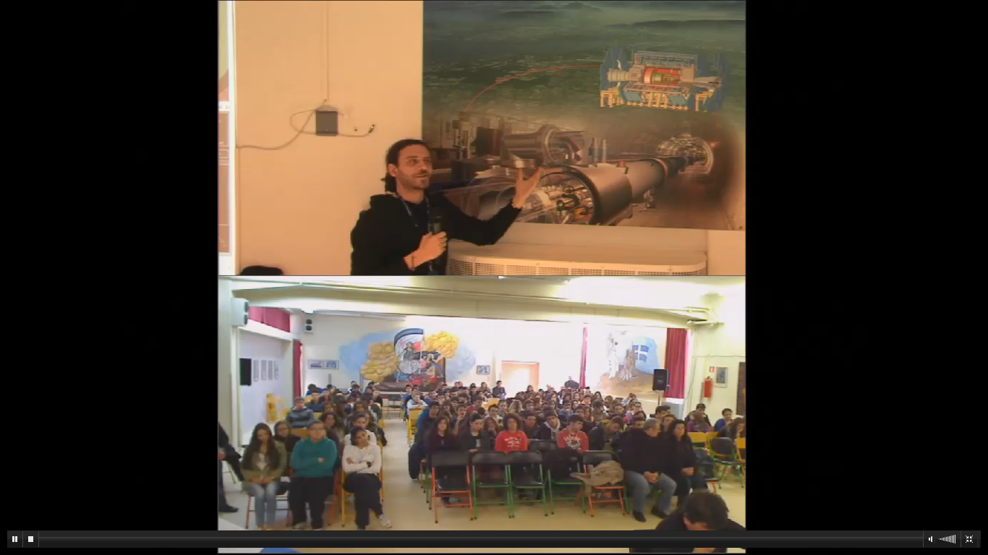
Examples of school activities
Virtual connection with CERN- Greece, 3rd Senior High-School of Komotini

Slide 11
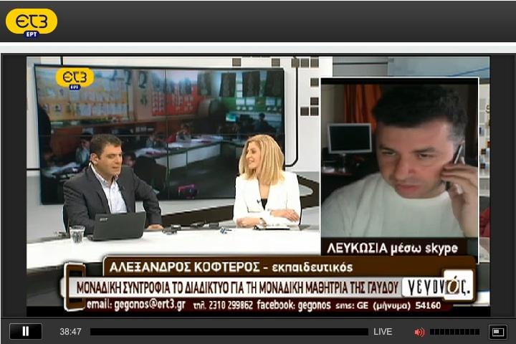
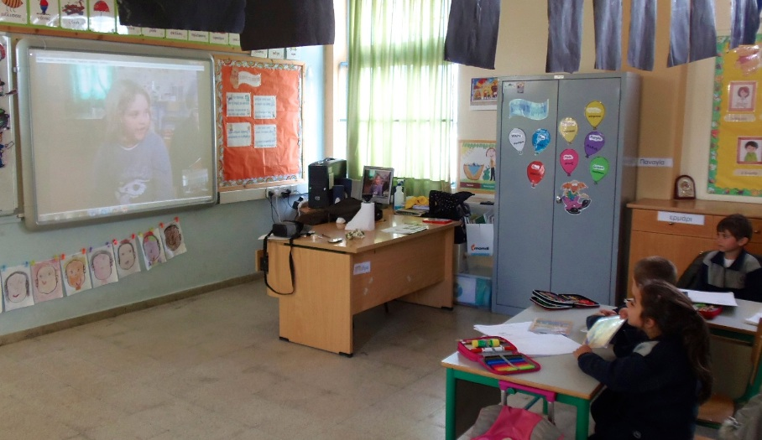
Examples of school activities
Virtual connection between a single pupil school in the island of Gavdos (the southernmost island) with Aghios Spyridonas school in Cyprus, Nicosia- Science and Environmental Education - more coming...

Slide 12
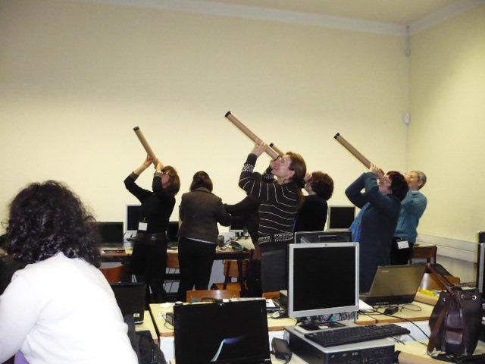
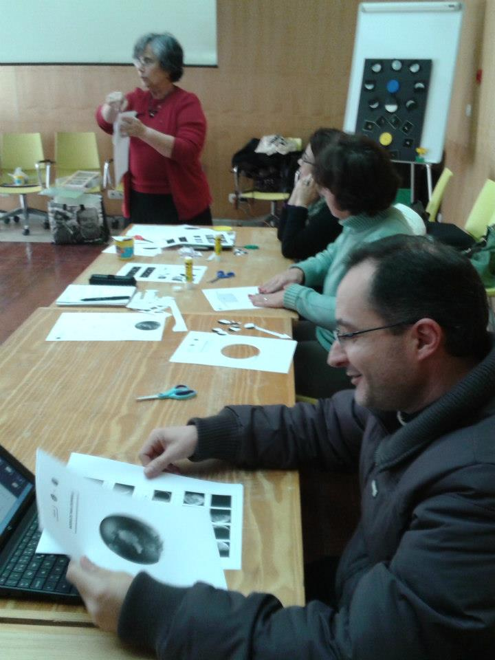
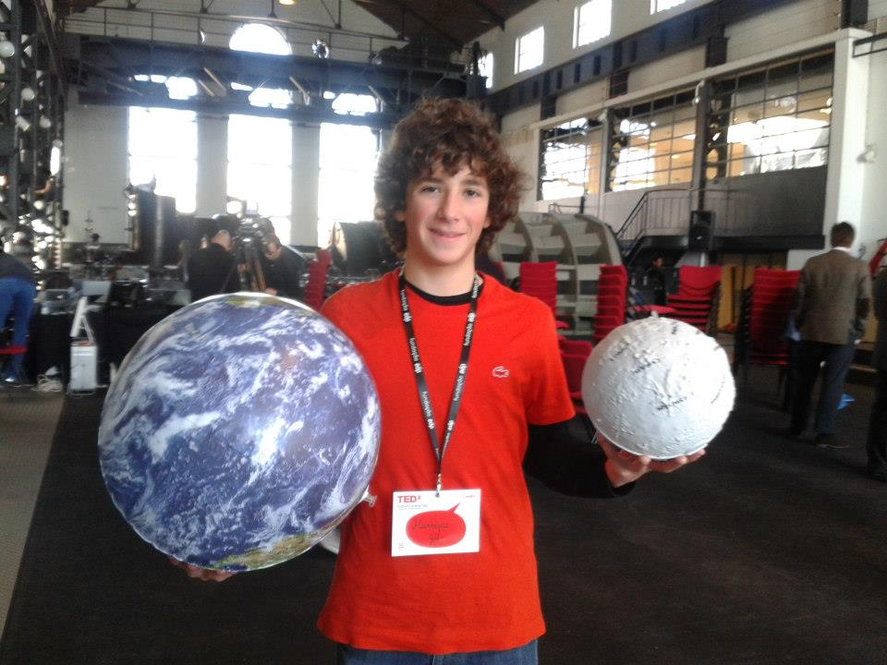
Examples of school activities
Teachers’ training on Discover the Cosmos (Portugal, Lisbon and Chaves)
TED-X Kids (Portugal, Cantral Tejo)

Slide 13
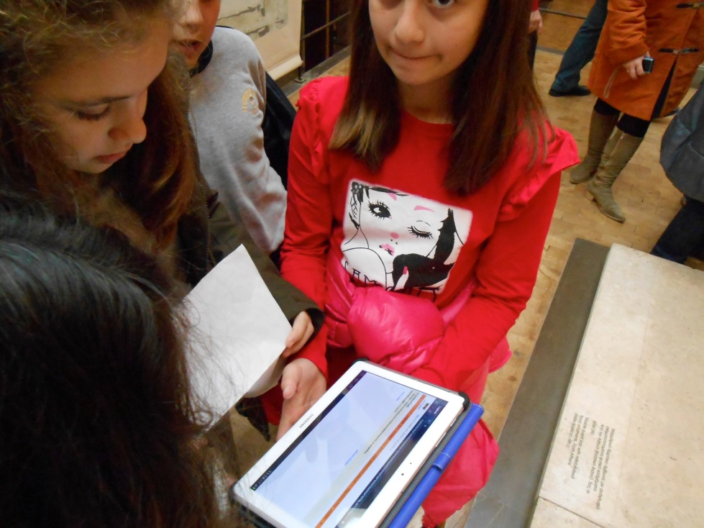
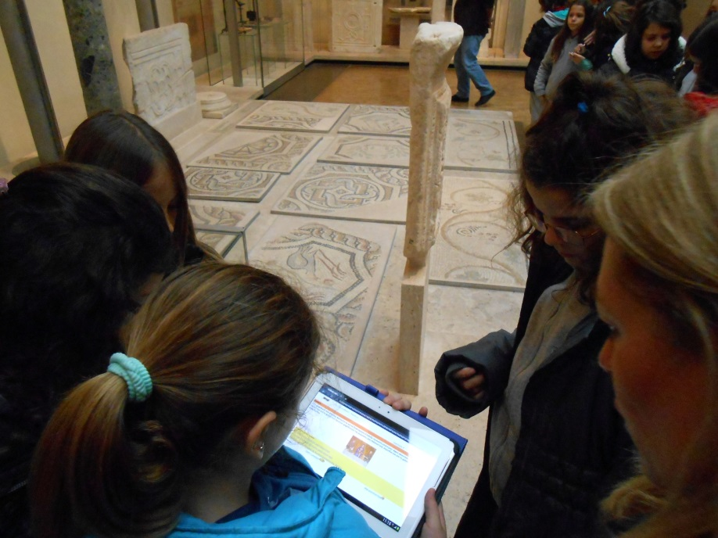
Examples of school activities
Exploring the Byzantine Museum in a playful way, using tablets and material from the Collage portal (Athens)

Slide 14
Examples of school activities
Collaborative activitites
Let’s share the music!

Slide 15
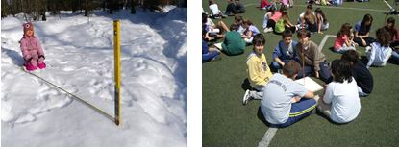
Examples of school activities
Collaborative activities
Observation Weeks for the ODS Schools
Eratosthenes' measurement of the Earth's Circumference

Slide 16
Contact us:
Eleni Chelioti chelioti@ea.gr
Stephanos Cherouvis stecherouvis@ea.gr

