Slide 1
Mobile Learning in Science Education
Dr Eric Demoncheaux
Open Discovery Space Workshop
July 2015

Slide 2
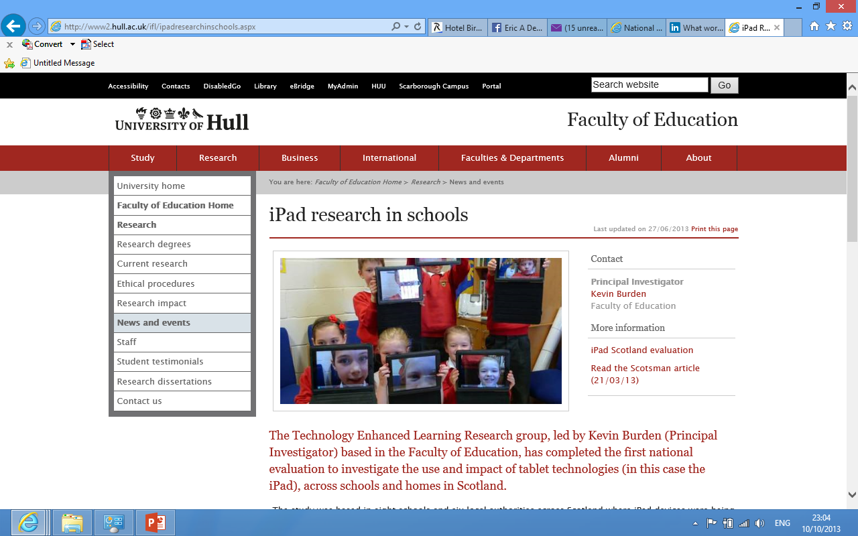
Ipads and mobile learning in the classroom
http://www2.hull.ac.uk/ifl/ipadresearchinschools.aspx

Slide 3
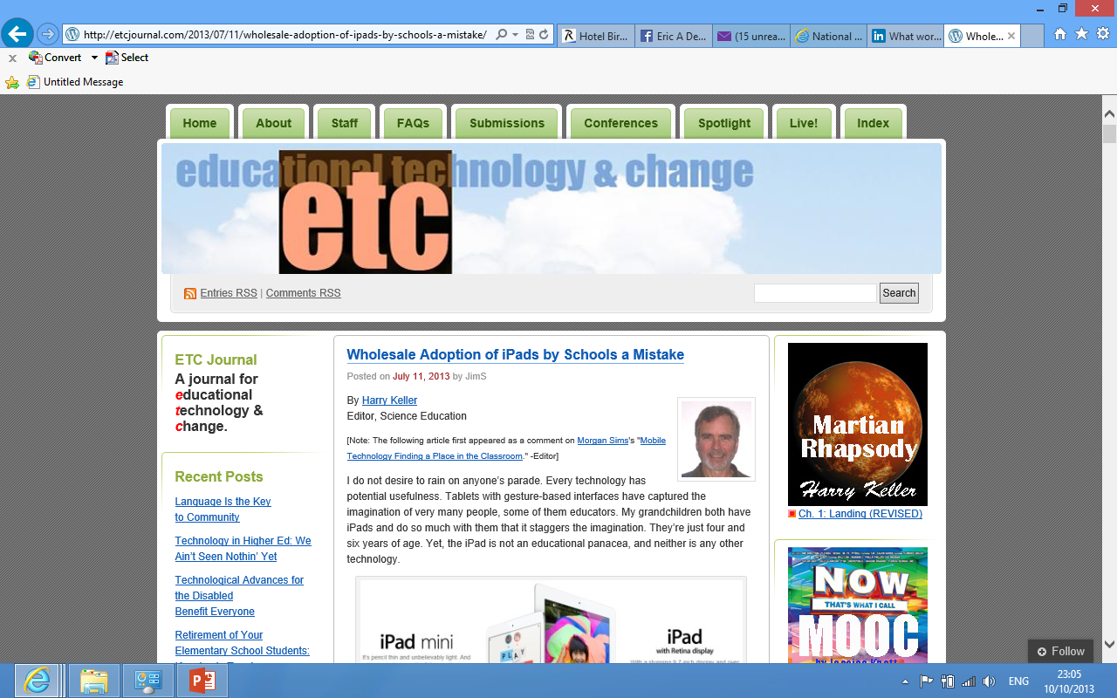
iPADS in the classroom
For another perspective, see

Slide 4
Online resources
Lots of online resources for Chemistry - related teaching here: http://www.rsc.org/learn-chemistry The Royal Society of Chemistry has also recently released a free app for ipads, iphones and android phones called Elements of Nutrition which can be downloaded. It is a game related to Healthy Eating.

Slide 5
Mobile learning
Amplify, Spongelab, Edmodo and Educade.
If you use Edmodo, there's a way to lock their ipads and sync them with yours so they can't get out of the app and misuse the ipad during the lesson. And you can keep them locked in as long as you like.
Nearpod allows you to make interactive presentations.

Slide 6
Edshelf “tools”
https://edshelf.com/search This link takes you to the edshelf “tools” and on that page you can filter by “subject” to fine vetted apps based on
your subject area.
age of learners
platform of your device.
Also check out http://www.onlineuniversities.com/blog/2012/05/50-best-ipad-apps-for-stem-education/

Slide 7
‘Exploriments'
The 'exploriments' range of apps are very useful for high school classes (http://www.exploriments.com/index.htm)
I have used the circuit ones quite effectively and they can manipulate the circuits over and over to practice the concepts.
Notability is an app you can use for worksheets and submitting work for electronic assessment.

Slide 8
More apps …
Biology - Protozoan - Might microbes - colour test - motion pics - google earth -science 360 Chemistry - Lab assisstant -Mahjong chem - chemical -chemical by design - circular motion -Mol.Wt.Finder -formulas lite -Molarity - molecules - chemistry -Atoms in motion - Elements -Atoms HD -sMole Builder - Lewis Dots -Nova elements -Salts - The elements Astronomy - GoSkyWatchP -NASA -NASA Viz -Nasa science - Starwalk - Hubble site - Solar walk - earth viewer - Saturn Anatomy - 3D brain - Essential Skeleton - 3D cardiovascular system -3D Digestive system Physics -E fields -Fourier Touch -Angry birds -Projectile -string

Slide 9
Apps for revision
CGP has some good apps for revision. One version is free and the full app is not.
iCell is great for discovery of cell structures. Your best bet is to search specific topics.
Virtual dissections are fun as each student can get involved.
Students can also make up their own word searches on puzzle-maker. For higher ability, I would suggest they create their own crossword puzzles.

Slide 10
Apps
I have found this resource to be most helpful with implementing student collaborative tasks http://www.edudemic.com/2013/01/6-ways-students-can-collaborate-with-ipads/
Socrative is a VERY handy tool for data tracking and diagnostic testing
Notes:
Socrative is a VERY handy tool for data tracking and diagnostic testing giving you the ability to track individual levels of student understanding by having poll their answers for on the on the spot.

Slide 11
iPADS and its camera functions
My students love the camera function. Use it. It draws on their on their creativity.
Use StoMo, a free stop motion, to help with recording certain events that are important to assessment or to hit home concepts that often stump them.
An example of this is getting them to use play dough and capture the transitions within meiosis and then again for mitosis. I find that REALLY helps!

Slide 12
My favourites (at the moment)
Biology - POMT, Gene Screen
Chemistry - Organic 3D, MPSE (Best free Periodic table app I have found)
Teaching - Explain Everything, Lino (Good for student response to question.)

Slide 13
Avoiding the technology is impossible
iPads or tablets in the classroom allow us to move away from the 'sage on the stage' and can enhance the learning for everyone.
A colleague used an iPad with a student with a writing disability very successfully last year.
We are always looking for apps that can be used across several courses, such as Notability and Explain Everything.
Yet, so many apps are 'nice to haves', but not 'must haves'.
Notes:
Avoiding the technology is not only impossible today but would also be moving back in time to a place where the focus was more on teaching and less on learning.
One last point, although each app only costs somewhere between 99c and 2.99 on average, they add up quickly and as my parents have to pay for them I am very careful about which apps I expect them to have. I can only ask them to buy an app that will be used often throughout the year, not in a single class or topic.

Slide 14

Case Study: Education First
In 2012 Education First introduced nationwide a new learning facilitator – iPads and an interactive learning app for language schools catering for 14-18 year olds.
Instead of doing a presentation as a final project, students made a film using iPads.
EF designed an App that mimicked the topics of the EF textbook for the 5 levels of language capabilities.

Slide 15
Advantages in the Classroom
The dynamic variations of levels of capabilities meant those students who were slightly more advanced could move on at their own pace.
Students enjoyed making and viewing films and it was a great way to get different nationalities to mix.
Competition: all films made by students were uploaded onto an EF ActionLearning forum and the students who made the best films all won iPads.
These films were used as a promotion of the brand and a visual to potential customers as an experience.

Slide 16
Disadvantages in the Classroom
As this was a new scheme there were widespread issues that occurred in each destination:
Some teachers were unfamiliar with the new technology and found it difficult to instruct and deliver sessions and pupils became disruptive with lack of direction.
In some schools the technology and internet services were not compatible with the iPads and students were disappointed.
Students who did not follow instruction through a lack of understanding lost work.

Slide 17
Support the learning of others
Taking away i-Pads or tablets, or giving them to students to use, does not make good learners.
Good learners are developed by:
an atmosphere that values learning
a curriculum that provides challenges that can be satisfied by hard work and commitment.
Notes:
"I am struggling to understand what's currently missing to make student's role in the system more active. "
This comment made me want to chime in.
Taking away digital resources, or giving them to students to use, does not make good learners.
Good learners are developed by an atmosphere that value learning and a curriculum that provide challenges that can be satisfied by hard work and commitment.

Slide 18
Don't be afraid to learn from your students! Thank you for listening.

