Slide 1
Outline
This Presentation contains slides appropriate for all the sections of the activity.
White slides are included (but hidden from the Slideshow) as bookmarks.
You will need to show or hide slides according to which sections you are using.
Note that some slides include animations – it is recommended that you view the Slideshow itself before presenting it.

Slide 2
Multi-wavelength Astronomy

Slide 3
Introduction Slides

Slide 4
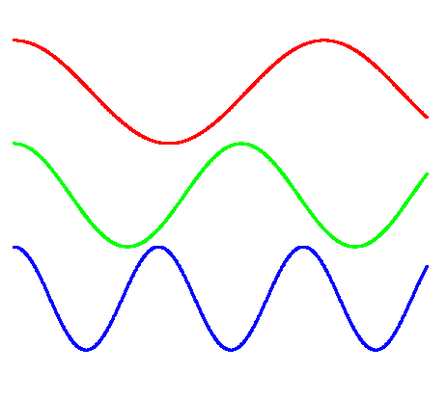
Electromagnetic radiation
We describe EM radiation by:
Frequency
Wavelength
Light travels at:
300,000,000 m/s
Wavelength

Slide 5
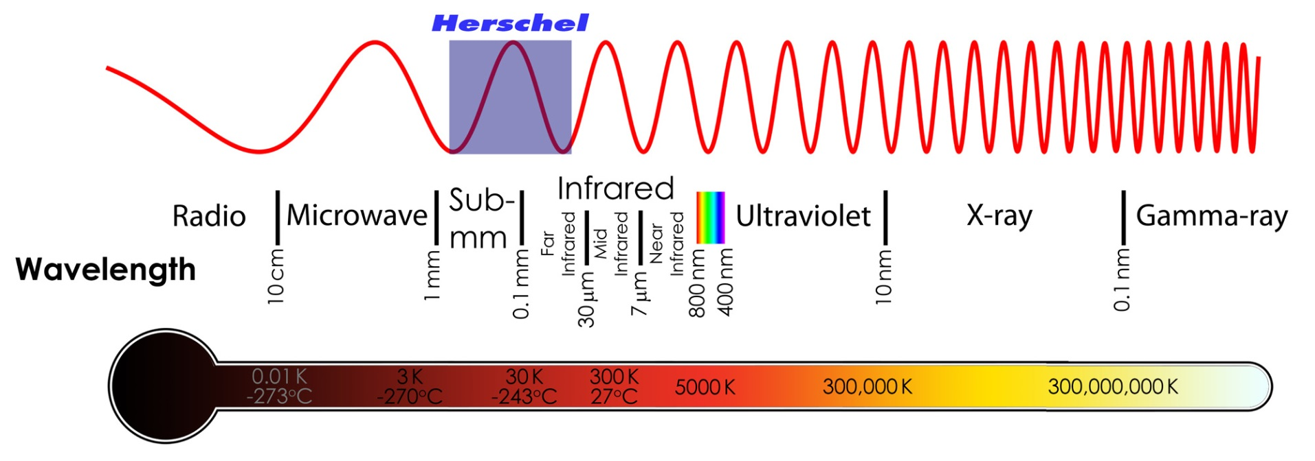
The Electromagnetic Spectrum
The EM spectrum is (arbitrarily) split up:

Slide 6
Black Body Radiation
(A-level Only)

Slide 7
“Black Body” radiation
A black body is a perfect emitter and absorber of radiation
It emits and absorbs radiation with a particular “spectrum”
The shape of the spectrum is always the same, but the peak wavelength changes with temperature.
But not all objects are black bodies.
Atoms, molecules and electrons emit radiation with a different spectrum – this is called “non-thermal radiation”

Slide 8
Black Body Temperature
The wavelength with most emission is related to the black body temperature
Max. wavelength (m) x Temperature (K) = Wien’s Displacement Constant
λ_{max} x T = 0.0029 K.m
T = 0.0029 / λ_{max}
Notes:
This is also called Wein’s Displacement Law

Slide 9
Herschel (+ Planck) Intro
Launch video requires the video file “HP_launch.wmv” (may need to be re-linked)

Slide 10
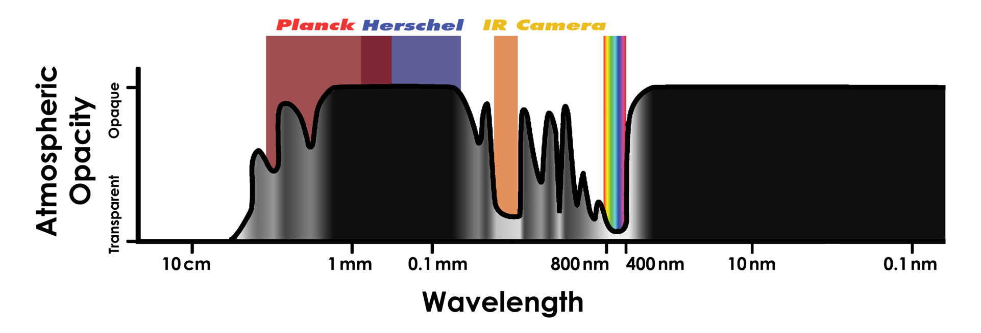
The Atmosphere
The Earth’s atmosphere blocks radiation at some wavelengths
This is why many telescope are in space
Notes:
Radio telescope can observe during the day, because the radio waves are not absorbed by the Earth’s atmosphere.
The atmosphere isn’t completely transparent at visible wavelengths, which is why the biggest telescopes are high up mountains

Slide 11
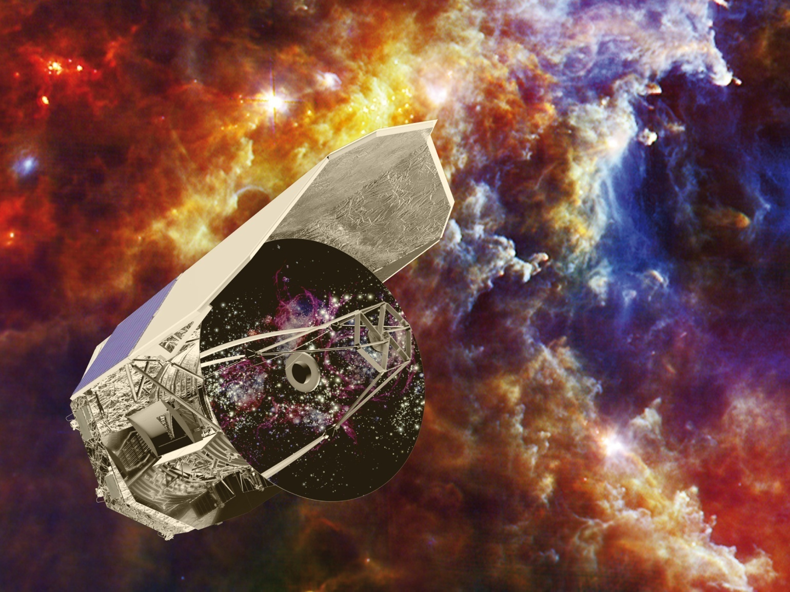
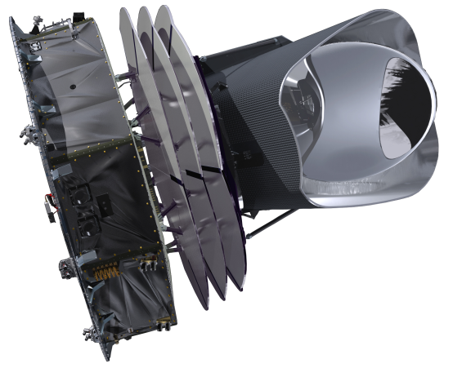
Herschel and Planck

Slide 12
Herschel
Notes:
Herschel is a European Space Agency mission to observe in far-infrared and sub-millimetre light

Slide 13
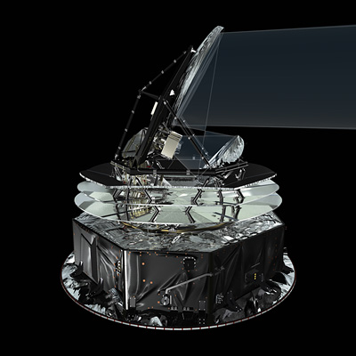
Planck
4x4x4m
2 tonnes on launch
2m mirror
Cooled to 0.1K
2 instruments
300-10000 microns

Slide 14
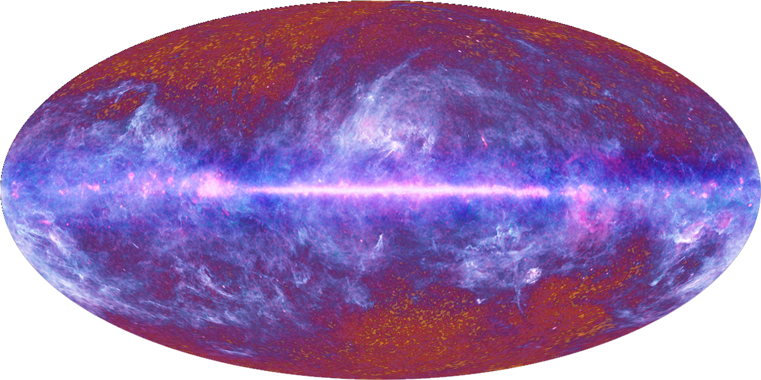
Planck’s view of the sky

Slide 15
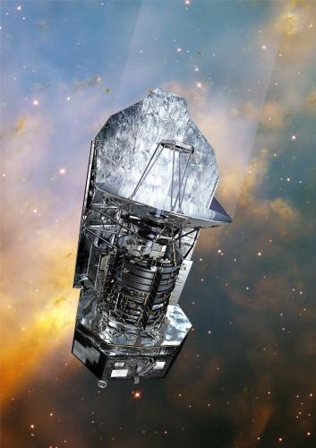
Herschel
8x4x4m
4 tonnes on launch
3.5m mirror
2500 litres of He
Cooled to 0.3K
3 instruments
70-700 microns

Slide 16
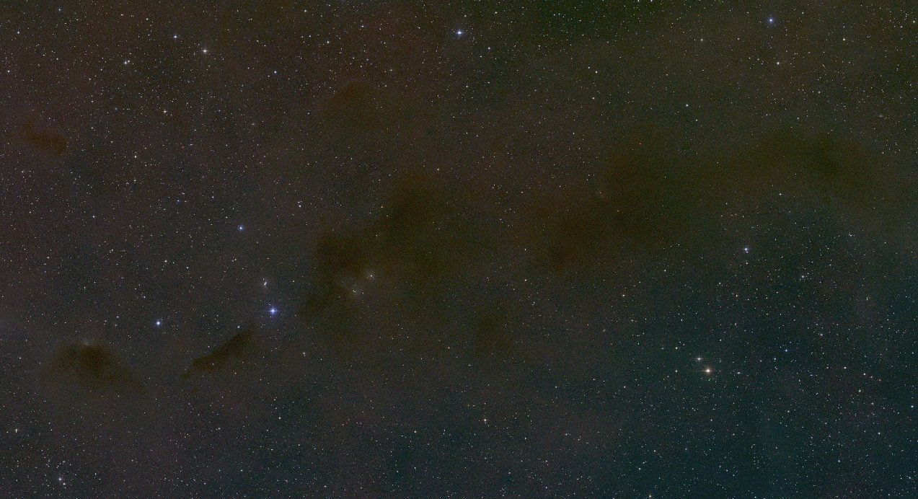
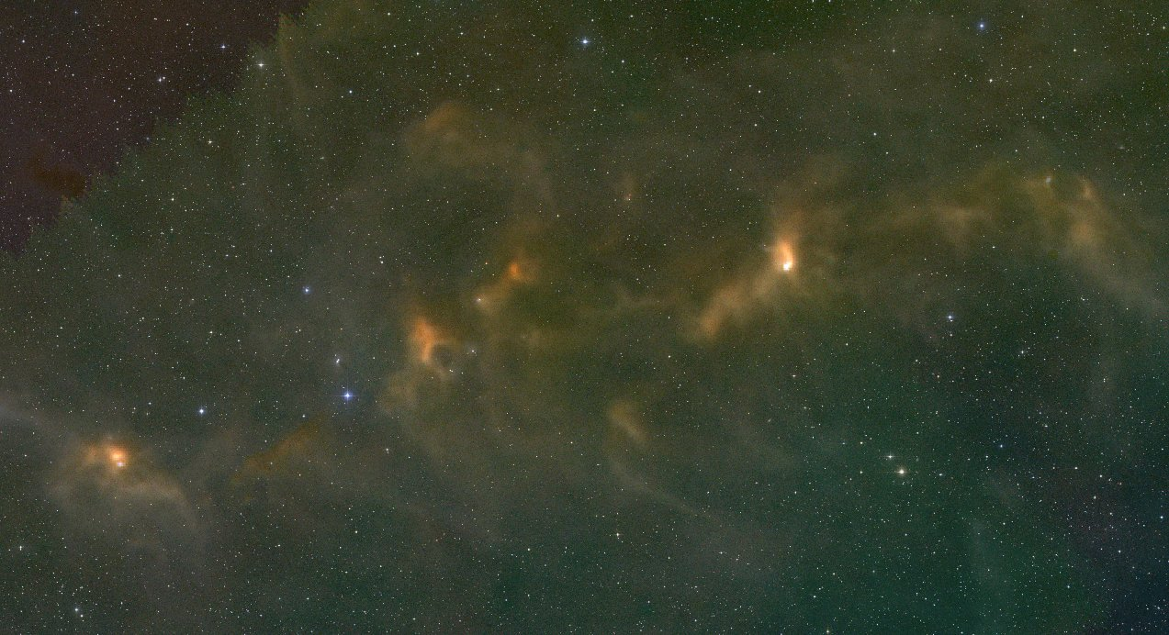
Herschel’s view of the sky
Notes:
Clouds of gas & dust in constellation of Taurus
First shows visible light, then click to add in far-infrared light from Herschel
Dark regions in visible light are blocked by cold dust
These regions glow in far-infrared light as the dust shines at these wavelengths

Slide 17
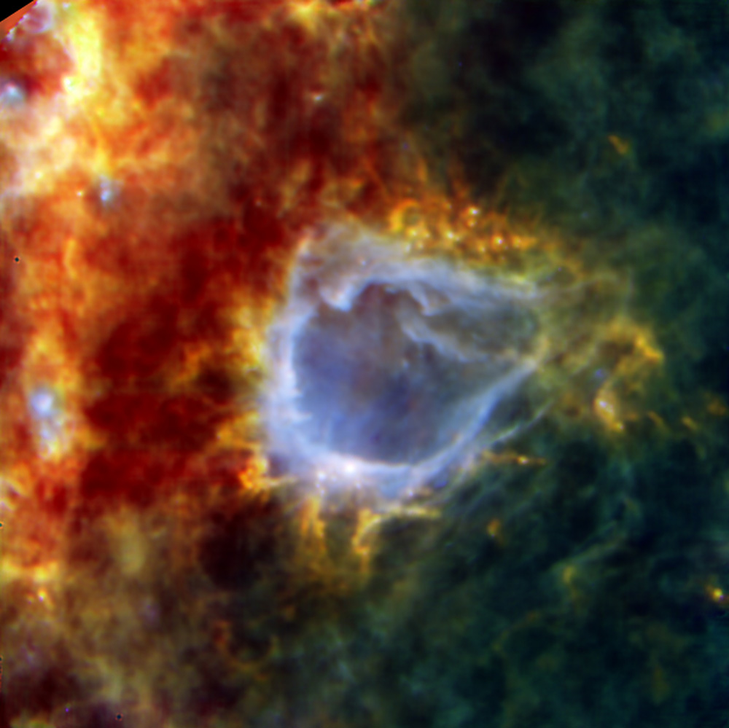
Star formation
Notes:
Newly-formed stars blow bubbles of hot material in their surroundings.
In this Herschel image, the bluer material is warmer, while the orange and red are colder.
The blue bubble is heated and blown outwards by a star in the centre (unseen by Herschel).
As the bubble hits the surrounding material it compresses it, triggering more star formation, such as the bright white dot at the bottom of the bubble

Slide 18
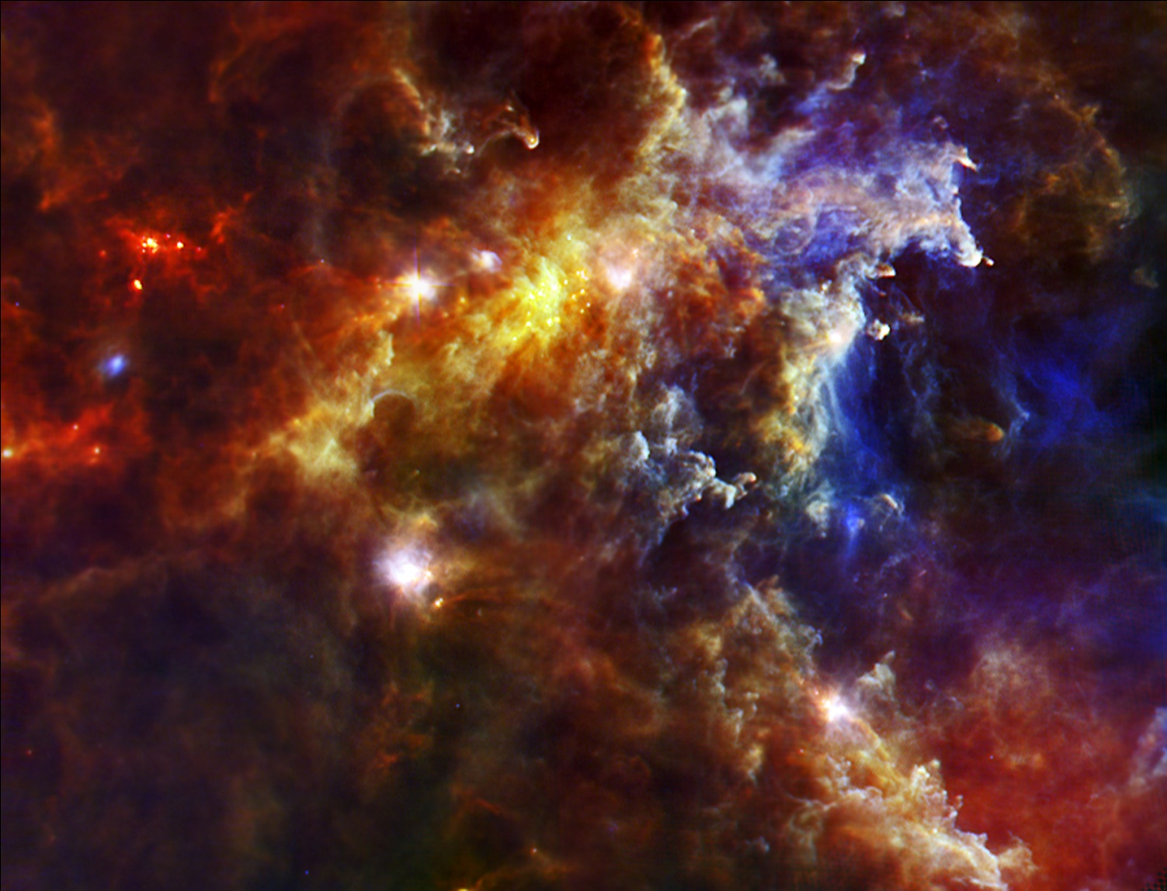
The Rosette Nebula
Notes:
This part of the Rosette Nebula shows clouds of dust heated by stars off to the right (unseen by Herschel)
The bluer material glows at shorter wavelengths, so is warmer.
The bright blue and white clumps are heated by newly-formed stars.
The red and orange clumps are clouds of gas and dust in the process of collapsing under gravity, which will eventually form stars

Slide 19
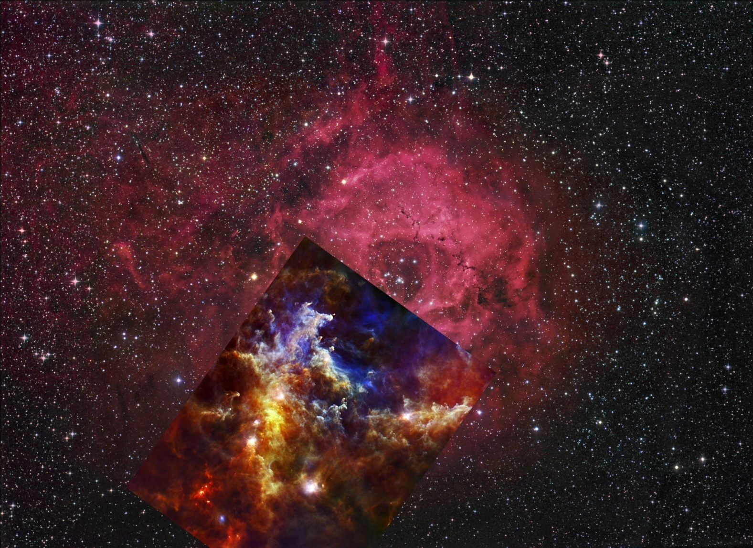
The Rosette Nebula
© Robert Gendler
Notes:
Herschel’s view of the Rosette Nebula in context with the whole thing seen in visible light. The cluster of young stars which are heating the dust are in the centre of the round cloud

Slide 20
Spectral Regimes
Fill in the wavelength summary table
(Note that slides have animations)

Slide 21
The Spectral regimes
Fill in the Wavelength Summary Table
You will need this later.

Slide 22
Visible
λ=400-800 nm
f=375-750 THz T=3,500-7,000 K
Day-to-day:
The Sun (6000 K)
Glowing coal (1000 K)
Astronomy
Stars
Nebulae (reflected, emission, absorption)

Slide 23
Ultraviolet
λ=10-400 nm
f=0.75-30 PHz T=7,000-300,000 K
Day-to-day:
UV lights
The Sun (thermal radiation)
Astronomy:
Hot, young stars

Slide 24
X-ray
λ=0.02-10 nm
f=30-1500 PHz T=300,000-15,000,000 K
Day-to-day:
X-ray machines
Astronomy:
Supernovae
X-ray binary stars
Very hot gas

Slide 25
Gamma-ray
λ<20 pm
f>1500 PHz T>15,000,000 K
Day-to-day
Nuclear Power stations
Nuclear explosions
Astronomy:
Gamma-ray bursts
Extremely hot gas

Slide 26
Near-Infrared
λ=0.8-3 μm
f=100-375 THz T=1,000-3,500 K
Day-to-day:
Hot things
Night-vision goggles
Astronomy:
Cooler stars
Dust is transparent!

Slide 27
Mid-infrared (MIR) (λ=3-30 μm ; f=10-100 THz ; T=100-1000 K)
Day-to-day:
Us!
Thermal cameras
Astronomy:
Warm dust
Proto-planetary disks (warm dust!)

Slide 28
Far-Infrared (FIR) (λ=30-300 microns ; f=1-10 THz ; T=10-100 K)
Day-to-day:
Not much really
The atmosphere blocks it all
Astronomy:
Cool dust

Slide 29
Sub-millimetre and millimetre (λ=0.3-3 mm ; f=0.1-1 THz ; T=1-10 K)
Day-to-day:
Airport security systems
Astronomy:
Cold dust
The early Universe!

Slide 30
Microwave (λ=3-30 mm ; f=10-100 GHz ; T=0.1-1 K)
Day-to-day
Microwave ovens
Some communications
Astronomy:
Energetic electrons in magnetic fields
The early Universe

Slide 31
Radio (λ>30 mm ; f<10 GHz ; T<0.1 K)
Day-to-day:
TV, Radio, communications, satellites, …
Wi-fi, RADAR, Bluetooth, …
Astronomy
Electrons
Neutral hydrogen

Slide 32
Telescope sizes
The best possible resolution a telescope can see depends on the size of the mirror and the wavelength of light it is measuring
Wavelength (m)
Resolution (deg) ~ 60 x
Diameter of mirror (m)
λ
θ ~ 60 x
D
1 degree = 60 arcminutes ; 1 arcminute = 60 arcseconds
1 degree = 3600 arcseconds
Notes:
Just doing wavelength / diameter gives the resolution in radians
The factor of 60 in the first two lines of equations is the rough conversion from radians to degrees (actually 57.3)

Slide 33
Examples of telescopes
Hubble Space Telescope
D=2.2 m ; λ=500 nm
θ=2.3x10⁻⁷ degrees = 0.8 milliarcsecond
Lovell Telescope, Jodrell Bank
D=76 m ; λ=1 m
θ=0.75 degrees
Spitzer Space Telescope
D=0.7 m ; λ=100 μm
θ=1.4x10⁻⁴ degrees = 0.5 arcseconds
Herschel
D=3.5 m ; λ=100 μm
θ=2.9x10⁻⁵ degrees = 0.1 arcseconds

Slide 34
Wavelength Matching activity
Distribute question sheet and images
Suggested group size: 2-3

Slide 35
Match up the wavelengths
There are 12 objects provided with images in visible light
You have to match up the other wavelengths for each object
Some are quite straightforward…
Others are not!
There is a prize for the highest score!

Slide 36
Matching Activity: Answers
Swap sheets

Slide 37
Answers
Swap your answer sheet with another group

Slide 38
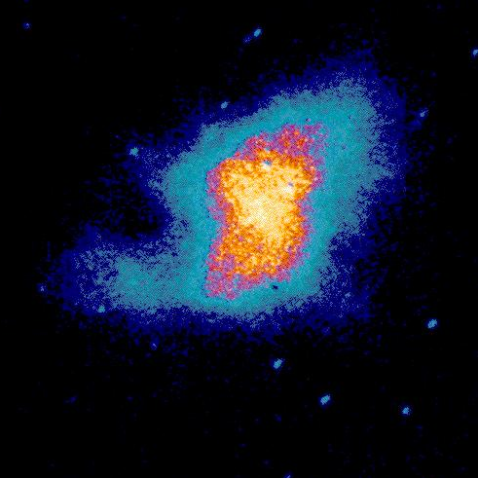
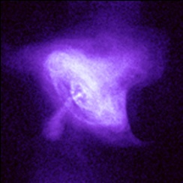
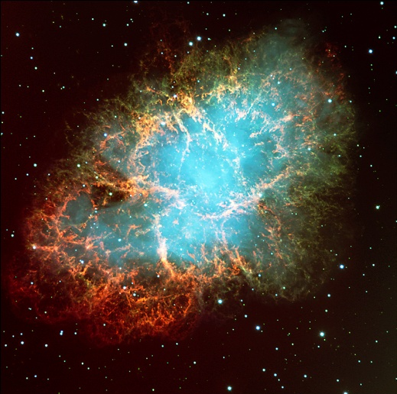
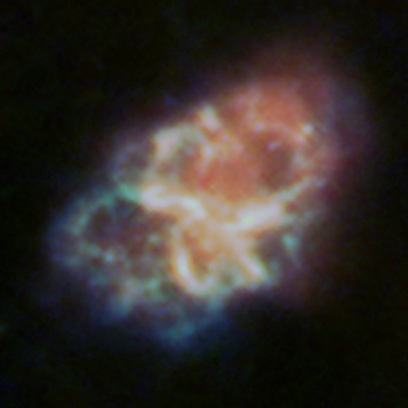
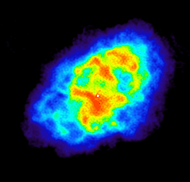
Crab Nebula
U5 (UIT)
X4 (Chandra)
Crab (VLT)
F7 (Herschel)
R9 (NRAO)

Slide 39
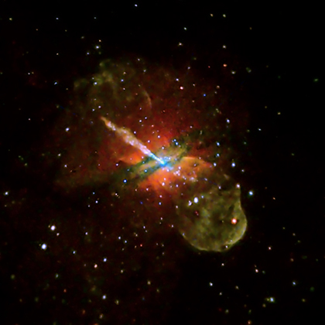
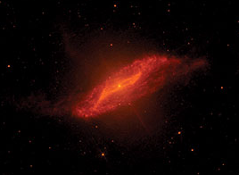
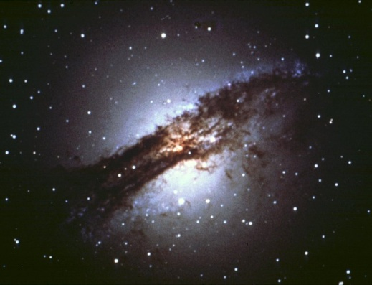
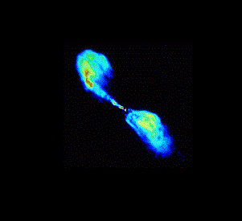
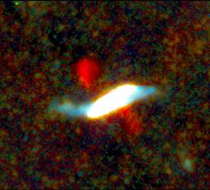
Centaurus A
M7 (Spitzer)
X3 (Chandra)
Centaurus A (NOAO)
F8 (Herschel)
R7 (NRAO)

Slide 40
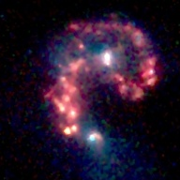
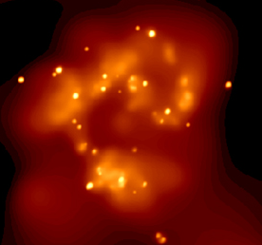
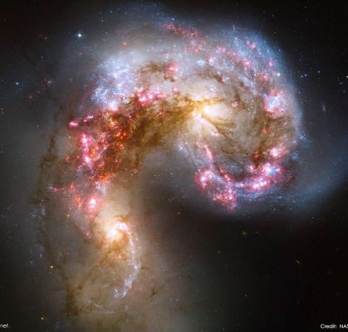
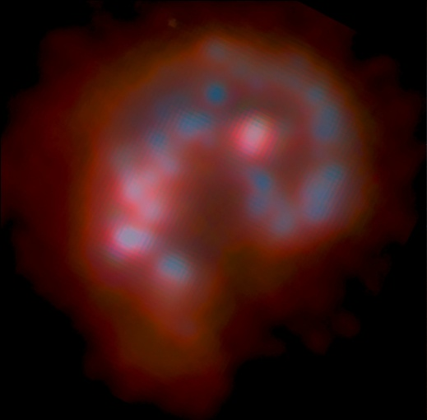
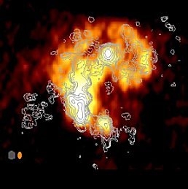
Antennae
M6 (Spitzer)
X5 (Chandra)
Antennae (Hubble)
F1 (Herschel)
R8 (VLA)

Slide 41
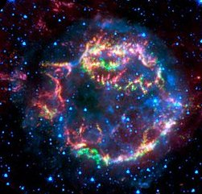
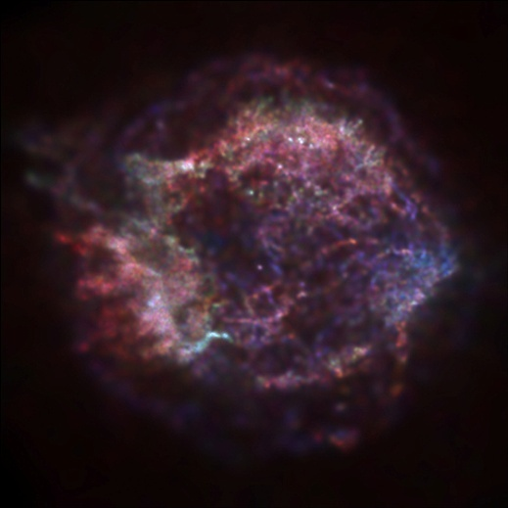
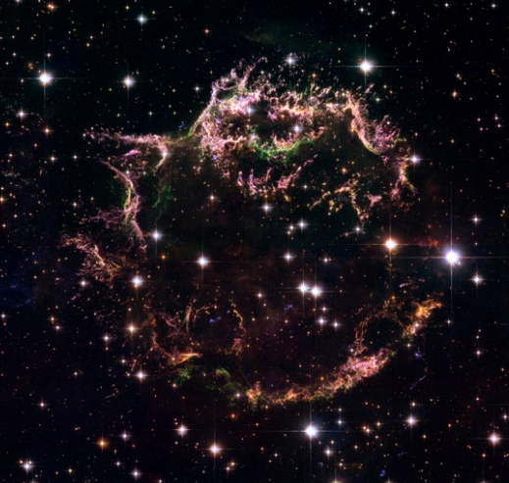
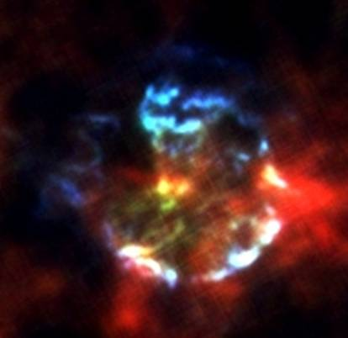
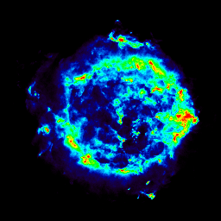
Cassiopeia A
M2 (Spitzer)
X6 (Chandra)
Cassiopeia A (Hubble)
F2 (Herschel)
R11 (NRAO)

Slide 42
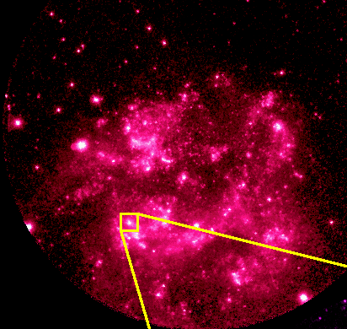
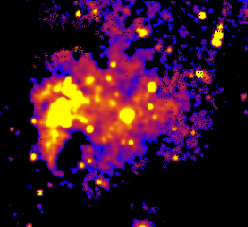
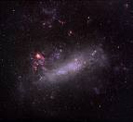
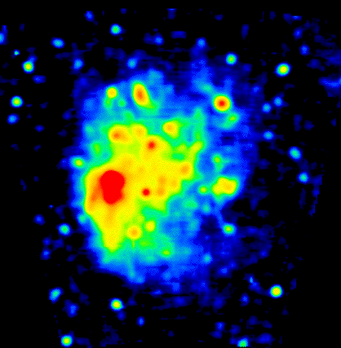
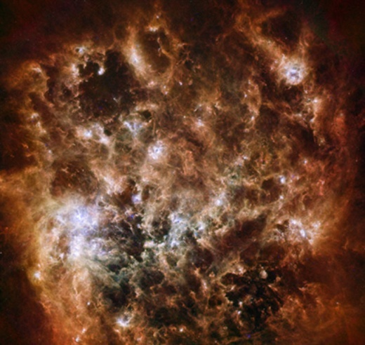
Large Magellanic Cloud
U4 (Rocket)
X1 (ROSAT)
LMC (AAO)
F3 (Herschel)
R10 (RAIUB)

Slide 43
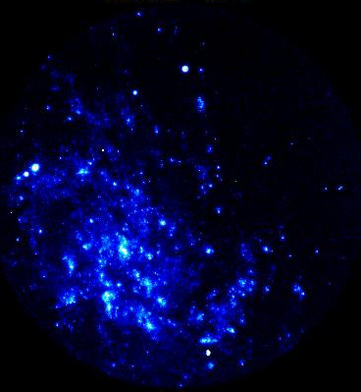
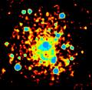
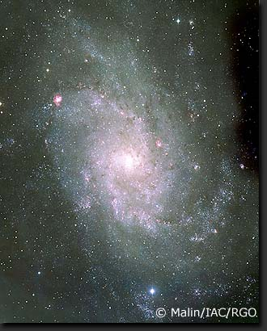
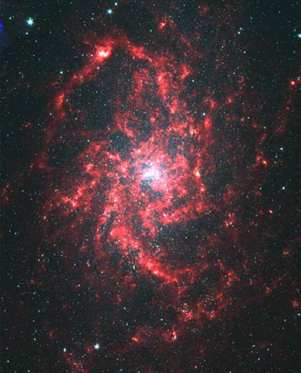
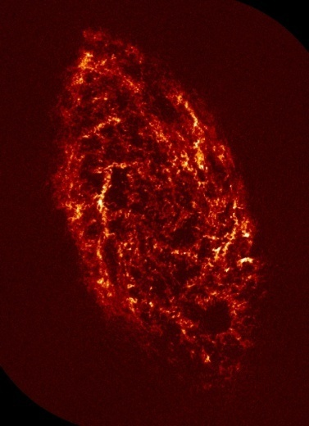
Triangulum
U1 (UIT)
X8 (ROSAT)
Triangulum (INT)
M4 (Spitzer)
R2 (NRAO)

Slide 44
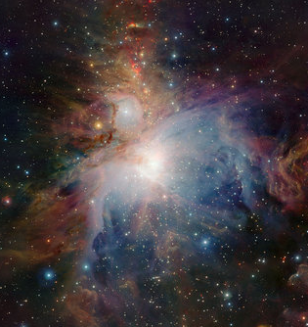
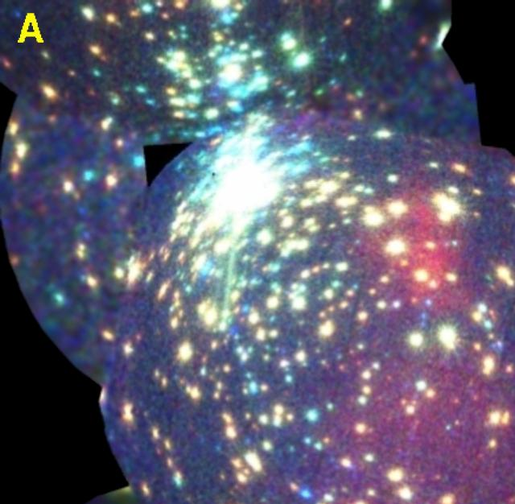
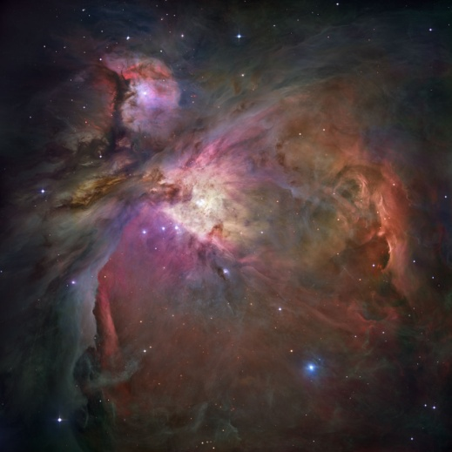
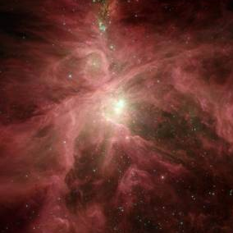
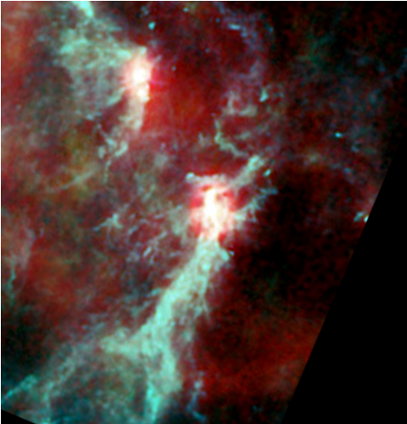
Orion
X2 (XMM)
N1 (VISTA)
Orion (Hubble)
M3 (Spitzer)
F9 (Planck)

Slide 45
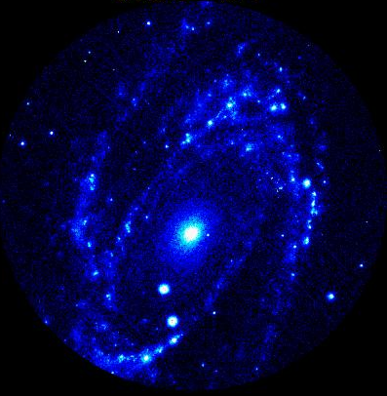
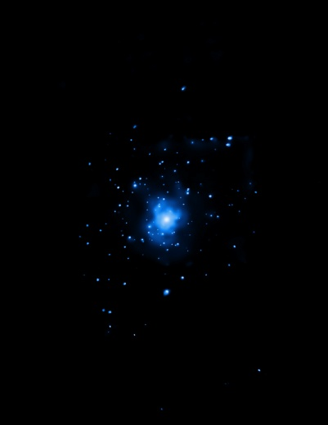



M81
U2 (UIT)
X12 (Chandra)
M81 (Gendler)
F5 (Herschel)
R1 (VLA)

Slide 46





M87
X9 (Chandra)
M5 (IRAS)
M87 (AAT)
F4 (Herschel)
R4 (NRAO)

Slide 47





Sombrero
N2 (2MASS)
X10 (Chandra)
Sombrero (Hubble)
M1 (Spitzer)
R3 (VLA)

Slide 48





M82
M8 (Spitzer)
X11 (Chandra)
M82 (Gendler)
F6 (Herschel)
R5 (VLA/Merlin)

Slide 49





Andromeda
U3 (GALEX)
X7 (XMM-Newton)
Andromeda (Gendler)
F10 (Herschel)
R6 (Effelsberg)

Slide 50
Chromoscope introduction
Requires internet connection or stand-alone version of Chromoscope (see http://blog.chromoscope.net/download

Slide 51
Chromoscope
http://www.chromoscope.net
Allows zooming and panning around the sky
Fade between wavelengths

Slide 52
Further Investigation
Take your assigned objects and investigate them further
Fill in the question sheet

Slide 53
Poster Design
Using what you have learned, design a poster.
A poster template is available.

Slide 54
Summary Slide

Slide 55
What have we learned?
To understand the Universe fully, we need to observe at multiple wavelengths
The temperature of an object can affect the wavelength it emits most radiation at.
Some wavelengths are blocked by the Earth’s atmosphere and must be observed from space

