Slide 1
MultiDimensional Scaling (MDS)
Dr. Eleni Tomai, NTUA

Slide 2
MDS technique
Multidimensional scaling (MDS) is a means of visualizing the level of similarity of individual cases of a dataset. It refers to a set of related ordination techniques used in information visualization, in particular to display the information contained in a similarity matrix.
An MDS algorithm aims to place each object in N-dimensional space such that the between-object distances are preserved as well as possible. Each object is then assigned coordinates in each of the N dimensions. The number of dimensions of an MDS plot N can exceed 2 and is specified a priori.

Slide 3
Similarity matrix
Symmetrical matrix (Δ) of which each element δ(i, j), corresponds to the result of comparing object i to j.
Example taken from an experiment conducted by NTUA for assessing similarity of geospatial features based on semantic analysis of their definitions.
Mountain
Hill
River
Valley
Mountain
1
0.9
0.01
0.2
Hill
0.9
1
0.02
0.3
River
0.01
0.02
1
0.03
Valley
0.2
0.3
0.03
1

Slide 4
Assessing similarity
Two types of similarity measures:
distance
Euclidean distance in n-space
S_{ij}=
Where X_{in} και x_{jn} = “coordinates” of objects in n dimensions
matching
2.1 Α, Β alphanumeric; A=“name”, B=“names”
Comparison result Α to Β = [11110]
S_{AB}= (number of successful matches/ number of comparisons) = 4/5 = 0.8
2.2 A, B classes; Α(α,β,γ,δ), Β(β,α,ε,ζ,η,θ)
Comparison results Α to Β = [11000000]
S_{AB}= (number of successful matches/ number of attributes) = 2/8 = 0.25

Slide 5
Dimensionality reduction
In other words, MDS attempts to find a way to project the set of objects (input dataset) into R^{N} such that distances are preserved. If the number of dimensions N is chosen to be 2 or 3, the dataset is plotted to obtain a visualization of the similarities between the objects of the dataset by reducing dimensionality, in 2- or 3-dimensional space, which can be easily grasped by human cognition.

Slide 6
Stress Function
The similarity matrix sets simultaneously distances of objects in the projection space.
Similarity then is inversely proportional to the distance
Stress Factor shows how close the distances of objects on the projection space are to the similarity specified in the similarity matrix.
Stress Factor is given by this function f (S (xS_{ij} - xT_{ij}), S (yS_{ij} - yT_{ij}))

Slide 7
Running the MDS algorithm (1)
Formulate the problem;
What variables do you want to compare?
How many variables do you want to compare?
What purpose is the study to be used for?
Obtain input data;
Run the MDS statistical program; Software for running the procedure is available in many software for statistics.

Slide 8
Running the MDS algorithm (2)
Decide number of dimensions; The more dimensions, the better the statistical fit, but the more difficult it is to interpret the results.
Map the results and define the dimensions; The map will plot each element of the dataset (usually in two-dimensional space). The proximity of which to each other indicates how similar they are.

Slide 9
Running the MDS algorithm (3)
Test the results for reliability and validity
Report the results comprehensively; Along with the mapping, at least distance measure and reliability (e.g., stress value) should be given. Also, provide
the algorithm , which is often defined by the program used (sometimes replacing the algorithm report),
the number of runs,
the assessment of dimensionality,
the number of iterations,
the assessment of stability.

Slide 10
MDS algorithm in a nutshell
Ascribes random positions of objects in the dataset.
Calculates all distances between points and stores them in a temporary table, T (nxn).
Compares the values in the table T with those of the similarity matrix S while calculating the Stress factor. The smaller this value, the better result of the projection.
Adjusts the coordinates of each point in the direction that reduces Stress.
Repeats steps 2, 3 and 4 until no further decrease of the Stress functions is observed.

Slide 11
MDS Example (1)
The dataset
38 car models
7 attributes:
manufacturer country
miles per gallon
weight
drive ratio in the highest gear
horsepower
engine displacement in cubic inches,
number of cylinders.

Slide 12
MDS Example (2)
Attribute table (excerpt):

Slide 13
Result

Slide 14
MDS applications
scientific visualisation and data mining in fields such as cognitive science, information science, psychophysics, psychometrics, marketing and ecology.
used extensively in geostatistics, for modeling the spatial variability of the patterns of an image and
in natural language processing, for modeling the semantic and affective relatedness of natural language concepts.

Slide 15
To form the big picture...
MDS constitutes one technique – among others – for reducing dimensions of datasets and is used extensively in an information visualization process known as spatialization.

Slide 16
Spatialization
Two definitions:
Kuhn & Blumenthal (1996): Spatialization is the process by which abstract information spaces are represented depicted in geometric space using spatial metaphors.
Skupin & Buttenfield (1997): Spatialization is the process that represents multidimensional information in the space of limited dimensions.

Slide 17
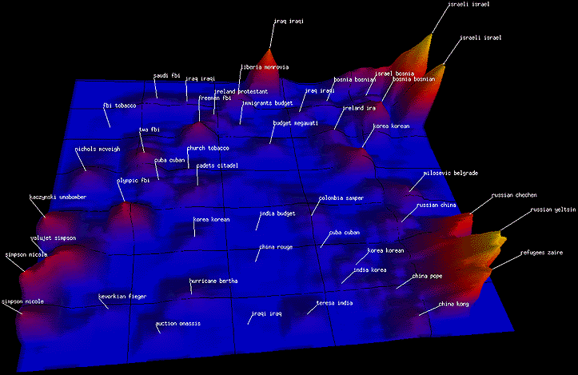
Definition 1: Documents’ spatialization

Slide 18
Definition 1: Documents’ spatialization (visualization explained)
Points on the topographic map ⇒ Documents or points of the interpolation surface
Height ⇒ Number of documents of the same topic
Distance ⇒ Semantic similarity between document’s topics
Peaks ⇒ High density of documents of a specific topic
Mountains/hills ⇒ Categories of documents of a specific topic
Map orientation: no significance, as long as relative distances are preserved

Slide 19
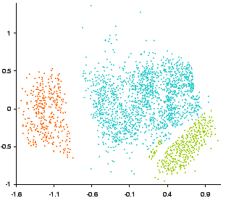
Definition 2: Cars’ attributes spatialization

Slide 20
Definition 2: Cars’ attributes spatialization (visualization explained)
Points in the visualization ⇒ Cars
Distance ⇒ Similarity of the cars’ attributes
Color ⇒ Group of similar cars
Map axes: no significance, as long as relative distances are preserved

Slide 21
Other spatialization techniques
PCA (Principal Component Analysis)
SOM (Self-Organizing Map) or Kohonen Maps
Benediktine Spaces

Slide 22
Bibliography and suggested reading
Multidimensional scaling, Wikipedia, the free encyclopedia
Kruskal, J. B., and Wish, M. (1978), Multidimensional Scaling, Sage University Paper series on Quantitative Application in the Social Sciences, 07-011. Beverly Hills and London: Sage Publications.
Marinos Kavouras, Margarita Kokla, and Eleni Tomai. 2005. Comparing categories among geographic ontologies. Computers and Geosciences. 31, 2 (March 2005), 145-154.

