Slide 1
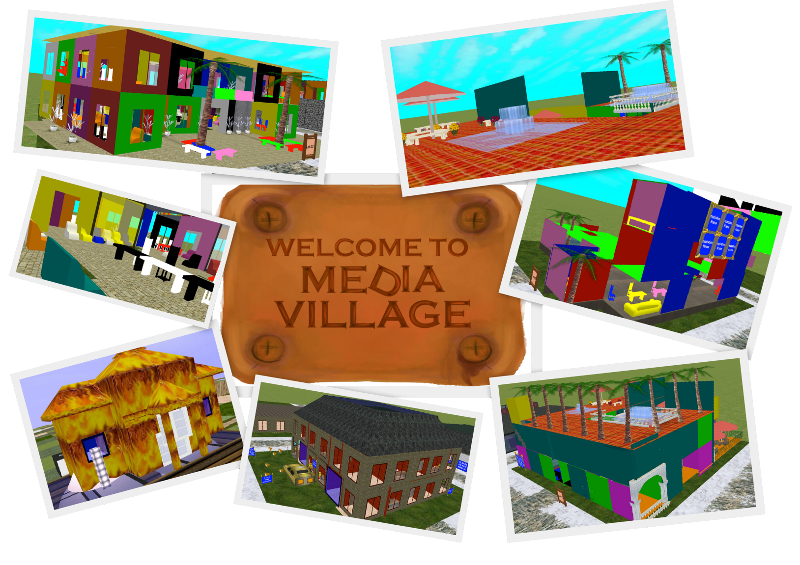
Collaborative Creativity
The social aspect of creativity and gaming
Maria Solomou, Cyprus

Slide 2
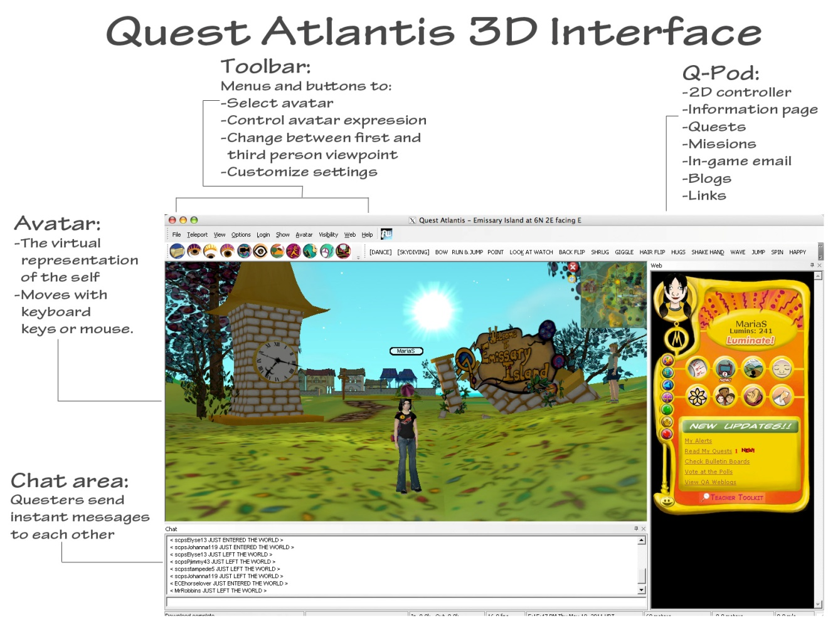

Slide 3

Section A: For the teacher

Slide 4
Goals, Purpose and other stuff
How creative ideas emerge within a community and spread amongst its members
Take up the themes of creativity and constraint within the production of their own virtual 3D building designs
How the domain evolves over time given the feedback and contributions of its members
10-16 year olds
Online community, after school programs

Slide 5
Rationale
Using an entire creative system in the everyday world can be a challenging endeavor
Players formulate their ideas through immersion in a narrative, positioning them as active agents of change
Explore the nature of creativity and collaborative learning within the context of virtual 3D architectural construction
Teacher as facilitator

Slide 6

Section b: For the student

Slide 7
Beginning
Creativity Vs constraint
Personal integrity Vs social alignment
Howard Roark - struggle in obscurity rather than compromise his artistic and personal vision
Peter Keating - chooses to sacrifice his creative freedoms in favor of capital gains, represents the antithesis of Roark’s philosophy in the work

Slide 8
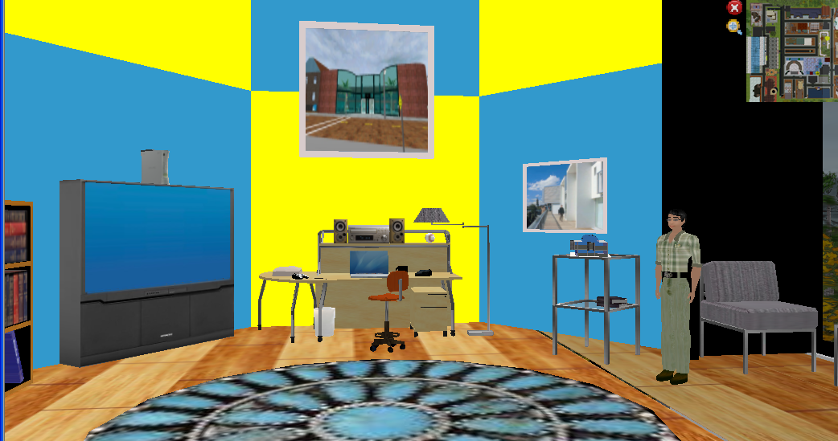
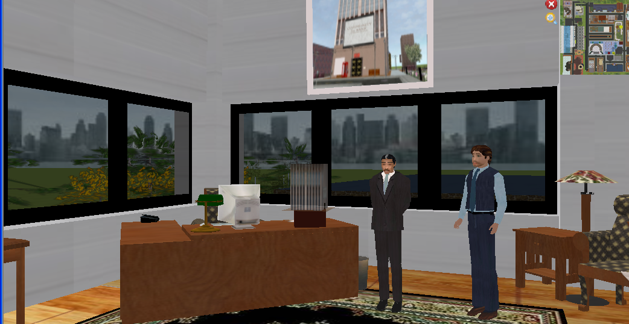

Slide 9
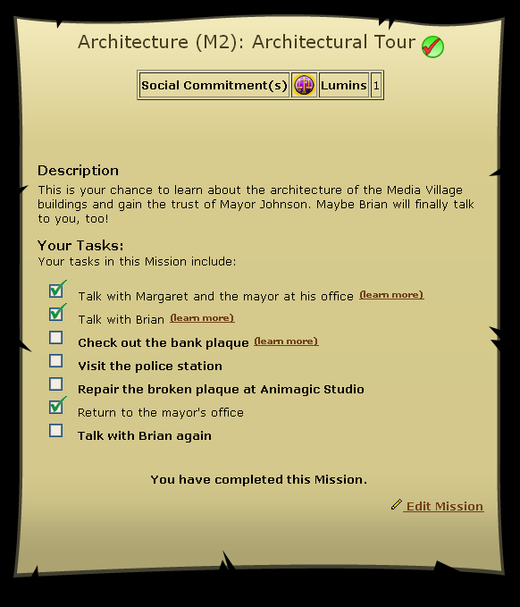
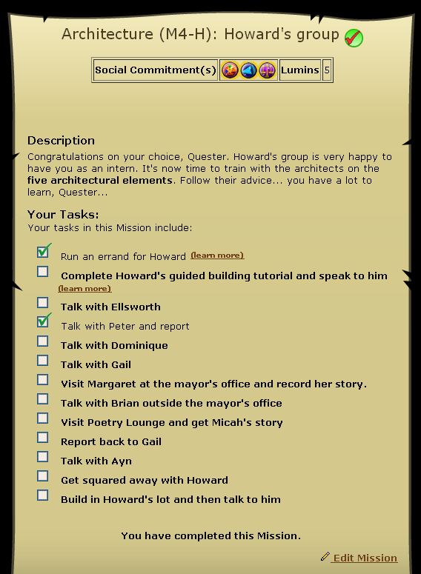

Slide 10
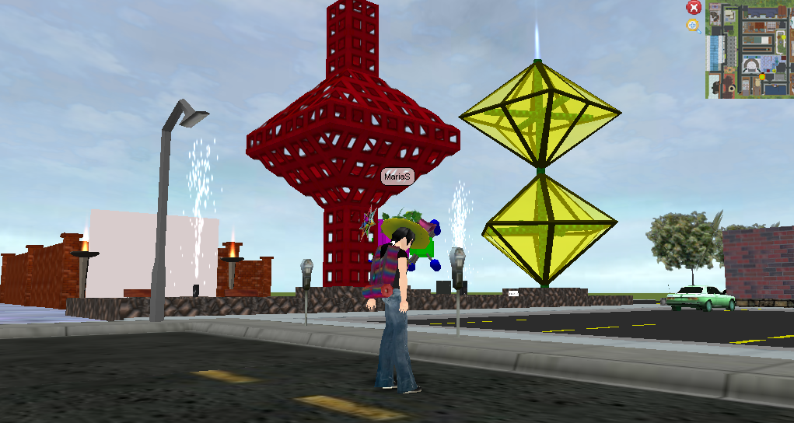
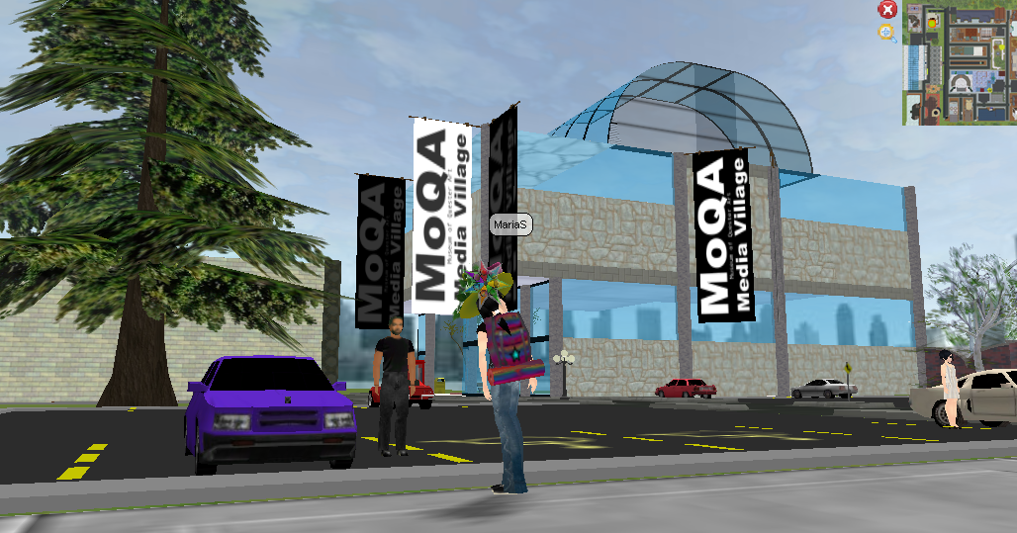
Middle
Choosing which architect to work with
Learn the architect’s principles and ideas
Review existing buildings and complete quests from the architect

Slide 11
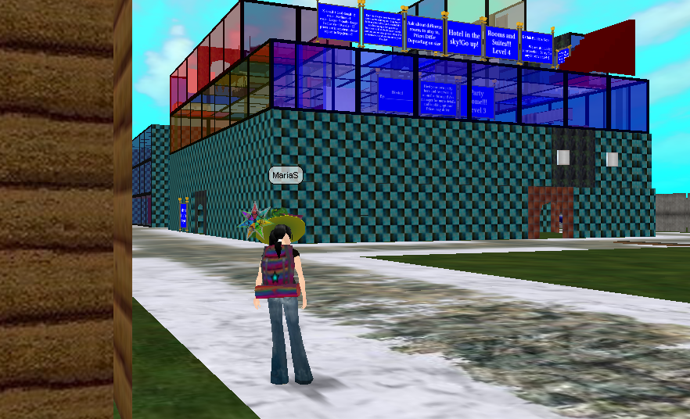
End
Questers build their own buildings in the architect’s sandbox world

Slide 12
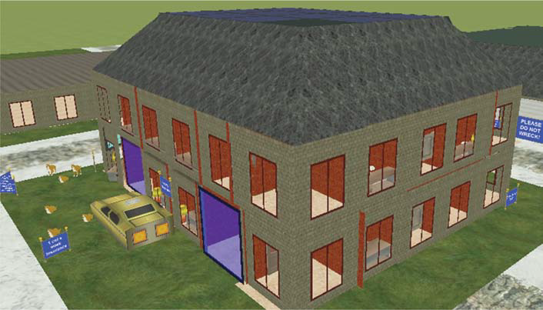
Peter

Slide 13
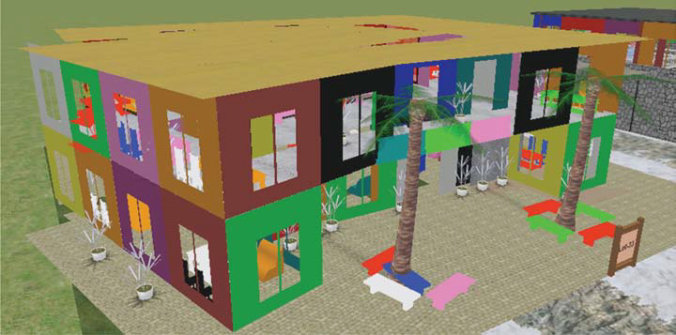
Howard

Slide 14
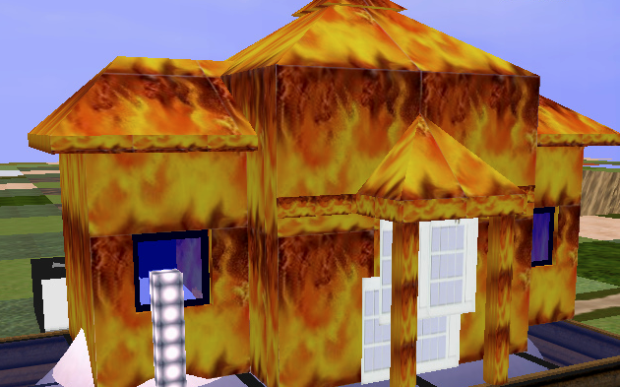
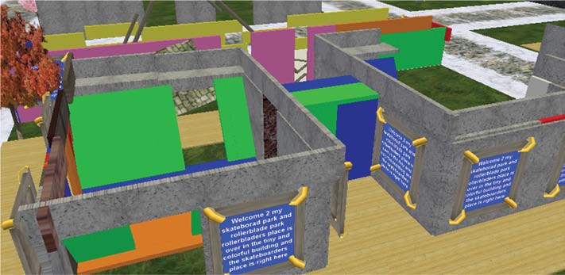
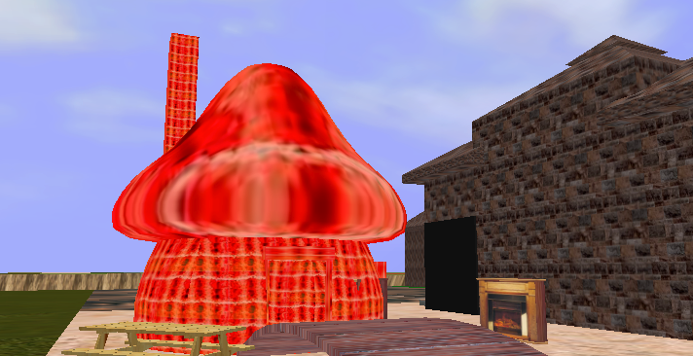
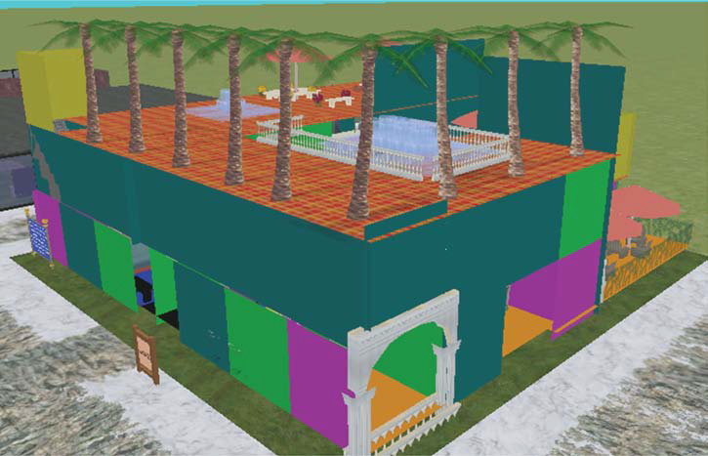
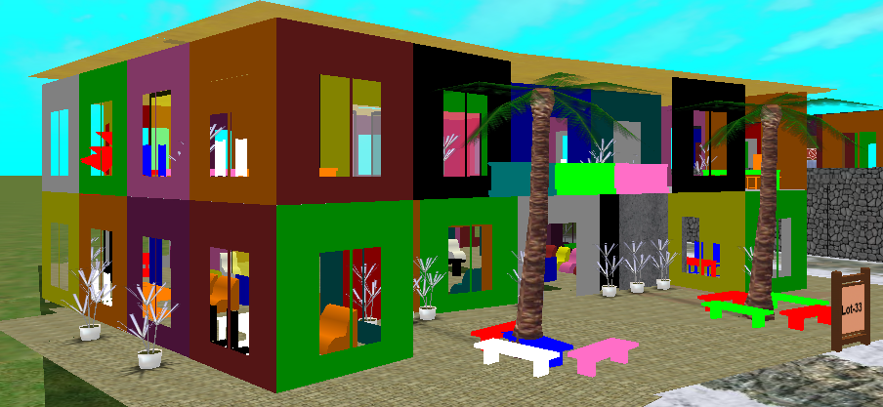

Slide 15
Thank you!
For more information visit: http://www.mariasolomou.com/architecture.html

