Slide 1

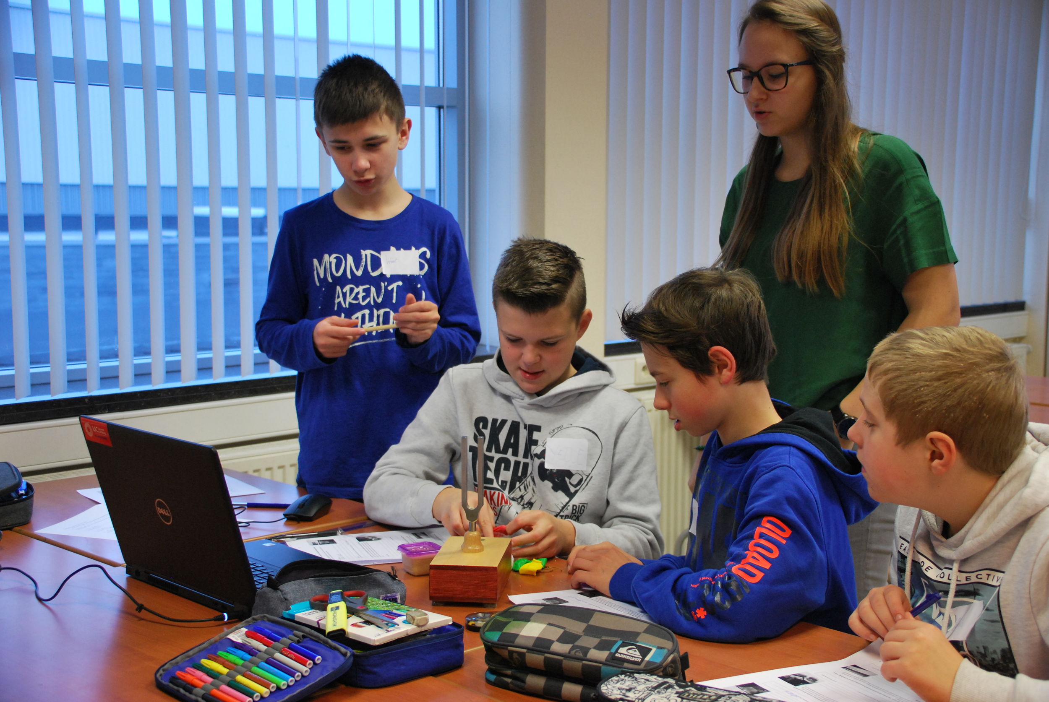


iMuSciCA STEAM pedagogy where music, science and engineering reinforce each other
Erica Andreotti, Renaat Frans, Jeroen Op den Kelder
Expertise cel Art of Teaching, Vakdidactiek
UC Leuven-Limburg, Campus Diepenbeek
In cooperation with
Manolis Chaniotakis, Petros Stergiopoulos, Thomas Fischer
Ellinogermaniki Agogi

Slide 2
What is a STEAM pedagogy?
A project based approach where all STEAM subjects are used
It’s a way to teach Engineering at school
It’s a methodology of inquiry learning
…
??
Short discussion of ~5 min.

Slide 3
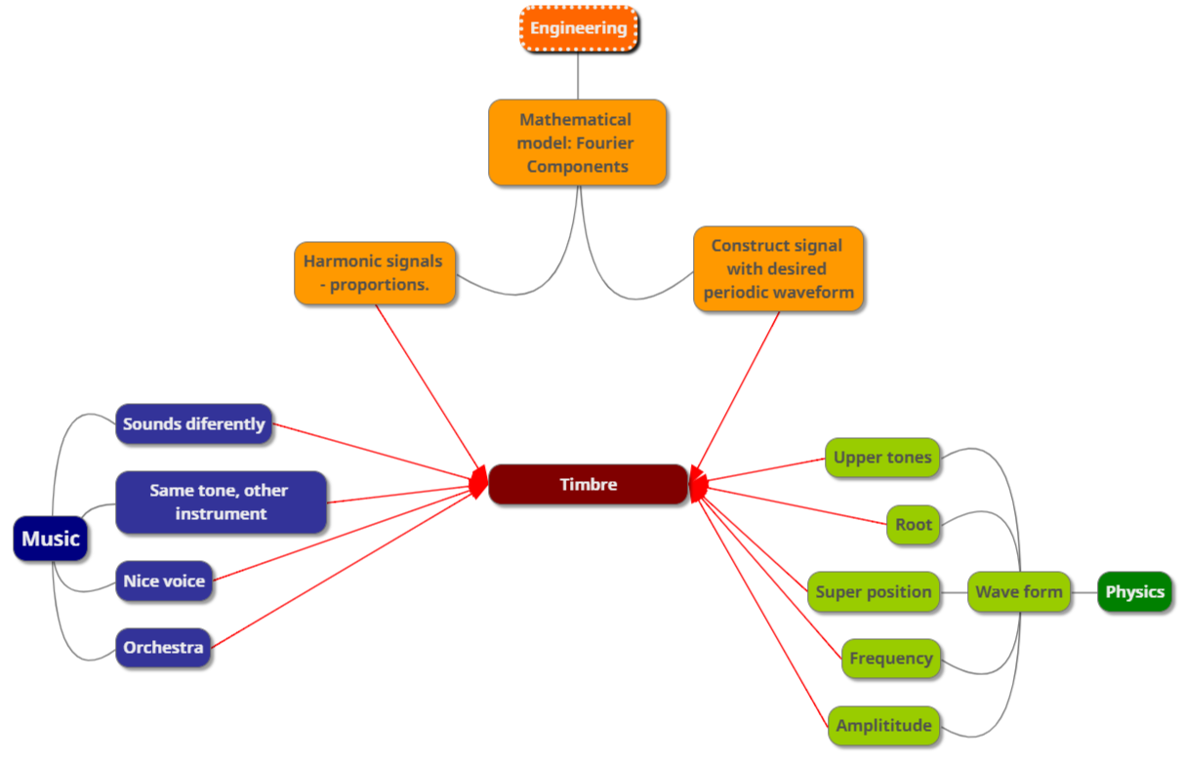
Example of a iMuSciCA concept map

Slide 4
Make a concept map of E, S, M
Music
Engineering
Engineering & Technology
Science
Science & math

Slide 5
No contradiction
What is a STEAM pedagogy?
Disciplinary
Interdisciplinary
By digging into the disciplines…
…you see the connections better!

Slide 6
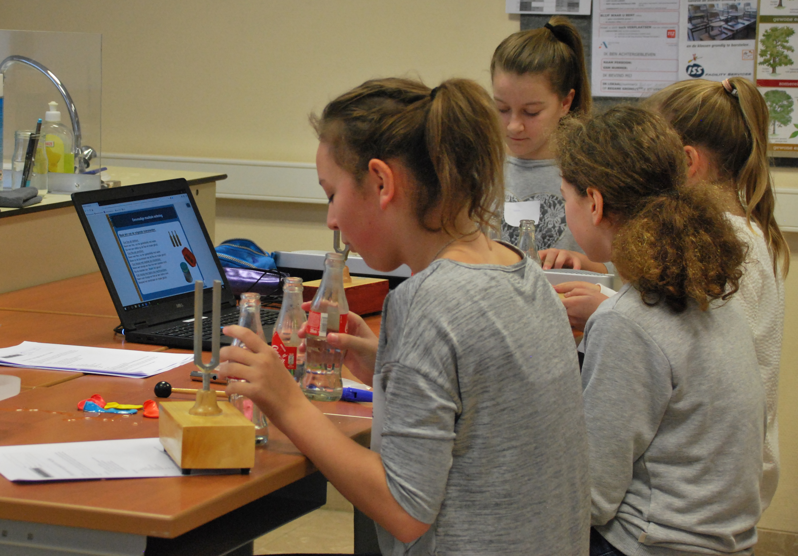
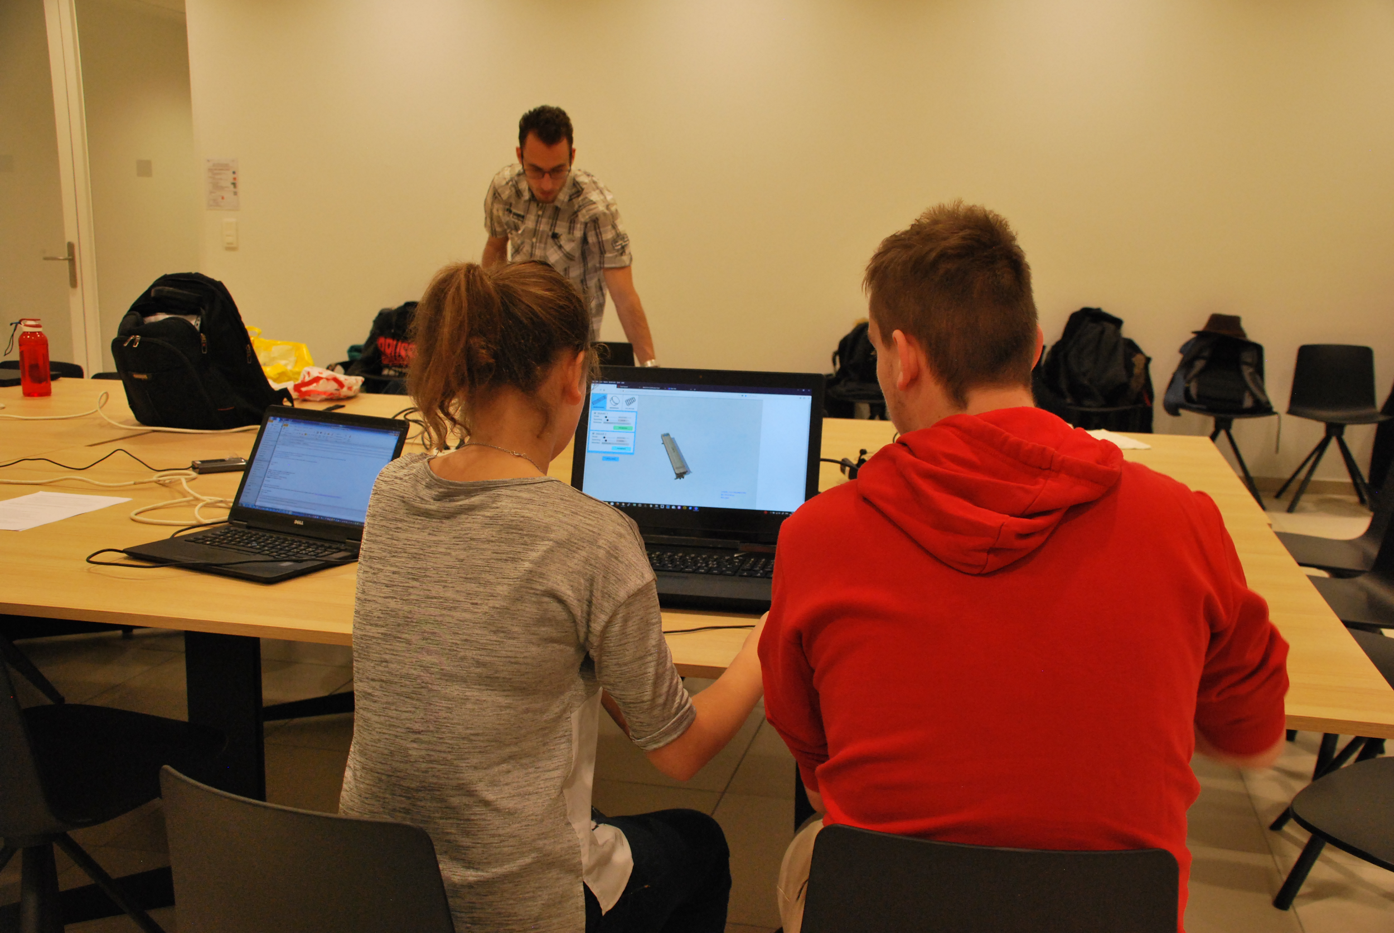
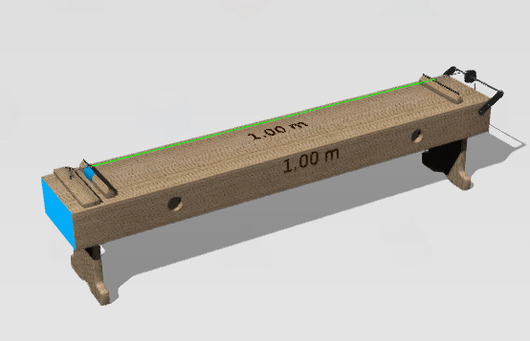
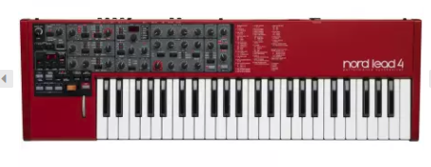
iMuSciCA STEAM pedagogy reflects
Arts / Design | Science / Maths | Engineering / Technology
real world of STEAM

Slide 7

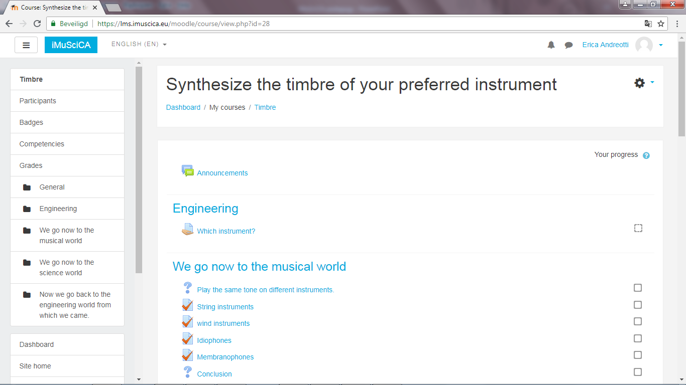
iMuSciCA STEAM pedagogy: How?
iMuSciCA workbench: https://workbench.imuscica.eu/
iMuSciCA scenarios and lesson plans (in Moodle)
For lower (12-15 yo) and
upper seconday (15-18 yo)

Slide 8
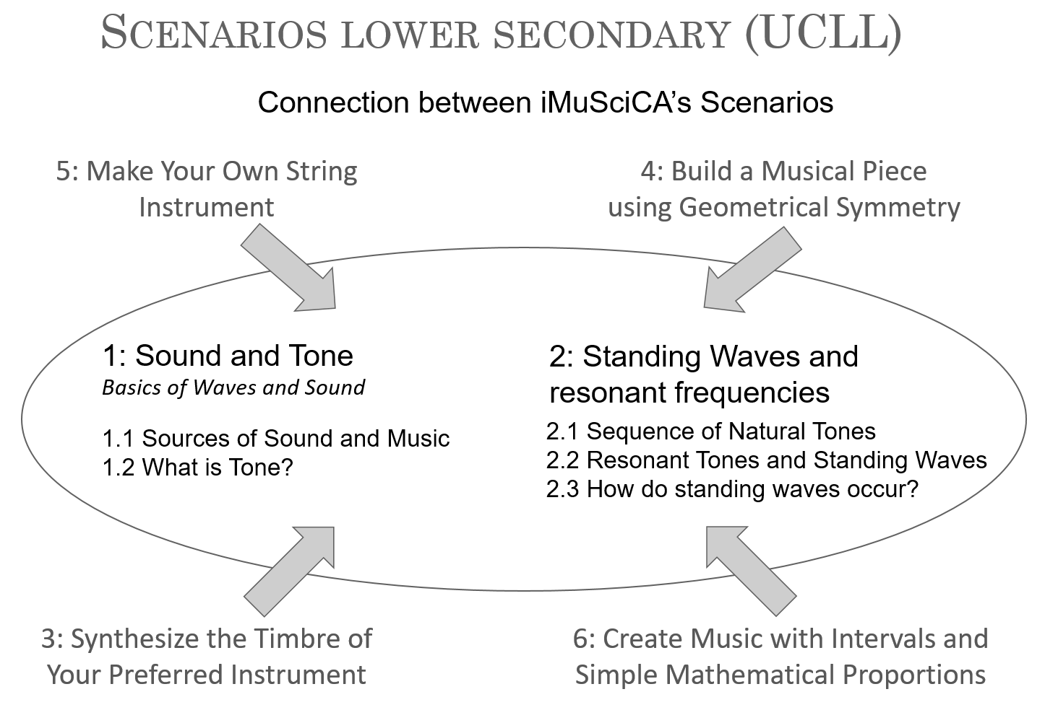
Connections between scenarios
E→S/M
M→ S →M
More guided scenarios
(S/M)
(S/M)
E→S/M
To be developed

Slide 9
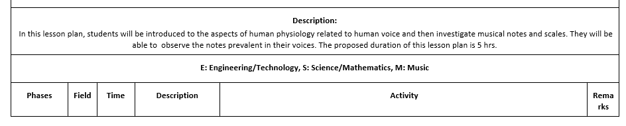
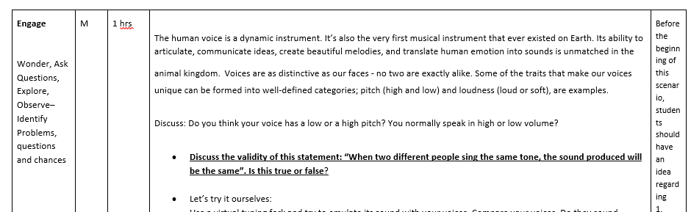
Structure of scenarios

Slide 10

The iMuSciCA Scenarios show a possible path.
You don’t have to follow them literally!
Find the best dosis of S - T - E - A - M for your specific case
E.g. S activities in science lessons, M activities in music lessons, etc…
Work in a ‘teachers STEAM team’

Slide 11
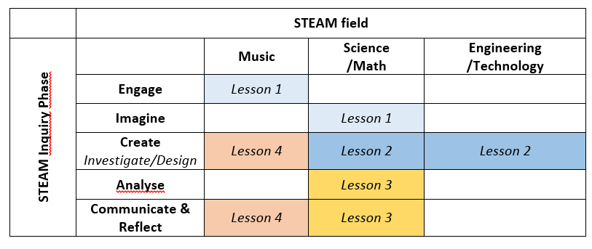
IBSE in iMuSciCA
Model!
Different meaning of each phase in different fields!
Different inquiry phases and STEAM fields can be visited in a pathway over different lessons of a certain scenario.
Inquiry phases can come back and do not necessarily follow a standard sequence!

Slide 12
Open inquiry vs guided inquiry?
Subtle shift towards more genuine inquiry!
students can choose their own learning path:
different starting points, start using workbench going out from different questions
teachers can alter degree of guiding/scaffolding
very crucial factor to let students grow towards more genuine and independent science inquiry
(Rankin, 2017; Tiberghien, A., 2000).
Pitfalls:

Slide 13
Subtle shift towards more genuine inquiry!
Gradually growing towards
open-ended questions
learners gradually choose what to investigate. (iMuSciCA gives contexts M, E, S as a start, suggested inquiry questions as scaffold)
learners formulate hypothesis and propose way of investigating (with the workbench tools many possibilities are suggested)
reporting what they think is significant (Comm & Reflect phase, develop own data sheets…)
expectations to have new questions when finished, just as scientists do.
:
(Rankin, 2017)

Slide 14
Warning! Gradually growing
Appropriate scaffolding for students (with weaker backgrounds)
If scaffolding lacks, weaker students tend to have lower learning outcomes than more privileged ones (Kirschner et al., 2006).
Important to refer students to other iMuSciCA scenarios when background is needed.
Work with iMuScicA concept maps: which background concepts needed?
iMuSciCA scenarios last column more suggestions and also background your students might need when performing the task
:
(Rankin, 2017)

Slide 15
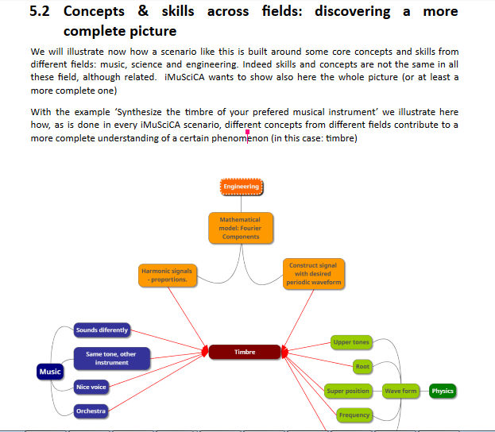
iMuSciCA Pedagogical guide

Slide 16
iMuSciCA
Thanks to UCLL teacher students

