Slide 1
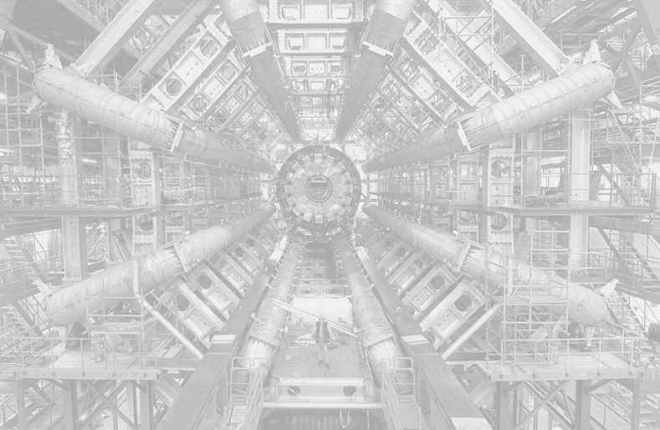
H Y. P. A . T. I. A. HYbrid Pupil’s Analysis Tool for Interactions in Atlas
Stelios Vourakis
University of Athens/IASA
http://hypatia.iasa.gr/

Slide 2
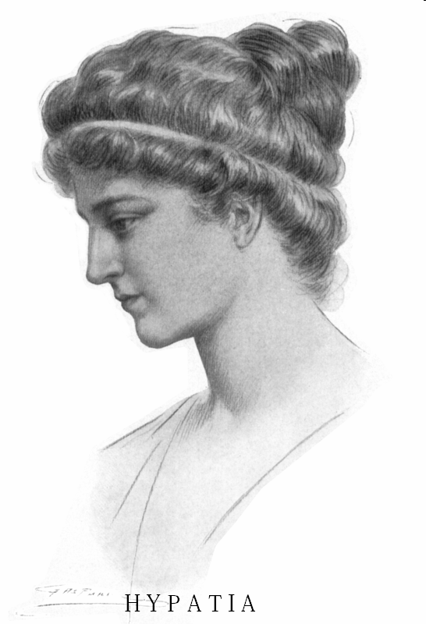
HYPATIA of Alexandria
First woman mathematician
Alexandria, Egypt (370 - 418 A.D.)

Slide 3
HY.P.A.T.I.A.
Event Display for real ATLAS data
Developed at UoA as a part of Learning with ATLAS@CERN, The Pathway to Inquiry Based Science Teaching, Discover the Cosmos, GoLab and ISE
Allows high school students and their teachers to study the elementary particles and their interactions
Suitable for scientific and educational use

Slide 4
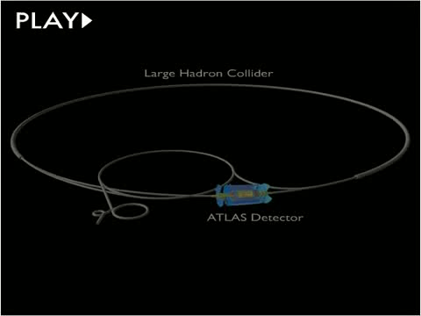

Slide 5
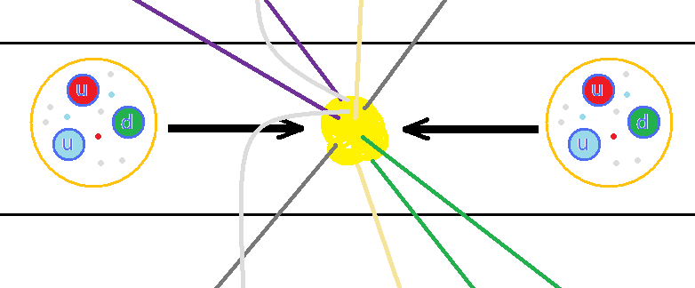
Collisions
Energy of each beam 4 TeV
2 x 4 TeV = 8 TeV
Some of the particles produced are unstable and decay immediately

Slide 6
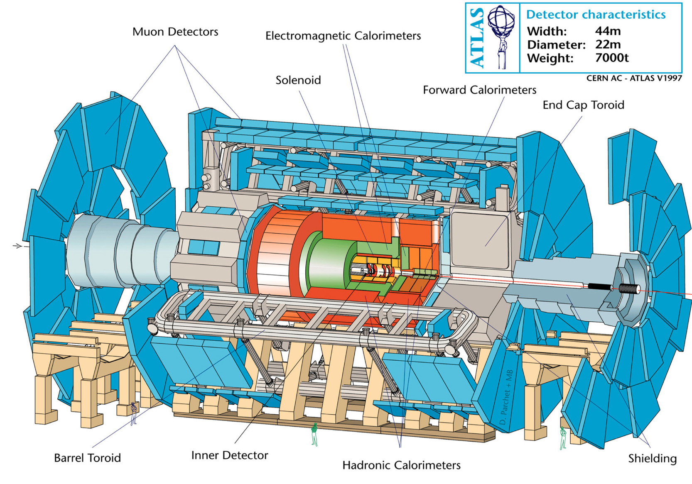

Slide 7
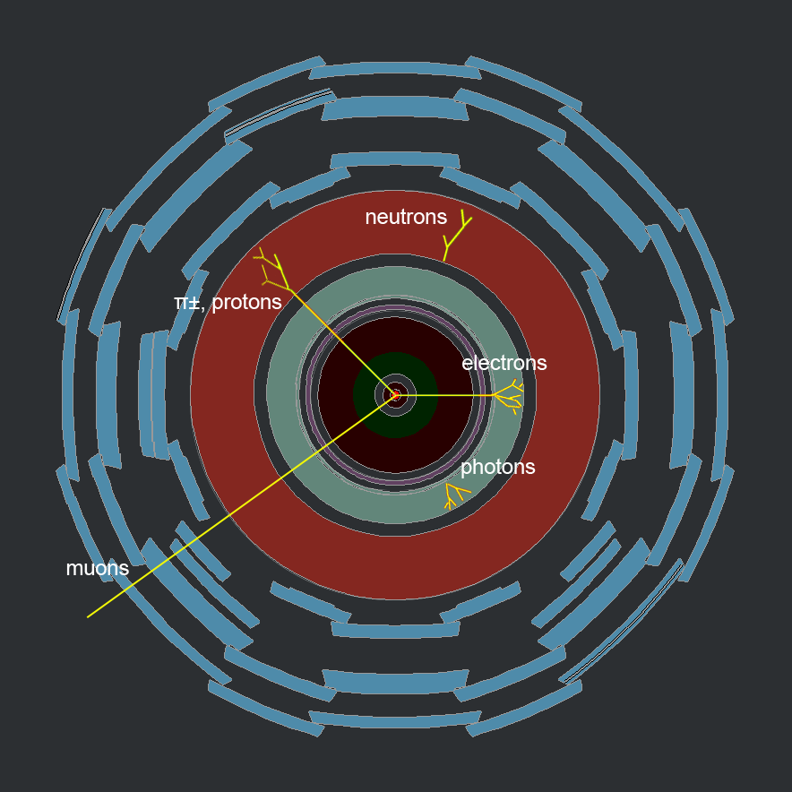
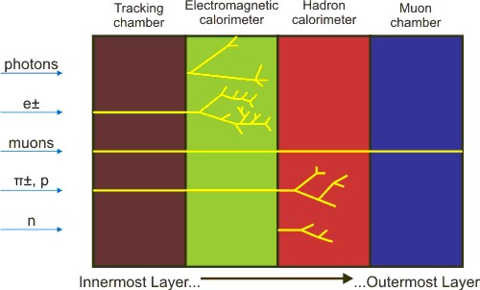
ATLAS
Particle tracks appear as lines on the detectors
The length of each track is determined by particle type
Each particle leaves a trace only on specific detectors according to its type

Slide 8
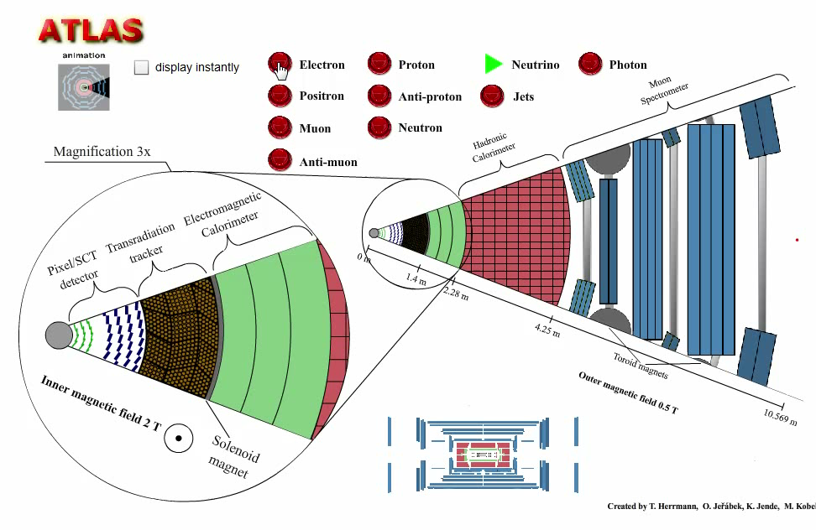

Slide 9
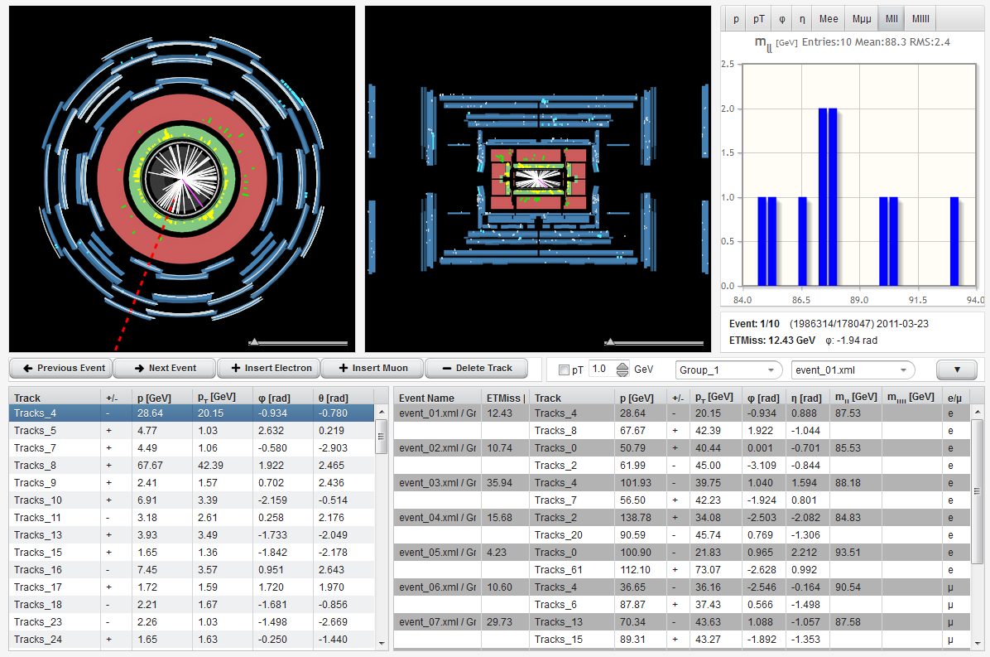

Slide 10
http://hypatia.iasa.gr/
General information about CERN, LHC, ATLAS
Basic physics knowledge about the ATLAS experiment
Instructions for the use of the HYPATIA web application
Related links for further information

Slide 11
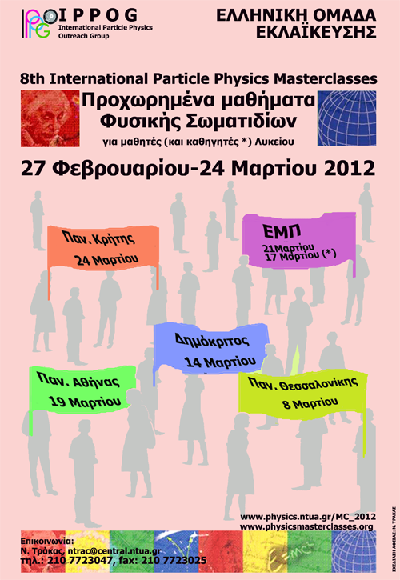
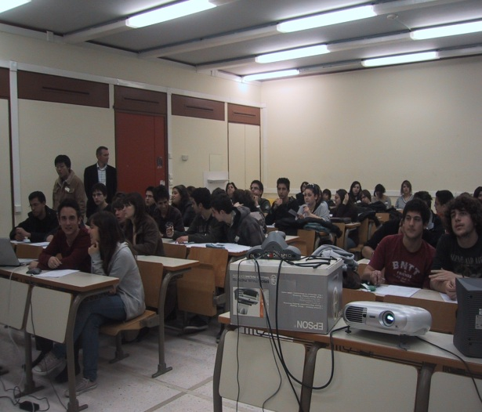
Activities
International Physics Masterclasses 2008, 2009, 2010, 2011, 2012, 2013, 2014
Nuclear Physics Lab – University of Athens
Activities in Greece and abroad
Part of EU actions:
Learning with Atlas @ CERN
The Pathway to Inquiry Based Science Teaching
Discover the Cosmos
Go-Lab
Inspiring Science Education

Slide 12
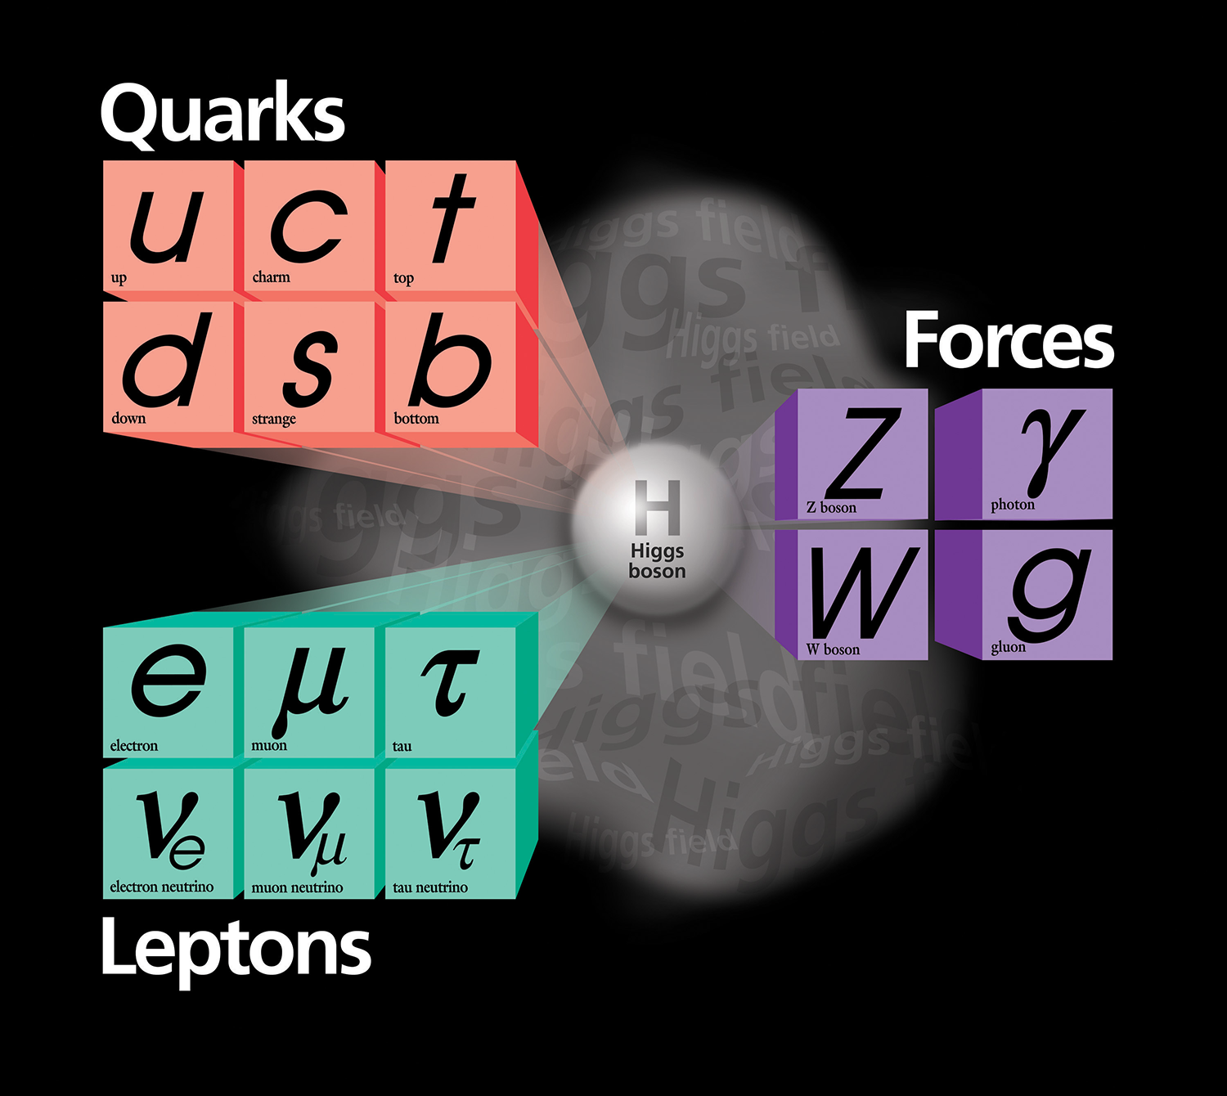
Laboratory Exercise

Slide 13
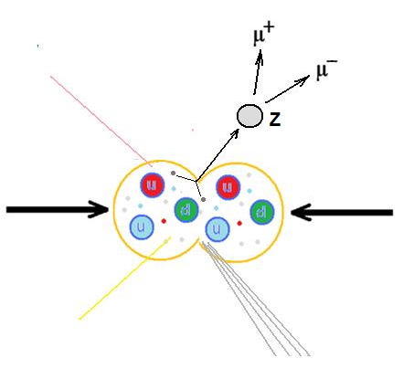
Laboratory Exercise
Detection and mass calculation of Z bosons
Real Events
Z → μ⁻ + μ⁺ Z → e⁻ + e⁺
2 tracks, opposite charge, not diametrical
Invariant mass 91,2 GeV
Small missing energy ETMiss
Background events
Leptons from quark decays are in jets
Cosmic rays : diametrical tracks on both detector views
Large missing energy ETMiss (because of neutrinos)

Slide 14
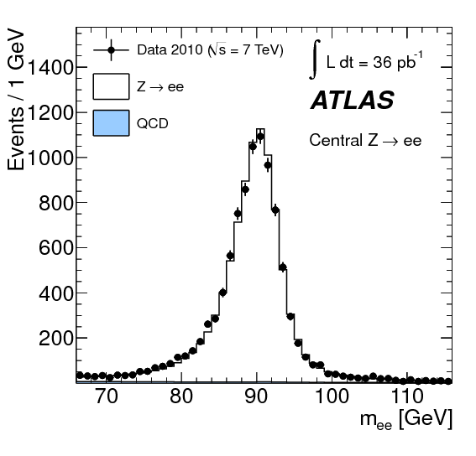
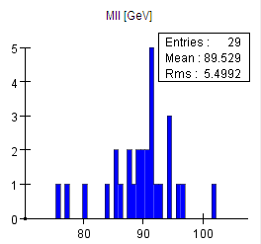
Laboratory Exercise
Detection and mass calculation of Z bosons - Histogram

Slide 15
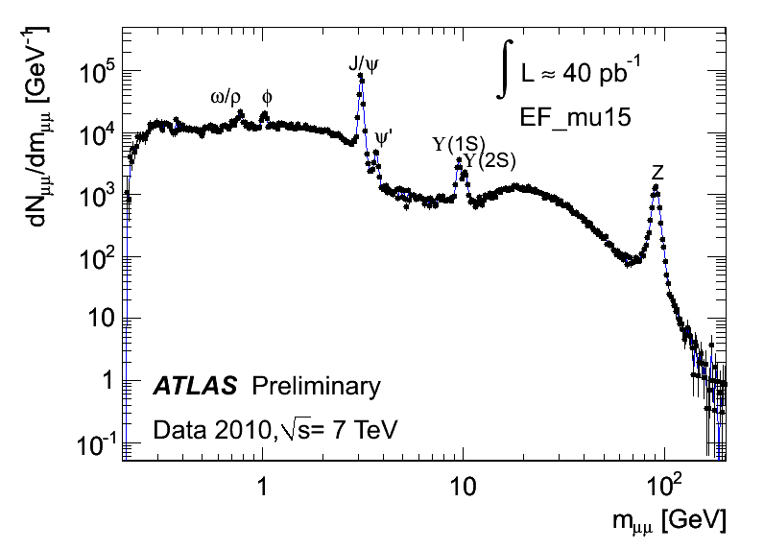
Laboratory Exercise
Detection and mass calculation of elementary particles

Slide 16
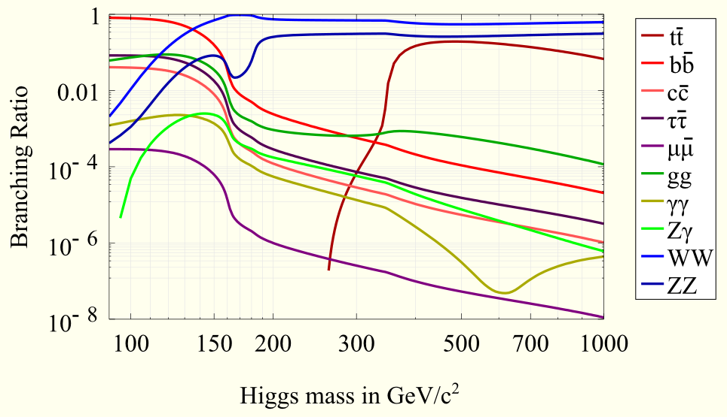

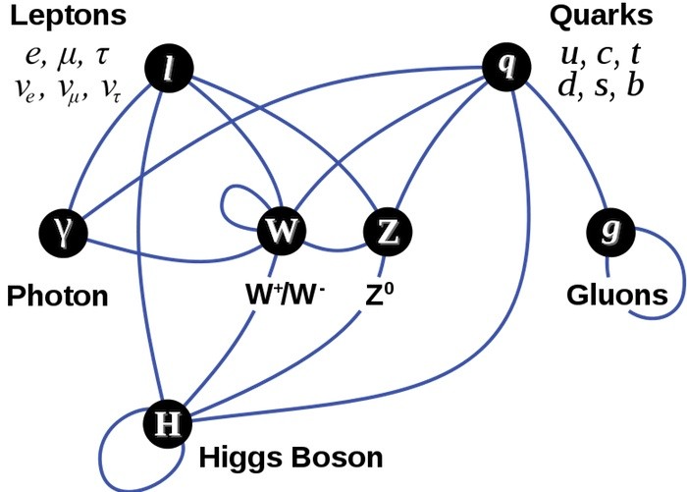
Discover the Higgs

Slide 17
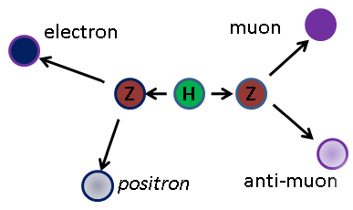
Laboratory Exercise
Discover the Higgs
H → 2 Z → 4l
Z → e⁻ + e⁺ or Z → μ⁻ + μ⁺
H → 2 e⁻ + 2 e⁺
H → 2 μ⁻ + 2 μ⁺
Η → e⁻ + e⁺ + μ⁻ + μ⁺
Isolated tracks
6 GeV Cut
4-track Invariant mass
Simulated Higgs, mass 180 GeV

Slide 18
Track Examples

Slide 19
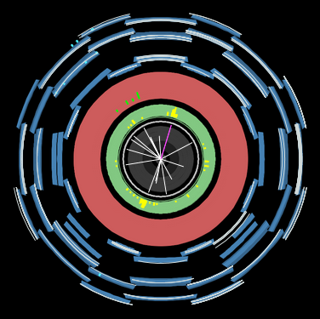
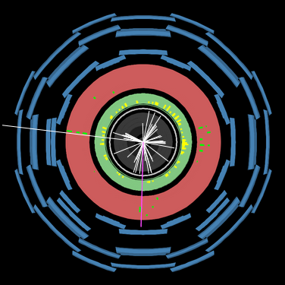
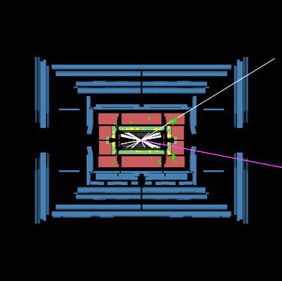
Recognition of electrons - muons
e⁻/e⁺ : charged particles, usually isolated that leave a trace in the E/M calorimeter
μ⁻/μ⁺ : charged particles that leave a trace in the muon chambers

Slide 20
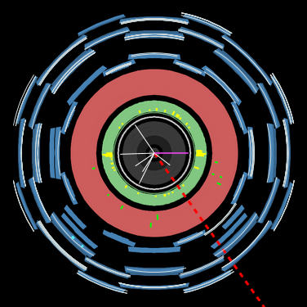
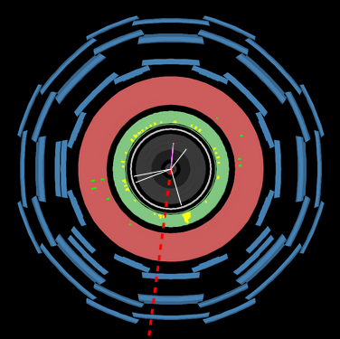
Recognition of electrons - muons

Slide 21
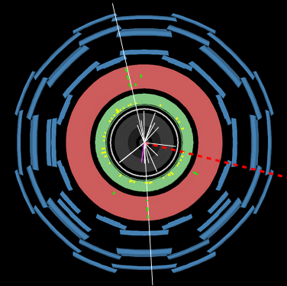
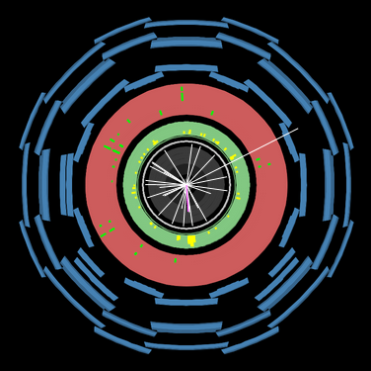
Recognition of electrons - muons

Slide 22
Laboratory Exercise

Slide 23
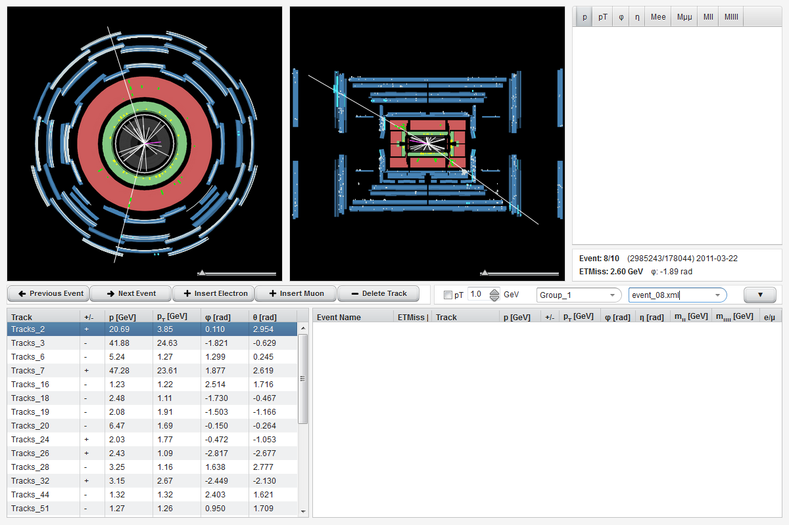

Slide 25
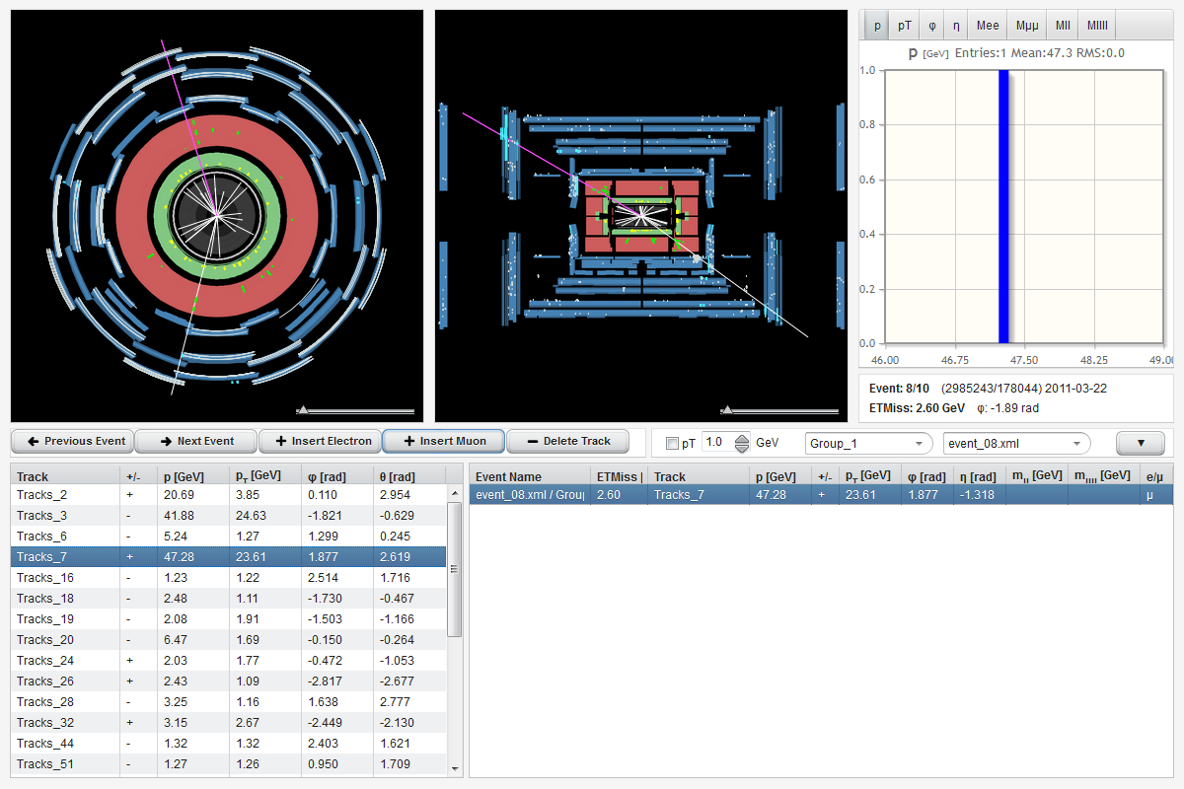

Slide 26
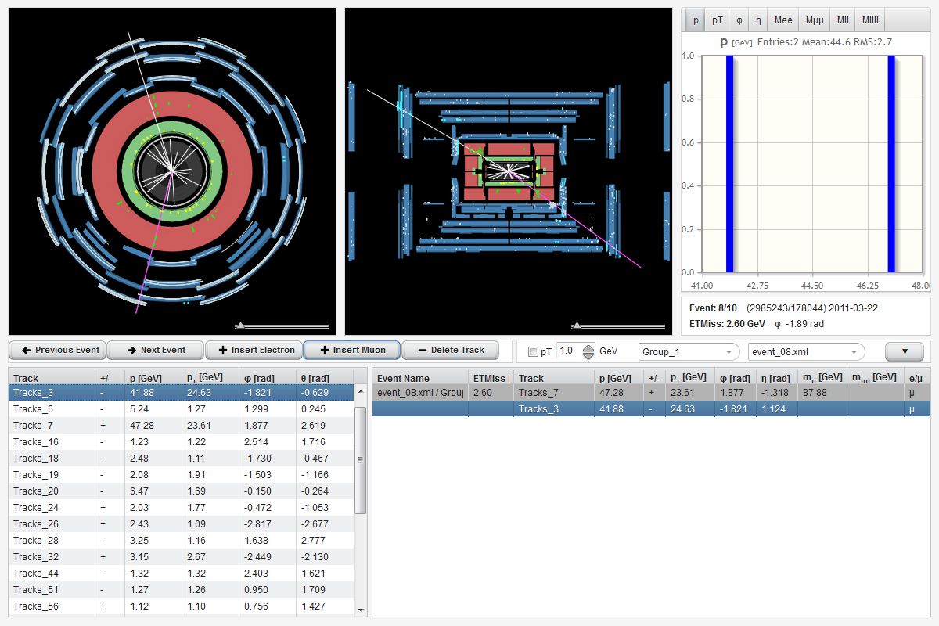

Slide 27


Slide 28
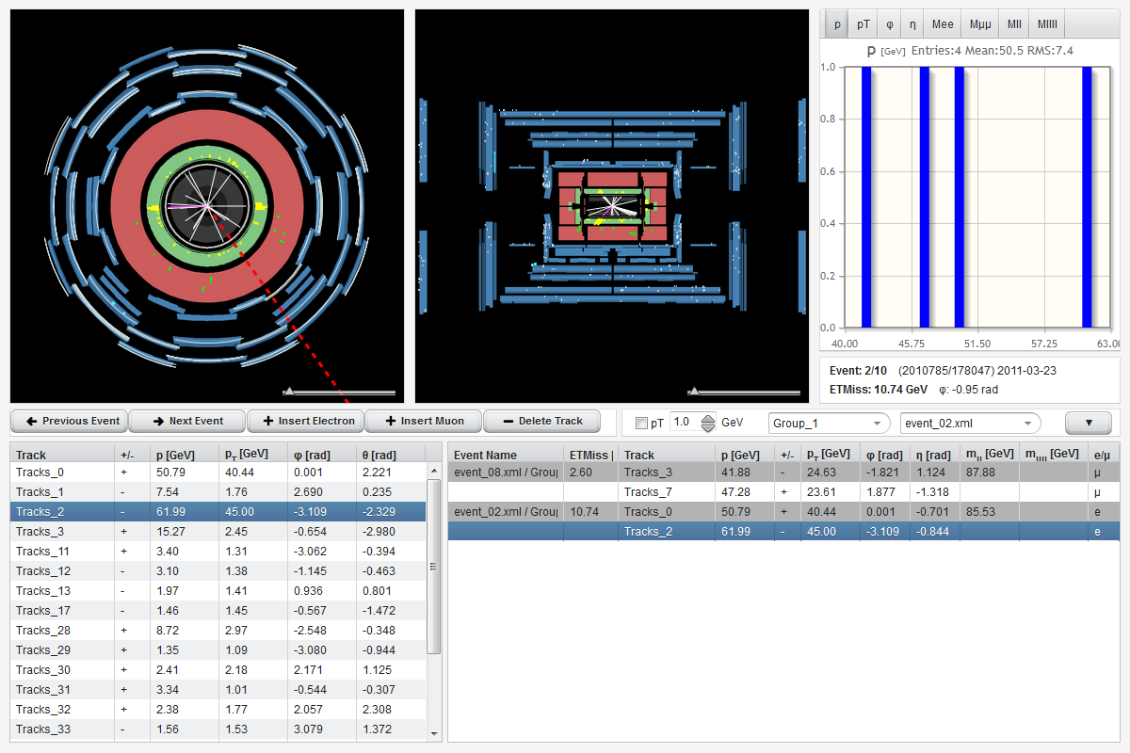
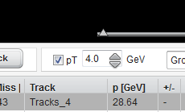

Slide 29
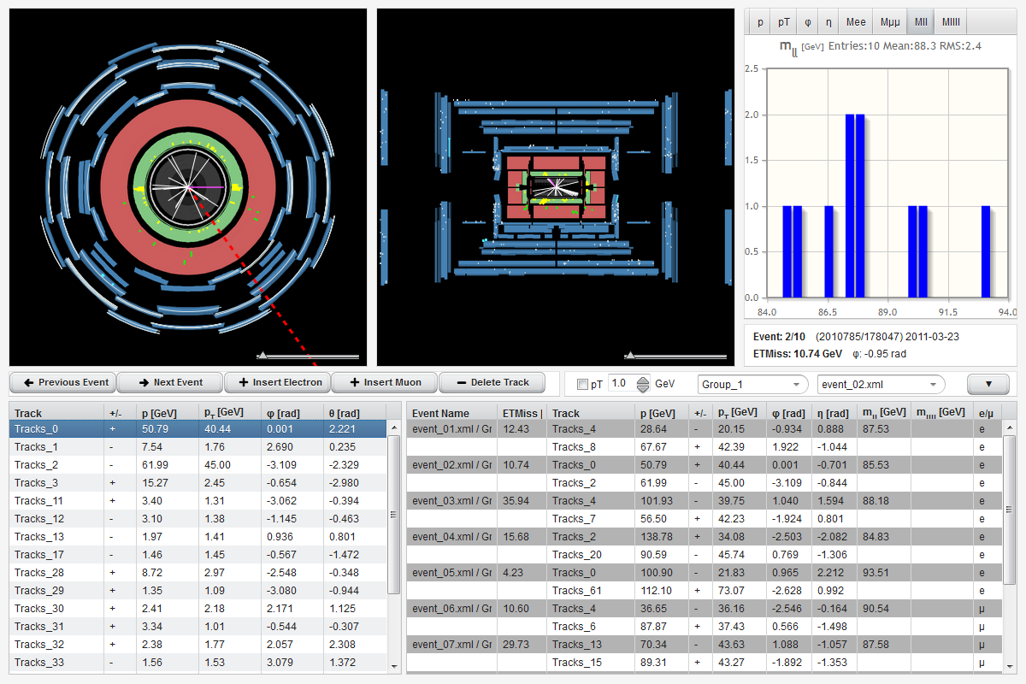

Slide 30
Review
hypatia.iasa.gr/app
Z → e⁻ + e⁺ ή Z → μ⁻ + μ⁺ 91,2 GeV
Background events
H → 2 Z → 4l 180 GeV
Background events

