Slide 1
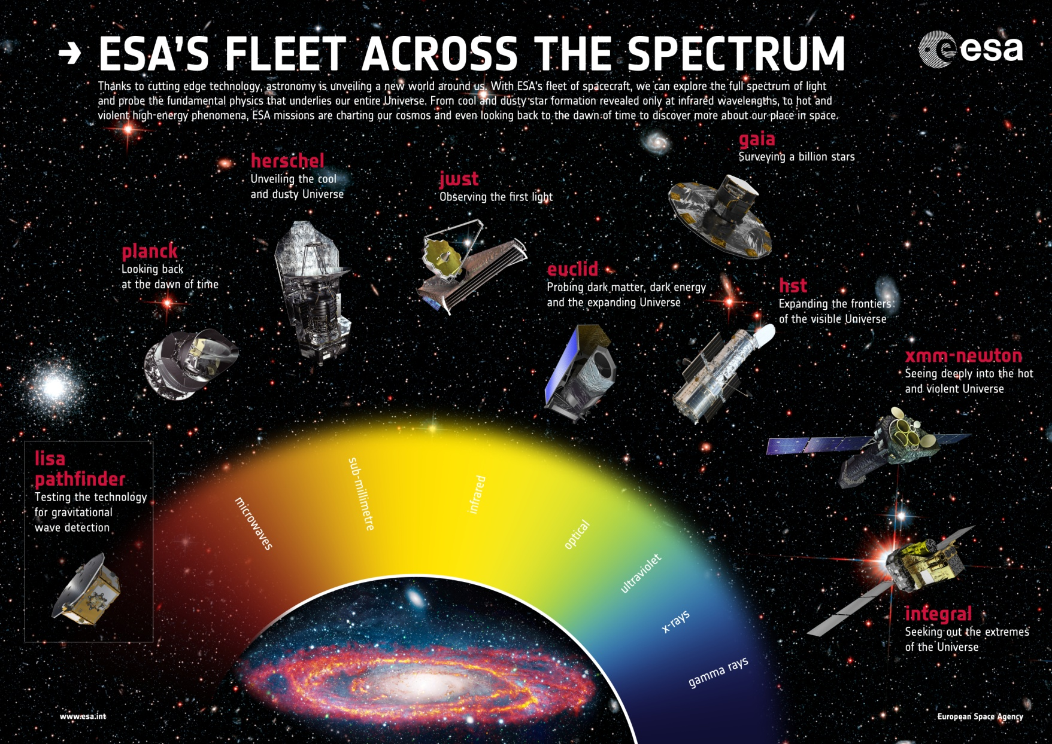
SPACE EDUCATION INTERNATIONAL WORKSHOP 2016

Slide 2
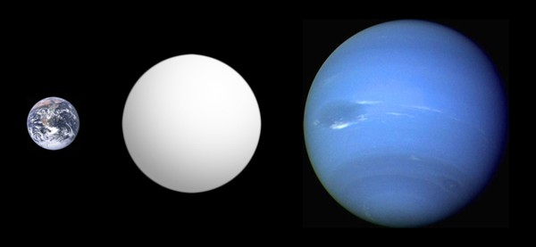
HIGHTLIGHTS IN ASTRONOMY AND ASTROPHYSICS
COLEGIUL NATIONAL AUGUST TREBONIU LAURIAN
Workshop Botosani
ROMANIA
DELLIA-RAISSA FORŢU
High school physics teacher

Slide 3
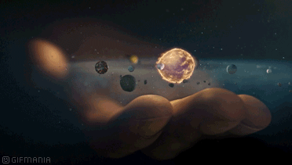
This workshop highlights the latest aspects of astronomy and astrophysics for high school teachers.
It contains :
- A "Skills Lab" where the participants learn a level skill valuable in education, introducing ITC tools;
- Lecture presentations about a current topic of astronomy research, such as exoplanets, galaxy evolution, comets, gravitational waves, craters,next-generation telescopes or stars and black holes;
- The workshop will culminate in a 10-15 minute presentation of the project's procedures and findings, as well as submission of a research log and brief summary of results;

Slide 4
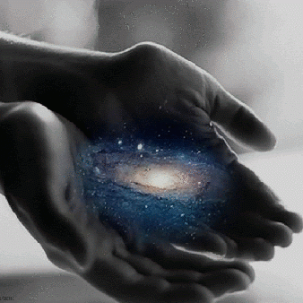
1. Where we are?
Our galaxy

Slide 5
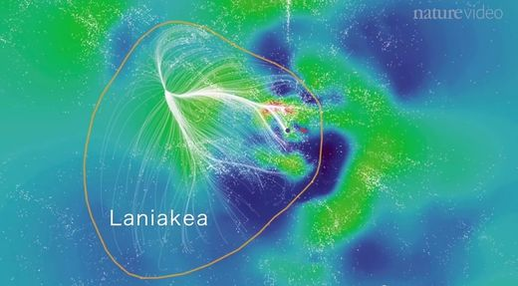
Laniakea
How, exactly, does the Milky Way fit in
among the billions of other galaxies in the known universe? It is thousands of galaxies in our immediate vicinity, and
discovered that the Milky Way is part of a jaw-droppingly massive "supercluster" of galaxies that they named Laniakea
(“infinite sky” in hawaina). Laniakea contains more than 100000 galaxies, stretches 500 million light years across.

Slide 6
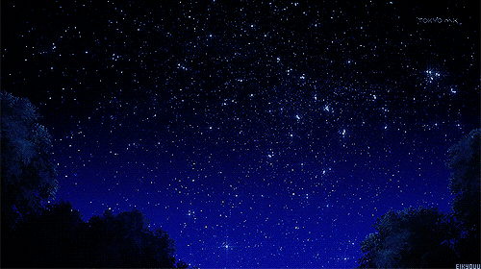
2. ABOUT STARS
Stellarium (software)
Sun and stars in Univers

Slide 7
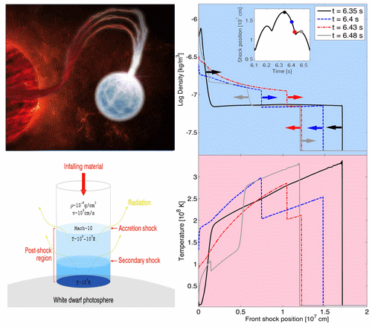
white dwarfs

Slide 8
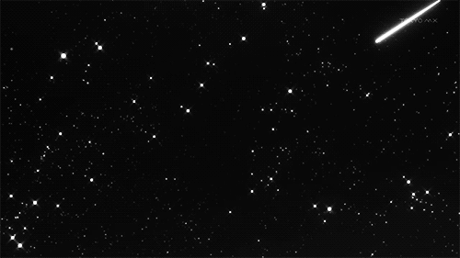
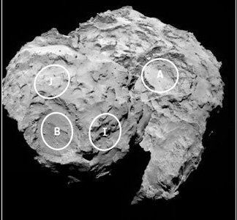
3. Comets
About Comet 67P/Churyumov–Gerasimenko
Rosetta and Philae

Slide 9
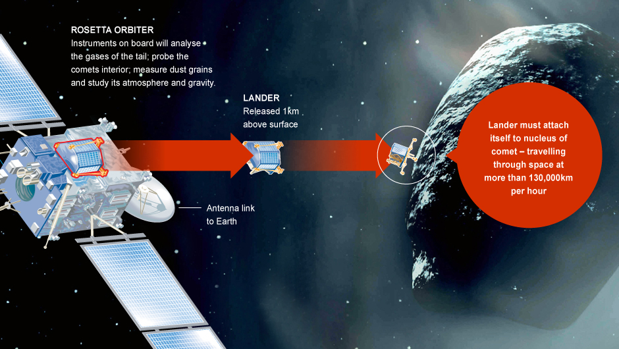
The contest to name Philae’s landing site on Comet 67P/Churyumov–Gerasimenko has resulted in an Egyptian-themed name. “Agilkia”, which is named after an Egyptian island that hosts the Temple of Isis and other buildings that previously were on the island Philae. The buildings were moved due to the Aswan dams flooding Philae in the past century.

Slide 10
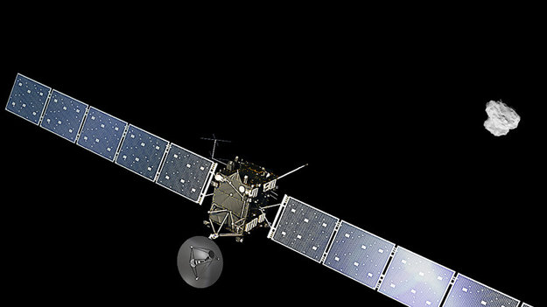
Rosetta is set to complete its mission in a controlled descent to the surface of its comet on 30 September.

Slide 11
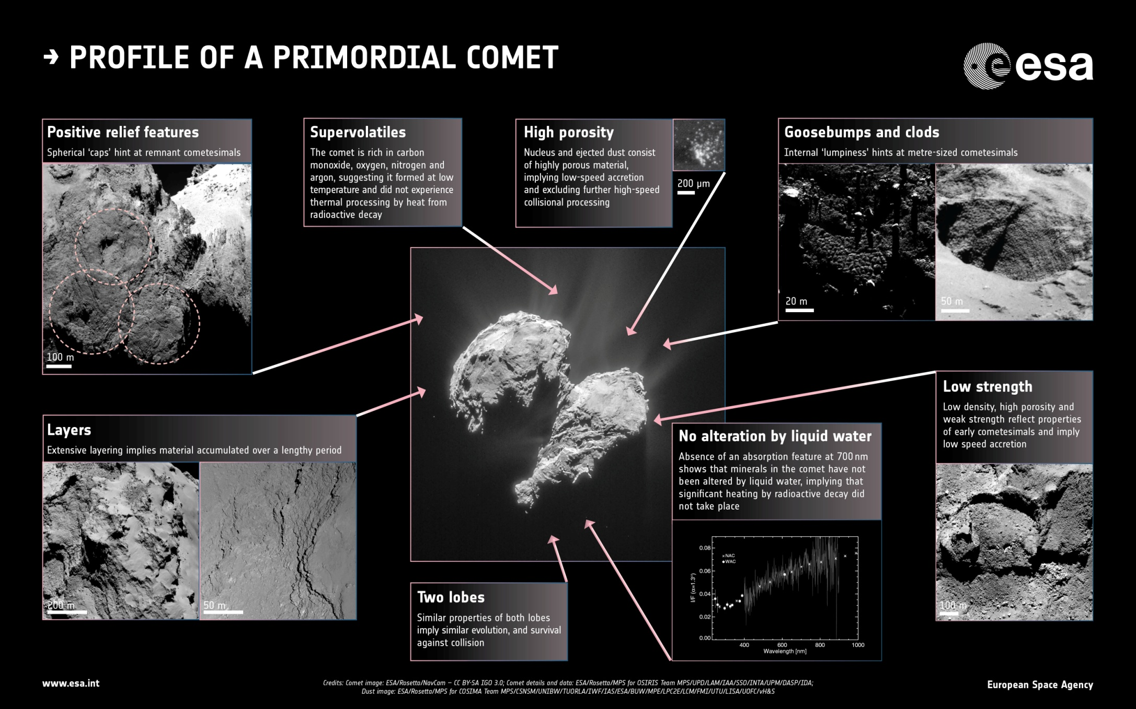

Slide 12
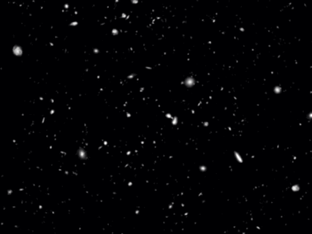
5. Another planetary systems

Slide 13

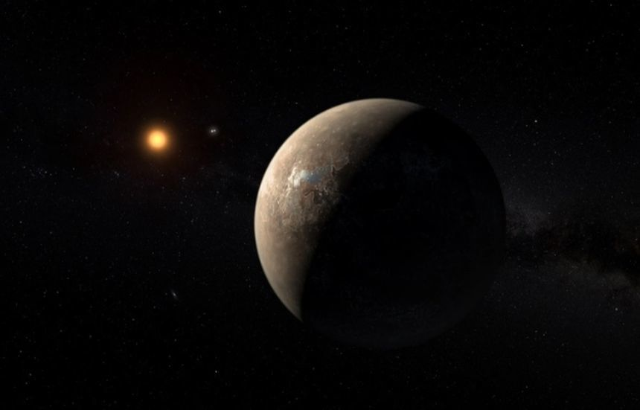
Exoplanets
Proxima b - orbiting the star Proxima Centauri

Slide 14
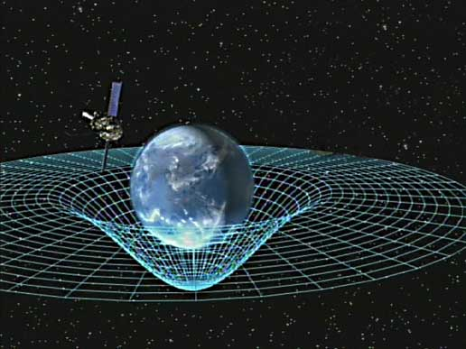
6. GRAVITATIONAL WAVES
Gravitational waves are 'ripples' in the fabric of space-time caused by some of the most violent and energetic processes in the Universe.

Slide 15
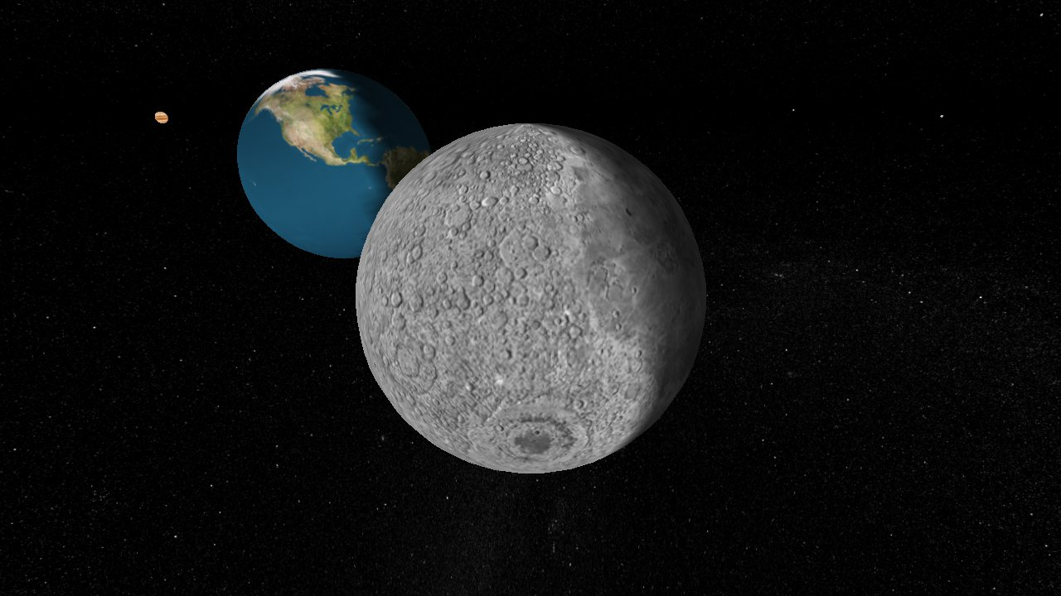
7. Craters
Sofware Salsa J allows students to display, analyse, and explore real astronomical images and other data in the same way that professional astronomers do, making the same kind of discoveries that lead to true excitement about science.
The Go-Lab Portal thus offers students:
access to scientific instruments (remote and virtual laboratories) for investigations.
Editor : Forțu Dellia- Raissa

Slide 16
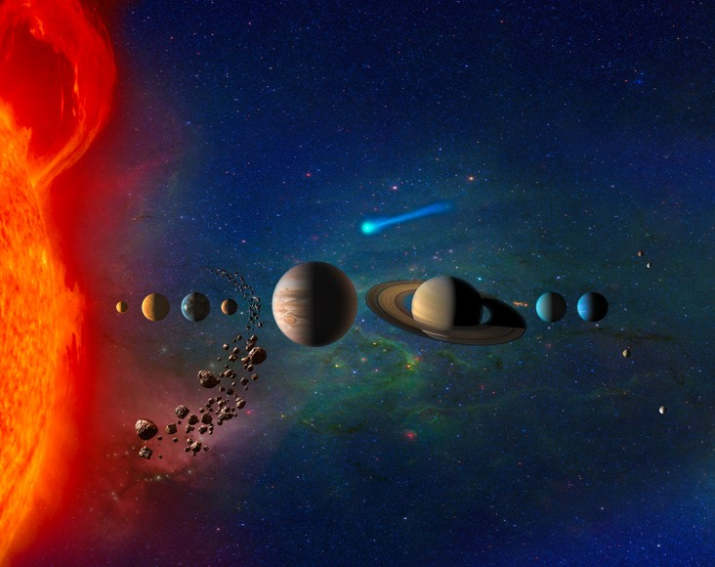
Educational Objectives (Types of knowledge):
Factual: Learn about the different types of craters in the Solar System:formation and structure
Conceptual: Learn about the interaction between colliding bodies: Moon or a planet and asteroid or comet.
Procedural: Learn about simulations and how to use them in a concrete scientific context
Meta- cognitiv : Get acquainted with making and studying astronomical observations.
Editor : Forțu Dellia- Raissa

Slide 17
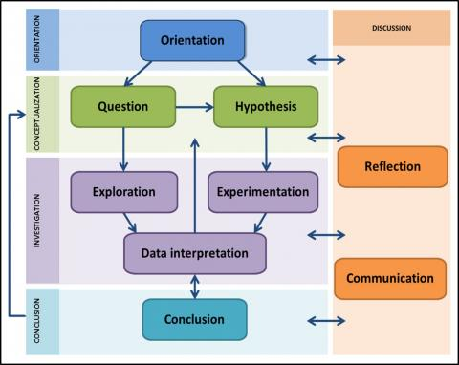
LESSON PLAN TEMPLATE
Inquiry Learning Cycle specify the consecutive steps of an inquiry learning process. This cycle contains five main phases.

Slide 18

ORIENTATION
Have a look at the following video Tour of the Moon on www.youtube.com or another.
a)Can you describe the moon's surface? b) List the craters shown?
MOTIVATION
Do you think that there are craters on other solar system bodies? Do you know about the craters on Earth?

Slide 19
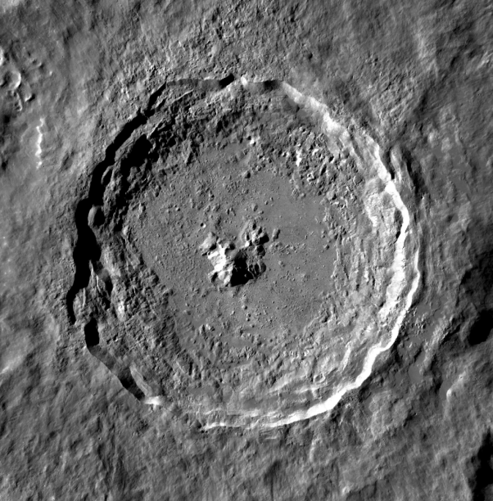
CONCEPTUALIZATION
Which is the composition of a crater?
  How are formed the craters in the Solar System?
About:
Asteroids
Comets
Meteorites
Parts of a crater

Slide 20
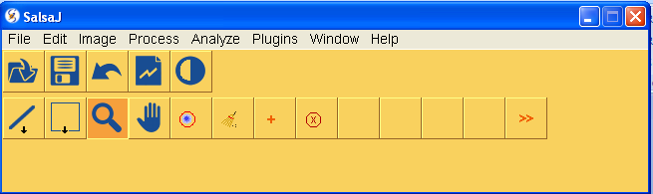
INVESTIGATION
Experimentation
Measure length Humboldt crater, a large crater located on the eastern side of the moon, using software SalsaJ.
Using online lab: Craters on earth and Other Planets (http://education.down2earth.eu)
Interpretation of the data

Slide 21
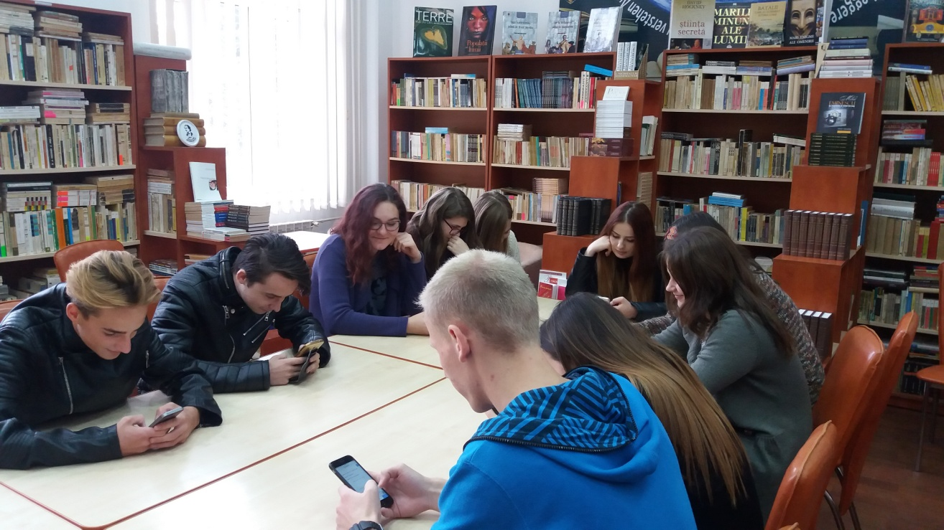
CONCLUSSIONS
Quizzes on Socrative, using smartphones.

Slide 22
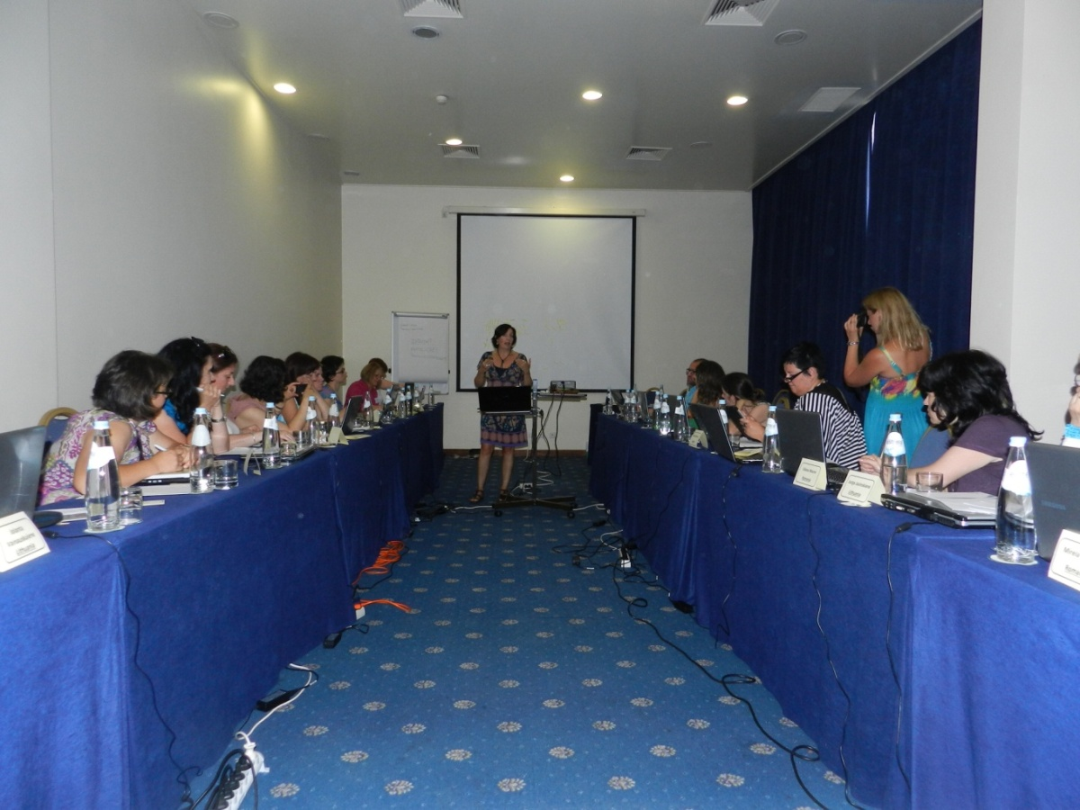
DISCUSSIONS
Make a powerpoint presentation or a prezi presentation to summarize your research team, or work on PADLET.

Slide 23

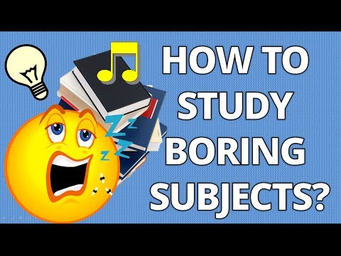

In order to successfully bring inquiry into the science classroom, one of the main challenges is to achieve turning a traditional and otherwise boring teaching subject into a fun inquiry experience for the students.

Slide 24
ITC TOOLS
www.padlet.com..........................discussions
www.socrative.com......................quizzes
www.golabz.eu.............................online labs
www.stellarium.org......................planetarium
www.euhou.net............................Salsa J
www.learningdesigner.org............lesson plan
www.graasp.eu.............................Inquiry Learning Space (ILS)

Slide 25

I AM HAPPY
OR
I AM SAD, it is a choice.

Slide 26
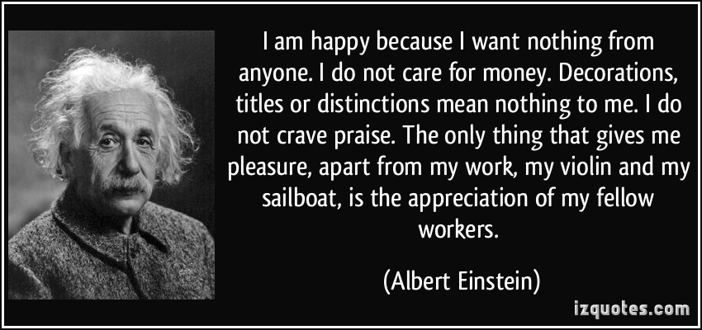

Slide 27
Let's make things better!

