Slide 1
Hands-on Astronomy
Enquiry Based Learning
The Solar System
(Learning Aim A)
Helen Burn

Slide 2
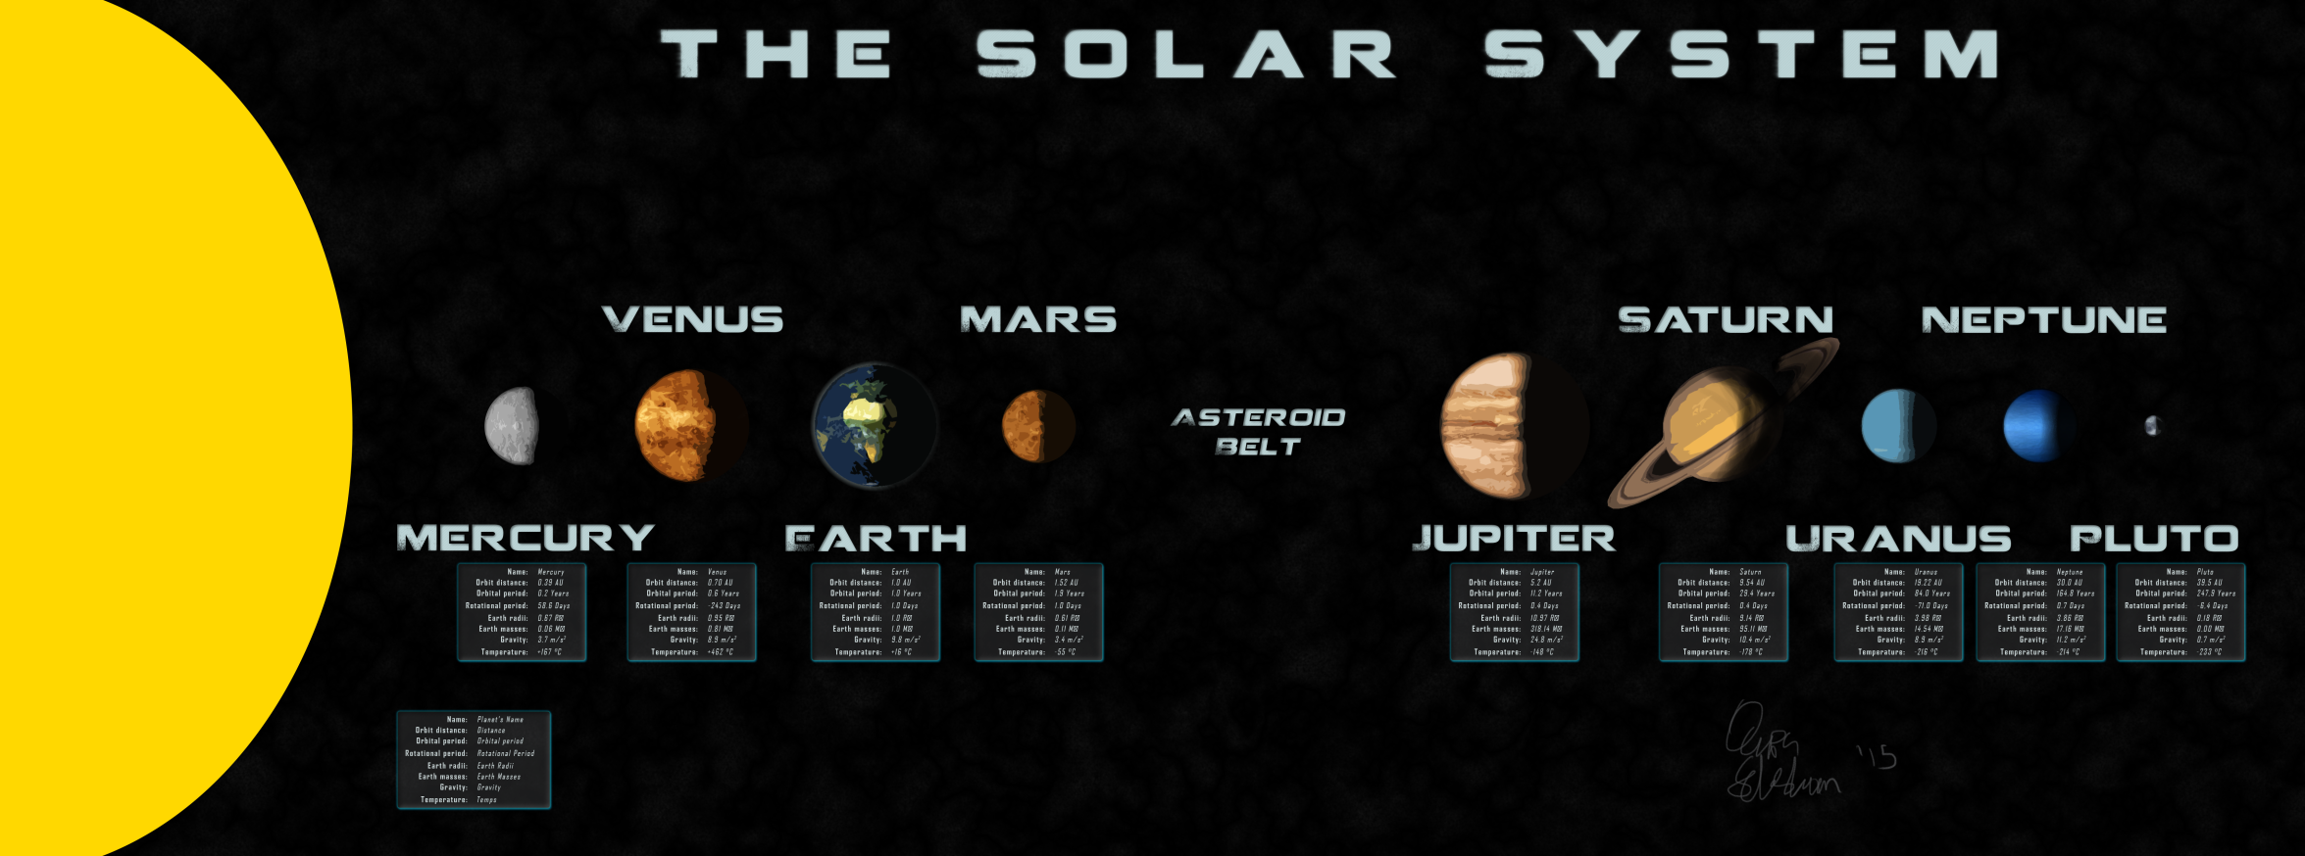
- Were the activities successful, and what would you do differently?
The students really enjoyed the EBL.
They collaborated to produce a display board:

Slide 3
Which activities did I intend to use, and which did I achieve?
I initially intended to use:
EBL
Faulkes
NSO
In reality I finally managed to use just the EBL for my Solar System BTEC L2 group:
http://graasp.eu/spaces/552cdfd44622e942b7053c5b
And this was not to the extend I had hoped…

Slide 4
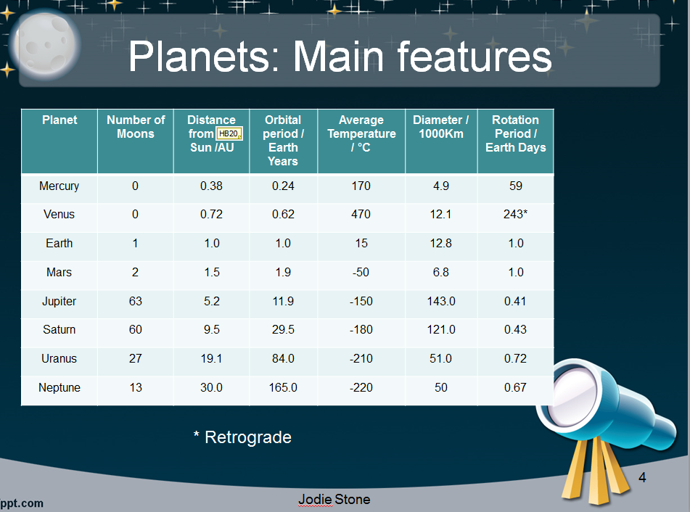
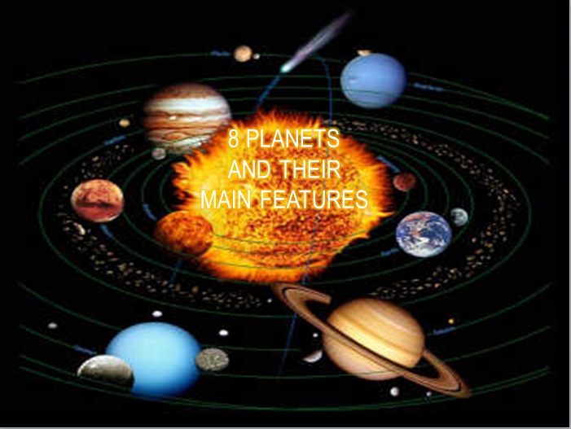
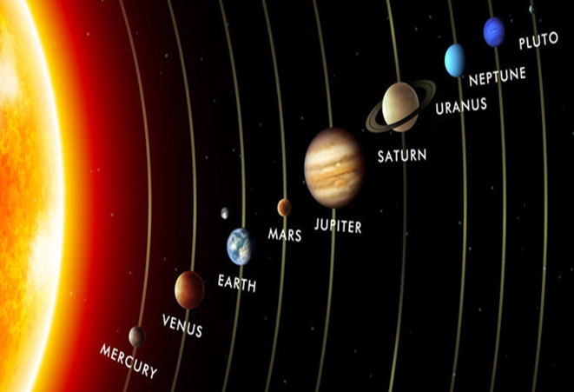
Were the activities successful, and what would you do differently?
They produced individual pieces of work for the Learning Aim A (Solar System):
I stole their PPT designs…

Slide 5
What would I do differently?
I would definitely approach the building of the EBL differently and make sure that evidence of discussions, peer feedback and self-assessment was added as soon as it was completed.
I would take this wider to the other Science groups at L3 / FD and GCSE
I would like to include some actual observations using the Faulkes telescope and NSO

Slide 6
(ODS/GoLab/ISE Portals, and if so how did you find them?
Did I use the online portals?
I reality, NO! But I did make a whole Moodle course for L2 Astronomy:
I had a look but didn’t have time to use them all.
I really want to use GoLab for the Medical Physics Radioactivity in L3 year 2 next year, so that will be one of my pilots along with a new Astronomy Unit for L3 year 2 which will be IBL similar to the Level 2 course I showed you.

Slide 7
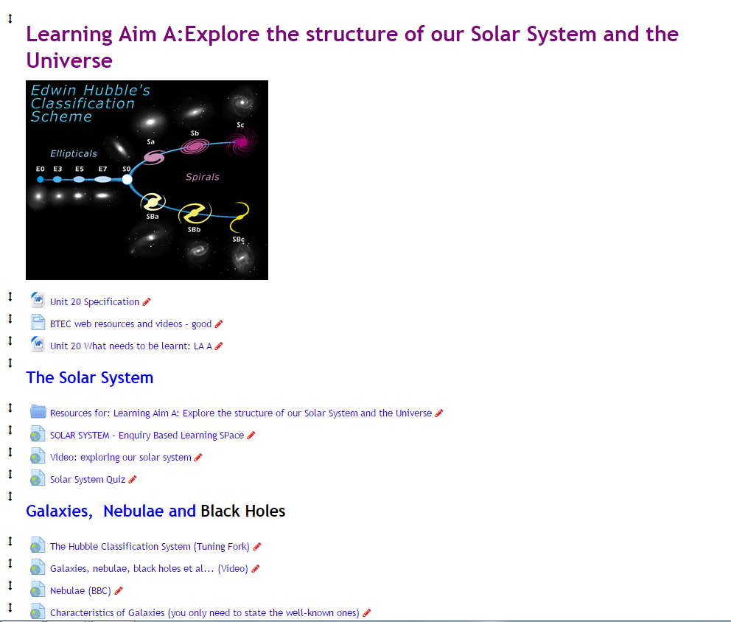
The beginning of my Moodle page:

Slide 8
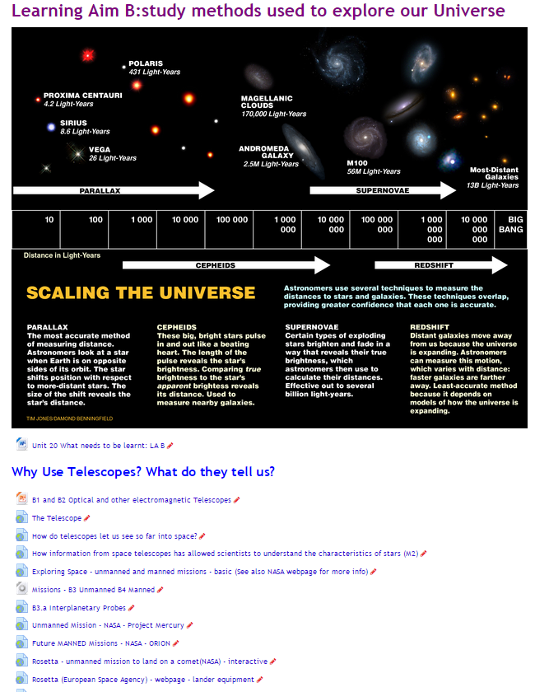
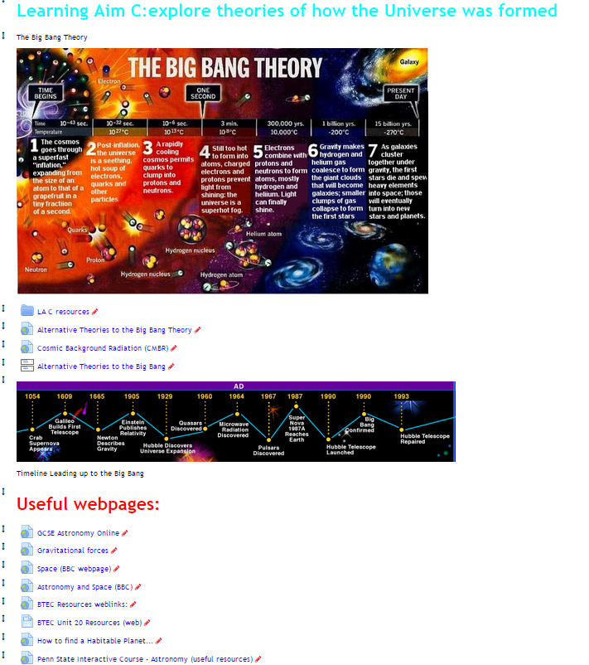
Final 2 Learning Aims:

Slide 9
What were the major challenges I faced?
Time…
Timing…
Moving Deadlines… (always forward)
External pressures (Standards Verifier)
ICT issues (access to internet and software mainly)
Notes:
Time - Lack thereof
Timing – more time over summer to improve
Deadlines – moved forward a month for this unit
Ext Pressures - Was made Lead IV for science across 4 centres! Arghhhhhhh
ICT issues – had to get a Technician to install new software

