Slide 1
Open Discovery Space:
A social platform for school communities

Slide 2
“Lessons Learnt from Open Discovery Space Schools”
Sofoklis A. Sotiriou
Head of Research and Development, Ellinogermaniki Agogi

Slide 3
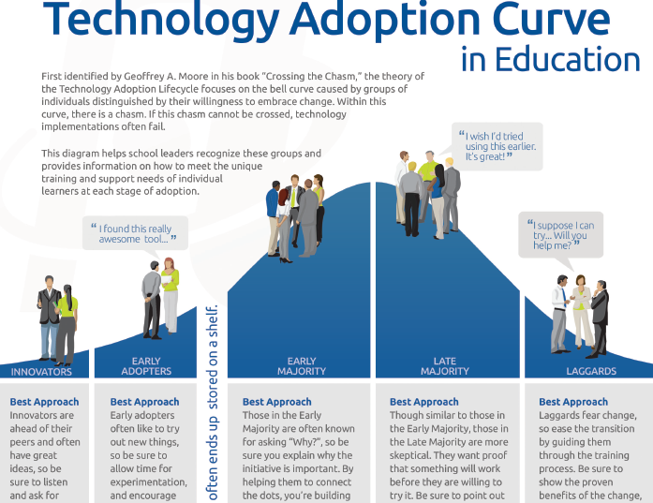
Users profile

Slide 4
CURRENT TRENDS
Social Platforms and Open Tools support the development of teachers and students competences
Bottom up approaches are providing alternative ways to support teachers professional development

Slide 5
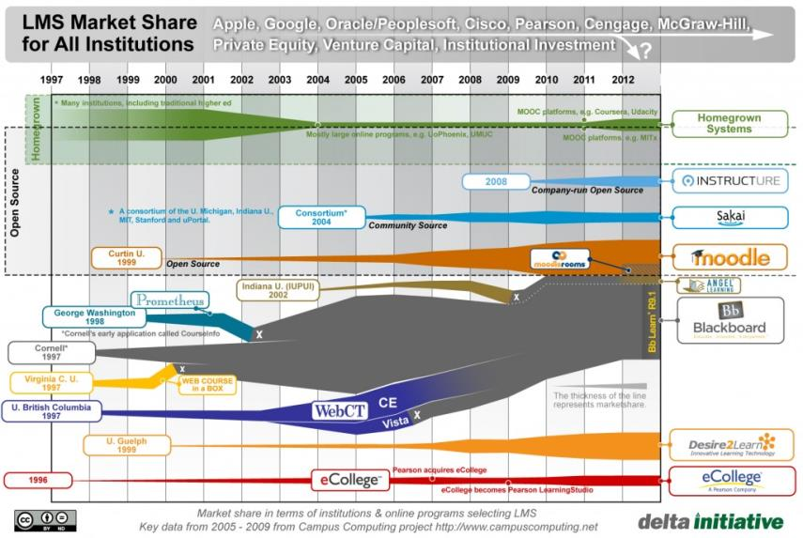
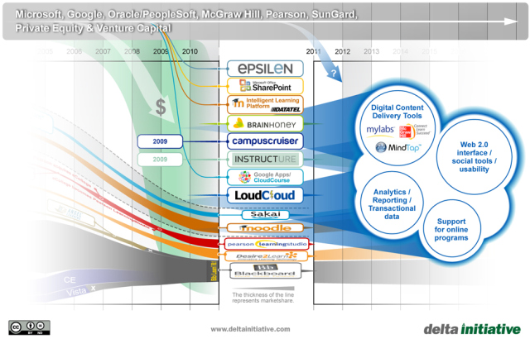

Slide 6
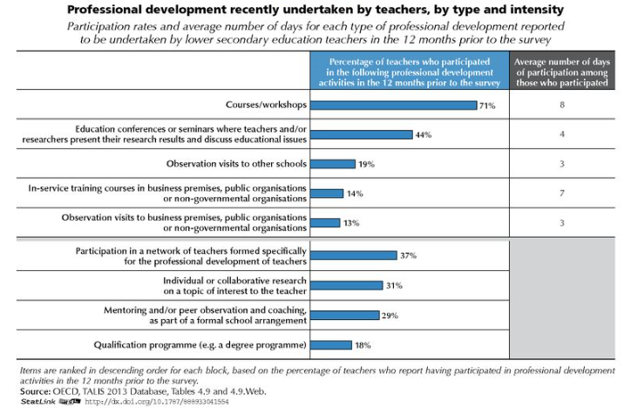
PD programmes

Slide 7
Collaborative Learning and Community Development
What is the mission of a change agent?
A pioneering teacher who leads the team of the participating teachers from each school, and:
Takes initiative in order to implement innovative practices that aim to have long-term effect on the development of the school as a whole.
Develops a strategy for involving and disseminating the results of innovative practices to the whole school community
Develops a strategy for dealing with resistance to change
Reflects on the progress of organizational changes
Explains why innovation is important to ensure long-term success
Supporting the role of change agents (innovative teachers)

Slide 8
Open Discovery Space: Large Scale School Innovation Initiative
3500 schools currently involved
9000 teachers registered

Slide 9
Open Discovery Space: From 2013 to 2015
3,500 schools
9,000 teachers
1,000,000 educational resources

Slide 10
School Innovation Model

Slide 11





















ODS Academies and Communities to support the introduction of innovation in schools
School pages, Blogs & portals
External Educational Repositories & Aggregators
(e.g. TES Connect)
ODS public cloud infrastructure
(ODS users data, ed. Resources, social data)
-computing power
- high availability
User-generated educational content
MyDiscoverySpace Portals
(e.g. school, national, thematic communities)
Teachers Competence Profiles
External Educational Repositories & Aggregators
(e.g. Organic.Edune)
ODS Academies
School Action Plans and e-maturity Data
11

Slide 16
Data
Schools
Communities
Content in the communities

Slide 17
Open Discover Space Schools (e-maturity level)

Slide 19
Comparison Between Countries (Greece vs Finland)

Slide 20
Assessing the impact of the intervention at school level
April-May 2013
April-May 2014

Slide 21
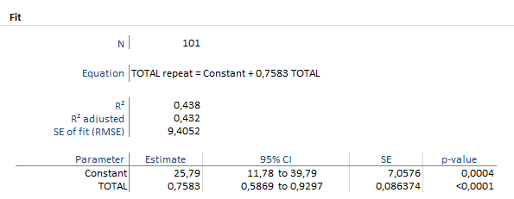
Mapping the Change

Slide 22
Impact on ICT Culture

Slide 23
Impact on Professional Development

Slide 26
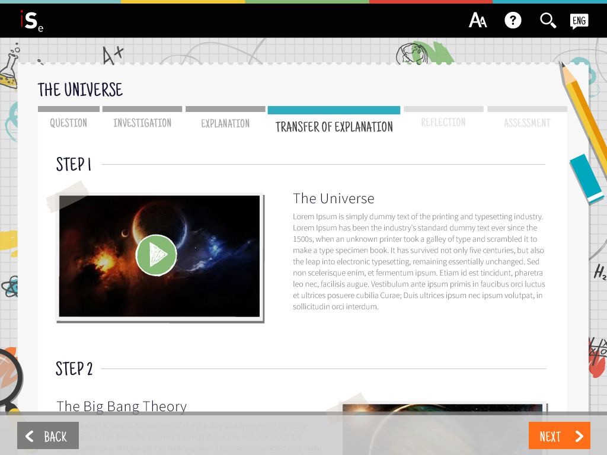
Authoring – Access – Deliver - Assess
Design Lessons/Scenarios by using existing resources and tools (such as online labs, AR/VR tools) and store them on the cloud
Deliver Lessons/Scenarios to students.
Collect Educational Data for student assessment based on PISA Framework

Slide 28
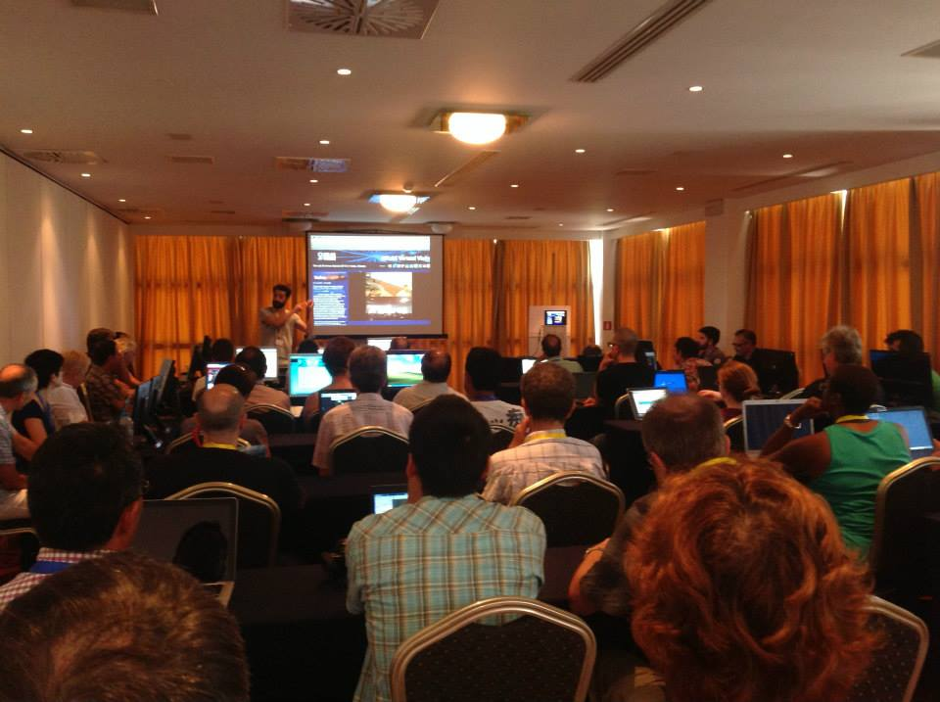
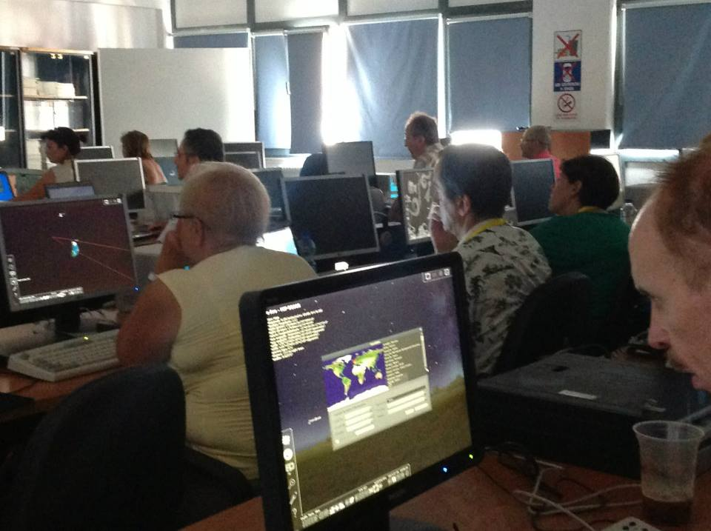
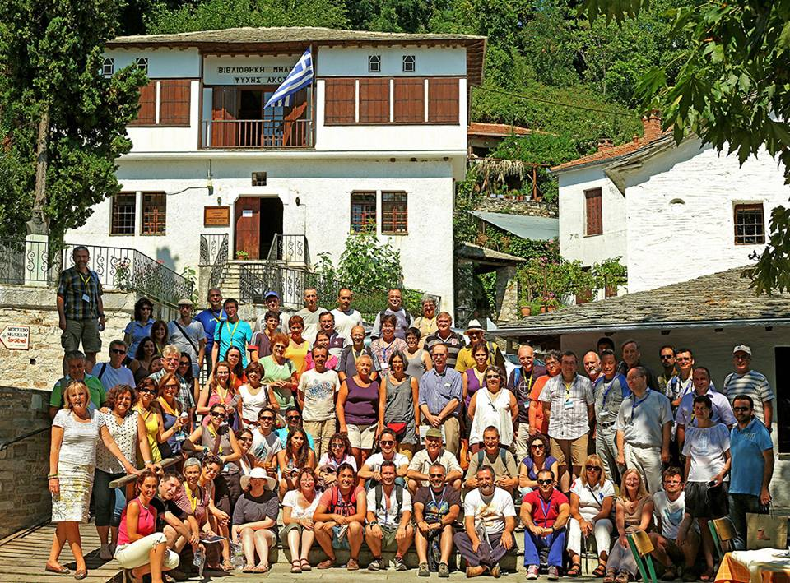
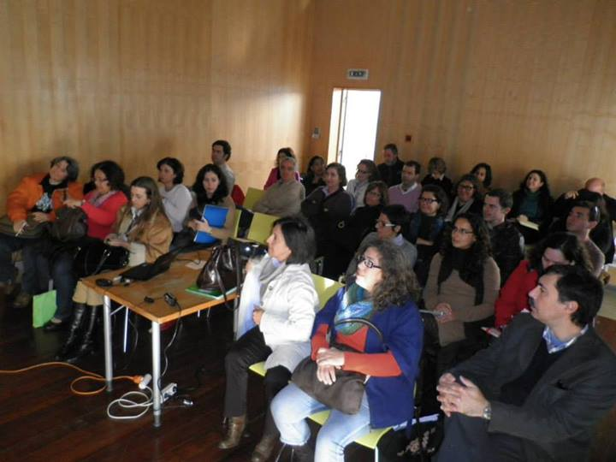
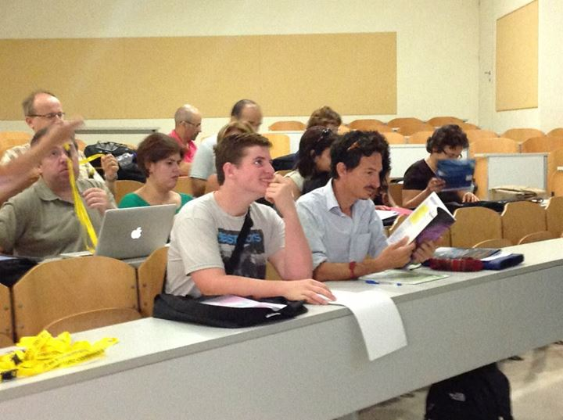
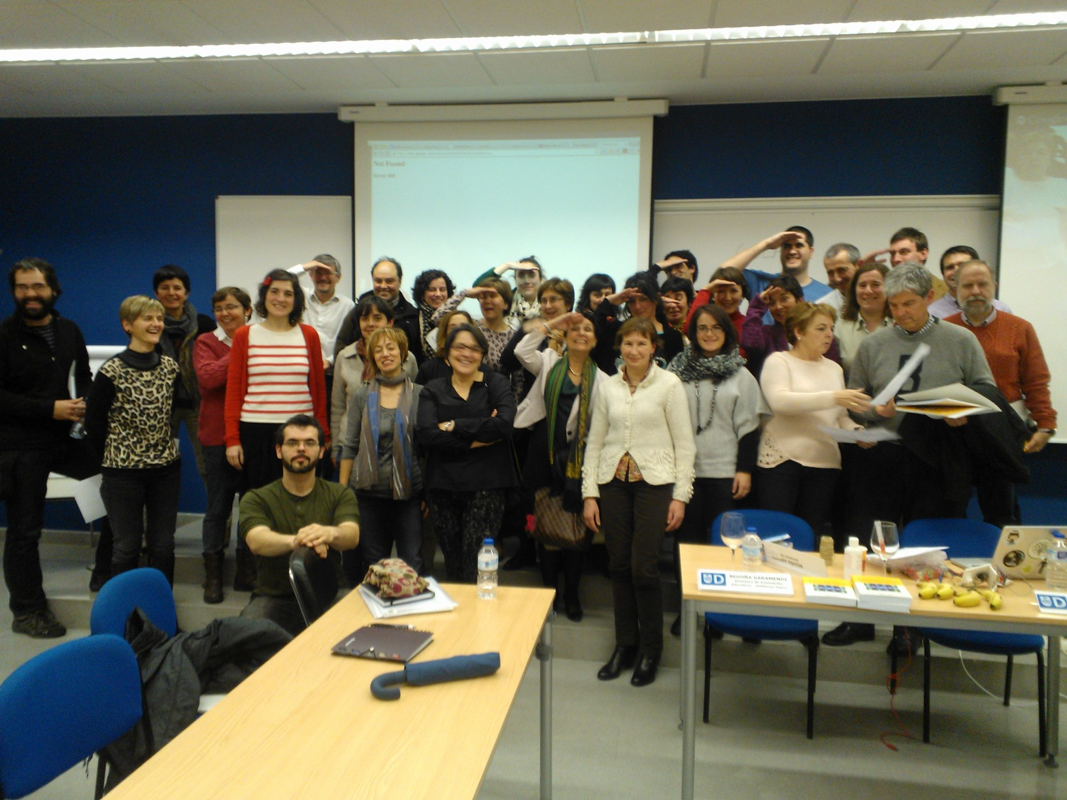

Slide 29
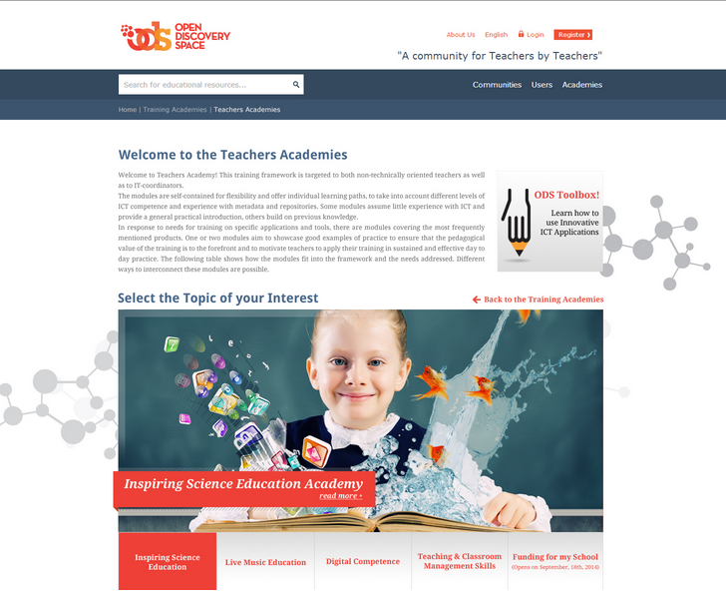
Training framework based on Open Discovery Space Documentation and Approach
ODS Innovation Model
ODS Tool Kit
ODS Best Practices
Guidelines for Teachers (ODS Academies)

Slide 30
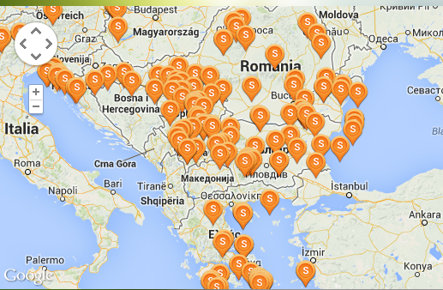

Further Activities
Organisation of workshops in different countries to further develop the proposed framework (in Parallel with EDEN conferences)
Organisation and Support of Teachers and Students Contests
Cooperation with UNESCO in Balkan Countries
Presentations in Conferences and Workshops

Slide 31
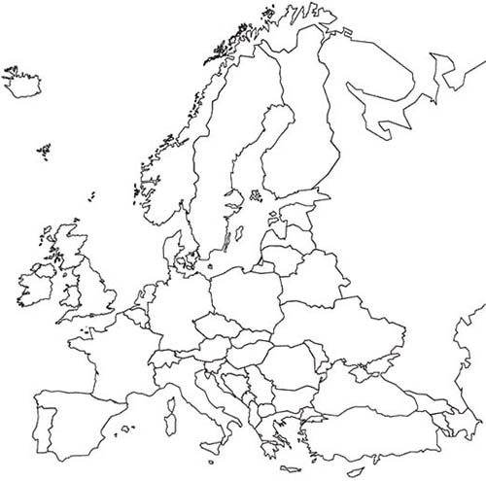
Action Plan for 2015-2016
Helsinki
Split
Varna
Lisbon
Athens

Slide 32

Questions?

