Slide 1


GEOTHNK Semantic pathways for building a spatially-thinking society EXEMPLARY SCENARIOS
European Commission
Education, Audiovisual and Culture Executive Agency (EACEA) Managing programmes and activities on behalf of the European Commission
Unit P1 - Lifelong Learning: Comenius, ICT, Languages and Programme Coordination
Kick-off meeting
Athens, 3-4 Dec. 2013
Grant Agreement N° 2013-3954/ 001-001, Project Number - 543451-LLP-1-2013-1-GR-KA3-KA3MP

Slide 2
Objective
To show schematically how a scenario/pathway involving geospatial concepts and thinking can be designed and represented innovatively to take advantage of existing knowledge resources.
This is to be technologically supported by the GEOTHNK educational platform which will facilitate semantic comparison of geospatial concepts to concepts from other domains (e.g., Environment, Earth Sciences, Social Sciences, etc.) and infer and associate knowledge.
The documentation of the pathways can take advantage of the existing OSR Pathway Authoring Tool.

Slide 3

Using the OSR approach

Slide 4

Steps

Slide 5


Exemplary Activity: Design your own town

Slide 6
GENERAL | Activity | Design your own town | WP3 (Innovative Learning pathways in GEOTHNK). WP5 (Implementation and Trials).
 | Group-level/Duration | Teaching Ages 12-15 ή 16-18. Project duration 3 months. | WP2 (Pedagogical Framework and User Needs Analysis)
 | Objective | The world in spatial terms Human systems Uses of geography Understanding space and environment Understanding urban space and interactions how maps work | WP2 (Pedagogical Framework and User Needs Analysis) WP3 (Innovative Learning pathways in GEOTHNK).
 | Spatial concepts | Location, distance, areas, proximity, connectivity, adjacency, elevation, aspect/slope, scale/detail, time spatial structures spatial properties space-time context position spatial dynamics spatial relations spatial interaction spatial transformations representation spatial principles | WP3 (Innovative Learning pathways in GEOTHNK). WP4 (Developing the GEOTHNK Educational Platform).
 | Advanced concepts | See structured ODS-based vocabularies | WP3 (Innovative Learning pathways in GEOTHNK). WP4 (Developing the GEOTHNK Educational Platform).

Slide 7
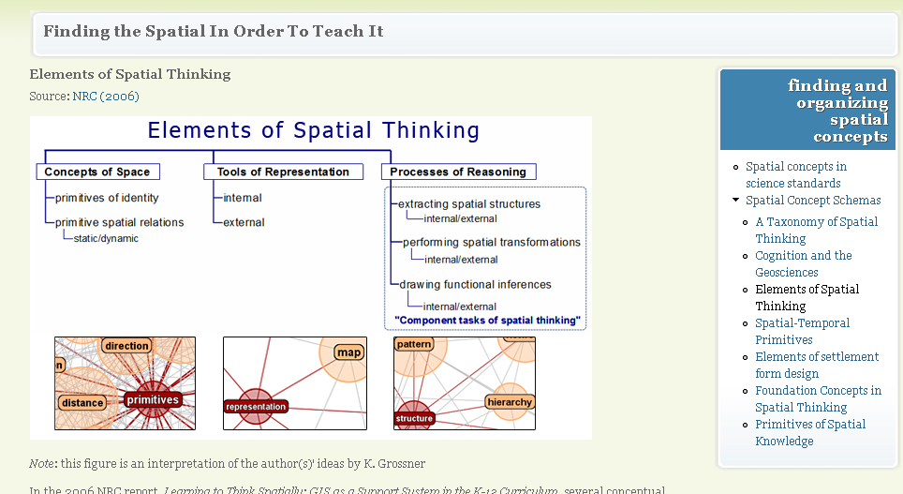
Teachspatial resource http://www.teachspatial.org/

Slide 8

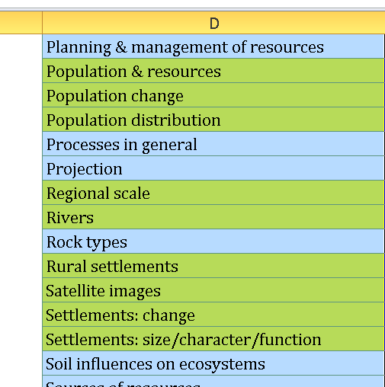
Open Discovery Space vocabulary
Geography | Africa
 | Antarctica
 | Asia
 | Atlases
 | Biomes
 | Changes in distribution of economic activity & their impact
 | Cape
 | Classifications of economic activity
 | Climate
 | Climatic influences on ecosystems
 | Coasts
 | Conflicting demands on environments
 | Deposition
 | Development & quality of life
 | Differences in development between countries
 | Differences in development within countries
 | Dynamic Shape
 | Earthquakes
 | Ecosystems
 | Effects of resource use
 | Environmental issues
 | Erosion
 | European countries outside the European Union
 | European Union
 | Factors influencing development
 | Geographical distribution of economic activity
 | Geographical variations in weather & climate
 | Geomorphological processes - general information
 | GIS
 | Global distribution of tectonic activity
 | Global scale
 | Globes
 | Goods & services
 | Hazards/geomorphological
 | Hazards & human responses
 | Human influences on ecosystems
 | Human patterns
 | Human processes
 | Internal Structure
 | International scale
 | Land use
 | Landforms
 | Less economically developed countries
 | Local scale
 | Location of settlements
 | Maps & plans
 | Migration
 | More economically developed countries
 | Mountain
 | National scale
 | Natural population change
 | North America
 | Oceania
 | Other geomorphological processes
 | Other influences on ecosystems
 | Patterns in general
 | Physical patterns
 | Physical processes
 | Planning & management of resources
 | Population & resources
 | Population change
 | Population distribution
 | Processes in general
 | Projection
 | Regional scale
 | Rivers
 | Rock types
 | Rural settlements
 | Satellite images
 | Settlements: change
 | Settlements: size/character/function
 | Soil influences on ecosystems
 | Sources of resources
 | South & Central America
 | Space-Time Information
 | Spatial information
 | Spatial properties
 | Spatial interactions
 | Spatial interpolation
 | Spatial transformations
 | Supply of resources
 | Surface
 | Tectonic hazards & human responses
 | Tectonic processes
 | Topical geographical issues
 | Types of economic activity
 | Urban settlements
 | Volcanoes
 | Water
 | Water cycle
 | Water, landscapes & people - general information
 | Weather
 | Weathering

Slide 9
INTRO DUCTION | Guidance | The teacher or trainer needs to Develop the necessary background knowledge about semantic pathways in education Be introduced to the ICT tools available in the GEOTHNK platform pick an interesting geographic location possibly but not necessarily with some self-containment (e.g., an island, a cove, a plane terrain) . E.G. dream island decide about the size/population of a town and possibly its primary role/character (a rural/ fishing town, a touristic resort, a university town, a regional center/capital, etc). | WP3 (Innovative Learning pathways in GEOTHNK). WP4 (Developing the GEOTHNK Educational Platform). WP5 (Implementation and Trials).

Slide 10
PRE-VISIT | 1.1 Provoke curiosity | The teacher shall present to the students examples of different town types, good, unexpected, paradoxical, or bad design/evolution. Also he/she can ask the students some provocative questions about their realizations, criticism of familiar urban sites neighborhoods. Tools would be historical or recent imagery, available on the web, google earth, maps. | WP5 (Implementation and Trials). WP3 (Innovative Learning pathways in GEOTHNK).
 | 1.2 Define questions from current knowledge | The teacher asks/directs students to think and express more systematically and scientifically the concepts involved (city, town, infrastructures, environment, designated areas/zones, etc.) and their spatial relations/ interaction. Special attention will be paid in the main representation tool (map), the spatial qualitative/quantitative characteristics of the available landscape (understand topography, scale, location and distance, boundaries, slope zones, aspect, proximity, buffer zones, etc.). | WP5 (Implementation and Trials). WP4 (Developing the GEOTHNK Educational Platform).
 | 2.1 Propose preliminary explanations or hypotheses | The teacher should be guided here to identify possible misconceptions in students' thinking. The teacher may form groups and ask them to follow different approaches in explaining urban space cases. The teacher is supposed to combine the feedback from students’ answers into the design of the hypothesis. | WP5 (Implementation and Trials). WP4 (Developing the GEOTHNK Educational Platform).
 | 2.2 Plan and conduct simple investigation | Describe ways and materials (resources already available in the OSR Portal, or other) that the teacher can use to facilitate the students to focus on evidence as a source of answers to scientific questions. This is the phase in which students are being prepared for the subsequent phase of evidence gathering during observation. http://www.un.org/cyberschoolbus/habitat/units/un01txt.asp http://www.ukcities.co.uk/definitions/ http://ec.europa.eu/regional_policy/sources/docgener/focus/2012_01_city.pdf | WP5 (Implementation and Trials). WP4 (Developing the GEOTHNK Educational Platform).

Slide 11
VISIT | 3.1 Gather evidence from observation | This is the core stepwise approach for designing the town. The teacher will search in the platform or the web for other similar/related educational pathways town planning He/she will determine the extent of the knowledge domain (supporting spatial/aspatial concepts needed) depending on the group characteristics (age, background, interest) The teacher will define the proposed new pathway with the use of the platform tools: the connection/”sequence” of high level concepts involved, the associated spatial concepts, the resources available including other existing pathways. The teacher will define same or different criteria for the groups to follow and assist them throughout the exercise providing methodological and technical support guidance. The representation tools available include light and open digital GI environment, statistical and reasoning tools. | WP5 (Implementation and Trials). WP4 (Developing the GEOTHNK Educational Platform).
 | 4.1 Explanation based on evidence | The teacher will observe the progress of the town design and provoke internal or cross- group discussion on the approach taken and the results of their effort. | WP6 (Validation). WP5 (Implementation and Trials). WP4 (Developing the GEOTHNK Educational Platform). WP2 (Pedagogical Framework and User Needs Analysis)

Slide 12
POST-VISIT | 5.1 Communicate explanation | Guide the teacher to facilitate each student group to reflect on the previous experiences and produce a report with its findings, presenting and justifying its proposed explanations to other groups and the teacher. Make available or direct to materials (resources already available in the OSR Portal, or other) which the teacher can use to help the students familiarize themselves with and become effective in scientific writing. The solutions taken will be presented by visual means, mainly maps and technical reports . Other more advanced means may be used such as 3D rendering or other. Furthermore, at this step, the teacher organizes the process of a comparison-contest of the solutions proposed/exhibited in order to assess/compare proposed solutions on various criteria (functionality, variability, quality of life, environment, sustainability, etc.) | WP5 (Implementation and Trials). WP2 (Pedagogical Framework and User Needs Analysis) WP6 (Validation). WP4 (Developing the GEOTHNK Educational Platform).
 | Follow-up activities and materials | Describe and direct the user to any follow-up activities or materials that can be used to wrap-up the main visit experience. These could include appropriate learning assessment and/or reminder materials (e.g. quizzes, games, other user-friendly tests), hints for further activities, suggestions for other relevant visits, etc. This includes a post/self-evaluation report indicating the experience of running the pathway approach, new knowledge facilitated/acquired, drawbacks, functionality of the technical tools, …. | WP6 (Validation). WP5 (Implementation and Trials). WP4 (Developing the GEOTHNK Educational Platform).
 | Sustainable contact |  | WP7 (Dissemination)
FINAL | Final |  | WP8 (Exploitation)

Slide 13
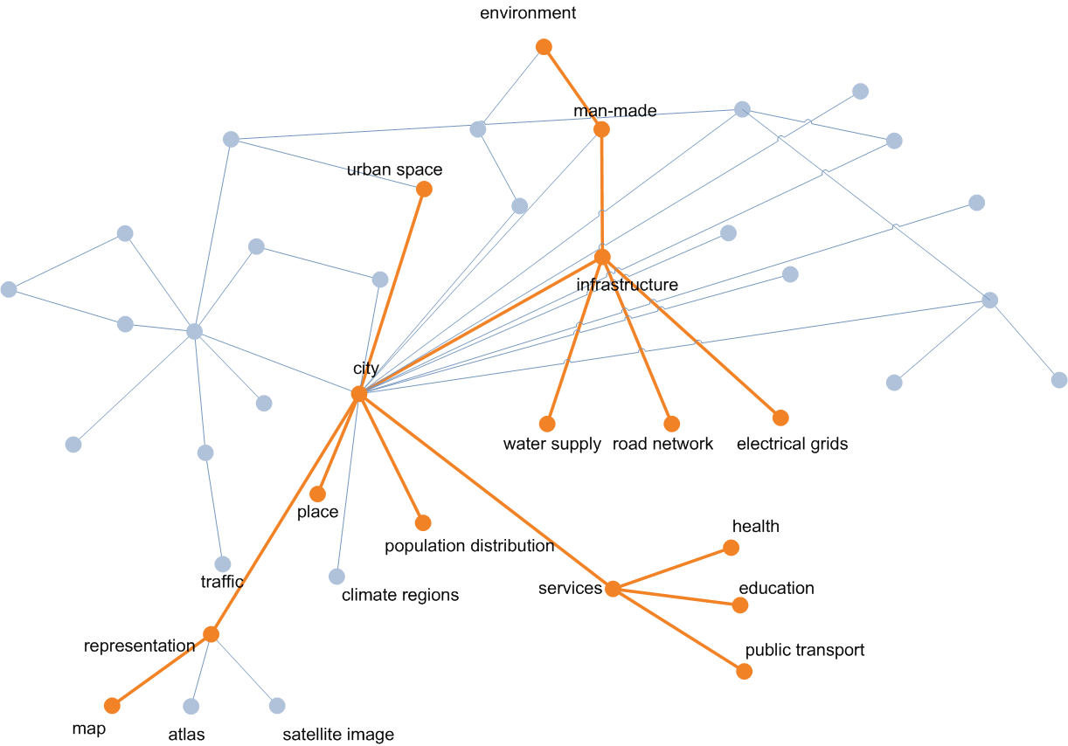
Design your own town

