Slide 1


Star in a Box
Exploring the lifecycle of stars

Slide 2
Guide to this presentation
White slides are section headings, and are hidden from the presentation. Show or hide the slides in each section as appropriate to the level required.
Rough guide to the levels:
Beginner: KS3
Intermediate: KS4 (GCSE)

Slide 3
Introduction
Basics of what a star is and how we observe them.
Level: Beginner +

Slide 4
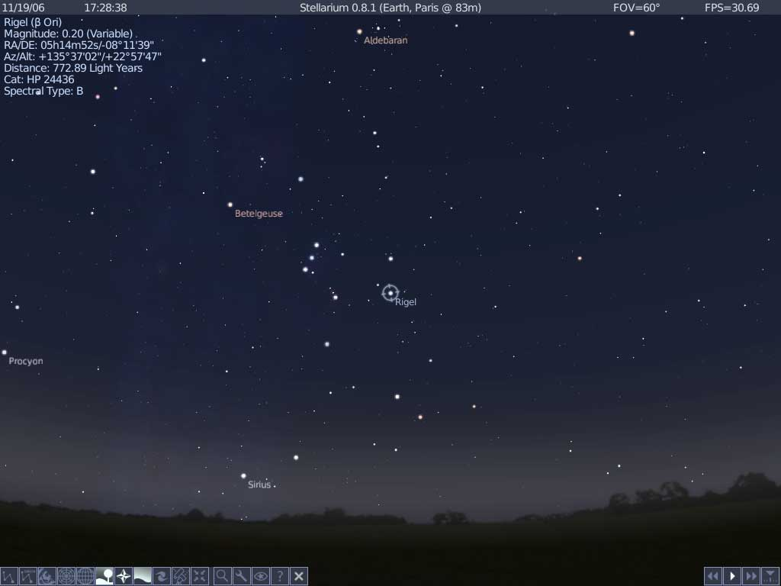
Stars in the Night Sky

Slide 5
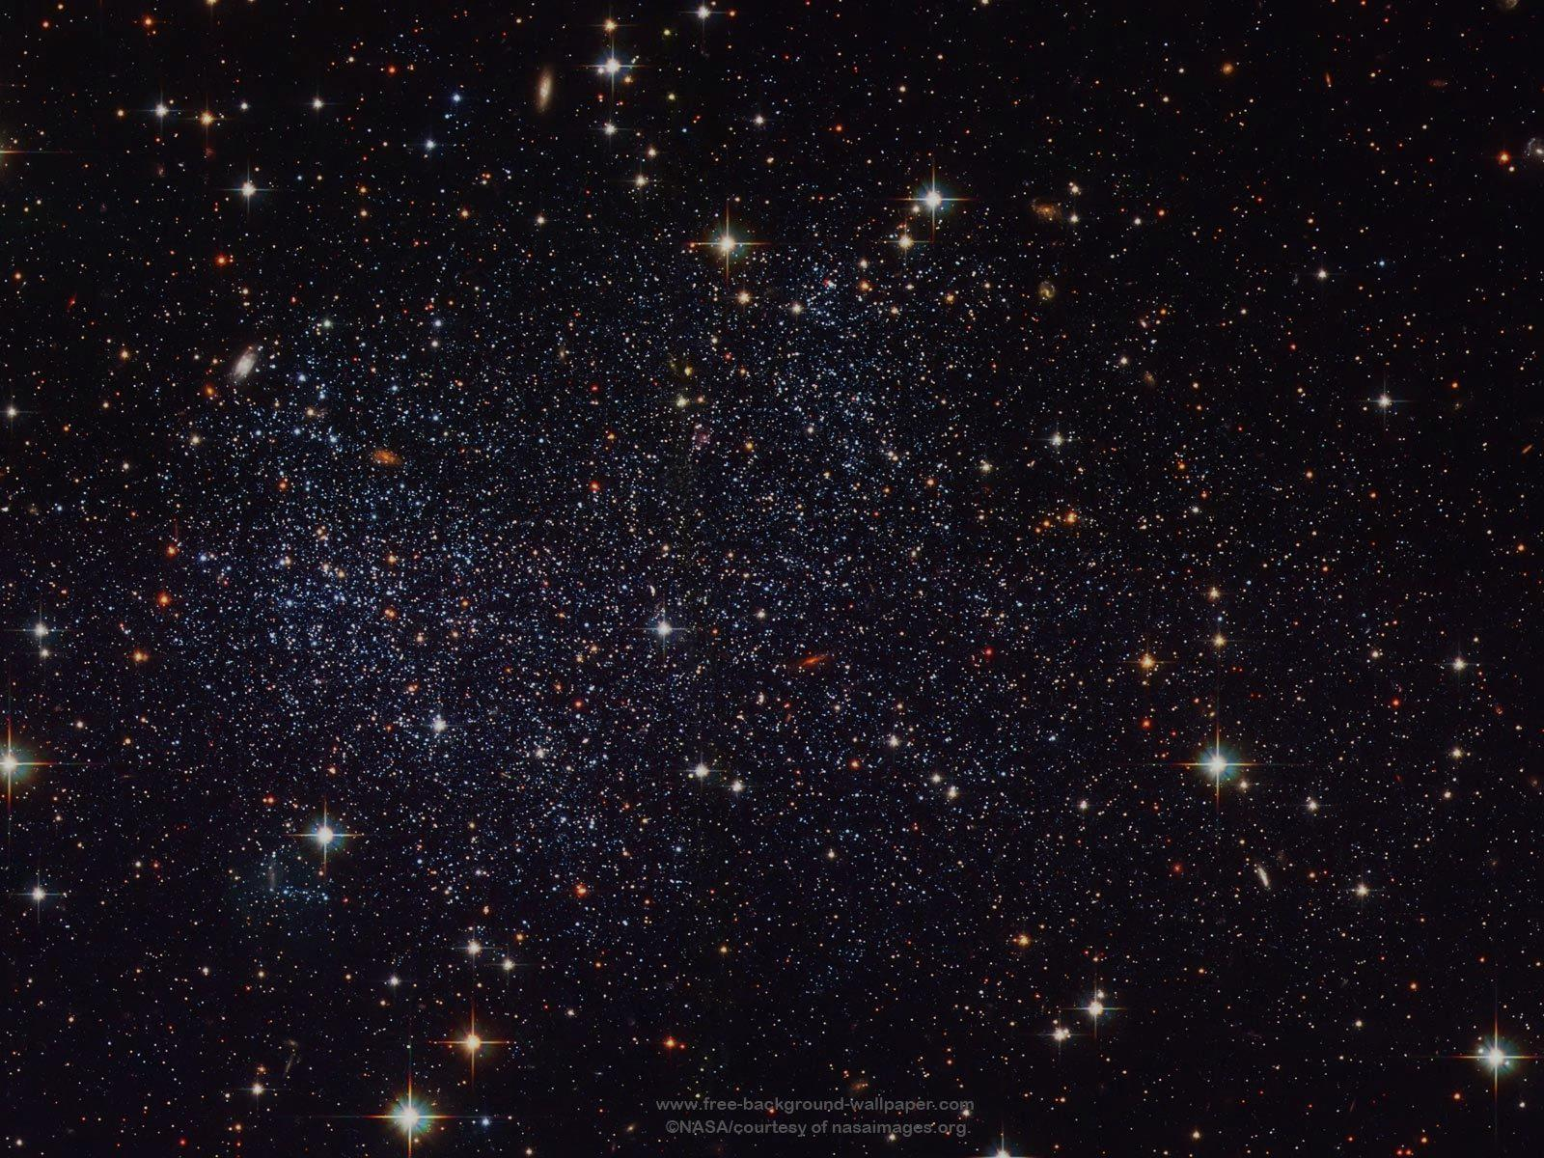
What is a Star?
A cloud of gas, mainly hydrogen and helium.
The core is so hot and dense that nuclear fusion can occur.
  This is where the energy comes from that makes the stars shine.
The fusion converts light elements into heavier ones.
  This is where all the atoms in your body have come from.

Slide 6
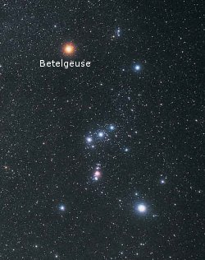
All the Stars in the
Night Sky are Different
Luminosity:
  Tells us how bright the star is, i.e. How much energy is being produced in the core.
Colour:
  Tells us the surface temperature of the star.
Rigel

Slide 7
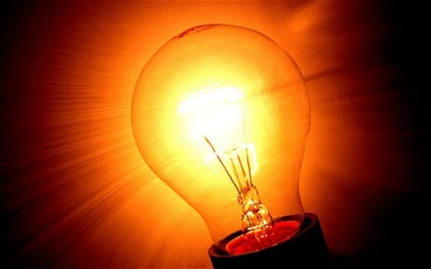
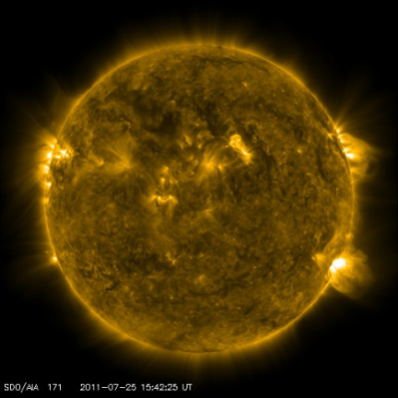
Units of Luminosity
We measure the luminosity of every day objects in Watts.
  How bright is a light bulb?
  10-20W
By comparison, the Sun outputs:
  380,000,000,000,000,000,000,000,000 Watts
  (380 million million million million Watts!)
  or 3.8 x 10²⁶ Watts
We measure the luminosity of other stars relative to the Sun.

Slide 8
Units of Temperature
Temperature is measured in Kelvin.
The Kelvin temperature scale is the same as the Celsius scale, but starts from -273º.
  0 K (or -273ºC) is known as “absolute zero”
-273 ºC
-173 ºC
0 ºC
100 ºC
1000 ºC
0 K
100 K
273 K
373 K
1273 K
Kelvin = Celsius + 273

Slide 9
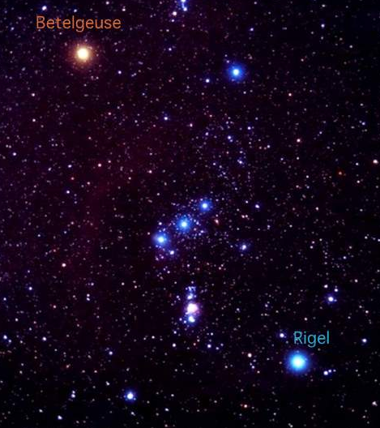
Measuring the Temperature
The colour of a star indicates its temperature.
Red stars are cold, and blue stars are hot.
The Sun is a yellow star, its temperature is 5800 K.
Betelgeuse is a red supergiant.
Its temperature is 3,000 K
Rigel is a blue
supergiant.
Its temperature is 12,000K

Slide 10
Hertzsprung-Russell Diagram
An introduction to the H-R diagram, on which various stars will be plotted – try to get the students to suggest where they might appear before they are plotted.
Level: Beginner +

Slide 11
The Hertzsprung Russell Diagram
We can compare stars by
showing a graph of their
temperature and luminosity.
Where do the stars in the
night sky fit on this graph?
Aldebaran
Betelgeuse
Rigel
Sirius

Slide 12
We start by drawing the axes:
Luminosity up the vertical axis (measured relative to the Sun)
Temperature along the horizontal axis (measured in Kelvin)
10,000
The stars Vega and Sirius are brighter than the Sun, and also hotter. Where would you put them?
100
Where would you mark the Sun on the plot?
It has Luminosity of 1 relative to itself
Its temperature is 5800 K
Vega
Sirius
Main Sequence
Luminosity (relative to Sun)
1
Sun
In fact, most stars can be found somewhere along a line in this graph.
This is called the “Main Sequence”.
0.01
Some stars are much cooler and less luminous, such as the closest star to the Sun, Proxima Centauri. Where would you plot these?
These stars are called red dwarfs.
Proxima Centauri
0.0001
25,000
10,000
7,000
5,000
3,000
Temperature (Kelvin)

Slide 13
The bright star Betelgeuse is even more luminous than Aldebaran, but has a cooler surface.
This makes it a red supergiant.
Betelgeuse
Rigel
10,000
Deneb
Aldebaran
Arcturus
100
Vega
Sirius
Main Sequence
Luminosity (relative to Sun)
1
Sun
Even brighter than Betelgeuse are stars like Deneb and Rigel, which are much hotter.
These are blue supergiants.
But not all stars lie on the main sequence. Some, such as Arcturus and Aldebaran, are much brighter than the Sun, but cooler. Where would these lie on the diagram?
These are red giant stars.
Sirius B
0.01
Proxima Centauri
Some of the hottest stars are actually much fainter than the Sun. Which corner would they be in?
These are white dwarfs, such as Sirius B which orbits Sirius.
0.0001
25,000
10,000
7,000
5,000
3,000
Temperature (Kelvin)

Slide 14
Supergiants
Betelgeuse
Rigel
10,000
Deneb
Giants
Arcturus
100
Vega
Sirius
Main Sequence
Luminosity (relative to Sun)
Almost all stars we see are in one of these groups, but they change groups during their lives.
1
Sun
Sirius B
0.01
As stars evolve they change in luminosity and temperature.
This makes them change position on the Hertzprung-Russell diagram.
Proxima Centauri
White Dwarfs
0.0001
25,000
10,000
7,000
5,000
3,000
Temperature (Kelvin)

Slide 15
10,000
100
Luminosity (relative to Sun)
1
Sun
The Sun has been on the Main Sequence for billions of years, and will remain there for billions more.
But eventually it will swell into a giant star, becoming more luminous but cooler.
0.01
0.0001
25,000
10,000
7,000
5,000
3,000
Temperature (Kelvin)

Slide 16
10,000
100
Sun
Luminosity (relative to Sun)
1
At this point it is a red giant star.
It will get then hotter and slightly brighter.
0.01
0.0001
25,000
10,000
7,000
5,000
3,000
Temperature (Kelvin)

Slide 17
10,000
Sun
100
Luminosity (relative to Sun)
1
0.01
Finally nuclear fusion in the core will cease.
The Sun will become a white dwarf, far less luminous, but with a hotter surface temperature.
0.0001
25,000
10,000
7,000
5,000
3,000
Temperature (Kelvin)

Slide 18
Star in a Box
At this point, run star in a box to explore the Hertzsprung-Russell diagram for different mass stars.
Level: Beginner +

Slide 19
Nuclear fusion
The processes taking place in the centre of a star.
Level: Intermediate +

Slide 20
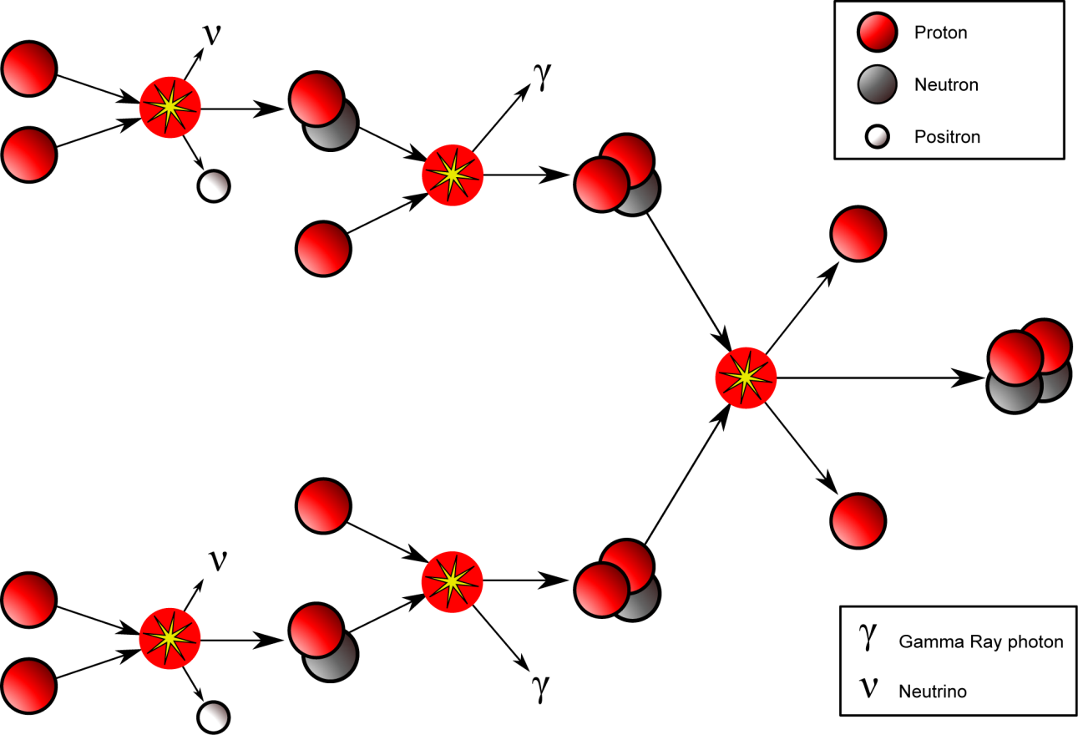





Nuclear Fusion
The luminosity of a star is powered by nuclear fusion taking place in the centre of the star converting hydrogen into helium.
  The temperature and density must be high enough to allow nuclear fusion to occur.
  Stars are primarily composed of hydrogen, with small amounts of helium.
$${}_{}^{1}H$$
$${}_{}^{2}H$$
$${}_{}^{1}H$$
$${}_{}^{1}H$$
$${}_{}^{3}{He}$$

Slide 21
Stable Stars
While the star is on the Main Sequence, it is in a stable state.
The inward force of gravity trying to collapse it, and the radiation pressure outwards from Hydrogen fusion are balanced.

Slide 22
Running out of Hydrogen
As the hydrogen runs out, the energy released from fusion decreases which reduces the outward force.
The forces are now unbalanced, and the larger force of gravity causes the star core to collapse.
If the star is massive enough, the core temperature increases until helium fusion starts.

Slide 23
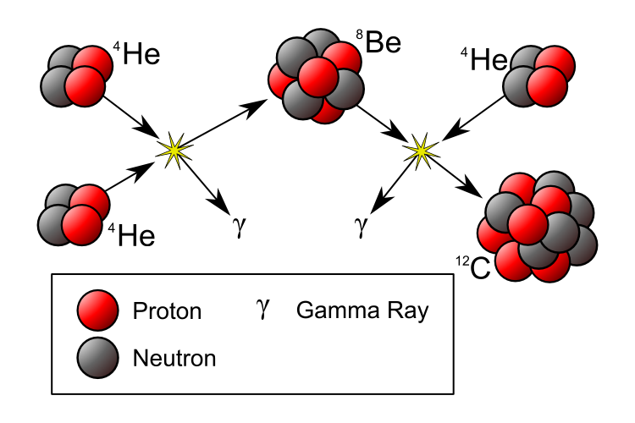
Helium Fusion
When the temperature is greater than 100 million Kelvin, 3 Helium nuclei can be fused together to produce 1 carbon nucleus.

Slide 24
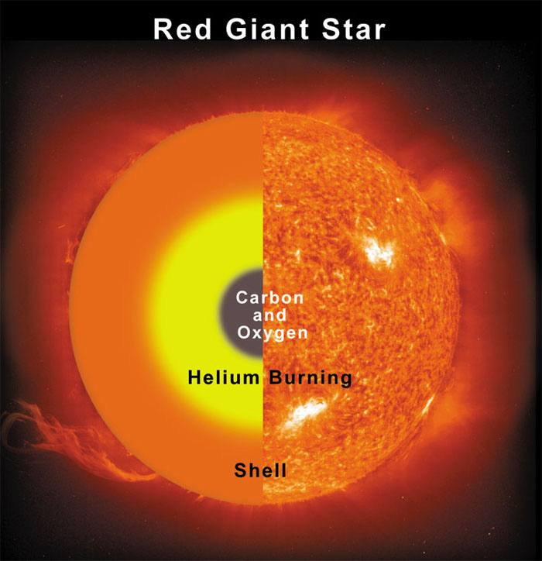
Running out of Helium
The carbon nucleus can then fuse with another helium nucleus to make oxygen.
Eventually the helium supply
will run out and the
star will collapse.
If the star has enough mass, the temperature in the collapsed core will increase enough to allow carbon-carbon fusion.
Fusion

Slide 25
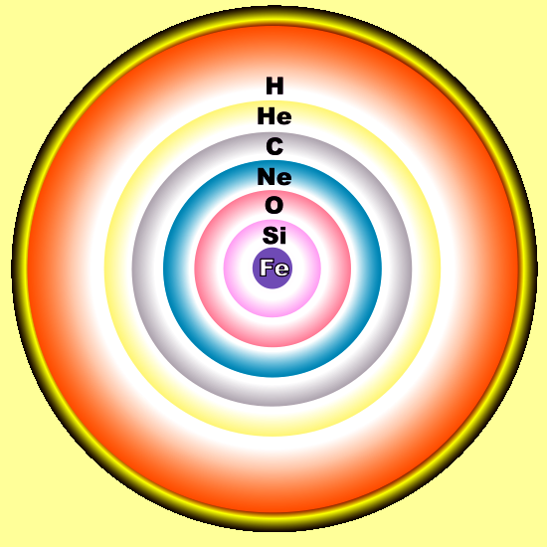
Heavier Elements
This cycle continues, fusing heavier elements each time the core collapses.
  e.g. neon, magnesium, silicon and iron
The more massive a star is,
the heavier the elements it
can create in its core.
Iron is the heaviest element that can be created through nuclear fusion without adding extra energy.

