Slide 1
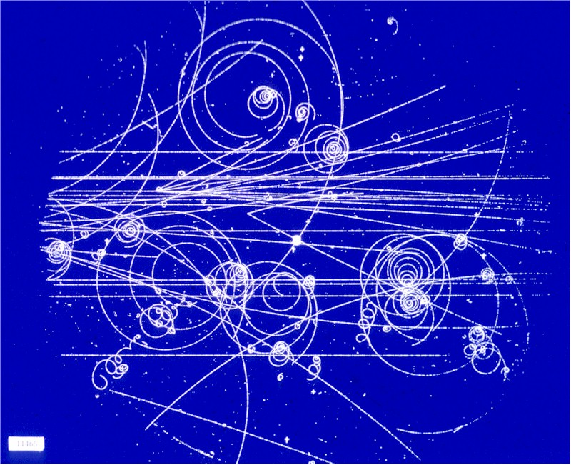
A short journey to the infinitely small
Fundamentals of Particle Physics
The Standard Model
Building blocks: particles and forces
Current areas of research - NEUTRINOS
Smyrnaiou Zacharoula, Liana Petropoulou, Zois Asimakopoulos, George Philippou
April 2016

Slide 2


Warning
This journey may change your vision of the Universe.
What you will hear may alter your perception of reality.
Stay awake and keep an open mind!
We are entering a Quantum World..
Notes:
Quantum is the Latin word for amount and, in modern understanding, means the smallest possible discrete unit of any physical property, such as energy or matter . Quantum came into the latter usage in 1900, when the physicist Max Planck used it in a presentation to the German Physical Society.

Slide 3
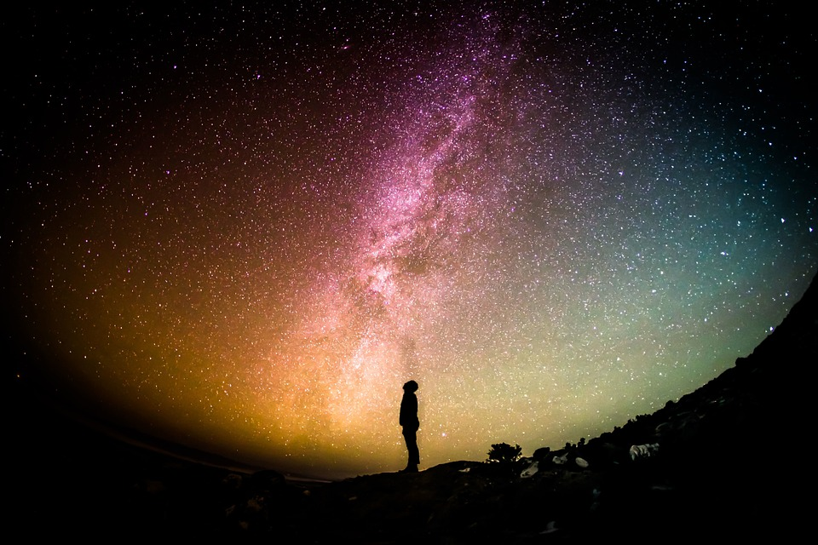
Top Mysteries of the Universe
What does C.E.R.N stand for?
What are the goals of CERN’s research?
What is the universe made of?
Which are the fundamental particles?
How many different types of matter particles exist?
What are the ‘anti-particles’?
Notes:
European Council for Nuclear Research Study matter, fields and The origin of the Universe 13.7 billion years Particle accelerators

Slide 4
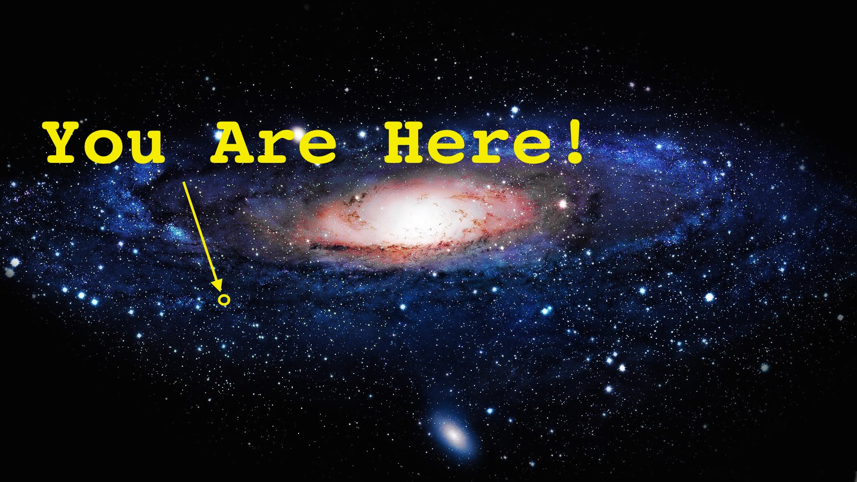
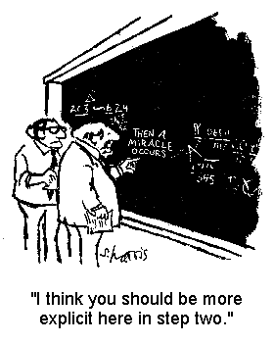
What is the universe made of? OR
Which are the fundamental particles?
http://popplet.com/app/#/3092760
Notes:
What does the word fundamental mean? Give a definition.

Slide 5

A particle is fundamental = elementary if it has no inner structure (i.e not “made” of some even smaller entities).

Slide 6
What is the Universe made of?
BRAINSTORMING

Slide 7
One of the primary goals in modern physics is to answer the question "What is the Universe made of?" Often that question reduces to "What is matter and what holds it together?“* This continues the line of investigation started by Democritus, Dalton and Rutherford.
Which particles were considered elementary throughout History?
Gradual discoveries and where we stand now.
1ST WORKSHEET
*Which are the fundamental particles? OR the smallest building blocks of matter? OR What did the Big Bang produce during its first few minutes?

Slide 8
Earliest times - 1550 AD: The Ancients

Slide 9
1550 - 1900 AD: The Scientific Revolution and Classical Mechanics

Slide 10
1900 - 1964 AD: Quantum Theory

Slide 11
‘Contemporary discoveries in Particles Physics’

Slide 12
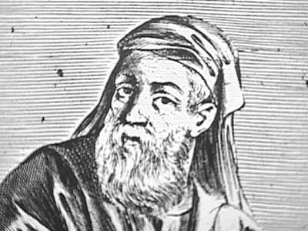
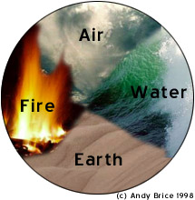
History of search
for basic building
blocks of nature
Empedocles:
Earth
Air
Fire
Water

Slide 13
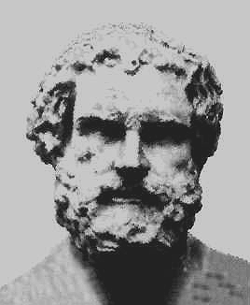
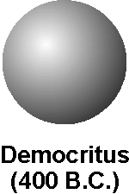
Democritus
Democritus’s model stated :
that matter consists of invisible particles called atoms and a void (empty space).
that atoms are indestructible and unchangeable.
that all atoms differ in size, shape, mass, position and arrangement, with a void existing between them.

Slide 14
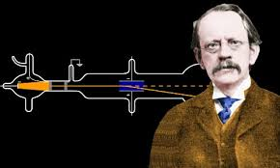
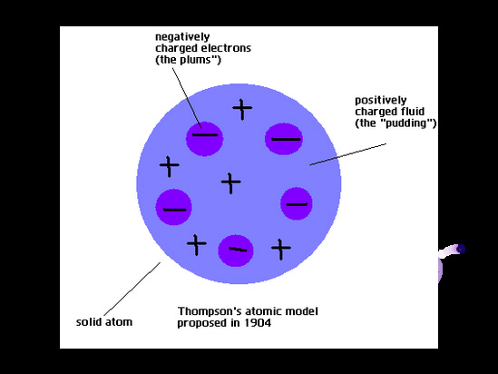
THOMSON
John Thomson discovered the electron and proposed a model for the structure of the atom. Thomson’s model was known as the "Plum Pudding Model” (or "Raisin Bread Model.")

Slide 15
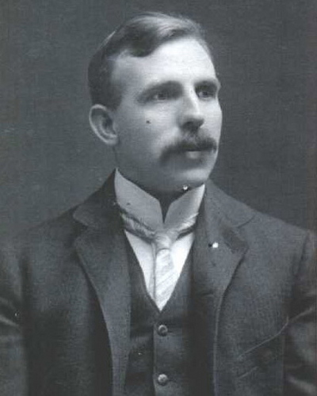
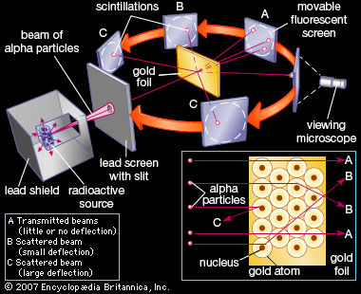
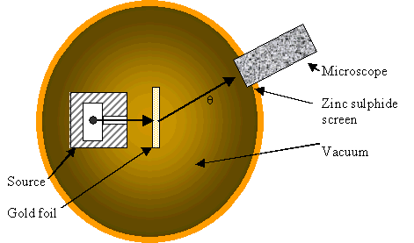
Rutherford: atoms are not elementary particles!
http://www.mhhe.com/physsci/chemistry/essentialchemistry/flash/ruther14.swf
1911
Rutherford found a nucleus in the atom by firing alpha particles at gold and observing them bounce back
Precursor of modern scattering experiments at accelerator

Slide 16
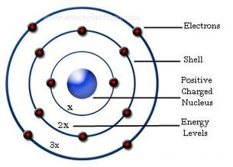
Bohr’s Model
RULE 1: Electrons can orbit
only at certain allowed distances from the nucleus.
in fixed, circular orbits (or energy levels) around the nucleus, called electron shells.
RULE 2: Atoms radiate energy when an electron jumps from a higher-energy orbit to a lower-energy orbit. Also, an atom absorbs energy when an electron gets boosted from a low-energy orbit to a high-energy orbit
NB. electrons furthest from the nucleus have higher energy
1. www.cs.sbcc.edu/physics/solar/sciencesegment/bohratom.swf

Slide 17
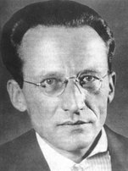
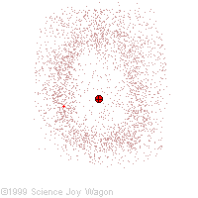
Erwin Schrödinger
Erwin Schrödinger took the Bohr atom model one step further.
The quantum mechanical model of the atom :
does not define the exact path of an electron
predicts the odds of the location of the electron
This model can be portrayed as a nucleus surrounded by an electron cloud.
Where the cloud is most dense, the probability of finding the electron is greatest, and conversely, the electron is less likely to be in a less dense area of the cloud.
Imagine, as the electron moves it leaves a trace of where it was

Slide 18
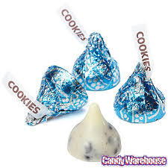


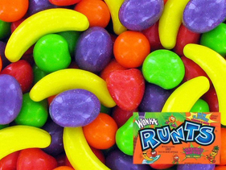
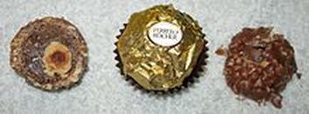
Candy model quiz
Can you figure out which "candy model" best represents :Democritus' /Thomson's / Rutherford's /Bohr's / Schrödinger’s model of the atom?
1. Hershey's Cookies N' Cream Kiss
2. Cotton Candy
3. Gobstopper
5. Ferrero Rocher
4. Runts

Slide 19

From the particle garden to the jungle
Σ⁰
Λ⁺
Δ⁻
Δ^{ο}
Κ⁻
π^{ο}
Δ⁺
Ω⁻
π⁻
p
π⁺
Δ⁺⁺
Κ⁰
Κ⁺
W h a t a j u n g l e !

Slide 20
Video CERN: ‘The Standard Model of Particle Physics’ (5.02 min))
https://www.youtube.com/watch?v=V0KjXsGRvoA
2nd Worksheet

Slide 21
Task 1: Glossary. Match the words in column A wit the definitions in column B
Task 2: Complete the sentences based on the video
1. The objective of Particle Physics is to understand the ______________________ and ________________ in nature.
The beginning...
2. . but a great simplification was made when we realised that all atoms are just made out of three particles, the _________________, the __________________ and the _________________.
3. But it became much more complicated in the beginning of the 20th century when we found many many new particles from ______________________.
4. And this was the birth of the __________________________________.
Building the model
5. In addition to these quarks there’s another set of fundamental ___________________________of matter, the so called leptons ....
The forces
6. The weak force explains the energy production of the sun and is responsible for the __________________________ beta decay.
7. The electromagnetic force is responsible for the propagation of __________________ or for the fact that a _____________ can pick up a paper clip.
The Higgs
8. This is a beautiful theory, it is ______________________, it is __________________ but it is __________________________.
9. There’s one last missing piece of this puzzle. It’s the ______________________ of the particle physics.
Beyond the Model
10. These are things like __________________, ________________________ or even ________________________________.
Column A | Column B
element | Being an original or primary source
B. decay | 2. Act between bodies of matter and that are mediated by one or more particles
C. dark matter | 3. The branch of physics that deals with the properties and behavior ofelementary particles.
d. fundamental | 4. A process in which a particle disappears and in its place different particles appear.
e. building blocks | 5. Being an indication of the future or of future conditions
f. forces | 6. A theory of physics that attempts to unify the fundamental forces of matter under one theory
g. force carrier | 7. A basic element or component
h. self-consistent | 8. Any of four elementary particles that mediate one of the four fundamental forces.
i. predictive | 9. Not having parts or aspects which are in conflict or contradiction with each other.
j. particle physics | 10. The simplest type of chemical substance.
k. supersymmetry | 11. It is in space but is not visible to us because it emits no radiation that we can observe
l. Standard Model | 12. A theory of fundamental particles and interactions developed by physicists
Task 3: Write (T) for true and (F) for false.
Elements are all made of the same atoms.
All atoms are made of three particles.
The particles’ properties are things like spin, electrical charge, the mass of the particles and the frequency of the particle.
Leptons are composed of an electron, the muon and the tau and their neutrinos.
The gluon, the force carrier of the strong interaction glues together the quarks in the electrons and it holds the atom together.
The Standard Model is a totally complete theory that explains everything about the creation of the world.

Slide 22
‘The Adventure of particles’: Interactive Simulation
http://pdg.web.cern.ch/pdg/cpep/startstandard.html
3rd Worksheet

Slide 23
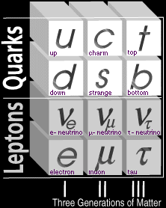
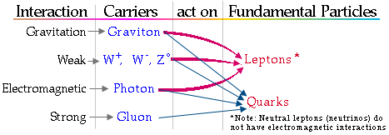
http://pdg.web.cern.ch/pdg/cpep/summary_inter.html
1.Which interactions act on neutrinos?
2.Which force carriers have not been observed?
3. What does stable matter around us contain?

Slide 24

Leptons vs Quarks

Slide 25
The Particles IN THE Standard Model and their Properties
https://www.youtube.com/watch?v=nlv06lSAC7c quarks (3.17)
https://www.youtube.com/watch?v=E99HuhaXO08 leptons (2.31)
There are two types of particles that are thought to be fundamental = cannot be broken down into any smaller constituent particles.
Leptons, anti-leptons,
Quarks, anti-quarks
However, these can, under the right conditions, be converted into energy, or be formed from bundles of energy. Also, the heavier ones can decay into lighter ones, with the release of some of their energy.
As the regions of the universe near us are now in a much lower-energy state than they were shortly after the big bang, only the lightest particles in each family are now very commonly observed.
Others can be re-created by high-energy collisions, such as those produced in particle accelerators.

Slide 26
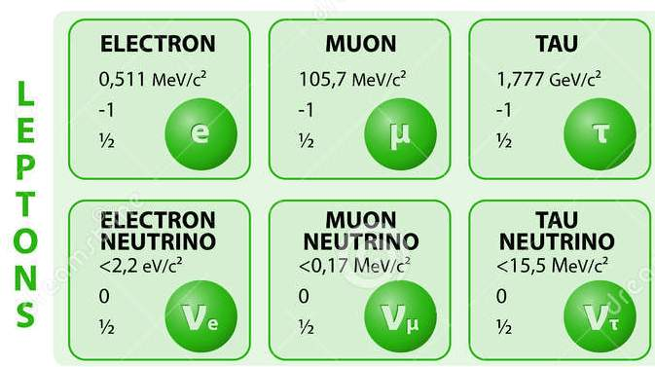
1. The Leptons
The most familiar member of this group is the electron, but there are also similar, heavier (and hence more energetic) particles called the muon and the tau.
For each one of these, there is a smaller “partner” called a neutrino – the electron neutrino, the muon neutrino and the tau neutrino.
Each of these 6 also has an antiparticle, for example, the anti-electron or positron.

Slide 27
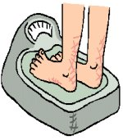
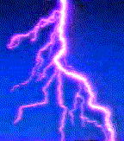
Properties of the Leptons
The electron, muon and tau all have mass. The neutrinos have very little mass, according to the Standard Model.
The electron, muon and tau all have electric charges of –1, and their anti-particles have electric charges of +1. The neutrinos have no electric charge.
All of the leptons have another property called “spin”. Their spins can be +½ or -½.

Slide 28
Table of Leptons
Table of anti-leptons
 | Lepton flavour | Symbol | Charge | Mass (MeV/c²⁾
1st Generation | Electron | e⁻ | -1 | 0.511
 | Electron neutrino | ν _{e} | 0 | <3 x 10⁻⁶
2nd Generation | Muon | μ | -1 | 106
 | Muon neutrino | ν _{μ} | 0 | < 0.2
3rd Generation | Tau | τ | -1 | 1.777
 | Tau neutrino | ν _{τ} | 0 | < 20
 | Lepton flavour | Symbol | Charge | Mass (MeV/c²⁾
1st Generation | Positron | e⁺
 | Electron antineutrino | _ ν _{e}
2nd Generation | Antimuon | μ⁺
 | Muon antineutrino | _ ν _{μ}
3rd Generation | Antitau | τ⁺
 | Tau antineutrino | _ ν _{τ}

Slide 29
2. The Quarks
The quarks are not capable of independent existence, and are found only as groups, making up larger particles (called “hadrons”).
There are 6 quarks: up, down, charm, strange, bottom and top. The “everyday” quarks are the up and down quarks. For each quark there is an anti-quark.
The quarks have mass and electric charge. The electric charges are either +⅔ or -⅓ for quarks, and -⅔ or +⅓ for the matching anti-quarks.
They also have spin of ±½. There is also another property called “colour” charge, which comes in 3 varieties, red, green and blue.

Slide 30
Table of quarks
Table of anti-quarks
 | Quark flavour | Symbol | Charge | Mass (MeV/c²⁾
1st Generation | Up | u | +⅔ | ~3
 | Down | d | -⅓ | ~6,5
2nd Generation | Charm | c | +⅔ | ~11,5
 | Strange | s | -⅓ | ~1,250
3rd Generation | Top | t | +⅔ | ~4,250
 | Bottom | b | -⅓ | ~175,000
 | Quark flavour | Symbol | Charge | Mass (MeV/c²⁾
1st Generation | Antiup | - u |  | ~
 | Antidown | - d |  | ~
2nd Generation | Anticharm | - c |  | ~
 | Antistrange | - s |  | ~
3rd Generation | Antitop | - t |  | ~
 | Antibottom | - b |  | ~

Slide 31
Neutrinos
https://www.youtube.com/watch?v=WzHSI-NlYUI -Announcement of the Nobel Prize in Physics 2015 (0.54/1.18/3.20)
https://www.youtube.com/watch?v=nkydJXigkRE -Why neutrinos matter (4.40)

Slide 32
Is the whole Universe made only of quarks and electrons?
ν
No! There are also neutrinos!
Electron, proton and neutrons are rarities!
For each of them in the Universe there is 1 billion neutrinos
Neutrinos are the most abundant matter-particles in the Universe!
Within each cm³ of
space: ~300 neutrinos
from Big Bang
ν ν ν ν ν νννννννν
νν ν ν νν ν ννννννν
ν νν νν νν ν ν ν ν ν
νν ν ν νν ν νννννν
ν νν νν νν ννννννν
νν νν ν ννν ννννννν
νν νν ν ννν ννννννν
1 cm
1 cm
Neutrinos are everywhere!
in the outer space, on Earth, in our bodies..

Slide 33
Neutrinos get under your skin!
  Every cm² of Earth surface is crossed every second by more than 10 billion (10¹⁰) neutrinos produced in the Sun
  Within your body at any instant: roughly 30 million neutrinos from the Big Bang
ν
10¹⁴ neutrinos
per second from Sun
are zipping through you
No worries!
Neutrinos do not harm us.
Our bodies are transparent to neutrinos

Slide 34
The particles of ordinary matter
charge
0
+2/3
ν_{e}
u
Leptons:
ν = neutrino
e = electron
Quarks:
u = up
d = down
-1
-1/3
e⁻
d
All stable matter around us
can be described using
electrons, neutrinos, u and d “quarks”

Slide 35
3 Families (or Generations)
1st generation
2nd generation
3rd generation
0
+2/3
0
+2/3
0
+2/3
ν_{e}
u
ν_{μ}
c
ν_{τ}
t
-1
-1/3
-1
-1/3
-1
-1/3
e⁻
d
μ⁻
s
τ⁻
b
Ordinary matter
Cosmic rays
Accelerators
3 generations in everything similar but the mass
We believe these to be the fundamental
building blocks of matter

Slide 36
Quark masses
175 GeV
Top
(discovered 1995)
E= mc²
1 proton mass ~ 1GeV (10⁻²⁷ Kg)
0.003
0.006
0.095
1.2
4.5
The mass grows larger in each successive family

Slide 37
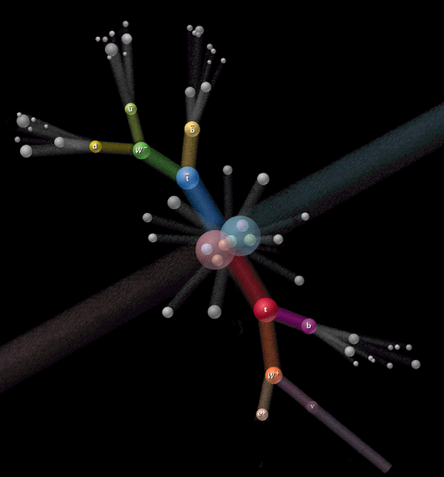
Top quark discovery (Fermilab 1995)

Slide 38
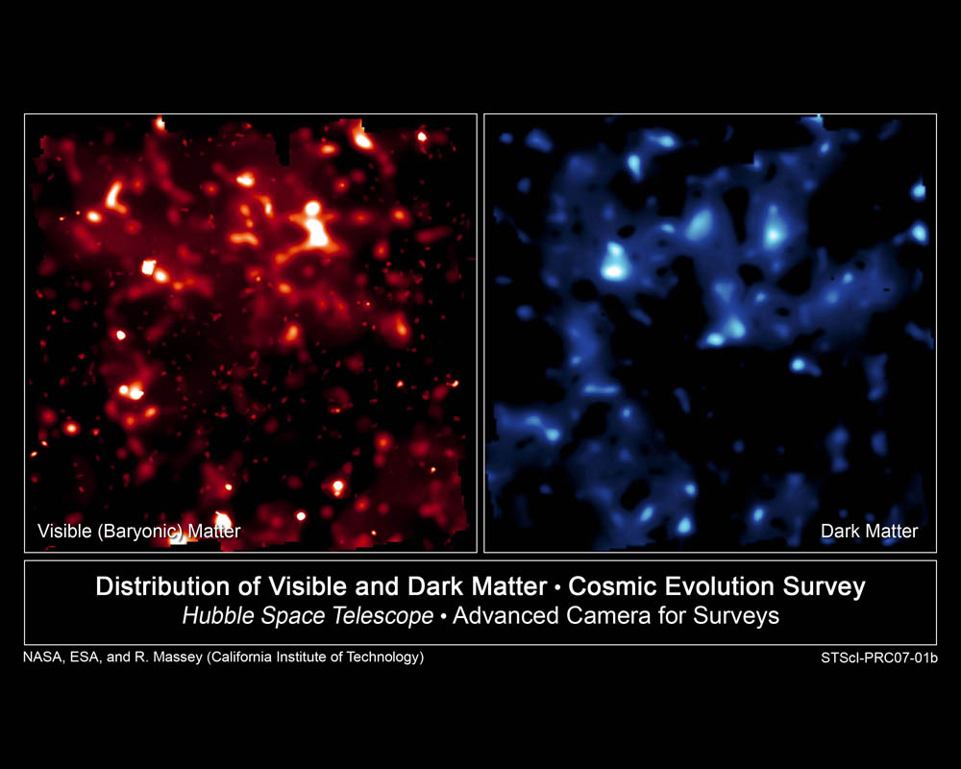
Another open question:
What is the Dark Matter?
Astronomical observations have shown that “observable” mass represent less than 4% of the Universe!
What is dark matter? We don’t really know …
  Perhaps partially composed of neutrinos, or possibly neutralinos particles predicted by super-symmetric theories beyond the Standard Model?
Visible Matter
Dark Matter
False-color images
The brightness of clumps
corresponds to the
density of mass.

Slide 39
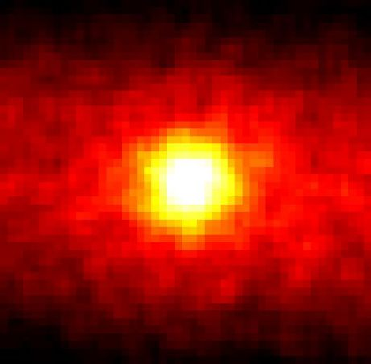
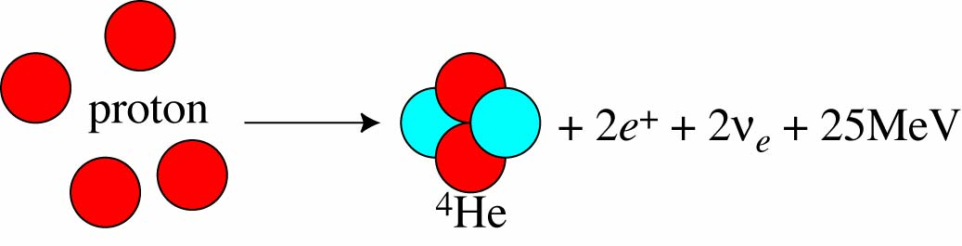
Neutrinos do matter to us:
If there were no neutrinos the sun would not shine!
Puzzling neutrinos
  Almost no interactions (only weak)
    Can cross light-years of material without being affected
    Can travel from the most remote corners of the Universe bringing information from the origin of space and time

Slide 40
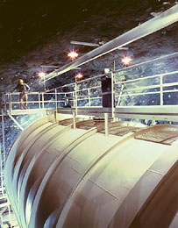
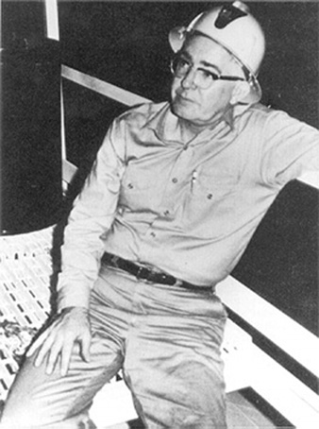
R. Davis: measuring the solar neutrino flux in a gold mine in South Dakota for 30 years (1969-1999)
R. Davis
Solar neutrinos
pioneer
…and observing only 1/3 of the expected flux!! Why?

Slide 41
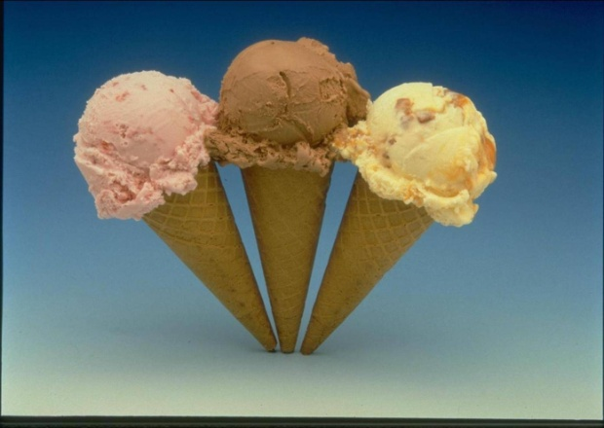
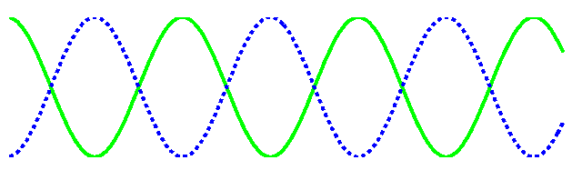
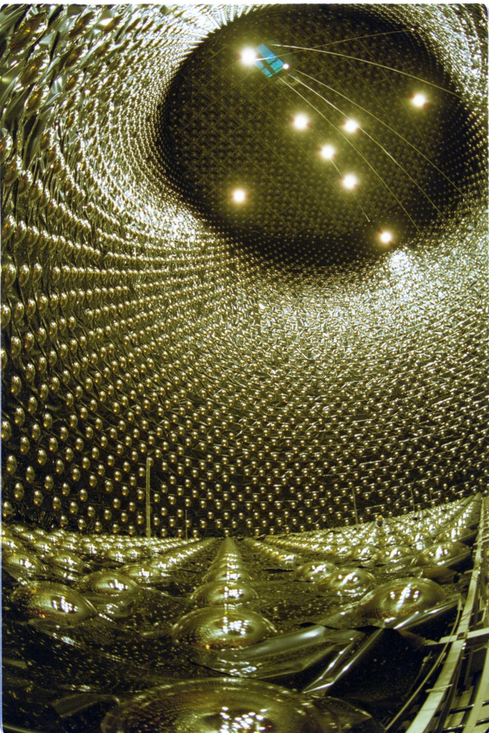
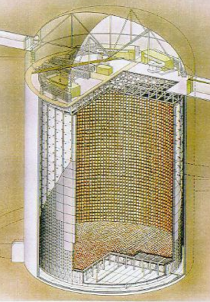
Neutrino oscillations
ν_{e}
ν_{μ}
ν_{τ}
If you let the neutrino travel enough,
it can change its flavour!
ν_{μ}
ν_{τ}
a huge neutrino detector
exists!
a huge neutrino detector
in the right place exists!
A detector here
does not see any ν_{μ}
A detector here
sees all ν_{μ}
Kamioka Observatory, ICRR (Institute for
Cosmic Ray Research),
The University of Tokyo

Slide 42
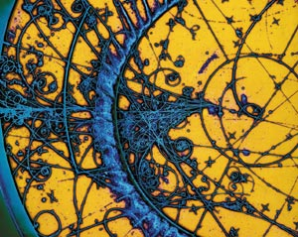
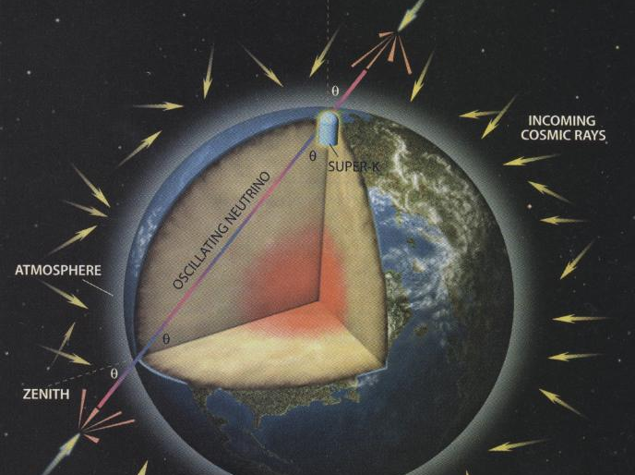
in the Kamioka mine in Japan
SuperKamiokande is measuring neutrinos born in the atmosphere
above the detector..
ν_{μ} flux from below only ½ of flux from above!
..and below the detector (on the other side of the Earth!!)
Total neutrino flux from below = total flux from above _

Slide 43
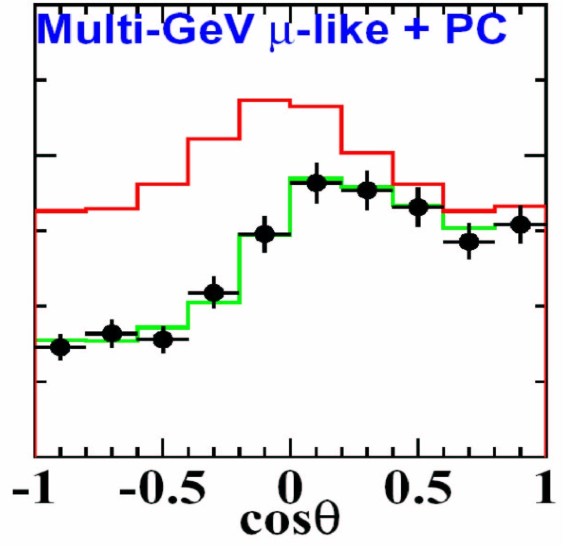
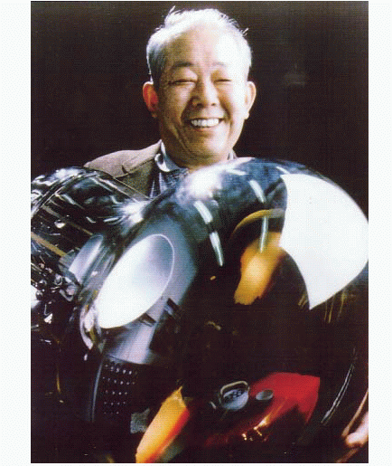
Discovery of neutrino oscillation Super-Kamiokande (1998)
2002 Nobel Prize
Koshiba
(superK Spokesman)
shared with Davis
Up-going
Down-going
Half of the ν_{μ} are lost!
Oscillated to undetected ν_{τ}

Slide 44
What have we learnt?
A number of surprising things:
  A limited number of forces and matter particles describe all the Universe we know about;
  A theory of the interactions of matter with forces called the Standard Model describes successfully the phenomena of the subatomic world;
  There are evidences that there is lot more that we do not know about and our research should find: such as the missing anti-matter, dark matter, puzzling neutrino properties, but also the Standard Model key-vault ..the Higgs!

Slide 45
TOMORROW
There are no theoretical reasons for the quarks to be the final elementary particles.
The electron is still being probed, in search of an internal structure.
New accelerators (LHC) will provide higher energies to explore yet uncharted territories (“small Big Bangs”) and maybe discover new particles (Higgs Boson). The Higgs is predicted by the Standard Model.

