Slide 1
ESCAPE THE ICE AGE
Naziye Kaşka - Turkey

Slide 2
Section A: For the teacher

Slide 3
A1: Educational context
Time frame: 40 minutes
Setting: In the classroom
School resources: PC, papers, coloured post-it, coloured pencils
Curriculum mapping: Global Warming and Animals

Slide 4
A2: Rationale
Why you propose the scenario: To make learning more creative and fun
What problem you address: The Effects of Global warming
What your (i.e. teacher’s) goals are:
1.To make students more creative and be the boss of their learning process
2.To enable social consciousness for a better world
3.To get rid of the chains of traditional teaching methods

Slide 5
Section b: For the student

Slide 6
B1: Beginning
Design purpose: setting the stage and defining student’s goals
You are the only human on earth in the First Ice Age. All your best friends are wonderful exotic animals. But as time passes by and the world grows colder and colder, you realize that soon your home will be nothing but snow and ice. One day though you are hearing the story of a place not too far away that miraculously is untouched by the climate change.

Slide 7
To escape your certain death, you and your friends start searching for it. Almost at your destination altough your way gets blocked by a labyrinth. Can you find your way through it? Can you face the challenges you encounter on your way? Will you reach the Safe Zone or be stucked in the Ice Age?

Slide 8
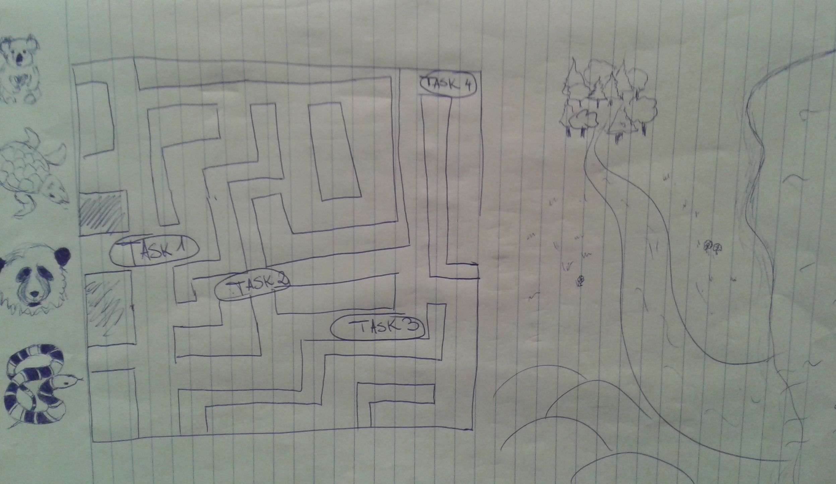

Slide 9
B2: Middle
Design purpose: providing means, structure, and support for students to be autonomous but substantially engaged
Activities:
Drawing fantasy animals
Naming the animals
Choosing the animals to save
Finding the way through the labyrinth by completing certain tasks
Materials and tools
Papers
Coloured pencils
A PC
Coloured post-it
A labyrinth

Slide 10
Rules:
You have to find the way through the labyrinth and safe your friends.
You have to complete four tasks about global warming on the way
You are only allowed to give 3 wrong answers overall
Division of labor
The teacher will hand the students labyrinths and different tasks
The pupils will draw animals and take them through the labyrinth
Timeframe (overall duration, frequency etc.)
40 minutes or more…
Learning supports
The teacher will guide the students throughout the process

Slide 11
B3: End
Design purpose: providing closure to the activity
Attainment of goal:
Reaching the safe zone
Final product (if any) :
Awareness about global warming

