Slide 1
European Funding Opportunities for my school
Dr. Sofoklis A. Sotiriou & Rosa Doran
Ellinogermaniki Agogi

Slide 2
Expertise
Effective Community Building – International Network
(more than 10,000 science teachers, 5,000 schools across Europe)
Teachers Professional Development
(Training materials, National and International courses, Workshops, Conferences)
Design of Innovative Scenarios combining advanced technological tools, science and art (augmented reality applications, 3D environments, Global Science Opera)
Assess the impact of the interventions in real settings (setting up large scale experimentations involving numerous schools, teachers, students)

Slide 3
How to build a strong Action Plan/European Development Plan for your school according to the Erasmus+ Framework

Slide 4
How to apply
Detailed instructions step-by-step available:
  INSPIRING SCIENCE EDUCATION: http://ise.ea.gr
  ODS Summer school website: http://ods.ea.gr
  ESEA Courses: http://esea.ea.gr
  ERASMUS + National Agencies

Slide 5
The application
Download the application from the website of your National Agency- Make sure it is the final one!
First section:
  Factual data about the school defined generally as “organisation”

Slide 6
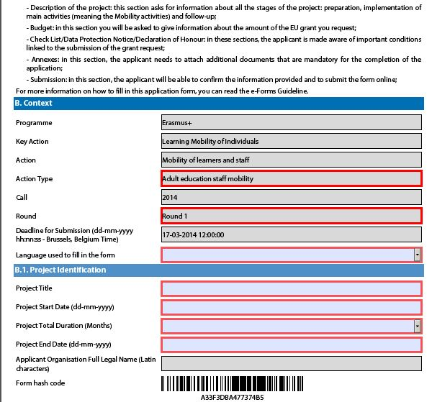
  Project title and duration: Project= the total of the activities that you will use the funding for

Slide 7
The School European Development Plan
1) The needs of the school in terms of quality development and internationalisation:
  What are the areas or competences that you need to improve in your school?
    E.g. staff competences, language competences- possibly linked with European dimension, skills for new teaching methods and tools, school management and organisation.
TIPS!
Carefully monitor the actual needs in every aspect of your school- organize a meeting with the rest of the staff!
Identify specific training (courses etc.)or mobility activities that can serve those needs!
Study carefully their objectives, methods and skills/ competences they are addressing

Slide 8
TIPS!
Clearly link those needs with the improvement of the quality of education offered by your school and with reaching European standards.
Add information on the profile of the school to support the needs that you identified: e.g. Area of the school, socioeconomic background, type of school, students and students’ families backgrounds, possible drop-out rates, access to other European schools, teachers’ and staff’s skills and needs to deal with possible obstacles.

Slide 9
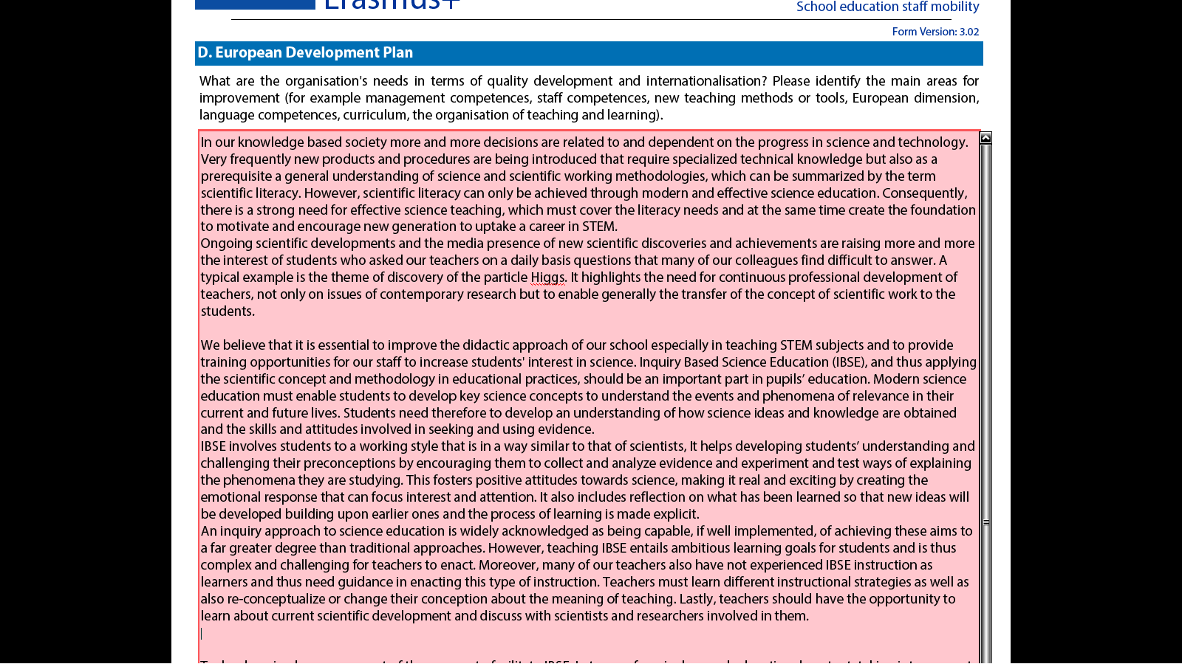
EU Development Plan - Part Ia (Needs)

Slide 10
2) Please outline the organisation's plans for European mobility and cooperation activities, and explain how these activities will contribute to meeting the identified needs
TIPS!
Fill in the section with your planned activities before completing this part of the European development plan.
You must give here a summary of these activities (training courses, e.g. ODS Summer School, ISE Summer Academy and other mobility activities)
Explain what measures you are taking in order to avoid disrupting the regular function of the school, e.g. ODS Summer School -> during Summer holidays.

Slide 11
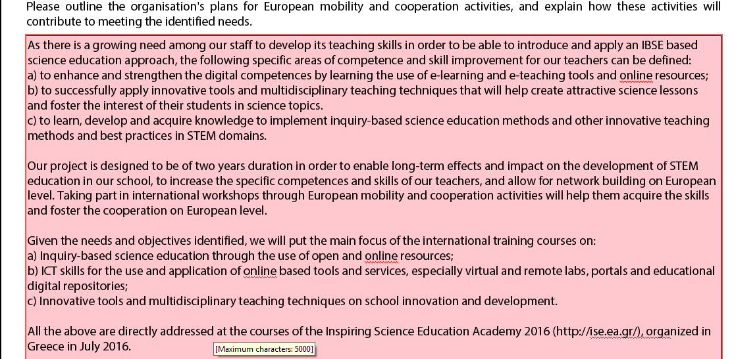
EU Development Plan - Part IIa (Objectives)

Slide 12
3) Please explain how your organisation will integrate the competences and experiences acquired by staff participating in the project,
into its strategic development in the future?
TIPS!
Describe the practical application of the new knowledge acquired- How will you put them into practice? E.g. describe specific school-based activities that will put these new skills into practice
Describe follow-up training activities -> How will this new knowledge be sustainable and updated?

Slide 13
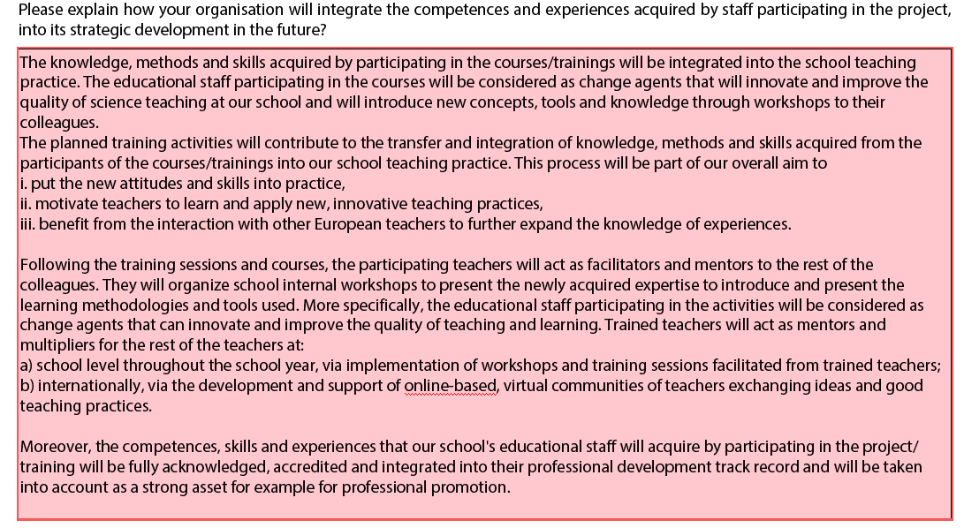
EU Development Plan - Part III (Impact)

Slide 14
Other fields of the application
Participants’ role: Profiles of the staff who will participate in the activity- no names yet!
  Describe the criteria and process for choosing the staff
Preparation of participants:
  Consult the description of the course – ODS Summer School “Preparation”
  Consider the language of the course
  Describe how you will organise the preparation of the participants
  Remember that a dedicated part of the funding covers participants’ preparation!
Evaluation:
  Consult the ODS Summer School section on “Follow-up”

Slide 15
Please contact your National Agency!
Erasmus+ Programme Guide: http://ec.europa.eu/programmes/erasmus-plus/documents/erasmus-plus-programme-guide_en.pdf See “Key Action 1: School education Staff Mobility”
The new application form for schools: http://ec.europa.eu/programmes/erasmus-plus/discover/guide/2015/documents/school-education-staff-mobility_en.pdf

Slide 16
Schools in ERASMUS+
http://ec.europa.eu/education/opportunities/school/index_en.htm
Guide for School Leaders

Slide 17
Inspiring Science Education Summer Academy
(ise.ea.gr)
For teachers, Inspiring Science Education Summer Academy offers pedagogical “plug, share, and play” through a web-based authoring interface and a community framework to disseminate best practices and find mutual support. A modular approach and inquiry classroom scenarios promote a seamless incorporation of eLearning tools into the classroom.

Slide 18





Inspiring Science Education Summer Academy 2016
30 European Science Teachers
20 US Science Teachers (supported by NSF)
July 10-16, 2016, Marathon, Attica, Greece

Slide 19


Slide 20
Rationale and Aims
The aim of the Inspiring Science Education International Summer Academy is to support the modernisation of Science education and training, including in curricula, assessment of learning outcomes and the professional development of teachers and trainers, and to the wide adoption of the recommendations of the Rocard Report "A new Pedagogy for the Future of Europe" (Rocard et al., 2007), that sets the basics for the introduction of the Inquiry Based approach in the science curricula of the Member States. Teachers will not only be familiarized with a unique collection of open digital educational resources, but they will also be trained to link them with innovative pedagogical practices, such as using real world learning activities, implementing resource based and project-based approaches, in order to design educational scenarios by repurposing existing eLearning tools. The offered resources and tools, although associated with a broad range of curriculum areas, do not impose a fixed curriculum but support a model that can be customized based on location and culture, as well as cross-disciplinary situations, being thus ideal to be used for differentiated instruction.

Slide 21
Benefits for the participants
Teachers will also be trained to appropriately select and exploit freely available existing eLearning tools and resources in their educational scenarios that suit their own needs in terms of planning, implementing and sharing pedagogical ideas, managing their classroom and organizing the curriculum. This will further empower them to create effective project scenarios to use in the classroom, as well as in multiple environments such as face-to-face, online and other technology mediated learning. Such a comprehensive open learning networks approach that allows teachers to access their colleagues' course materials, share their own and collaborate is expected to enable all stakeholders to examine their own practices in the light of the best performing approaches.

Slide 22
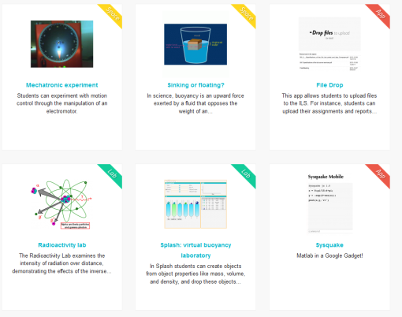
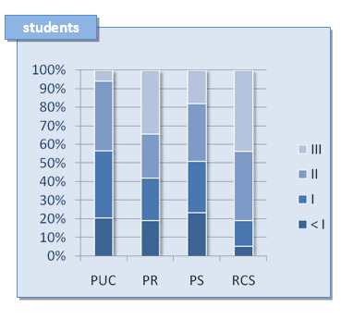
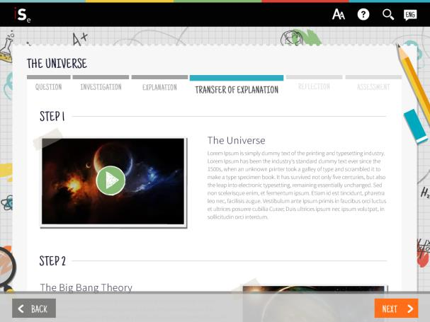
Authoring – Access – Deliver - Assess
Design Lessons/Scenarios by using existing resources and tools (such as online labs, AR/VR tools) and store them on the cloud
Deliver Lessons/Scenarios to students.
Collect Educational Data for student assessment based on PISA Framework

Slide 23

Astronomy Adventure in Canary Islands
25 – 29 July 2016

Slide 24
Main Experiences
Hands-on Telescopes – Using remote observing with research quality telescope as a tool in classroom for science teaching.
Handling data – How to retrieve and analyse data in the big data era.
Hands-on Minds-on Solar System – Innovative methods to engage students into the discovery of the Solar System (Seasons, Phases of the Moon, Space Exploration, etc.)
Meet the Scientist – Meet and teach the Universe

Slide 25

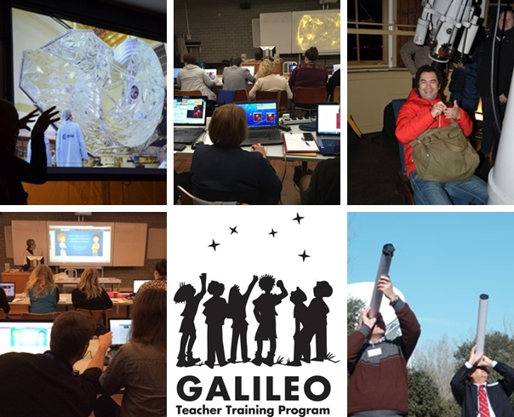
18 - 22 October 2016

Slide 26
Main Experiences
Meet the Space Scientist – An inside look to ESA headquarters.
Inspiring Astronomy – Hands-on activities to teach basic physics using daily material and innovative ideas.
Hands-on Telescopes – Using remote observing with research quality telescope as a tool in classroom for science teaching.
Handling data – How to retrieve and analyse data in the big data era.

Slide 27

Beyond Earth Orbit: Solar System Exploration and Spacesuits
9th – 14 th Jan 2017

Slide 28
Main Experiences
Travelling in Space – An overview of state-of-the-art on solar system exploration
Hands-on Space Exploration – Educational tools for classroom activities.
Robotics Simulation – Life on Mars simulation with rovers mockups
Being an Astronaut – a simulation of the life of an astronaut on Mars.

Slide 29
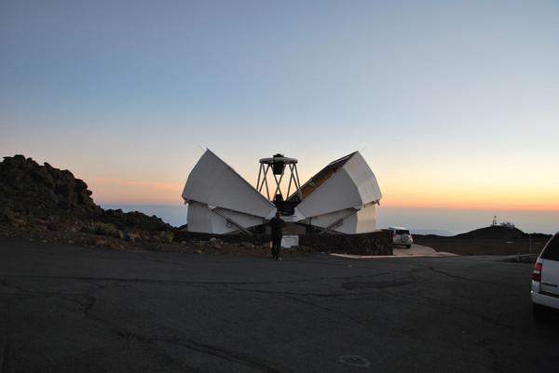
Science through Space and Time
9 – 14 April 2017

Slide 30
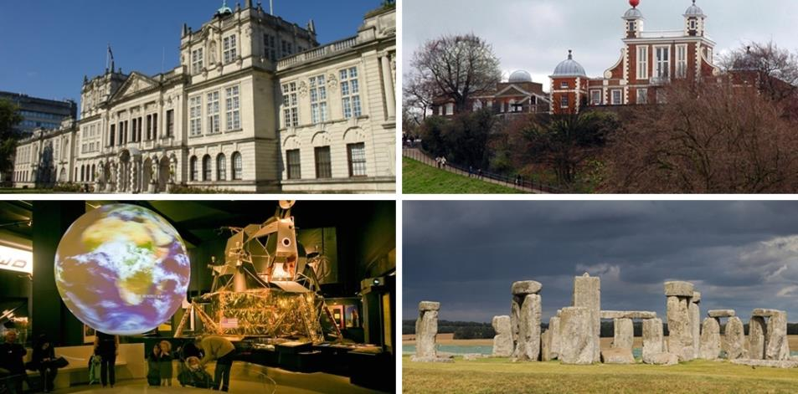
Course Sites: Stonehenge, Science Museum of London, Royal Greenwich Observatory, Cardiff University

Slide 31
Main Experiences
Hands-on Coding - Programing Rovers on Mars with Raspberry Pi – Cardiff University
Ancient Astronomy in Stonehenge
Black Holes in My School - Inquiring minds now: Mapping the scientific method with research data
Hands-on data - Using European Space Agency GAIA mission data archives to implement real research experiences in classroom- Cardiff University

Slide 32
KEY ACTION 2
COOPERATION FOR INNOVATION AND THE EXCHANGE OF GOOD PRACTICES
Strategic Partnerships aim to support the development, transfer and/or implementation of innovative practices as well as the implementation of joint initiatives promoting cooperation, peer learning and exchanges of experience at European level.

Slide 33
Strategic Partnerships
Strategic Partnerships supporting innovation
Projects are expected to develop innovative outputs, and/or engage into intensive dissemination and exploitation activities of existing and newly produced products or innovative ideas. Applicants have the possibility to request a dedicated budget for Intellectual Outputs and Multiplier Events
Strategic Partnerships supporting exchange of good practices
The primary goal is to allow organisations to develop and reinforce networks, increase their capacity to operate at transnational level, share and confront ideas, practices and methods. These results and activities will be co-financed through the standard budget for project management and implementation.

Slide 34
“School-only” Strategic Partnerships
These Strategic Partnerships in the field of school education aim at supporting exchanges of good practices between schools from different Programme Countries. In many cases, cooperation activities are also combined with class exchanges and/or long term mobility of pupils from the schools participating in the project.
The distinctive feature of this format of Strategic Partnerships is the modality of contractualisation with beneficiaries.

Slide 35
Duration
Duration: 12-36 months
Deadline: 31st March 2017
Start date: 1st September – 1st December 2017
Budget: max. 150.000 EUR / year
Budget categories “schools only”: PM+Meetings (+other costs)

Slide 36
Erasmus+
HORIZONTAL PRIORITIES - I
Improve achievement in relevant and high-level basic and transversal competences in a lifelong learning perspective, through formal or non-formal education and training.
Inclusive education, training and youth: in line with the Paris Declaration, priority will be given to actions addressing diversity in (formal and non-formal) education and training, developing social, civic, intercultural competences and media literacy, combating discrimination and segregation, tackling bullying, reducing disparities in particular through innovative integrated approaches.
Open and innovative education, training and youth work, embedded in the digital era: priority will be given to actions that contribute to disseminating learning outcomes of formal and non-formal learning activities as well as to mainstreaming and spreading the utilisation of open and innovative education, training and youth pedagogies, participatory education governance, work methods and resources for educators and learners at all levels, in particular those in a disadvantaged situation.

Slide 37
Erasmus+
HORIZONTAL PRIORITIES - II
Educators: priority will be given to actions that strengthen the recruitment, selection and induction of the best and most suitable candidates for the teaching profession as well as to actions supporting continuing professional development of educators (such as teachers, professors, tutors, mentors, etc.) and youth workers
Transparency and recognition of skills
Sustainable investment, performance and efficiency in education and training

Slide 38
Erasmus+
Specific Priorities – School I
Strengthening the profile of the teaching professions (…) by supporting teachers and leaders to deliver high quality teaching, deal with complex classroom realities and adopt new methods and tools.
In particular, (…) supporting teachers in dealing with diversified groups of learners (such as refugees, asylum seekers and migrants) and to adopt collaborative and innovative practices right from the start of their careers; to strengthen leadership roles in education, including distributed leadership, for designing necessary changes and improvements at institutional level.

Slide 39
Erasmus+
Specific Priorities – School II
Addressing underachievement in the basic skills of maths, science and literacy through more effective, innovative teaching methods.
In particular, through projects focused on student-centred and problem-based active learning using multidisciplinary and inter-disciplinary approaches and through fostering critical thinking skills by addressing cultural and/or environmental context in teaching science; developing innovative didactical materials to increase motivation for reading of all pupils; addressing multilingual classrooms through methods building on diverse language skills alongside the main language of instruction.

Slide 40
Ideas for School Projects:
Developing the Science Classroom of the Future

Slide 41

Thank you for your attention!
Contact us:
Sofoklis Sotiriou sotiriou@ea.gr

