Slide 1

Digital White Cane
Experimental High School of University of Patras
The use of low-cost microcomputers can contribute to the implementation of innovative ideas with social denominator. Such an idea is the integration of a micro processor Arduino or Raspberry – pi in canes for the visually impaired. This particular microcomputer will bring a camera-color sensor to the bottom of the cane, so that it can distinguish color contrasts in the ground that this person walks or moves with partial or total blindness.

Slide 2
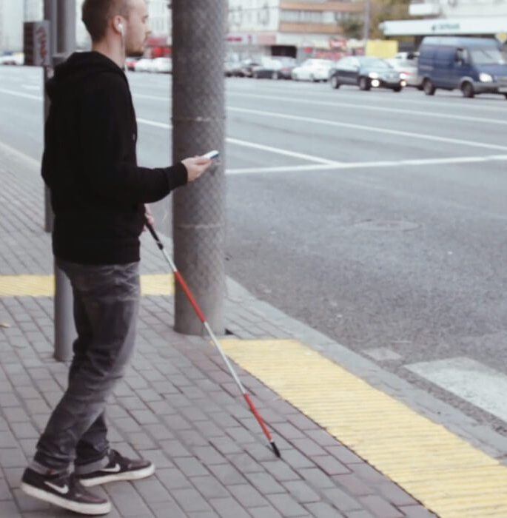
Digital White Cane
The recognition of color contrasts in the ground is in itself a useful function, but it is known that corridors for visually impaired on pavements are of a different color than the rest of the pavement. In addition to recognizing the color difference there will be a sound signal or vibration in the cane. Thus, the visually impaired person will be able to be warned in time for hazards to move.
On a second level we can incorporate a distance sensor so that with the accompanied sound signal bounded a possible obstacle. The possibility of the audible signal being disturbed or not heard, is solved by using a headset for the person with reduced or incomplete vision.

Slide 3
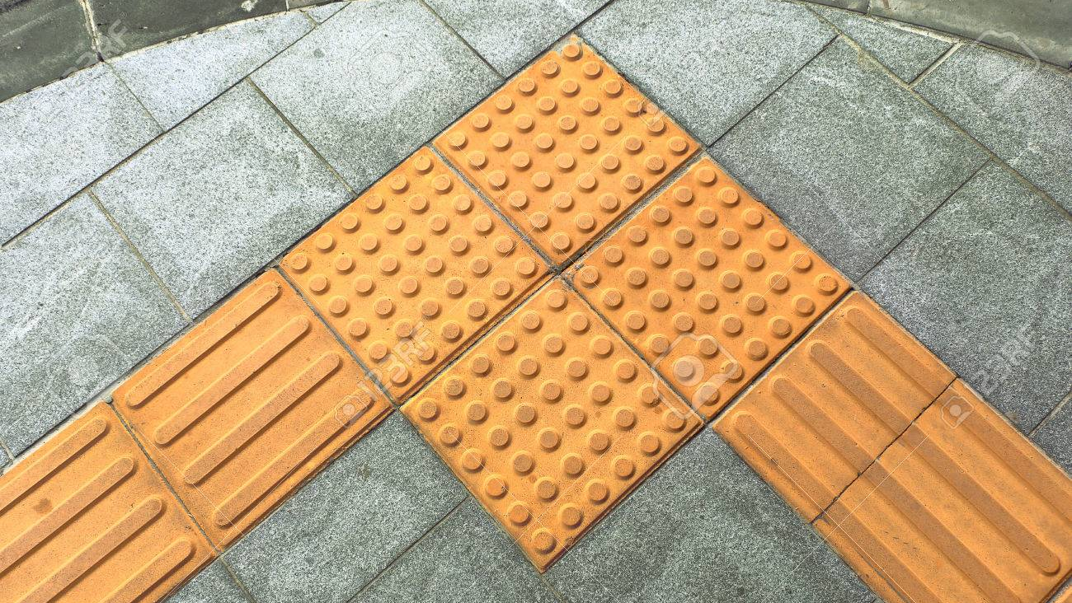
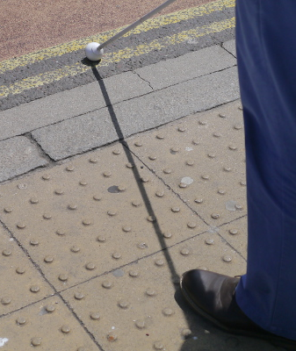
Digital White Cane
Walking corridors for people with Vision problems

Slide 4
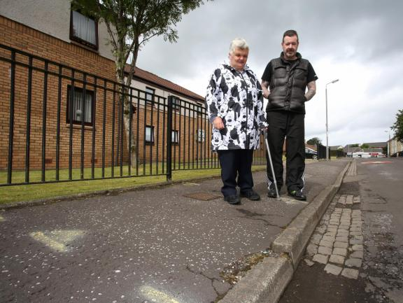
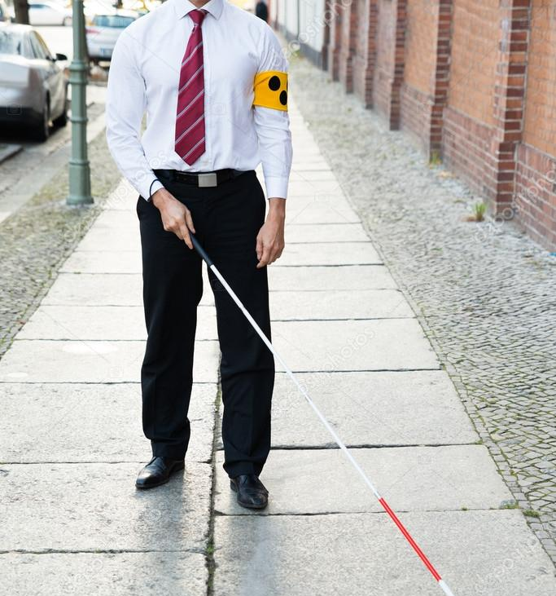
Digital White Cane
Worn or non-existent gait corridors for people with Vision problems

Slide 5
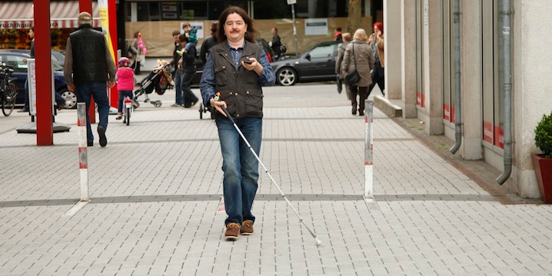
Digital White Cane
Use mobile phone providing travel instructions for visually impaired people

Slide 6
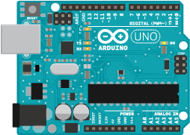
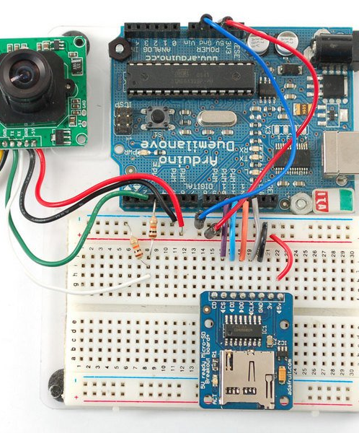
Digital White Cane
Arduino Micro-computer connected to camera

Slide 7
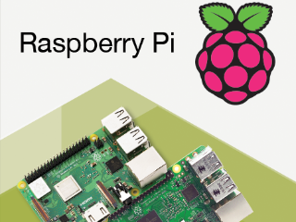
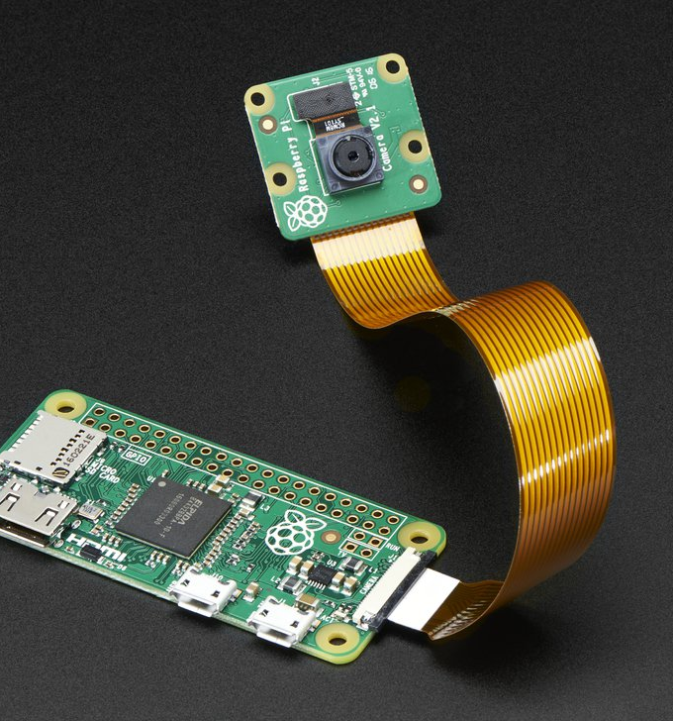
Digital White Cane
The microprocessor Raspberry Pi connected to a camera

Slide 8
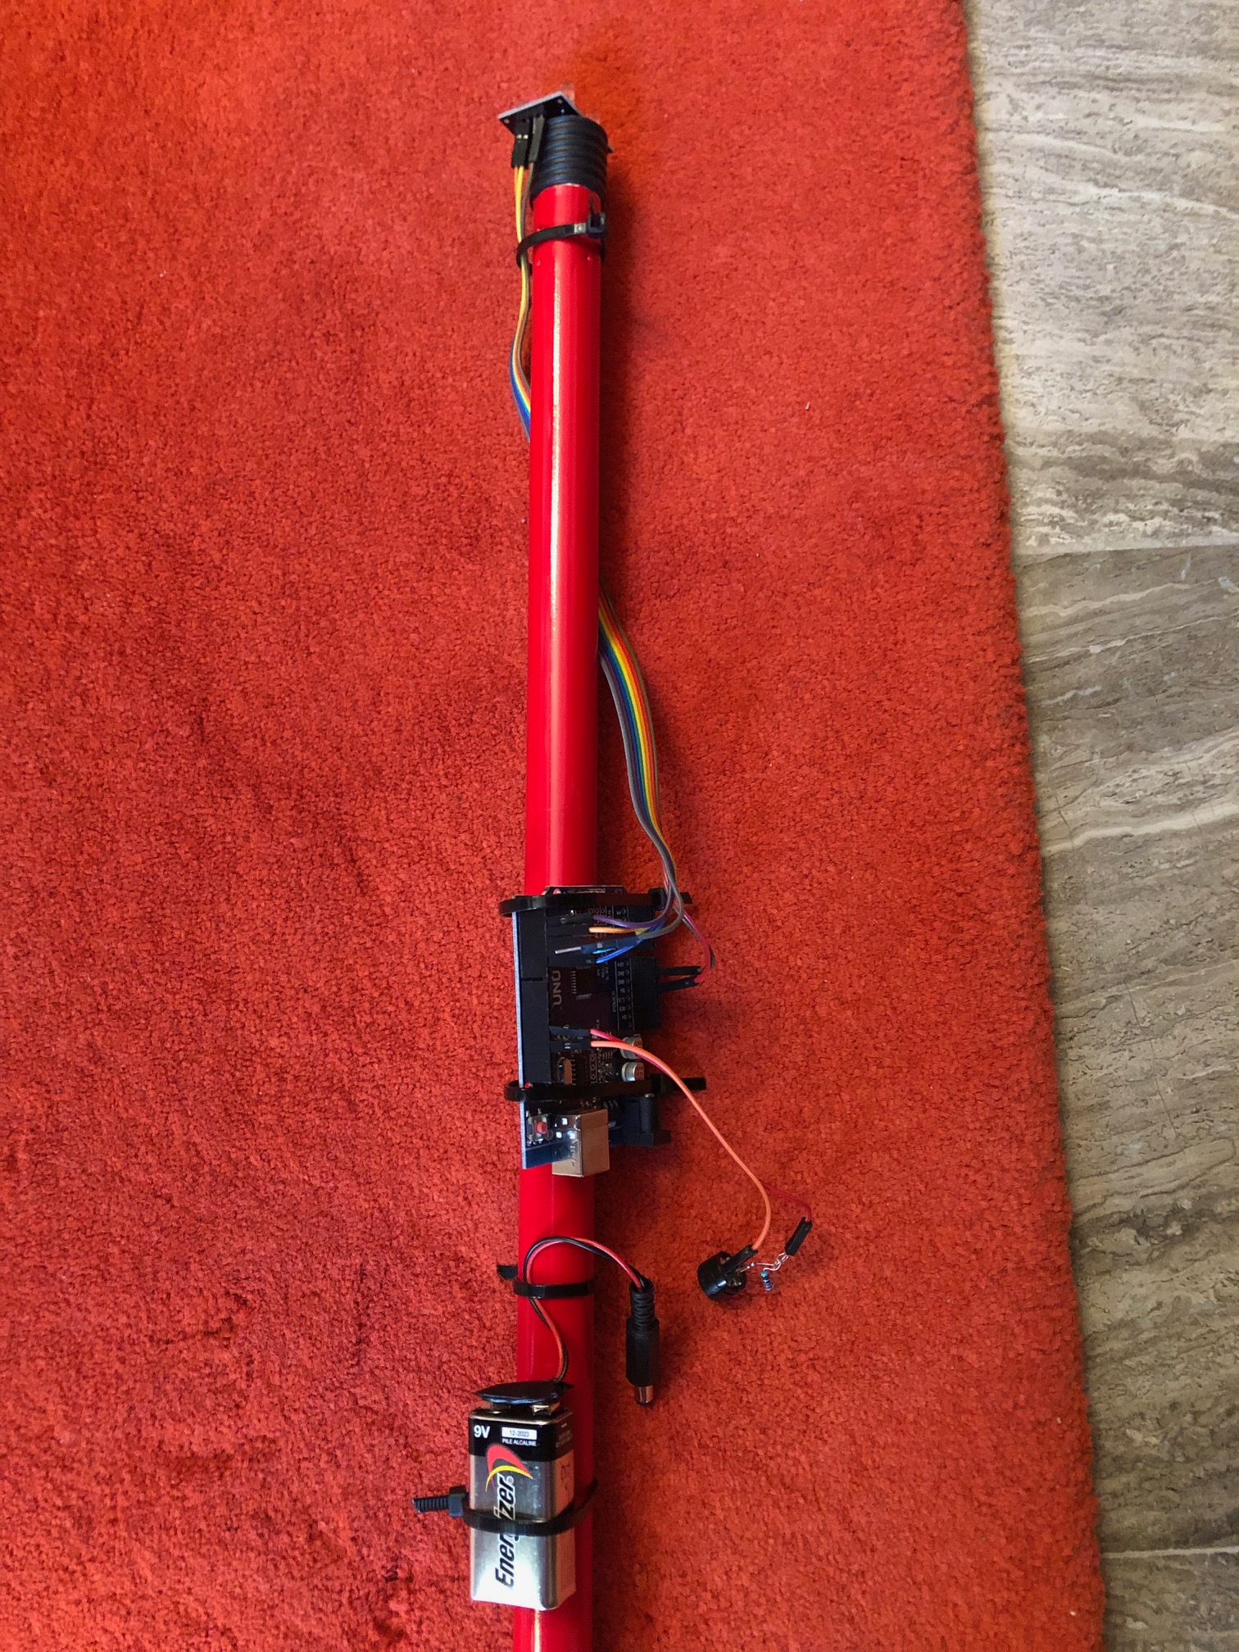
Digital White Cane
The experimental model of the digital white cane. We can easily see the camera on the edge and the Arduino processor with the power supply battery in the main part.

Slide 9
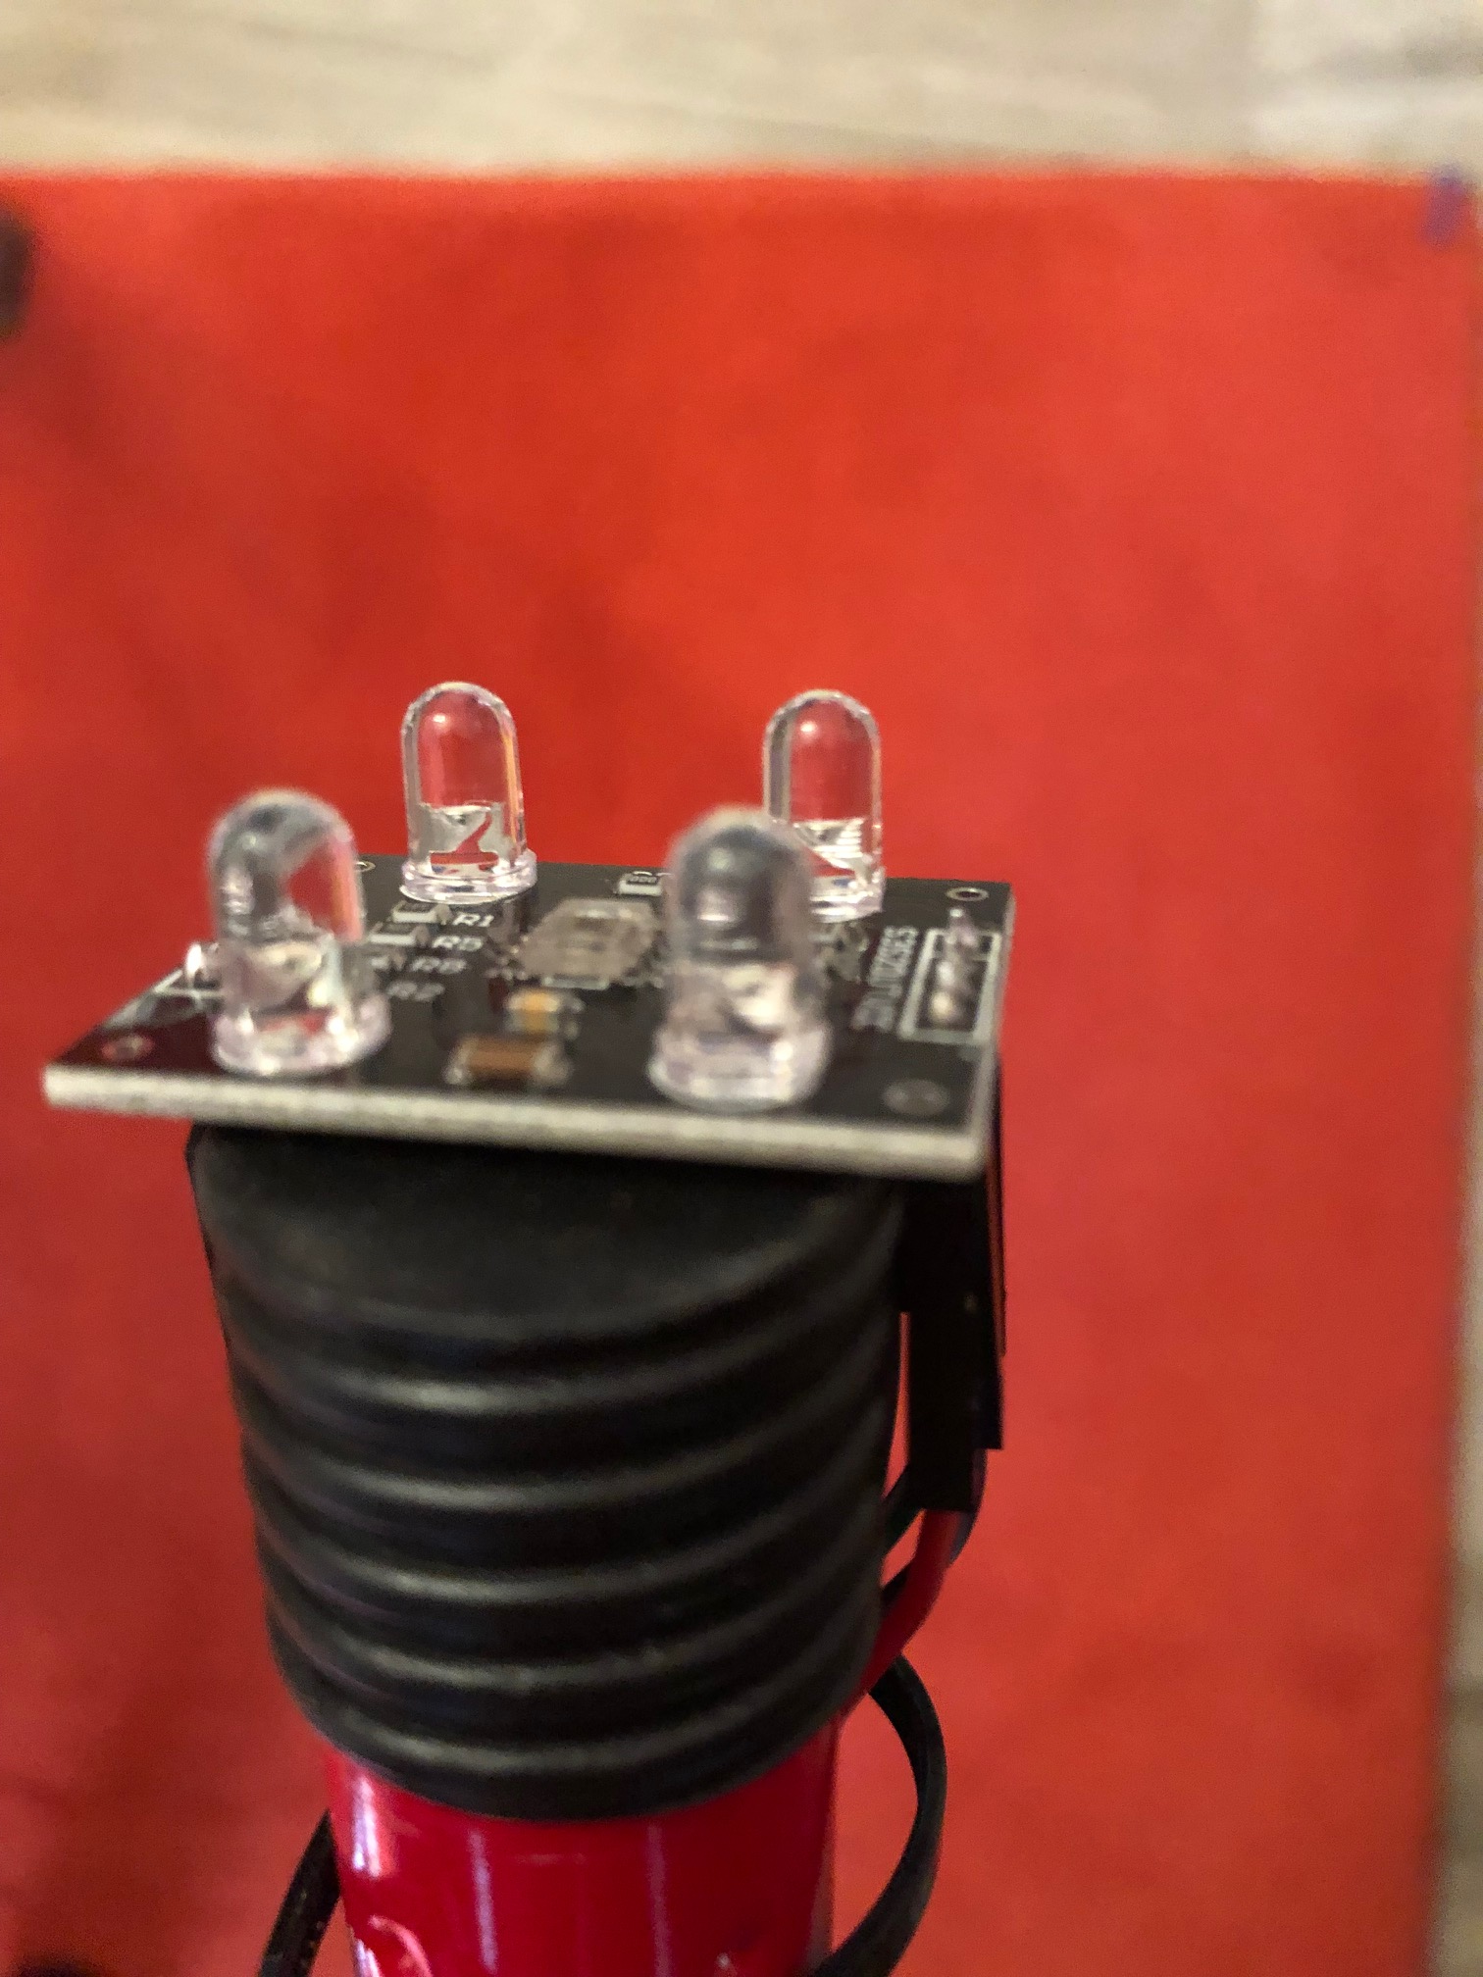
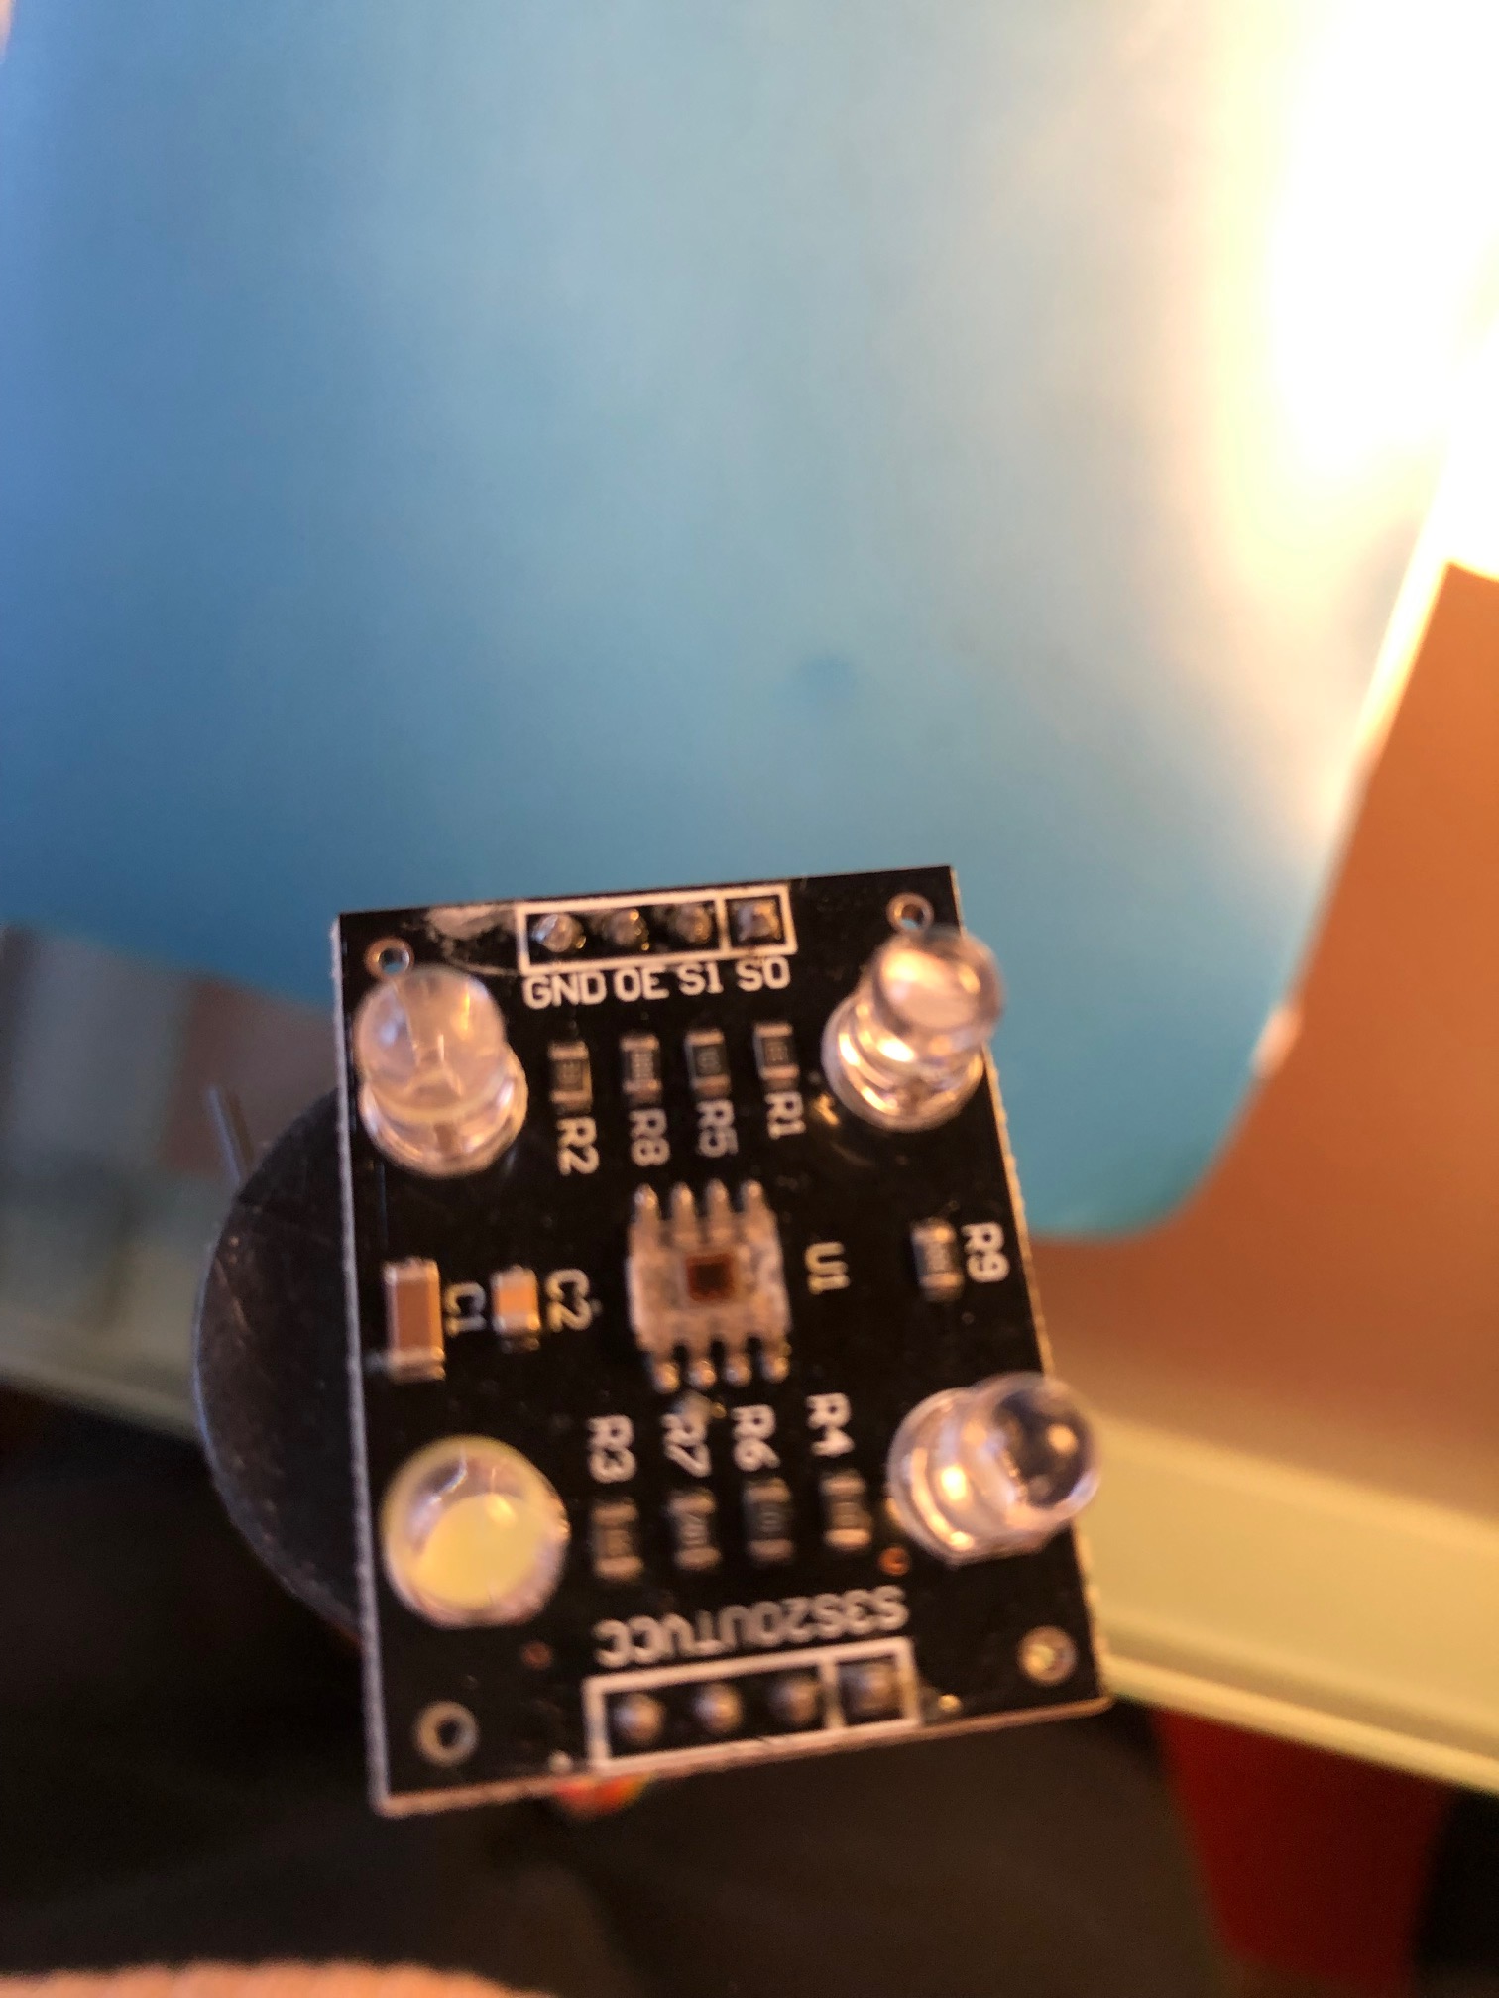
Digital White Cane
The camera at the edge of the digital white cane model.

Slide 10
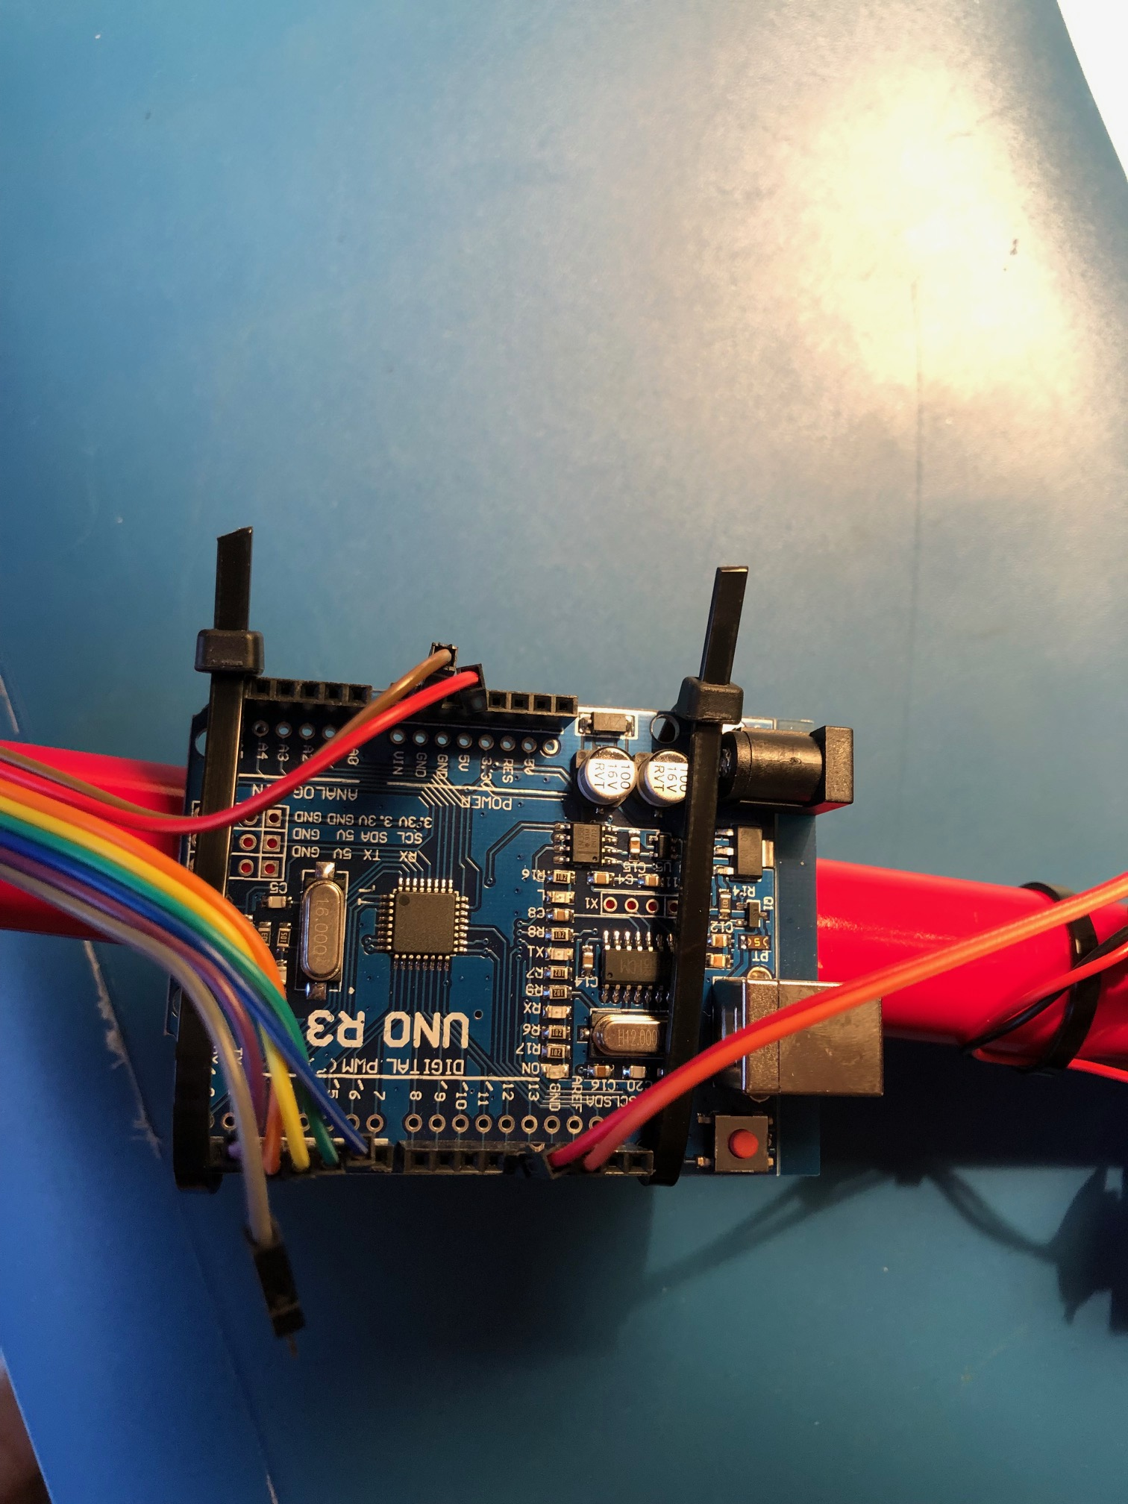
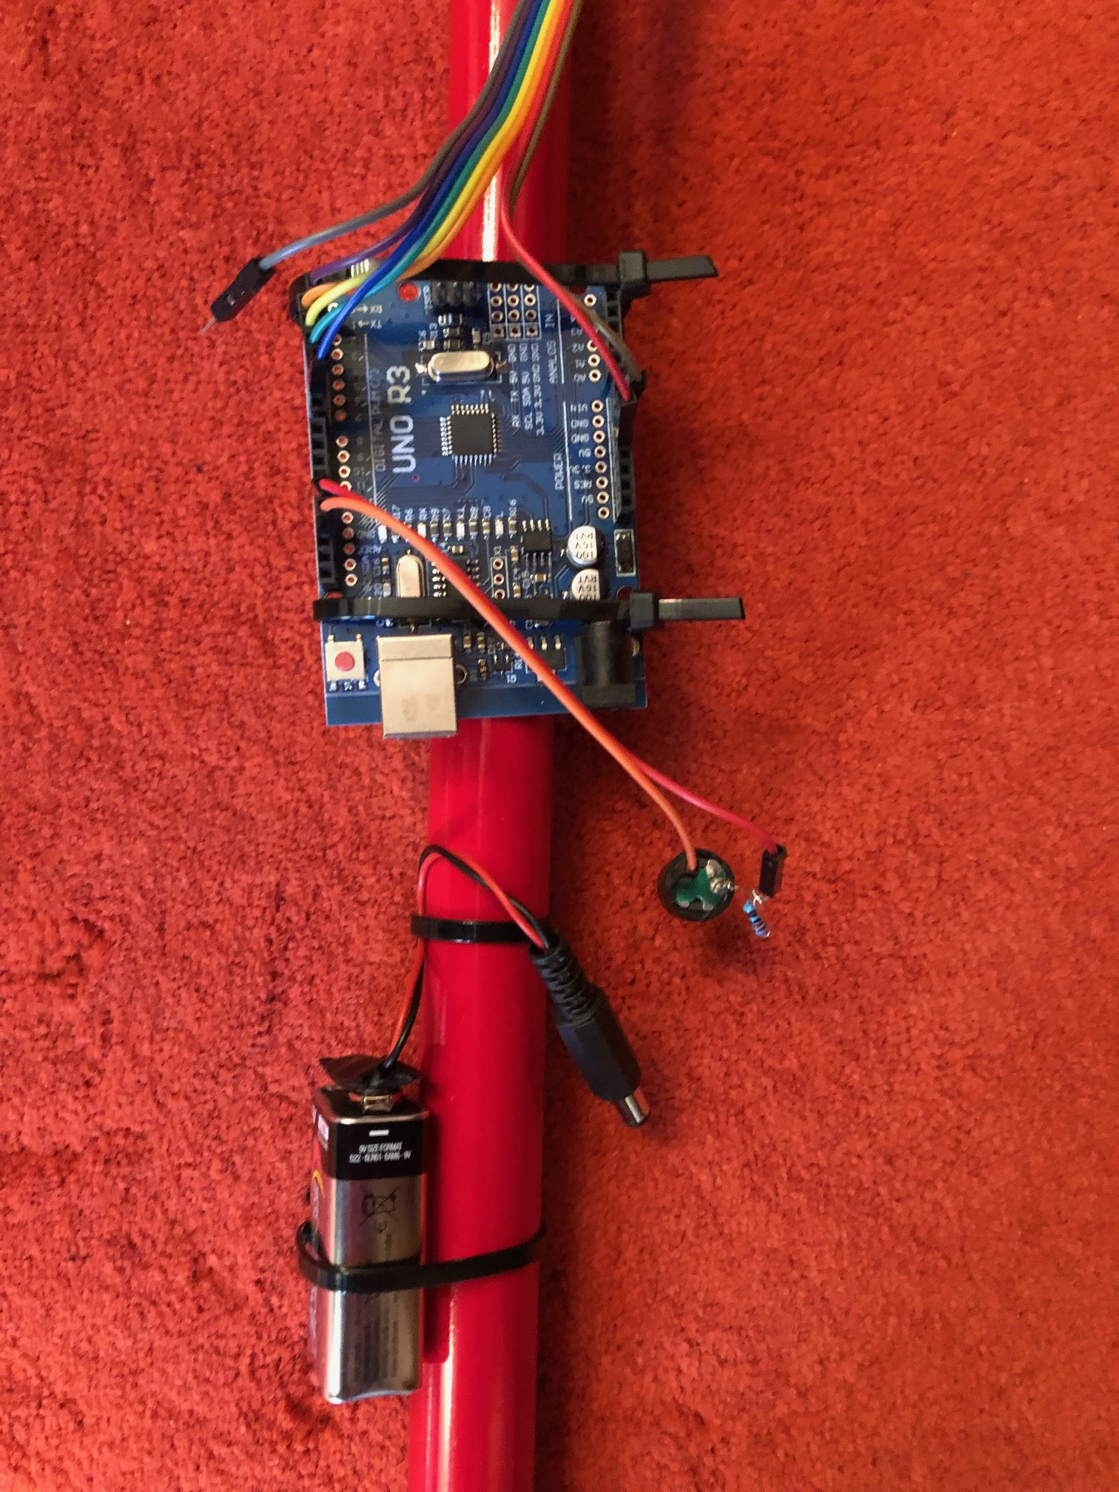
Digital White Cane
The Arduino processor in the experimental model of digital white cane.

Slide 11
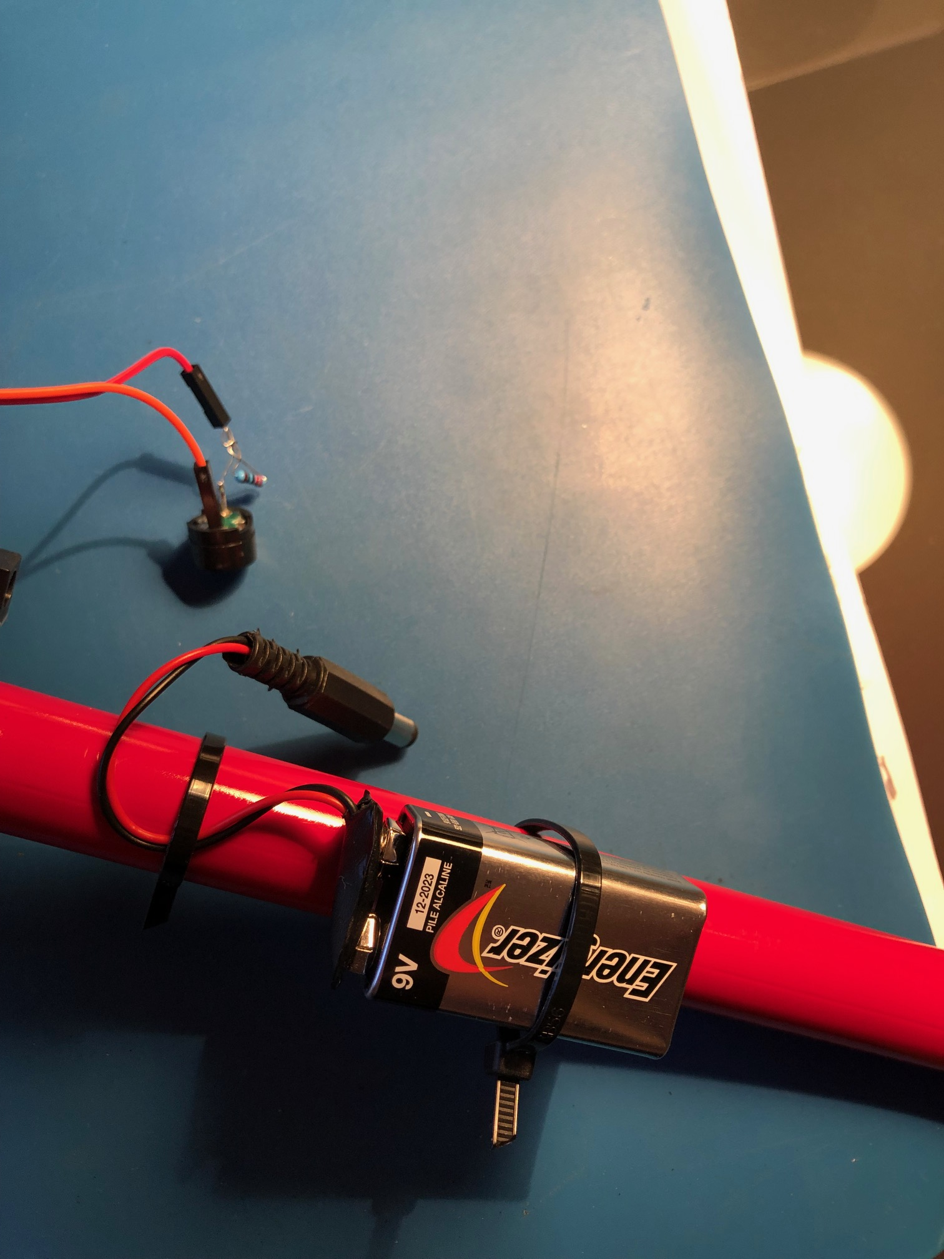
Digital White Cane
The power supply battery and the Arduino processor in the experimental model of the digital white cane.

Slide 12
Digital White Cane
Digital innovation in the service of human beings

