Slide 1
«One day like a…..fairytale»
2^{ο} NURSERY SCHOOL OF ZEFYRI
http: //blogs.sch.gr/2nipzefy
2014-2015

Slide 2
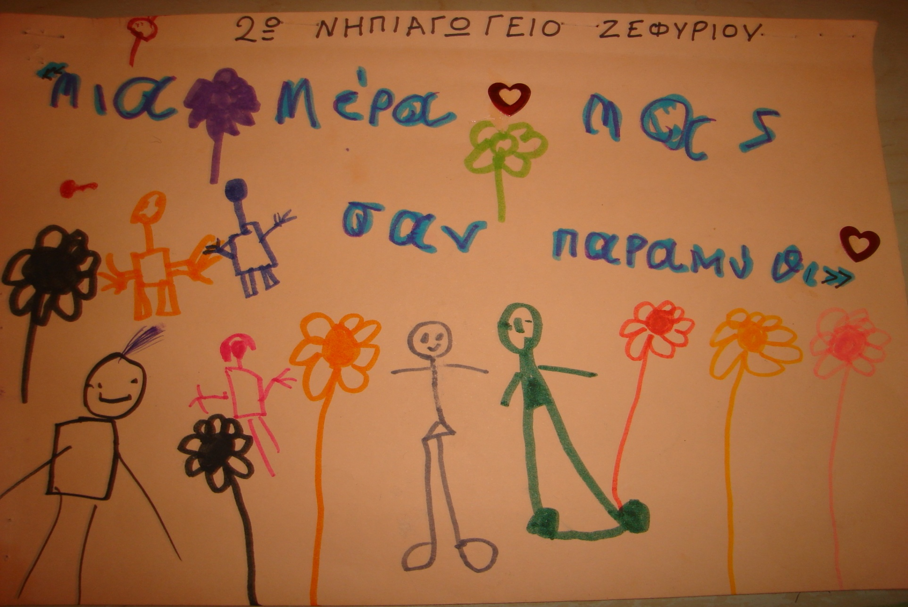
«A TRUE FAIRYTAILE»

Slide 3
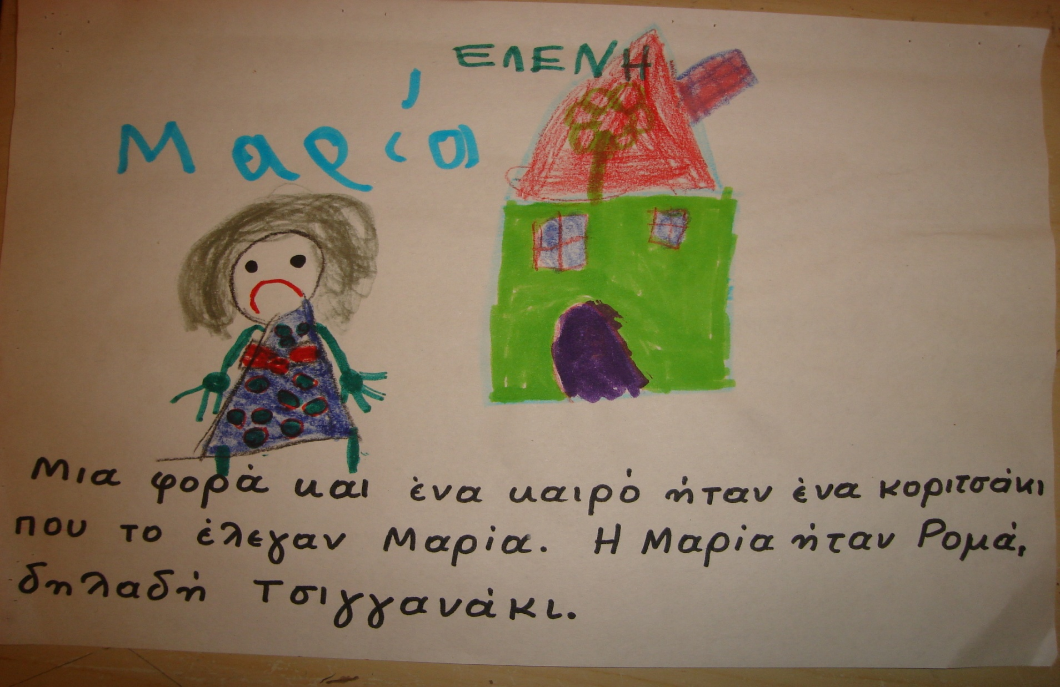
Once upon a time, there was a little girl, called Maria. Maria was Roma, which means that she was gypsy.

Slide 4
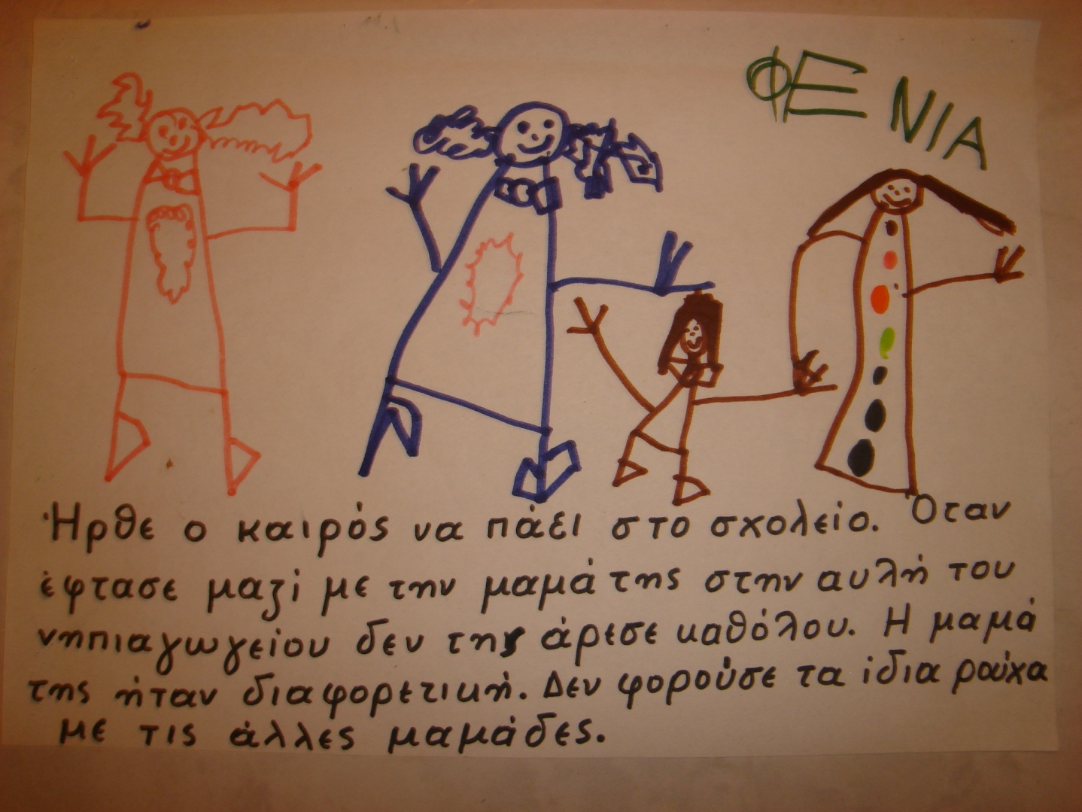
The time has come for her to go to the school. When she arrived with her mother in the nursery schoolyard, she didn’t like it at all. Her mother was different. She wasn't wearing the some clothes with the other mothers.

Slide 5
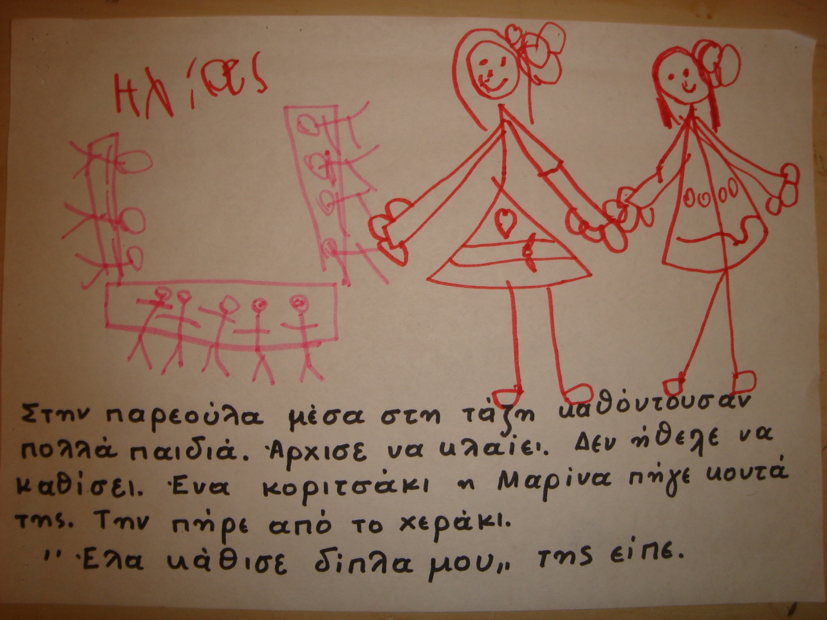
In the class there were a lot of children. Maria started crying. She didn't want to sit. A little girl, called Marina approached her. She took her by the hand. «Come, sit with me», she told her.

Slide 6
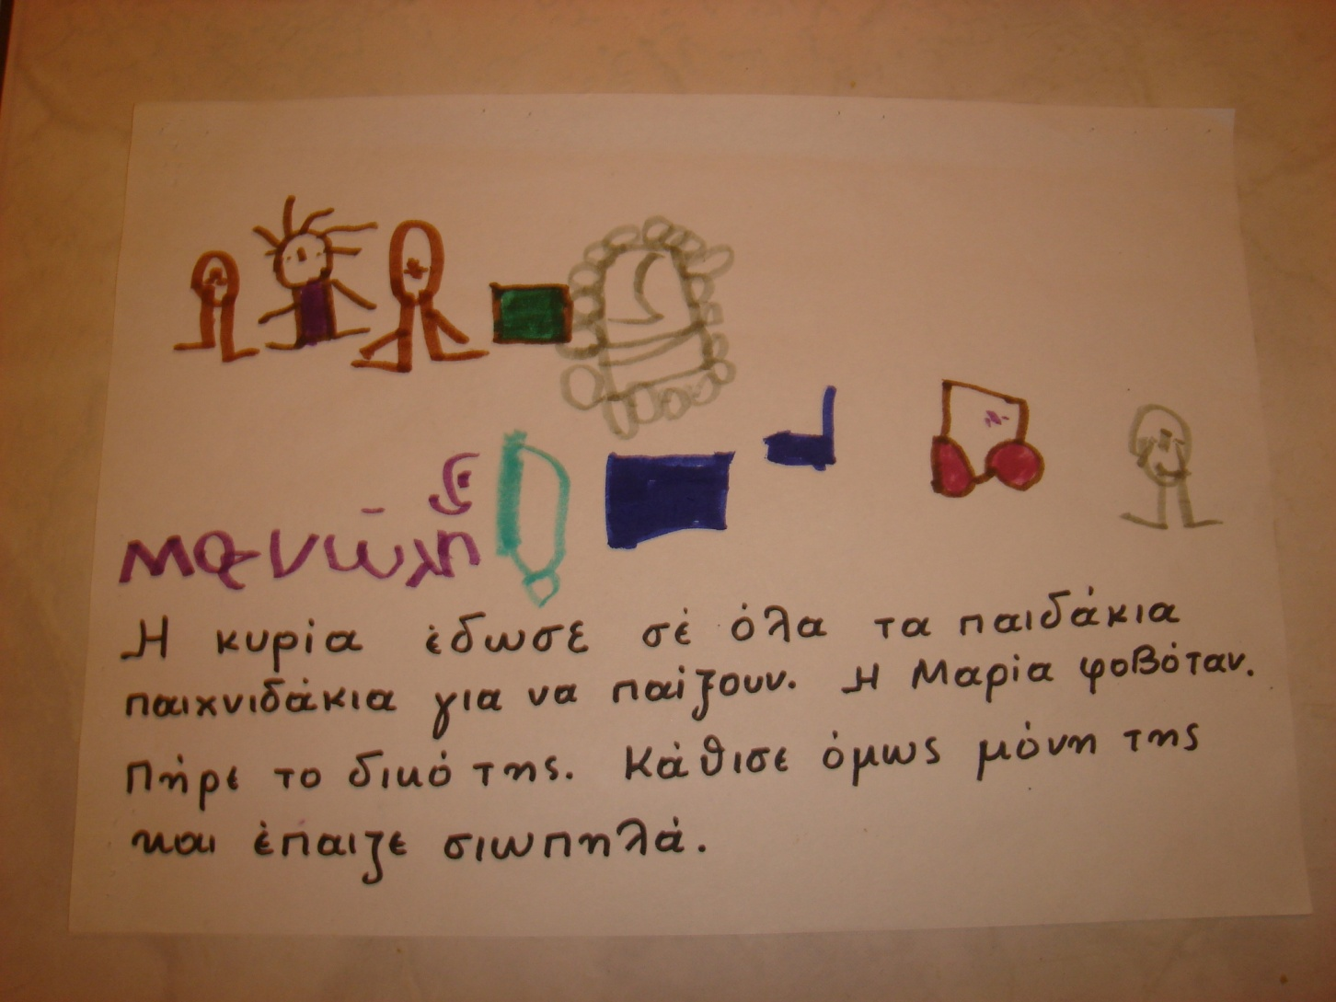
The teacher gave to all children toys in order to play. Maria was scared. She took her toy. But she sat alone and played quietly.

Slide 7
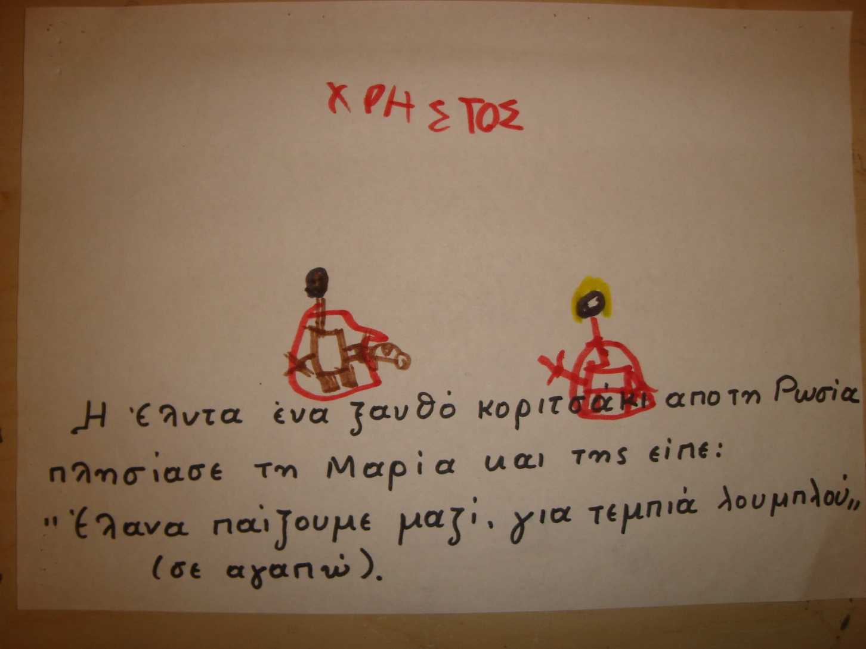
girl from Russia approached Maria and told her come we will Elda, a blonde play together, «gia tembia loublou (I love you)»

Slide 8
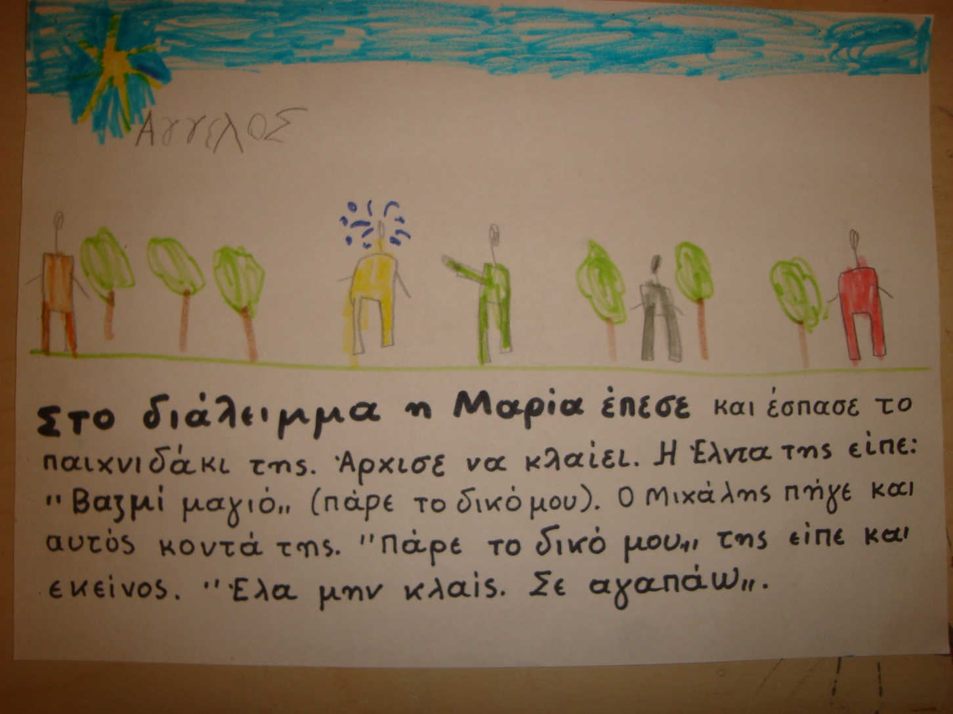
In the break Maria fell down and broke her toy. She started crying. Elda told her: « vazmi majo», ( take my toy). Michalis approached her . « take mines», he told her too. « come on , don’t cry. I love you.»

Slide 9
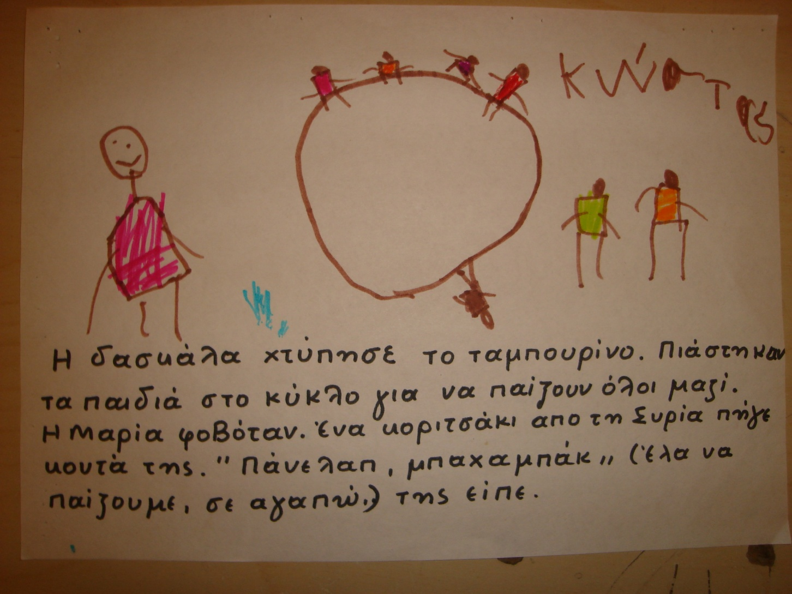
The teacher hit the drum. The children made a circle with the hands in order to play all together. Maria was scared. A little girl from Syria approached her. « panelap, bachabak (come, we will play, I love you)» she told her .

Slide 10
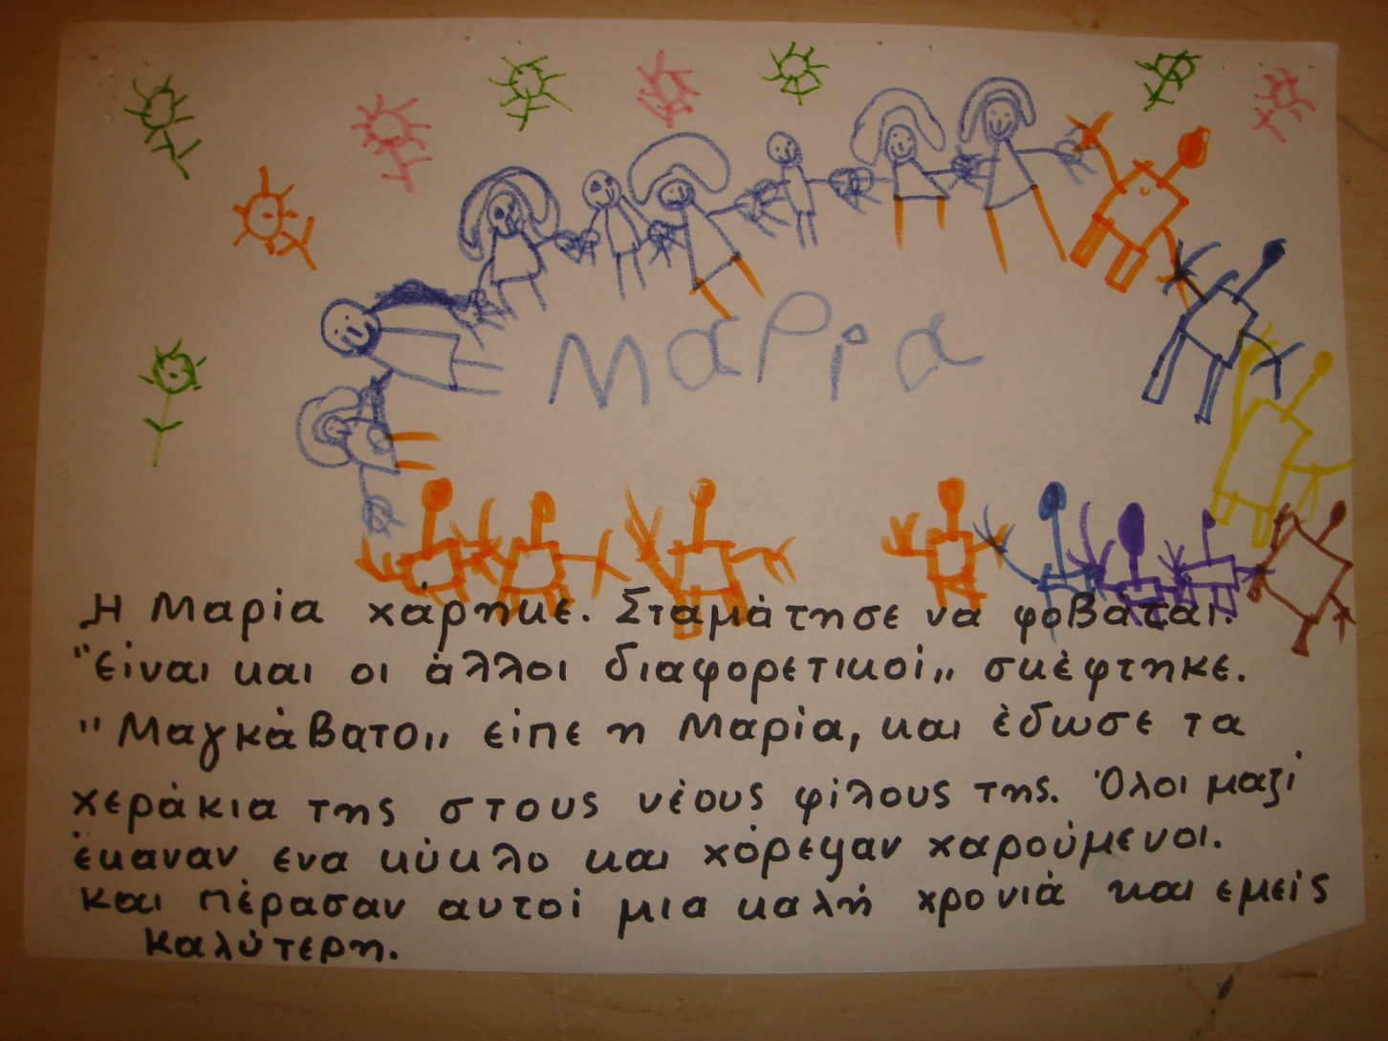
Maria was happy. She stopped being scared. « the others are different, too» she thought. «magavato (I love you)» she told and she gave her little hands to her new friends. All together made a circle and danced happily. And they had a good school year and we had a better one.

Slide 11
TSANTI PARASKEVI CHALKIOTOY MARIA 2014-2015
2o NURSERY SCHOOL OF ZEFYRI

