Slide 1
E-Step Training Materials
Module 1, Unit 2
Exploring own context

Slide 2
Unit objectives
To explore and identify purposes and priorities for parental engagement.
To agree a timeframe for change and development.
To consider the roles of stakeholders in school development processes.

Slide 3
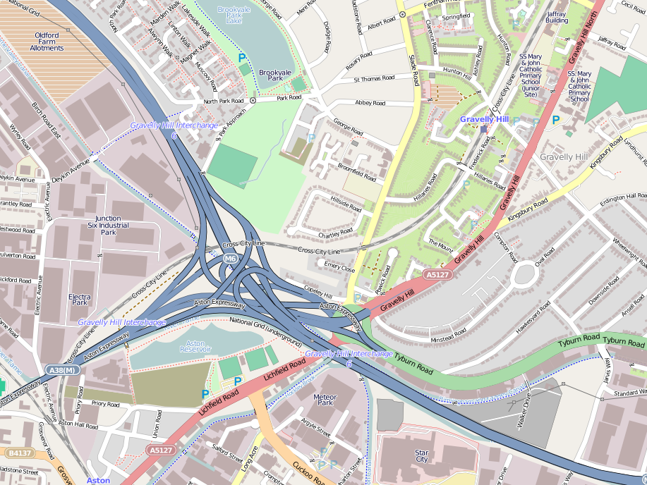











Defining terms, auditing practice and identifying priorities
Staying focused on benefits for children and young people
Merging priorities and actions into existing development plans
Listening to parents
and learners including through social media
Participatory action research
to check milestones, monitor progress and refine actions
A ‘roadmap’ for
parental engagement
Understanding and sharing evidence of impact (intended, contingent and serendipitous)

Slide 4

Activity – setting priorities
What are the current priorities for developing learners’ experiences and outcomes within your context?
Be as specific as you can.
‘Post-it’ them.

Slide 5
Prioritisation Activity
Adapted from School Improvement Planning Framework (TDA 2008)
Place your priority ‘Post-its’ on this map.
What are your priorities for parental engagement?

Slide 6
From priorities to strategic actions
Adapted from School Improvement Planning Framework (TDA 2008)
Priority
Strategic action
Priority
Strategic action
Strategic action
Priority
How will parents be engaged in strategic actions?
How can social media be used to support strategic actions?

Slide 7
From strategic actions to
key activities and milestones
Adapted from School Improvement Planning Framework (TDA 2008)
Strategic action
Strategic action
Strategic action
Strategic action
What key activities will be required?
What milestones will be used to check progress?

Slide 8
Learners
Teachers
Middle leaders
Senior leaders
Parents

Slide 9
References
TDA (2008) School Improvement Planning Framework. Training and Development Agency for Schools.

