Slide 1
E-Step Training Materials
Module 1, Unit 1
Introduction – definitions, values and attitudes

Slide 2
Unit objectives
To consider purposes of parental engagement.
To explore values and attitudes towards parental engagement.
To explore existing definitions and models of parental engagement.
To develop a shared understanding of parental engagement within your context.

Slide 3


Why parental engagement?
Assumptions or starting points:
Parental engagement is a ‘good thing’.
Social networking and media might help.
But what might be the reasons for these two starting points?
Why parental engagement?
Why social networking?

Slide 4
If I had one wish for all of our institutions, and the institution called school in particular, it is that we dedicate ourselves to allowing them to be what they would naturally become, which is human communities, not machines. Living beings who continually ask the questions: Why am I here? What is going on in my world? How might I and we best contribute?
Senge (2000, p.58)

Slide 5

Why parental engagement?
Parental engagement and social networking are perhaps best understood as processes to support learning, achievement and wider positive outcomes.

Slide 6
Exploring understandings of parental engagement
Use creative methods to explore our understandings of parental engagement.
Create an artifact/picture.
Share our stories about parental engagement in our own context.
Generate ideas about we might use creative methods in our own context.

Slide 7
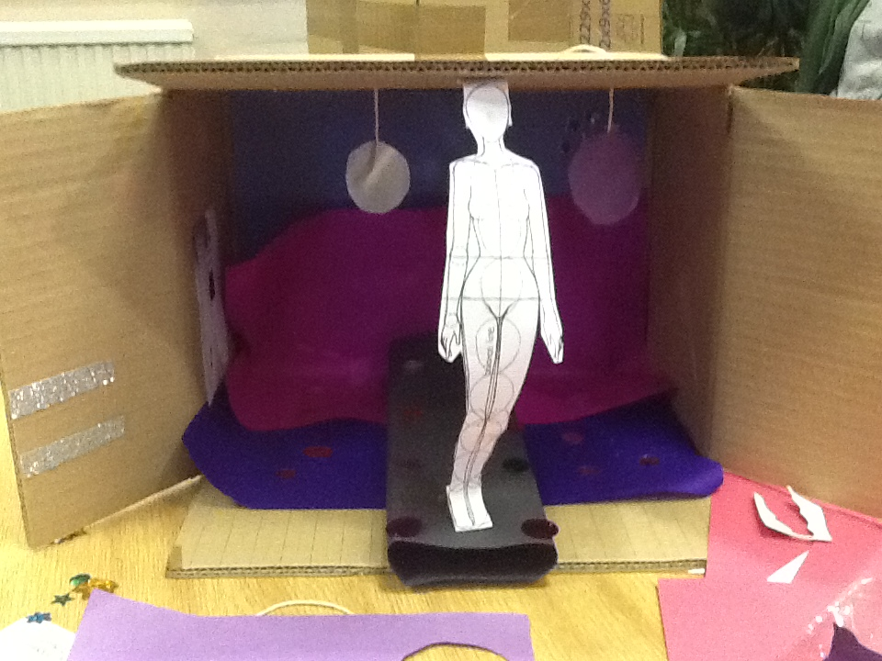
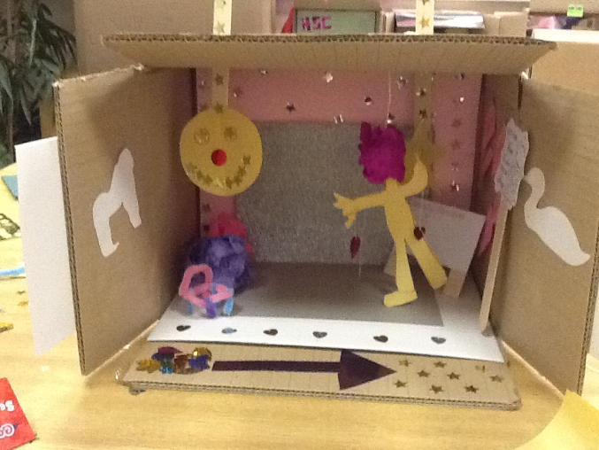
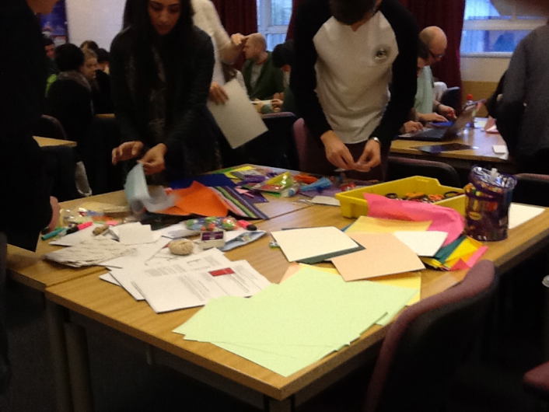
Activity
Create something that helps tell a story...

Slide 8
Activity – defining terms
Parental involvement
Parent-school partnerships
Parent engagement
What do these terms mean to you?
In what ways do they feature in your school/context?
What are the overlaps and differences?
Discuss and share ideas.
Jot down some key words to summarise each term.

Slide 9
Activity – defining terms
Parental involvement
Parent-school partnerships
Parent engagement
Key words:
Key words:
Key words:

Slide 10
Spheres of influence 1
Family
Community
School
Schools make choices. They might conduct only a few communications and interactions with families and communities, keeping the three spheres of influence that directly affect student learning and development relatively separate. Or they might conduct many high-quality communications and interactions designed to bring all three spheres of influence closer together.
Epstein (2009, p.8)
Learner
Family
Community
School
Learner

Slide 11
Six types of involvement
See examples on handout.
Which of these types of involvement does your school/college currently promote?
How could social media be used?
What are the limitations of this model?
How is power exercised?
Epstein (2009, p.14)

Slide 12
Spheres of influence 2
What are the key influences at each level, in your context?
The Children’s Society (2013, p.31)

Slide 13


Potential problems
Parental involvement, spheres of influence and transfer of information and knowledge can be seen as:
a ‘unidirectional process’;
lacking ‘the characteristics of a learning organization, where people’s capacity to learn exists at all levels (Senge, 2006)’.
Price-Mitchell (2009, p.16)
How can working with parents become a two-way process?

Slide 14
(Re-)defining terms
Parental involvement
Parent-school partnerships
Parent engagement
‘…explicit ways in which families help children learn and develop.’
‘…shared and equally valued roles in education…’
‘…parent’s active power-sharing role as citizens of the education community rather than people who participate only when invited.’
Price-Mitchell (2009, p.13)

Slide 15
A broad definition
Schools which were successful in relation to parental engagement operated with a broad definition of parental engagement: this included work with the child at home, interest in the learning of the child, rather than just interaction with the school. They also spent time making parents aware of their rights and responsibilities in relation to their children’s education.
Goodhall and Vorhaus (2011, p.66)

Slide 16
References
The Children’s Society (2013) The Good Childhood Report. Available from: http://www.childrenssociety.org.uk/sites/default/files/tcs/good_childhood_report_2013_final.pdf [Accessed 01.07.14]
Epstein, J. L. (Ed.). (2009) School, family, and community partnerships: your handbook for action (3rd ed.). Thousand Oaks, Calif: Corwin Press.
Goodhall, J. & Vorhaus, J. (2011) Review of best practice in parental engagement, Research Report DFE-RR156. London: Institute of Education; Department for Education.
Price-Mitchell, M. (2009) Boundary Dynamics: Implications for Building Parent-School Partnerships. The School Community Journal, Vol. 19, No. 2.
Senge, P. (2000) Systems Change in Education. Reflections, Vol .1, No. 3.

