Slide 1

Debate in Primary School: Empowering Teachers and Students
Dr. A. Vavouraki, Ellinogermaniki Agogi

Slide 2
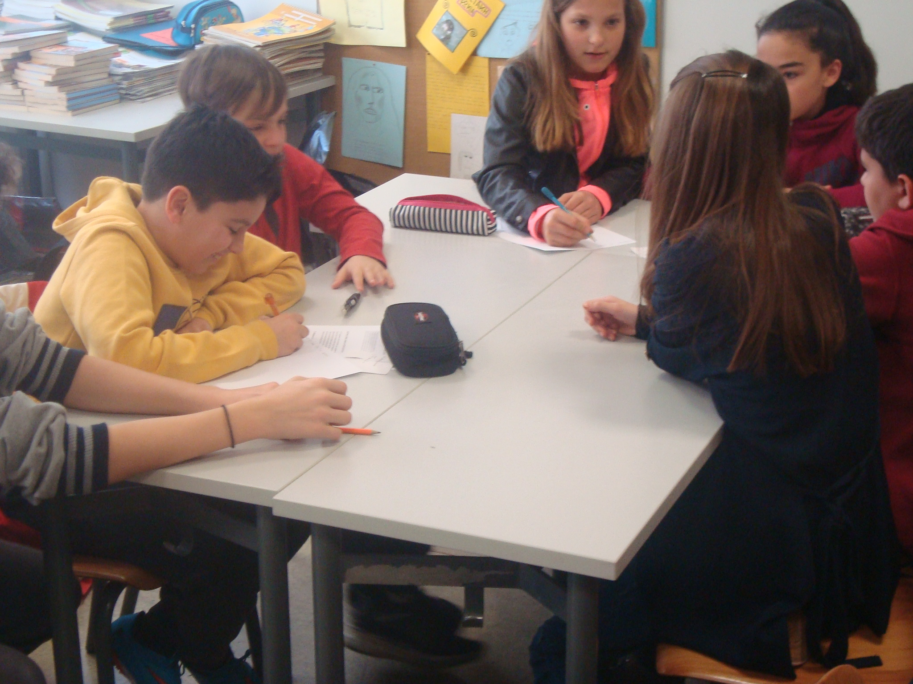
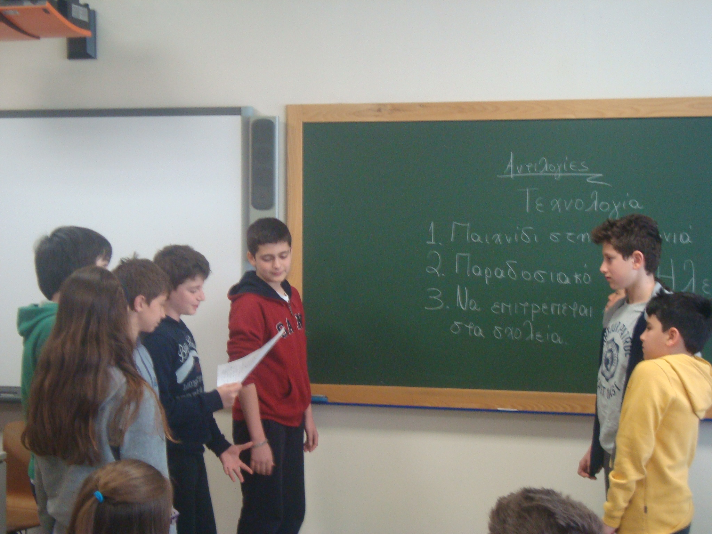
Debate in primary school
Debate between students of 6th grade on science issues that influence the quality of our life and environment

Slide 3
Debate: why in the primary school?
The National Curriculum
Greek Language
develop their communication skills (argue, make a case)
Citizenship
develop a responsible and active involvement in the social welfare
Science
get involved in science investigations and scientific method of thinking and research

Slide 4
Debate: why in the primary school?
Empowering students
Authentic activity
Meaningful, take initiative, develop ideas, take action
Interdisciplinary approach
Science, language, mathematics, ICT, culture, values
Groupwork
Learn to cooperate, discuss, disagree, analyse, synthesise, decide
Responsible, Democratic, active citizens

Slide 5
Debate: how?
Empowering Teachers
Teachers must work smarter not harder…
Today most innovation is the activity of networked teams, not individuals …
Hargreaves (n.d.2003)
Notes:
Η ανάπτυξη κοινοτήτων εκπαιδευτικών ενθαρρύνει τη διαμόρφωση καινοτομικών προγραμμάτων, το «μοίρασμα» και τη διάχυση.

Slide 6
Debate: how?
Empowering Teachers
Teacher as a social learner
Professional learning community
try out the new idea, process not a product, develop a shared meaning, share problems, exchange and discuss ideas, support each other

Slide 7
Debate: how?
Empowering Teachers
Teacher in an Open School
Broader community that interact
School Hub – Schools – University – Administrators

Slide 8






The Debate Community

Slide 9

The digital platform

Slide 10
The vision

