Slide 1
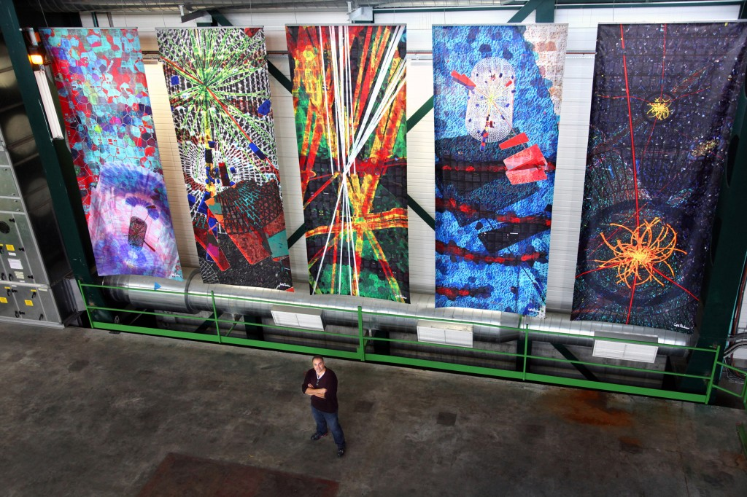


CREATIONS Summer School 2018
E. Chaniotakis¹, J. Alexopoulos¹, B. Muller², D. Dvorzhitskaia² on behalf of the CREATIONS consortium ¹ Ellinogermaniki Agogi, ² Rhine-Waal University of Applied Sciences

Slide 2
About CREATIONS
How can young people’s interest in science be increased? 16 partners from ten European countries want to break new ground. In CREATIONS, a project funded by the European Union, they develop creative approaches based on art for an engaging science classroom. The partners are planning a variety of events with theatre, photography, exhibitions in which young people can experience an active and playful role within science and research. CREATIONS establishes a pan-European network of scientists, teachers, artists and students.

Slide 3
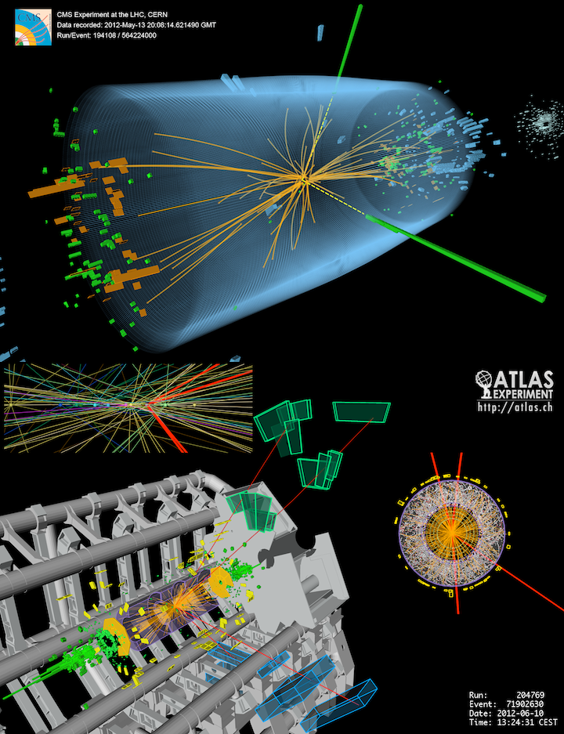
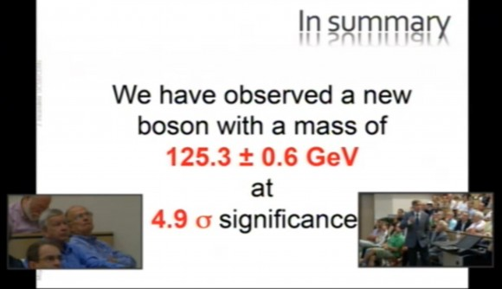
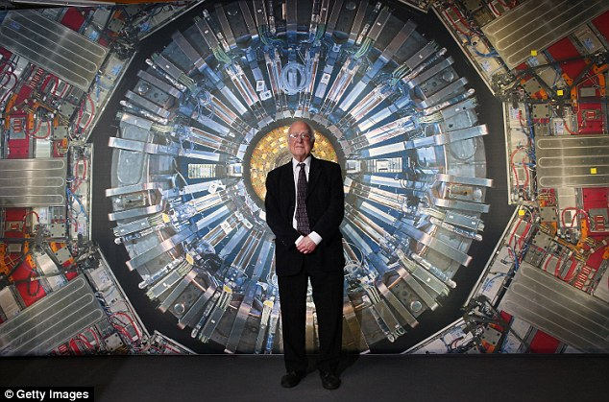
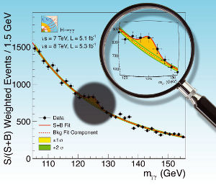

Bringing Nobel Prize Physics in the Classroom
Discovery of The Higgs Boson

Slide 4

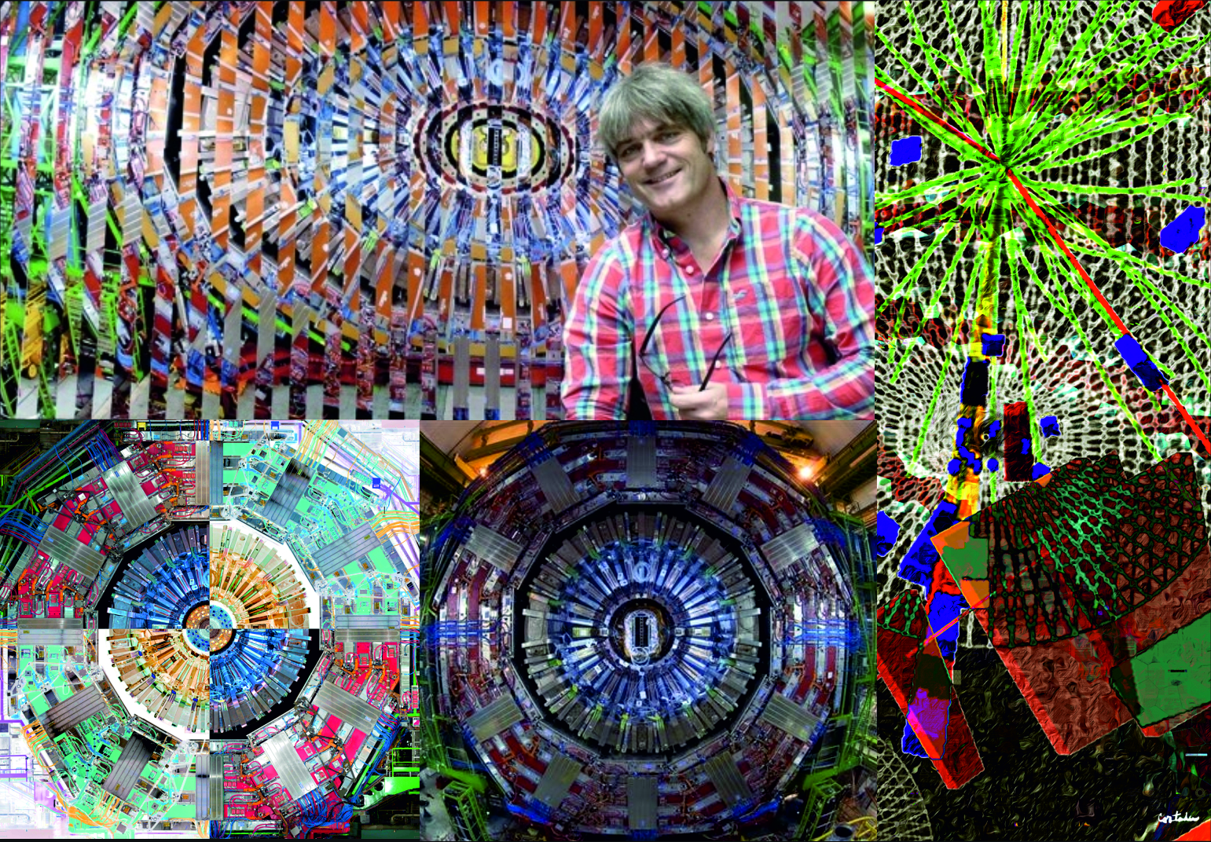

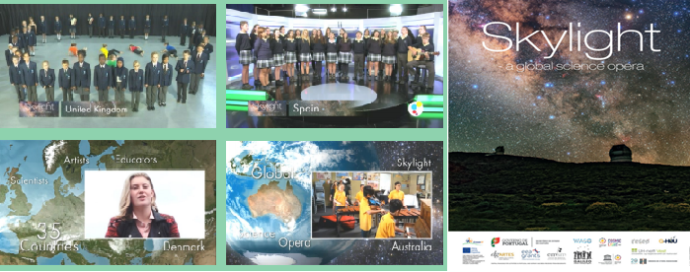
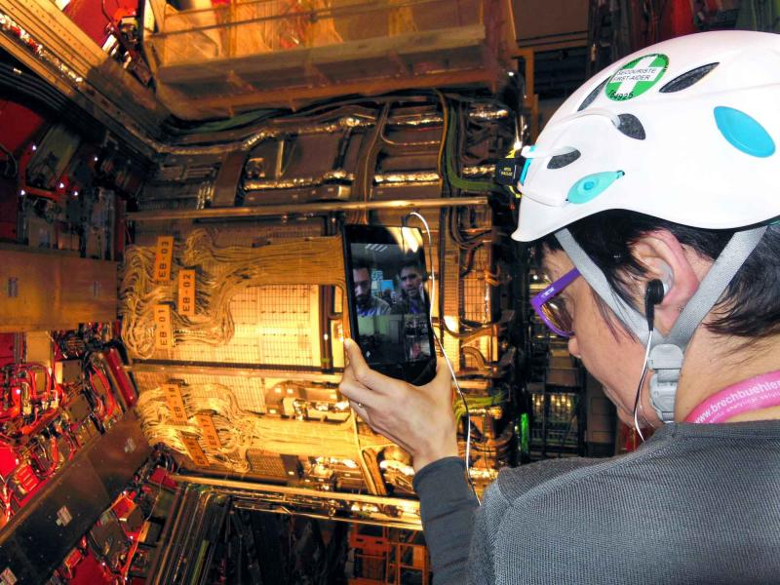
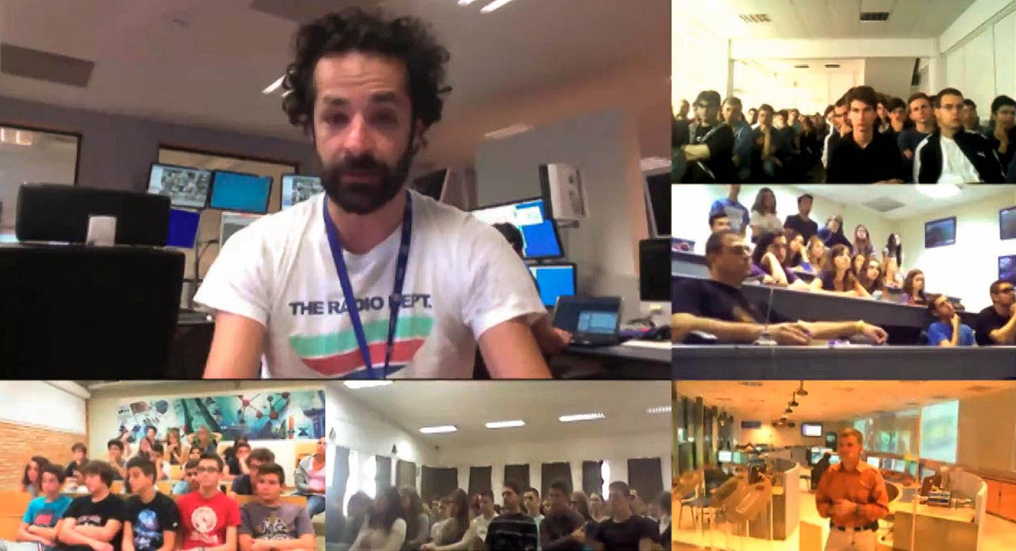
Through STEAM Case Studies

Slide 5
The CREATIONS Challenges
The project was launched in October 2015 and runs for three years. CREATIONS aims to improve the skills of young people in STEM (science, technology, engineering, mathematics) and to pool talent to scientific careers by: • combining art and science in an effective way, enhancing the creative thinking of students and giving students and teachers opportunities to experiment with many different places, activities, personal identities, and people
• Bringing the culture of large research infrastructures (e.g CERN) to the school classroom • simulating the work of the scientist and researcher in the classroom • promoting a better understanding of how science works • enhancing students’ science related career aspirations • encouraging and empowering science teachers to affect change • implementing and promoting inquiry-based science teaching and learning • learning and (self)creating in emotionally rich learning environments

Slide 6
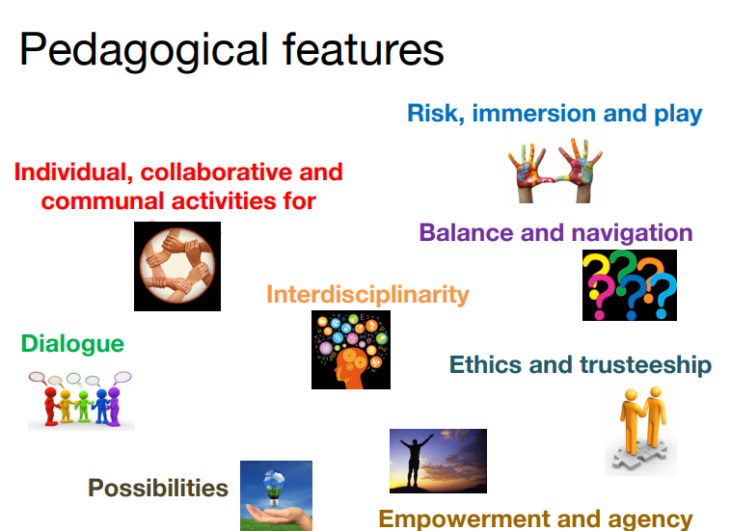
Pedagogical Features
Notes:
Pedagogical Framework to address the CREATIONS challenges

Slide 7
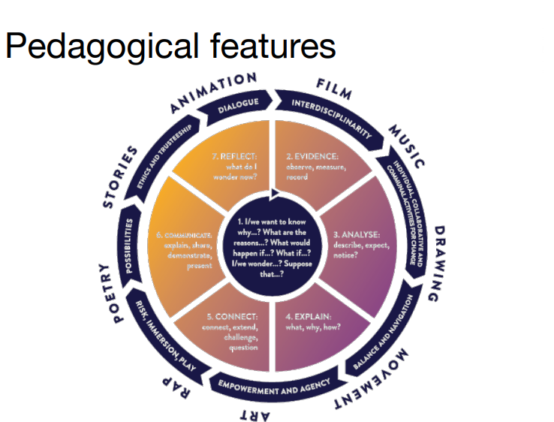


Slide 8
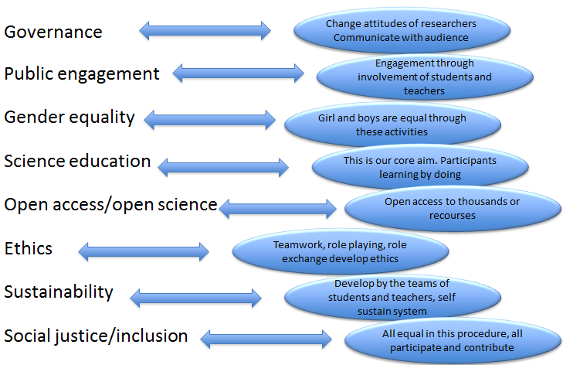
Tackling Responsible Research and Innovation aspects

Slide 9
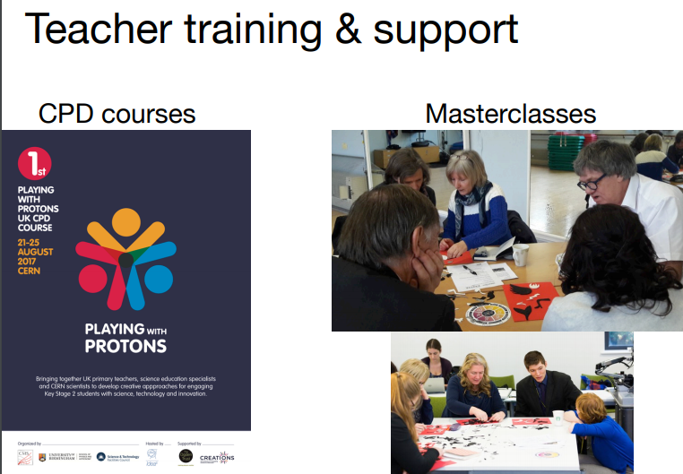
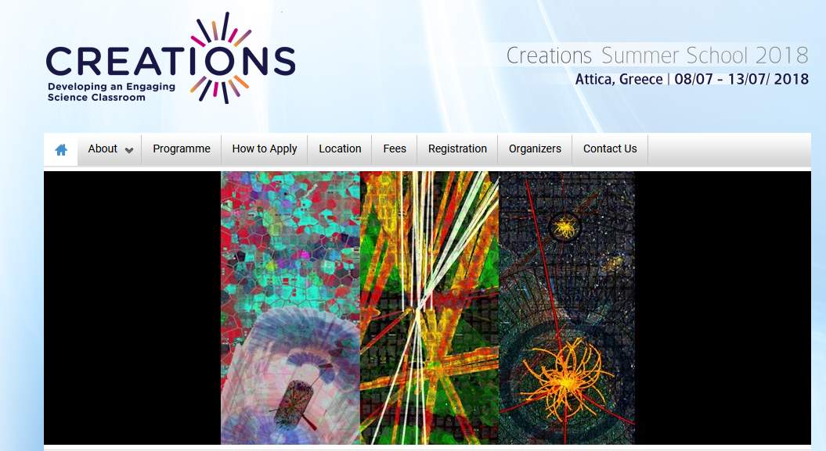
Tools to meet the CREATIONS Challenges
Trainings: Workshops with teachers and students at National or Local level. Intensive 5 days Summer Schools for teachers and students
Implementation of the CREATIONS Demonstrators: Within the project the partners involve teachers and students in activities that follow the CREATIONS Demonstrators. Implementing these activities engages teachers and students in the CREATIONS Approach and demonstrate the way to implement these activities. >50 Demonstrators have been developed for the first phase of the project, with a final goal of 100 demonstrator by the end of CREATIONS’ duration.
Online Communities of Practice: The main aim is to create and develop communities between the participants (teachers and students) with a main aim to set the CREATIONS approach as a self sustained approach where the participants will lead the activities and implement the proposed methodologies in their everyday life in schools. For this purpose the CREATIONS project has already developed a web community to elaborate the communication and exchange of good practices between the participants in several countries. The CREATIONS online communities are hosted by the Open Discovery Space platform and are accessible to all the stakeholders.

Slide 10
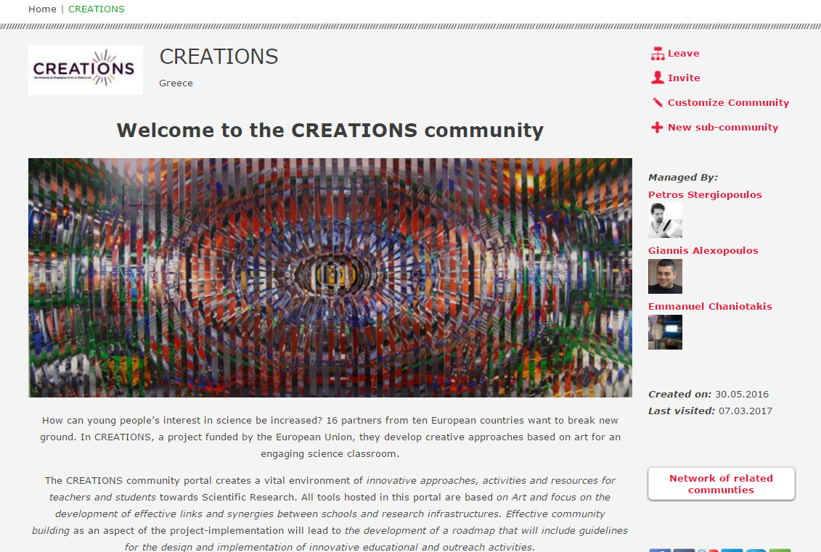
The CREATIONS Community Support Environment
Online Communities: - An environment in which teachers can find, create and co-create open educational content.
Collectively evaluate educational material and online tools.
Exchange good practices through groups and participatory activities.
Create and maintain their own educational communities.
http://portal.opendiscoveryspace/creations Registration is free of charge and all resources are available to the visitors, registered or not

Slide 11
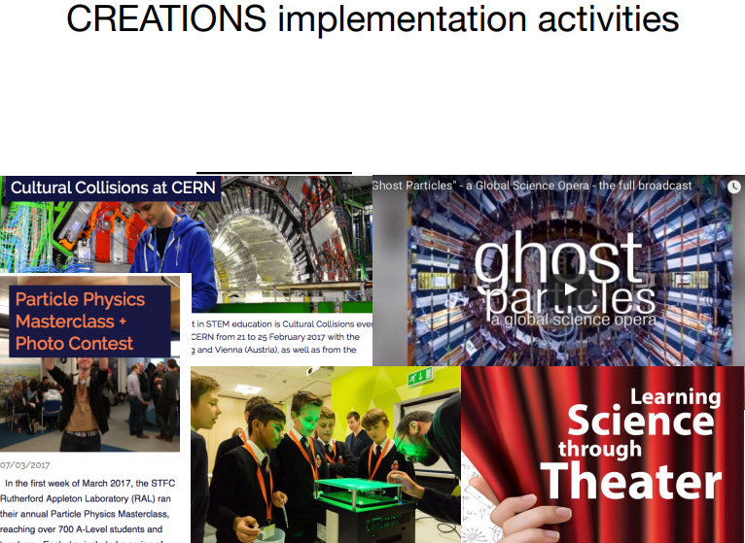


CREATIONS IMPLEMENTATION ACTIVITIES
up to January 2018
548 ACTIVITIES
1874
SCHOOLS
20522
STUDENTS
4000
TEACHERS

Slide 12
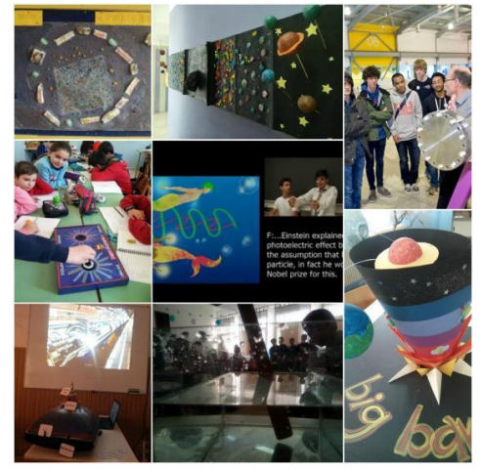
Local Implementation activities

Slide 13
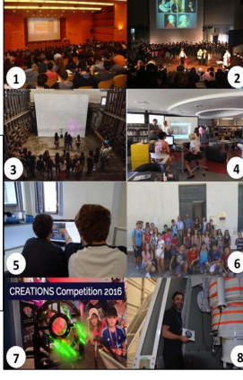
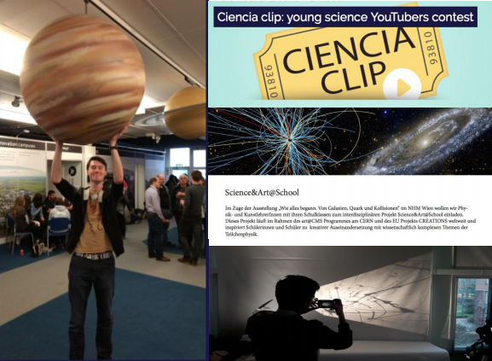
National Implementation activities

Slide 14
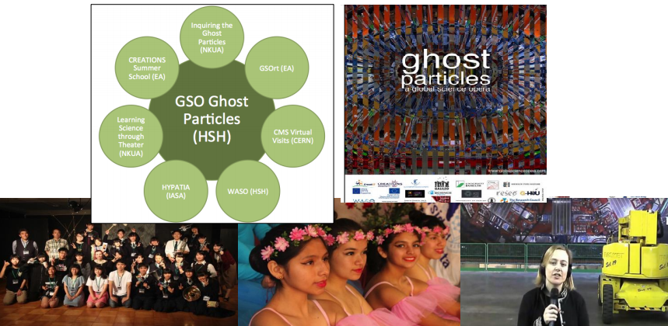

International Implementation activities

Slide 15
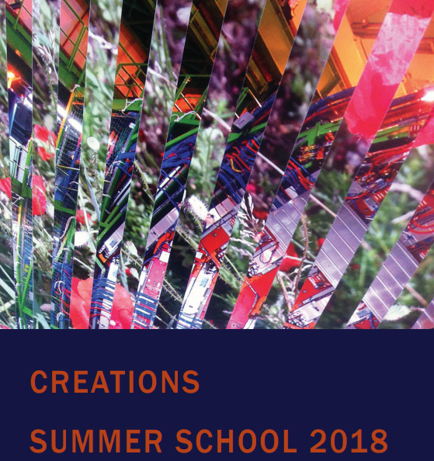
CREATIONS SUMMER SCHOOL 2018
CREATIONS Summer School 2018, 8-13 July 2018 Marathonas, Greece

Slide 16
About the 2018 CREATIONS Summer School
Organized by Ellinogermaniki Agogi in Marathonas, Attica, Greece in 08/07/2018 – 15/07/2018
Eligibility: Science and Arts tutors, Outreach officers, Researchers
Focuses on: Innovative approaches and activities that involve teachers and students in scientific research through creative approaches based on the Arts.
25 hours of workshop based training, such as presentations followed by hands-on sessions.
The lectures and the demonstrations of the training course will be held in an auditorium equipped with a data projector and a laptop, whereas, the workshops will be held in a multimedia laboratory where each participant will have direct access to a PC with internet connection and will carry out planned exercises.
Register @ CREATIONS Summerschool Website: http://creations.ea.gr

Slide 17
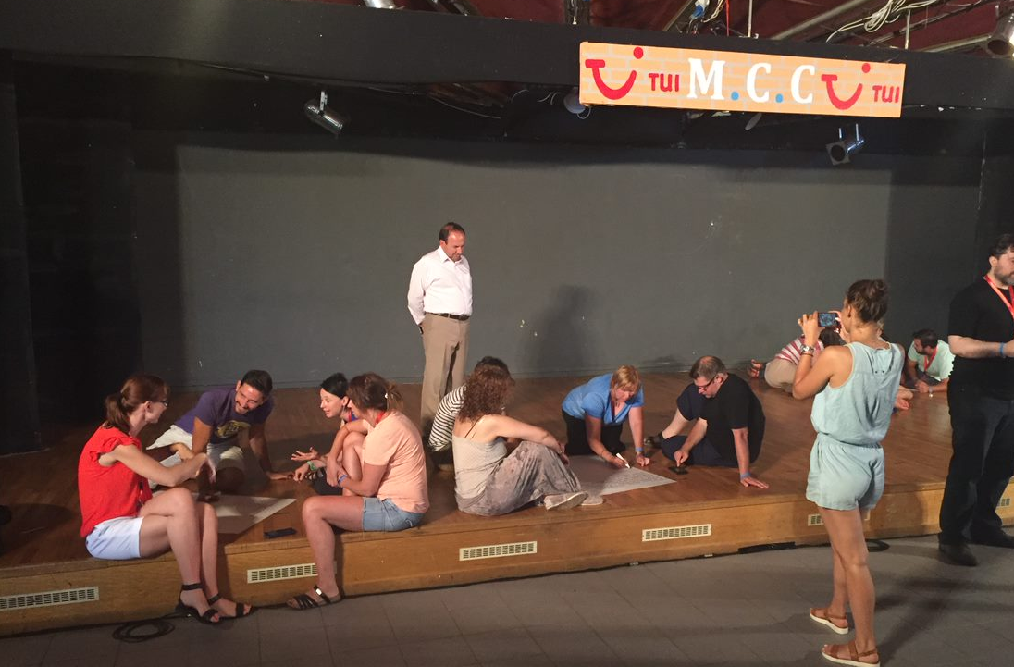
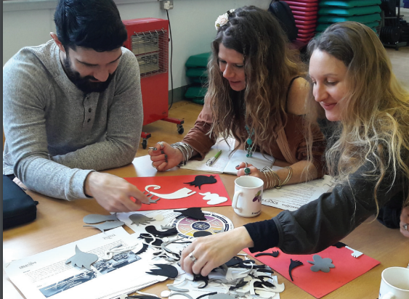
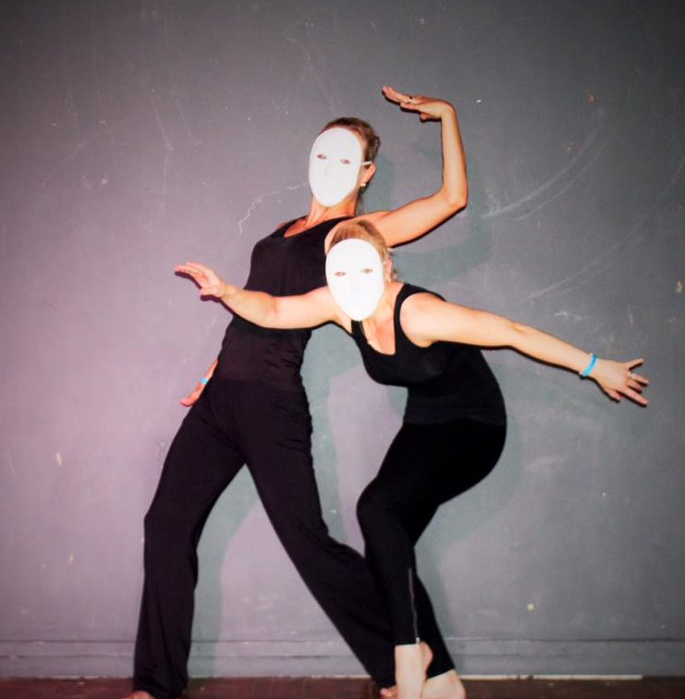
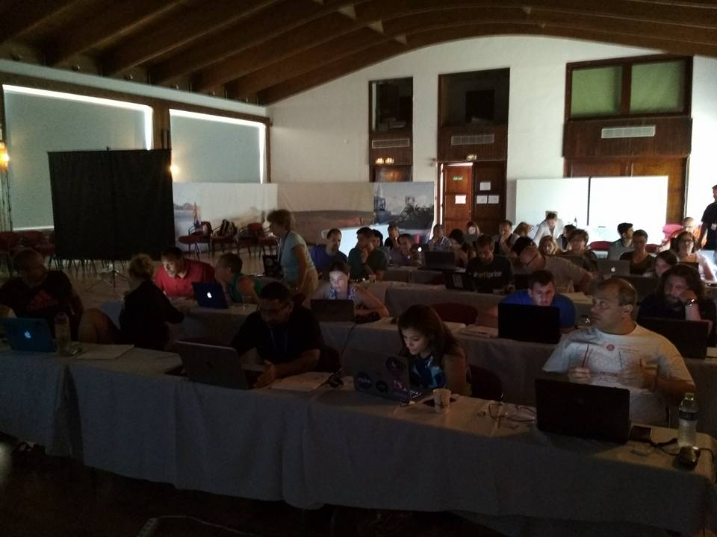
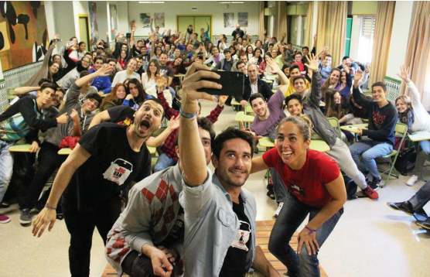
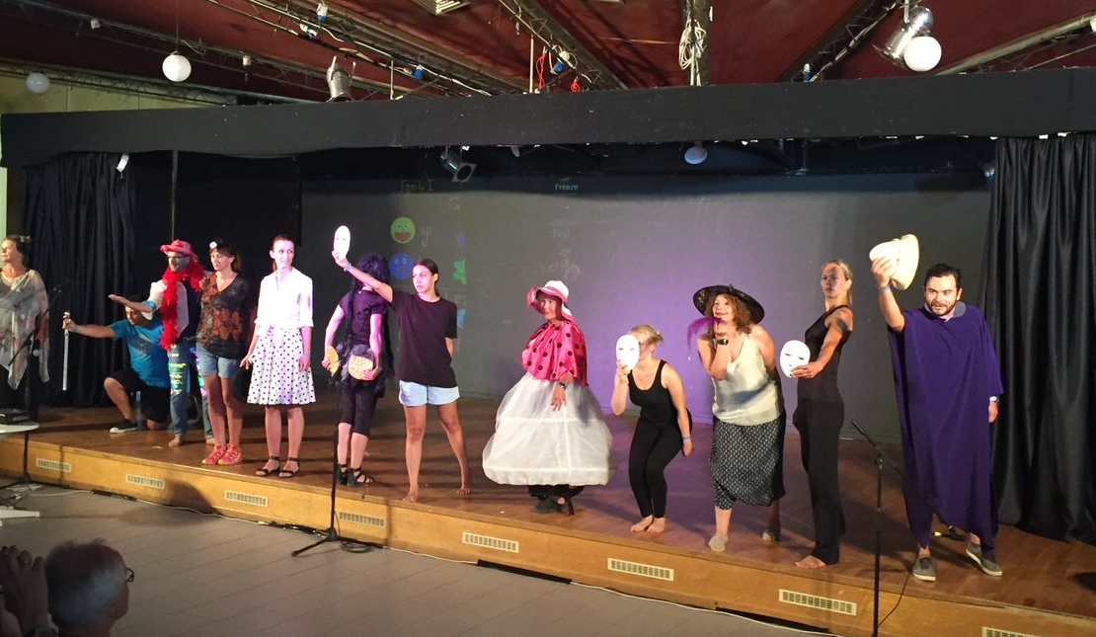
About the 2018 CREATIONS Summer School
The 2018 CREATIONS Summer School aims:
To introduce the culture of large research infrastructures such as CERN, as well as Nobel Prize Worthy Science, in the school classroom through creative and artful practices.
To introduce ways for effective community building between teachers, scientists, artists and students.
To empower students to use, share and exploit unique scientific resources such as research facilities, scientific instruments, advanced ICT tools, simulation and visualization applications and scientific databases.

Slide 18
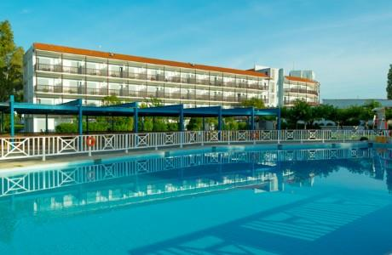
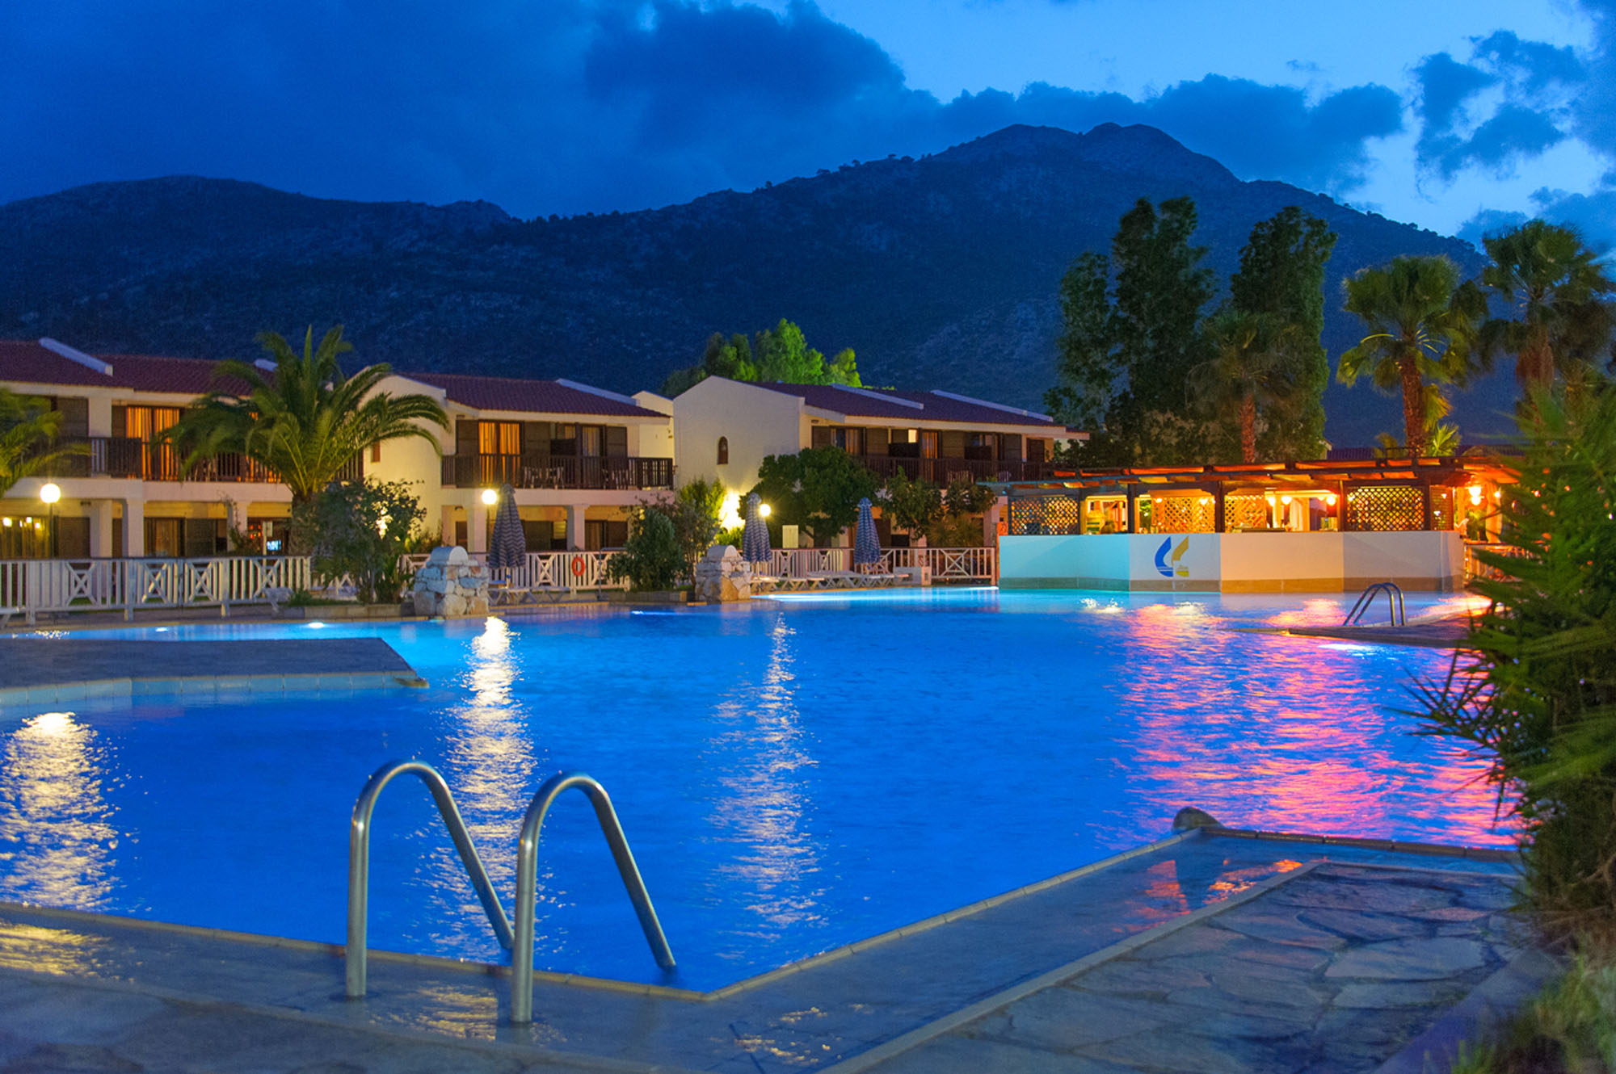
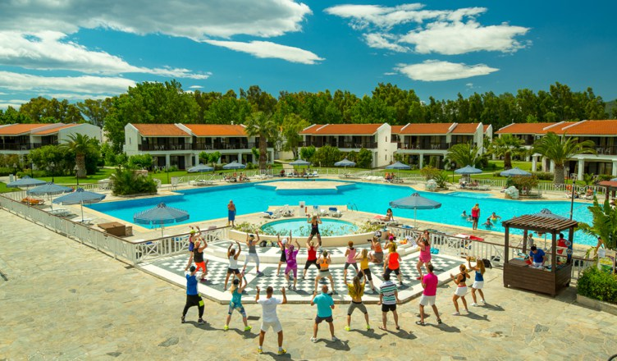
The Venue
Golden Coast Hotel & Bungalows, an A-class/4-star sea-side hotel which stretches on the golden, sandy beach of the Marathon Bay, near the historic location of Marathon, at the outskirts of Athens.

Slide 19
How to apply
For more information about the programme of CREATIONS Summer School 2018, registration, fees or how to apply, please visit http://creations.ea.gr/en/content/how-apply
Teachers’ and school leaders’ participation in the CREATIONS Summer School 2018 can be funded by the ERASMUS+ programme (Key Action 1, Mobility project for school education staff).

Slide 20
EU funding opportunities & Important Dates
Teachers’ and school leaders’ participation in the CREATIONS Summer School 2018 can be funded by the ERASMUS+ programme (Key Action 1, Mobility project for school education staff). The deadline for application is February 1st, 2018 at 12:00 CET.
Although the type of action is entitled “LEARNING MOBILITY OF INDIVIDUALS”, the applications are submitted by the participant’s schools – no individual applications can be submitted. Eligible countries for ERASMUS+ funding are the 28 EU member States, plus Iceland, Lichtenstein, Norway, Switzerland, Turkey and FYROM.
For more details on this funding option please visit http://creations.ea.gr/en/content/how-apply

Slide 21
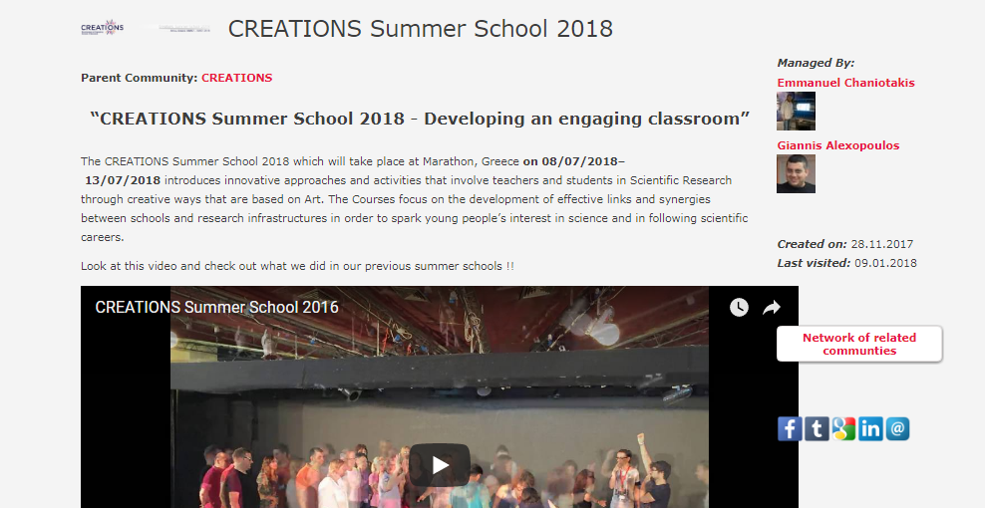
Preparation for the 2018 Summer School
Before coming to the summer school, participants will be asked to join the CREATIONS Summer School 2018 online Community of the CREATIONS portal in order to be informed about the basic aspects of the preparation they had to do for the summer school.
Notes:
Here we could play the draft summerschool video

Slide 22


Join us for an unprecedented journey in the heart of Artful Science Education !
Creations Project
Creations Summerschool 2018
For any question, don’t hesitate to contact us at: echaniot@ea.gr (Emmanuel Chaniotakis) galexopoulos@ea.gr (Giannis Alexopoulos)
Thank you!

