Slide 1


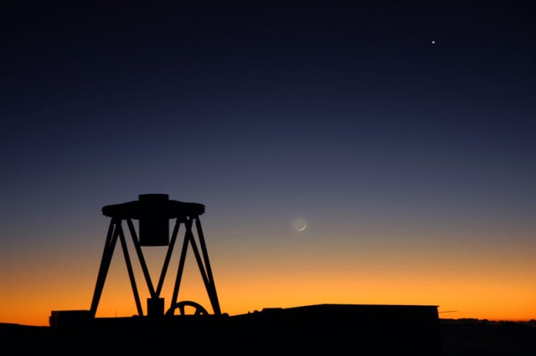




Linking Real Astronomy Research to the Classroom
Fraser Lewis
Faulkes Telescope Project
Liverpool John Moores University
The Open University

Slide 2
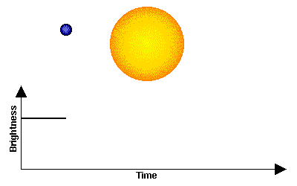
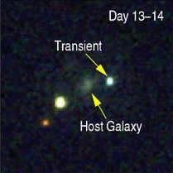
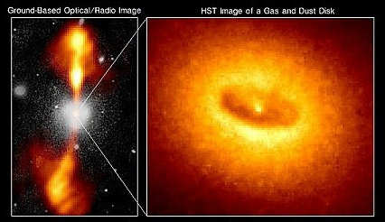
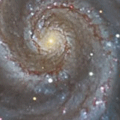
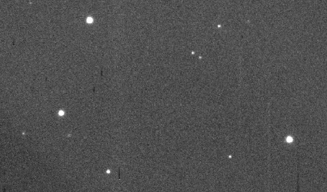
Robotic Telescopes – Why ?
Extra-solar planets
Active Galaxies
Supernovae
Gamma Ray Bursts
Designed to investigate how the Universe changes
Quickly reactions to sudden outbursts of energy
Asteroids

Slide 3
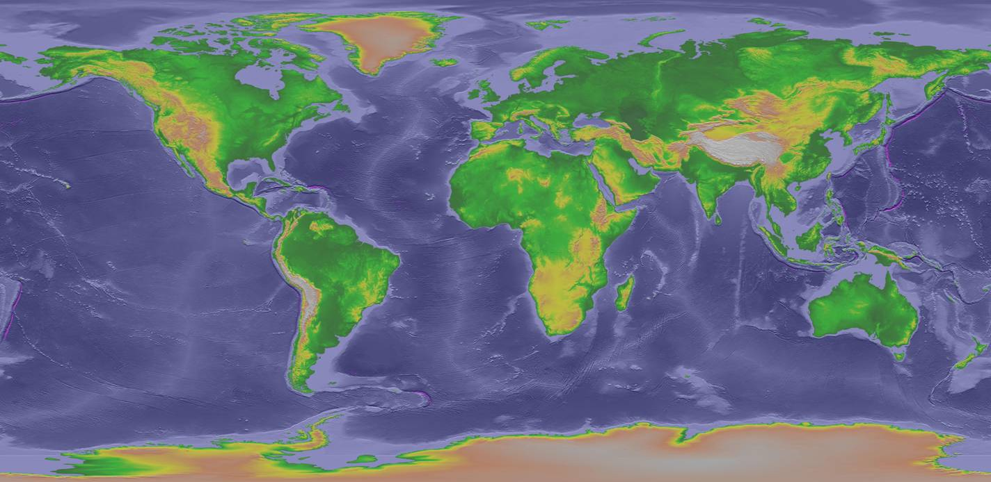
Robotic telescopes allow us to obtain images from distant good quality sites
There are ONLY 3 * 2-metre telescopes that do this for education (and only 1 person … !)
FT
LT

Slide 4
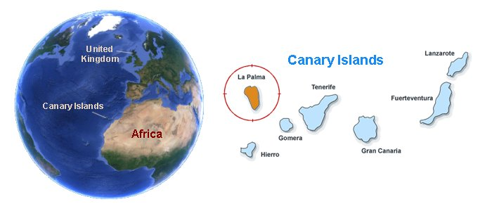
The Liverpool Telescope
On the Spanish island of La Palma.
At the summit of a 2400m extinct volcano, the Roque de los Muchachos observatory hosts 14 telescopes from a number of EU nations

Slide 5
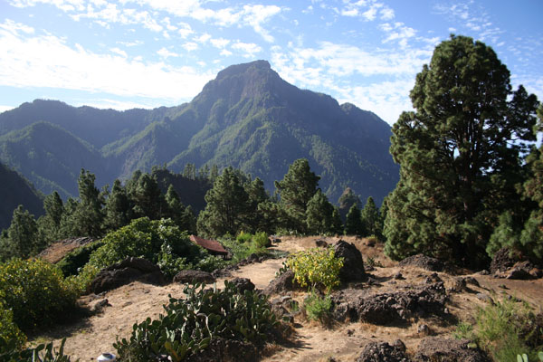
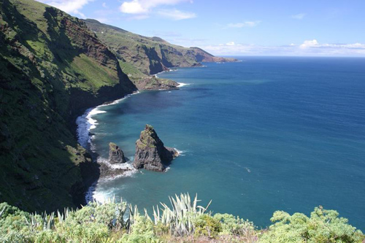
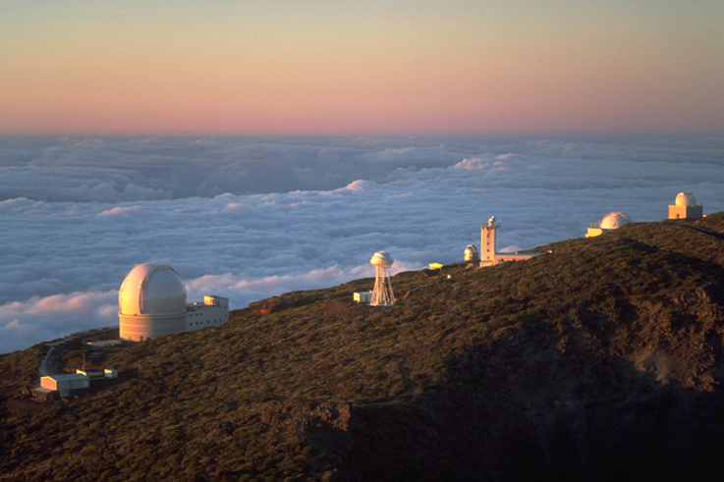
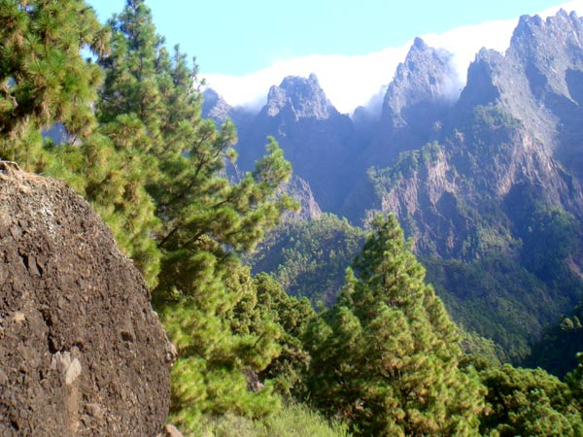

Slide 6
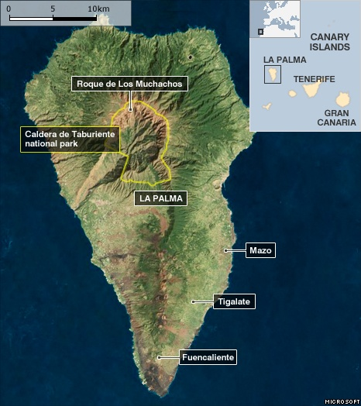

Slide 7
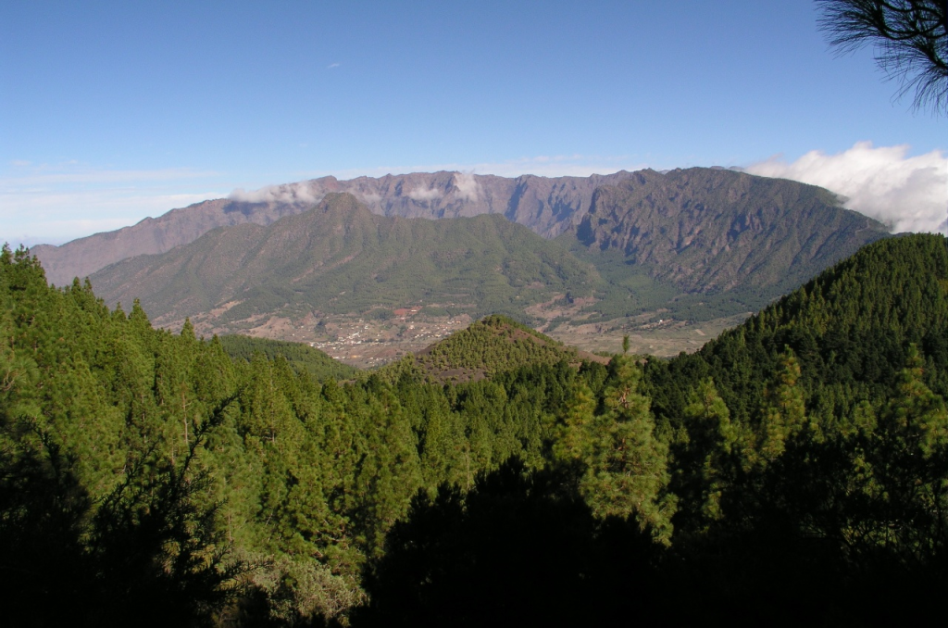
Observatory

Slide 8
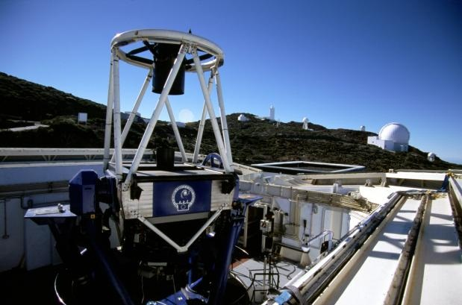
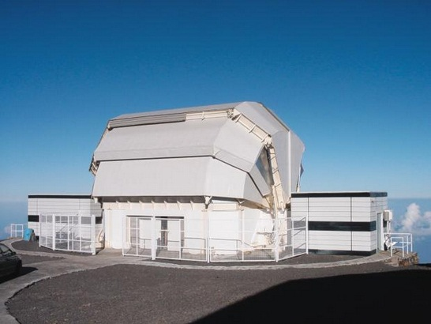
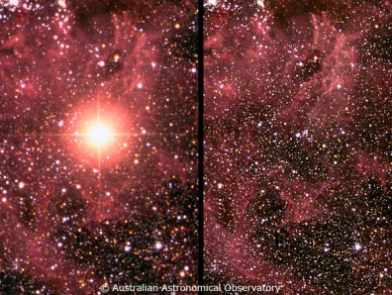
The Liverpool Telescope
Fully robotic 2 metre mirror telescope – Clamshell Enclosure
8.5 m high, 6.5 m wide and weighs 24 tonnes
Designed for rapid response – Supernovae, GRBs, NEOs
Six instruments – IO:O, RISE, RINGO3, FRODOspec, SPRAT, SkyCam
Sophisticated scheduling system – no human intervention
85% used by professional astronomers, 15% UK & Spanish schools

Slide 9
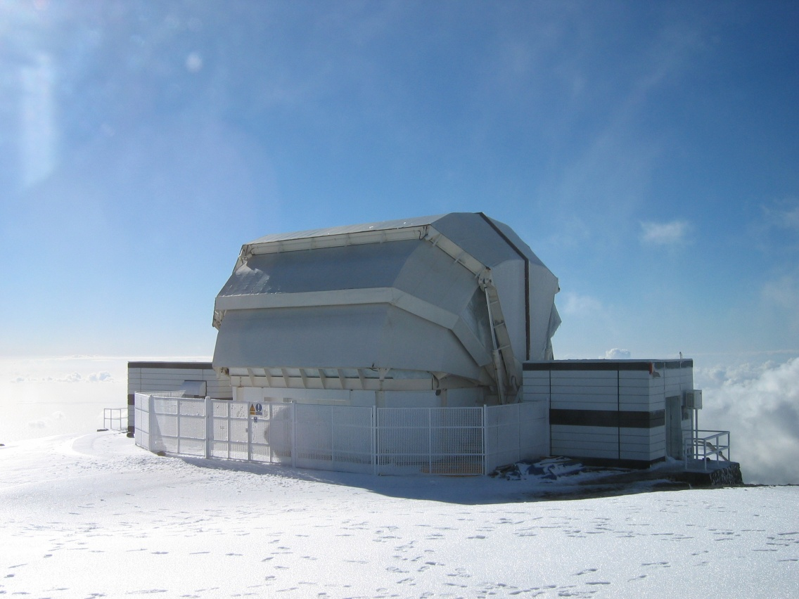
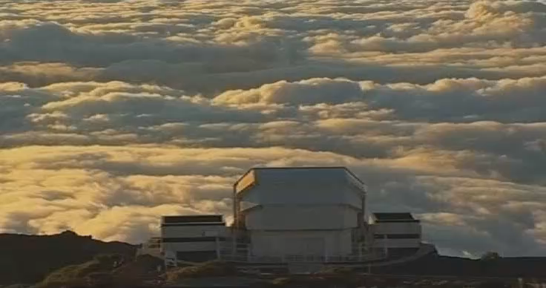
The Liverpool Telescope

Slide 10
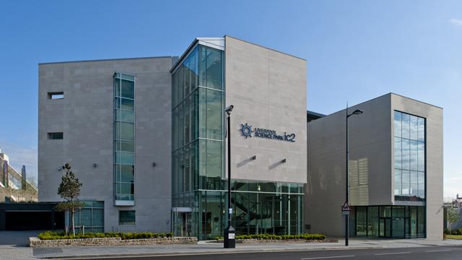
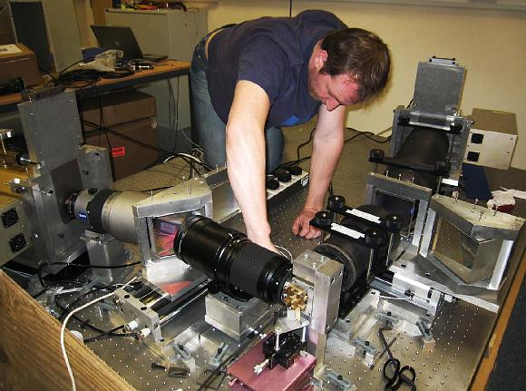
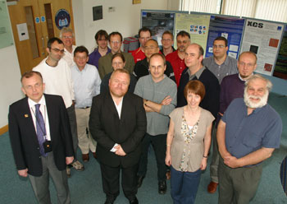

The Astrophysics Research Institute (ARI)
Based in Liverpool Science Park, IC2
Staff Number : 64
30 research staff and lecturers, 18 PhD students
10 on the LT Team and 6 support staff.

Slide 11
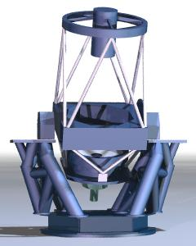
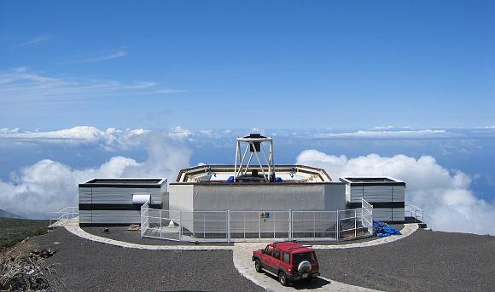
The LT (and FT) Design
Ritchey-Chrétien Cassegrain
f/10 focus

Slide 12
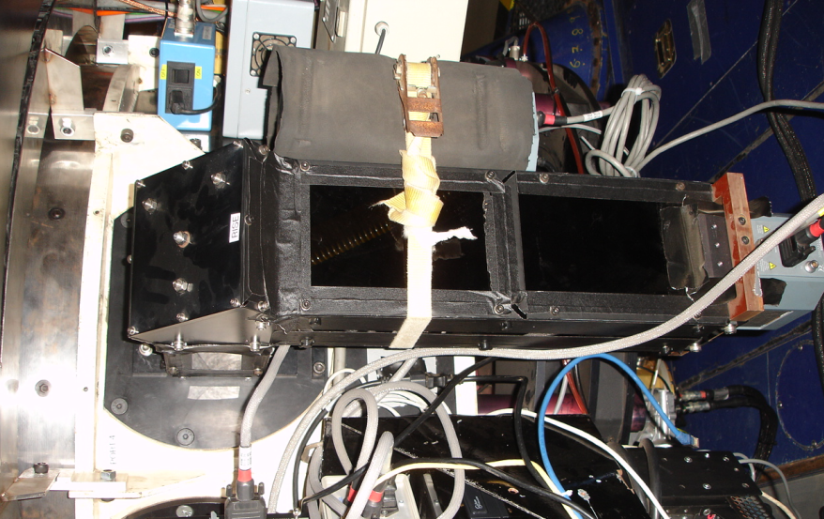
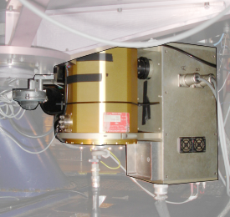
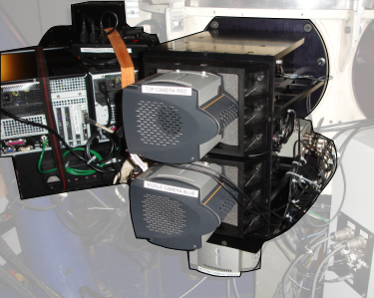
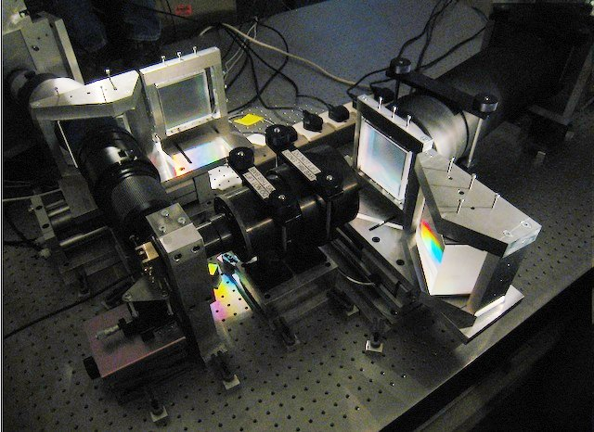
The LT Instruments
RISE
IO:O (4096 px : 10’ FOV)
IO:O (4096 px : 10’ FOV)
RINGO 3
FRODOSpec

Slide 13
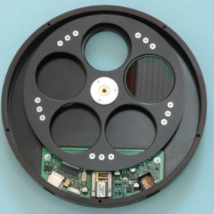
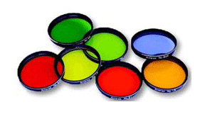
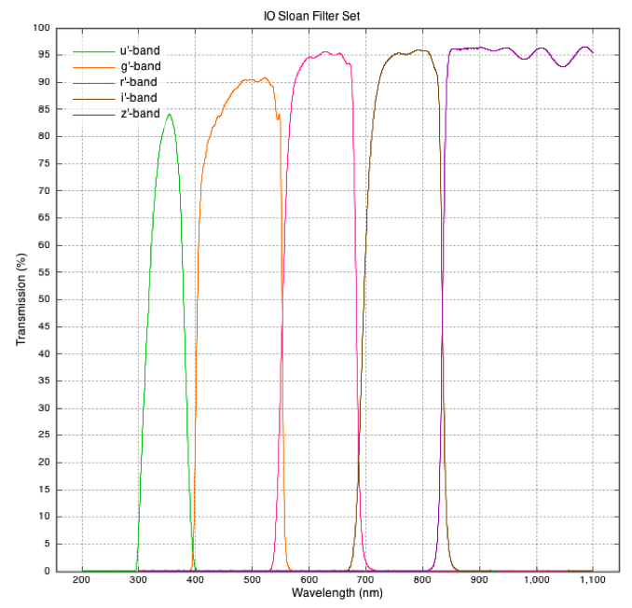
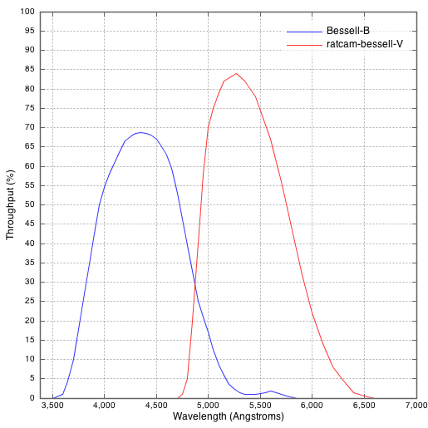
The LT Filters

Slide 14
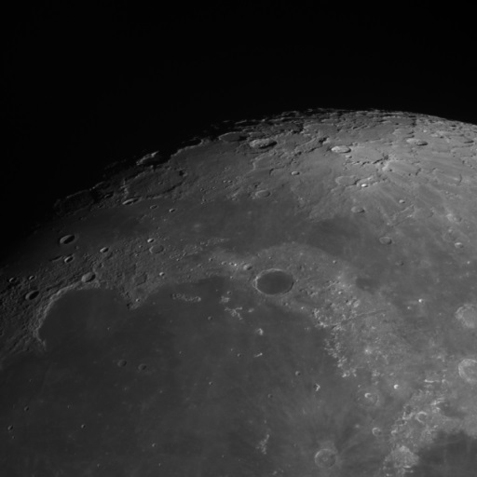
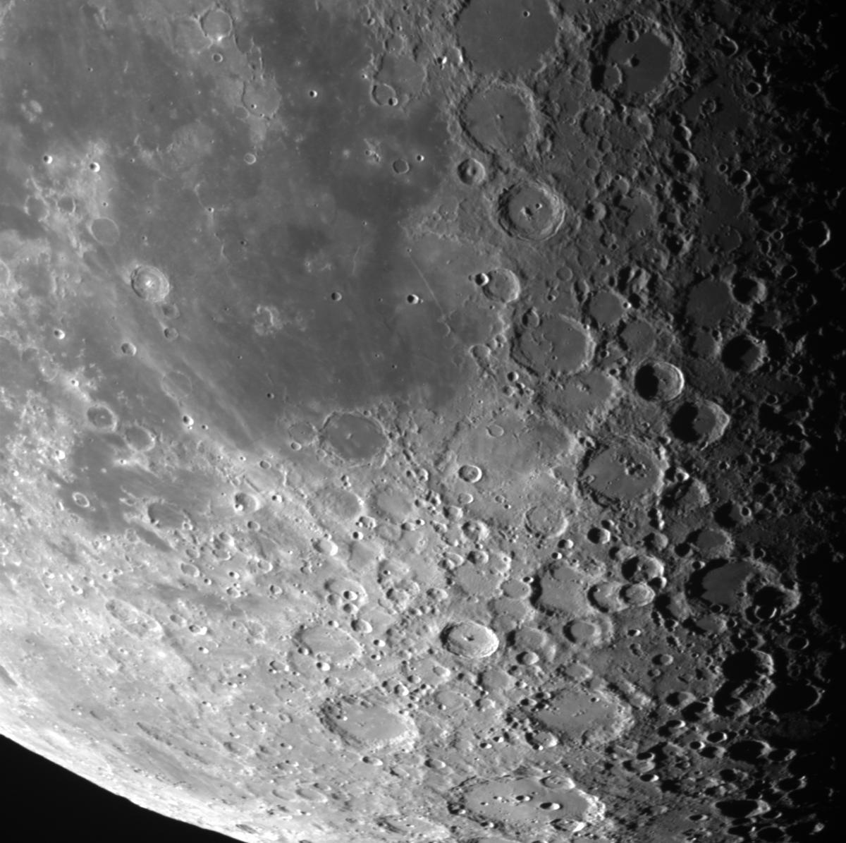
The Results – IO:O

Slide 15
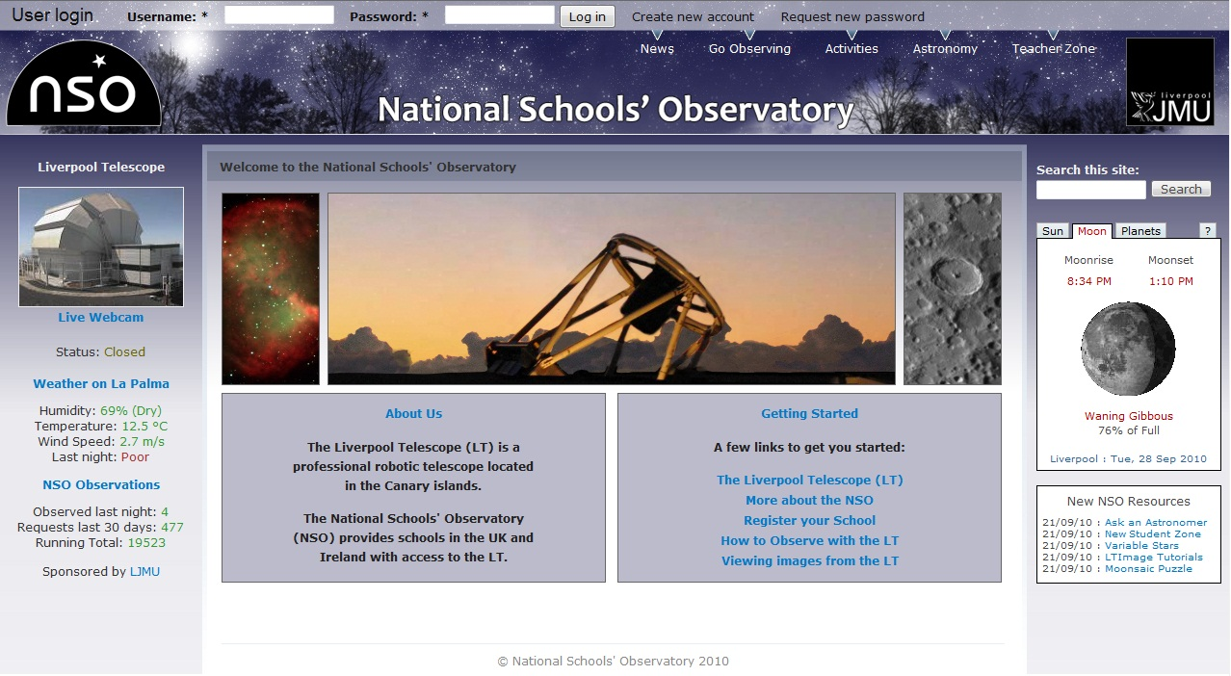
National Schools Observatory
Established (2004) to provide schools in the UK and Ireland with access to the Liverpool Telescope through a guided observing system, together with astronomy related content, news and learning activities.

Slide 16

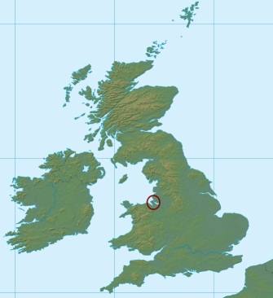
National Schools Observatory (LJMU)
User Accounts
4,345 Teachers ; 14,863 Students
Observing Requests
Total : 91,535 ; average 2,000+ per month in term time.
Website Visits
1,387,512 pages served in 2014;
339,512 visits ; 50% from UK ; 28% USA

Slide 17
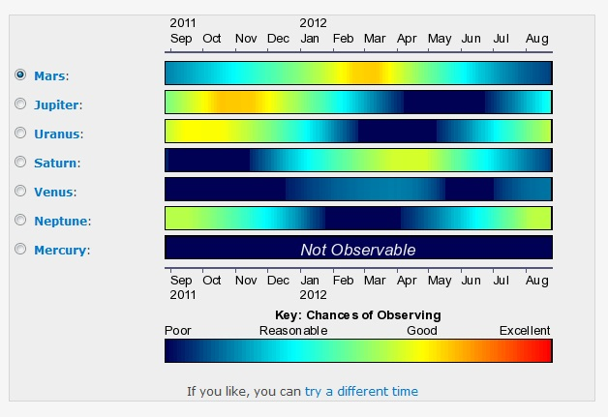
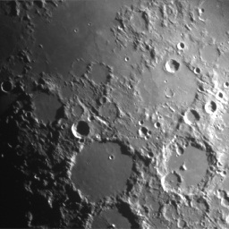
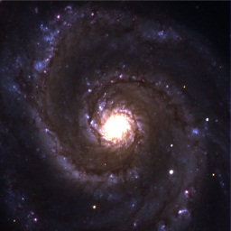
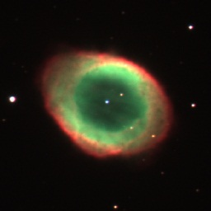
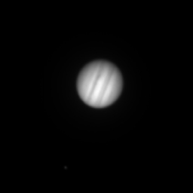
Guided Observing System
Designed for ages: 7+
Moon, Planets, Galaxies, Nebulae
Single Filter or
Three Filter (Colour)
Projects:
Exoplanet Transits
NEO, Asteroids
Supernovae
Go Observing

Slide 18
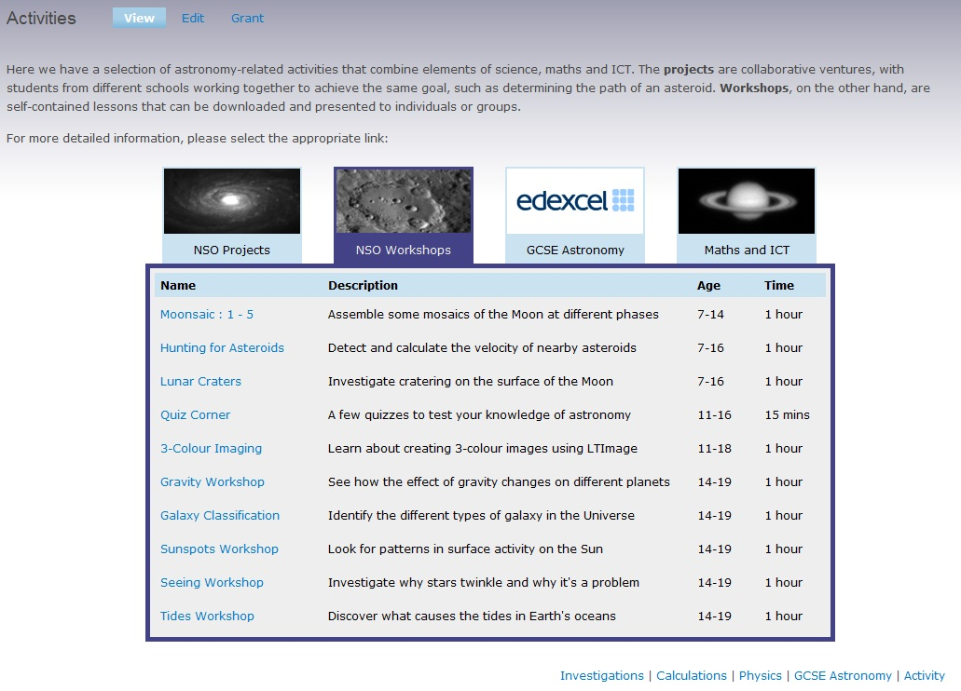
NSO Projects and Activities

Slide 19
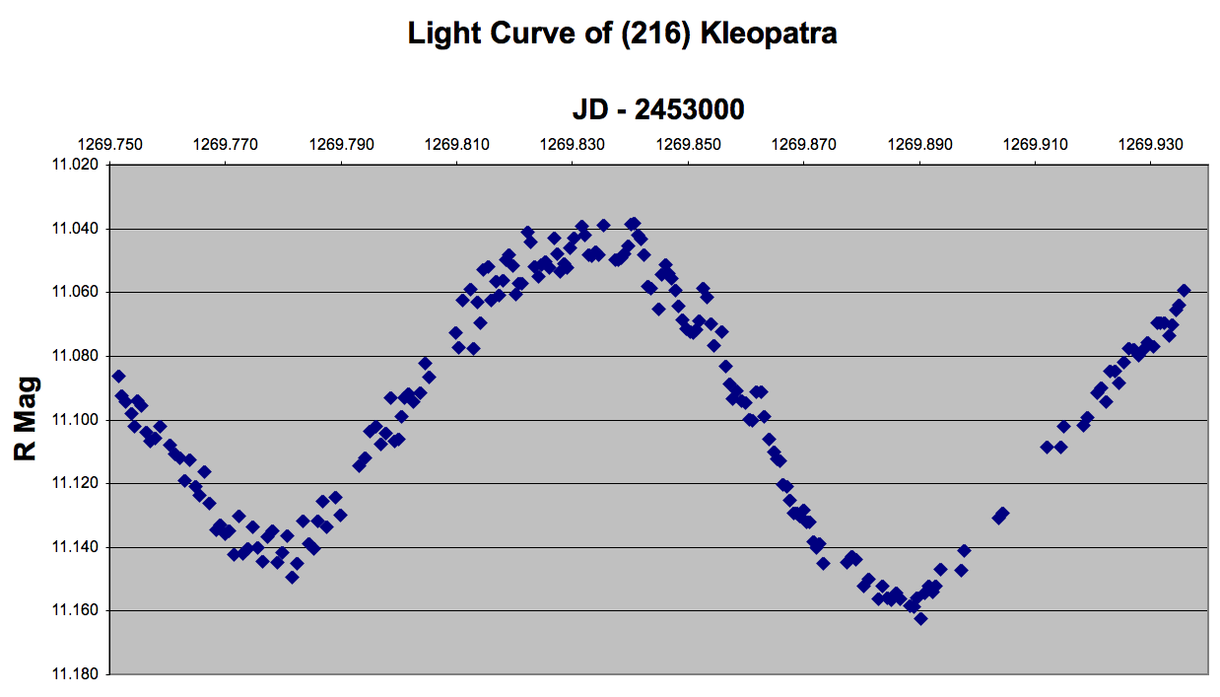
Asteroid Rotation
Requires collaboration
Asteroid brightness measured to produce light curves

Slide 20
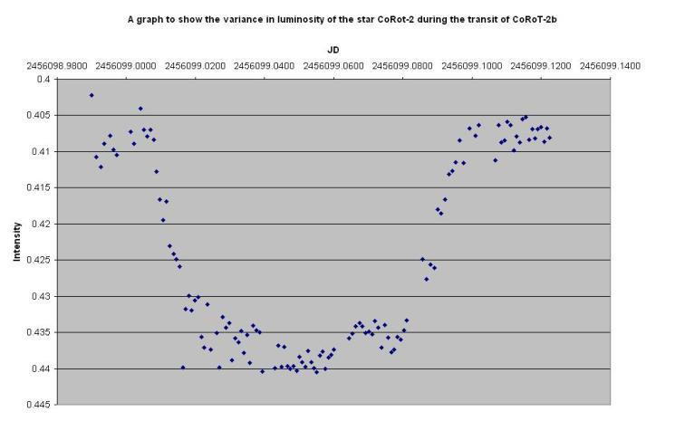
Exoplanet transits
CoRot 2b: David Hardy & Thomas Ham (Cardiff schools)
July 2012

Slide 21
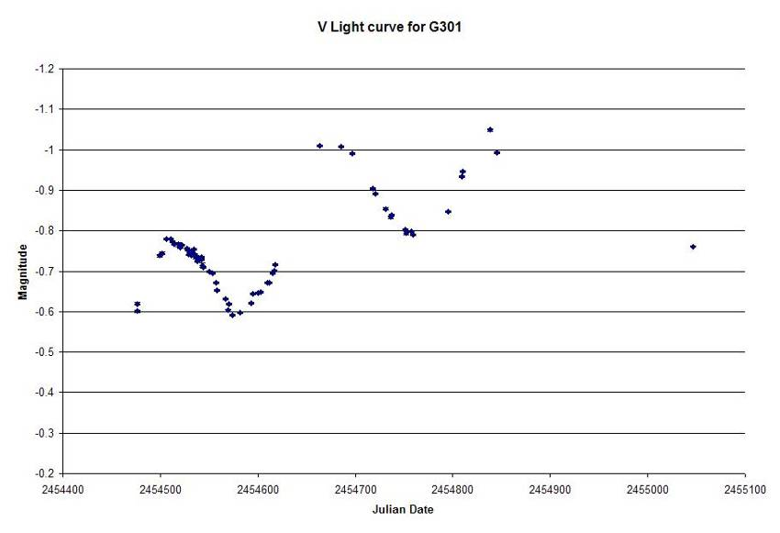
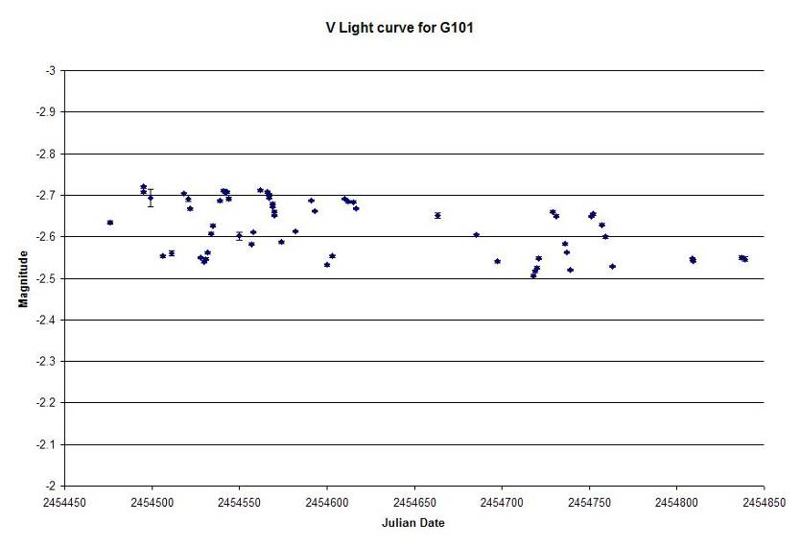
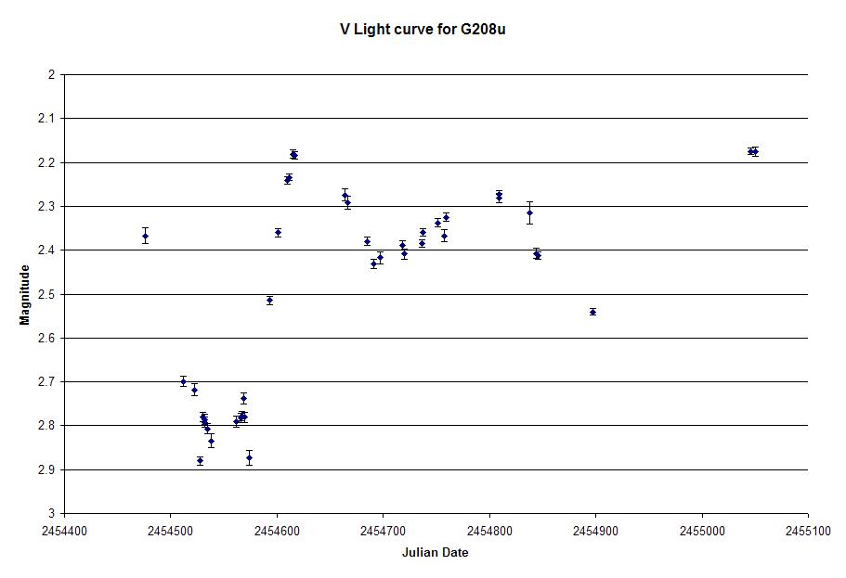
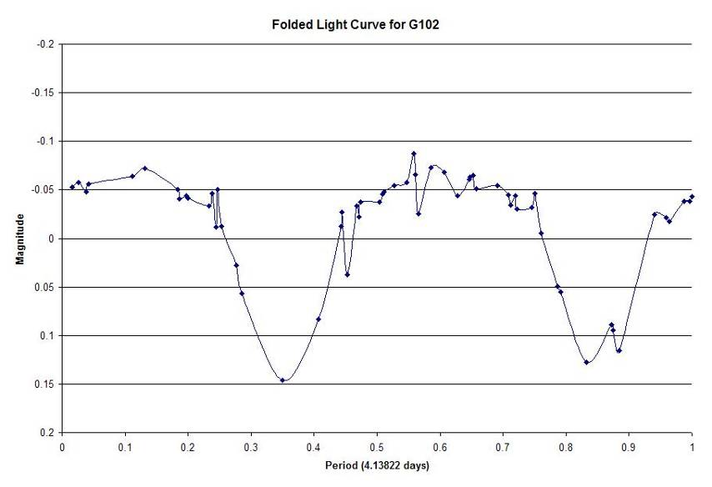

Slide 22
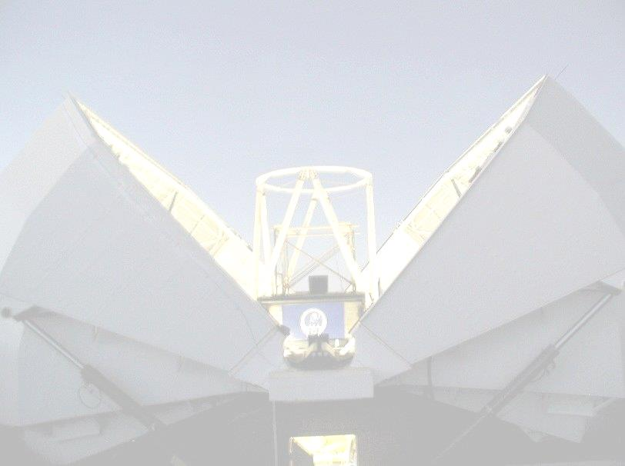
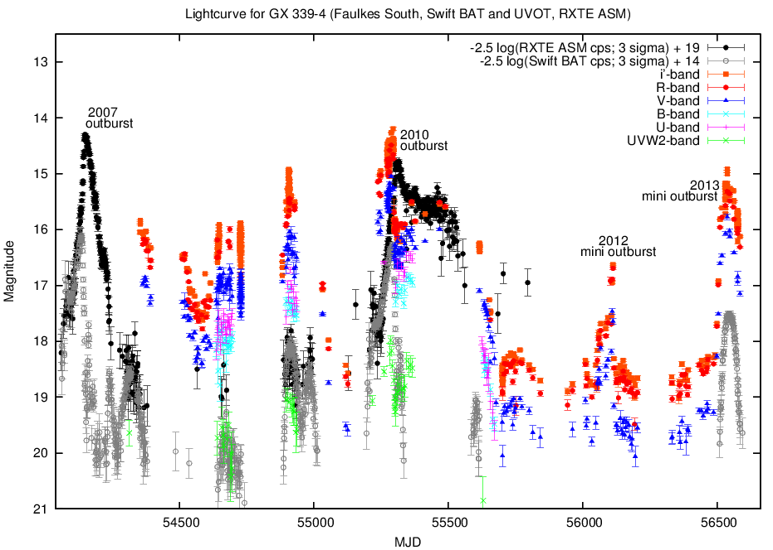
Faulkes Telescope Monitoring of GX 339-4
Notes:
22

Slide 23


A nearby and ‘easy-to measure’ black hole !
Coming soon via Rosa @ NUCLIO

Slide 24
Stop Press ! Neutron Star Becomes Active

Slide 25

Creating an IBSE environment at the National Schools’ Observatory
(what can we learn from imaging and
photometry of star clusters)

Slide 26
IBSE = Inquiry Based Science Education
Developing resources to tie-in the LT/ARI and its
researchers with the National Schools’ Observatory
(NSO) and its users
Providing skills and knowledge (also background
material and data) to allow students and teachers to
perform their own scientific inquiries
(Where possible) identify links with the curricula

Slide 27

IBSE is non-prescriptive
Encourages independent study
Doesn’t offer ‘one path’ through the activities
Provides tools and instructions as suggestions rather than instructions

Slide 28
Two Main Types of Star Clusters
Hypotheses based on …
Open (or Galactic)
Loosely bound containing 10s to 100s of young, blue stars
~1500 in our Galaxy, many associated with nebulosity
Found in Galaxy’s spiral arms
e.g. Pleiades, M67
Globular
Tightly bound spherical concentration of 100s to 1000s of stars
~ 160 in our Galaxy
Typically old stars (smaller, redder)
Found in Galactic halo (where you find old stars)
e.g. M3, M13, 47 Tuc
How do stars live their lives ?
What factors determine this ?
Are there groups of stars that can allow us to study populations (and how they evolve) ?
How do stars die and what do they leave behind ?

Slide 29

Hertzsprung-Russell Diagram (HRD)
Notes:
29

Slide 30
The Hertzsprung-Russell Diagram (HRD; sometimes CMD)
A theoretical diagram showing the properties of a population
of stars
Developed independently between 1911 and 1913 plotting
brightness/luminosity (y-axis) against colour (i.e. temperature)
or against spectral type (x-axis)

Slide 31
Conclusions we might be able to make (eventually) from the HRD
Stars do not appear randomly all over the HRD;
rather, they form distinct groups
The biggest group shows a correlation between how
bright they are and how blue they are (luminosity and
temperature) but we may have had to invoke logs
and ratios to get here …
Establishing the existence of the ‘Main Sequence’
(representing hydrogen-fusing stars)

Slide 32
Background Materials
General guidance (non-package specific) on photometry
Package specific guides and spreadsheet (Excel ?) instructions
Data - an archive of our own data - or instructions on how to download suitable data
How do telescopes and CCDs work ? Optics, images (or movies) on how the LT works
What do ‘real’ scientists do with data ? How do their methods and data differ from what we are producing ?

Slide 33
Photometry
The science (or art) of measuring an object’s brightness
Several photometry packages available
e.g. AIP4WIN, Maxim DL (both cost £s)
or Salsa J (also used for basic image processing), APT, Makali’i,
LT Image (all free) but with varying degrees of complexity
(both actual and perceived)

Slide 34

CMD of the open cluster
NGC 957
(using Salsa J)

Slide 35

IBSE is open-ended
A ‘clusters’ project should provoke more questions than it answers
So further projects might include some or all of the following …

Slide 36

Exoplanets

Slide 37

Where do stars form ?

Slide 38





What are planetary nebulae ?
How do low-mass stars die and what do they leave behind ?
Notes:
38

Slide 39

How massive can a star become ? What limits this ?

Slide 40

What types of supernovae are there ?
Can we measure their changes in brightness ?
What might these changes tell us ?

Slide 41


What do supernovae leave behind in terms of remnants ?

Slide 42
In Production
Screencasts to provide instruction through Makali’i
Screencasts to provide instruction through Excel
Some ‘Talking Heads’ of ARI scientists talking about their work
A way of uploading your data in .csv format – this will generate an artifical CMD which morphs into the image allowing you to track where particular objects lie
A forum to contact ‘us’ and discuss results with other students
A Wiki-style hover-over glossary

Slide 43


Summary
Designing IBSE type activities for students and teachers
Based on existing resources and ARI expertise
Using data on a range of clusters and variable stars
Contact: fraser@schoolsobservatory.org.uk

Slide 44



Any Questions ?
Astrophysics Research Institute
Liverpool John Moores University

